Slide 1
TSP using
Ant Colony Optimization
Black Hole Optimization
Particle swarm optimization
-By(Group 6)
Himaniben Hareshkumar Patel (hhp46)
Karan Ashokkumar Pardasani (kp955)
Naishal Chiragbhai Patel (np781)

Slide 2
Goal
Travelling Salesman Problem is an NP-hard problem which means that currently there is no algorithm that solves this problem in a polynomial time.
We need to find the shortest possible tour that visits each city once and returns to the starting point given the list of cities and the distances between each pair of cities to find the solution of this problem.
In this project, we implement a meta-heuristic approach to trying to solve this problem using 3 different techniques as follows:
Ant Colony Optimization
Black Hole Optimization
Particle swarm optimization

Slide 3
Ant Colony Optimization(ACO)
Ant Colony Optimization is a Genetic Algorithm(GA), which uses probabilistic techniques to obtain approximate optimal solution of the given graph.
All possible solutions are represented by the parameter space which is traversed by artificial ants in order to obtain optimal solution.
As real ants leave pheromones along their path to guide other ants towards resources; artificial ants also mimic that behaviour by recording their position (giving probabilistic score) to guide other ants for better solutions.

Slide 4
Black Hole Optimization(BHO)
The Black Hole Algorithm is a nature-inspired algorithm that mimics the blackhole phenomenon that occurs in the nature.
In Black Hole Optimisation, initially a population of possible solutions is generated randomly.
Then, fitness value of each possible solution is evaluated and the best candidate among the population is chosen to be the black hole and the rest form the normal stars.
After black hole starts absorbing the stars around it, and all the stars starts move towards the black hole.

Slide 5
Particle Swarm Optimization(PSO)
To calculate the Travelling Salesman Problem using Particle Swarm Optimisation, we use the concept of Swap Operator and Swap Sequence. The Particle Swarm Optimisation is mimics the social behaviour that is commonly depicted in organisms. These organisms travel through possible solutions and can store the best solution so far. All the organisms share solutions with each other to calculate the global best solution.

Slide 6
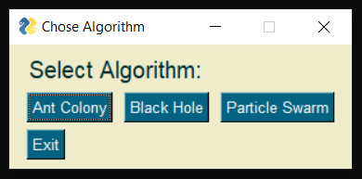
User Interface
In this interface the user can choose the algorithm he wants to use. There are three available algorithms:
Ant Colony Optimisation
Black Hole Optimisation
Particle Swarm Optimisation

Slide 7
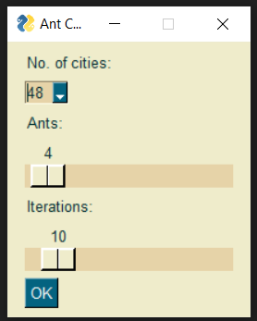
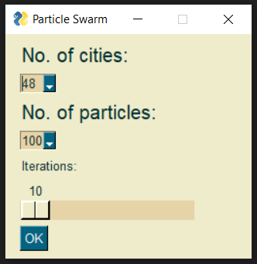
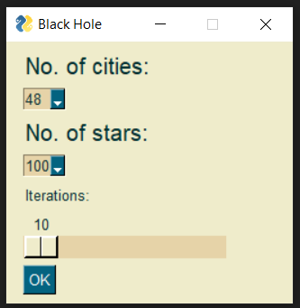
Here, we can choose the parameters for the algorithms which include number of cities, number of ants, articles and stars, and the number of iterations required.

Slide 8
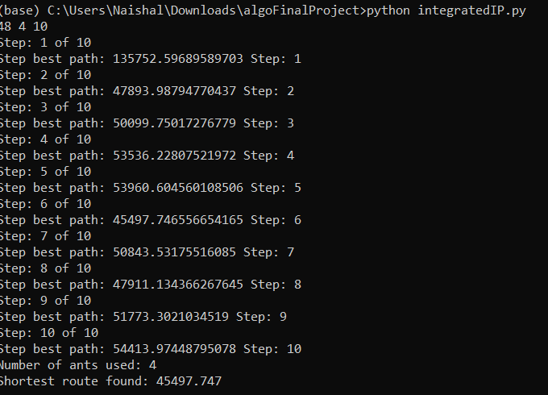
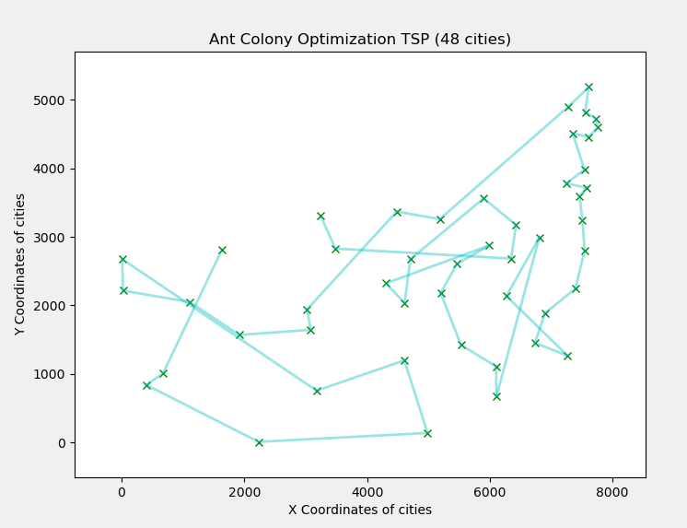
Output
Output (ACO)

Slide 9
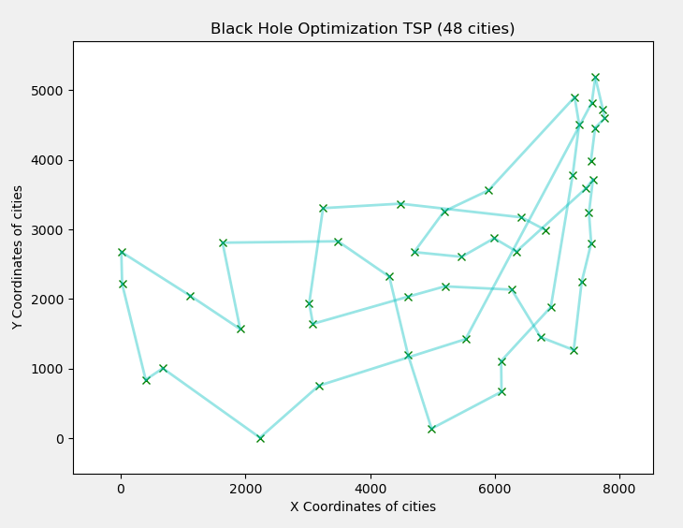
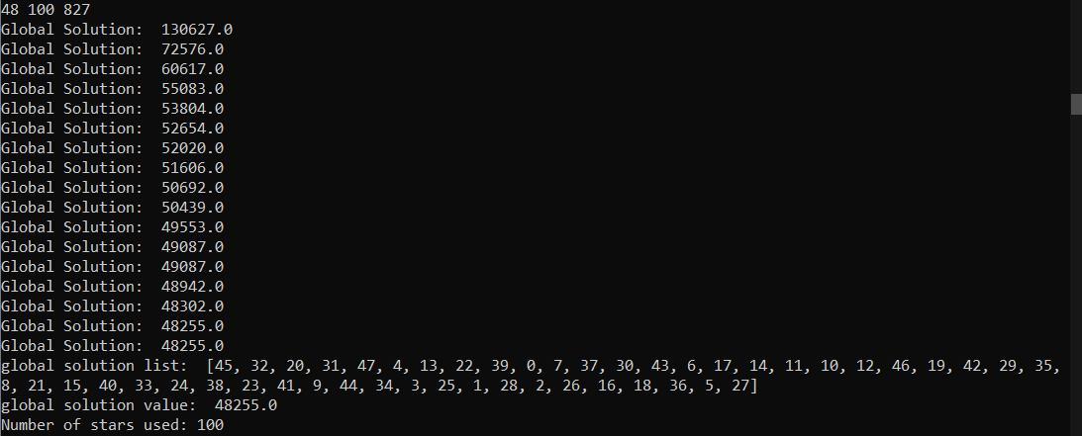
Output (BHO)

Slide 10
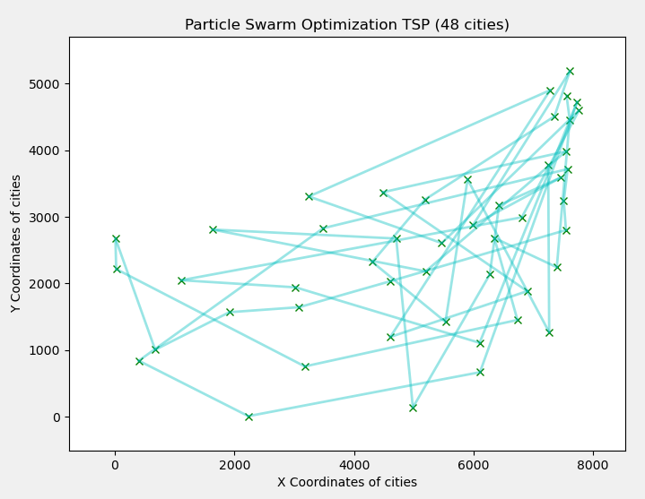
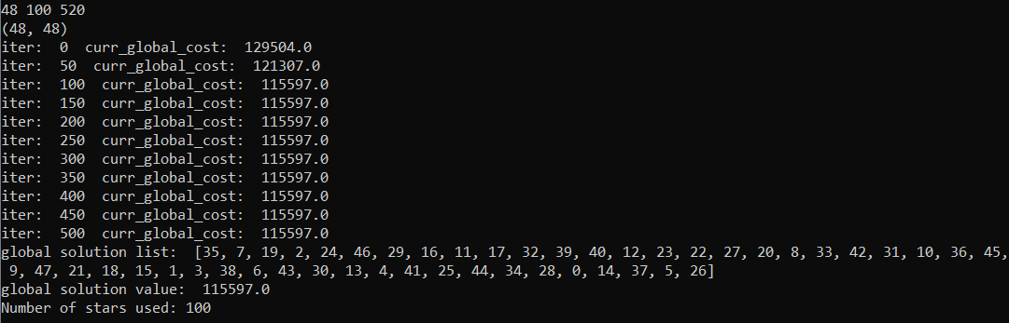
Output (PSO)

Slide 11
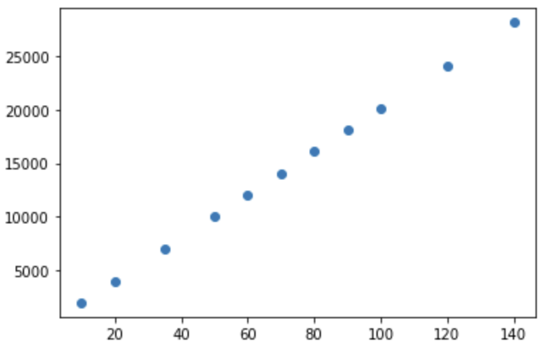
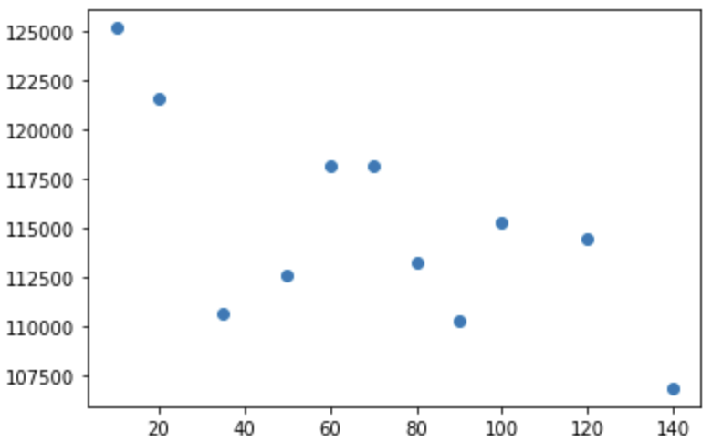
Analysis
Particle Swarm Optimisation:
From the plots, we can see that the global value found by the Ant Colony Optimisation improves as we increase the number of particles. Also, the search space for the algorithm is (n-1)!/2, hence for n=48, it is around 10⁶². So, this algorithm searches around 10⁴ solutions and it has been able to find a pretty good solution. The minimum answer we were able to find using Black Hole Optimisation is 107500 which gives the worst output among the algorithms. One of the reasons for this might be that it processes little solution, so if we increase the time i.e. increase the number of iterations, we might get a better solution.
Number of solutions covered vs Number of Particles
Solutions solved using PSO vs Number of Particles

Slide 12
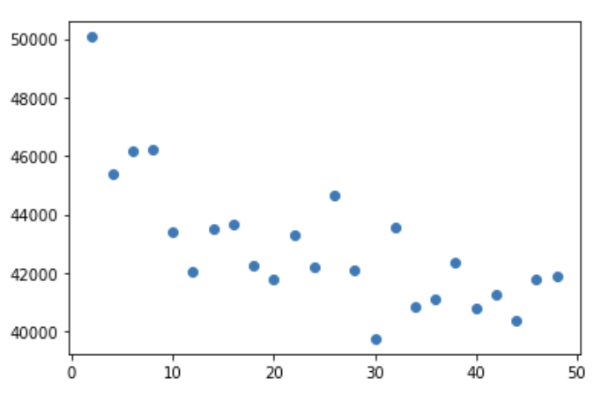
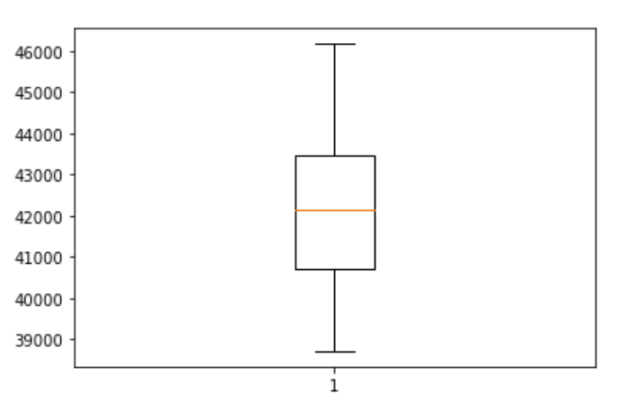
Ant Colony Optimization:
The first graph represents the cost of the route for travelling Salesman Problem using the Ant Colony Optimisation. From the scatter plot, we can see that as we increase the number of ants we get more optimal values.
From the second plot, we can infer that the average of algorithm is around 42500 and also the 25th percentile of the output is at 41000 and the 75th percentile is at 43000. These percentile is pretty close and so this algorithm seems more stable. Also, the minimum answer which is around 39000 is very close to the actual answer 33543.
Solutions solved using ACO vs Number of Ants
Number of solutions covered vs Number of Stars.

Slide 13
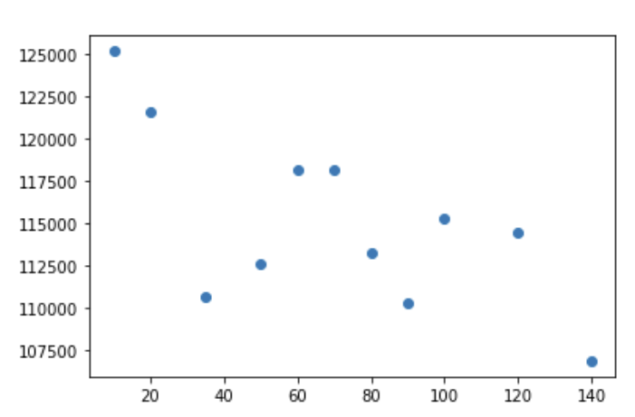
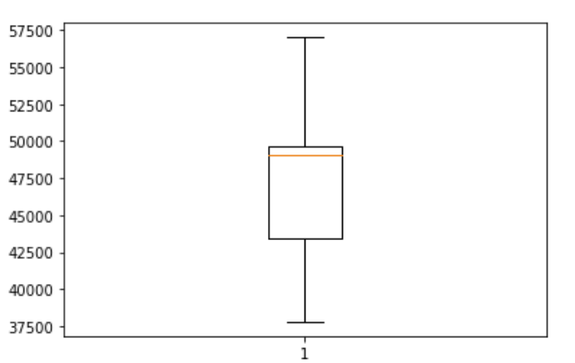
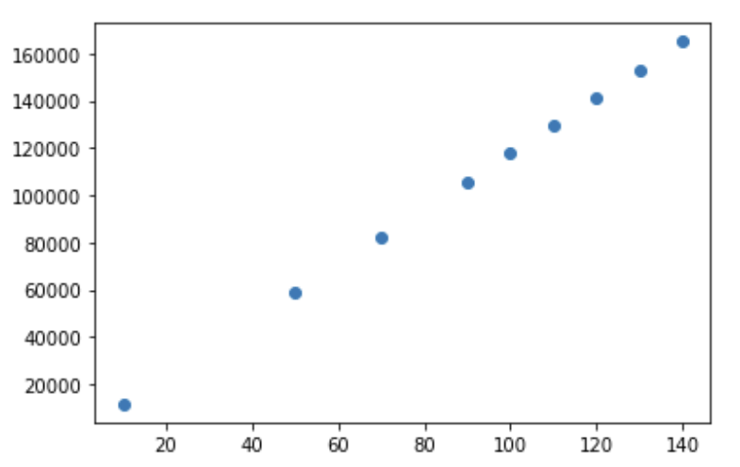
Black Hole Optimization:
From the first plot, we can see that the global value found by the BlackHole Optimisation improves as we increase the number of stars. Also, the searchspace for the algorithm is (n−1)!/2, hence for n= 48, it is around 1062. So, this algorithm searches around 105 solutions and it has been able to find a pretty good solution. The minimum answer we were able to find using Black Hole Optimisation is 37500 which is an improvement on the Ant Colony Optimisation algorithm.
From the second plot, we can infer that the average of algorithm is around 49000 and also the 25th percentile of the output is at 44000 and the 75th percentile is at 50000. These percentile are very far and so this algorithm seems less stable. Also, the minimum answer which is around 37500 is very close to the actual answer 33543.
Solutions solved using ACO vs Number of Stars
Number of solutions covered vs Number of Stars.
Boxplot for Solutions using BHO

Slide 14

Time Complexity and Space Complexity
For Ant Colony Optimisation,
The time complexity is
Where alpha is control of influence for proficiency and beta is control of attractiveness.

Slide 15
For Black Hole Optimisation,
Time Complexity:
The time complexity is O(n*m*iterations), where n is the number of stars, m is the number of cities and iterations is the number of iterations.
Space Complexity:
The space complexity of the algorithm is O(n*m).

Slide 16
For Particle Swarm Optimisation
Time Complexity:
The time complexity is O(n*m*iterations), where n is the number of particles, m is the number of cities and iterations is the number of iterations.
Space Complexity:
The space complexity of the algorithm is O(n*m).

Slide 17
References
[1] Dataset - https://people.sc.fsu.edu/ jburkardt/datasets/tsp/tsp.html
[2] Ant Colony Optimisation - Y. Zhou, "Runtime Analysis of an Ant Colony Optimization Algorithm for TSP Instances," in IEEE Transactions on Evolutionary Computation, vol. 13, no. 5, pp. 1083-1092, Oct. 2009, doi:10.1109/TEVC.2009.2016570.
[3] Black Hole Optimisation - https://link.springer.com/content/pdf/10.1007/s00500-017-2760-y.pdf
[4] Particle Swarm Optimisation - https://ieeexplore.ieee.org/document/1259748

Slide 18
Resources
Python 3.8
PySimpleGui

