Slide 1

Employee Attrition/ PREDICTION DETECTION
Prepared By:- Devansh Pandya(200050131038)
Himanshi Kashyap(200050131035)

Slide 2
What is Employee Attrition Prediction?
Project Description
Employee attrition is used to describe the reduction of employees. Employee attrition can take place for a multitude of reasons. The reasons may include employees retiring, finding other job opportunities, or leaving due to unhappiness within the company
Employee attrition is downsizing in any organization where employees resign. Employees are valuable assets of any organization. It is necessary to know whether the employees are dissatisfied or whether there are other reasons for leaving their respective jobs.

Slide 3
Various Reasons for employee attrition
Poor job satisfaction and pay
Not enough career opportunities
Poor workplace culture
Lack of employee motivation
Poor work-life balance.
Not fitting in and feeling a sense of belonging.
Project Delay

Slide 4
Need OF Employee ATTRITION PREDICTION
Managing workforce
If the supervisors or HR came to know about some employees that they will be planning to leave the company then they could get in touch with those employees which can help them to stay back or they can manage the workforce by hiring the new alternative of those employees.
Smooth pipeline
Hiring Management
If all the employees in the current project are working continuously on a project then the pipeline of that project will be smooth but if suppose one efficient asset of the project(employee) suddenly leave that company then the workflow will be not so smooth
If HR of one particular project came to know about the employee who is willing to leave the company then he/she can manage the number of hiring and they can get the valuable asset whenever they need so for the efficient flow of work.

Slide 5
Dataset
Dataset is like records or kind of database can be available in many format files like excel,csv.
We take dataset from one website called “kaggle”(https://www.kaggle.com)
Our Dataset contains total of 35 variables and 1470 entries in the data

Slide 6
Analysis
In our project we used different libraries of python for analysis Like :-
Pandas serves as one of the pillar libraries of any data science workflow as it allows you to perform processing, wrangling and munging of data.
Matplotlib for different type of chart’s Matplotlib provides various method to Visualize data in more effective way. Matplotlib allows to quickly make line graphs, pie charts, histograms, and other professional grade figures. Using Matplotlib, one can customize every aspect of a figure.
Seaborn for heatmaps

Slide 7
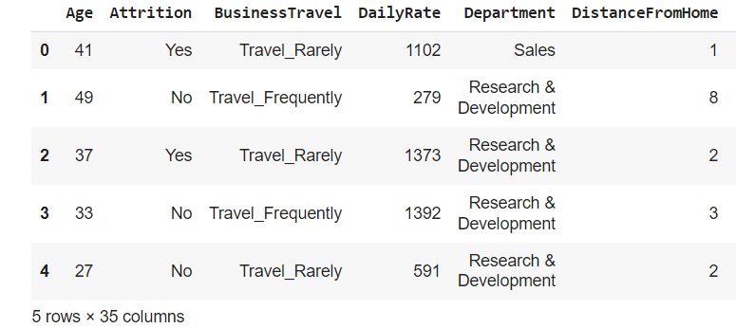
Reading the Dataset
The Head & tail of dataset
So, we can get the First & Last five entries of dataset

Slide 8
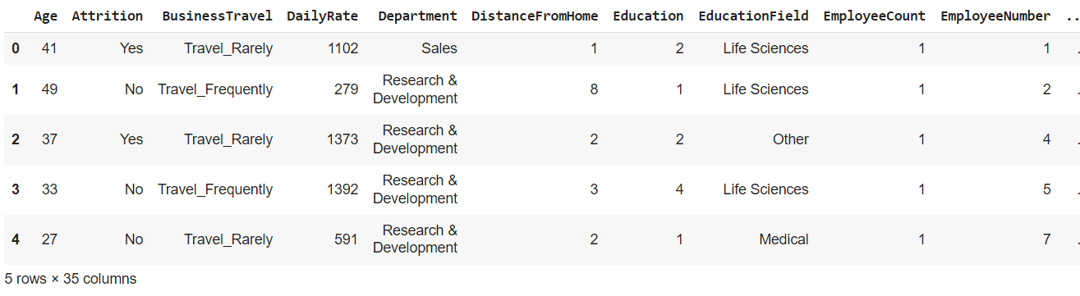
OUTPUT

Slide 9
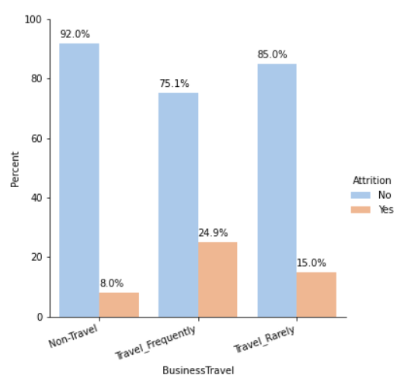
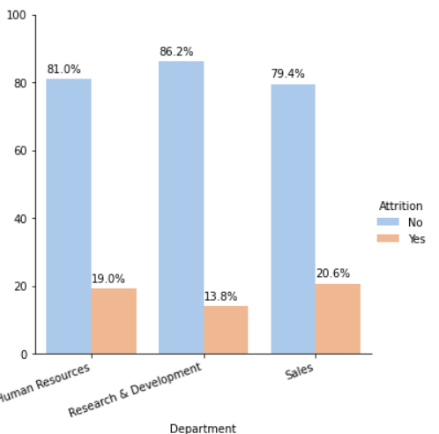
Visualizing the data

Slide 10
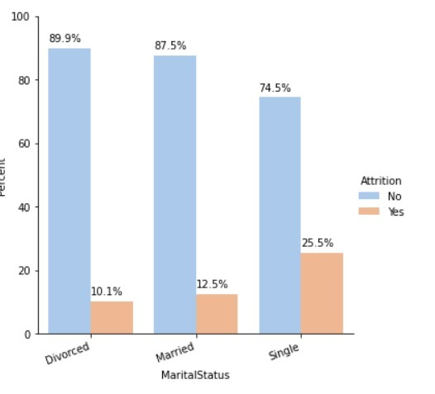
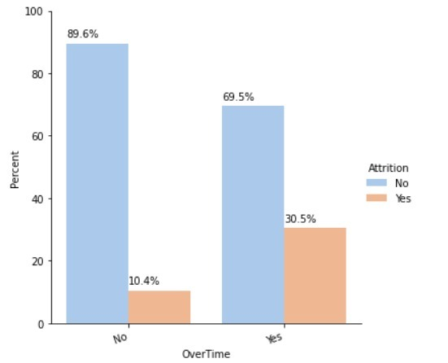
Visualizing the data

Slide 11
Conclusion
Major reason concluded of High Attrition Rate from data
From Graph it is evident that Frequent Business Travelers Attrition rate is high compared to non traveler
Sales department is having highest attrition rate
R&D department have less attrition rate
Single employee have higher attrition rate compared to other marital status
Employee who is doing more overtime have higher attrition rate

Slide 12


