Slide 1
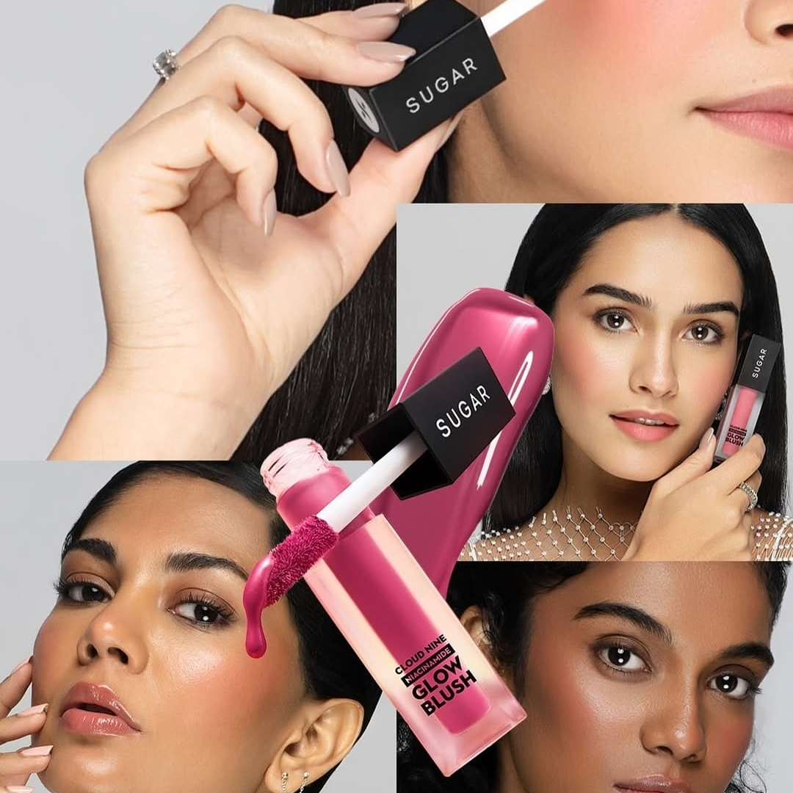
Instagram Performance Analytics- Sugar cosmetics

Slide 2
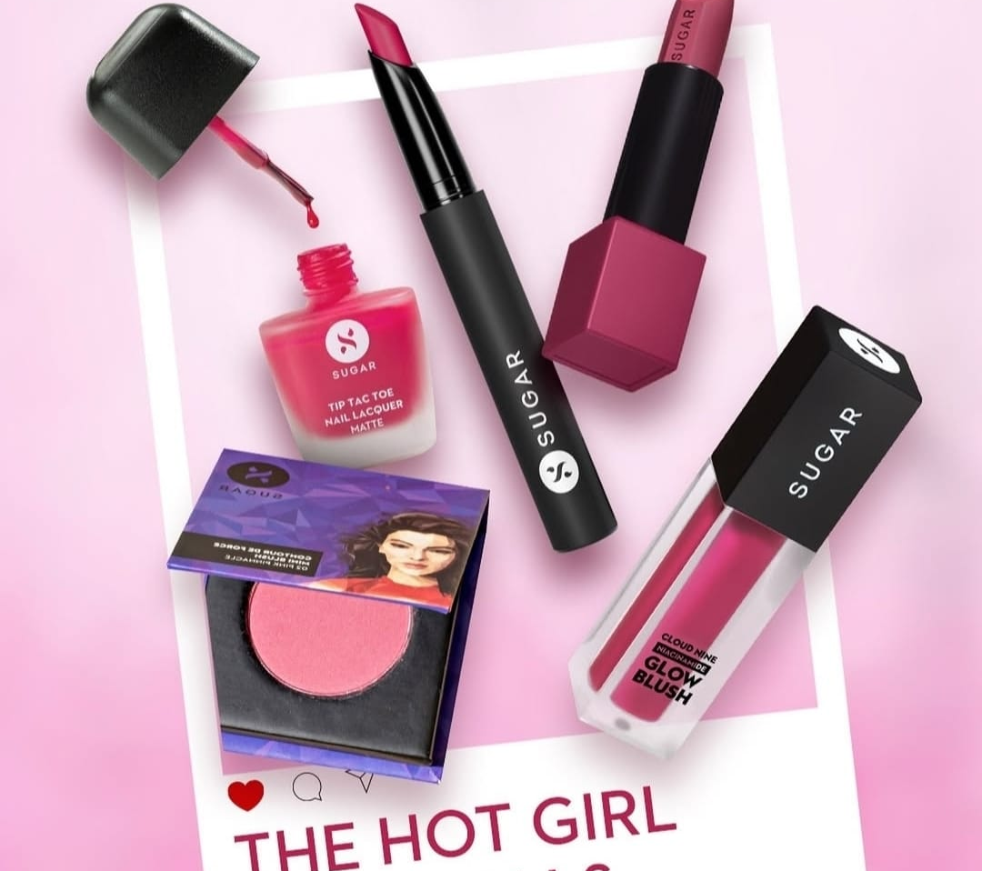
Objectives
Evaluate the performance of Sugar Cosmetics' Instagram account based on engagement and reach.
Identify trends in content performance (e.g., posts, reels, stories).
Determine the best-performing content types, hashtags, and posting times
Analyze audience demographics and growth trends.
Provide data-driven insights to refine and support social media strategy.

Slide 3
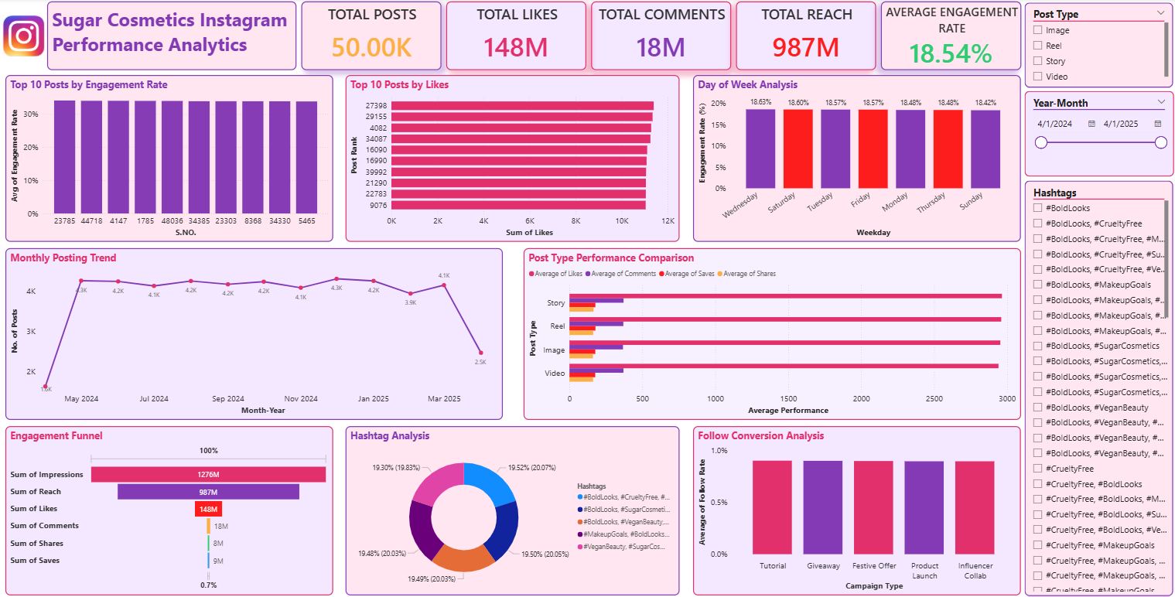
DASHBOARD

Slide 4
STRATEGIC RECOMMENDATIONS

Slide 5
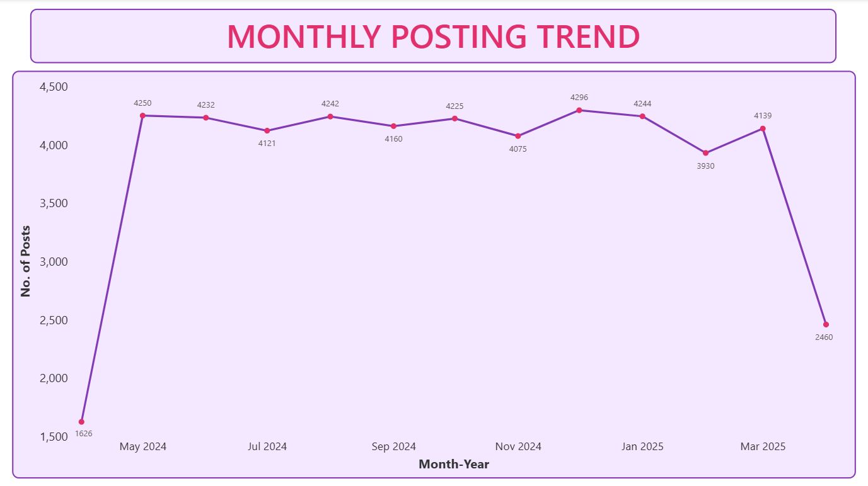
Key Takeaways From the Data
Stable Posting Frequency
Monthly posts remain consistent around 4,000+ per month, except two low months (Apr 24 & 25)
This indicates an already strong, consistent content pipeline.

Slide 6
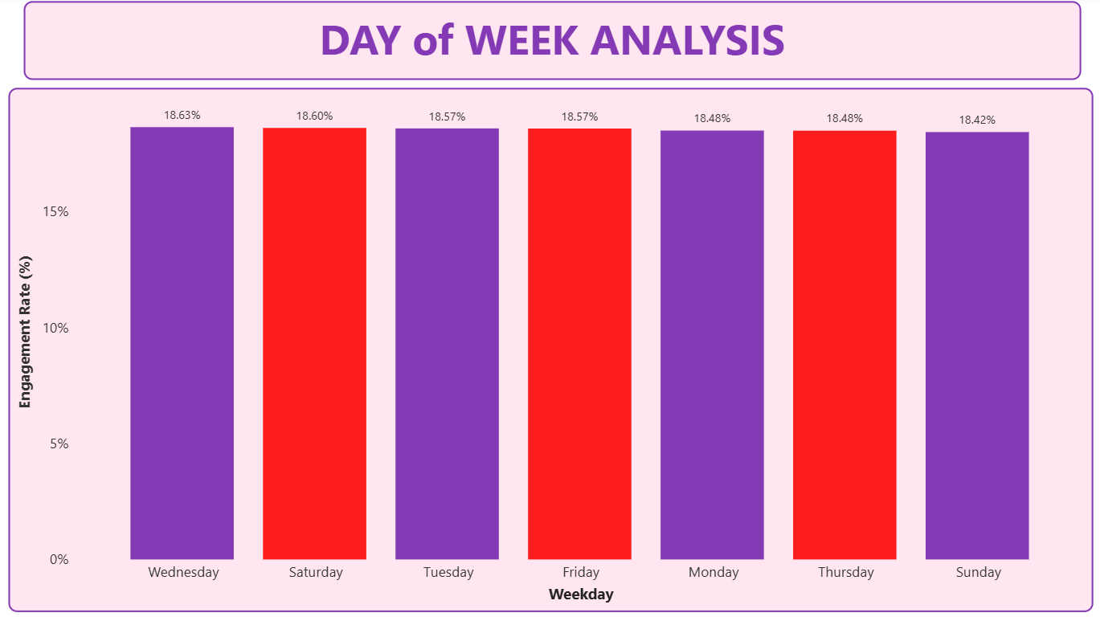
2. Engagement Peaks Occur on Specific Days
Wednesday, Saturday & Tuesday show the highest engagement (18.57–18.63%)
Sunday shows slightly lower performance.

Slide 7
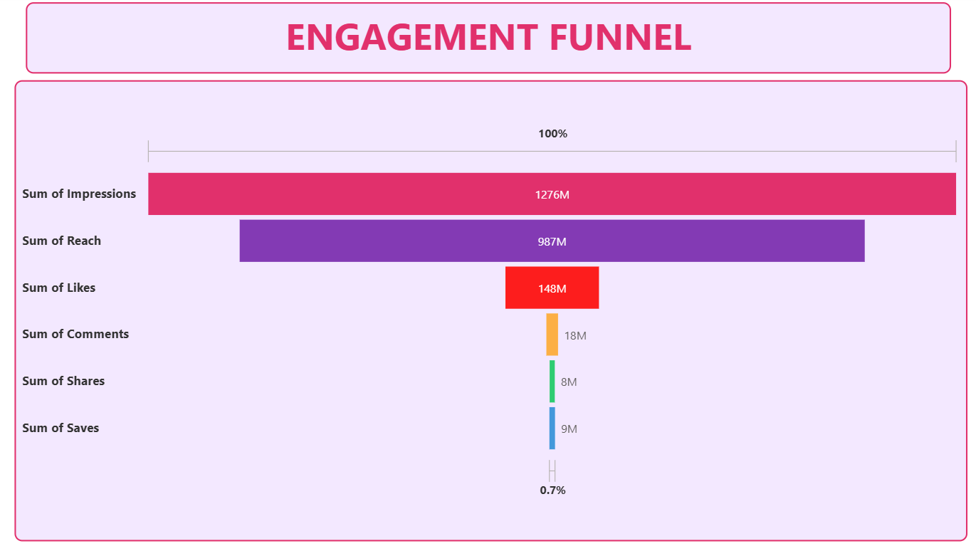
1.27B Impressions
987M Reach
148M Likes
18M Comments
8M Shares
9M Saves
3. Engagement Funnel Indicates Significant Drop
After Reach Sharp drop to 148M Likes
Shows a large top-of-funnel but weak conversion to deeper engagement

Slide 8
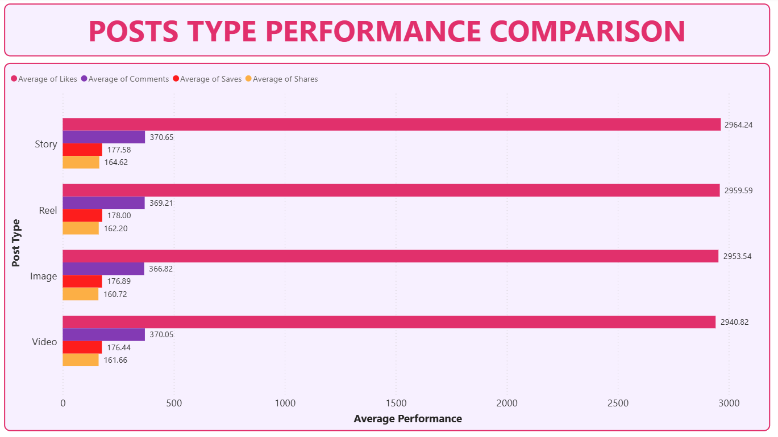
4. Post Types Perform Similarly
Reels, Stories, Images & Videos all fall around 2950 average likes.
No major variation → means platform audience responds well to all formats

Slide 9
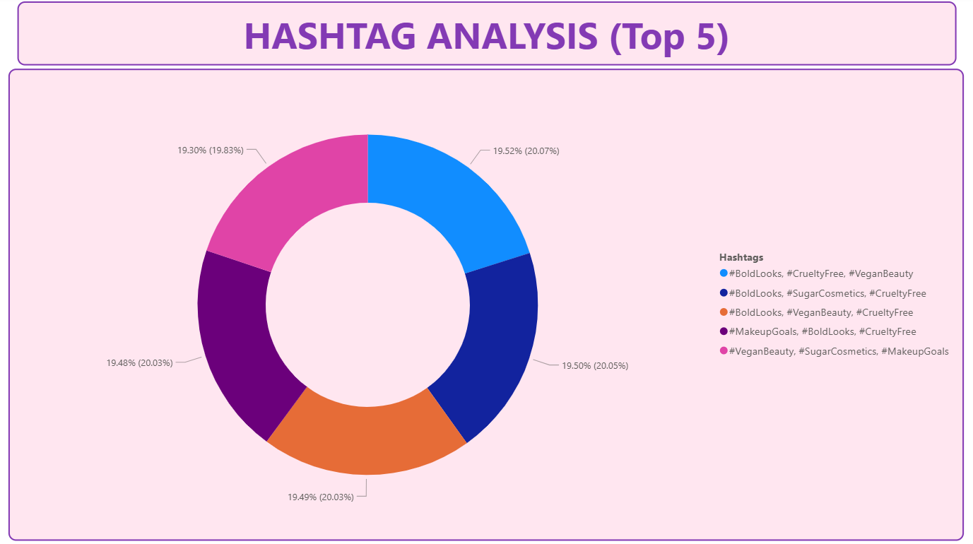
5. Hashtags Are Evenly Used (Top 5)
All hashtag clusters have nearly equal share (~19.5%).
No single hashtag group is dominating — potential opportunity to optimize.

Slide 10
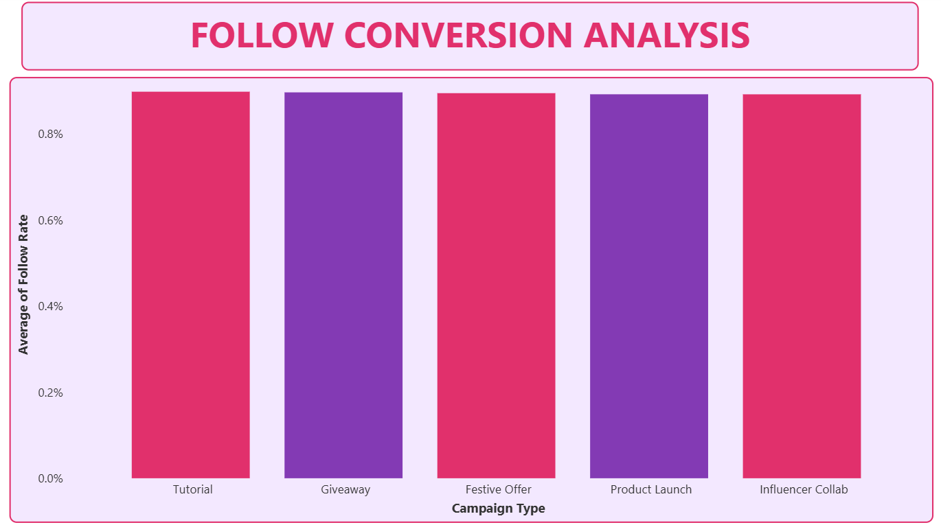
6. Follow Conversion Across Campaigns Is Uniform
All campaign types show follow rates around 0.9%.
No campaign type clearly outperforms others.

Slide 11
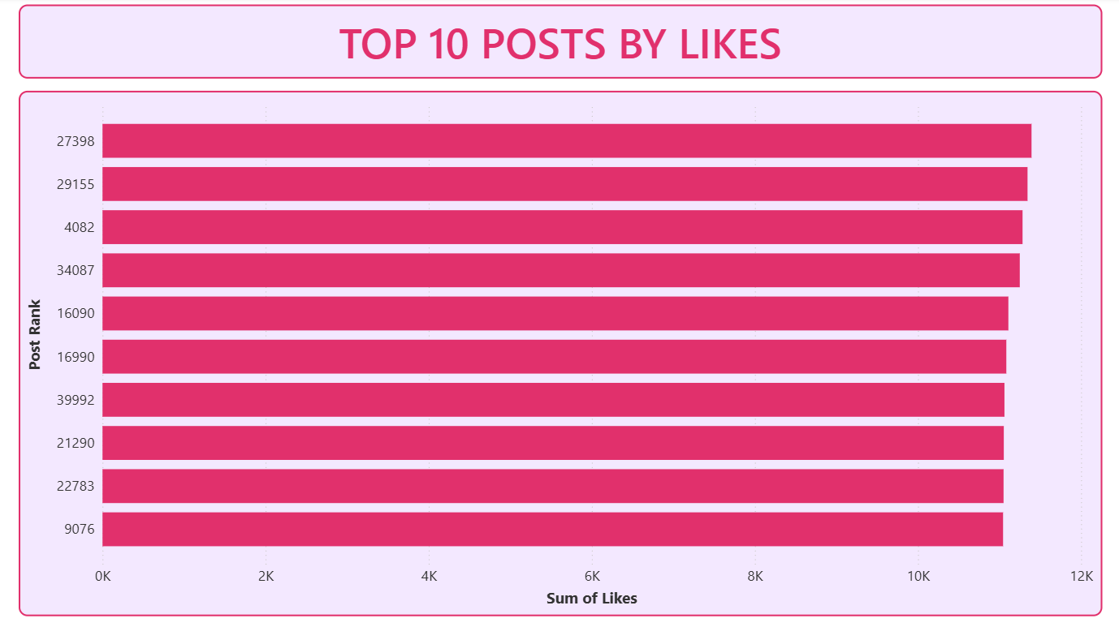
7. Top Likes
Post 27398 leads in likes which is an Influencer Collab reel, indicating it resonated most with the audience in terms of visual appeal or timing.
Top 5 likes are of Influencer Collab or Giveaway

Slide 12
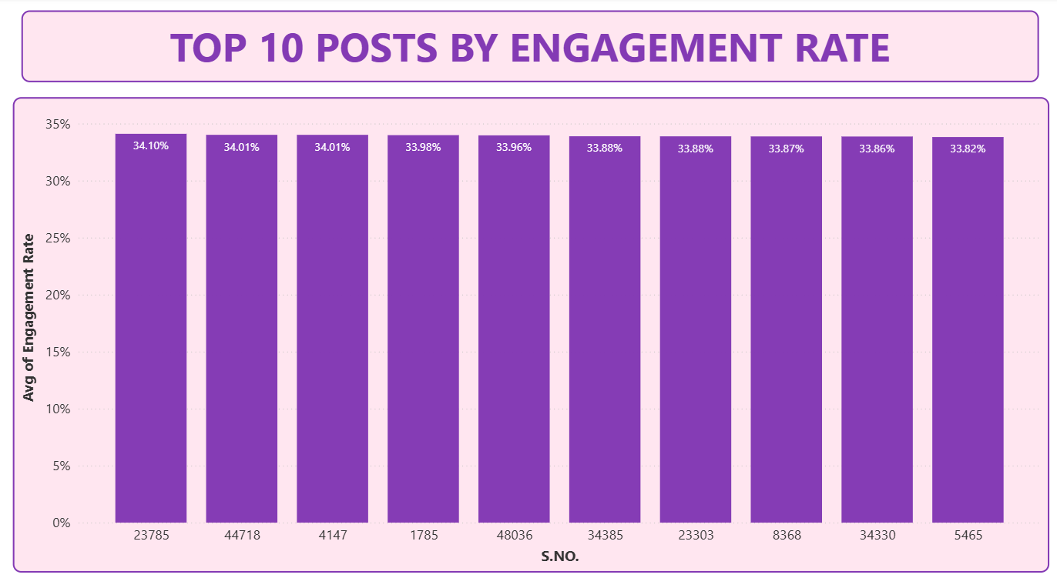
8. Engagement Rate
Post 23785 has the highest engagement rate (34.10%), showing exceptional audience interaction relative to reach.
Engagement rates are tightly clustered (33.82%–34.10%), implying consistent performance across top posts, possibly due to similar content strategy or audience targeting.

Slide 13
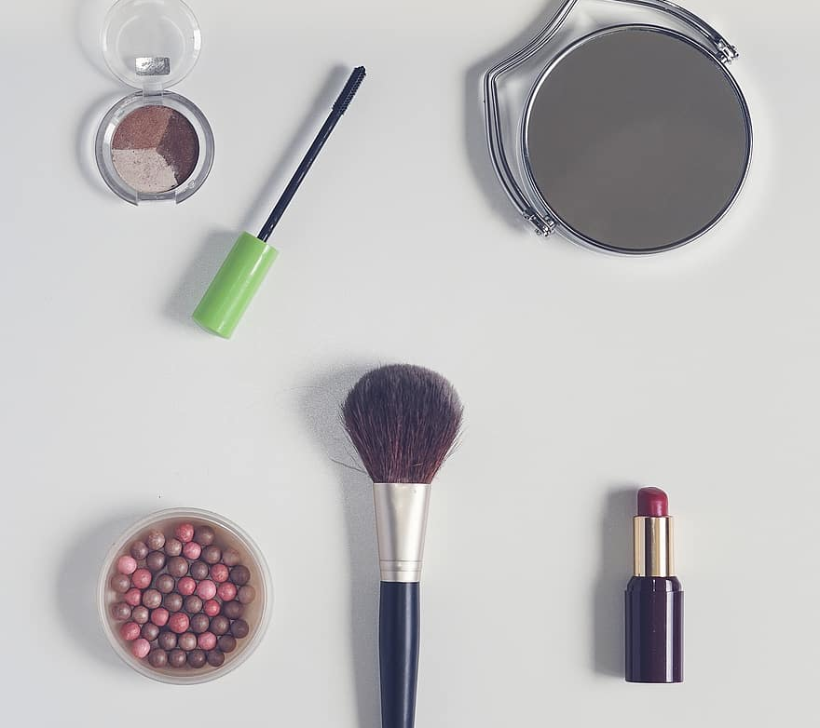
Recommended Posting Strategy

Slide 14
Best Days to Post
Post most frequently on: Wednesday, Saturday, Friday
Maintain regular posting on: Monday, Tuesday, Thursday
Reduce important announcements on: Sunday (lowest engagement)
2. Posting Frequency
Maintain current posting volume (4000 posts/month)
Avoid sudden dips like it is in April 24 & 25 → ensure consistent calendars.
3. Best Performing Formats
Since performance is similar:
Reels for reach
Images for clarity/product highlights
Stories for quick engagement
Videos for tutorials/demos
Recommendation: Mix formats strategically; don’t rely heavily on a single type.

Slide 15
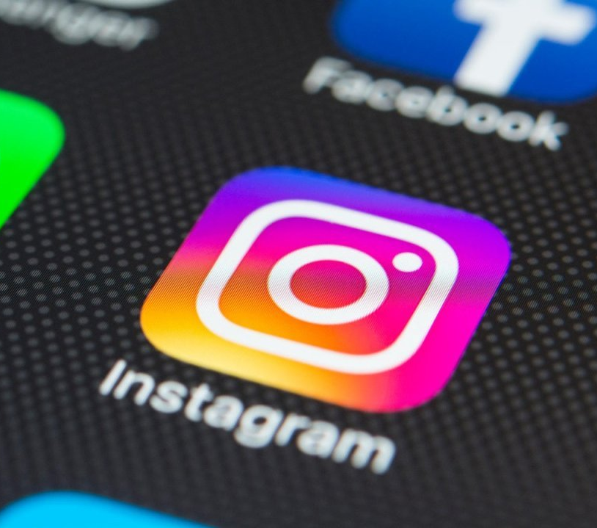
Strategies to Improve Engagement & Follower Growth
1. Improve Mid-funnel Engagement
Funnel shows large drop from Reach → Likes. Fix this by:
Using engaging hooks in first 3 seconds of reels
Posting carousel posts, proven to increase saves.
2. Increase Saves & Shares
These two metrics are extremely low vs likes.
Create educational content (tutorials, tips) → increases saves
Launch share-worthy templates/memes
3. Boost Comments with Conversation Starters:
“Which shade would you pick?”
“Tag a friend who needs this look!”
4. Enhance Follow Conversion
Follow Rate is flat (~0.9%). Improve via:
Story highlights for new visitors
‘Behind the scenes’ + authenticity to increase trust
Exclusive follower-only offers
This Photo by Unknown Author is licensed under CC BY-SA

Slide 16

Proposed Campaign & Content Ideas
“Bold Looks Challenge” Reel Campaign- Fans recreate signature SUGAR looks → tag brand → best entries reposted. Boosts: Reels, Shares, Follows.
“Ask SUGAR” Weekly Expert Series- Short tutorial videos, tips, Q&A. Boosts: Saves, Comments, Engagement.
Influencer ‘Get Ready With Me’ (GRWM) Collabs- Influencers demonstrate products in real-time. Boosts: Reach, Follow Conversion.
Festival “Limited Edition” Carousel Announcements- Carousels drive more saves → higher engagement.
“Behind the Scenes” Brand Storytelling Series- Shows authenticity → good for new followers.

Slide 17
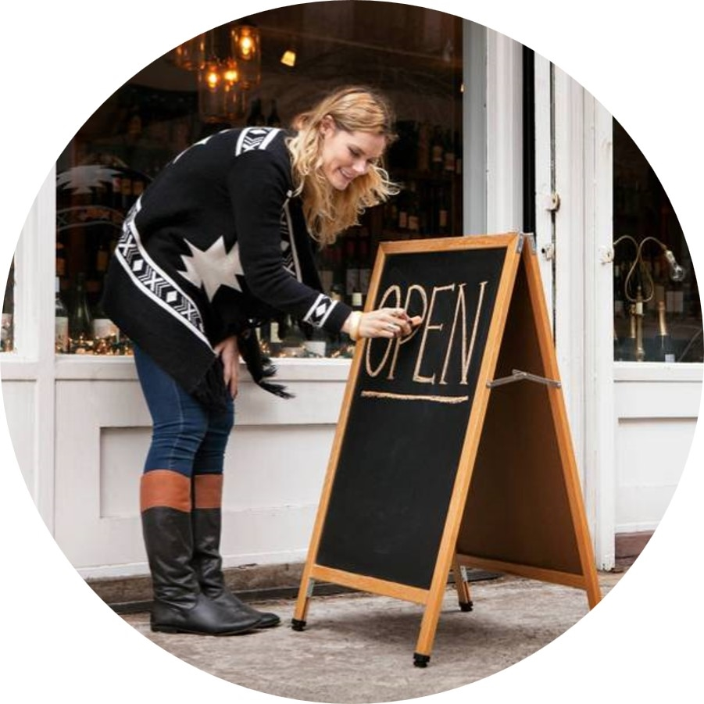
THANK YOU
Himanshu
hiimanshuu0406@gmail.com
Domain- Data Analytics

