Slide 1

Web Application Project
Group 12

Slide 2

I.Introduction
- Web scraping is the process of collecting structured web data in an automated fashion. It’s also called web data extraction.
- In general, web data extraction is used by people and businesses.

Slide 3

II. Purpose
115.000

Slide 4

II. Purpose
Collecting and analyst data from online websites into databases to form a Data Lake.
Helping people to update and synthetic the news easily in order to help the patients surpass the cancer.

Slide 5
III. Risk assessment.
Risk | Precautions
Crawlers can fall for “spider trap". | Use a ‘max crawl depth’ setting.
Detect multiple access IPs (5 requests/s) | Use IP rotator for each request.
Detect multiple access user-agents | Use different user-agent for each request.
Use Cookies, Capcha to block crawlers | Use some script bypass Cloudfare.

Slide 6
IV. Benefits and limitation
Inexpensive
Easy to implement
Low maintenance and speed
Accuracy

Slide 7
IV. Benefits and limitation
not able to crawl the private informations or the informations needed to be accessed.
If the website changes the HTML structure then having to update our algorithm in order to adapt with the changes.
Difficult to analyze: The extracting processes are confusing to read.
Data analysis

Slide 8
V. Methodology
1. Requests
2. Beautiful Soup
3. Pandas

Slide 9
V. Methodology
dantri.com.vn
vnexpress.net
tuoitre.vn

Slide 10
V. Methodology
Inspect the website
01
Parse HTML
02
Find specific elements in the page
03

Slide 11

VII. User interface

Slide 12
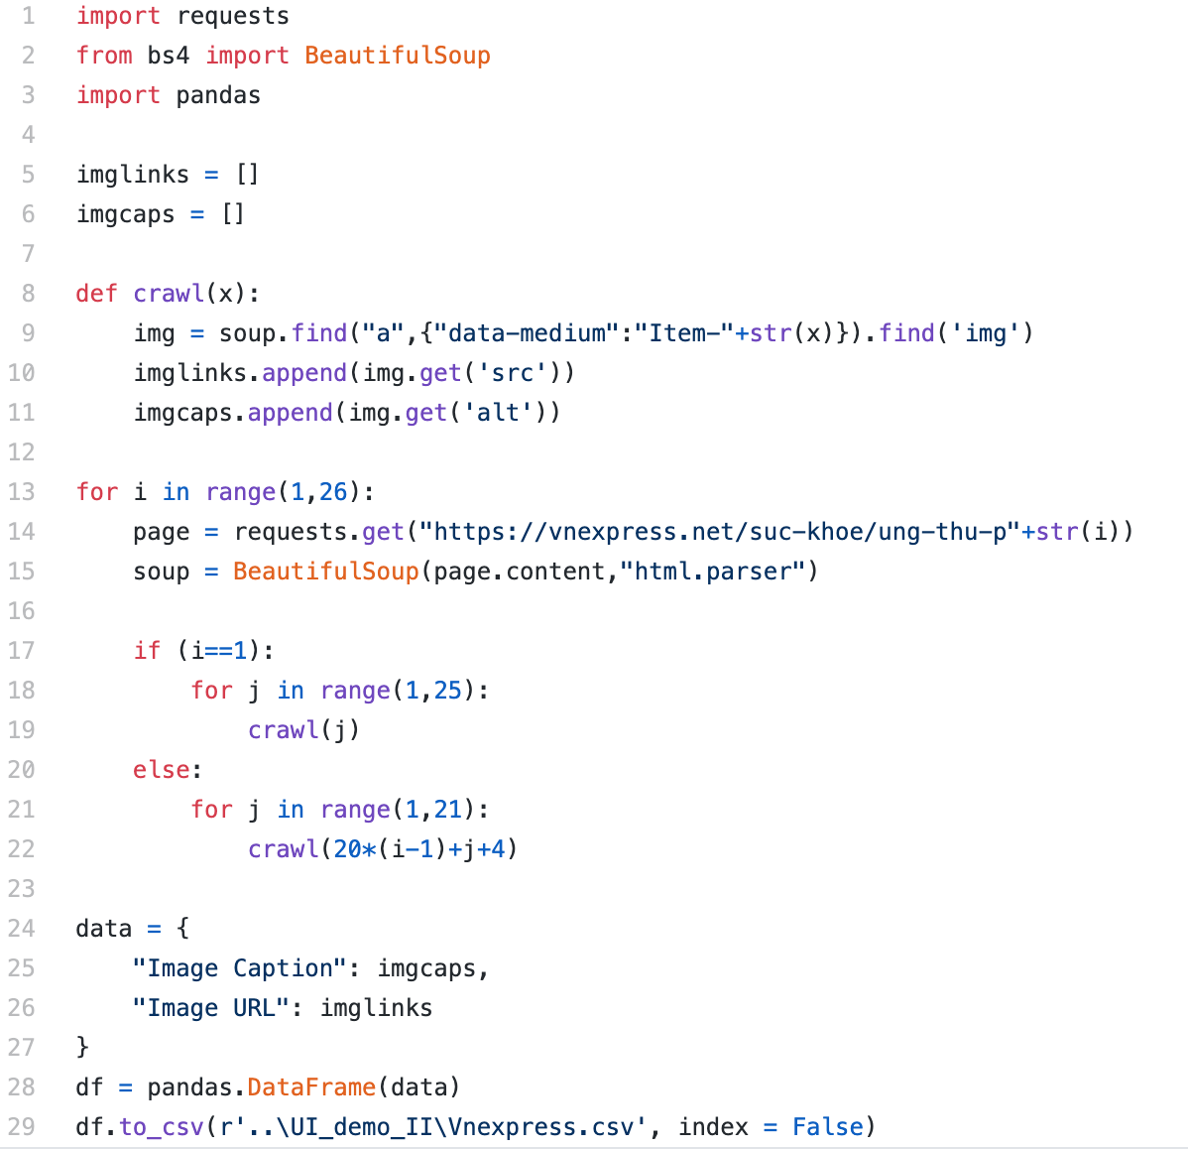
VIII. Code
Vnexpress

Slide 13
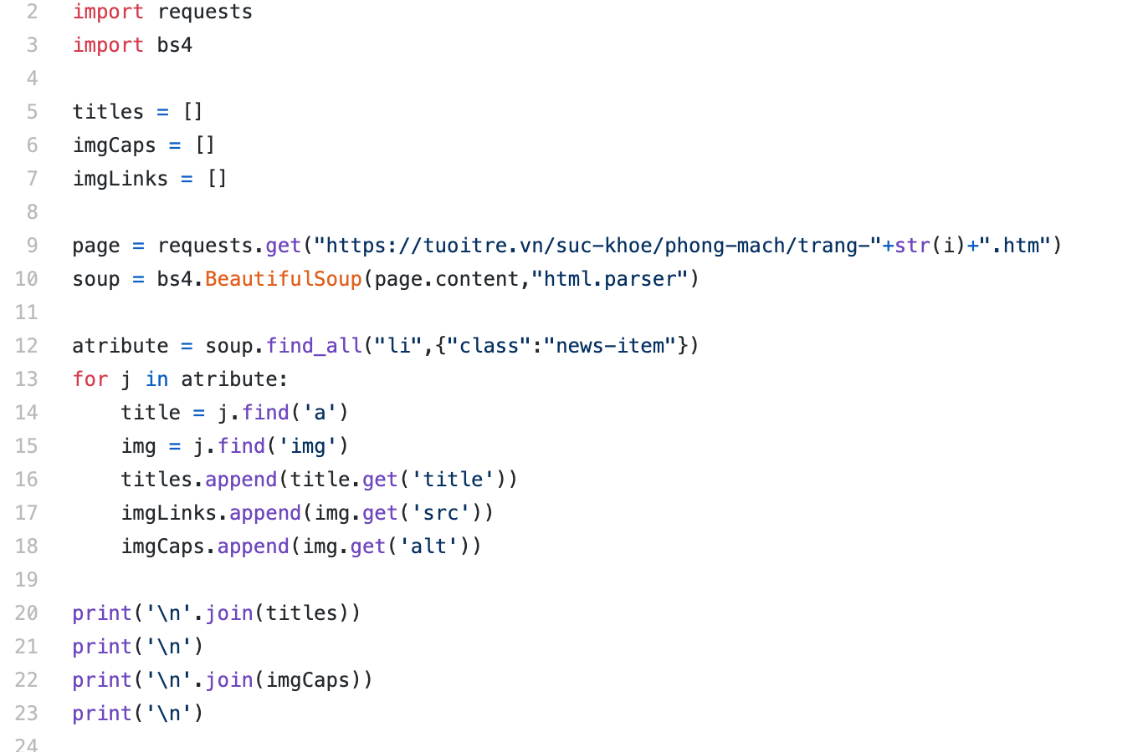
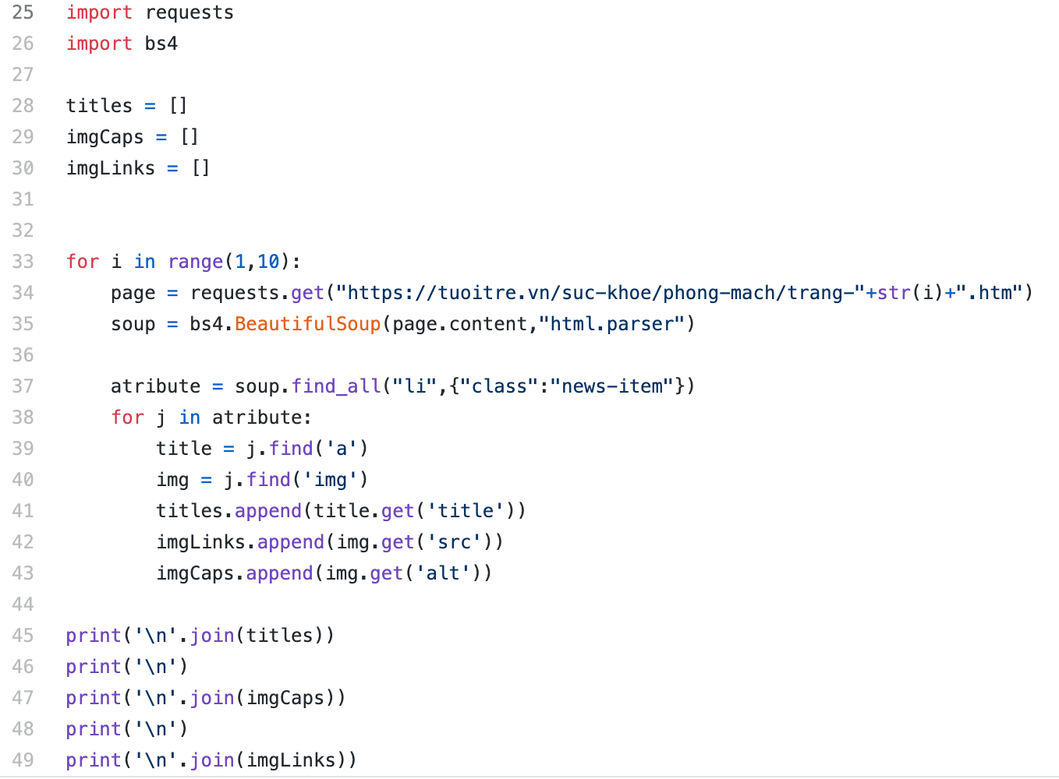
VIII. Code
Tuoitre.vn

Slide 14
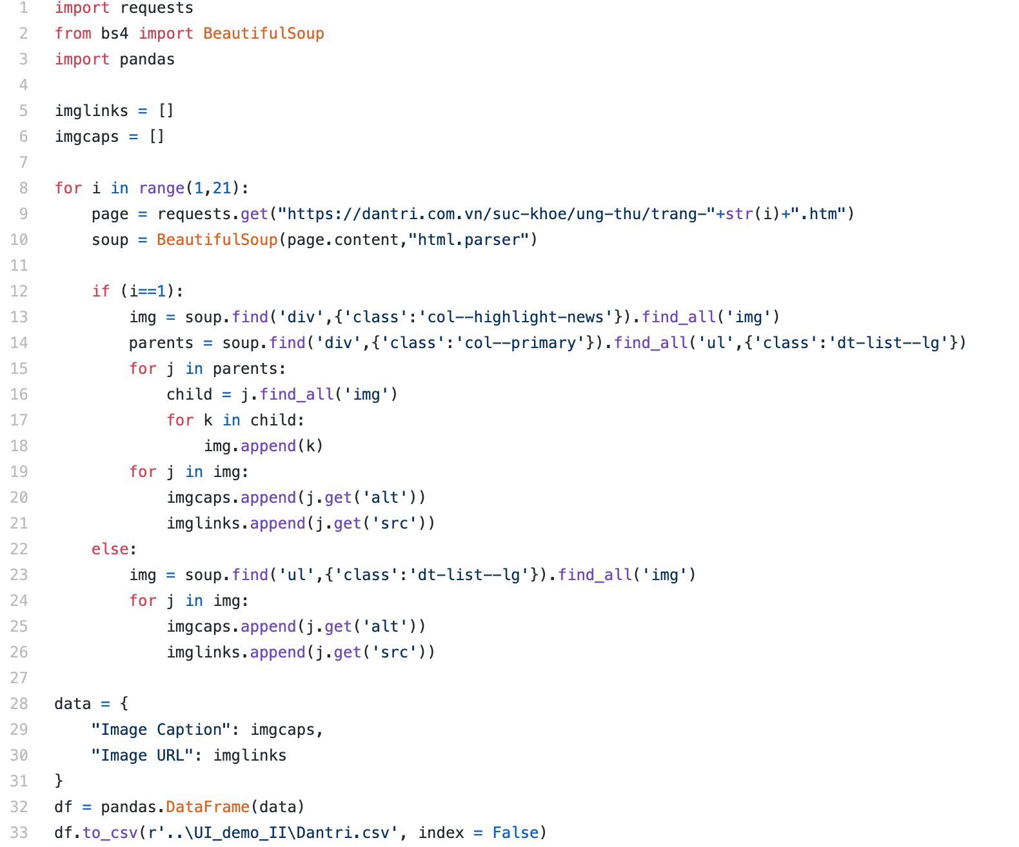
VIII. Code
Dantri.vn

Slide 15
Group 12
Hoàng Nhật Tân
Nguyễn Tiến Dũng
Đinh Gia Lượng
Nguyễn Minh Hiếu
Đặng Hữu Nhật Quang

Slide 16

Thank for watching

