Slide 1
Strategies of Legitimizing Violations of International Law in Leaders’ Speeches at the United Nations General Assembly (1945–2023)
Thesis Paper | Ayvazyan Aram | 4th year, Group 222
Supervisor: Ivan Pavlyutkin, Candidate of Science in Sociology, Associate Professor
HSE University | Moscow, 2026

Slide 2
Problem
Every year, states face allegations of violating international law — yet their leaders return to the UN General Assembly floor to publicly justify those actions before 193 member states.
The problem is that existing research cannot explain:
• which legitimation strategies actually dominate across the full postwar period;
• how the repertoire has shifted across historical turning points;
• whether geopolitical blocs draw on distinguishable rhetorical approaches.
This leads to a gap between theoretical claims about deliberative legitimacy and the systematic corpus-based evidence needed to test them.

Slide 3
Relevance
Legitimacy matters in IR:
States do not rely on military power alone — they invest diplomatic resources in constructing public justifications even after decisions are made (Rapp, 2022)
The UNGA General Debate is the primary public arena:
11,127 speeches, 198 countries, 1946–2023 — genre-stable, universal, on the record
Empirical gap:
Published research consists of deep vertical case studies (Kosovo 1999, Iraq 2003, Suez 1956). The horizontal view — across states, across time, across violation types — remains unavailable.
This study addresses that gap
with a corpus-based, longitudinal, multi-bloc account of legitimation strategies 1946–2023.

Slide 4
Literature Review
Core Works
Full Reference List
Habermas, J. (1984) Theory of communicative action — 4-type typology of social action; validity claims (truth, rightness, sincerity)
Bjola, C. (2005) Deliberative legitimacy at the UNGA; communicative action → justification of force (Kosovo, Iraq)
Risse, T. (2000) "Let's argue!": logic of arguing as third mode of social interaction in IR; arguing vs. bargaining
Müller, H. (2004) Communicative rationality and appropriateness logic in multilateral institutions
Franck, T. M. (1990) Compliance pull of legitimate rules — legitimacy as measurable property of norms
Hurd, I. (1999) Legitimacy as normative belief — third mechanism of social control alongside coercion and interest
Wiener, A. (2014) Contestation as norm-generative practice — legitimation repertoires evolve through challenge and justification
Rapp, K. (2022) Justifying force through international law — actors feel compelled to portray conduct as legal even when tenuous
Baturo et al. (2017); Jankin et al. (2025) Harvard UN General Debate Corpus — 11,127 speeches, 198 countries, 1946–2023
Baturo, A., Dasandi, N., & Mikhaylov, S. J. (2017). Understanding state preferences with text as data. Research & Politics, 4(2), 1–9.
Bjola, C. (2005). Legitimating the use of force in international politics. EJIR, 11(2), 266–303.
Dinkel, J. (2019). The Non-Aligned Movement: Genesis, Organization and Politics (1927–1992). Brill.
Franck, T. M. (1990). The power of legitimacy among nations. Oxford University Press.
Gronau, J., & Schmidtke, H. (2016). The quest for legitimacy in world politics. Review of International Studies, 42, 535–557.
Haberman, S. J. (1973). The analysis of residuals in cross-classified tables. Biometrics, 29(1), 205–220.
Habermas, J. (1984). The theory of communicative action: Vol. 1. Beacon Press.
Head, N. (2008). Critical theory and its practices: Habermas, Kosovo and IR. Politics, 28(3), 150–159.
Hsieh, H.-F., & Shannon, S. E. (2005). Three approaches to qualitative content analysis. Qualitative Health Research, 15(9), 1277–1288.
Hurd, I. (1999). Legitimacy and authority in international politics. International Organization, 53(2), 379–408.
Jankin, S., Baturo, A., & Dasandi, N. (2025). Words to unite nations: The complete UNGDC. Journal of Peace Research, 62(4), 1339–1351.
Koskenniemi, M. (2005). From apology to utopia (Reissue). Cambridge University Press.
Landis, J. R., & Koch, G. G. (1977). The measurement of observer agreement. Biometrics, 33(1), 159–174.
Müller, H. (2004). Arguing, bargaining and all that. EJIR, 10(3), 395–435.
Prashad, V. (2007). The darker nations: A people's history of the Third World. The New Press.
Rapp, K. (2022). Justifying force: International law and foreign policy decision-making. EJIR, 28(2), 337–360.
Risse, T. (2000). "Let's argue!": Communicative action in world politics. International Organization, 54(1), 1–39.
Wiener, A. (2014). A Theory of Contestation. Springer.
PRIMARY SOURCES
United Nations (1945). Charter of the United Nations.
UNGA (2014). Territorial integrity of Ukraine, A/RES/68/262.
UNSC (2001). Threats to peace and security caused by terrorist acts, S/RES/1373(2001).

Slide 5
Research Questions
Main Research Question:
“What legitimation strategies are employed by state leaders in speeches delivered at the UN General Assembly General Debate to justify conduct alleged to violate international law, from 1946 to 2023?”
Sub-Questions:
SQ1. Which of the identified strategies occur most frequently across the sampled corpus?
SQ2. How has the distribution of strategies shifted across historical periods (Cold War → post-9/11 → post-2014)?
SQ3. Do states from different geopolitical blocs draw on distinguishable legitimation repertoires, or does discourse converge across bloc boundaries?

Slide 6
Hypotheses
H1 — Ideational Convergence:
Post-9/11 counter-terrorism framing increased across ALL geopolitical blocs without statistically significant inter-bloc differentiation
H2 — Repertoire Character:
Dominant strategies function as normative-legal action in Habermas’s typology (Charter invocations, self-defense claims, sovereignty appeals) — not as strategic evasion or denial
H3 — Temporal Dynamics:
Strategy distribution shifts across periods: counter-terrorism dominant post-2001, sovereignty-revisionist framing intensifies post-2014
H4 — Geopolitical Variation:
Western states show significantly lower reliance on normative-legal framing relative to Soviet/Eastern and Non-Aligned states

Slide 7
Object — Subject — Goal
Object
UNGA General Debate speeches in which a state leader addresses conduct facing documented external allegation of legal or normative violation (11,127 speeches, 198 countries, 1946–2023)
Subject
The type, frequency, temporal evolution, and geopolitical differentiation of legitimation strategies deployed in response to allegations of international law violations
Goal
To establish empirically which legitimation strategies dominate, how their distribution has shifted across four historical periods, and whether Cold War bloc membership predicts systematic divergence in rhetorical register

Slide 8
Research Framework
Object
UNGA General Debate Corpus (Harvard UNGDC): 11,127 speeches, 198 countries, 1946–2023
Subject
Distribution, evolution, and geopolitical differentiation of legitimation strategy types
Theory
Habermas (1984) theory of communicative action; directed qualitative content analysis (Hsieh & Shannon, 2005); IR applications: Risse (2000), Müller (2004), Bjola (2005)
Time frame
Four periods: Cold War (1946–89) | Post-CW (1990–2001) | Post-9/11 Security Turn (2002–13) | Post-2014 Fragmentation
Research gap
No prior study combines 77-year corpus breadth, Habermasian theoretical coding, and systematic cross-bloc comparison of legitimation strategies

Slide 9




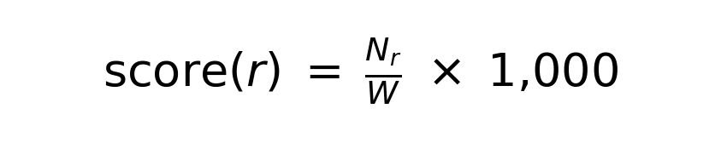
Methodology
Method
Data
What is measured
Level 1: Keyword Signal Analysis
Harvard UNGDC 11,127 speeches
Normalized keyword density by signal, bloc, period (hits per 1,000 words)
Level 2: Directed QCA
33 case-years 102 coded segments
Habermas action type per segment; co-occurrence of strategy & violation type
Statistics
Chi-sq, Fisher exact, ANOVA, t-tests, CA, V, kappa
H1: ANOVA/t-tests | H3: chi-sq/V H4: Fisher exact/CA | Reliability: kappa
Key formulas:
Inter-coder reliability target: kappa >= 0.70 (substantial agreement, Landis & Koch 1977)

Slide 10
Structure of the Work
Introduction
Research problem, RQs, hypotheses, design overview, limitations
Ch. 1 Literature Review
Legitimacy in IR (Franck, Hurd, Wiener); UNGA as rhetorical arena; contributions and gaps
Ch. 2 Theoretical Framework
Habermas’s typology of social action; IR applications (Risse, Müller, Bjola); operationalization of legitimation strategy
Ch. 3 Methodology
Two-level analytical design; Harvard UNGDC; criterion-based sampling; coding framework; statistical methods
Ch. 4 Empirical Analysis
Aggregate distribution; comparative case analysis; temporal dynamics (H3); H1 convergence test; geopolitical differentiation (H4)
Ch. 5 Discussion
Hypothesis assessment (H1–H4); communicative vs. strategic action in practice; theoretical contributions; limitations; future research
Conclusion
Direct answer to the main RQ; what the analysis has established

Slide 11
Coding Framework
Master Architecture: Habermas’s (1984) Four-Type Taxonomy of Social Action
Habermas Type
Validity Claim
Communicative Roles (9 total)
Communicative action (Verständigung)
Truth
Justification; Dialogue appeal
Normative action (Richtigkeit)
Rightness
Legal-normative invocation; Sovereignty norm
Dramaturgical action (Wahrhaftigkeit)
Sincerity
Historical context; Victim narrative
Strategic action (success-oriented)
—
Denial; Counter-accusation; Delegitimation
Manual strategy layer (8 types): Self-defense & necessity | Sovereignty & non-interference | Counter-terrorism & securitization | Procedural-legal claims | Historical & existential narratives | Denial & reinterpretation | Whataboutism & tu quoque | Moral & humanitarian framing

Slide 12
Empirical Analysis: Analytical Procedure
ANALYZE
102 coded segments × 9 communicative roles × 4 periods × 3 blocs Keyword density scoring: score(r) = Nᵣ/W × 1,000
↓
COMPARE
Chi-square tests (bloc, period) | Fisher’s exact (pairwise blocs) | Adjusted residuals | Correspondence analysis | ANOVA + t-tests (H1)
↓
RESULT
Frequency & co-occurrence distributions | Temporal shift statistics | Bloc-differentiation p-values | CA biplots | Hypothesis assessments
Sample: 33 case-years | 18 states | 4 periods | 3 geopolitical blocs | 102 segments | 4.9% unclassified

Slide 13
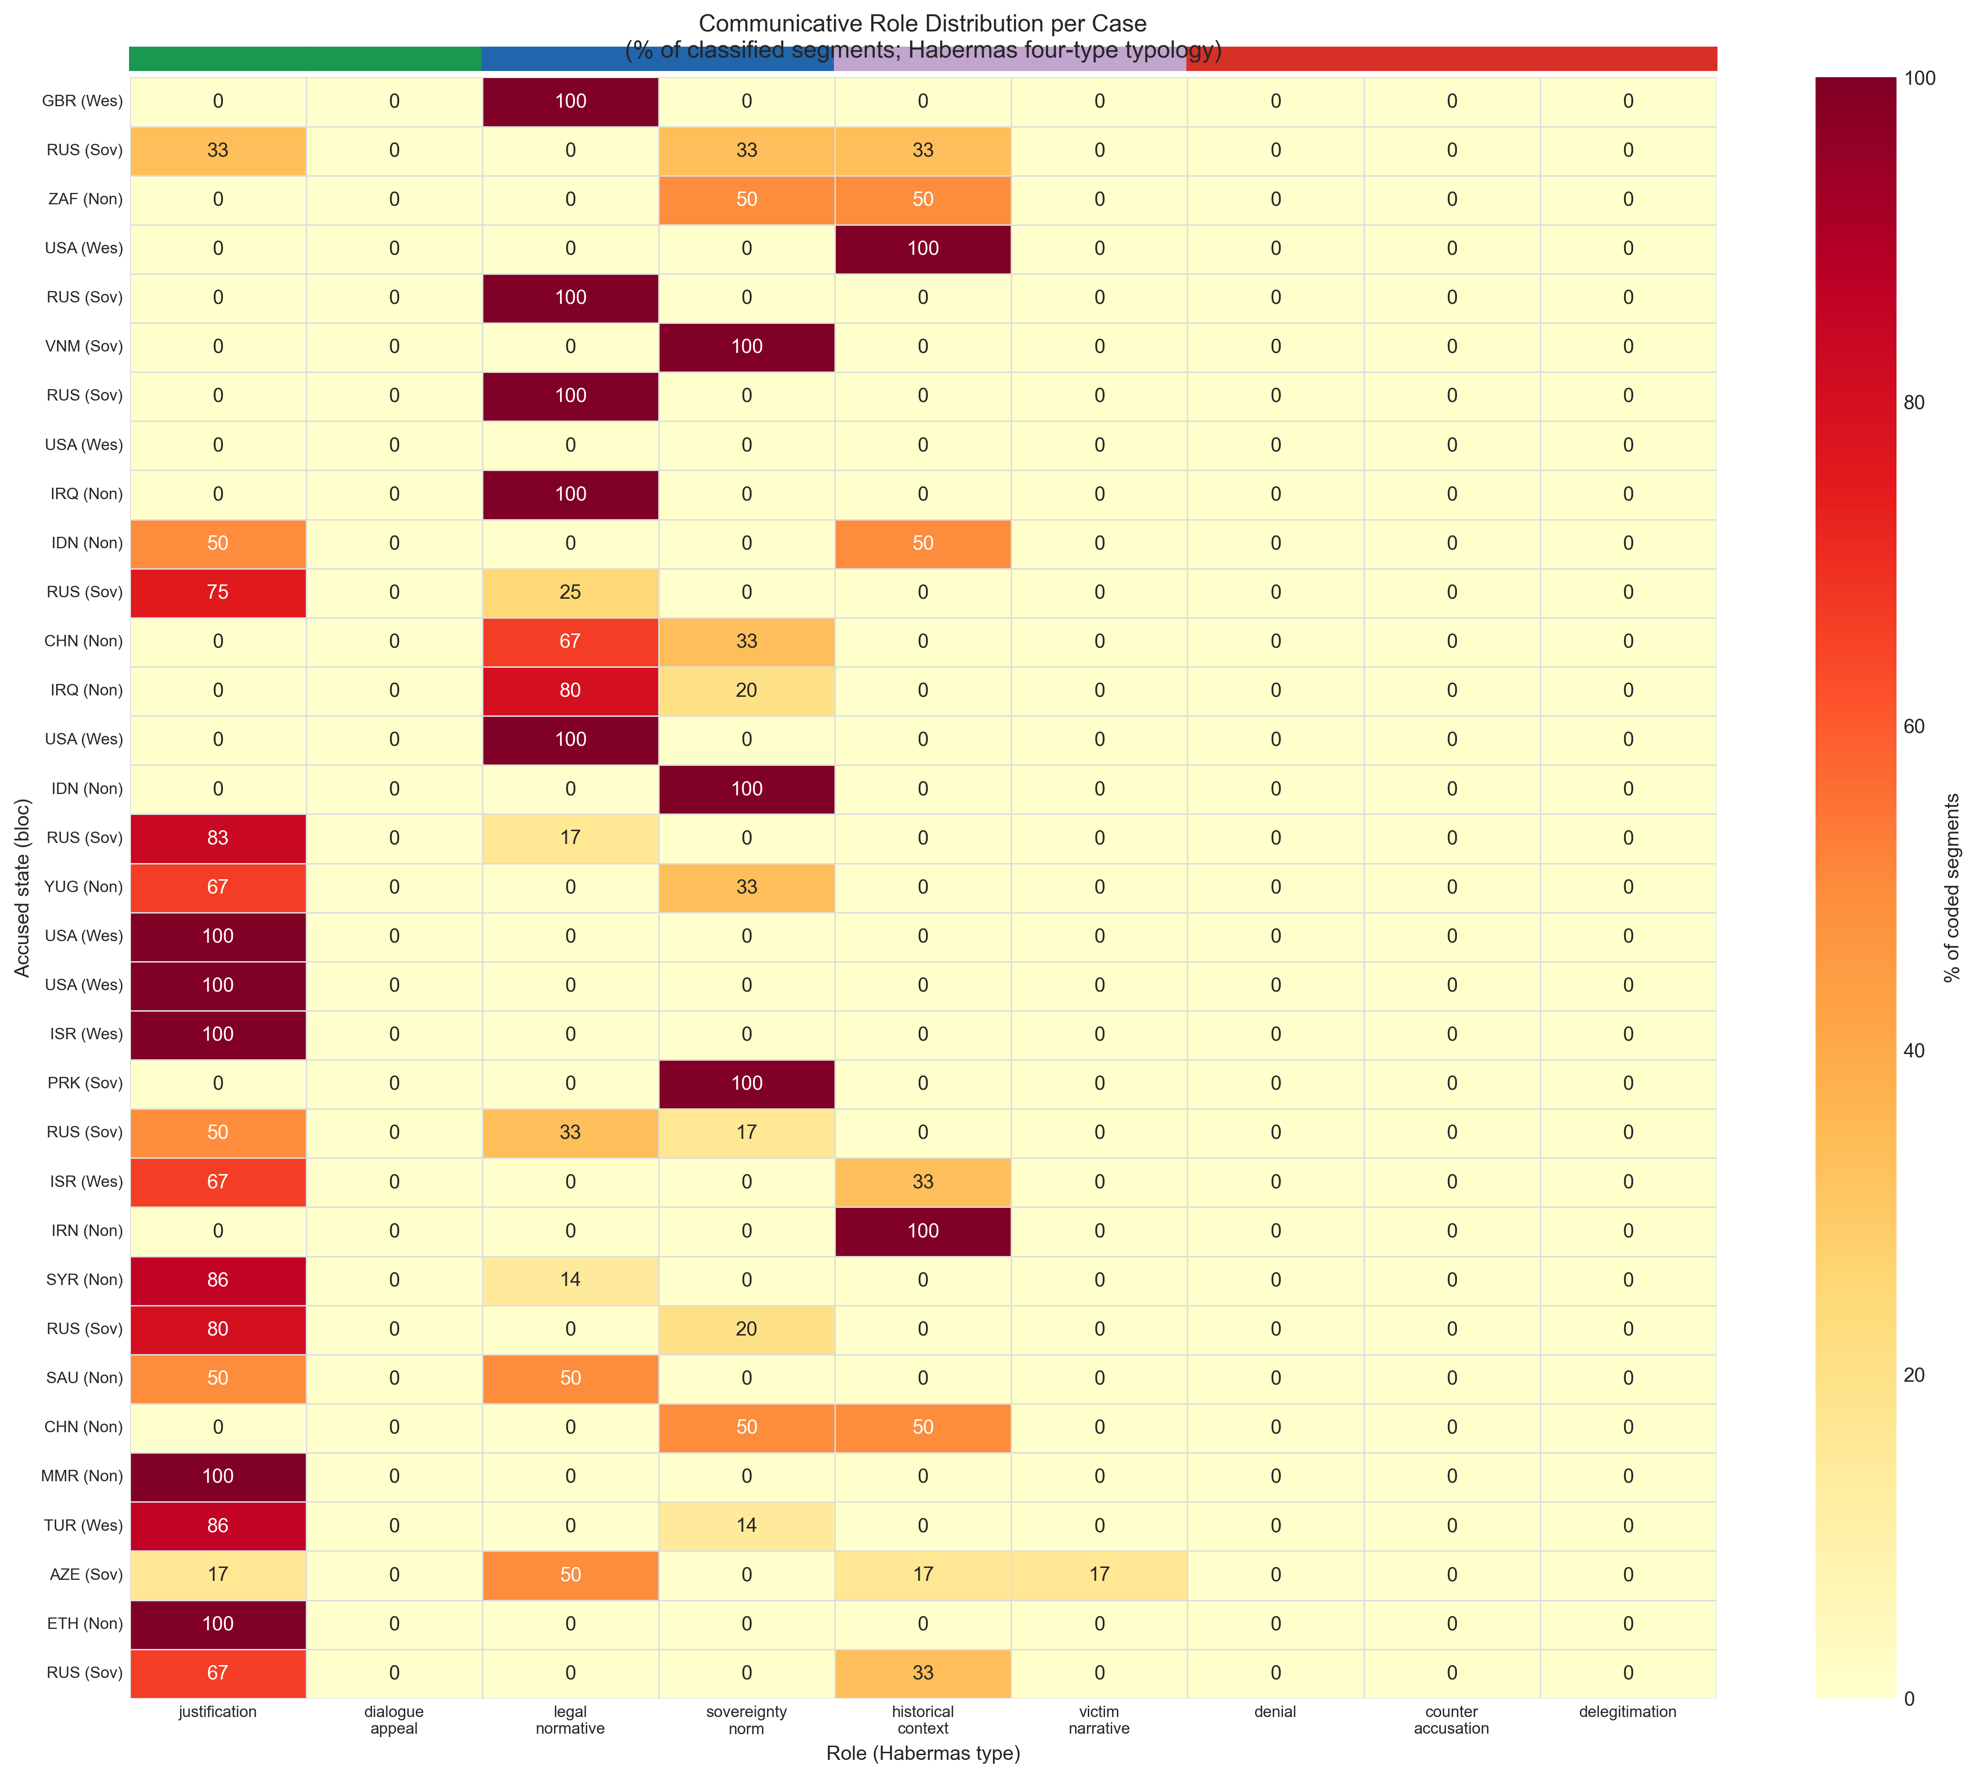
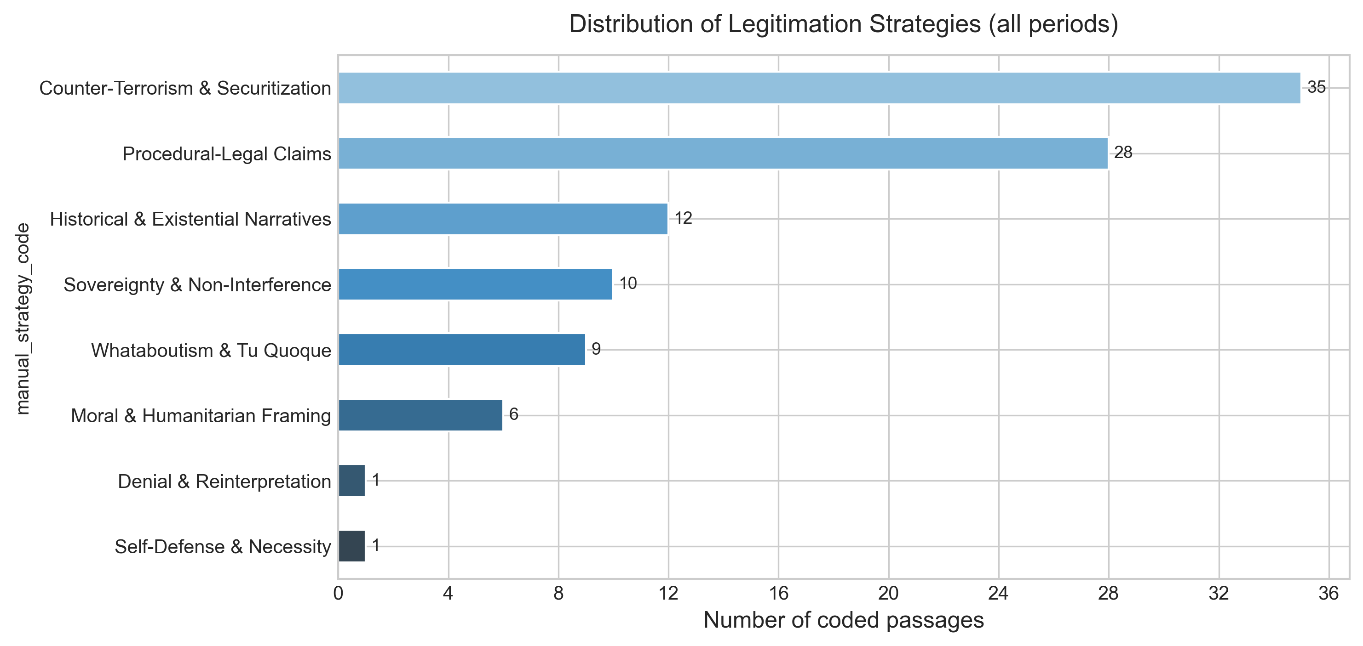
Empirical Findings: Sample Overview (Figure 4.1)
Figure 4.1 — Role Heatmap: Communicative Roles per Case-Year Grouped by Habermas Action Type and Period Each row = one case-year (33 total) Each column = one of 9 communicative roles Color intensity = keyword density score Banded background = Habermas action type Strategic roles (denial, counter-accusation, delegitimation): absent as dominant mode in every row of the sample

Slide 14
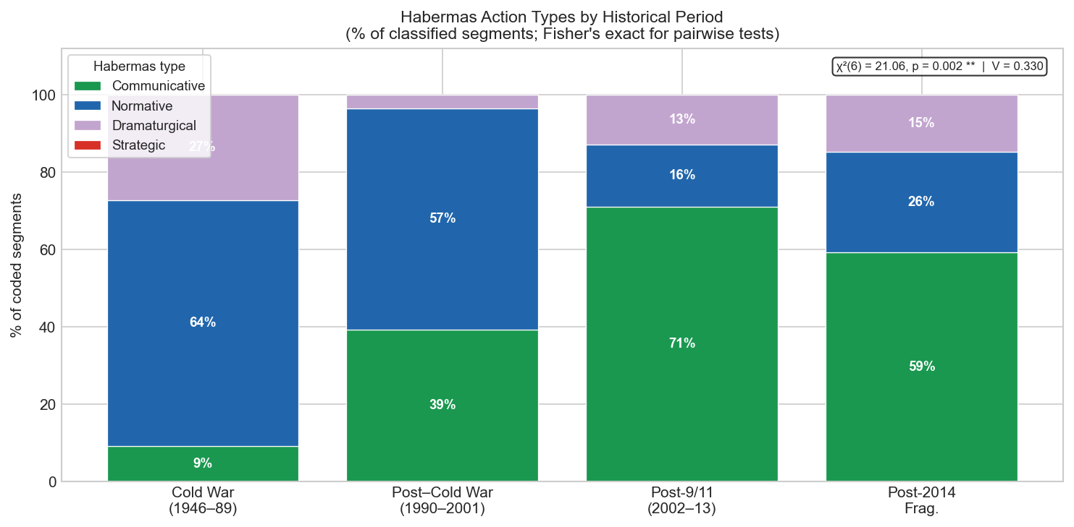
Temporal Dynamics — H3 Assessment
χ²(6) = 21.06, p = .0018, Cramér’s V = .33 (moderate effect)
Cold War (1946–89): Normative dominant — 64% | Communicative: 9%
Post-CW (1990–2001): Normative still dominant — 57% | Communicative rises: 39%
Post-9/11 (2002–13): Decisive reversal — Communicative surges to 71% | Normative: 16%
Post-2014 (frag.): Partial reversion — Communicative: 59% | Normative recovers: 26%
→ September 2001 is a discursive turning point, not a gradual drift
→ H3 supported

Slide 15
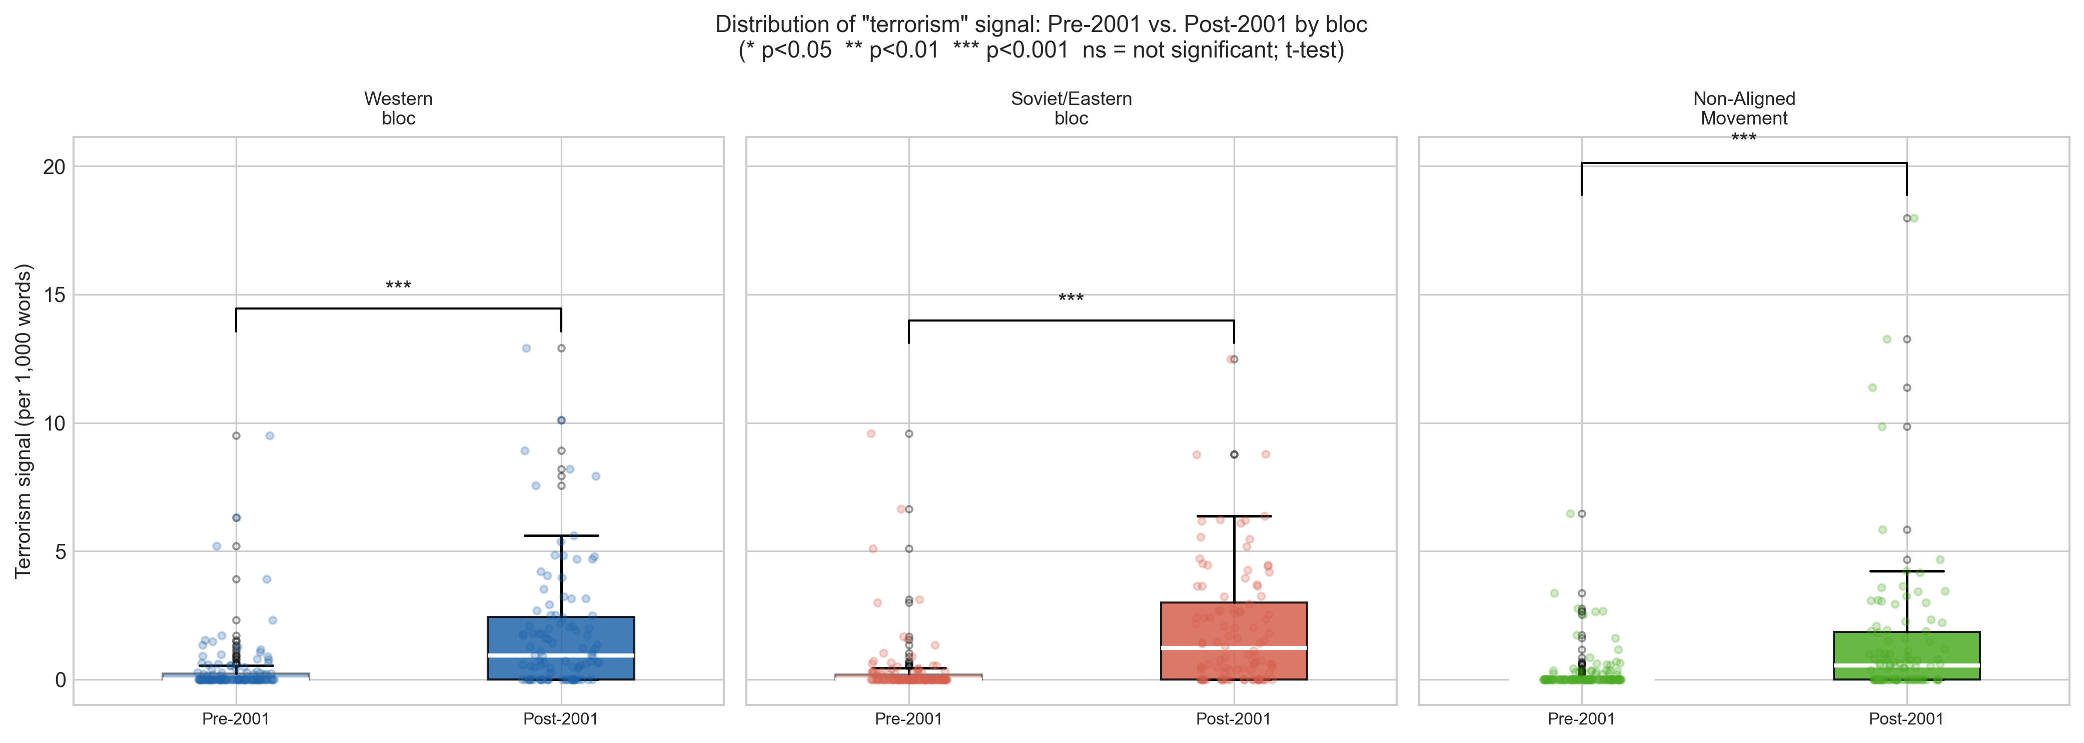
Cross-Bloc Convergence in Counter-Terrorism Framing — H1
ANOVA, pre-2001: F = 0.39, p = .678 (no inter-bloc differentiation)
ANOVA, post-2001: F = 1.29, p = .288 (no inter-bloc differentiation)
Within-bloc t-tests (pre vs. post 2001):
Western: p < .001 — significant increase
Soviet/Eastern: p < .001 — significant increase
Non-Aligned: p < .001 — significant increase
→ Counter-terrorism framing became a universal rhetorical commons after September 2001
→ H1 supported: adoption was cross-bloc, not concentrated in any single bloc

Slide 16
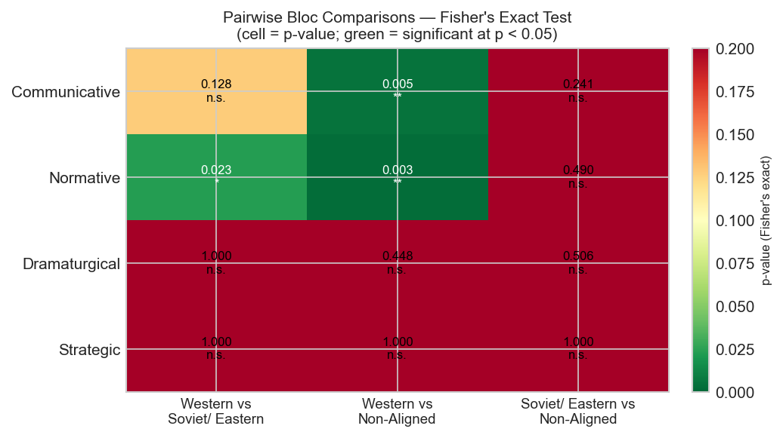
Geopolitical Bloc Differentiation — H4 Assessment
Fisher’s Exact Tests (pairwise, normative action):
Western vs. Soviet/Eastern: OR = 0.20, p = .023 ✓ significant
Western vs. Non-Aligned: OR = 0.14, p = .003 ✓ significant
Soviet/Eastern vs. NAM: p = .490 (not significant)
Habermas types by bloc:
Western bloc: 79% communicative (justification) | 12% normative
Soviet/Eastern: 50% communicative | 39% normative
Non-Aligned: 34% communicative | 49% normative
CA: 82.5% of inertia on Dimension 1 Western bloc ↔ justification role Non-Aligned/Soviet ↔ legal-normative, sovereignty-norm roles
→ H4 supported

Slide 17
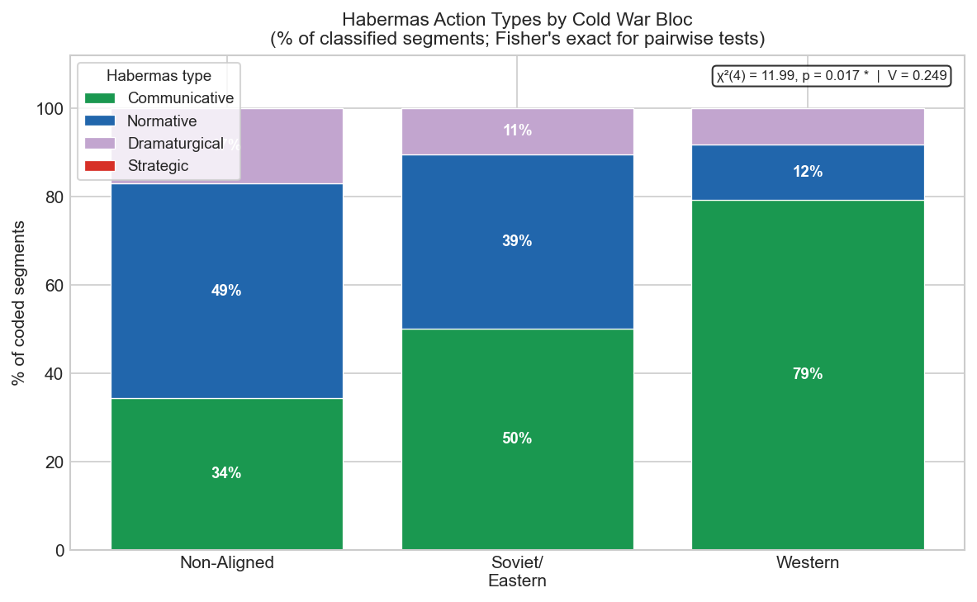
H4: Habermas Action Types by Cold War Bloc
Communicative action dominates in all blocs, but at different levels: Western bloc: 79% communicative | 12% normative Soviet/Eastern: 50% communicative | 39% normative Non-Aligned: 34% communicative | 49% normative chi-sq(4) = 11.99, p = .017, V = .249 (Figure 4.2, thesis p. 36)

Slide 18
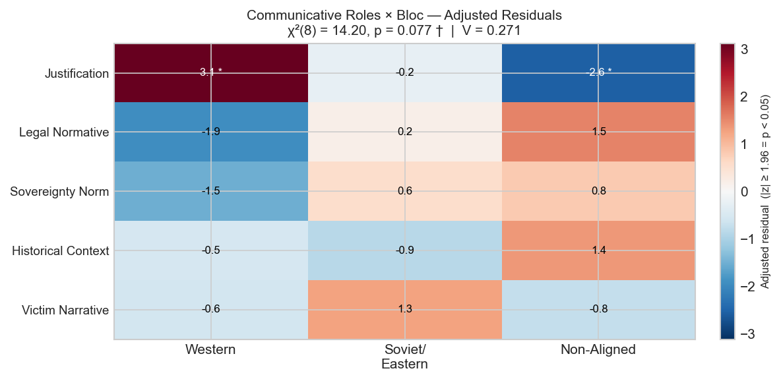
H4: Adjusted Residuals — Communicative Roles x Bloc
Justification is significantly over-represented in the Western bloc (+3.1*). Legal-normative and sovereignty-norm are over-represented in Soviet/Eastern and Non-Aligned blocs. chi-sq(8) = 14.20, p = .077, V = .271 Cells with |z| >= 1.96 marked with * (Figure 4.4, thesis p. 39)

Slide 19
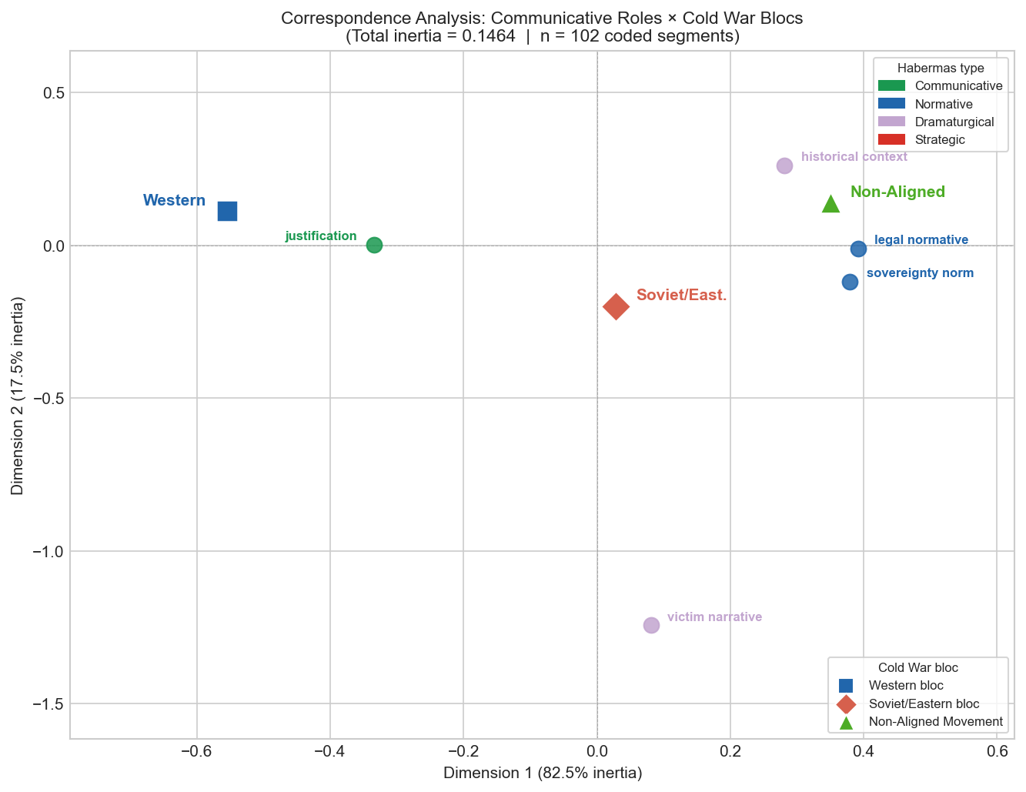
H4: Correspondence Analysis — Roles x Cold War Blocs
CA decomposes 82.5% of inertia on Dimension 1. Western bloc (coord. -0.555): co-located with justification role (-0.334) Non-Aligned (+0.350): co-located with legal_normative (+0.392) and sovereignty_norm (+0.379) Soviet/Eastern: near origin (+0.028) (Figure 4.12, thesis p. 163)

Slide 20
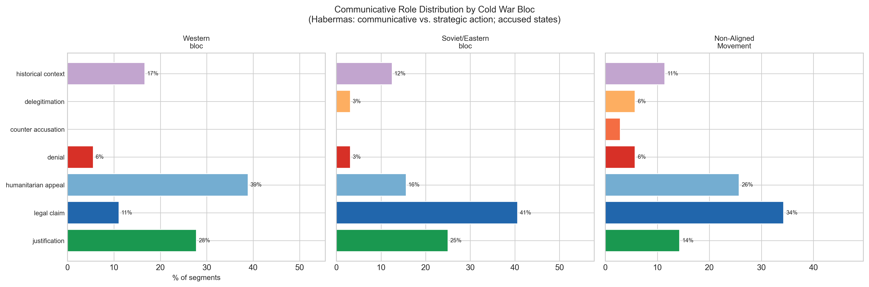
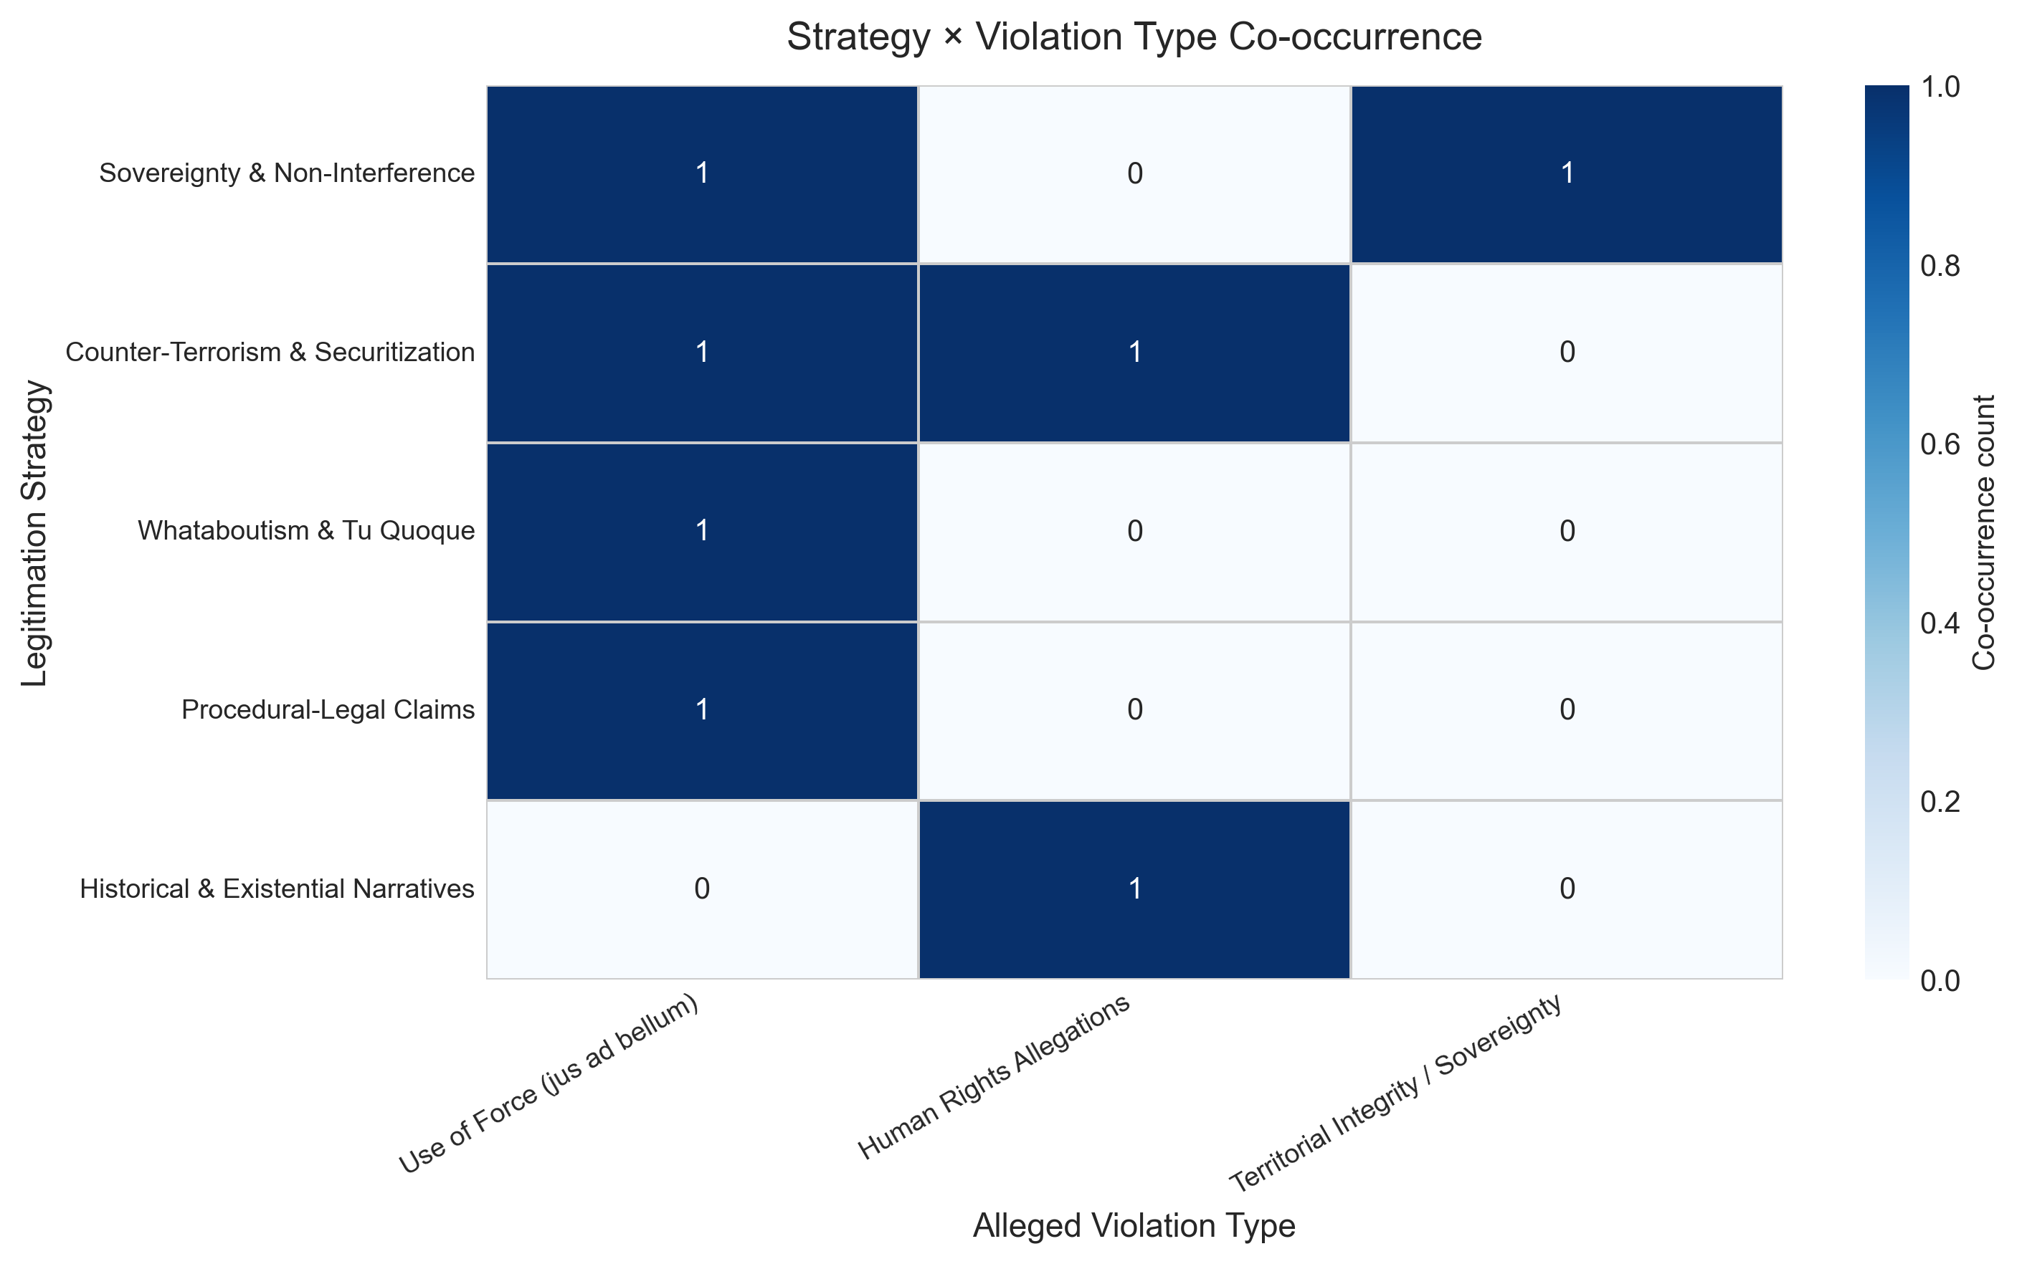
Figure 4.3: Role Distribution by Bloc — Nine Communicative Roles
Bars show the percentage of classified segments assigned to each communicative role within each Cold War bloc. Western bloc: dominated by justification (communicative) Soviet/Eastern: mix of justification and legal-normative Non-Aligned: strongest legal-normative and sovereignty-norm Strategic roles (denial, counter-accusation, delegitimation): absent as dominant mode across all three blocs (Figure 4.3, thesis p. 37)

Slide 21
Results
Result 1: Strategic action is absent as a dominant mode
0 of 97 classified segments coded under denial, counter-accusation, or delegitimation → The UNGA forum imposes a structural demand for normative performance on every state
Result 2: Counter-terrorism framing is a universal post-9/11 rhetorical commons
ANOVA p > .65 (pre-2001) | p > .28 (post-2001): no bloc-based differentiation → UNSC Resolution 1373 created a legitimation resource adopted uniformly across blocs
Result 3: Strategy distribution shifts significantly across historical periods
χ²(6) = 21.06, p = .0018, V = .33: Cold War normative → Post-9/11 communicative surge → September 2001 functions as a discursive turning point, not a gradual drift
Result 4: Western–non-Western asymmetry in normative register is measurable
Fisher’s exact: Western vs. NAM p = .003; Western vs. Soviet/Eastern p = .023 → Structural position — not rhetorical preference — drives the differential

Slide 22
Conclusion
All four hypotheses are supported:
H1 ✓
Counter-terrorism rhetoric is a cross-bloc ideational common, not bloc-specific
H2 ✓ (qualified)
Repertoire is legitimation-oriented; dominant register is argumentative (communicative), not norm-invoking — states argue rather than simply assert
H3 ✓
Statistically significant temporal shift (χ² = 21.06, p = .0018, V = .33): Post-9/11 communicative surge, partial normative recovery post-2014
H4 ✓
Western–non-Western asymmetry in normative register reflects structural positions in the Charter architecture, not rhetorical preference
What the analysis has established:
States before the UNGA cannot appear strategically oriented — the forum requires the performance of normative justification regardless of underlying intent.

Slide 23
Value and Application
Where the findings can be applied:
Diplomatic communication analysis:
Predicting legitimation repertoires by actor bloc and historical period
International law scholarship:
Corpus-based evidence for deliberative legitimacy theory (Bjola 2005; Risse 2000)
IR theory:
Empirical test of Habermasian communicative action claims at institutional scale
Policy analysis:
Understanding what rhetorical resources states deploy in future contested military actions
Boundaries of the findings:
UNGA General Debate only — Security Council, bilateral channels, domestic discourse out of scope
Translation constraints for non-English subcorpora may affect keyword precision
33 case-years — adequate for pattern detection; insufficient for precise frequency estimation

