Slide 1
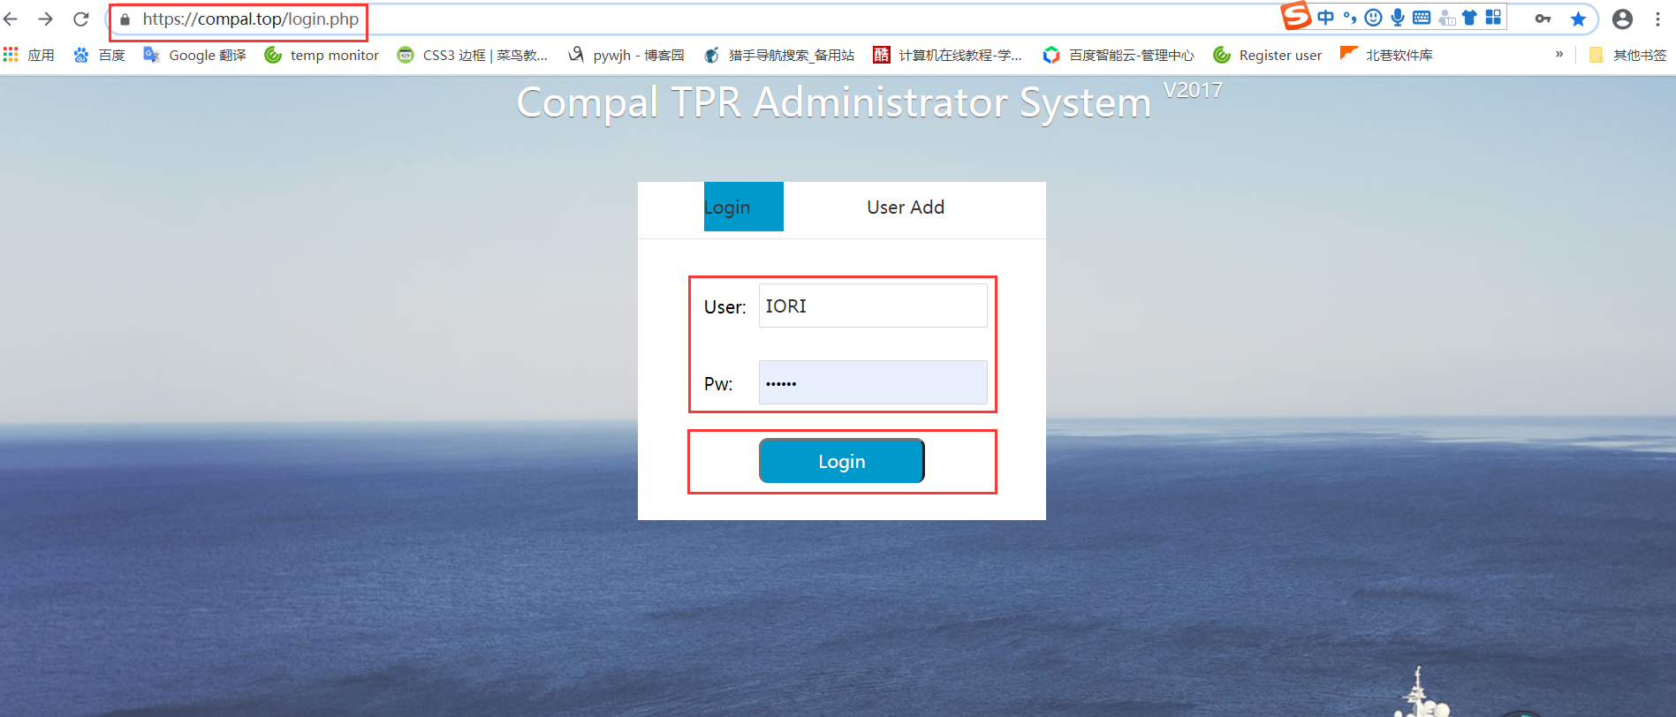
空白演示
单击输入您的封面副标题

Slide 2
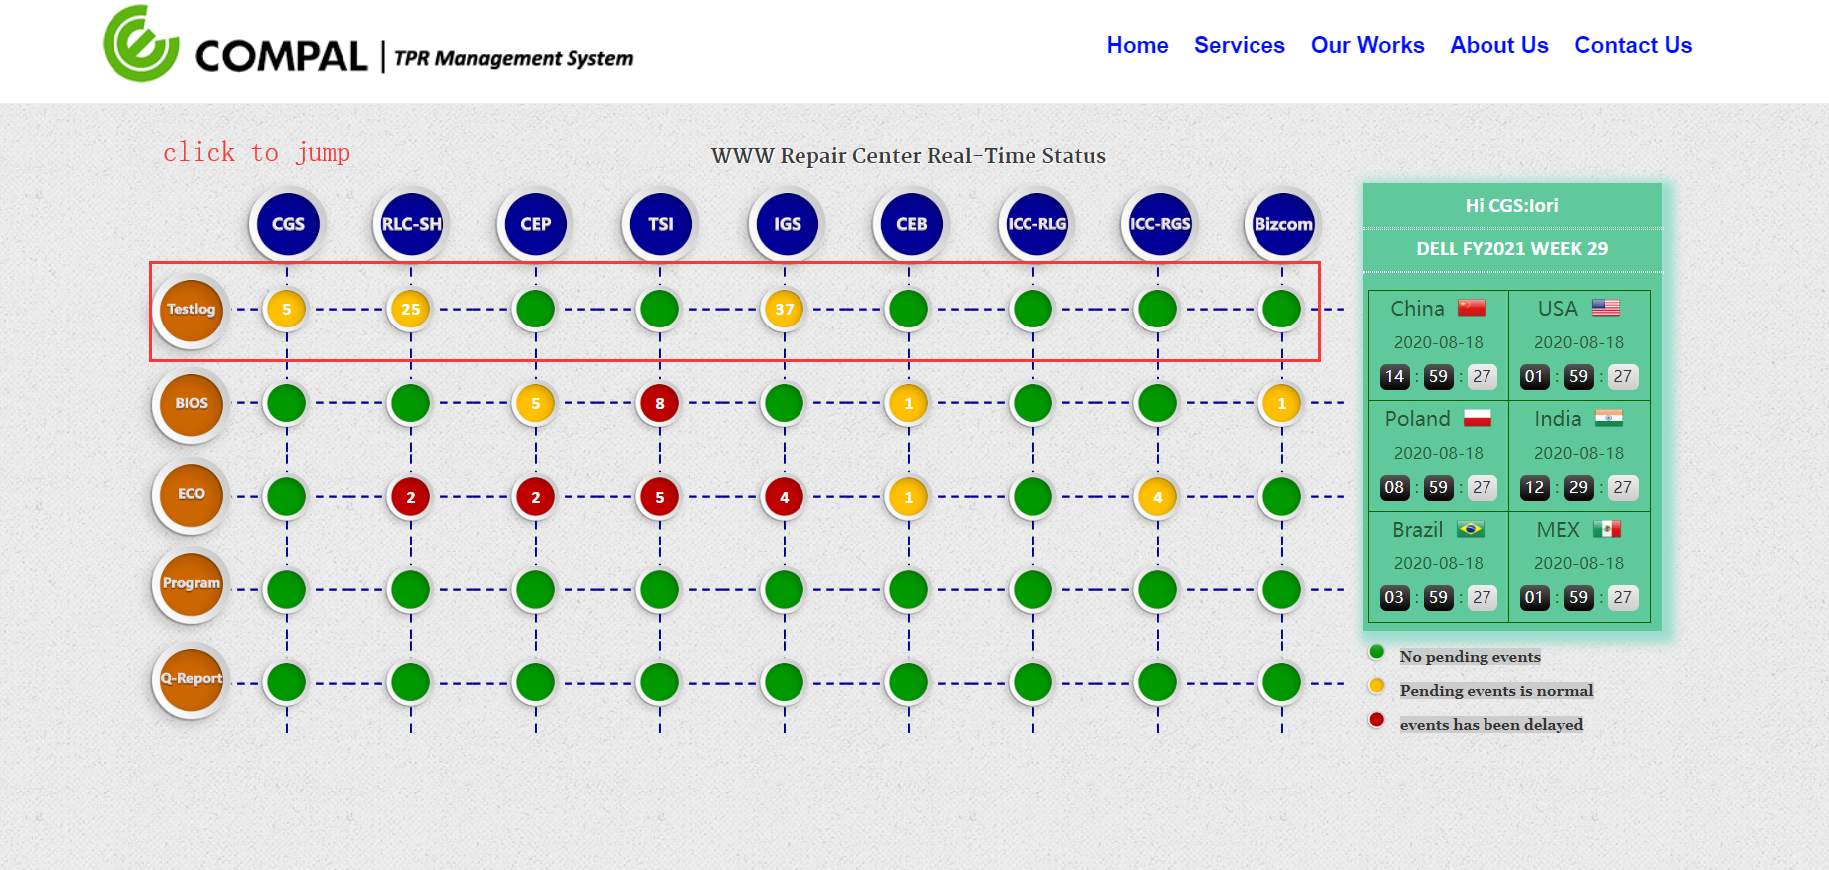


Slide 3
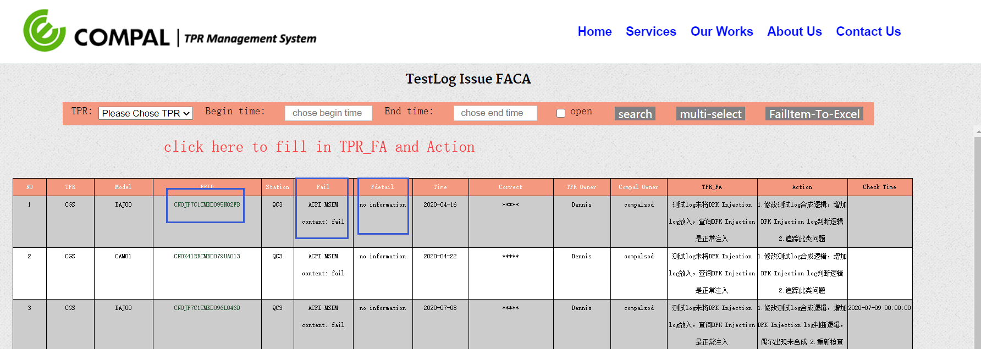
COMPAL Owner click to check pass or not

