Slide 1

Havelock Dive Club
Dive into Another World – Explore Andaman

Slide 2

About Havelock Dive Club
Havelock Dive Club is a trusted scuba diving center in the Andaman Islands offering safe, fun, and
professional diving experiences for beginners and experts.

Slide 3

Our Activities
• Discover Scuba Diving • Boat Dive & Shore Dive • Snorkeling & Sea Walk • Kayaking & Island
Tours

Slide 4
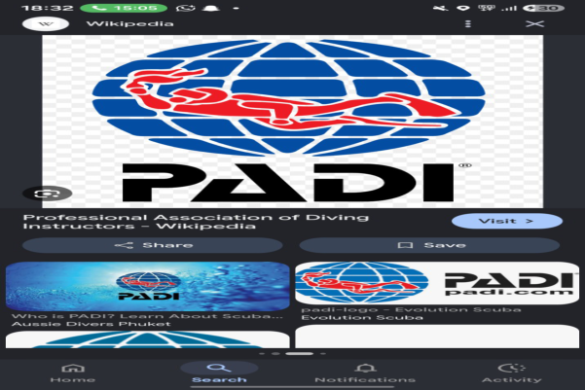

Dive Courses
We offer certified diving courses including Open Water, Advanced, Rescue Diver, and Divemaster
programs.

Slide 5

KK Tours and Travels
KK Tours and Travels provides complete Andaman travel solutions including packages, transport,
and bookings.

Slide 6
Contact Us
Phone: 9434290393 / 9679572772 Instagram: @havelockdiveclub Location: Havelock Island,
Andaman

