Slide 1



SynthAI Squad
AUTOMATIC PRICE & REVIEW COMPARISON
Making informed decisions, instantly.
NAME OF PROJECT:
Automatic Service Price & Review Comparison
We are SynthAI Squad A team of developers and researchers from IUBAT and MIU

Slide 2


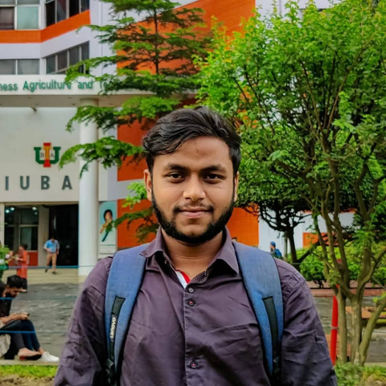


02/12
We Are SynthAI Squad
Md. Taher Bin Omar Hijbullah
Farhida Islam Toushi
Md. Masud Rana
Md. Rony Mia
Project Lead & Backend
NLP & Data Science
Web Scraping & DevOps
Frontend & UI/UX
https://www.linkedin.com/in/hijbullah/
https://www.linkedin.com/in/farhidah/
https://www.linkedin.com/in/md-masud-rana-2037592b7/
https://www.linkedin.com/in/muhammad-rony/
https://github.com/hijbullahx
https://github.com/farhida
https://github.com/whiteshadow-sohag
https://github.com/r-ony-s
IUBAT × Manarat International University

Slide 3

03/12
The Comparison Trap
  Finding the best local service is frustrating
  Manual & Slow
Browse 10+ websites to find prices
  Dozens of Tabs Copy-paste contact info and rates
  50+ Reviews
Hard to know who to trust
  Wasted Time & Money
poor decisions, overppaying, bad experiences
  No one has time for this.

Slide 4

04/12
A Large & Growing Digital Market
  Target Audience: Busy urban professionals, students, and families in Bangladesh who value time and trust.
Market
  Market Size (Services): The local digital service & consumer goods market is exploding. The e-commerce market alone is projected to hit $10.5 Billion by 2026.
  Key Trend: 4 in 10 Bangladeshi online shoppers state that online reviews are crucial to their decision.
  The Gap: There is no single tool that automates this trust-checking process.

Slide 5


One Search
All The Answers
05/12
We built an AI-powered platform that automatically gathers, analyzes, and compares service data — so you don’t have to.
[Messy browser tabs] → [SynthAI Icon] → [Clean comparison table]
From chaos to clarity in 10 seconds.

Slide 6
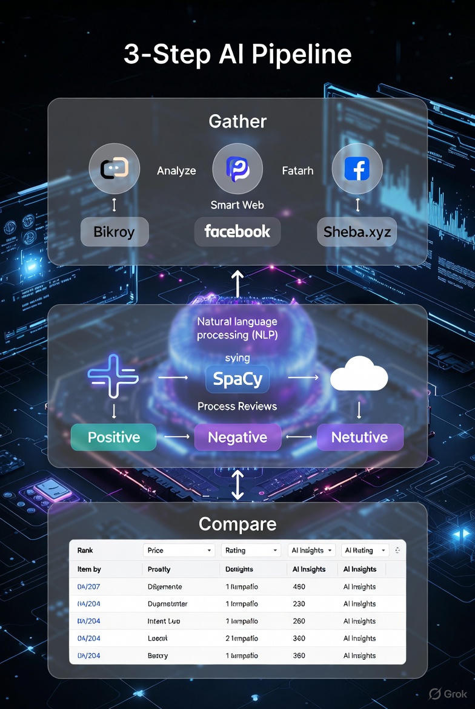
01
Gather
06/12
Smart web scrapers fetch price, reviews, and contact from Bikroy, Facebook, Sheba.xyz, and more
Our 3-Step
AI Pipeline
02
Analyze
SpaCy NLP reads every review
→ Classifies sentiment: Positive / Negative / Neutral
Tech Stack :
(Add this in a small box on the side)
AI :
SpaCy, SpacyTextBlob
Backend :
Python, Flask
Data :
Pandas, BeautifulSoup
03
Compare
Clean, ranked table by price, rating, and AI insights
Frontend :
HTML, Bootstrap
Fully automated. No human in the loop.

Slide 7
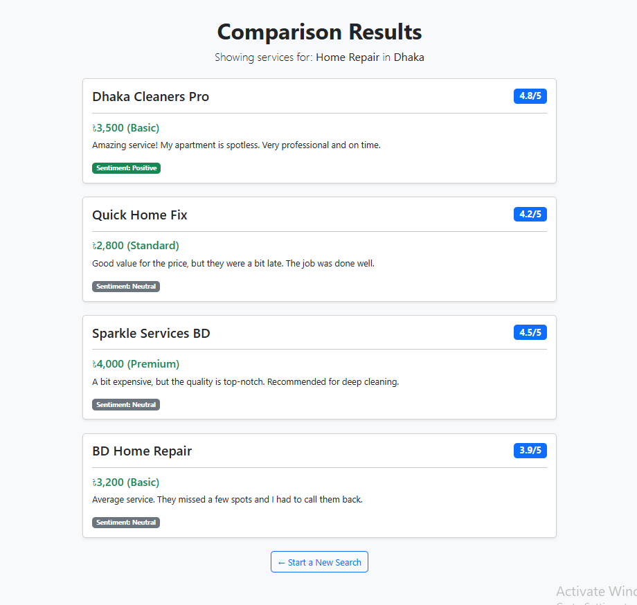
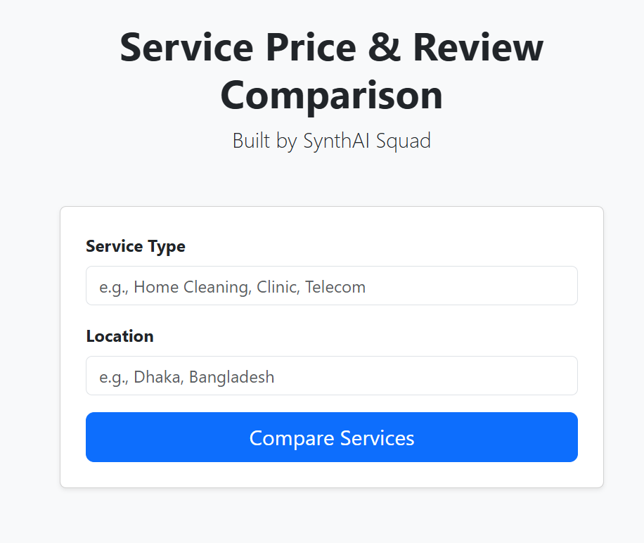
07/12
LIVE DEMO
Watch this →
  Open: http://127.0.0.1:5000
  Type: "Home Cleaning" + "Dhaka"
  Click: Compare Services
  See AI-powered results in < 10 seconds
Point out :
  Prices in BDT
  Star ratings
  Colored Sentiment Badges (Green = Positive)

Slide 8
08/12
We Don't Just Compare Price
We Compare Trust
Competitors (e.g., Bikroy, Facebook) →
  They are just LISTS.
  The user still has to do all the work of reading 50+ reviews.
Our AI Advantage (UVP):
  We are an ANALYZER.
  Our NLP model is the only tool that reads all the reviews for the user.
  Benefit: We save users hours of research and give them the confidence to make a decision in minutes.

Slide 9

09/12
A Clear Path to Revenue
  We have a 3-phase monetization strategy:
  Phase 1: Affiliate Links (Services & E-commerce)
  A small commission when a user books a service or buys a product (from Daraz, etc.) through our link.
  Phase 2: Premium Listings
  Businesses can pay a flat fee to be "featured" at the top of relevant search results.
  Phase 3: B2B Data API
  Sell anonymized market trend data to businesses and researchers.

Slide 10
10/12
Reaching Our First 10,000 Users
  Our launch strategy is targeted and low-cost.
  Phase 1 : Guerilla Marketing (Community)
  Target Bangladeshi university, apartment, and community Facebook/WhatsApp groups where people ask for service recommendations.
  Phase 2 : Content & SEO
  Write blog posts like “Top 5 Cleaning Services in Dhaka” that drive organic search traffic directly to our tool.
  Phase 3 : Student-led Partnerships
  “For-student, by-student” campaigns at IUBAT, MIU, and other universities.

Slide 11
11/12
Our Roadmap & What We Need
Our Next Steps:
  v1.0 (Now) :
Complete prototype for local services.
  v2.0 (Next 6 Months) :
Expand to E-commerce (Daraz, Pickaboo) and implement our affiliate revenue model.
  v3.0 (Next 12 Months) :
Develop a mobile app and launch premium listings for businesses.
Our Ask :
We are seeking mentorship from industry experts to help us refine our web scraping technology and scale our platform to handle nationwide traffic.

Slide 12
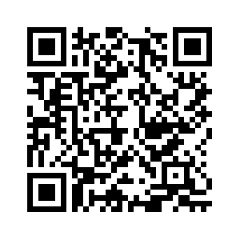
12/12
Thank you
GitHub Repo:: github.com/hijbullahx/SynthAI-Squad_AutomaticPriceComparison

