Slide 1
MiniLink
Jacob Tomy

Slide 2
MiniLink
- A URL shortening service
- Goal: Generate a short URL for a given URL, which redirects to the original URL when used
- User capabilities:
View short URLs created
See statistics of created URLs
Deactivate / Reactivate a created URL

Slide 3
MiniLink - Requirements
- Functional:
Generation and redirection of short URLs
User access to created URLs and their statistics
Ability to deactivate URLs
- Non-Functional:
Survive DC outages
survive spike of hits

Slide 4
MiniLink - Assumptions
- Total users: 10M
- Average number of links created per user: 100
- Maximum URL length: 2083 characters
- Length of short URL: 7 characters
- URLs are stored indefinitely
- Deactivated URLs return 404 and are not counted in stats until reactivated

Slide 5
MiniLink - Data Schema and Storage
User data
_id - 12 byte
userId - int - 4 bytes - not using _id as it will cost 12 byte vs 4 byte in next collection
Email - 320 bytes - (max)
Name of user - 50 bytes
Total size of a document ~ 418 bytes
Url data
_id - 12 byte
userId - the id of the user who created the url - int - 4 bytes.
the original url - a string of length up to 2083 char, - 2083 bytes.
the short url suffix - 7 bytes
isDeactivated - 2 byte
countOfHits - int - 4 bytes Total size of a document - 2112 bytes
User data - 10M * 418 bytes = 4180 MB ~< 4.2 GB
Url data - 10M * 100 * 2112 bytes = 2112 GB ~< 2.2 TB.

Slide 6
MiniLink - Unique URL Generation
- Use of Redis as unique sequence generator
- Distributed algorithm for unique number generation in a distributed environment
- Workers generate short URLs using unique numbers from Redis

Slide 7
MiniLink - Services
- Synchronous:
URL creation
URL redirection
User reports
- Asynchronous:
Update count of URL hits on DB

Slide 8
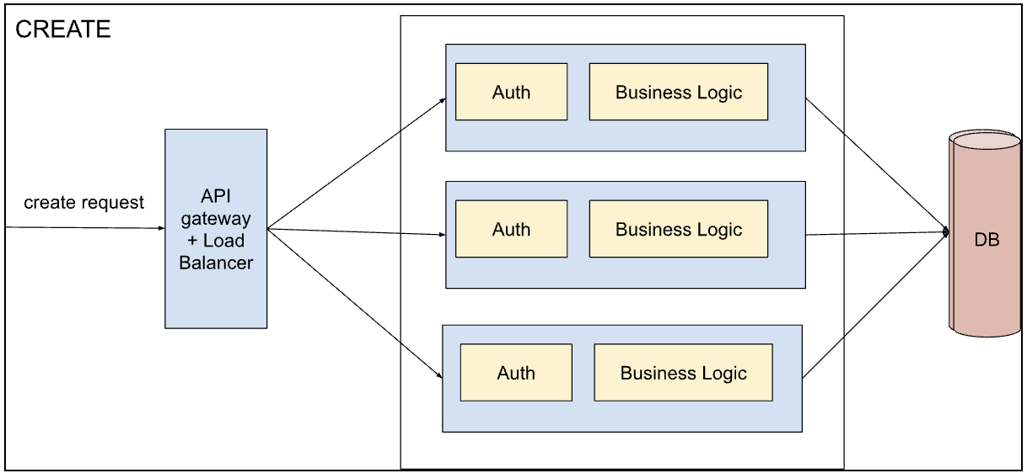
MiniLink - Services

Slide 9
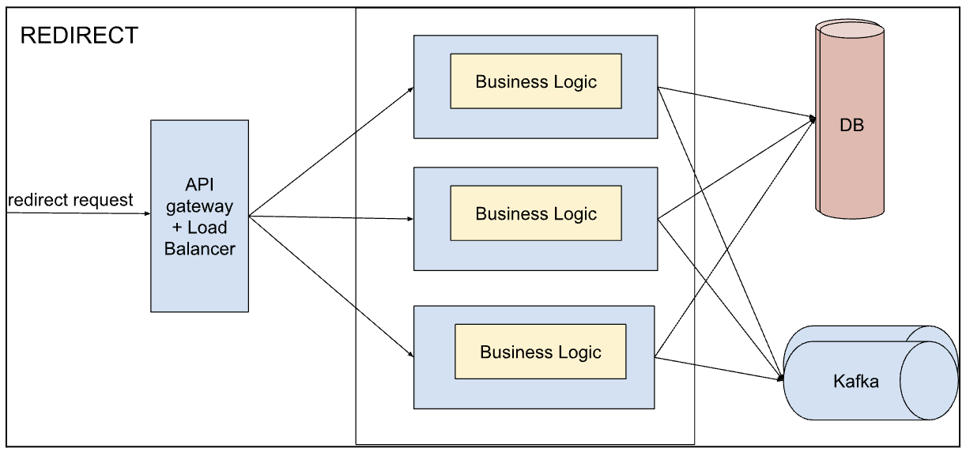
MiniLink - Services

Slide 10
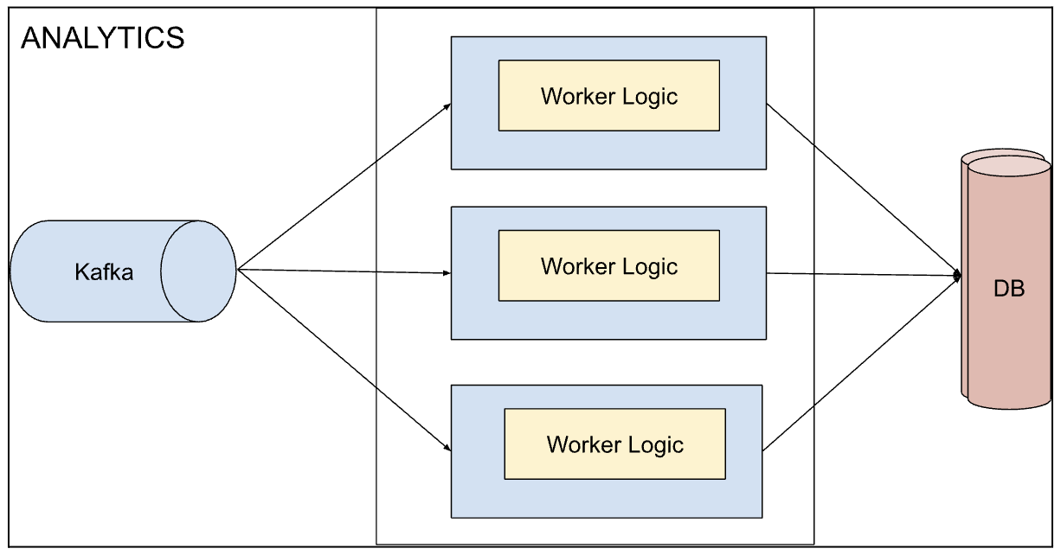
MiniLink - Services

Slide 11
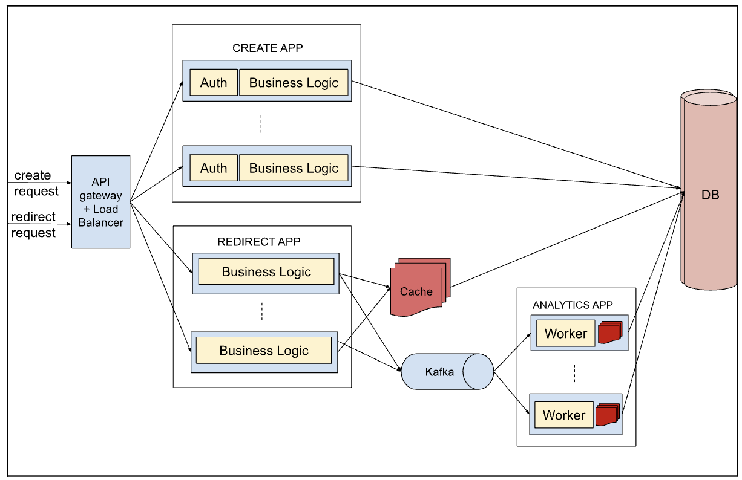
MiniLink - Caching
- In the redirect flow between business logic and DB
- In-memory caching in workers to flush counts to DB at regular intervals

Slide 12
MiniLink - Security and Rate Limiting
APIs
- Rate limiting at the gateway level
- Protection of secure endpoints using OAuth
Data
- Role configuration for AWS instances
Service | DB access | Kafka Access | Redis access
Main service | RW | - | RW
Redirect service | R | W | RW
Deactivate service | RW | - | RW
Report service | R | - | -
User service | RW | - | -
Analytics service | RW | R | -

Slide 13
MiniLink - CICD Pipeline
- Github for version control
- Jenkins for build and deployment

Slide 14
MiniLink - Metrics and Monitoring
- AWS cloud watch for monitoring and alerts
- Metrics:
User creations
Auth failures
URL creations
Redirections
Cache misses
DB reads/writes
Deactivation requests
API latency
DB latency
Kafka consumer lags

Slide 15
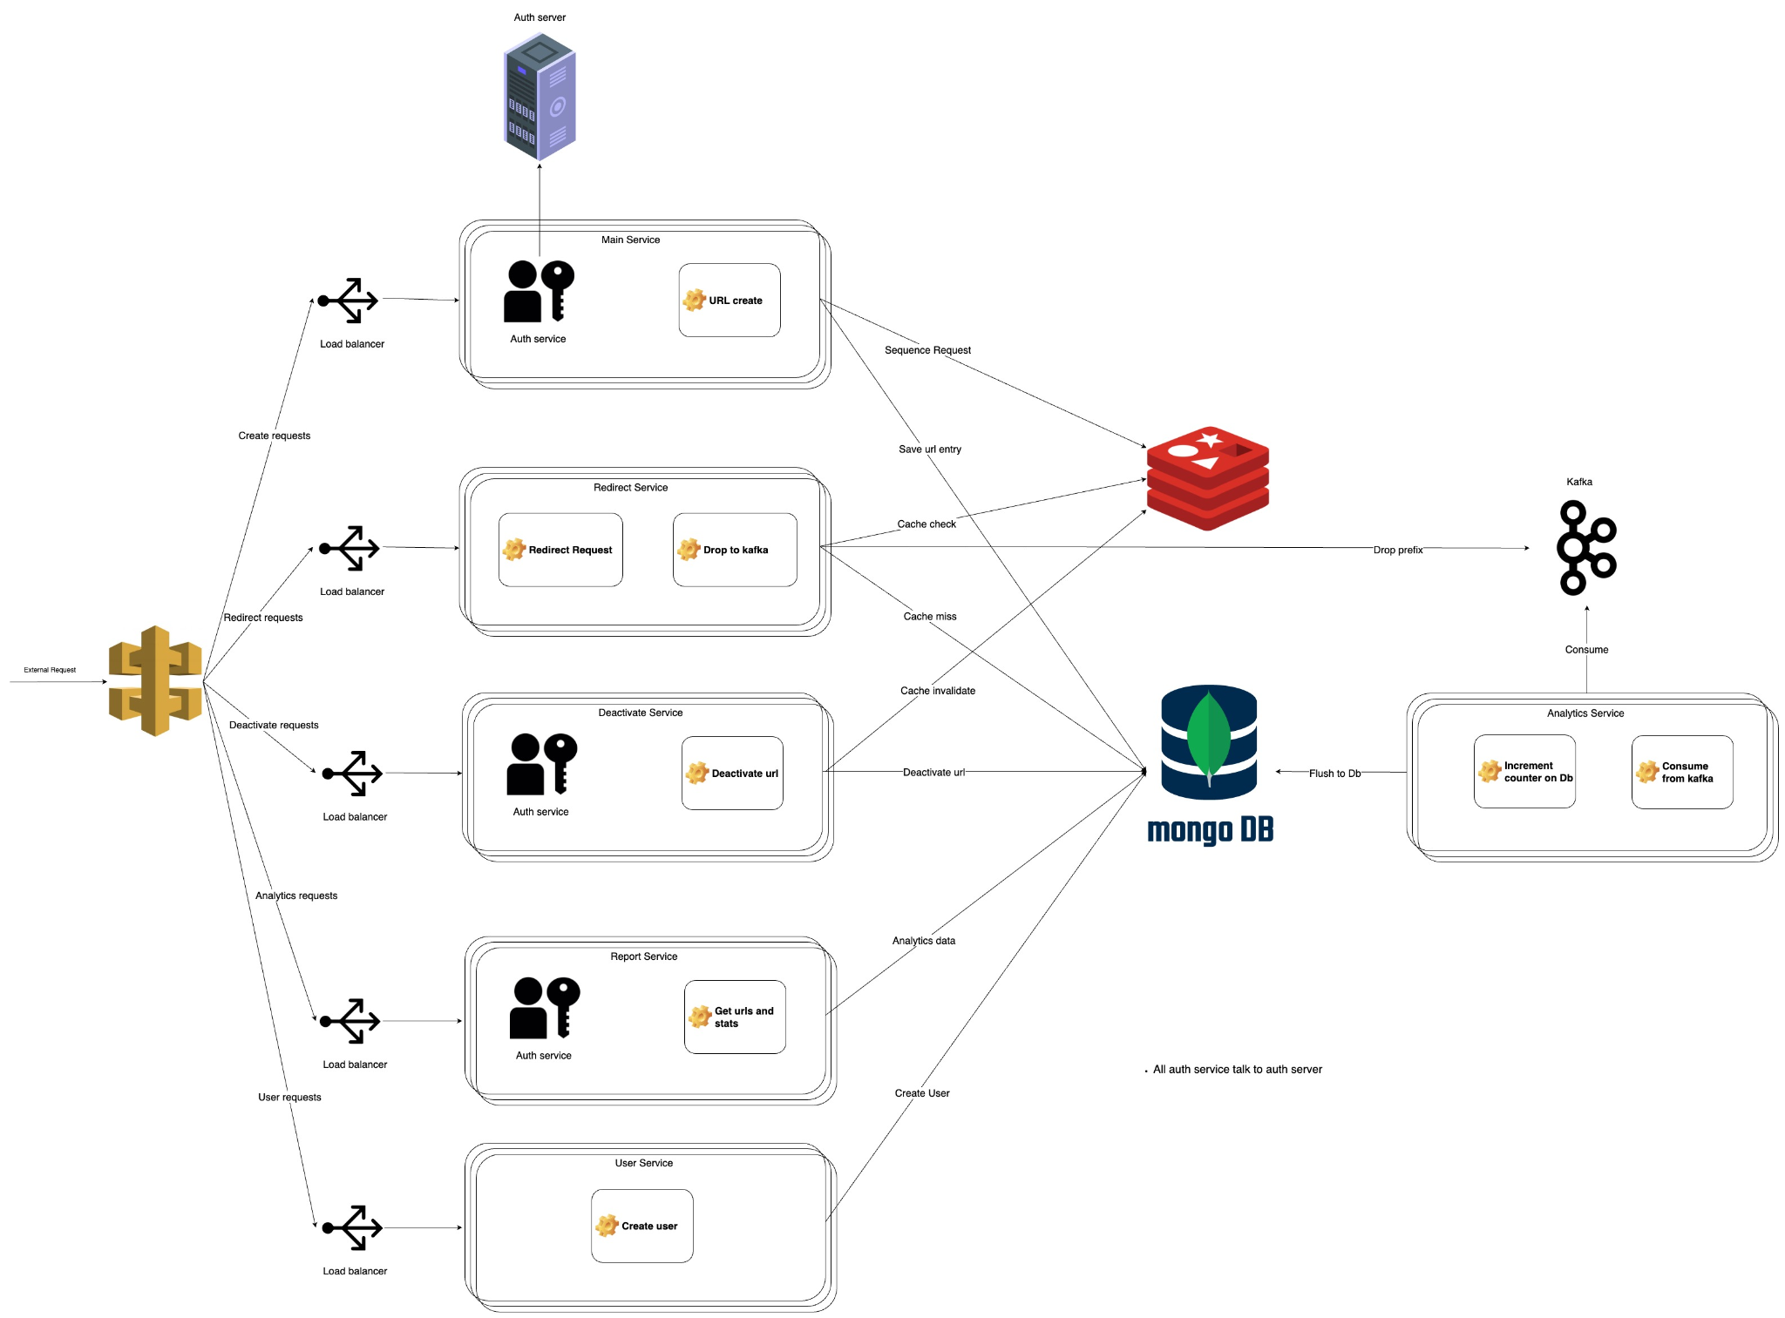

Slide 16
Thank you

