Slide 1
Lab 5
Harrison Knight

Slide 2
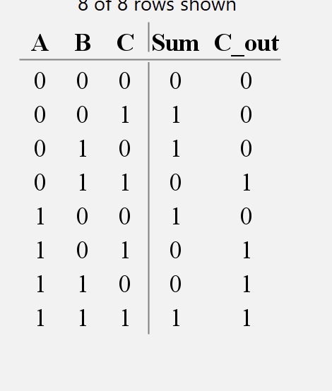
Truth Table for Full Adder

Slide 3
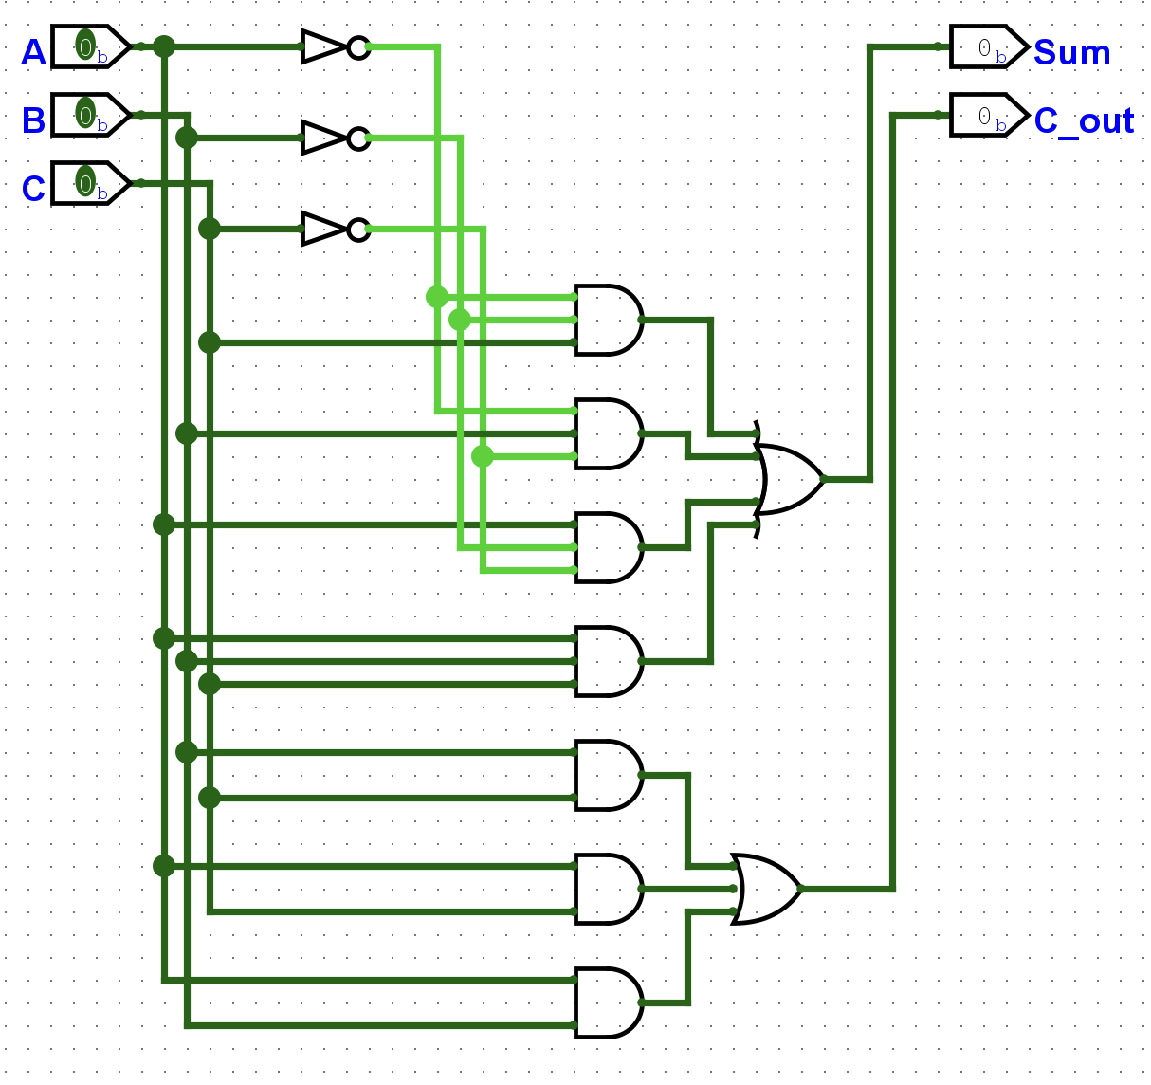
Circuit

Slide 4
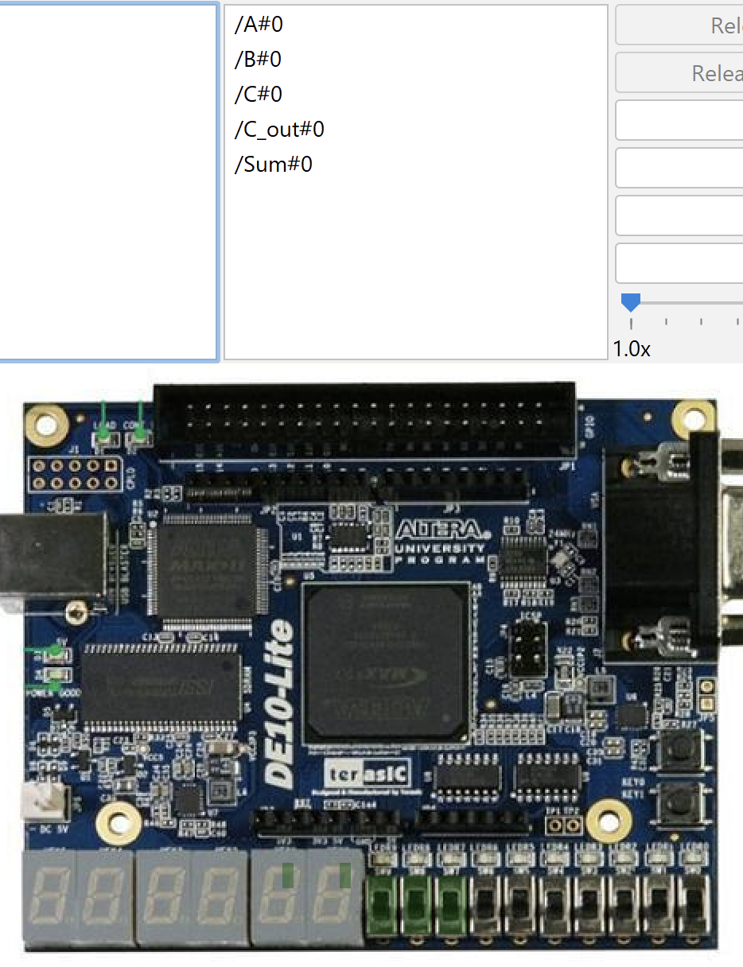
Mapping
Sum
A
B
C
C_out

