Slide 1
Lab 6
Harrison Knight

Slide 2
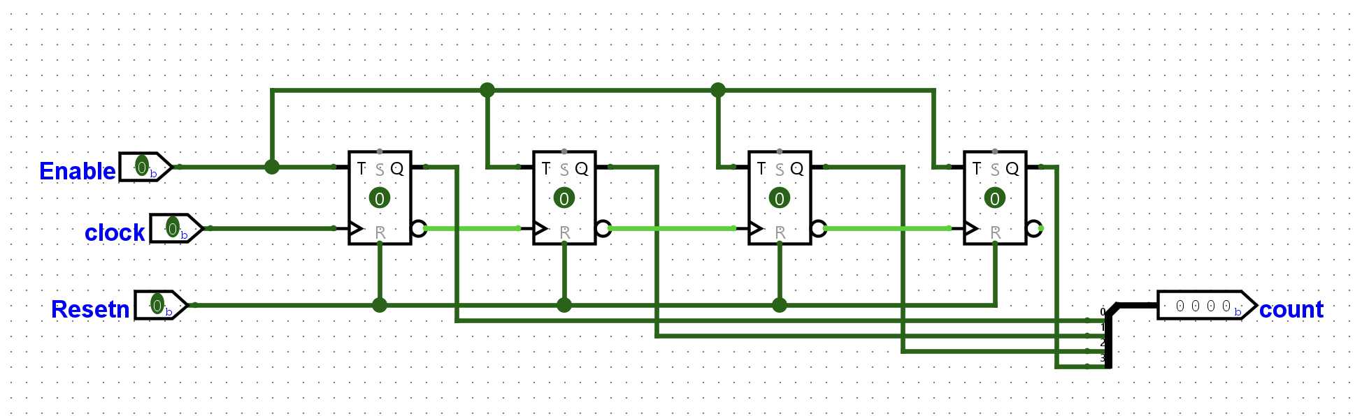
UpCounter with Active Low Reset

Slide 3
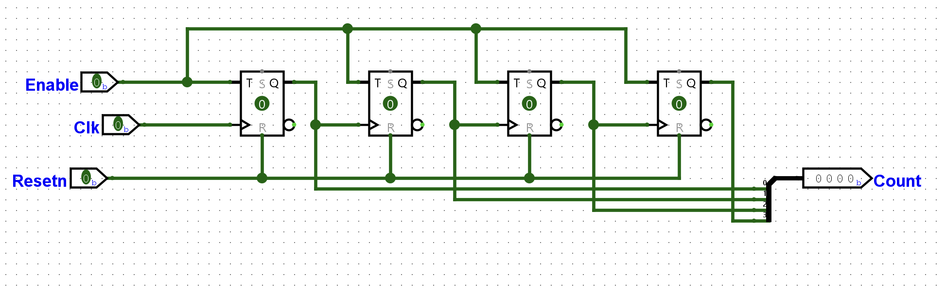
Down Counter with Active Low Reset

Slide 4
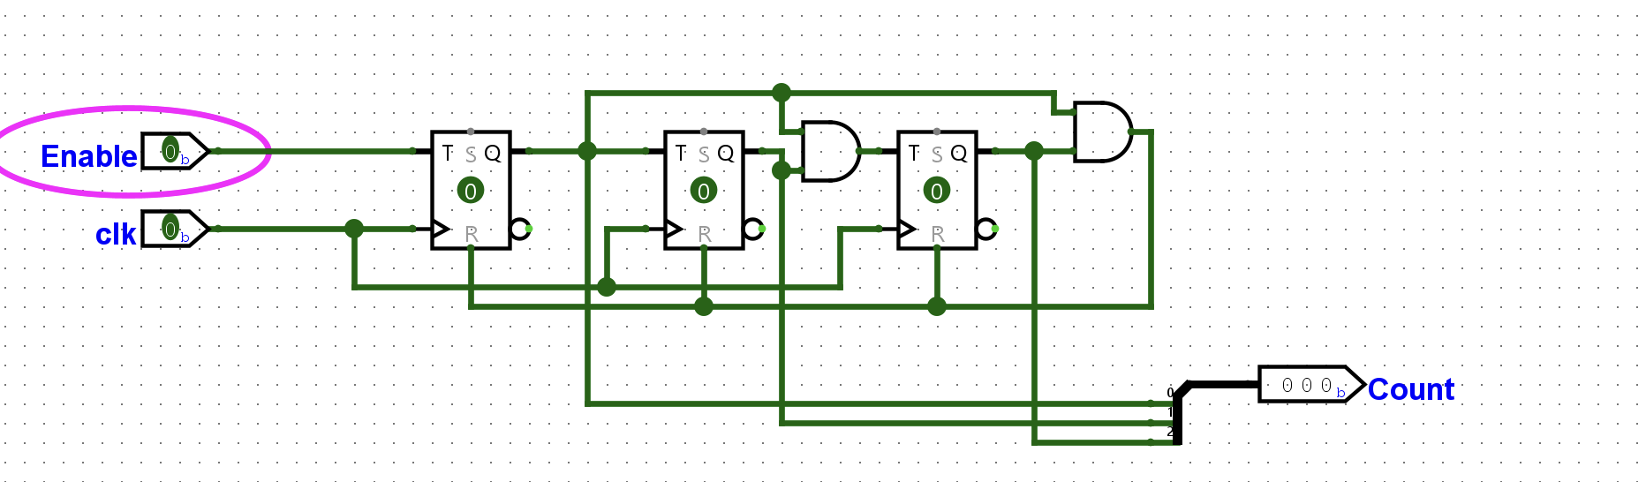
Mod 5 Counter

Slide 5
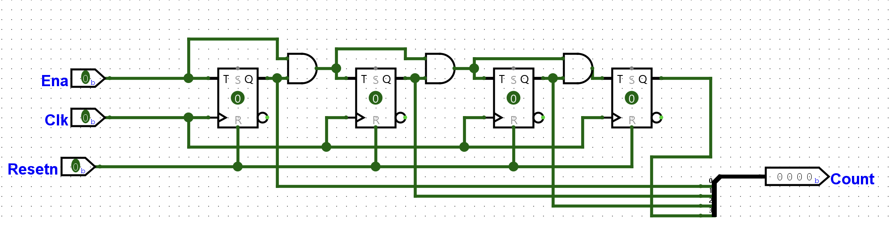
Counter with Enable and Resetn

Slide 6
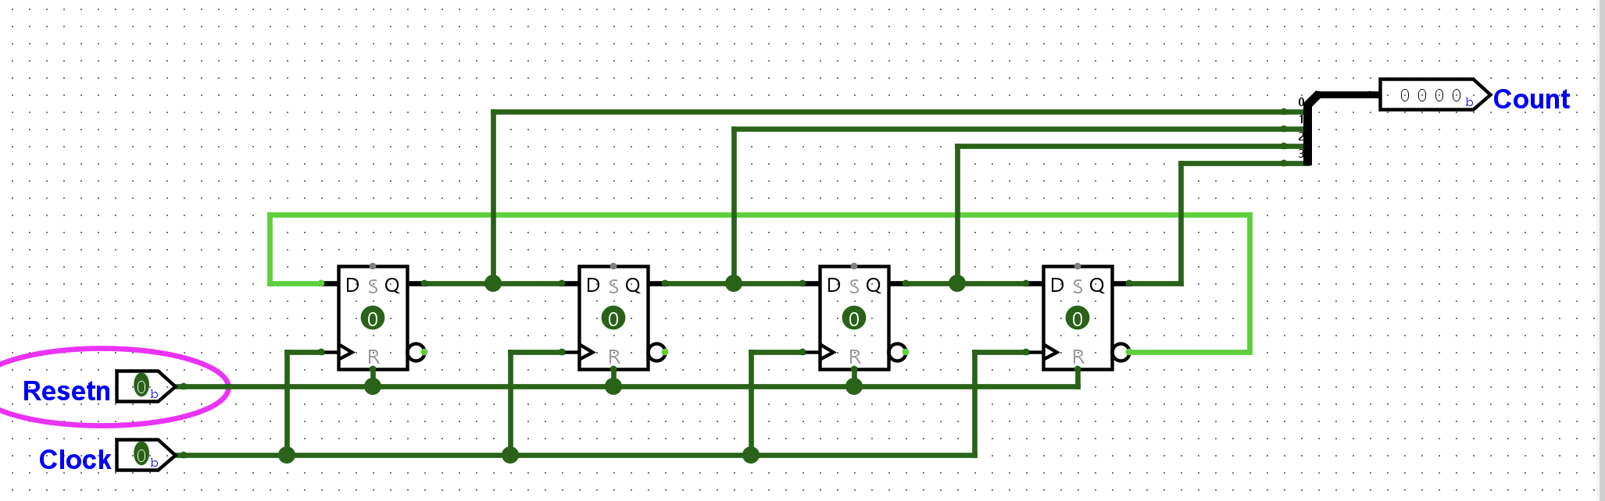
Johnson Counter with Reset

Slide 7
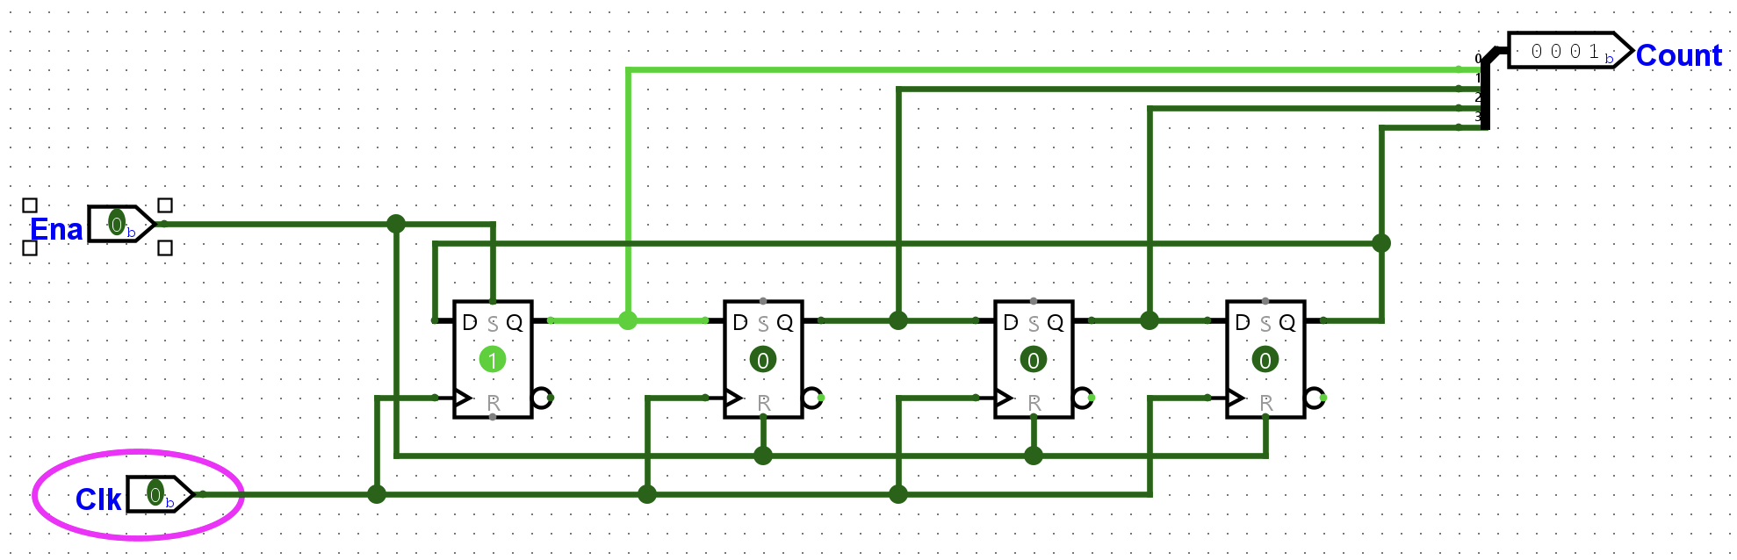
Ring counter

