Slide 1
Data Visualization HIKA Haley & Irene & Ken & Amy

Slide 2
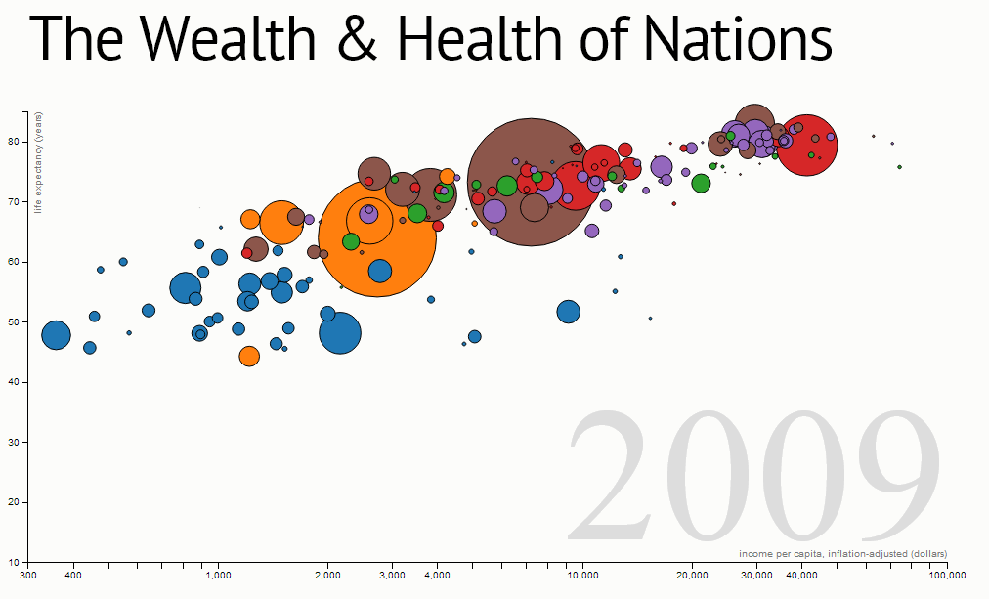
A Specific Example

Slide 3
4 Kinds of Data
Life Expectancy(years): veriticle axis
Income Per Capita(dollars):horizontal axis
Population: bubble size
Year of Data

Slide 4
Process
Web Scraping
Data Cleaning
Data Visualization
Interface to Present

