Slide 1
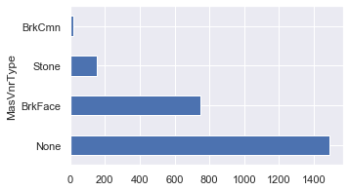
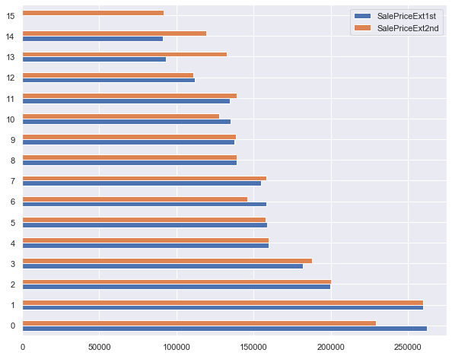
Exterior
In columns such as MasVnrType and MasVnrArea (Mason Veneer Type and Mason Veneer Area) the majority of the data appears as None and therefore doesn’t carry much significance. Exterior1st and Exterior2nd show similar yield when the typos in Exterior2nd are fixes. Typos were: ‘Wd Shng’ : ‘WdShng’, ‘CmentBD’ : ‘CemntBD’, ‘Brk Cmn’ : ’Brk Comm’

Slide 2
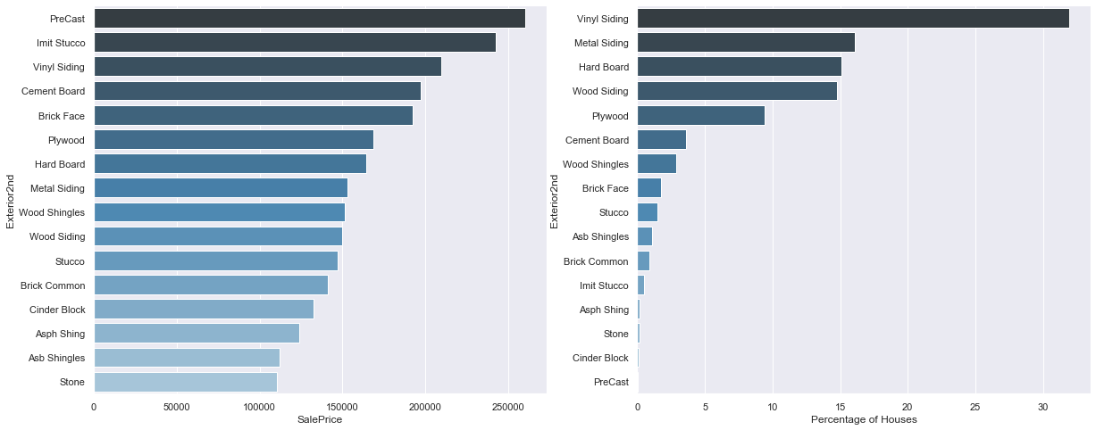
We selected to explore Exterior2nd feature deeper. The mean SalePrice per Exterior feature displayed on the left. The Percentage of Houses that have that Exterior material displayed on the right
We grab 10 houses with Plywood Exterior and use our model to predict the prices for these houses.
Next, we predict the prices for these same houses if they had Vinyl Exterior instead of Plywood.
Our model yields: 0.9158010328166403

Slide 3
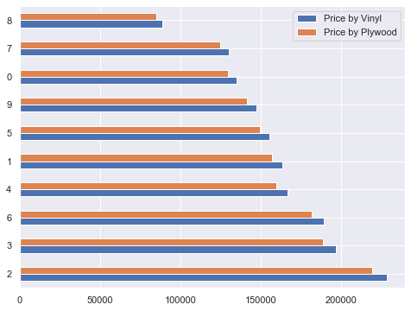
Again, we compare the predicted value of the houses with Plywood Exterior with predicted value of the same houses if they had Vinyl exterior as opposed to Plywood. Each house with Plywood exterior shows an increase in price if it had Vinyl exterior
 | Price by Plywood | Price by Vinyl | Difference
0 | 129287.19 | 134746.74 | 5459.55
1 | 156843.44 | 163466.64 | 6623.20
2 | 219061.00 | 228311.53 | 9250.53
3 | 188527.81 | 196488.98 | 7961.17
4 | 159762.70 | 166509.18 | 6746.48
5 | 149058.09 | 155352.53 | 6294.44
6 | 181585.60 | 189253.61 | 7668.01
7 | 124476.14 | 129732.53 | 5256.39
8 | 85087.79 | 88680.89 | 3593.10
9 | 141097.01 | 147055.27 | 5958.26

Slide 4
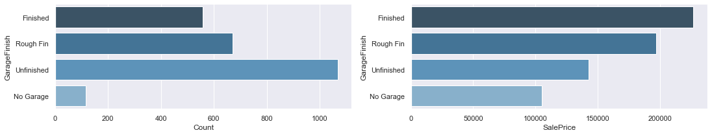
Garage
After a closer look at all Garage columns we chose to evaluating Garage Finish
The count of Finished, Rough Finish, Unfinished and No Garage displayed on the left. The mean Sale Price for Finished, Rough Finish, Unfinished and No Garage displayed on the right
By the same logic we grab 10 houses with Unfinished Garage and use our model to predict the prices for these houses. Next, we predict the prices for these same houses if they had Finished Garage instead of Unfinished.
Again, our model yields: 0.9154034290784837

Slide 5
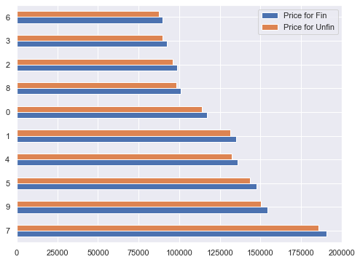
Below are the prices for houses with Unifinished Garages and predicted prices for the same houses if their Garages were Finished. The houses are predicted to increase in price if the Garages were Finished
 | Price for Unfin | Price for Fin | Difference
7 | 185629.90 | 190662.88 | 5032.98
9 | 150367.72 | 154444.64 | 4076.92
5 | 143491.54 | 147382.02 | 3890.48
4 | 132237.32 | 135822.67 | 3585.35
1 | 131259.17 | 134818.00 | 3558.83
0 | 113766.68 | 116851.23 | 3084.55
8 | 98434.30 | 101103.15 | 2668.85
2 | 96028.32 | 98631.94 | 2603.62
3 | 89853.38 | 92289.57 | 2436.19
6 | 87298.49 | 89665.41 | 2366.92

