Slide 1
Roof Material and Fence Quality

Slide 2
Roof Material
How does the material used for the roof of the house affects the sale price?
Roof Material
Clay or Tile
Standard (Composite) Shingle
Membrane
Metal
Roll
Gravel & Tar
Wood Shakes
Wood Shingles

Slide 3
Roof Material
Number of houses grouped by roof material
Roof Material | Percentage
Standard (Composite) Shingle | 98.673850
Membrane | 0.041442
Metal | 0.041442
Roll | 0.041442
Gravel & Tar | 0.621633
Wood Shakes | 0.290095
Wood Shingles | 0.290095

Slide 4
Roof Material
Analyzing house year built grouped by roof material
Roof Material | Minimum | Maximum | Average
Standard (Composite) Shingle | 1872 | 2010 | 1969
Membrane | 1954 | 1954 | 1954
Metal | 1969 | 1969 | 1969
Roll | 1948 | 1948 | 1948
Gravel & Tar | 1940 | 2004 | 1963
Wood Shakes | 1967 | 1993 | 1979
Wood Shingles | 1892 | 1994 | 1966

Slide 5
Roof Material
Number of houses built after 1990 grouped by roof material
Roof Material | Percentage of Houses
CompShg | 99.64
Tar&Grv | 0.12
WdShake | 0.12
WdShngl | 0.12

Slide 6
Roof Material
Findings
We are not able to determine from the data available how much the value of the house would increase or decrease depending on the roof material.
Should the house roof material requires replacement we recommend to use standard shingles. Almost all the houses in our dataset have standard shingles.

Slide 7
Fence Quality
How much does the quality of the fence will affect the sale price of the house?
Rating | Description
4 | Good Privacy
3 | Minimum Privacy
2 | Good Wood
1 | Minimum Wood/Wire
0 | No Fence

Slide 8
Roof Material
Number of Houses with a Fence
Fence Rating | Percentage (%)
Good Privacy | 4.43
Minimum Privacy | 11.86
Good Wood | 4.1
Minimum Wood/Wire | 0.41
No Fence | 79.2

Slide 9
Roof Material
Houses built after 1990
Fence Rating | Percentage of Houses
Good Privacy | 2.99
Minimum Privacy | 1.79
Good Wood | 0.48
No Fence | 94.74

Slide 10
Roof Material
Using our descriptive model to predict house price
Minimum Wood/Wire | Good Wood | Minimum Privacy | Good Privacy
132,486 | 136,309 | 136,380 | 139,268
112,295 | 115,536 | 115,596 | 118,044
117,293 | 120,678 | 120,741 | 123,298
154,103 | 158,550 | 158,633 | 161,992
132,607 | 136,434 | 136,505 | 139,395
139,400 | 143,422 | 143,497 | 146,536
67,098 | 69,034 | 69,070 | 70,533
149,418 | 153,730 | 153,810 | 157,067
168,696 | 173,564 | 173,655 | 177,332
126,707 | 130,364 | 130,432 | 133,194

Slide 11
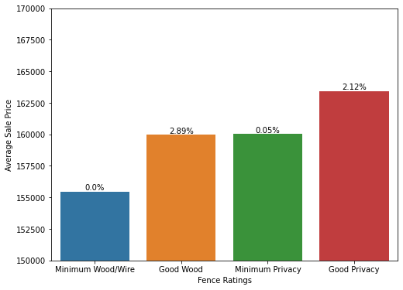
Roof Material
Change in house value depending on the fence quality
Fence Type | Sale Price (avg)
Minimum Wood/Wire | 155,466.8
Good Wood | 159,953.1
Minimum Privacy | 160,036.6
Good Privacy | 163,425.55

Slide 12
Roof Material
Findings
We are not able, given the data available, to determine how much value would be added to a house by installing a new fence. 80% of the houses in the dataset do not have fences.
If we take a look at only those houses with a fence we can see a trend:
Houses with Minimum Wood/Wire fences have the lowest values among houses with a fence.
Replacing a Minimum Wood/Wire fence with a Good Wood or Minimum Privacy fence can yield almost a 3% increase in the value of the house.
The best gains were observed when a Minimum Wood/Wire fence was replaced by a Good Privacy fence, a ~5% increase in the value of the house. For example, a house priced at $150,000.00 with a Minimum Wood/Wire fence, according to the data available, can increase its sale price to $157,500.00 by replacing the existing fence for a Good Privacy fence.
It is clear from the data that most houses do not have a fence. Adding a fence to a house that does not have one is not recommended given the data available. However, it should be considered case by case.

