Slide 1
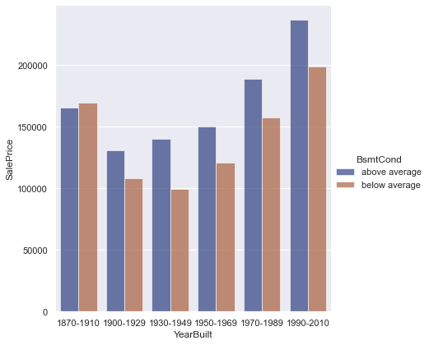
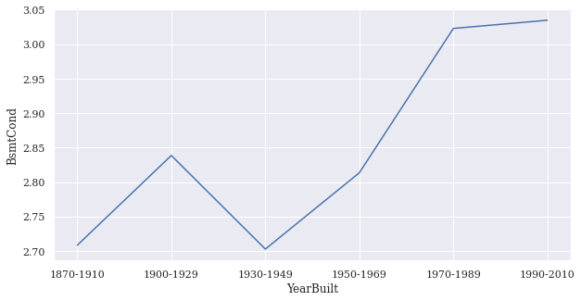
Basement Features
Sale price By Year built
Basement Condition
Basement condition By Year built

Slide 2
Basement Features
Good Condition Basement
107983.46668563686
123130.15449627236
122884.71261494295
88004.7697101475
229399.94570159857
181418.45290575086
83478.17146800073
129508.43160396238
130745.34717133654
191767.043404982
Low Condition Basement
113429.95158710395
129082.78860213881
92443.56635370036
240970.45162264357
190568.8617130106
87688.65492864167
136040.5956378985
137339.8989222897
201439.4158390404
129340.61011473842
Basement Condition

Slide 3
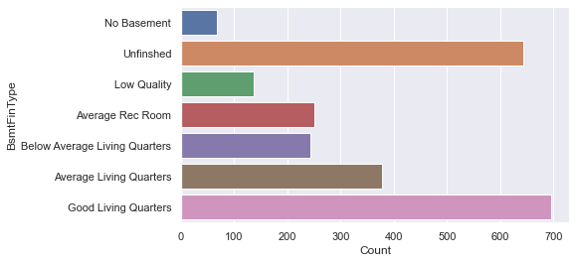
Basement Features
Basement Type
Basement types
Basement type
Unfinished and Good Living Quarters has similar number of houses. .
Analyze between two values.

Slide 4
Basement Features
Unfinished Basement
111714.96296681135
126187.10047974867
129978.74109681146
94384.43546476614
230702.09840539168
176027.3433500239
87986.1291615984
131470.10511840798
133945.75154089482
199197.32653456906
Good Living Quarters
117037.7217753148
132199.39715658355
136171.69386444366
98881.46587066584
241694.10515020293
184414.3227435735
92178.30657081575
137734.11525178445
140327.71605076734
208688.26039234787
Basement Type

Slide 5
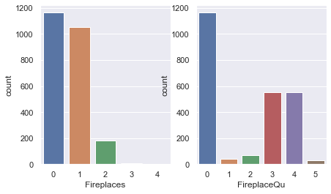
Fireplace features
Number of fireplaces
Basement type
The number of fireplaces are “0” or “1”.
Analyze between two values.

Slide 6
Fireplace features
No Fireplaces
112127.73058232357
128676.78602514447
93912.06895335056
231627.60730498075
128989.3049442917
179166.81178414568
88686.26043904475
131713.56359645436
136523.973935922
199973.84175565754
1 Fireplaces
116638.44635228571
133853.2433112885
134178.33435697114
97689.99835776884
240945.60826337957
186374.40047939026
92253.9640879442
137012.18549263407
142016.11079637983
208018.46333947615
Number of fireplaces

