Slide 1
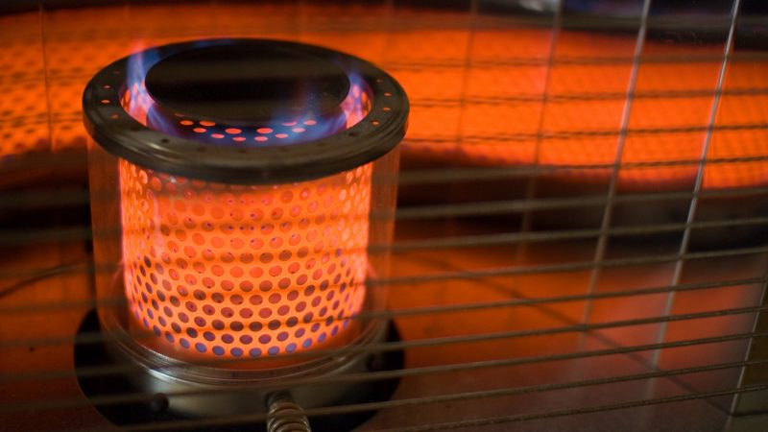
Heating Quality
Evaluate the condition of heating
Interpret how quality of the feature impacts price.
Rating | Quality | Description
5 | Ex | Excellent
4 | Gd | Good
3 | TA | Average/Typical
2 | Fa | Fair
1 | Po | Poor
Heating Quality | Percentage of Houses
Poor | 0.04
Fair | 3.31
Average/Typical | 30.08
Good | 17.48
Excellent | 49.06

Slide 2
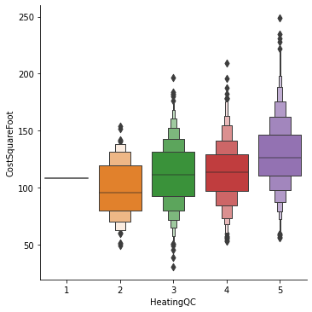
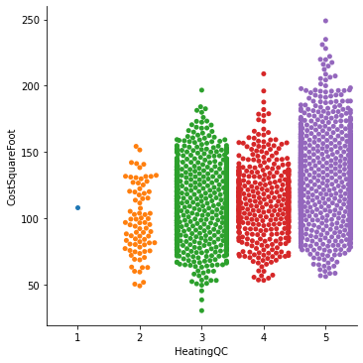
Heating: Cost Per Square Foot
Quality of heating system impacts price of the home
Most homes have a heating rating of 3 or higher. (Or Average and up)
Boxen Plot on the left shows the distribution and averages.
Swarm plot on the right shows frequency.
HeatingQC | Sale Price ($) | GrLivArea (sqft) | Cost Per Square Foot($)
5 | 206841.93 | 1613.84 | 129.12
4 | 155575.78 | 1402.72 | 113.64
3 | 141821.86 | 1317.72 | 111.86
2 | 125515.22 | 1309.72 | 98.48
1 | 87000.00 | 803.00 | 108.34

Slide 3
Heating: Prediction of Price Impact

Slide 4
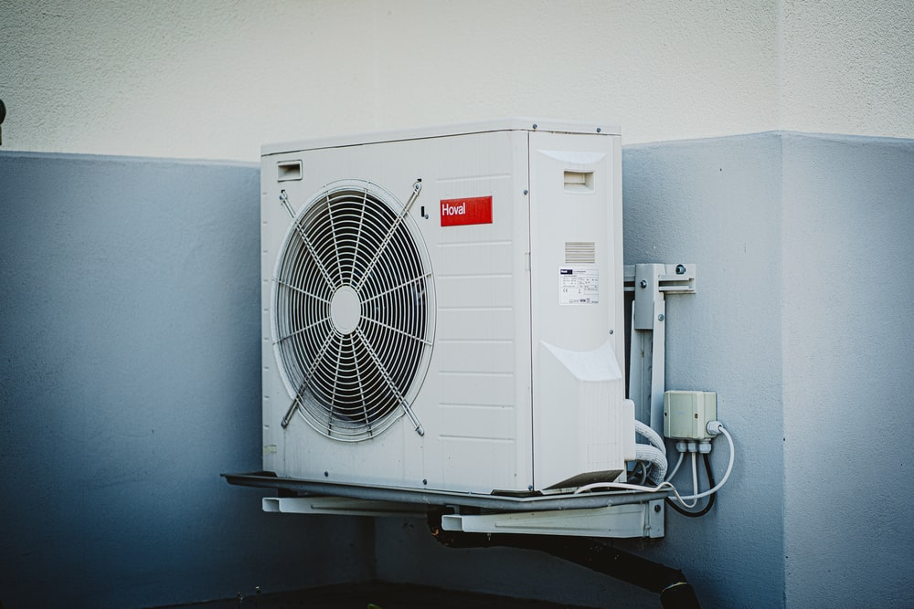
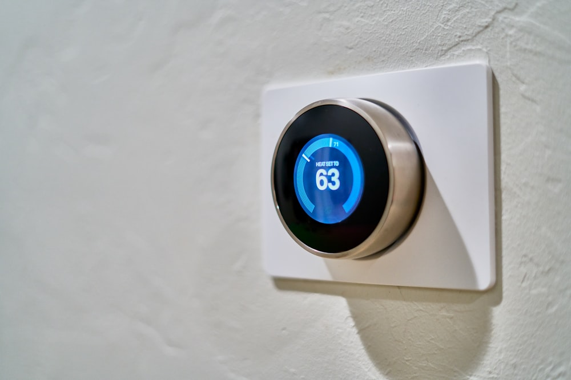
Central Air
How does central air impact the value of a home?
Central Air Present | Percentage of Houses
No | 6.34
Yes | 93.66
Vast majority of homes have a central air unit present (Over 93%)

Slide 5
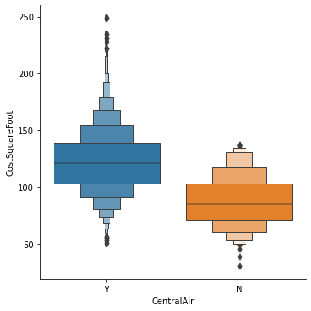
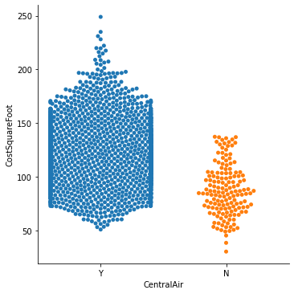
Central Air: Cost Per Square Foot
Having Central Air System greatly increases value of home.
Most homes have a central air unit present.
Boxen Plot on the left shows the distribution and averages.
Swarm plot on the right shows frequency.
Central Air Present | Sale Price($) | GrLivArea(sqft) | Cost Per Square Foot($)
Y | 180370.90 | 1491.64 | 122.42
N | 104617.53 | 1267.12 | 87.40

Slide 6
Central Air: Prediction of Price Impact

Slide 7
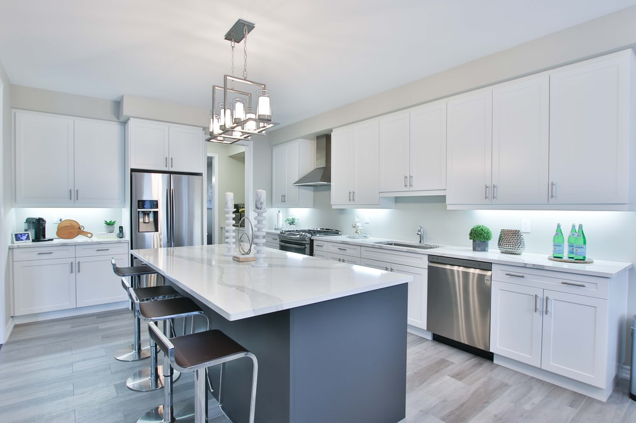
Kitchen Quality
Evaluate the condition of the Kitchen
Interpret how quality of the feature impacts price.
Rating | Quality | Description
5 | Ex | Excellent
4 | Gd | Good
3 | TA | Average/Typical
2 | Fa | Fair
1 | Po | Poor
Kitchen Quality | Percentage of Houses
Poor | 0.041442
Fair | 2.527973
Average/Typical | 53.626191
Good | 38.997099
Excellent | 4.807294

Slide 8
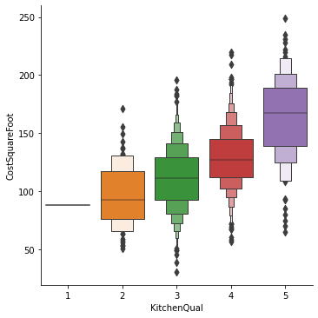
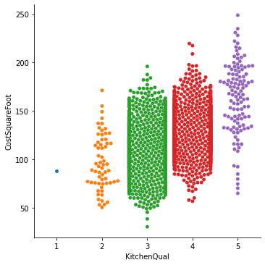
Kitchen Quality: Cost Per Square Foot
Quality of Kitchen has direct impact on price of home
Most homes have a Typical/ Average or Good rating
Boxen Plot on the left shows the distribution and averages.
Swarm plot on the right shows frequency.
Kitchen Quality | Sale Price ($) | GrLivArea (sqft) | Cost Per Square Foot ($)
5 | 327006.53 | 2017.65 | 163.56
4 | 207739.89 | 1639.31 | 128.86
3 | 141828.69 | 1326.27 | 111.12
2 | 108113.11 | 1162.80 | 97.19
1 | 107500.00 | 1224.00 | 87.82

Slide 9
Kitchen Quality: Prediction of Price Impact

