Slide 1
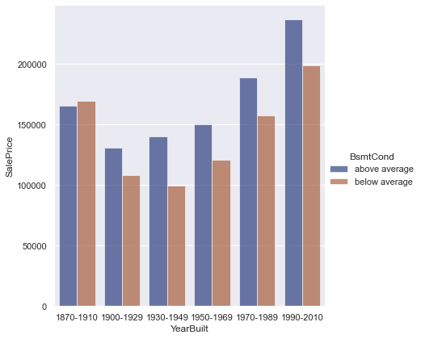
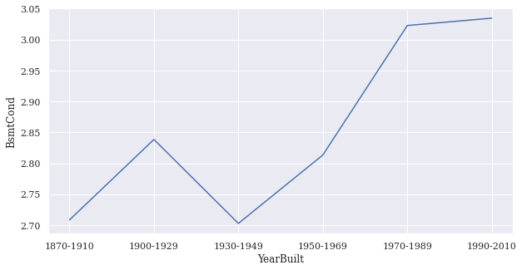
Basement Features
Sale price By Year built
Basement Condition
Basement condition By Year built

Slide 2
Basement Features
Good Condition Basement
$107983.46
$122884.71
$88004.76
$229399.94
$181418.45
$83478.17
$129508.43
$130745.34
$191767.04
$123130.15
Low Condition Basement
$113429.95
$129082.78
$92443.56
$240970.45
$190568.86
$87688.65
$136040.59
$137339.89
$201439.41
$129340.61
Basement Condition

Slide 3
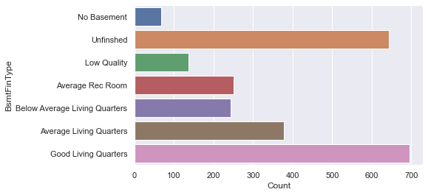
Basement Features
Basement Type
Basement types
Basement type
Unfinished and Good Living Quarters has similar number of houses. .
Analyze between two values.

Slide 4
Basement Features
Unfinished Basement
$111714.96
$126187.10
$129978.74
$94384.43
$230702.09
$176027.34
$87986.12
$131470.10
$133945.75
$199197.32
Good Living Quarters
$117037.72
$132199.39
$136171.69
$98881.46
$241694.10
$184414.32
$92178.30
$137734.11
$140327.71
$208688.26
Basement Type

Slide 5
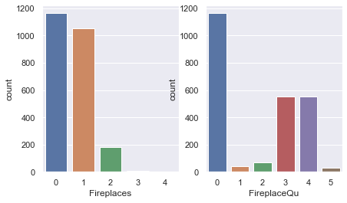
Fireplace features
Number of fireplaces
Basement type
The number of fireplaces are “0” or “1”.
Analyze between two values.

Slide 6
Fireplace features
No Fireplaces
$112127.73
$128676.78
$93912.06
$231627.60
$128989.30
$179166.81
$88686.26
$131713.56
$136523.97
$199973.84
1 Fireplace
$116638.44
$133853.24
$134178.33
$97689.99
$240945.60
$186374.40
$92253.96
$137012.18
$142016.11
$208018.46
Number of fireplaces

