Slide 1
Lecture 1
OUTLINE
Semiconductor Fundamentals
  General material properties
  Crystal structure
  Crystallographic notation
  Electrons and holes
Reading: Pierret 1.1-1.2, 2.1; Hu 1.1-1.2

Slide 2
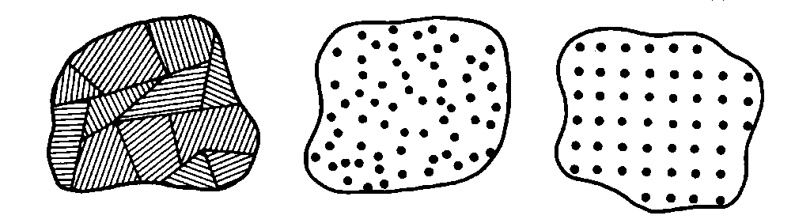
What is a Semiconductor?
Low resistivity => “conductor”
High resistivity => “insulator”
Intermediate resistivity => “semiconductor”
  conductivity lies between that of conductors and insulators
  generally crystalline in structure for IC devices
    In recent years, however, non-crystalline semiconductors have become commercially very important
polycrystalline amorphous crystalline
EE130/230M Spring 2013
Lecture 1, Slide <number>

Slide 3
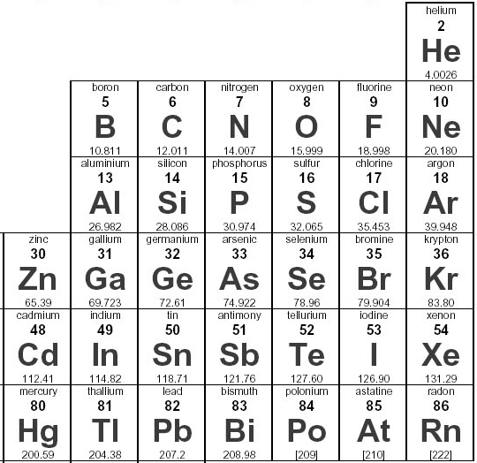
Semiconductor Materials
Elemental:
Compound:
Alloy:
EE130/230M Spring 2013
Lecture 1, Slide <number>

Slide 4
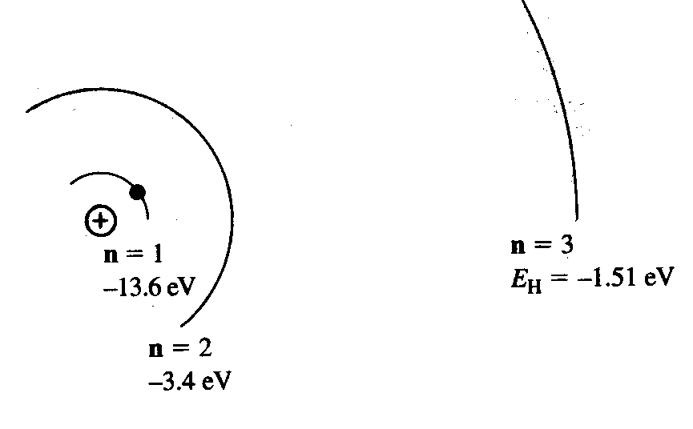
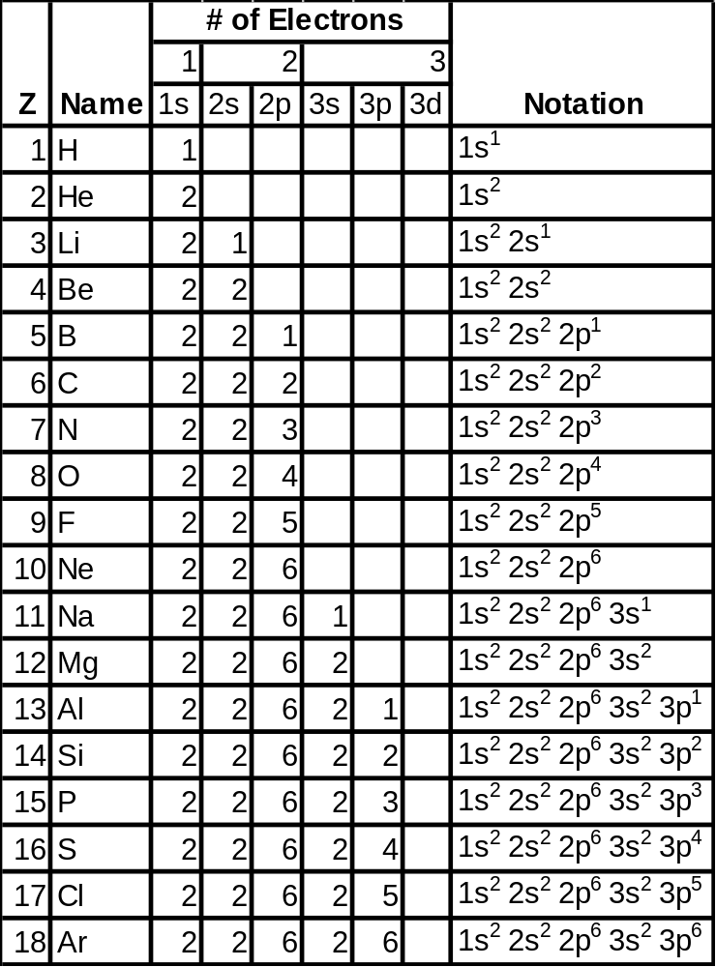
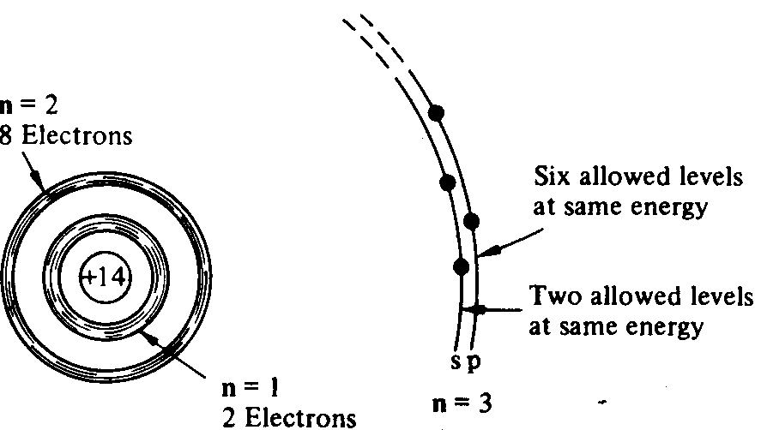
From Hydrogen to Silicon
EE130/230M Spring 2013
Lecture 1, Slide <number>

Slide 5
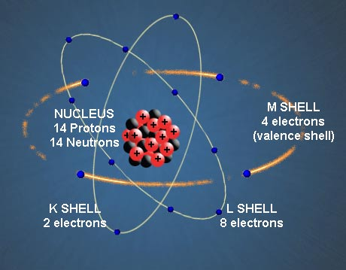
The Silicon Atom
14 electrons occupying the first 3 energy levels:
  1s, 2s, 2p orbitals filled by 10 electrons
  3s, 3p orbitals filled by 4 electrons
    To minimize the overall energy, the 3s and 3p orbitals hybridize to form 4 tetrahedral 3sp orbitals
      Each has one electron and
      is capable of forming a bond
      with a neighboring atom
EE130/230M Spring 2013
Lecture 1, Slide <number>

Slide 6
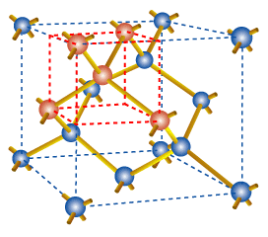
The Si Crystal
Each Si atom has 4 nearest neighbors
  “diamond cubic” lattice
  lattice constant = 5.431Å
EE130/230M Spring 2013
Lecture 1, Slide <number>

Slide 7
How Many Silicon Atoms per cm³?
Total number of atoms within a unit cell:
  Number of atoms completely inside cell:
  Number of corner atoms (1/8 inside cell):
  Number of atoms on the faces (1/2 inside cell):
Cell volume: (0.543 nm)³
Density of silicon atoms:
EE130/230M Spring 2013
Lecture 1, Slide <number>

Slide 8
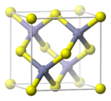
Compound Semiconductors
“zincblende” structure
III-V compound semiconductors: GaAs, GaP, GaN, etc.
  important for optoelectronics and high-speed ICs
EE130/230M Spring 2013
Lecture 1, Slide <number>

Slide 9
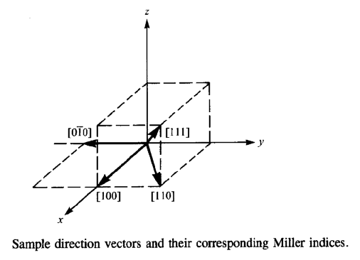
Crystallographic Notation
Miller Indices:
Notation | Interpretation
( h k l ) | crystal plane
{ h k l } | equivalent planes
[ h k l ] | crystal direction
< h k l > | equivalent directions
h: inverse x-intercept of plane
k: inverse y-intercept of plane
l: inverse z-intercept of plane
(Intercept values are in multiples of the lattice constant;
h, k and l are reduced to 3 integers having the same ratio.)
EE130/230M Spring 2013
Lecture 1, Slide <number>

Slide 10
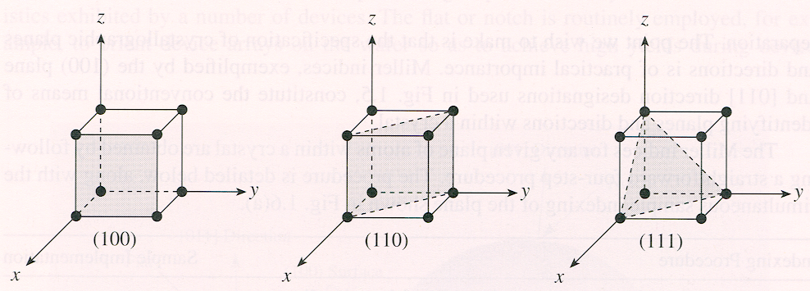
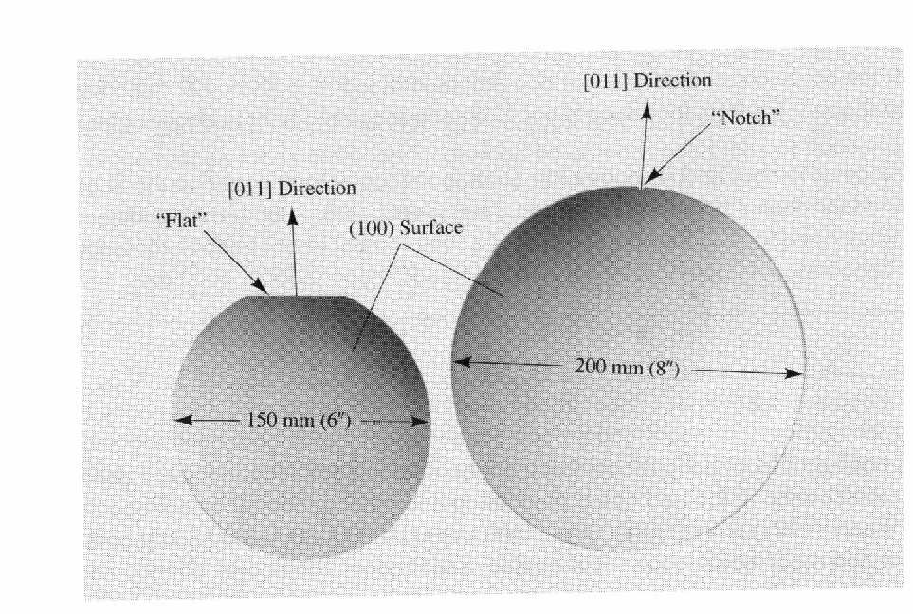
Crystallographic Planes and Si Wafers
Silicon wafers are usually cut along a {100} plane with a flat or notch to orient the wafer during IC fabrication:
EE130/230M Spring 2013
Lecture 1, Slide <number>

Slide 11
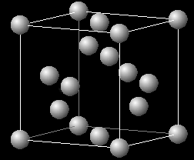
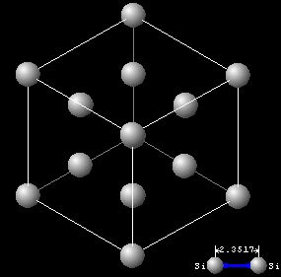
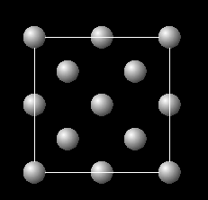
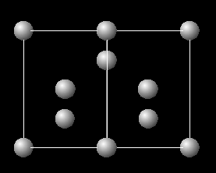
Crystallographic Planes in Si
Unit cell:
View in <111> direction
View in <100> direction
View in <110> direction
EE130/230M Spring 2013
Lecture 1, Slide <number>

Slide 12
Electronic Properties of Si
Silicon is a semiconductor material.
  Pure Si has relatively high electrical resistivity at room temp.
There are 2 types of mobile charge-carriers in Si:
  Conduction electrons are negatively charged
  Holes are positively charged
The concentration (#/cm³) of conduction electrons & holes in a semiconductor can be changed:
    by changing the temperature
    by adding special impurity atoms ( dopants )
    by applying an electric field
    by irradiation
EE130/230M Spring 2013
Lecture 1, Slide <number>

Slide 13
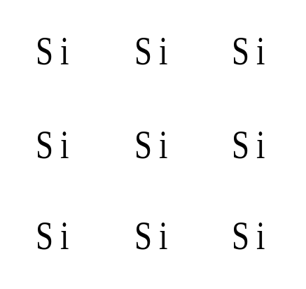
Electrons and Holes (Bond Model)
2-D representation of Si lattice:
When an electron breaks loose and becomes a conduction electron, a hole is also created.
Si
Si
Si
Si
Si
Si
Si
Si
Si
EE130/230M Spring 2013
Lecture 1, Slide <number>

Slide 14
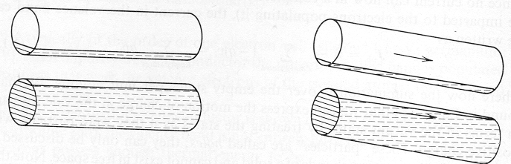
What is a Hole?
Mobile positive charge associated with a half-filled covalent bond
  Can be considered as positively charged mobile particle in the semiconductor
Fluid analogy:
EE130/230M Spring 2013
Lecture 1, Slide <number>

Slide 15
The Hole as a Positive Mobile Charge
EE130/230M Spring 2013
Lecture 1, Slide <number>

Slide 16
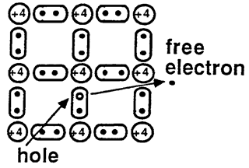
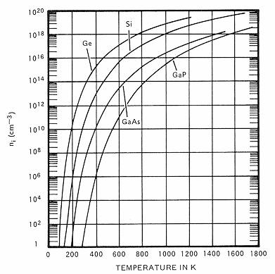
Intrinsic Carrier Concentration, n_{i}
conduction
At temperatures > 0 K, some electrons will be freed from covalent bonds, resulting in electron-hole pairs.
For Si: n_{i} ≅ 10¹⁰ cm⁻³ at room temperature
EE130/230M Spring 2013
Lecture 1, Slide <number>

Slide 17
Definition of Terms
n ≡ number of electrons/cm³
p ≡ number of holes/cm³
n_{i} ≡ intrinsic carrier concentration
In a pure semiconductor,
n = p = n_{i}
EE130/230M Spring 2013
Lecture 1, Slide <number>

Slide 18
Summary
Crystalline Si:
  4 valence electrons per atom
  diamond lattice (each atom has 4 nearest neighbors)
  atomic density = 5 x 10²² atoms/cm³
  intrinsic carrier concentration n_{i} = 10¹⁰ cm⁻³
  Miller indices are used to designate planes and directions within a crystalline lattice
In a pure Si crystal, conduction electrons and holes are formed in pairs.
  Holes can be considered as positively charged mobile particles.
  Both holes and electrons can conduct current.
EE130/230M Spring 2013
Lecture 1, Slide <number>

