Slide 1
Lecture 10
OUTLINE
pn Junction Diodes (cont’d)
  Derivation of the Ideal Diode Equation (for a step junction)
Reading: Pierret 6.1; Hu 4.3, 4.6, 4.8-4.9

Slide 2
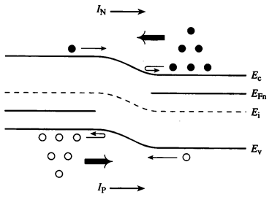
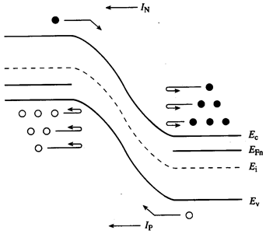
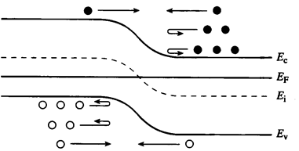
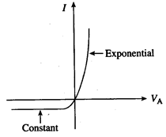
Current Flow (Qualitative View)
Equilibrium (V_{A} = 0)
Forward Bias (V_{A} > 0)
Reverse Bias (V_{A} < 0)
EE130/230M Spring 2013
Lecture 10, Slide <number>

Slide 3
Minority Carrier Action under Forward Bias
When a forward bias (V_{A}>0) is applied, the potential barrier to diffusion across the junction is reduced
  Minority carriers are “injected” into the quasi-neutral regions => Δn_{p} > 0, Δp_{n} > 0
Minority carriers diffuse in the quasi-neutral regions, recombining with majority carriers
EE130/230M Spring 2013
Lecture 10, Slide <number>

Slide 4
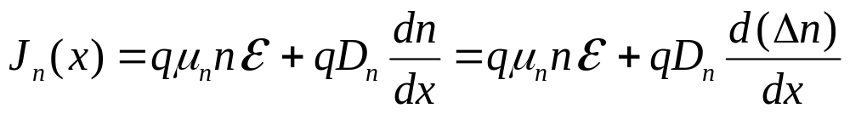
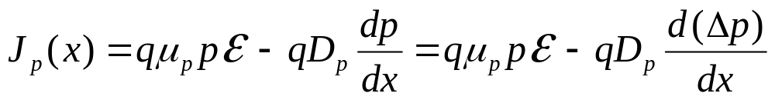
Components of Current Flow
Current density J = J_{n}(x) + J_{p}(x)
J is constant throughout the diode, but J_{n}(x) and J_{p}(x) vary with position:
J
J
x
-x_{p}
x_{n}
EE130/230M Spring 2013
Lecture 10, Slide <number>

Slide 5
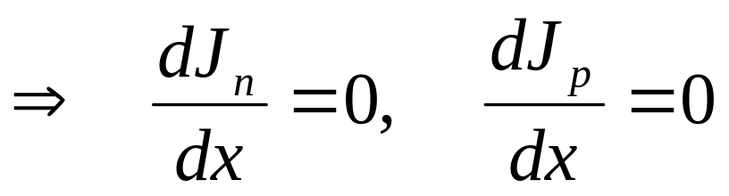
Ideal Diode Analysis: Assumptions
Non-degenerately doped step junction
Steady-state conditions
Low-level injection conditions in quasi-neutral regions
Recombination-generation negligible in depletion region
i.e. J_{n} & J_{p} are constant inside the depletion region
EE130/230M Spring 2013
Lecture 10, Slide <number>

Slide 6
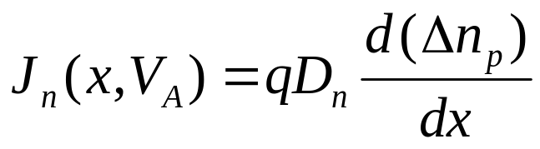
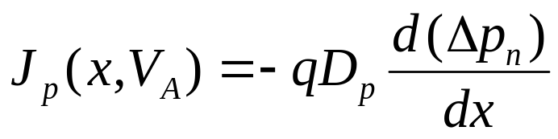
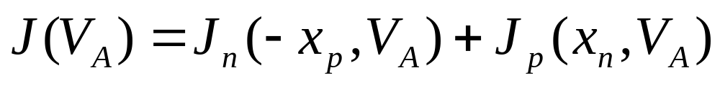
“Game Plan” for Obtaining Diode I-V
Solve minority-carrier diffusion equations in quasi-neutral regions to obtain excess carrier distributions Δn_{p}(x,V_{A}),Δp_{n}(x,V_{A})
  boundary conditions:
    p side: Δn_{p}(-x_{p}), Δn_{p}(-∞)
    n side: Δp_{n}(x_{n}), Δp_{n}(∞)
Find minority-carrier current densities in quasi-neutral regions
Evaluate J_{n} at x=-x_{p} & J_{p} at x=x_{n} to obtain total current density J:
EE130/230M Spring 2013
Lecture 10, Slide <number>

Slide 7
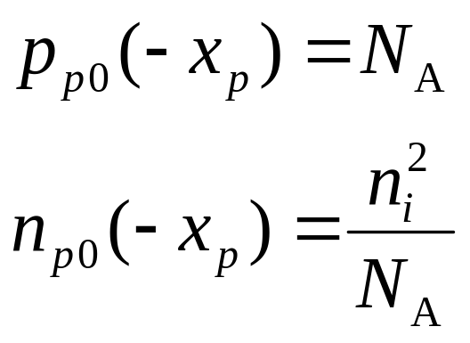
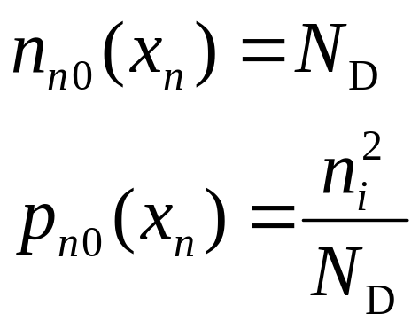
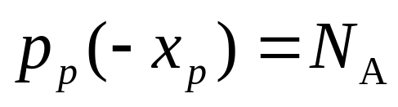
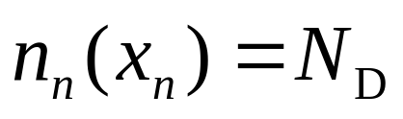
Carrier Concentrations at –x_{p}, x_{n}
Consider the equilibrium (V_{A} = 0) carrier concentrations:
p side
n side
If low-level injection conditions hold in the quasi-neutral regions when V_{A} ≠ 0, then

Slide 8
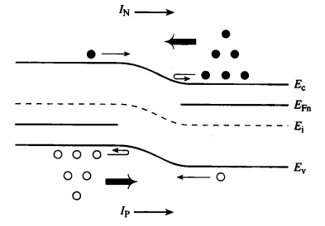
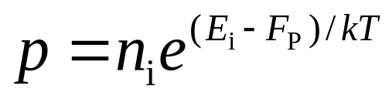
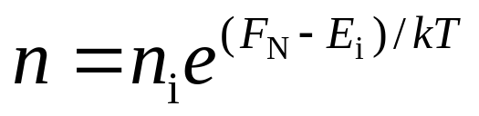
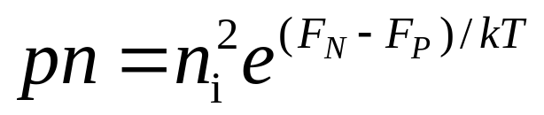
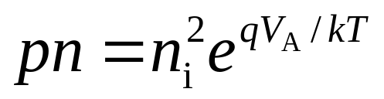
“Law of the Junction”
The voltage applied to a pn junction falls mostly across the depletion region (assuming low-level injection in the quasi-neutral regions).
We can draw 2 quasi-Fermi levels in the depletion region:
EE130/230M Spring 2013
Lecture 10, Slide <number>

Slide 9
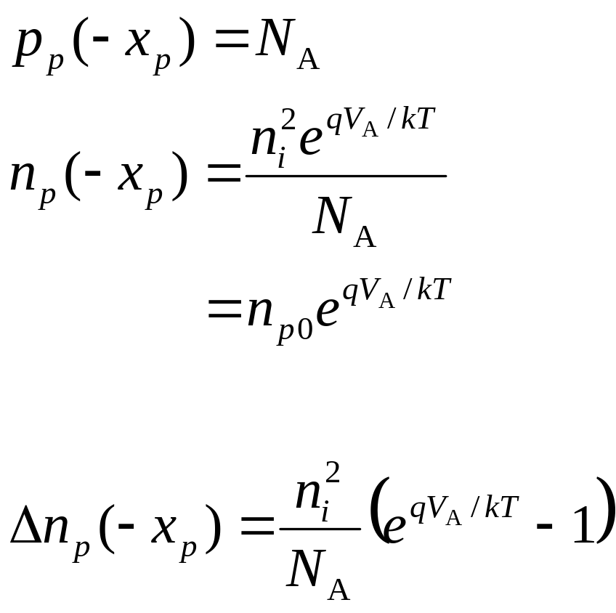
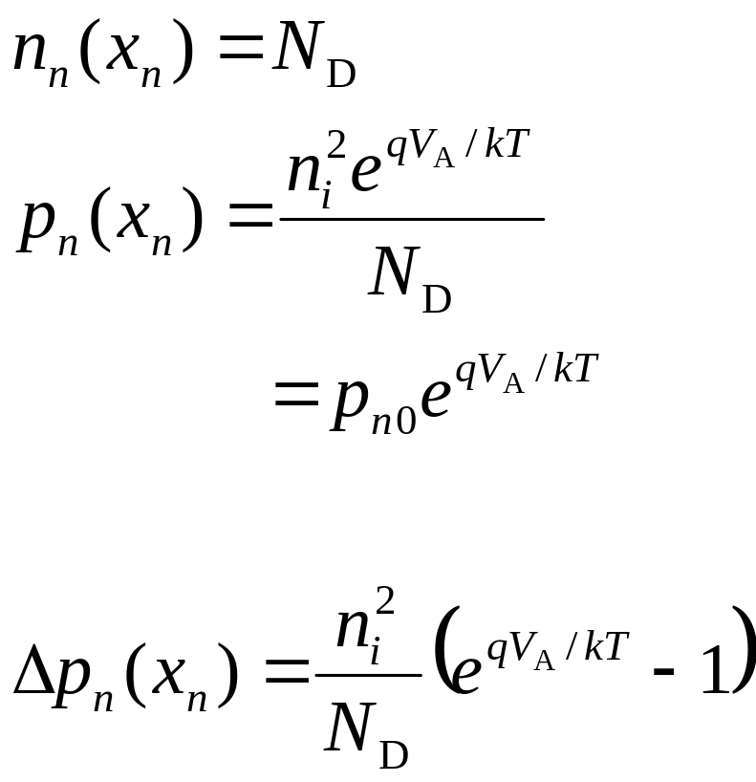
Excess Carrier Concentrations at –x_{p}, x_{n}
p side
n side
EE130/230M Spring 2013
Lecture 10, Slide <number>

Slide 10
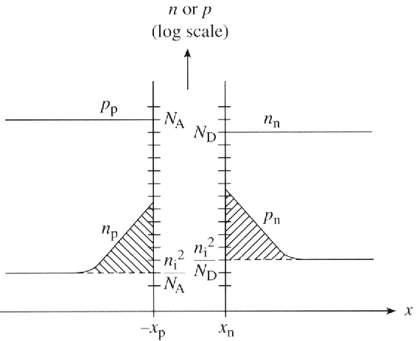
Carrier Concentration Profiles under Forward Bias
EE130/230M Spring 2013
Lecture 10, Slide <number>

Slide 11
Example
Consider a pn junction with N_{A}=10¹⁸ cm⁻³ and N_{D}=10¹⁶ cm⁻³, under a forward bias of 0.6 V.
What are the minority carrier concentrations at the edges
of the depletion region?
(b) What are the excess minority carrier concentrations at
the edges of the depletion region?
EE130/230M Spring 2013
Lecture 10, Slide <number>

Slide 12
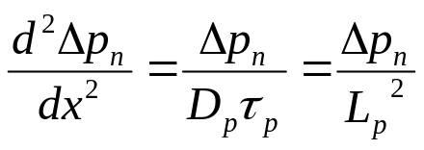
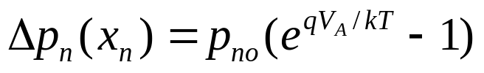

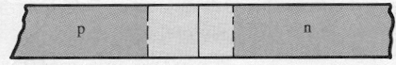
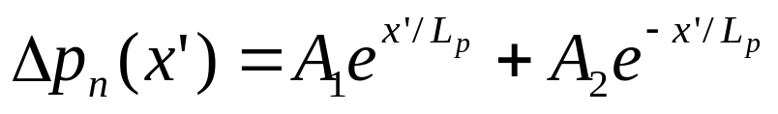
Excess Carrier Distribution (n side)
From the minority carrier diffusion equation:
We have the following boundary conditions:
For simplicity, use a new coordinate system:
Then, the solution is of the form:
NEW:
x’’ 0 0 x’
EE130/230M Spring 2013
Lecture 10, Slide <number>

Slide 13
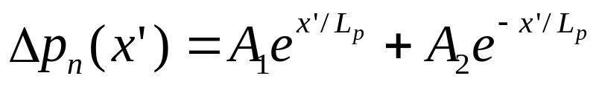
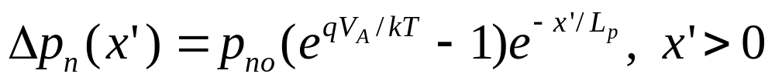
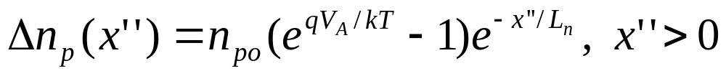
From the x = ∞ boundary condition:
From the x = x_{n} boundary condition:
Therefore
Similarly, we can derive
EE130/230M Spring 2013
Lecture 10, Slide <number>

Slide 14
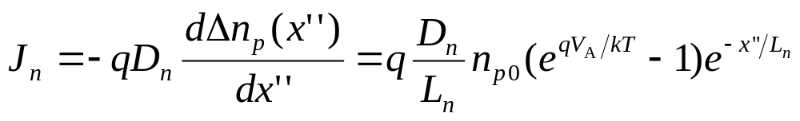
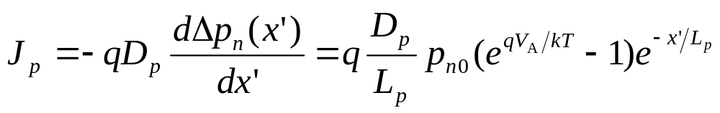
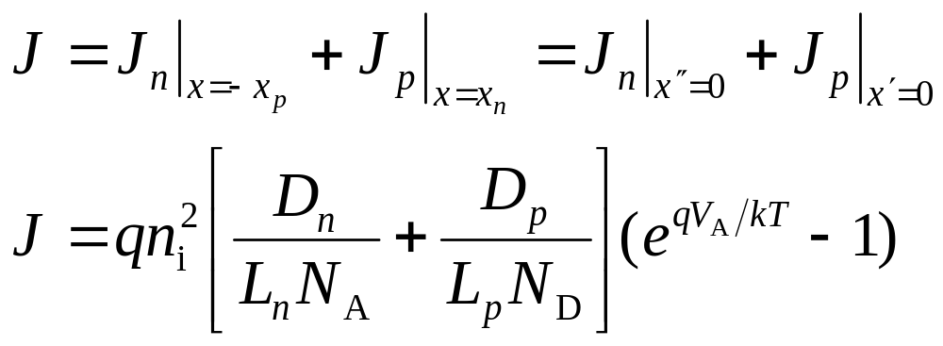
Total Current Density
p side:
n side:
EE130/230M Spring 2013
Lecture 10, Slide <number>

Slide 15
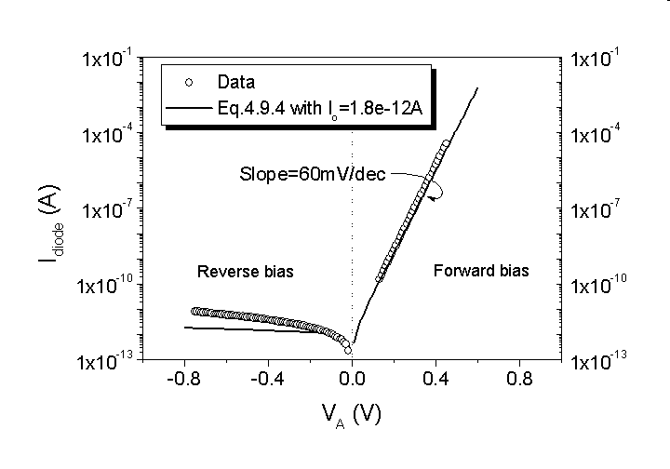
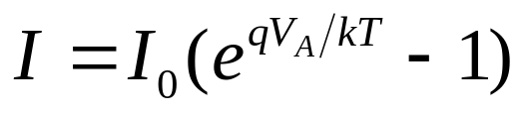
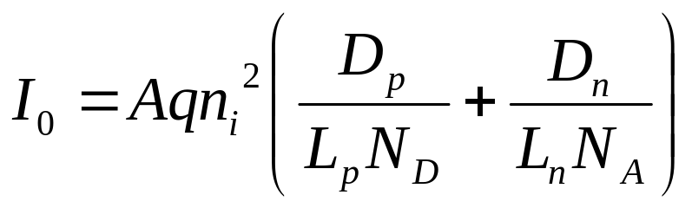
Ideal Diode Equation
EE130/230M Spring 2013
Lecture 10, Slide <number>

Slide 16
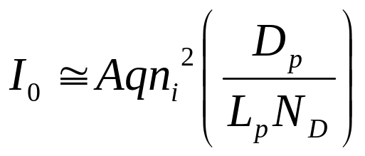
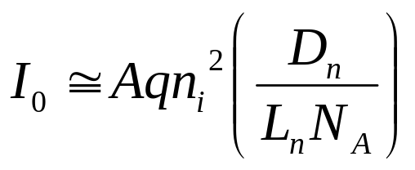
Diode Saturation Current I₀
I₀ can vary by orders of magnitude, depending on the semiconductor material and dopant concentrations:
In an asymmetrically doped (one-sided) pn junction, the term associated with the more heavily doped side is negligible:
  If the p side is much more heavily doped,
  If the n side is much more heavily doped,
EE130/230M Spring 2013
Lecture 10, Slide <number>

Slide 17
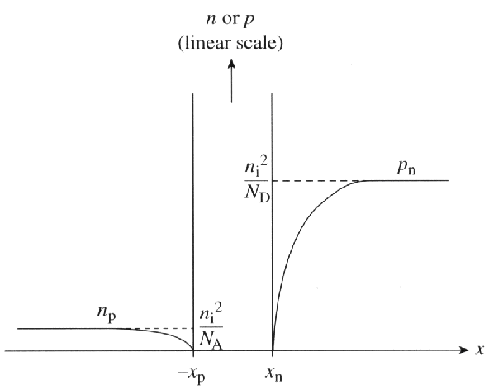
Carrier Concentration Profiles under Reverse Bias
Depletion of minority carriers at edges of depletion region
The only current which flows is due to drift of minority carriers across the junction. This current is fed by diffusion of minority carriers toward junction (supplied by thermal generation).
EE130/230M Spring 2013
Lecture 10, Slide <number>

Slide 18
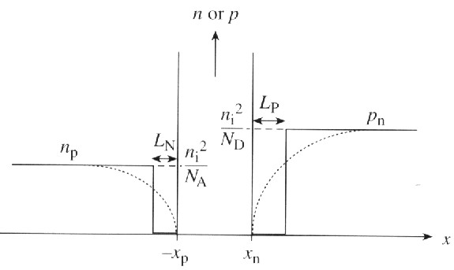
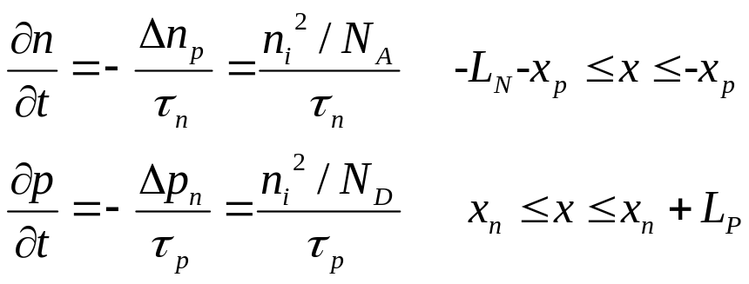
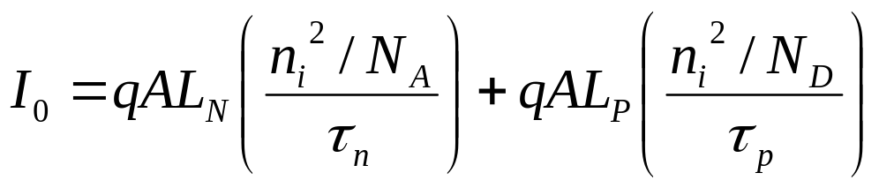
Alternative Derivation of Formula for I₀
“Depletion approximation”:
I₀ is the rate at which carriers are thermally generated within one diffusion length of the depletion region:
EE130/230M Spring 2013
Lecture 10, Slide <number>

Slide 19

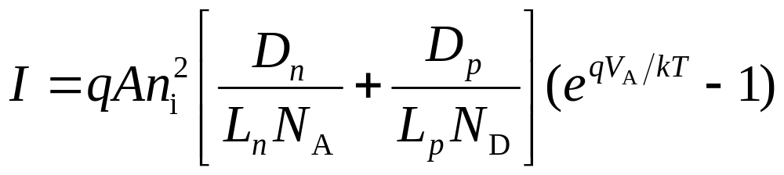
Summary
Under forward bias (V_{A} > 0), the potential barrier to carrier diffusion is reduced → minority carriers are “injected” into the quasi-neutral regions.
  The minority-carrier concentrations at the edges of the depletion region change with the applied bias V_{A}, by the factor
  The excess carrier concentrations in the quasi-neutral regions decay to zero away from the depletion region, due to recombination.
pn junction diode current
I₀ can be viewed as the drift current due to minority carriers generated within a diffusion length of the depletion region
EE130/230M Spring 2013
Lecture 10, Slide <number>

