Slide 1
Lecture 11
OUTLINE
pn Junction Diodes (cont’d)
  Narrow-base diode
Reading: Pierret 6.3.2

Slide 2
Introduction
The ideal diode equation was derived assuming that the lengths of the quasi-neutral p-type and n-type regions (W_{P}’ , W_{N}’) are much greater than the minority-carrier diffusion lengths (L_{n} , L_{p}) so that the excess carrier concentrations decay exponentially to 0 hence the minority carrier diffusion currents decay exponentially to 0 within these regions, due to recombination.
In modern IC devices, however, it is common for one side of a pn junction to be shorter than the minority-carrier diffusion length, so that a significant fraction of the “injected” minority carriers reach the end of the quasi-neutral region, at the metal contact.
  Recall from Lecture 8 that Δp = Δn = 0 at an ohmic contact.
→ In this lecture we re-derive the diode I-V equation with the boundary condition that Δp = 0 at a distance x_{c}’ (rather than ∞) from the edge of the depletion region.
EE130/230M Spring 2013
Lecture 11, Slide <number>

Slide 3
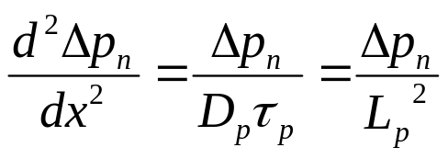
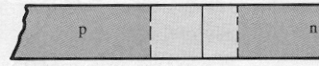
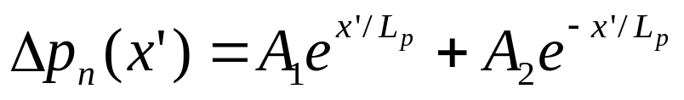
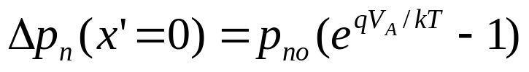
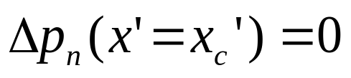
Excess Carrier Distribution (n side)
From the minority carrier diffusion equation:
For convenience, let’s use the coordinate system:
So the solution is of the form:
We have the following boundary conditions:
x’’ 0
0 x’
x'_{c}
EE130/230M Spring 2013
Lecture 11, Slide <number>

Slide 4
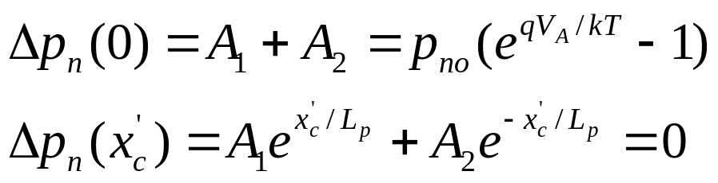
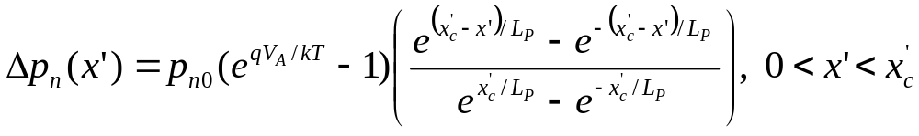
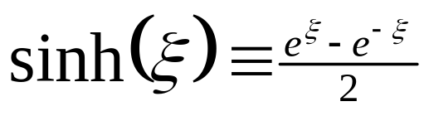
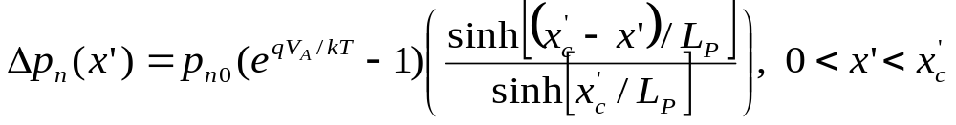
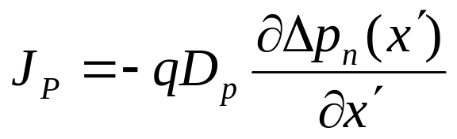
Applying the boundary conditions, we have:
Therefore
Since this can be rewritten as
We need to take the derivative of Δp_{n}’ to obtain the hole diffusion current within the quasi-neutral n region:
EE130/230M Spring 2013
Lecture 11, Slide <number>

Slide 5
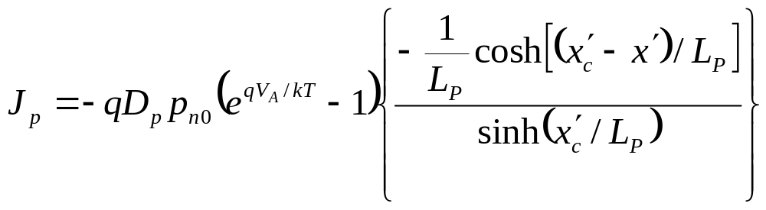
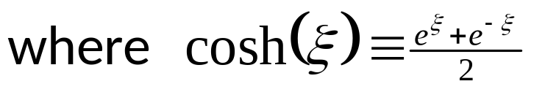
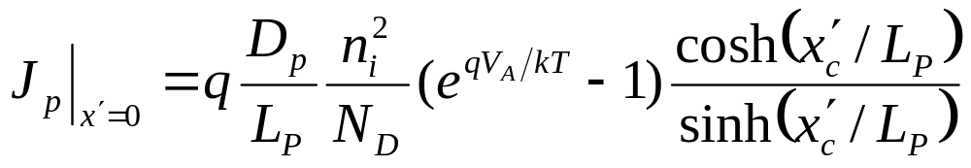
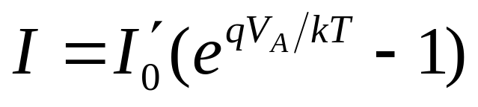
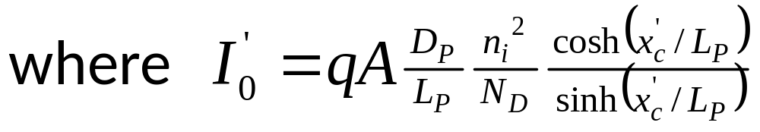
Evaluate J_{p} at x=x_{n} (x’=0) to find the injected hole current:
Thus, for a one-sided p⁺n junction (in which the current is dominated by injection of holes into the n-side):
EE130/230M Spring 2013
Lecture 11, Slide <number>

Slide 6


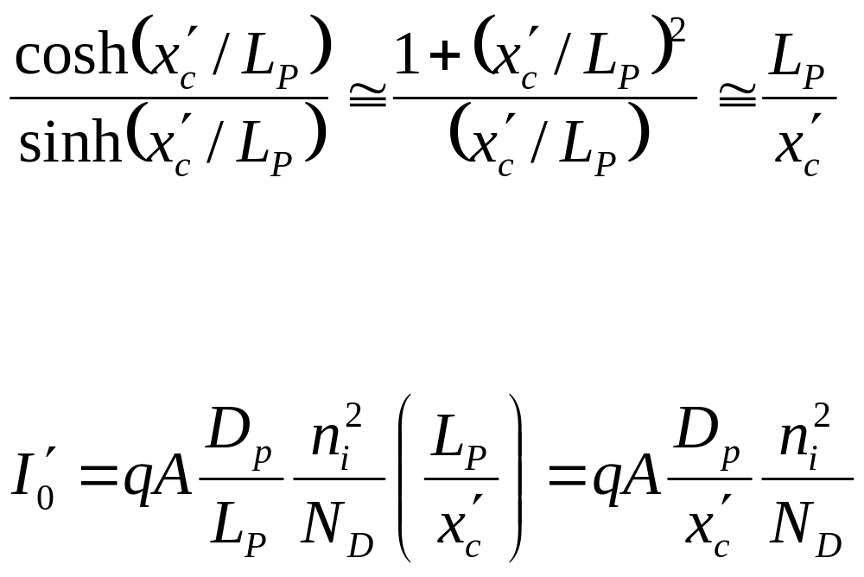
and
Therefore if x’_{c} << L_{P}:
For a one-sided p⁺n junction, then:
EE130/230M Spring 2013
Lecture 11, Slide <number>

Slide 7
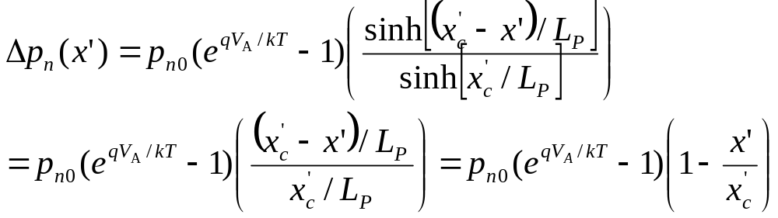
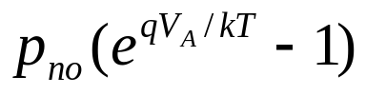
Excess Hole Concentration Profile
If x’_{c} << L_{P}:
Δp_{n}(x)
Δp_{n} is a linear function:
J_{p} is constant
(No holes are lost due to recombination as they diffuse to the metal contact.)
slope is
constant
0
x'
0
x'_{c}
EE130/230M Spring 2013
Lecture 11, Slide <number>

Slide 8
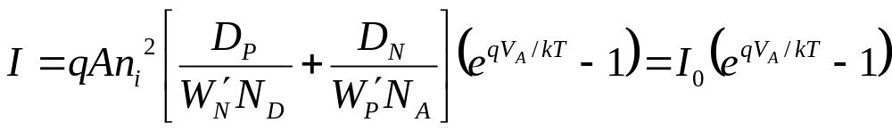
General Narrow-Base Diode I-V
Define W_{P}‘ and W_{N}’ to be the widths of the quasi-neutral regions.
If both sides of a pn junction are narrow (i.e. much shorter than the minority carrier diffusion lengths in the respective regions):
J
e.g. if the p side is doped more heavily than the n side:
J_{P}
J_{N}
x
-x_{p}
x_{n}
EE130/230M Spring 2013
Lecture 11, Slide <number>

Slide 9
Summary
If the length of the quasi-neutral region is much shorter than the minority-carrier diffusion length, then there will be negligible recombination within the quasi-neutral region and hence all of the injected minority carriers will “survive” to reach the metal contact.
  The excess carrier concentration is a linear function of distance.
    For example, within a narrow n-type quasi-neutral region:
  The minority-carrier diffusion current is constant within the narrow quasi-neutral region.
Shorter quasi-neutral region → steeper concentration gradient → higher diffusion current
Δp_{n}(x)
location of metal contact
(Δp_{n}=0)
0
x
x_{n}
W_{N}’
EE130/230M Spring 2013
Lecture 11, Slide <number>

