Slide 1
Lecture 12
OUTLINE
pn Junction Diodes (cont’d)
  Junction breakdown
  Deviations from the ideal I-V
    R-G current
    series resistance
    high-level injection
Reading: Pierret 6.2; Hu 4.5

Slide 2
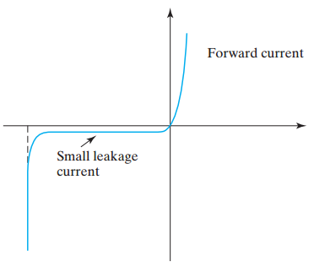
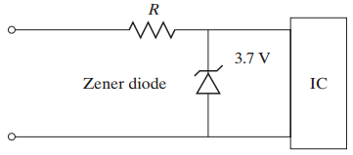
pn Junction Breakdown
Breakdown
voltage, V_{BR}
V_{A}
A Zener diode is designed to operate in the breakdown mode:
EE130/230M Spring 2013
Lecture 12, Slide <number>

Slide 3
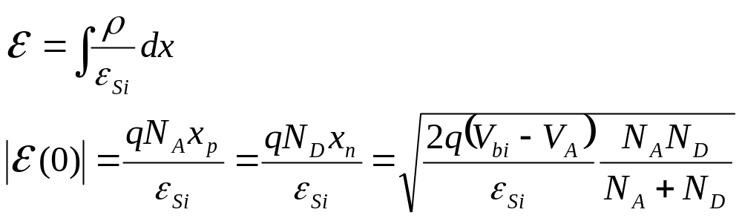
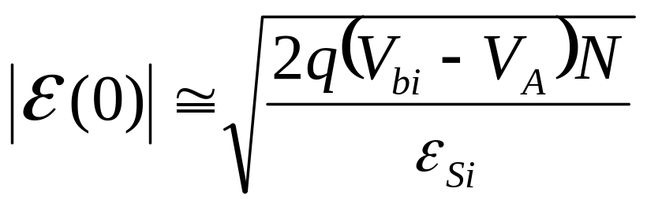
Review: Peak E-Field in a pn Junction
E(x)
-x_{p}
x_{n}
x
E(0)
For a one-sided junction,
where N is the dopant concentration on the lightly doped side
EE130/230M Spring 2013
Lecture 12, Slide <number>

Slide 4
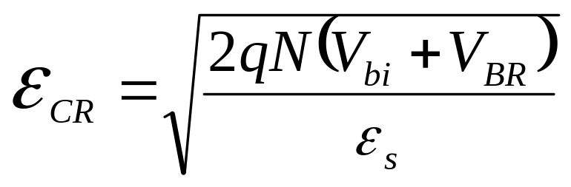
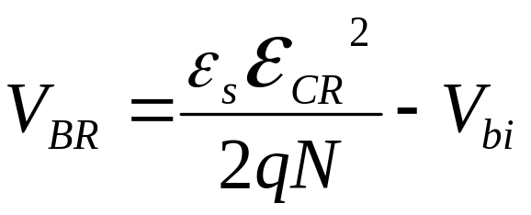
Breakdown Voltage, V_{BR}
If the reverse bias voltage (-V_{A}) is so large that the peak electric field exceeds a critical value E_{CR}, then the junction will “break down” (i.e. large reverse current will flow)
Thus, the reverse bias at which breakdown occurs is
EE130/230M Spring 2013
Lecture 12, Slide <number>

Slide 5
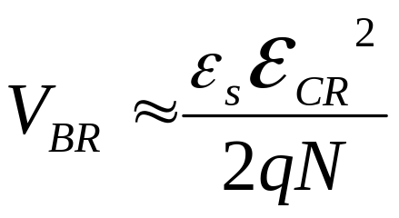
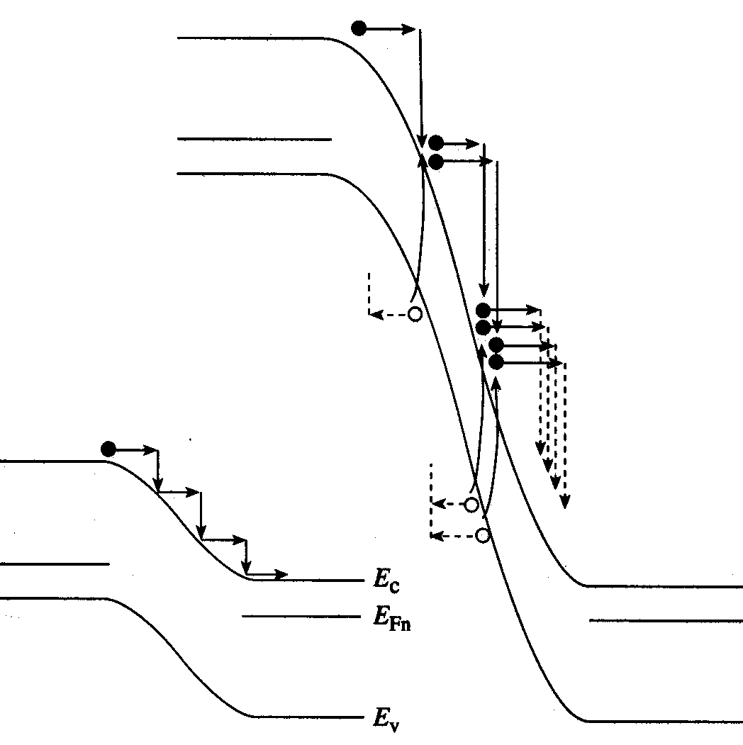
Avalanche Breakdown Mechanism
High E-field:
if V_{BR} >> V_{bi}
E_{CR} increases slightly with N:
  For 10¹⁴ cm⁻³ < N < 10¹⁸ cm⁻³,
  10⁵ V/cm < E_{CR} < 10⁶ V/cm
Low E-field:
EE130/230M Spring 2013
Lecture 12, Slide <number>

Slide 6
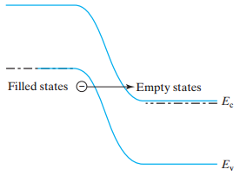


Tunneling (Zener) Breakdown Mechanism
Dominant breakdown mechanism when both sides of a junction are very heavily doped.
V_{A} = 0
V_{A} < 0
E_{c}
E_{v}
Typically, V_{BR} < 5 V for Zener breakdown
EE130/230M Spring 2013
Lecture 12, Slide <number>

Slide 7
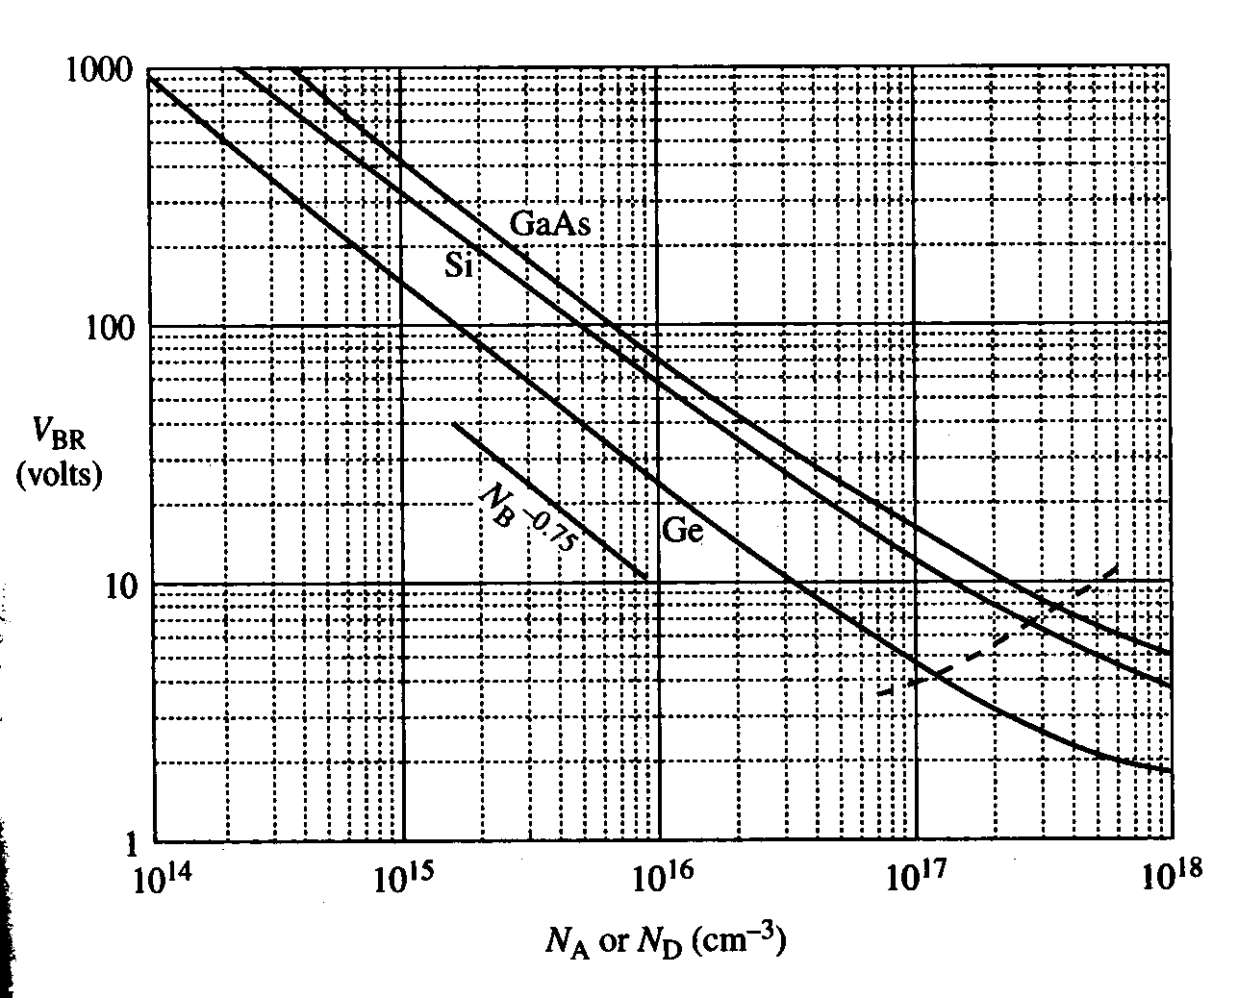
Empirical Observations of V_{BR}
V_{BR} decreases with increasing N
V_{BR} decreases with decreasing E_{G}
EE130/230M Spring 2013
Lecture 12, Slide <number>

Slide 8
V_{BR} Temperature Dependence
For the avalanche mechanism:
  V_{BR} increases with increasing T, because the mean free path decreases
For the tunneling mechanism:
  V_{BR} decreases with increasing T, because the flux of valence-band electrons available for tunneling increases
EE130/230M Spring 2013
Lecture 12, Slide <number>

Slide 9
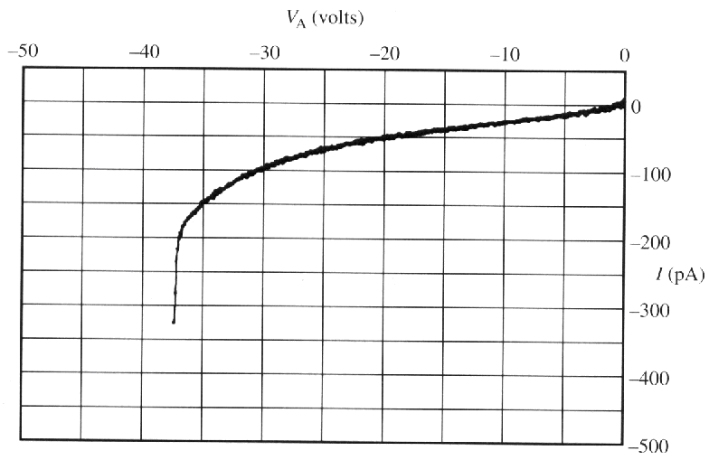
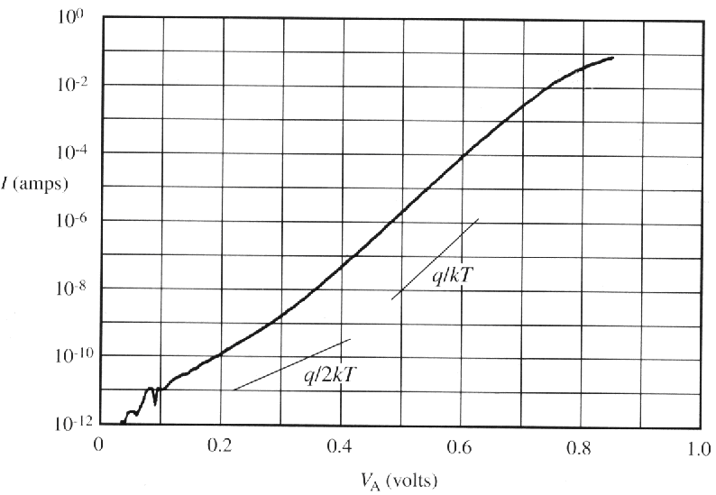

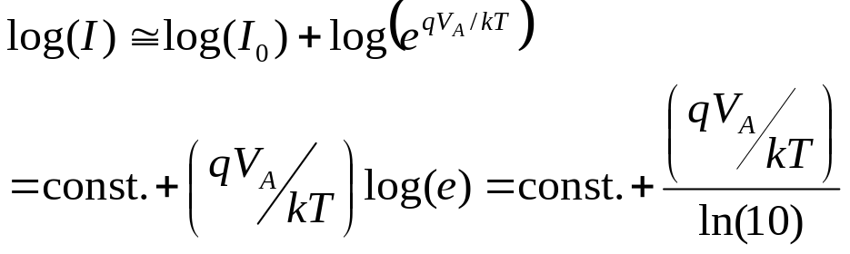
Deviations from the Ideal I-V
Forward-Bias Current
(log scale)
Reverse-Bias Current
(linear scale)
Ideally,
Ideally,
EE130/230M Spring 2013
Lecture 12, Slide <number>

Slide 10
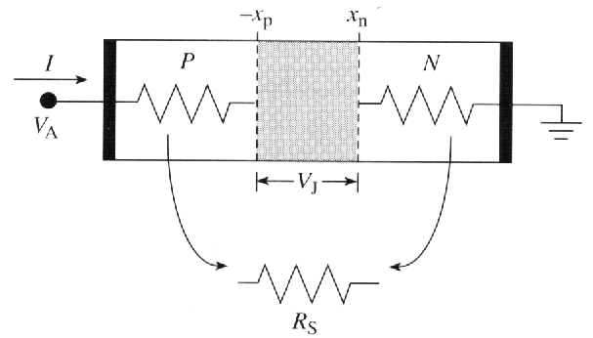
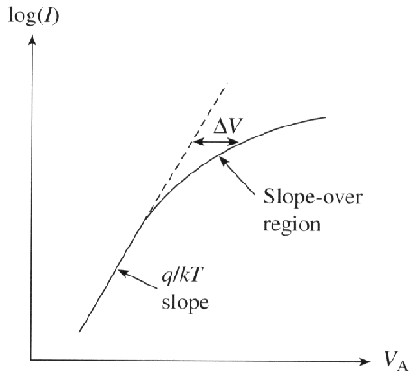
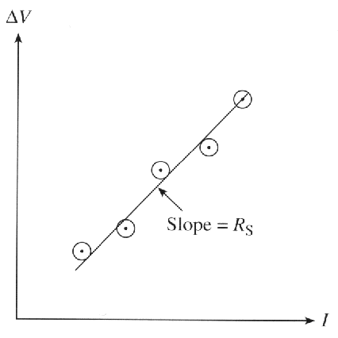
Effect of Series Resistance
EE130/230M Spring 2013
Lecture 12, Slide <number>

Slide 11
High-Level Injection (HLI) Effect
As V_{A} increases, the side of the junction which is more lightly doped will eventually reach HLI:
  significant gradient in majority-carrier profile
  Majority-carrier diffusion current reduces the diode
  current from the ideal case.
n_{n} > n_{no} for a p⁺n junction
or
p_{p} > p_{po} for a pn⁺ junction
EE130/230M Spring 2013
Lecture 12, Slide <number>

Slide 12
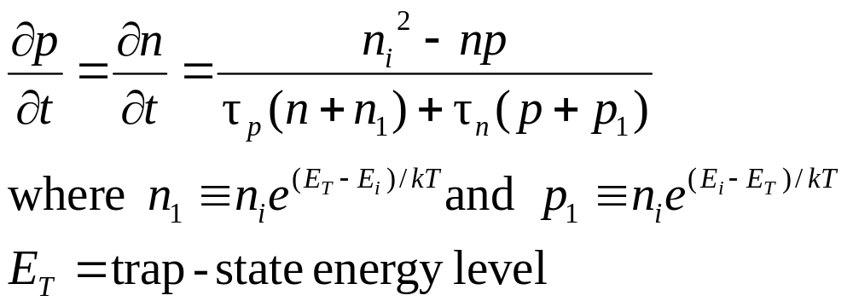
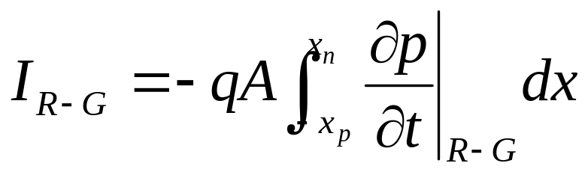
Effect of R-G in Depletion Region
The net generation rate is given by
R-G in the depletion region contributes an additional component of diode current I_{R-G}:
EE130/230M Spring 2013
Lecture 12, Slide <number>

Slide 13
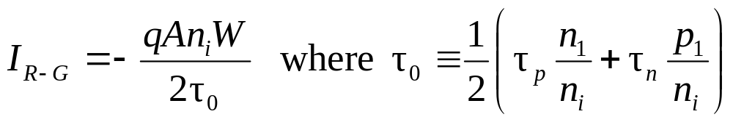
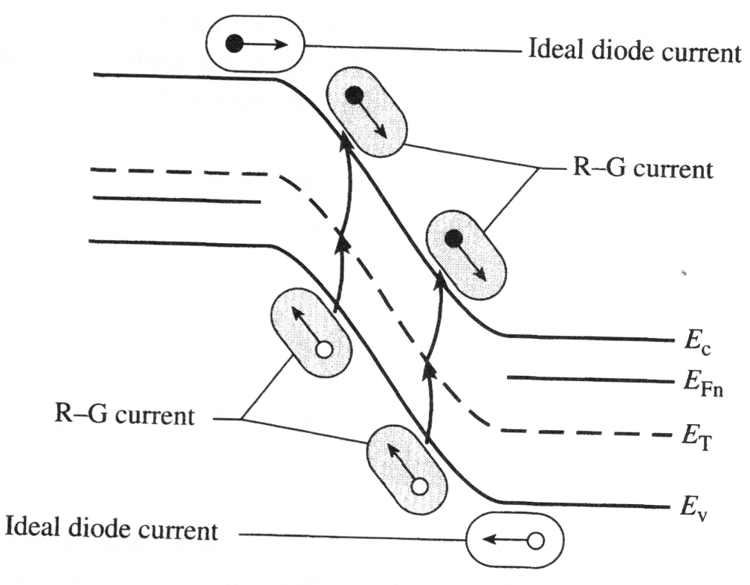
Net Generation in Reverse Bias
For reverse bias greater than several kT/q,
EE130/230M Spring 2013
Lecture 12, Slide <number>

Slide 14
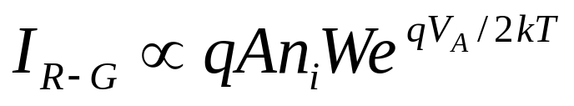
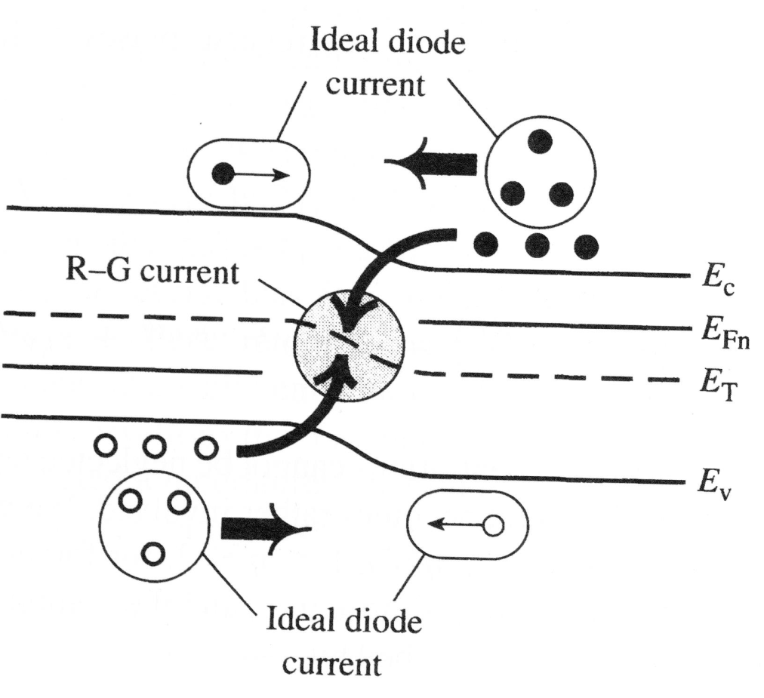
Net Recombination in Forward Bias
For forward bias:
EE130/230M Spring 2013
Lecture 12, Slide <number>

Slide 15
Summary: Junction Breakdown
If the peak electric field in the depletion region exceeds a critical value E_{CR}, then large reverse current will flow.
This occurs at a negative bias voltage called the breakdown voltage, V_{BR}:
  where N is the dopant concentration on the more lightly doped side
The dominant breakdown mechanism is
    avalanche, if N < ~10¹⁸/cm³
    tunneling, if N > ~10¹⁸/cm³
EE130/230M Spring 2013
Lecture 12, Slide <number>

Slide 16
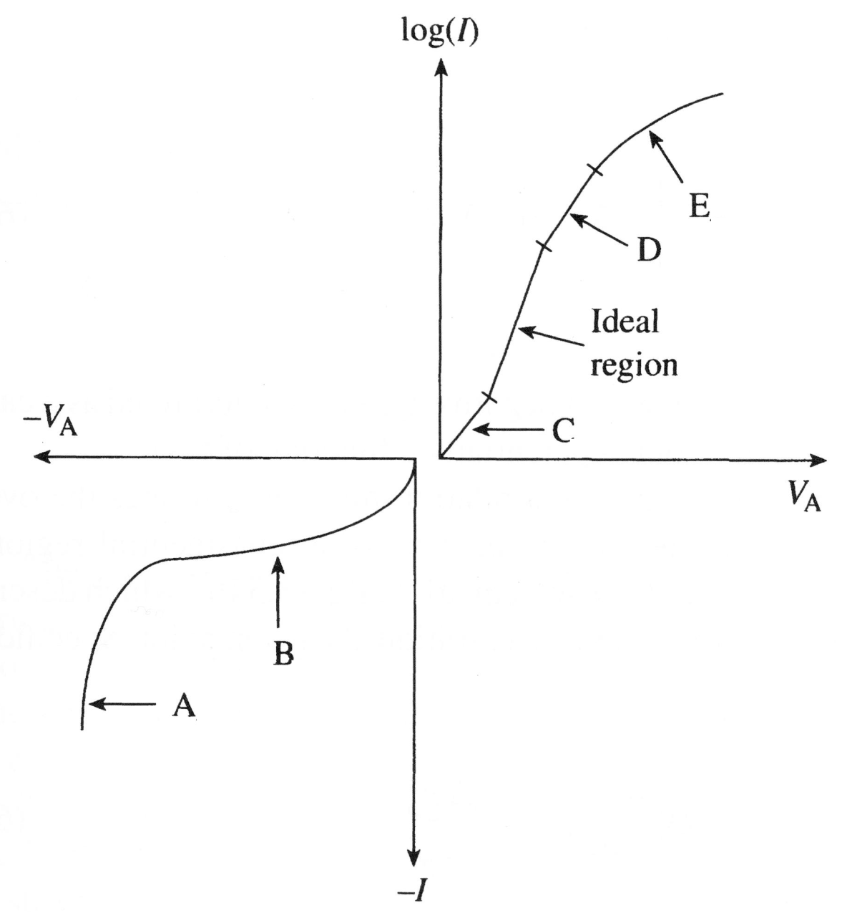



Summary: Deviations from Ideal I-V
At large forward biases (high current densities)
  D: high-level injection
  E: series resistance
limit increases in current with increasing forward bias voltage.
B: Excess current under reverse bias is due to net generation in the depletion region.
C: Excess current under small forward bias is due to net recombination in the depletion region.
A: At large reverse biases (high E-field), large reverse current flows due to avalanching and/or tunneling
EE130/230M Spring 2013
Lecture 12, Slide <number>

