Slide 1
Lecture 13
OUTLINE
pn Junction Diodes (cont’d)
  Charge control model
  Small-signal model
  Transient response: turn-off
Reading: Pierret 6.3.1, 7, 8.1; Hu 4.4, 4.10-4.11

Slide 2
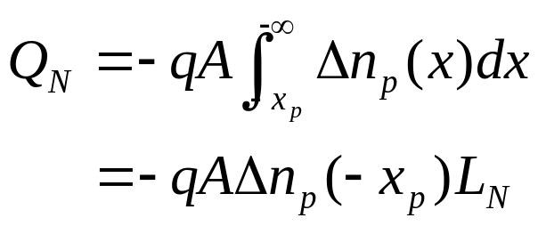
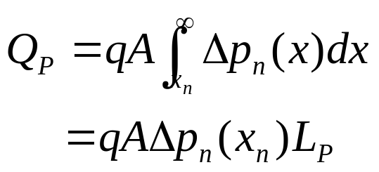
Minority-Carrier Charge Storage
Under forward bias (V_{A} > 0), excess minority carriers are stored in the quasi-neutral regions of a pn junction:
EE130/230M Spring 2013
Lecture 13, Slide <number>

Slide 3
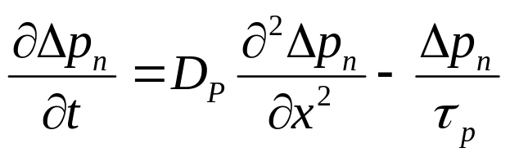
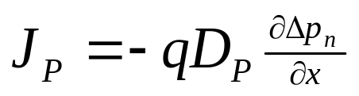
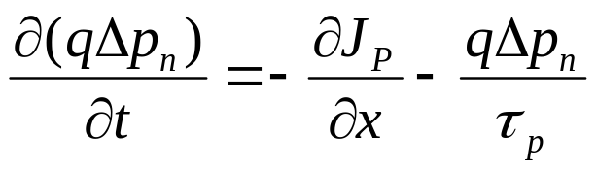
Derivation of Charge Control Model
Consider the n quasi-neutral region of a forward-biased pn junction:
The minority carrier diffusion equation is (assuming G_{L}=0):
Since the electric field is very small,
Therefore
EE130/230M Spring 2013
Lecture 13, Slide <number>

Slide 4
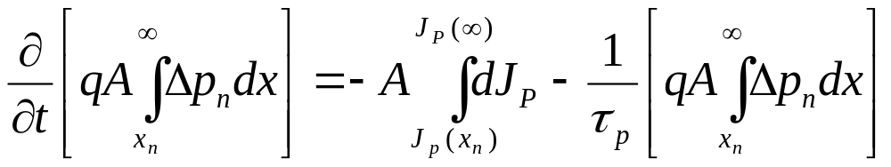
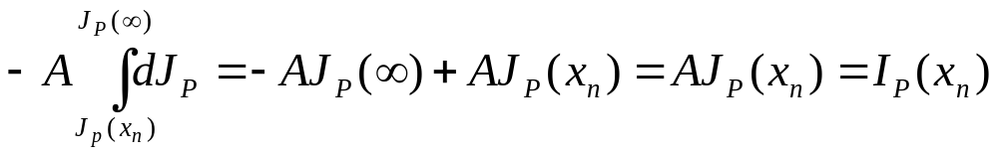
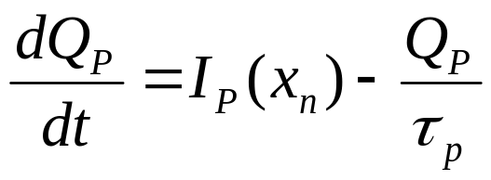
Derivation Assuming a Long Base
Integrating over the n quasi-neutral region:
Note that
So
EE130/230M Spring 2013
Lecture 13, Slide <number>

Slide 5
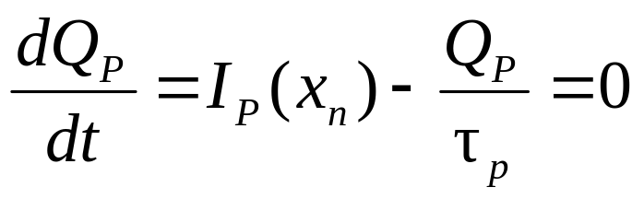
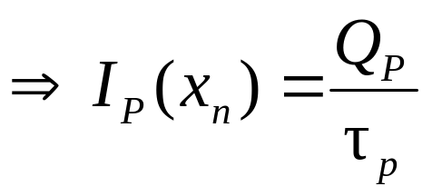
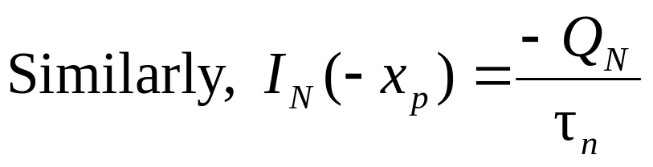
Charge Control Model
We can calculate pn-junction current in 2 ways:
  From slopes of Δn_{p}(-x_{p}) and Δp_{n}(x_{n})
  From steady-state charges Q_{N}, Q_{P} stored in each excess-minority-charge distribution:
EE130/230M Spring 2013
Lecture 13, Slide <number>

Slide 6
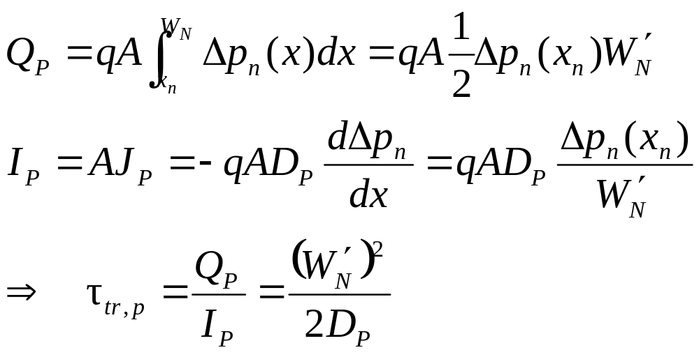
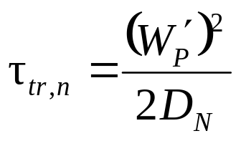
Charge Control Model for Narrow Base
For a narrow-base diode, replace τ_{p} and/or τ_{n} by the minority-carrier transit time τ_{tr}
  time required for minority carrier to travel across the quasi-neutral region
  For holes in narrow n-side:
  Similarly, for electrons in narrow p-side:
EE130/230M Spring 2013
Lecture 13, Slide <number>

Slide 7
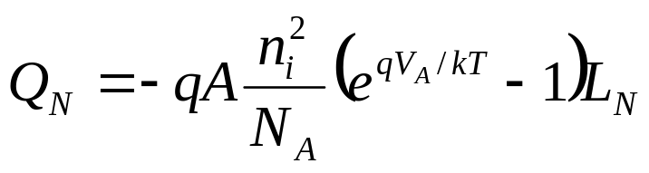
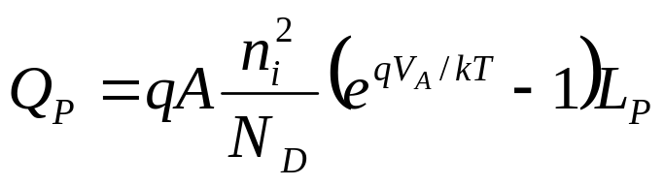
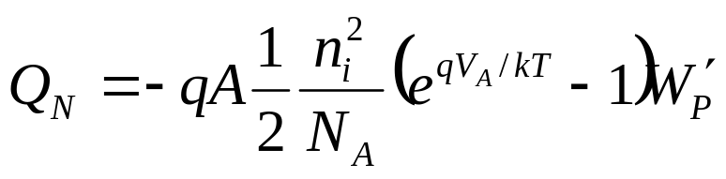
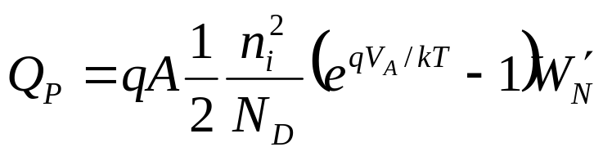
Charge Control Model Summary
Under forward bias, minority-carrier charge is stored in the quasi-neutral regions of a pn diode.
  Long base:
  Narrow base:
EE130/230M Spring 2013
Lecture 13, Slide <number>

Slide 8
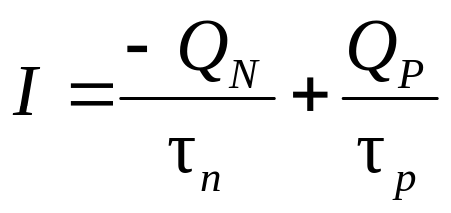
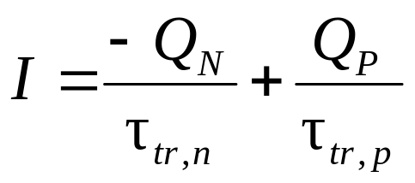
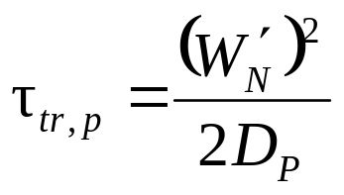
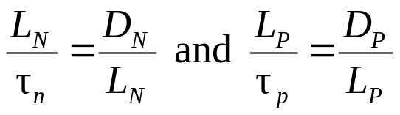
The steady-state diode current can be viewed as the charge supply required to compensate for charge loss via recombination (for long base) or collection at the contacts (for narrow base).
  Long base (both sides):
  Narrow base (both sides):
    where and
Note that
EE130/230M Spring 2013
Lecture 13, Slide <number>

Slide 9
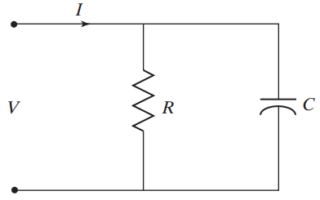
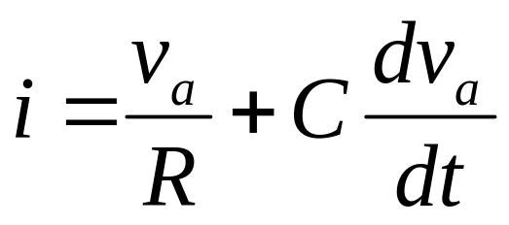
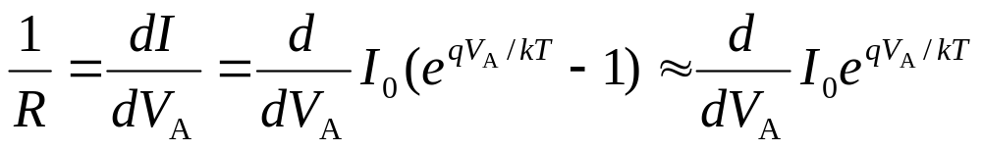
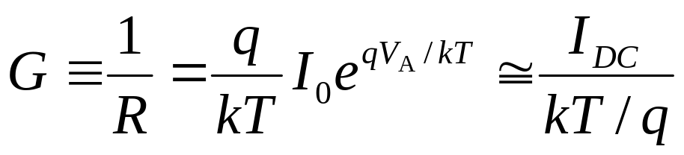
Small-Signal Model of the Diode
i
+
v
−
Small-signal
conductance:
EE130/230M Spring 2013
Lecture 13, Slide <number>

Slide 10
Charge Storage in pn Junction Diode
EE130/230M Spring 2013
Lecture 13, Slide <number>

Slide 11
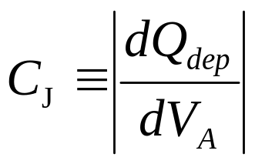
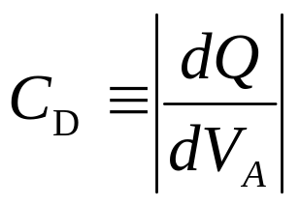
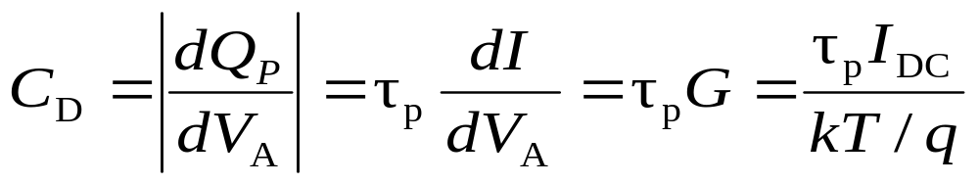
pn Junction Small-Signal Capacitance
2 types of capacitance associated with a pn junction:
  depletion capacitance
    due to variation of depletion charge
  diffusion capacitance
  due to variation of stored
  minority charge in the quasi-neutral regions
For a one-sided p⁺n junction Q = Q_{P} + Q_{N} ≅ Q_{P} so
EE130/230M Spring 2013
Lecture 13, Slide <number>

Slide 12
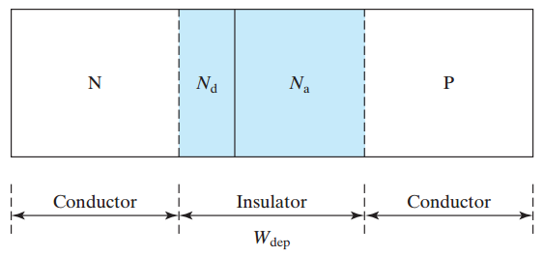
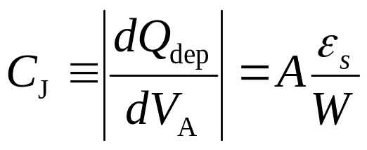
Depletion Capacitance
What are three ways to reduce C_{J}?
EE130/230M Spring 2013
Lecture 13, Slide <number>

Slide 13
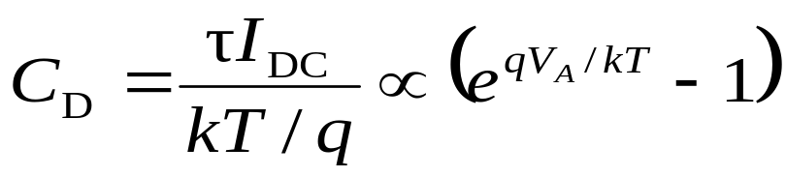
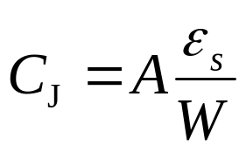
Total pn-Junction Capacitance
C = C_{D} + C_{J}
C_{D} dominates at moderate to high forward biases
C_{J} dominates at low forward biases, reverse biases
EE130/230M Spring 2013
Lecture 13, Slide <number>

Slide 14
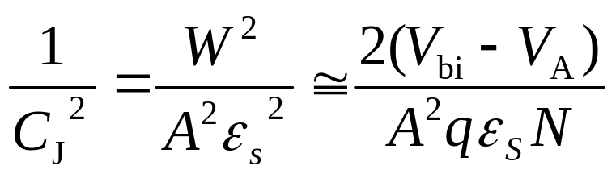
Using C-V Data to Determine Doping
EE130/230M Spring 2013
Lecture 13, Slide <number>

Slide 15
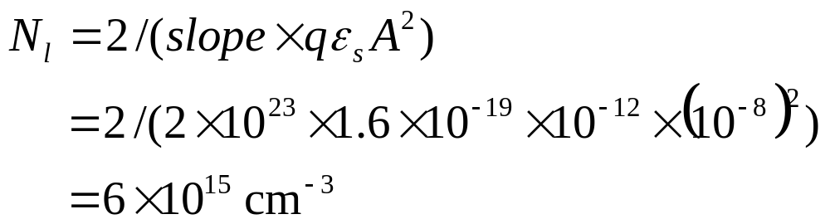
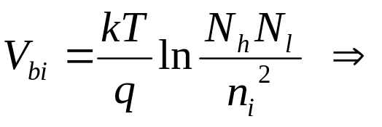
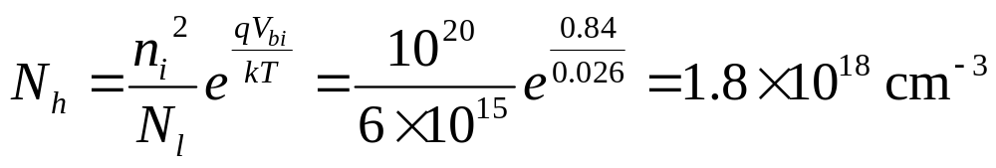
Example
If the slope of the (1/C)² vs. V_{A} characteristic is -2x10²³ F⁻² V⁻¹, the intercept is 0.84V, and A is 1 μm², find the dopant concentration N_{l} on the more lightly doped side and the dopant concentration N_{h} on the more heavily doped side.
Solution:
EE130/230M Spring 2013
Lecture 13, Slide <number>

Slide 16
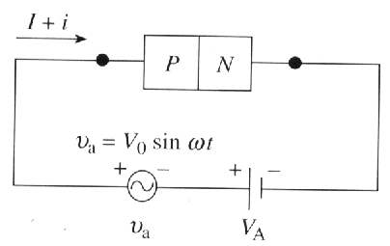
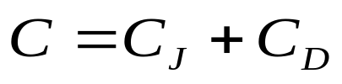
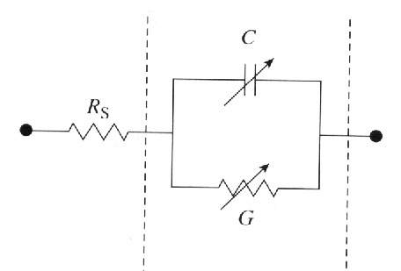

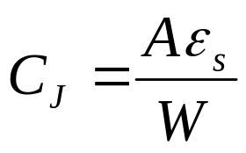
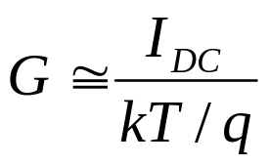
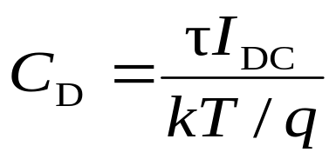
Small-Signal Model Summary
Depletion capacitance
Conductance
Diffusion capacitance
EE130/230M Spring 2013
Lecture 13, Slide <number>

Slide 17
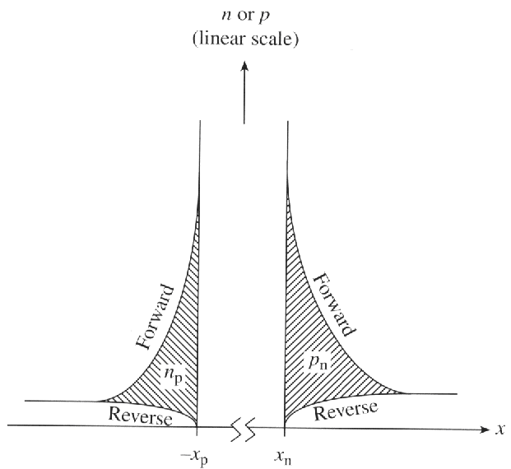
Transient Response of pn Diode
Suppose a pn-diode is forward biased, then suddenly turned off at time t = 0. Because of C_{D}, the voltage across the pn junction depletion region cannot be changed instantaneously.
The delay in switching between
the ON and OFF states is due
to the time required to change
the amount of excess minority
carriers stored in the
quasi-neutral regions.
EE130/230M Spring 2013
Lecture 13, Slide <number>

Slide 18
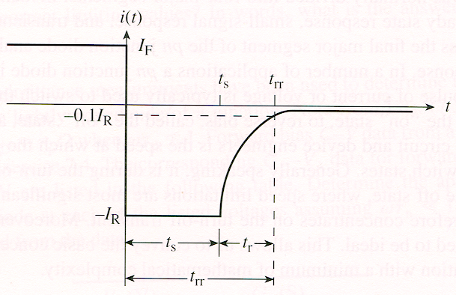
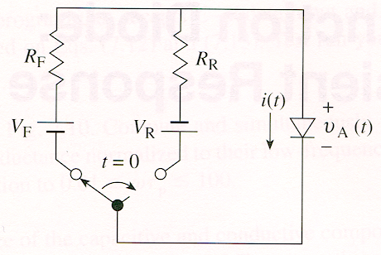
Turn-Off Transient
In order to turn the diode off, the excess minority carriers must be removed by net carrier flow out of the quasi-neutral regions and/or recombination
  Carrier flow is limited by the switching circuitry
EE130/230M Spring 2013
Lecture 13, Slide <number>

Slide 19
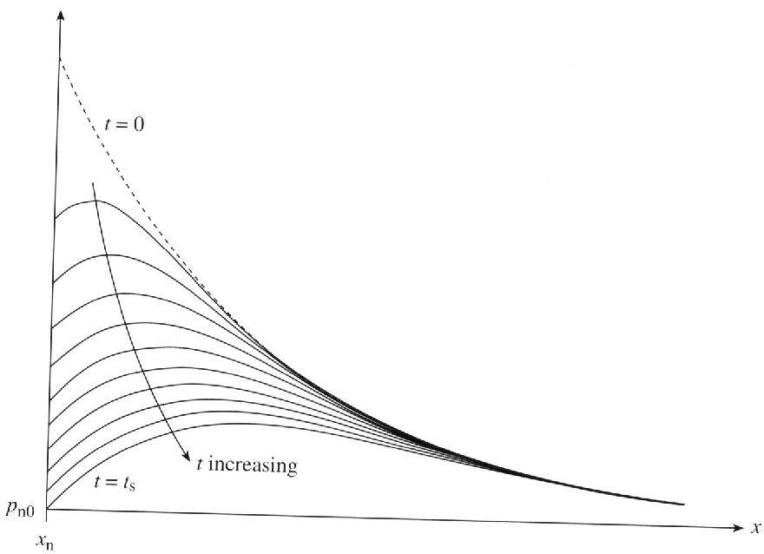
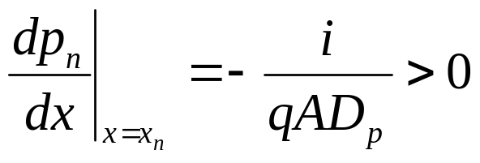
Decay of Stored Charge
Consider a p⁺n diode (Q_{p} >> Q_{n}):
Δp_{n}(x)
i(t)
t_{s}
t
v_{A}(t)
t
For t > 0:
t_{s}
EE130/230M Spring 2013
Lecture 13, Slide <number>

Slide 20
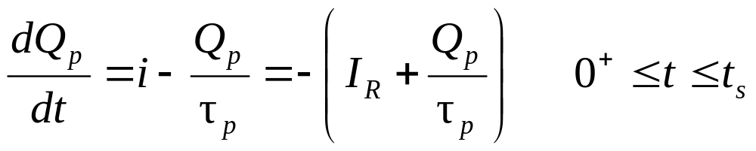
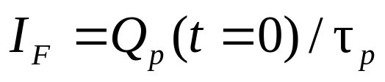
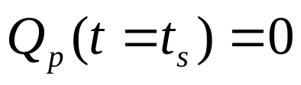

Storage Delay Time, t_{s}
t_{s} is the primary “figure of merit” used to characterize the transient response of pn junction diodes
By separation of variables and integration from t = 0⁺ to t = t_{s}, noting that
  and making the approximation
  We conclude that
EE130/230M Spring 2013
Lecture 13, Slide <number>

Slide 21
Qualitative Examples
Illustrate how the turn-off transient response would change:
Increase I_{F}
Increase I_{R}
Decrease τ_{p}
i(t)
i(t)
i(t)
t_{s}
t_{s}
t_{s}
t
t
t
EE130/230M Spring 2013
Lecture 13, Slide <number>

