Slide 1
Lecture 14
OUTLINE
pn Junction Diodes (cont’d)
  Transient response: turn-on
  Summary of important concepts
  Diode applications
    Varactor diodes
    Tunnel diodes
    Optoelectronic diodes
Reading: Pierret 9; Hu 4.12-4.15

Slide 2
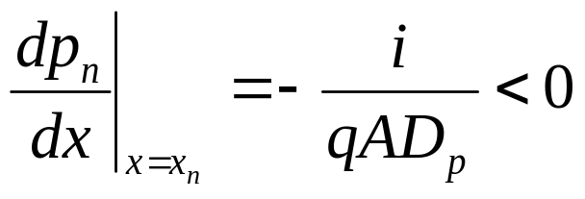
Turn-On Transient
Consider a p⁺n diode (Q_{p} >> Q_{n}):
Δp_{n}(x)
i(t)
t
v_{A}(t)
x
x_{n}
For t > 0:
t
EE130/230M Spring 2013
Lecture 14, Slide <number>

Slide 3
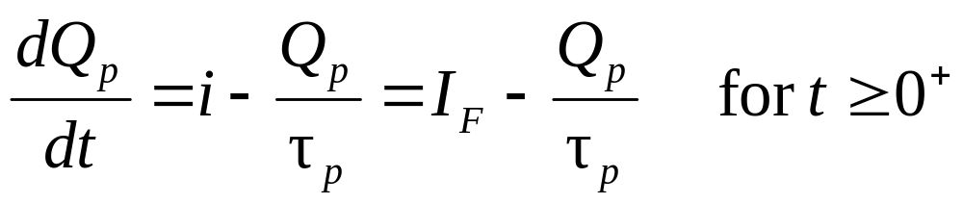
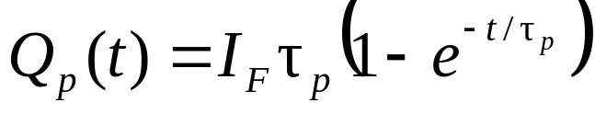
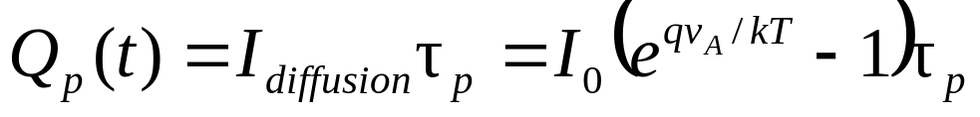
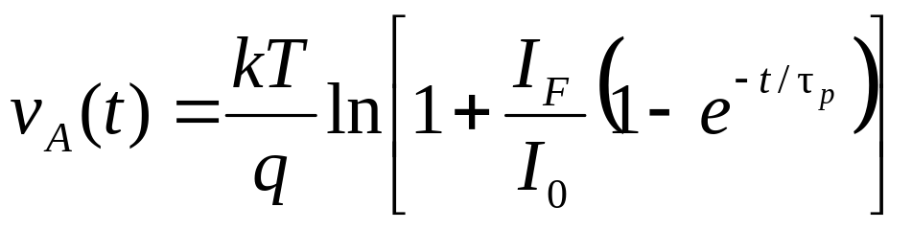
By separation of variables and integration, we have
If we assume that the build-up of stored charge occurs quasi-statically so that
then
EE130/230M Spring 2013
Lecture 14, Slide <number>

Slide 4
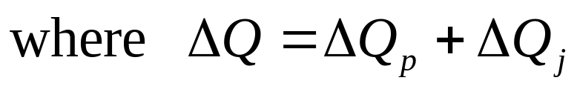
If τ_{p} is large, then the time required to turn on the diode is approximately ΔQ/I_{F}
EE130/230M Spring 2013
Lecture 14, Slide <number>

Slide 5
Summary of Important Concepts
Under forward bias, minority carriers are injected into the quasi-neutral regions of the diode.
The current flowing across the junction is comprised of hole and electron components.
  If the junction is asymmetrically doped (i.e. it is “one-sided”) then one of these components will be dominant.
In a long-base diode, the injected minority carriers recombine with majority carriers within the quasi-neutral regions.
EE130/230M Spring 2013
Lecture 14, Slide <number>

Slide 6
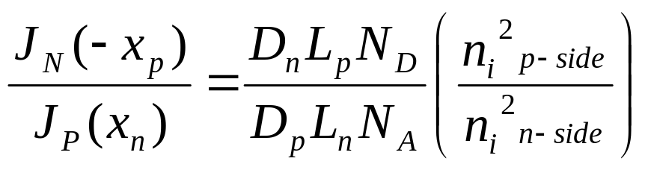
The ideal diode equation stipulates the relationship between J_{N}(-x_{p}) and J_{P}(x_{n}):
For example, if holes are forced to flow across a forward-biased junction, then electrons must also be injected across the junction.
EE130/230M Spring 2013
Lecture 14, Slide <number>

Slide 7
Under reverse bias, minority carriers are collected into the quasi-neutral regions of the diode.
  Minority carriers generated within a diffusion length of the depletion region diffuse into the depletion region and then are swept across the junction by the electric field.
The negative current flowing in a reverse-biased diode depends on the rate at which minority carriers are supplied from the quasi-neutral regions.
Electron-hole pair generation within the depletion region also contributes negative diode current.
EE130/230M Spring 2013
Lecture 14, Slide <number>

Slide 8
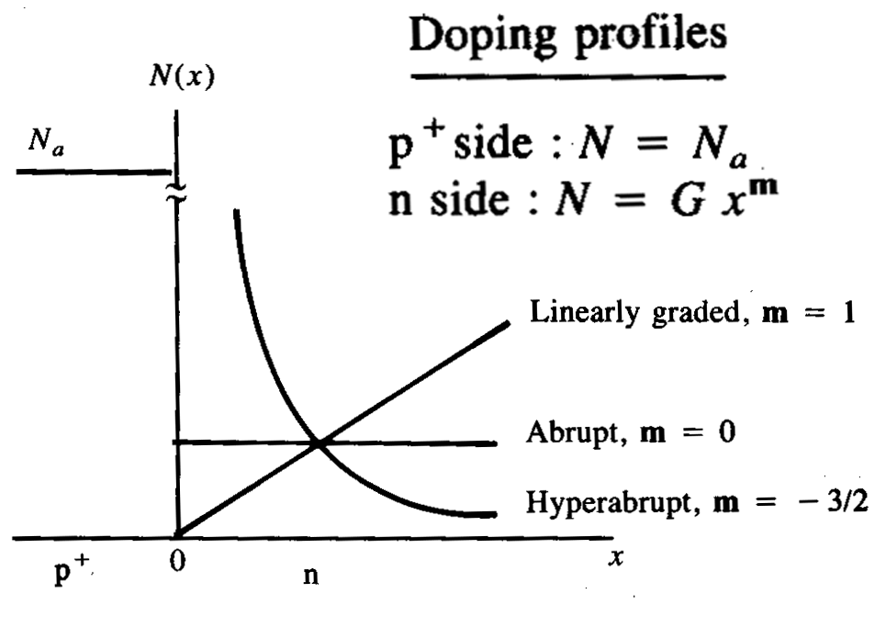
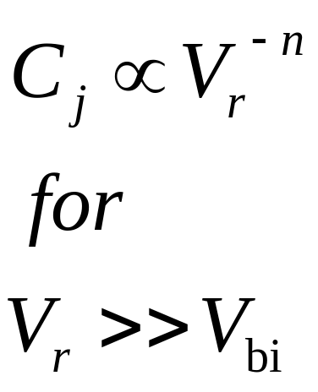
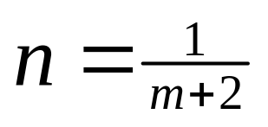
Varactor Diode
Voltage-controlled capacitance
  Used in oscillators and detectors
    (e.g. FM demodulation circuits in your radios)
  Response changes by tailoring doping profile:
EE130/230M Spring 2013
Lecture 14, Slide <number>

Slide 9
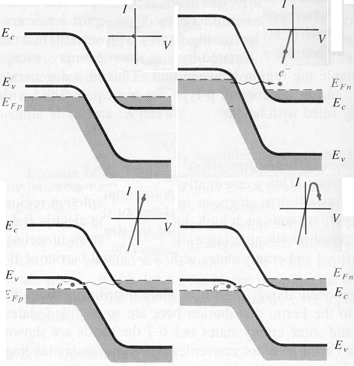
Tunnel Diode
Degenerately doped such that E_{Fp} < E_{v} and E_{Fn} > E_{c}
Exhibits negative differential resistance
  useful in high-speed
  circuits
EE130/230M Spring 2013
Lecture 14, Slide <number>

Slide 10
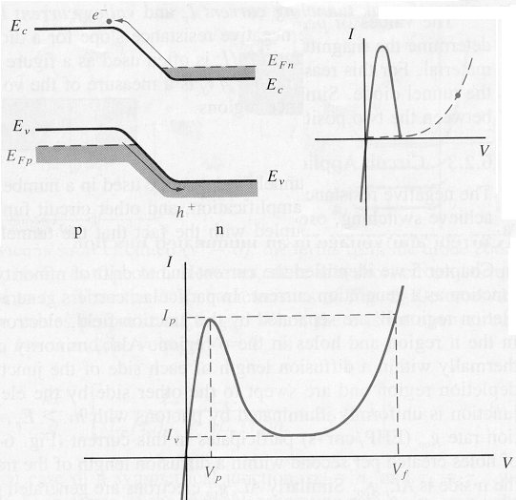
Tunnel Diode (cont’d)
EE130/230M Spring 2013
Lecture 14, Slide <number>

Slide 11
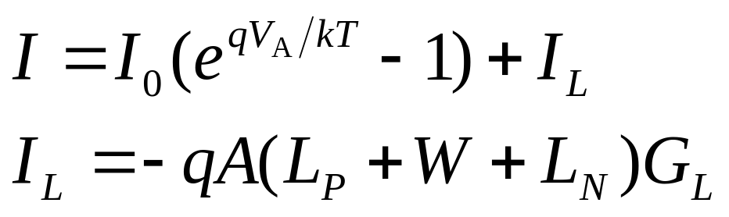
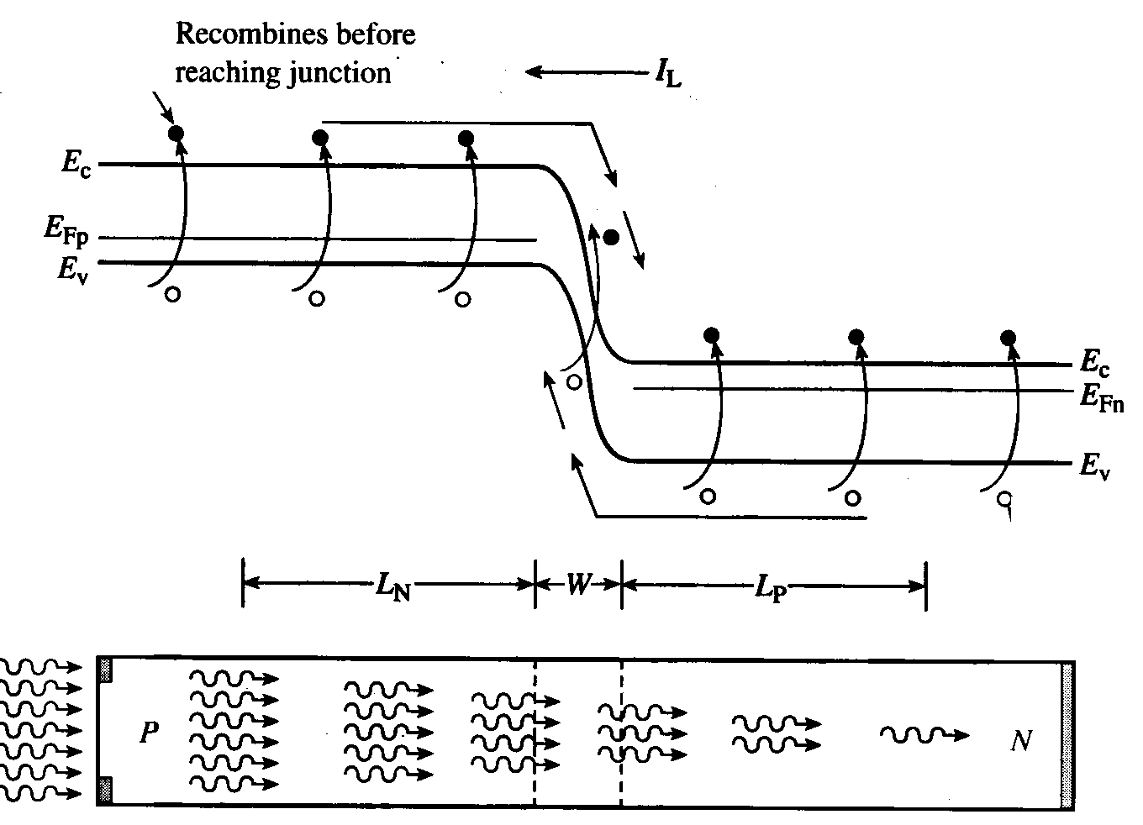
Optoelectronic Diodes
EE130/230M Spring 2013
Lecture 14, Slide <number>

Slide 12
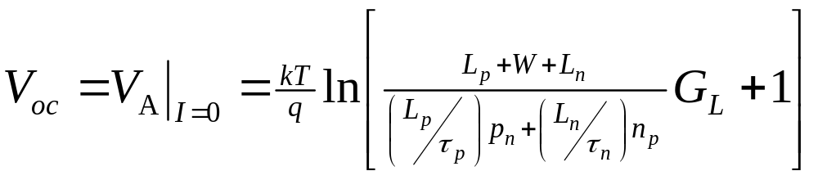
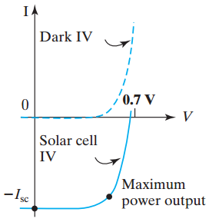
Open Circuit Voltage, V_{OC}
EE130/230M Spring 2013
Lecture 14, Slide <number>

Slide 13
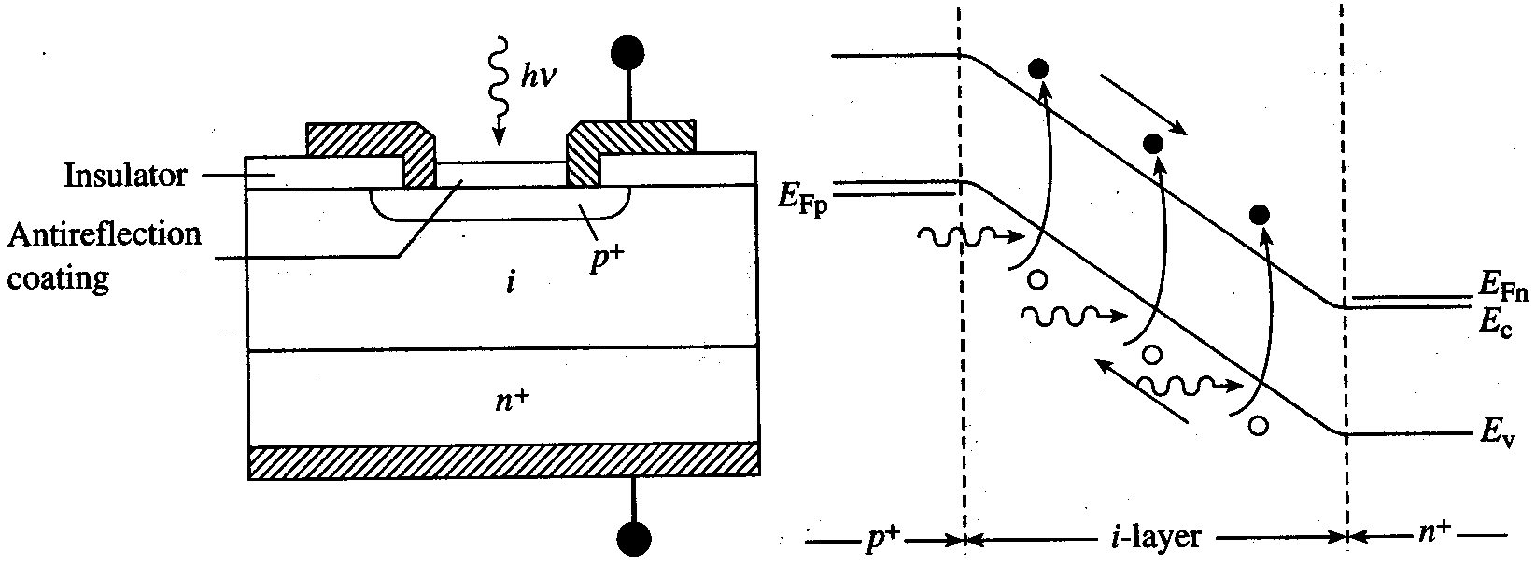
p-i-n Photodiodes
W ≅ W_{i-region}, so most carriers are generated in the depletion region
→ faster response time (~10 GHz operation)
Operate near avalanche to amplify signal
EE130/230M Spring 2013
Lecture 14, Slide <number>

Slide 14
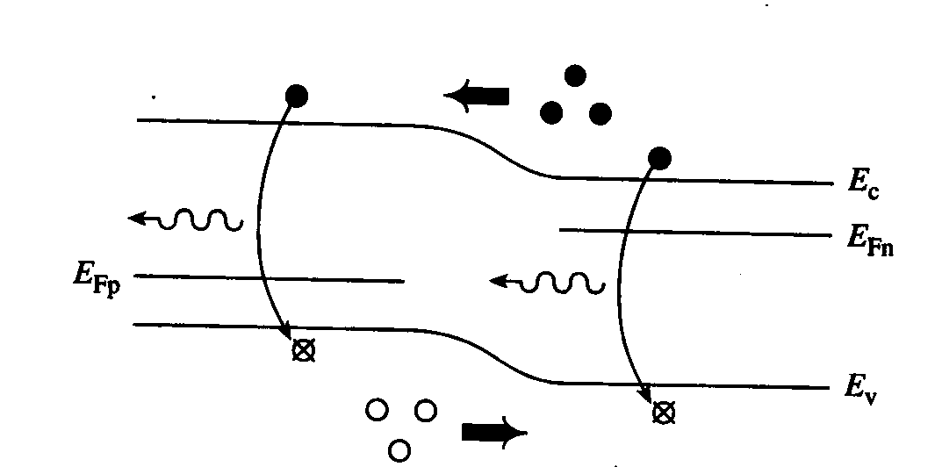
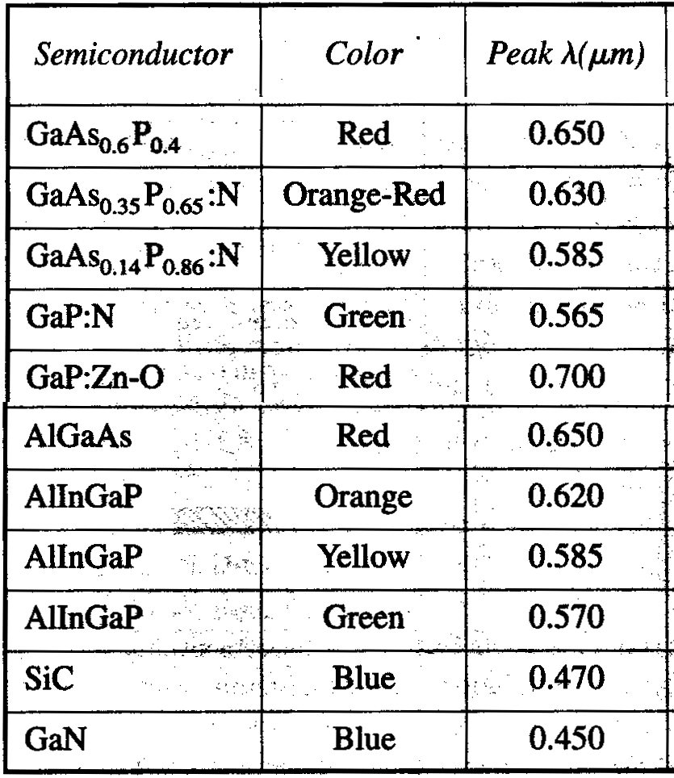
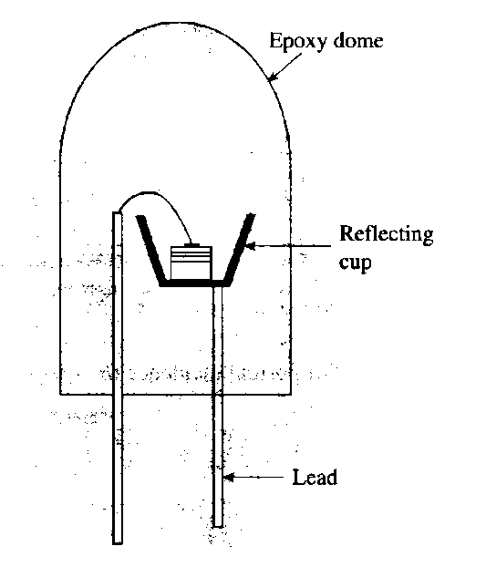
Light Emitting Diodes (LEDs)
LEDs are typically made of compound semiconductors
(direct bandgap)
EE130/230M Spring 2013
Lecture 14, Slide <number>

Slide 15
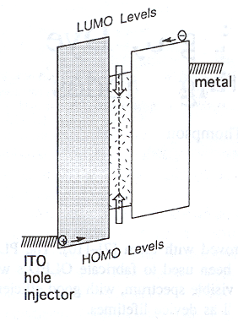
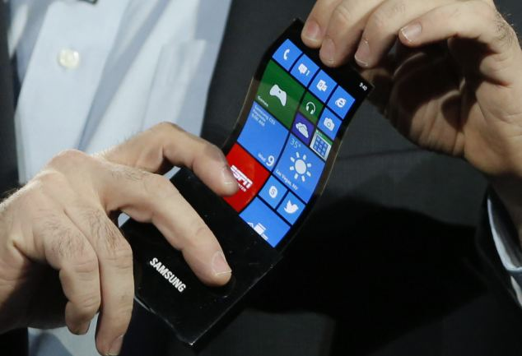
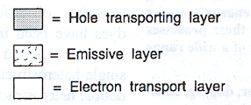
Organic LEDs
Some organic materials exhibit semiconducting properties
  OLEDs are attractive for low-cost, high-quality flexible displays
EE130/230M Spring 2013
Lecture 14, Slide <number>

