Slide 1
Lecture 15
OUTLINE
The MOS Capacitor
  Energy band diagrams
Reading: Pierret 16.1-16.2, 18.1; Hu 5.1

Slide 2
MOS Capacitor Structure
MOS capacitor
(cross-sectional view)
MOS devices today employ:
  degenerately doped polycrystalline Si (“poly-Si”) film as the gate-electrode material
      n⁺-type for “n-channel” transistors
      p⁺-type, for “p-channel” transistors
  SiO₂ as the gate dielectric
    band gap = 9 eV
    ε_{r,SiO2} = 3.9
  Si as the semiconductor material
    p-type, for “n-channel” transistors
    n-type, for “p-channel” transistors
GATE
x_{o}
+
Semiconductor
V_{G}
_
EE130/230M Spring 2013
Lecture 15, Slide <number>

Slide 3
MOS Equilibrium Band Diagram
metal
oxide
semiconductor
n+ poly-Si
SiO₂
p-type Si
E_{C}
E_{C}=E_{FM}
E_{FS}
E_{V}
E_{V}
EE130/230M Spring 2013
Lecture 15, Slide <number>

Slide 4
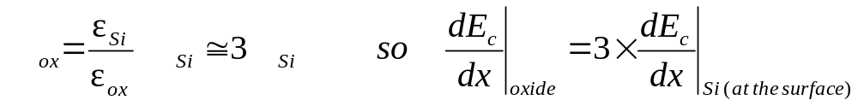
MOS Band Diagrams: Guidelines
Fermi level E_{F} is flat (constant with x) within the semiconductor
  Since no current flows in the x direction, we can assume that equilibrium conditions prevail
Band bending is linear within the oxide
  No charge in the oxide => dE/dx = 0 so E is constant
  => dE_{c}/dx is constant
From Gauss’ Law, we know that the electric field strength in the Si at the surface, E_{Si}, is related to the electric field strength in the oxide, E_{ox}:
E
E
E
EE130/230M Spring 2013
Lecture 15, Slide <number>

Slide 5
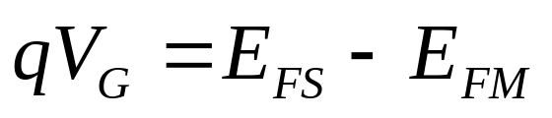
MOS Band Diagram Guidelines (cont’d)
The barrier height for conduction-band electron flow from the Si into SiO₂ is 3.1 eV
  This is equal to the electron-affinity difference (χ_{Si} and χ_{SiO2})
The barrier height for valence-band hole flow from the Si into SiO₂ is 4.8 eV
The vertical distance between the Fermi level in the metal, E_{FM}, and the Fermi level in the Si, E_{FS}, is equal to the applied gate voltage:
EE130/230M Spring 2013
Lecture 15, Slide <number>

Slide 6
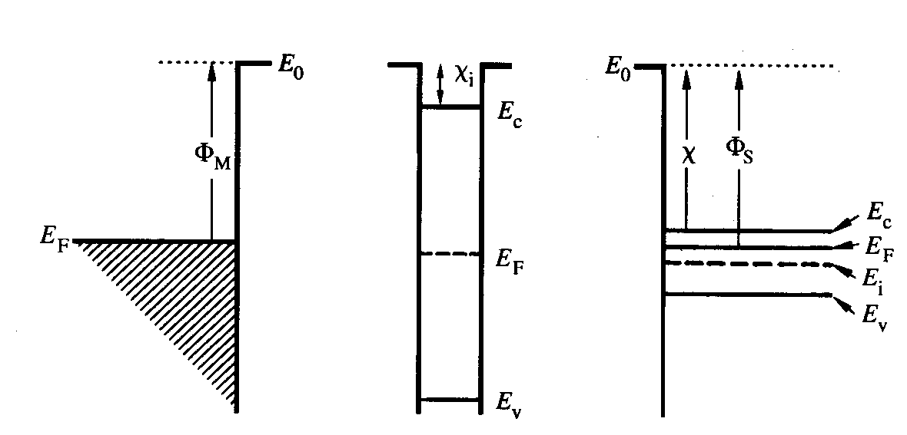
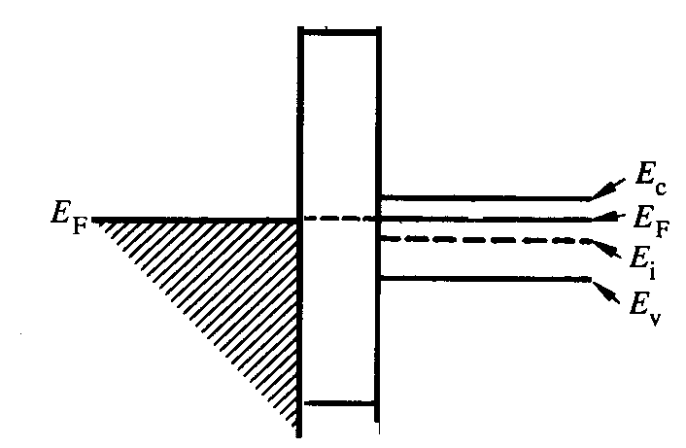
Special Case: Equal Work Functions
Φ_{M} = Φ_{S}
EE130/230M Spring 2013
Lecture 15, Slide <number>

Slide 7
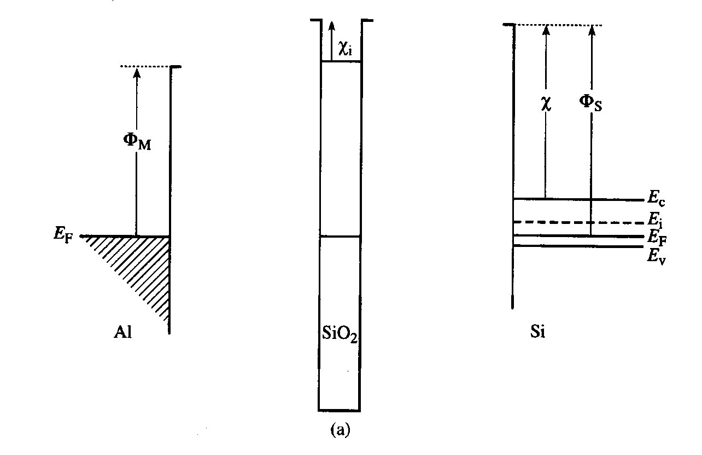
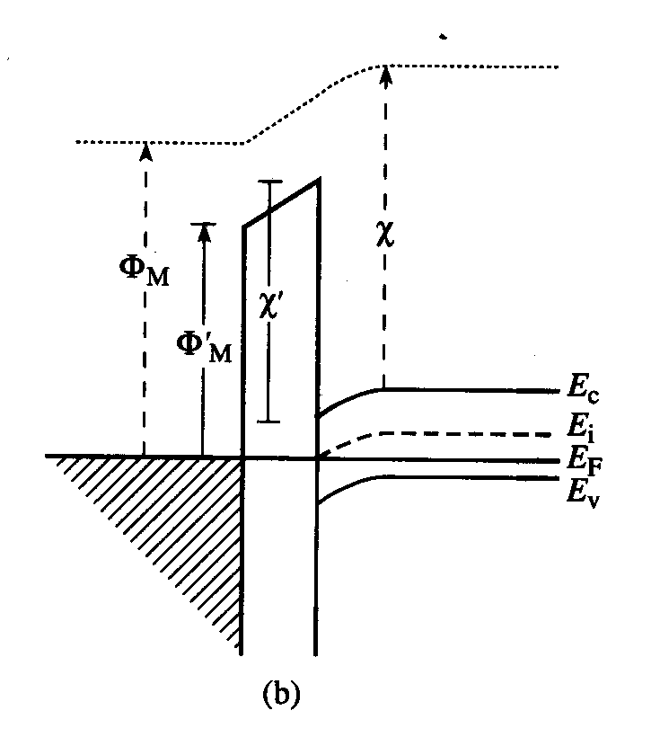
General Case: Different Work Functions
E₀
E₀
E₀
E₀
EE130/230M Spring 2013
Lecture 15, Slide <number>

Slide 8
Flat-Band Condition
EE130/230M Spring 2013
Lecture 15, Slide <number>

