Slide 1
Lecture 16
OUTLINE
The MOS Capacitor (cont’d)
  Electrostatics
Reading: Pierret 16.3; Hu 5.2-5.5

Slide 2
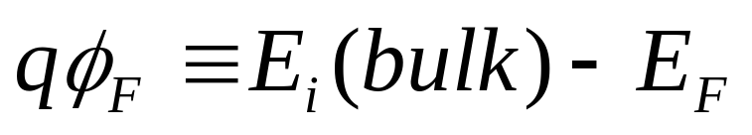
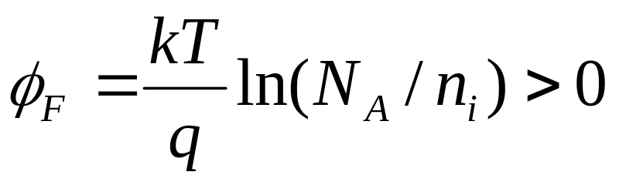
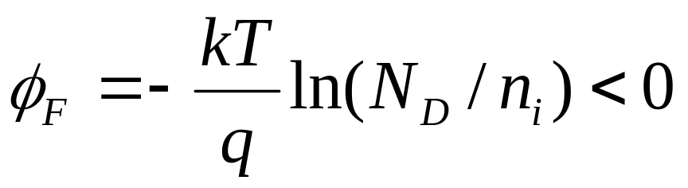
Bulk Semiconductor Potential, φ_{F}
p-type Si:
n-type Si:
E_{c}
E_{i}
qφ_{F}
E_{F}
E_{v}
E_{c}
E_{F}
|qφ_{F}|
E_{i}
E_{v}
EE130/230M Spring 2013
Lecture 16, Slide <number>

Slide 3
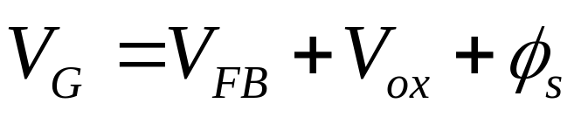

Voltage Drops in the MOS System
In general,
where
    qV_{FB} = Φ_{MS} = Φ_{M} – Φ_{S}
    V_{ox} is the voltage dropped across the oxide
    (V_{ox} = total amount of band bending in the oxide)
    φ_{s} is the voltage dropped in the silicon
    (total amount of band bending in the silicon)
For example:
When V_{G} = V_{FB}, V_{ox} = φ_{s} = 0, i.e. there is no band bending
EE130/230M Spring 2013
Lecture 16, Slide <number>

Slide 4
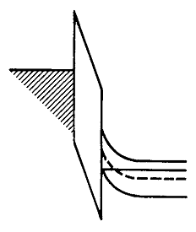
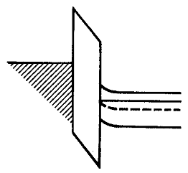
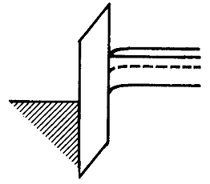
MOS Band Diagrams for n-type Si
Decrease V_{G} toward more negative values
→ move the gate electron energy increases relative to the Si
decrease V_{G}
decrease V_{G}
Accumulation
  V_{G} > V_{FB}
  Electrons accumulate at surface
Depletion
  V_{G} < V_{FB}
  Electrons repelled from surface
Inversion
  V_{G} < V_{T}
  Surface becomes p-type
EE130/230M Spring 2013
Lecture 16, Slide <number>

Slide 5
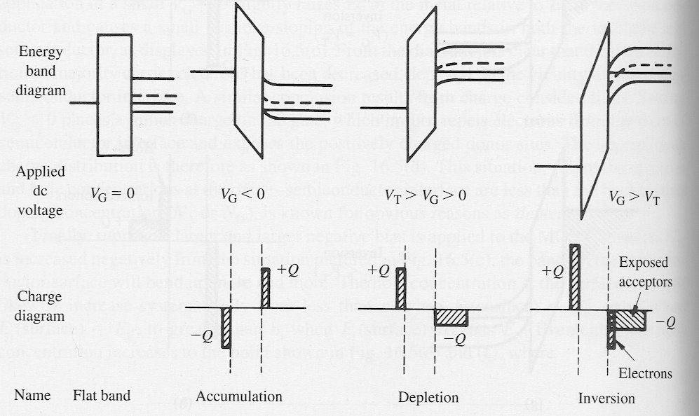
MOS Band Diagrams for p-type Si
increase V_{G}
increase V_{G}
V_{G} = V_{FB}
V_{G} < V_{FB}
V_{T} > V_{G} > V_{FB}
EE130/230M Spring 2013
Lecture 16, Slide <number>

Slide 6
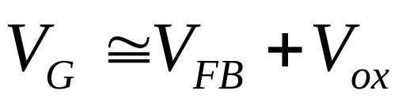
Accumulation
(n+ poly-Si gate, p-type Si)
M
O
S
V_{G} < V_{FB}
3.1 eV
| qV_{ox} |
E_{c}= E_{FM}
GATE
E_{v}
-
-
-
-
-
-
|qV_{G} |
x_{o}
|qφ_{S}| is small, ≈ 0
+
+
+
+
+
+
+
V_{G}
_
E_{c}
p-type Si
4.8 eV
E_{FS}
E_{v}
Mobile carriers (holes) accumulate at Si surface
EE130/230M Spring 2013
Lecture 16, Slide <number>

Slide 7
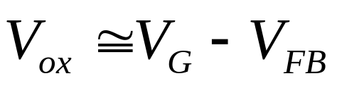
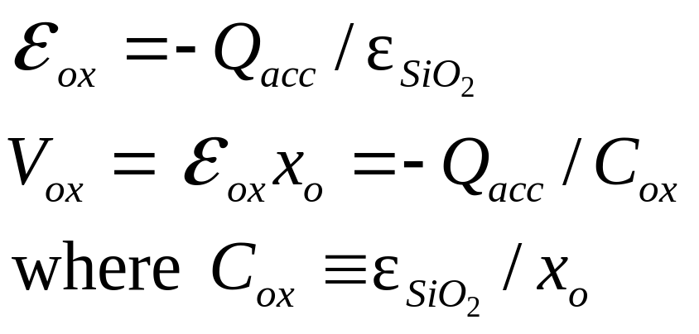
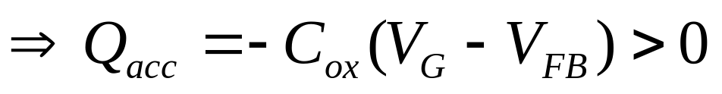
Accumulation Layer Charge Density
V_{G} < V_{FB}
From Gauss’ Law:
GATE
-
-
-
-
-
-
x_{o}
+
+
+
+
+
+
+
V_{G}
_
Q_{acc} (C/cm²)
p-type Si
(units: F/cm²)
EE130/230M Spring 2013
Lecture 16, Slide <number>

Slide 8
Depletion
(n+ poly-Si gate, p-type Si)
M
O
S
V_{T} > V_{G} > V_{FB}
qV_{ox}
W
E_{c}
GATE
E_{FS}
+
+
+
+
+
+
3.1 eV
qφ_{S}
E_{v}
-
-
-
qV_{G}
+
-
-
-
V_{G}
_
E_{c}= E_{FM}
p-type Si
E_{v}
4.8 eV
Si surface is depleted of mobile carriers (holes)
=> Surface charge is due to ionized dopants (acceptors)
EE130/230M Spring 2013
Lecture 16, Slide <number>

Slide 9
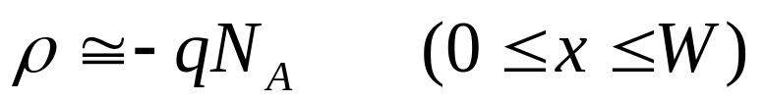
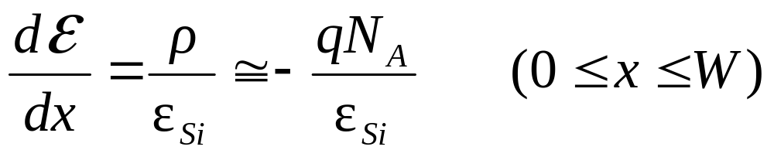
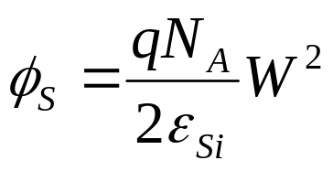
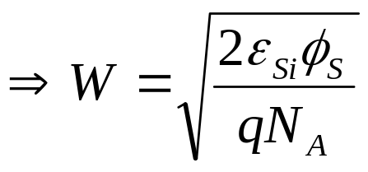
Depletion Width W (p-type Si)
Depletion Approximation:
  The surface of the Si is depleted of mobile carriers to a depth W.
The charge density within the depletion region is
Poisson’s equation:
Integrate twice, to obtain φ_{S}:
To find φ_{s} for a given V_{G}, we need to consider the voltage drops in the MOS system…
EE130/230M Spring 2013
Lecture 16, Slide <number>

Slide 10
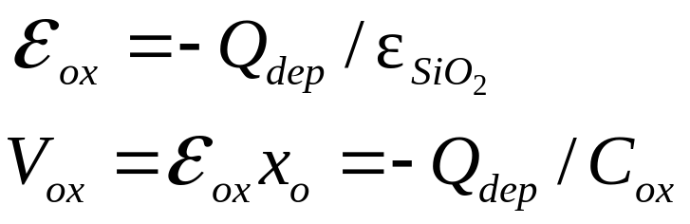
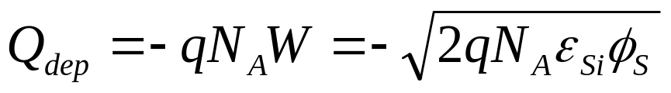
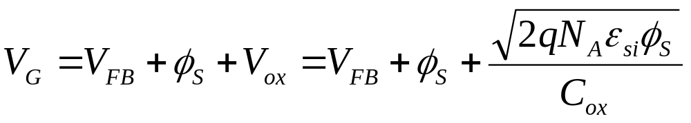
Voltage Drops in Depletion (p-type Si)
From Gauss’ Law:
GATE
+
+
+
+
+
+
-
-
-
-
-
-
V_{G}
+
_
Q_{dep} (C/cm²)
Q_{dep} is the integrated
charge density in the Si:
p-type Si
EE130/230M Spring 2013
Lecture 16, Slide <number>

Slide 11
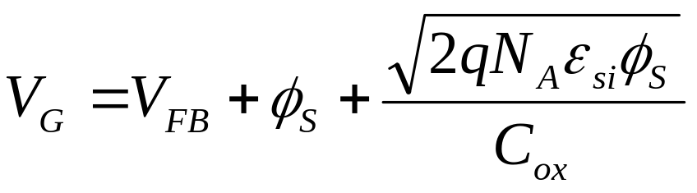
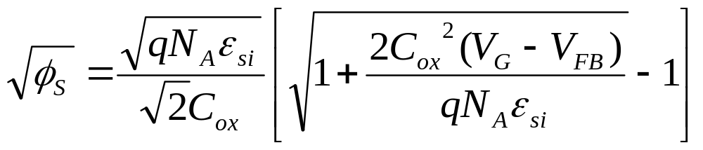
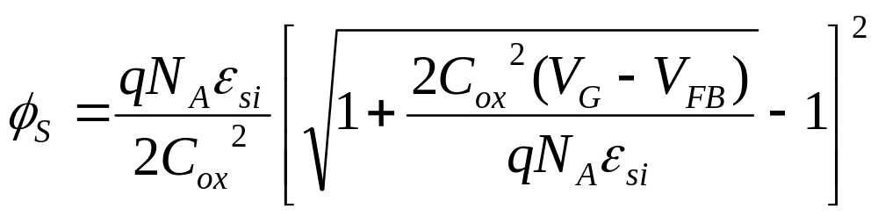
Surface Potential in Depletion
(p-type Si)
Solving for φ_{S}, we have
EE130/230M Spring 2013
Lecture 16, Slide <number>

Slide 12
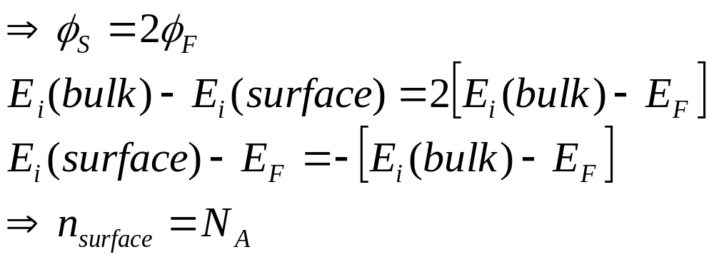
Threshold Condition (V_{G} = V_{T})
When V_{G} is increased to the point where φ_{s} reaches 2φ_{F}, the surface is said to be strongly inverted. This is the threshold condition.
  V_{G} = V_{T}
  (The surface is n-type to the same degree as the bulk is p-type.)
EE130/230M Spring 2013
Lecture 16, Slide <number>

Slide 13
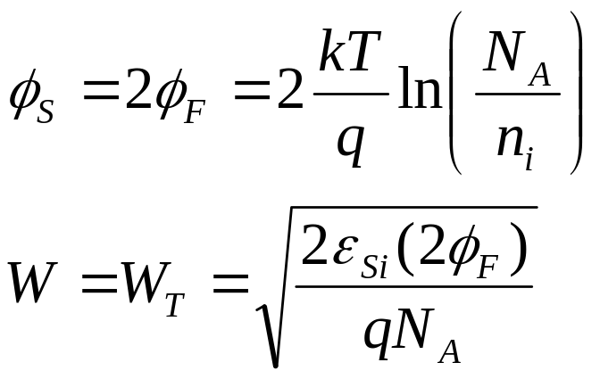
MOS Band Diagram at Threshold (p-type Si)
M
O
S
qV_{ox}
W_{T}
qφ_{F}
E_{c}
qφ_{F}
E_{FS}
qφ_{s}
E_{v}
qV_{G}
E_{c}= E_{FM}
E_{v}
EE130/230M Spring 2013
Lecture 16, Slide <number>

Slide 14
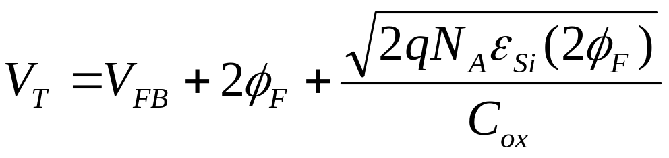
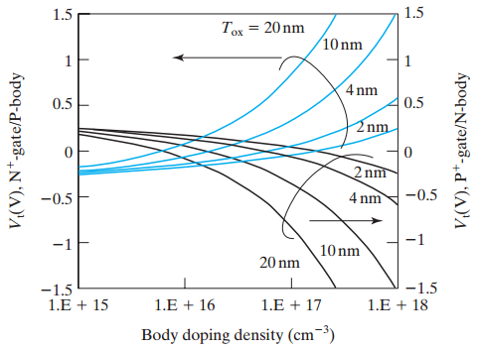
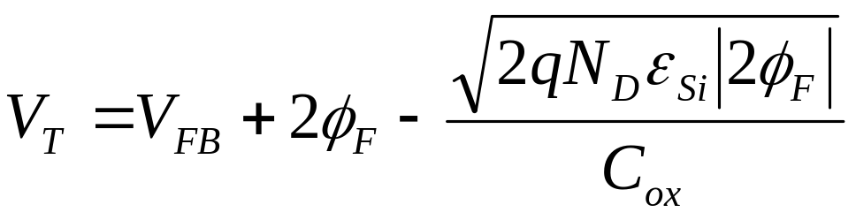
Threshold Voltage
For p-type Si:
For n-type Si:
EE130/230M Spring 2013
Lecture 16, Slide <number>

Slide 15
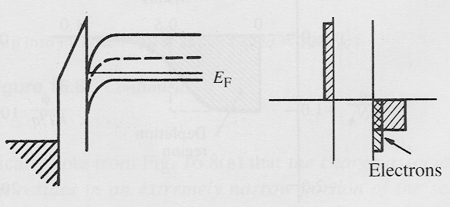
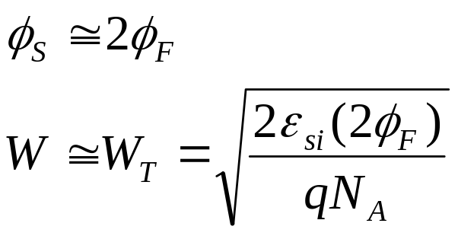
Strong Inversion (p-type Si)
As V_{G} is increased above V_{T}, the negative charge in the Si is increased by adding mobile electrons (rather than by depleting the Si more deeply), so the depletion width remains ~constant at W = W_{T}
W_{T}
ρ(x)
M O S
GATE
+
+
+
+
+
+
x
-
-
-
-
-
-
V_{G}
+
_
p-type Si
Significant density of mobile electrons at surface
(surface is n-type)
EE130/230M Spring 2013
Lecture 16, Slide <number>

Slide 16
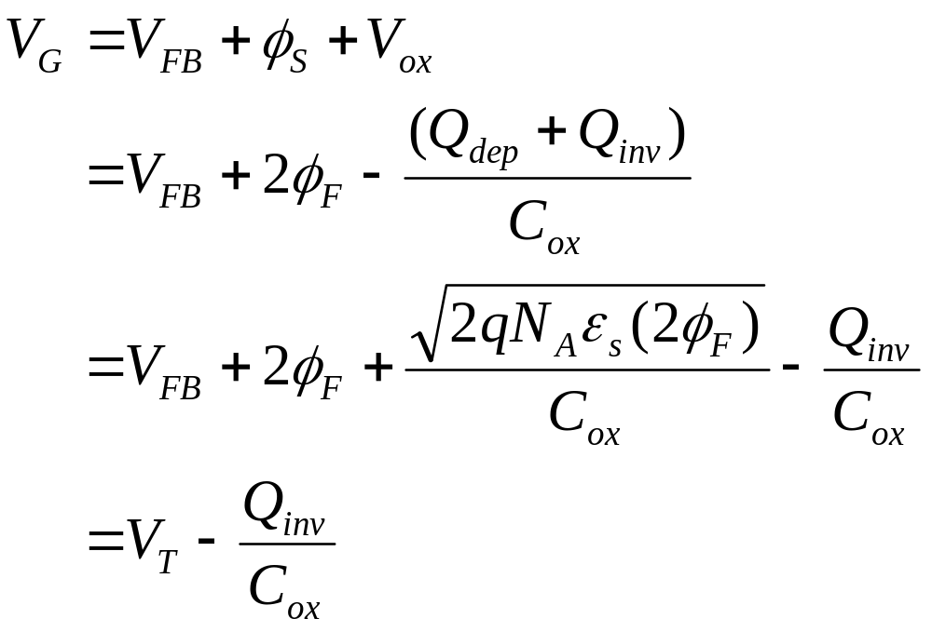
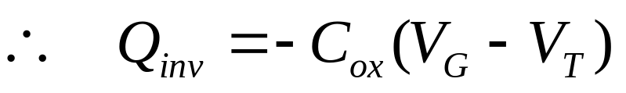
Inversion Layer Charge Density
(p-type Si)
EE130/230M Spring 2013
Lecture 16, Slide <number>

