Slide 1
Lecture 17
OUTLINE
The MOS Capacitor (cont’d)
  Small-signal capacitance
    (C-V characteristics)
Reading: Pierret 16.4; Hu 5.6

Slide 2
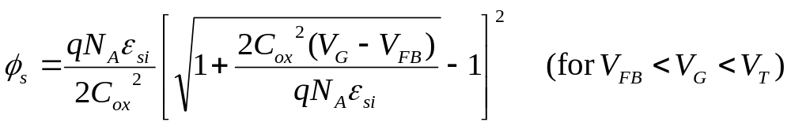
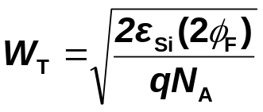
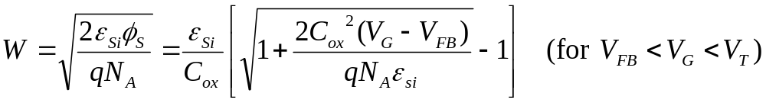
φ_{S} and W vs. V_{G}
(p-type Si)
2φ_{F}
φ_{S}:
0
V_{G}
accumulation
V_{FB}
depletion
V_{T}
inversion
W:
0
V_{G}
accumulation
V_{FB}
depletion
V_{T}
inversion
EE130/230M Spring 2013
Lecture 17, Slide <number>

Slide 3

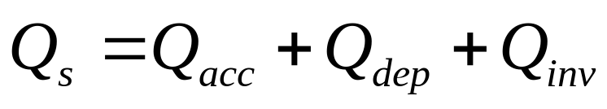


Total Charge Density in Si, Q_{s}
(p-type Si)
depletion
inversion
0
V_{G}
accumulation
V_{FB}
V_{T}
accumulation
depletion
inversion
accumulation
depletion
inversion
0
V_{G}
V_{FB}
V_{T}
V_{G}
0
V_{FB}
V_{T}
accumulation
depletion
inversion
0
V_{G}
Q_{inv}
V_{FB}
V_{T}
slope = -C_{ox}
EE130/230M Spring 2013
Lecture 17, Slide <number>

Slide 4
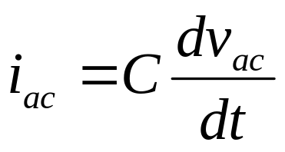
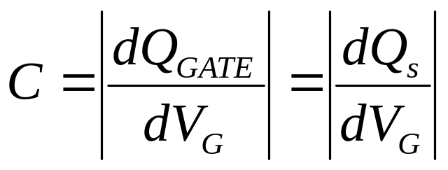
MOS Capacitance Measurement
V_{G} is scanned slowly
Capacitive current due
to v_{ac} is measured
C-V Meter
MOS Capacitor
i_{ac}
GATE
Semiconductor
v_{ac}
EE130/230M Spring 2013
Lecture 17, Slide <number>

Slide 5
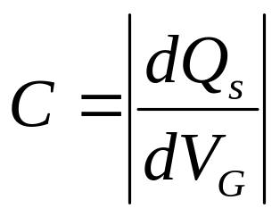
MOS C-V Characteristics
(p-type Si)
accumulation
depletion
inversion
V_{G}
V_{FB}
V_{T}
Q_{inv}
C
slope = -C_{ox}
C_{ox}
Ideal C-V curve:
V_{G}
V_{FB}
V_{T}
accumulation
depletion
inversion
EE130/230M Spring 2013
Lecture 17, Slide <number>

Slide 6
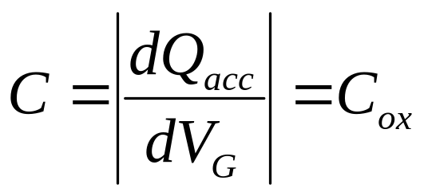
Capacitance in Accumulation
(p-type Si)
As the gate voltage is varied, incremental charge is added (or subtracted) to (or from) the gate and substrate.
  The incremental charges are separated by the gate oxide.
M O S
ΔQ
Q
-Q
−ΔQ
C_{ox}
EE130/230M Spring 2013
Lecture 17, Slide <number>

Slide 7
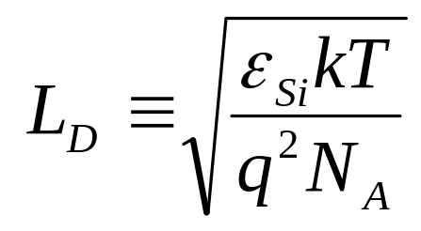
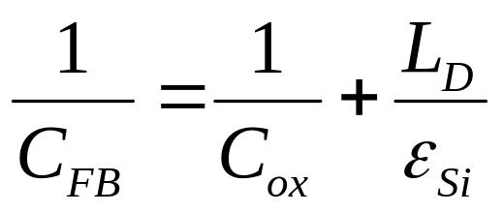
Flat-Band Capacitance
(p-type Si)
At the flat-band condition, variations in V_{G} give rise to the addition/subtraction of incremental charge in the substrate, at a depth L_{D}
  L_{D} is the “extrinsic Debye Length,” a characteristic screening distance, or the distance where the electric field emanating from a perturbing charge falls off by a factor of 1/e
C_{ox}
C_{Debye}
EE130/230M Spring 2013
Lecture 17, Slide <number>

Slide 8
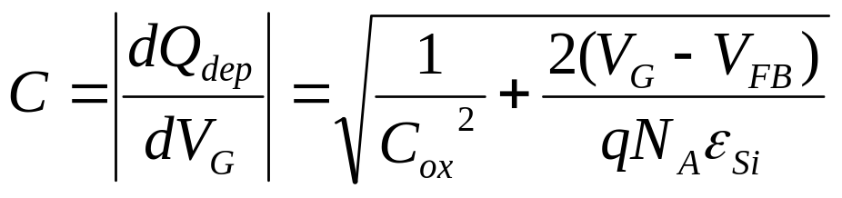
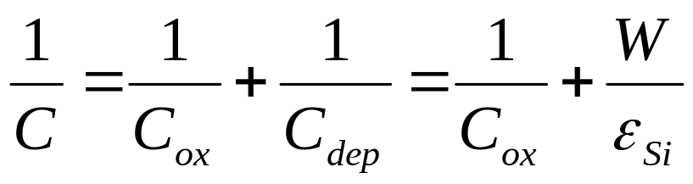
Capacitance in Depletion
(p-type Si)
As the gate voltage is varied, the depletion width varies.
Incremental charge is effectively added/subtracted at a depth W in the substrate.
M O S
ΔQ
Q
W
−ΔQ
-Q
C_{ox}
C_{dep}
EE130/230M Spring 2013
Lecture 17, Slide <number>

Slide 9
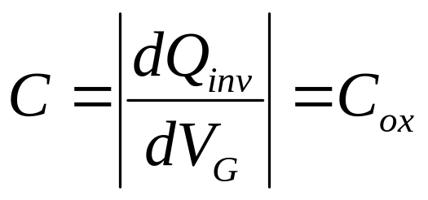
Capacitance in Inversion
(p-type Si)
CASE 1: Inversion-layer charge can be supplied/removed quickly enough to respond to changes in gate voltage.
Incremental charge is effectively added/subtracted at the
surface of the substrate.
ΔQ
M O S
Time required to build inversion-layer
charge = 2N_{A}τ_{o}/n_{i} , where
τ_{o} = minority-carrier lifetime at surface
W_{T}
−ΔQ
C_{ox}
EE130/230M Spring 2013
Lecture 17, Slide <number>

Slide 10
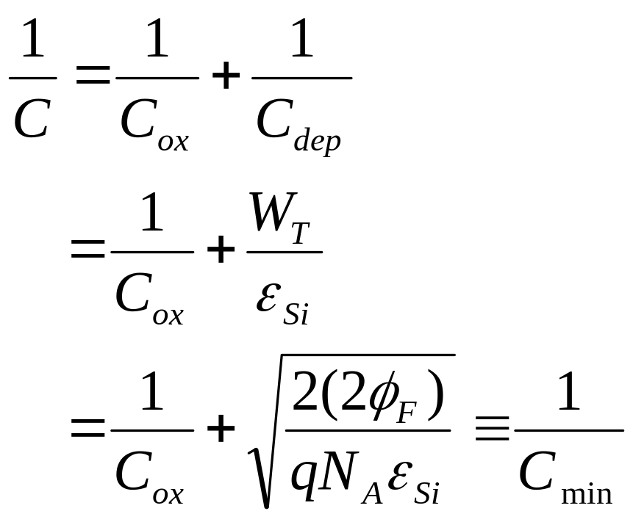
Capacitance in Inversion
(p-type Si)
CASE 2: Inversion-layer charge cannot be supplied/removed quickly enough to respond to changes in gate voltage.
Incremental charge is effectively added/subtracted at a
depth W_{T} in the substrate.
ΔQ
M O S
W_{T}
−ΔQ
C_{ox}
C_{dep}
EE130/230M Spring 2013
Lecture 17, Slide <number>

Slide 11
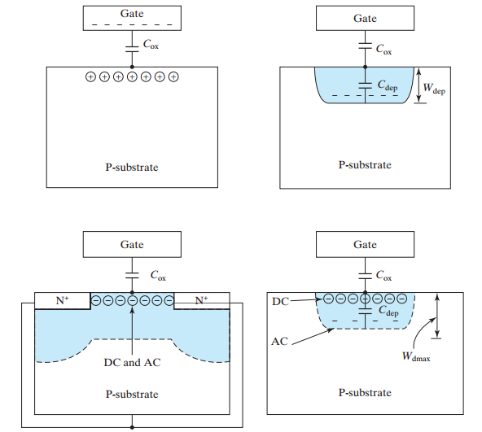
Supply of Substrate Charge
(p-type Si)
Accumulation:
Depletion:
Inversion:
Case 1
Case 2
EE130/230M Spring 2013
Lecture 17, Slide <number>

Slide 12
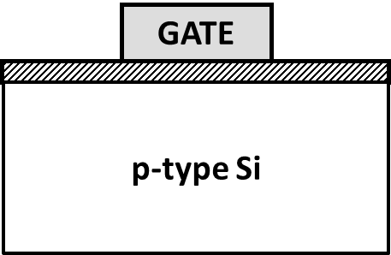
MOS Capacitor vs. MOS Transistor C-V
(p-type Si)
C
MOS transistor at any f,
MOS capacitor at low f, or
quasi-static C-V
C_{max}=C_{ox}
C_{FB}
MOS capacitor at high f
C_{min}
V_{G}
accumulation
depletion
inversion
V_{FB}
V_{T}
EE130/230M Spring 2013
Lecture 17, Slide <number>

Slide 13
Quasi-Static C-V Measurement
(p-type Si)
C
C_{max}=C_{ox}
C_{FB}
C_{min}
V_{G}
accumulation
depletion
inversion
V_{FB}
V_{T}
The quasi-static C-V characteristic is obtained by slowly ramping the gate voltage (< 0.1V/s), while measuring the gate current I_{G} with a very sensitive DC ammeter. C is calculated from I_{G} = C·(dV_{G}/dt)
EE130/230M Spring 2013
Lecture 17, Slide <number>

Slide 14
Deep Depletion
(p-type Si)
If V_{G} is scanned quickly, Q_{inv} cannot respond to the change in V_{G}. Then the increase in substrate charge density Q_{s} must come from an increase in depletion charge density Q_{dep}
  depletion depth W increases as V_{G} increases
    C decreases as V_{G} increases
C
C_{ox}
C_{min}
V_{G}
V_{FB}
V_{T}
EE130/230M Spring 2013
Lecture 17, Slide <number>

Slide 15
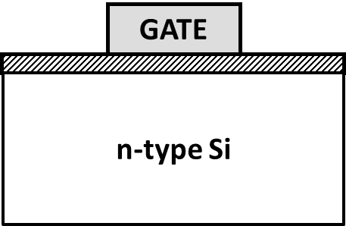
MOS C-V Characteristic for n-type Si
C
MOS transistor at any f,
MOS capacitor at low f, or
quasi-static C-V
C_{max}=C_{ox}
C_{FB}
MOS capacitor at high f
C_{min}
V_{G}
accumulation
depletion
inversion
V_{T}
V_{FB}
EE130/230M Spring 2013
Lecture 17, Slide <number>

Slide 16
Examples: C-V Characteristics
C
QS
C_{ox}
HF-Capacitor
V_{G}
V_{FB}
V_{T}
Does the QS or the HF-capacitor C-V characteristic apply?
MOS capacitor, f=10kHz
MOS transistor, i=1MHz
MOS capacitor, slow V_{G} ramp
MOS transistor, slow V_{G} ramp
EE130/230M Spring 2013
Lecture 17, Slide <number>

Slide 17
Example: Effect of Doping
How would the normalized C-V characteristic below change if the substrate doping N_{A} were increased?
  V_{FB}
  V_{T}
  C_{min}
C/C_{ox}
1
V_{FB}
V_{T}
EE130/230M Spring 2013
Lecture 17, Slide <number>

Slide 18
Example: Effect of Oxide Thickness
How would the normalized C-V characteristic below change if the oxide thickness x_{o} were decreased?
  V_{FB}
  V_{T}
  C_{min}
C/C_{ox}
1
V_{FB}
V_{T}
EE130/230M Spring 2013
Lecture 17, Slide <number>

