Slide 1
Lecture 18
OUTLINE
The MOS Capacitor (cont’d)
  Effect of oxide charges
  Poly-Si gate depletion effect
  V_{T} adjustment
Reading: Pierret 18.2-18.3; Hu 5.7-5.9

Slide 2
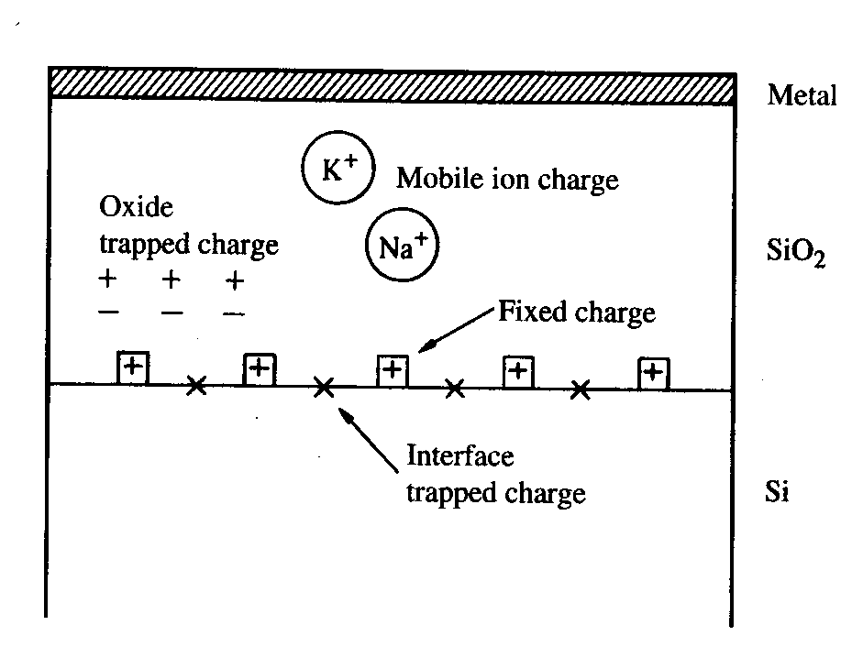
Oxide Charges
In real MOS devices, there is always some charge within the oxide and at the Si/oxide interface.
Within the oxide:
  Trapped charge Q_{ot}
    High-energy electrons and/or holes injected into oxide
  Mobile charge Q_{M}
    Alkali-metal ions, which have sufficient mobility to drift in oxide under an applied electric field
At the interface:
  Fixed charge Q_{F}
    Excess Si (?)
  Trapped charge Q_{IT}
    Dangling bonds
EE130/230M Spring 2013
Lecture 17, Slide <number>

Slide 3
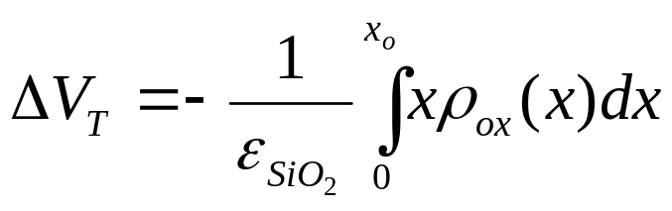
Effect of Oxide Charges
In general, charges in the oxide cause a shift in the gate voltage required to reach threshold condition:
  (x is defined to be 0 at metal-oxide interface)
In addition, they may alter the field-effect mobility of mobile carriers (in a MOSFET) due to Coulombic scattering.
EE130/230M Spring 2013
Lecture 17, Slide <number>

Slide 4
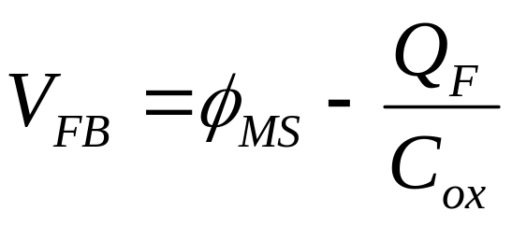
Fixed Oxide Charge, Q_{F}
M
O
S
qQ_{F} / C_{ox}
3.1 eV
E_{c}= E_{FM}
|qV_{FB} |
E_{v}
E_{c}
E_{FS}
E_{v}
4.8 eV
EE130/230M Spring 2013
Lecture 17, Slide <number>

Slide 5
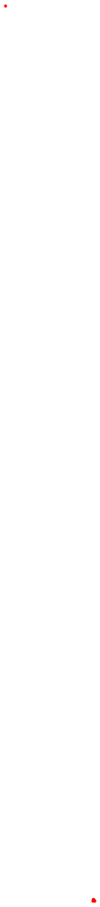
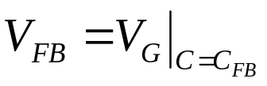
Parameter Extraction from C-V
From a single C-V measurement, we can extract much
information about the MOS device:
Suppose we know the gate material is heavily doped n-type poly-Si (Φ_{M}= 4.1 eV), and the gate dielectric is SiO₂ (ε_{r} = 3.9):
  From C_{max} = C_{ox} we can determine oxide thickness x_{o}
  From C_{min} and C_{ox} we can determine substrate doping (by iteration)
  From substrate doping and C_{ox} we can find flat-band capacitance C_{FB}
  From the C-V curve, we can find
  From Φ_{M}, Φ_{S}, C_{ox}, and V_{FB} we can determine Q_{f}
EE130/230M Spring 2013
Lecture 17, Slide <number>

Slide 6
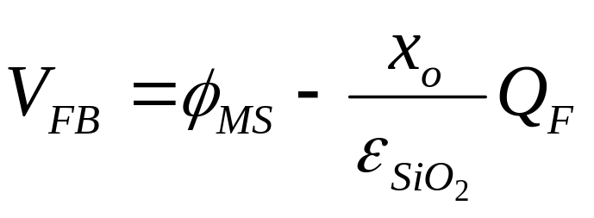
Determination of Φ_{M} and Q_{F}
Measure C-V characteristics of capacitors with different oxide thicknesses. Plot V_{FB} as a function of x_{o}:
V
FB
10nm
20nm
30nm
x_{o}
0
–0.15V
×
×
–0.3V
×
EE130/230M Spring 2013
Lecture 17, Slide <number>

Slide 7
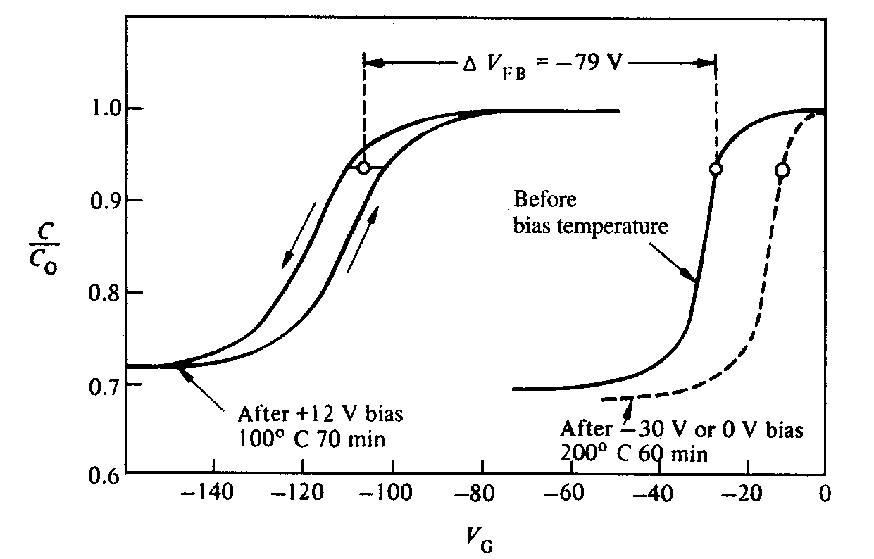
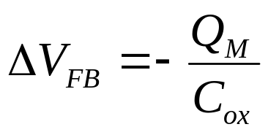
Mobile Ions
Odd shifts in C-V characteristics once were a mystery:
Source of problem: Mobile charge moving to/away from interface, changing charge centroid
EE130/230M Spring 2013
Lecture 17, Slide <number>

Slide 8
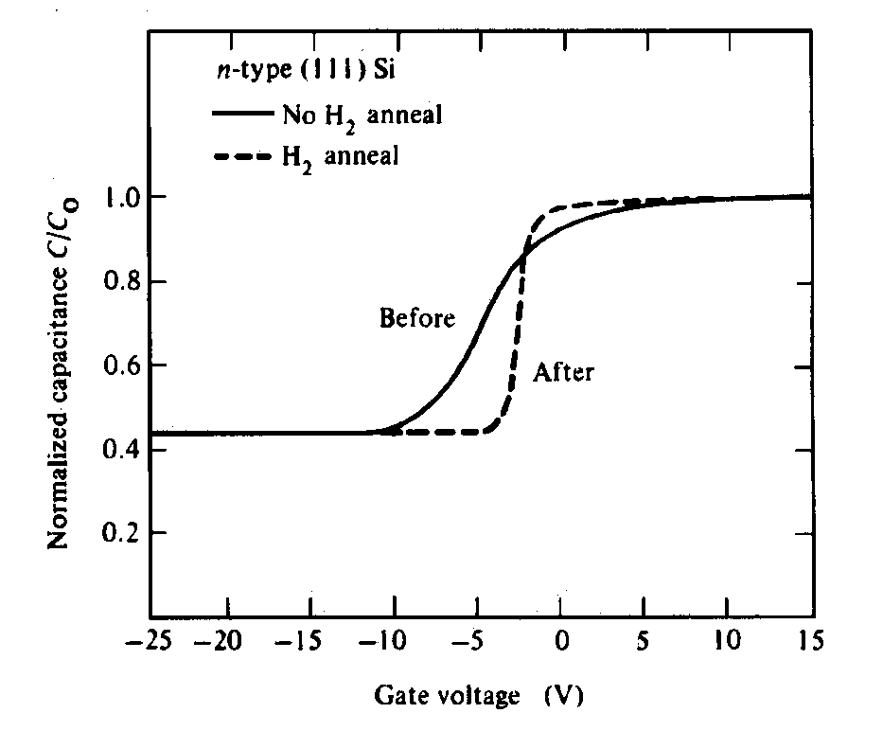
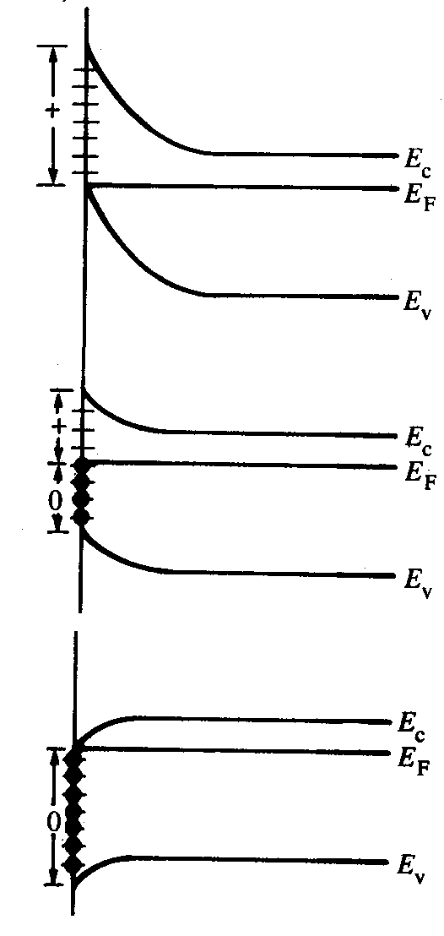
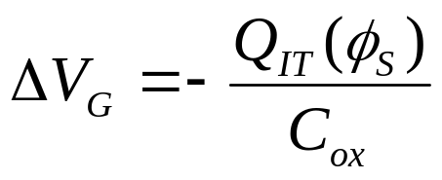
Interface Traps
Traps result in a “sloppy” C-V curve and also greatly degrade mobility in channel
EE130/230M Spring 2013
Lecture 17, Slide <number>

Slide 9
Poly-Si Gate Depletion
A heavily doped film of polycrystalline silicon (poly-Si) is often employed as the gate-electrode material in MOS devices.
  There are practical limits to the electrically active dopant concentration (usually less than 1x10²⁰ cm⁻³)
  The gate must be considered as a semiconductor, rather than a metal
NMOS
PMOS
n⁺ poly-Si
p⁺ poly-Si
p-type Si
n-type Si
EE130/230M Spring 2013
Lecture 17, Slide <number>

Slide 10
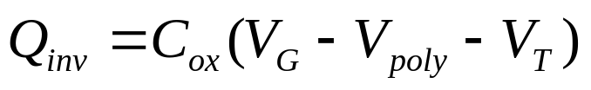
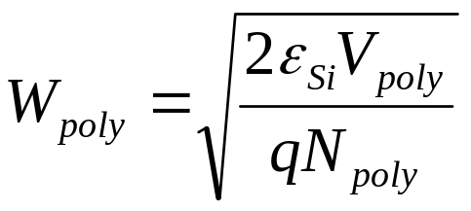
MOS Band Diagram w/ Gate Depletion
Si biased to inversion:
W_{T}
V_{G} is effectively reduced:
E_{c}
E_{FS}
qφ_{S}
E_{v}
qV_{poly}
qV_{G}
E_{c}
E_{v}
W_{poly}
How can gate depletion
be minimized?
n+ poly-Si gate
p-type Si
EE130/230M Spring 2013
Lecture 17, Slide <number>

Slide 11
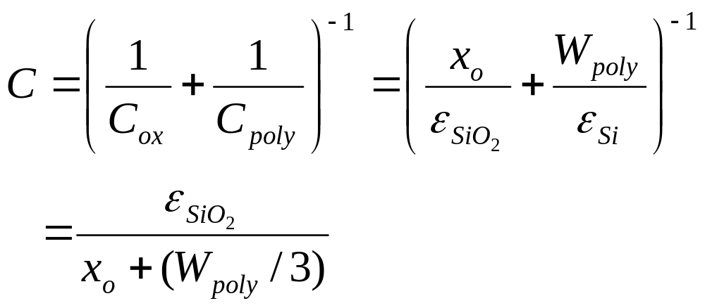
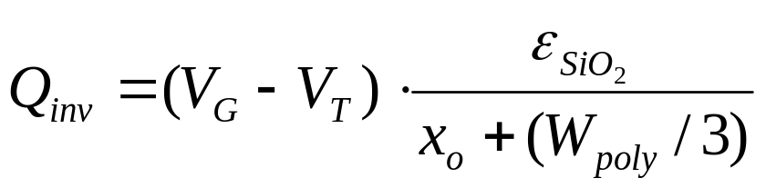
Gate Depletion Effect
Gauss’s Law dictates that W_{poly} = ε_{ox}E_{ox} / qN_{poly}
x_{o} is effectively increased:
n+ poly-Si
C_{poly}
+
+
+
+
+
+
+
+
C_{ox}
N+
-
-
-
-
-
-
-
-
-
p-type Si
EE130/230M Spring 2013
Lecture 17, Slide <number>

Slide 12
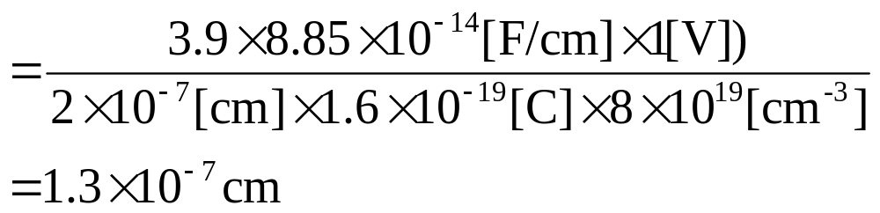
Example: Gate Depletion Effect
The voltage across a 2 nm oxide is V_{ox} = 1 V. The active dopant concentration within the n⁺ poly-Si gate is N_{poly} = 8 ×10¹⁹ cm⁻³ and the Si substrate doping concentration N_{A} is 10¹⁷ cm⁻³.
Find (a) W_{poly} , (b) V_{poly} , and (c) V_{T} .
Solution:
(a)
W_{poly} = ε_{ox}E_{ox} / qN_{poly} = ε_{ox}V_{ox} / x_{o}qN_{poly}
EE130/230M Spring 2013
Lecture 17, Slide <number>

Slide 13
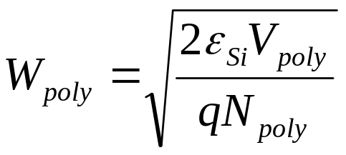
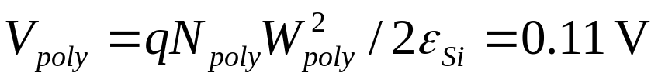
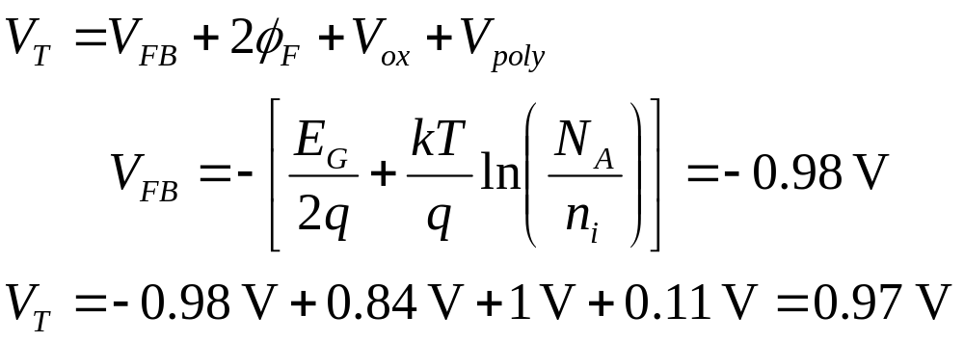
(b)
(c)
EE130/230M Spring 2013
Lecture 17, Slide <number>

Slide 14
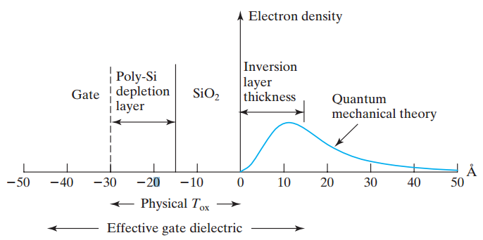
Inversion-Layer Thickness, T_{inv}
The average inversion-layer location below the Si/SiO₂ interface is called the inversion-layer thickness, T_{inv} .
EE130/230M Spring 2013
Lecture 17, Slide <number>

Slide 15
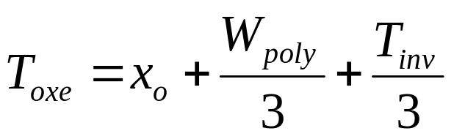
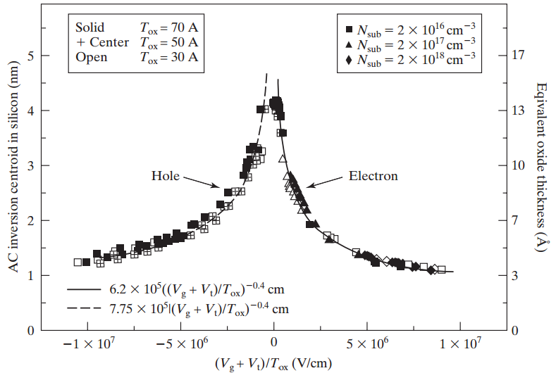
Effective Oxide Thickness, T_{oxe}
(V_{G} + V_{T})/T_{oxe} can be shown to be the average electric field in the inversion layer. T_{inv} of holes is larger than that of electrons due to difference in effective masses.
EE130/230M Spring 2013
Lecture 17, Slide <number>

Slide 16
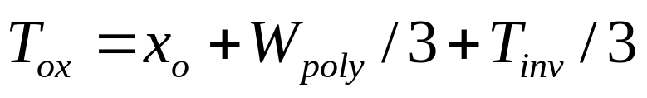
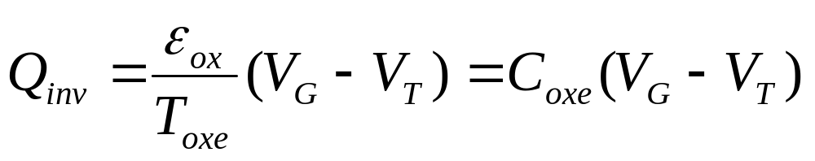
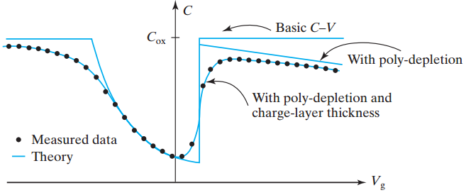
Effective Oxide Capacitance, C_{oxe}
EE130/230M Spring 2013
Lecture 17, Slide <number>

Slide 17
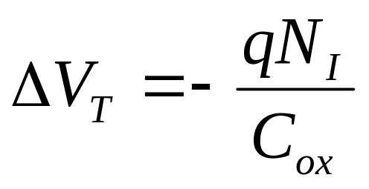
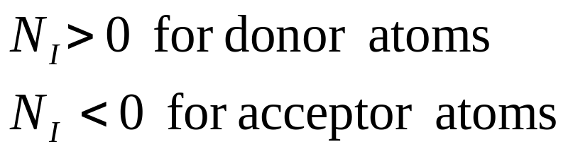
V_{T} Adjustment
In modern IC fabrication processes, the threshold voltages of MOS transistors are adjusted by adding dopants to the Si by a process called “ion implantation”:
  A relatively small dose N_{I} (units: ions/cm²) of dopant atoms is implanted into the near-surface region of the semiconductor
  When the MOS device is biased in depletion or inversion, the implanted dopants add to (or substract from) the depletion charge near the oxide-semiconductor interface.
EE130/230M Spring 2013
Lecture 17, Slide <number>

