Slide 1
Lecture 19
OUTLINE
The MOS Capacitor (cont’d)
Final comments
The MOSFET:
Structure and operation
CMOS devices and circuits
Reading: Pierret 17.1; Hu 6.1-6.2

Slide 2
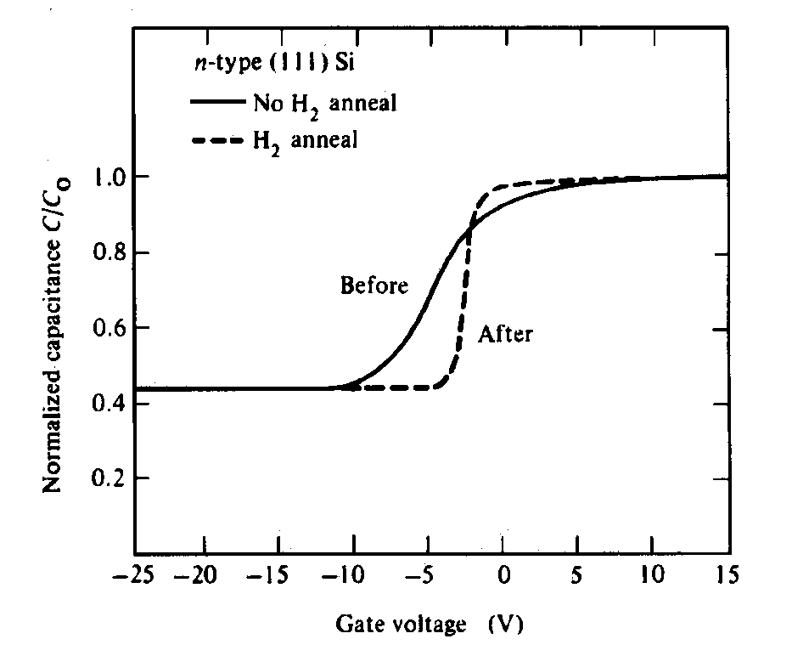
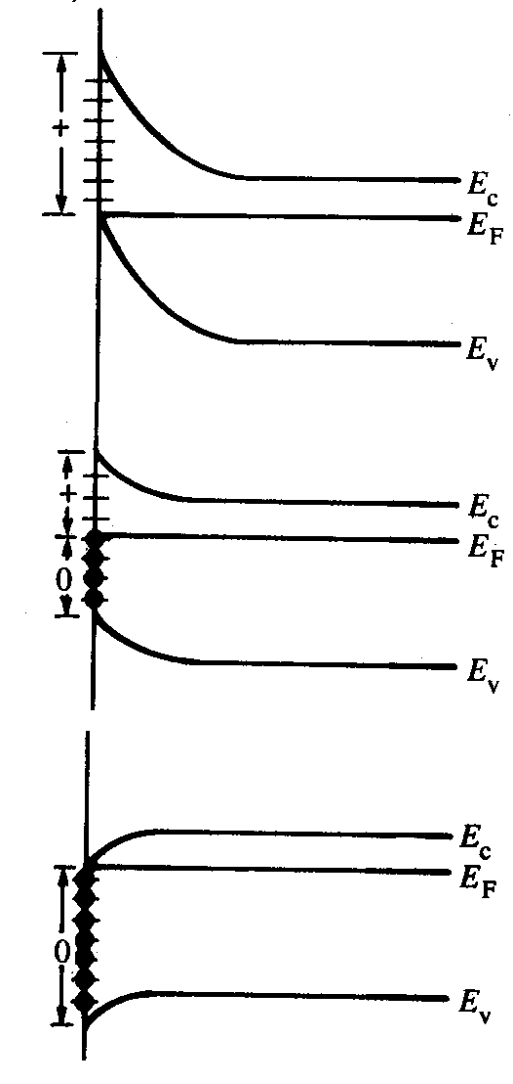
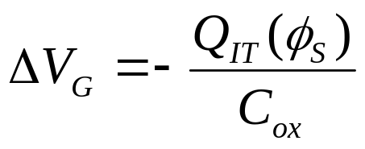
Clarification: Effect of Interface Traps
“Donor-like” traps are
charge-neutral when
filled, positively charged
when empty
Positive oxide charge
causes C-V curve to
shift toward left
(more shift as V_{G}
decreases)
(c)
(a)
(b)
(a)
(b)
Traps cause “sloppy” C-V and also greatly degrade mobility in channel
(c)
EE130/230M Spring 2013
Lecture 19, Slide <number>

Slide 3
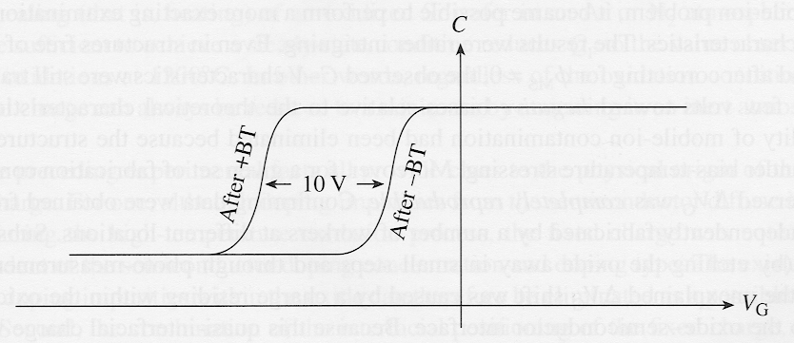
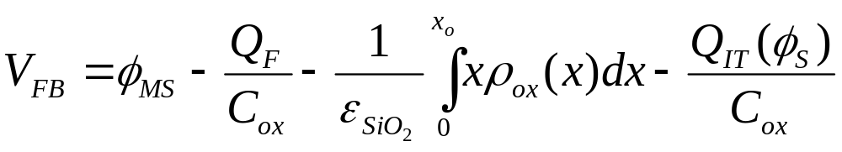

Bias-Temperature Stress Measurement
Used to determine mobile charge density in MOS dielectric (units: C/cm²)
Na⁺ located at
lower SiO₂ interface
→ reduces V_{FB}
ΔV_{FB}
Na⁺ located at
upper SiO₂ interface
→ no effect on V_{FB}
Positive oxide charge shifts the flatband voltage in the negative direction:
EE130/230M Spring 2013
Lecture 19, Slide <number>

Slide 4
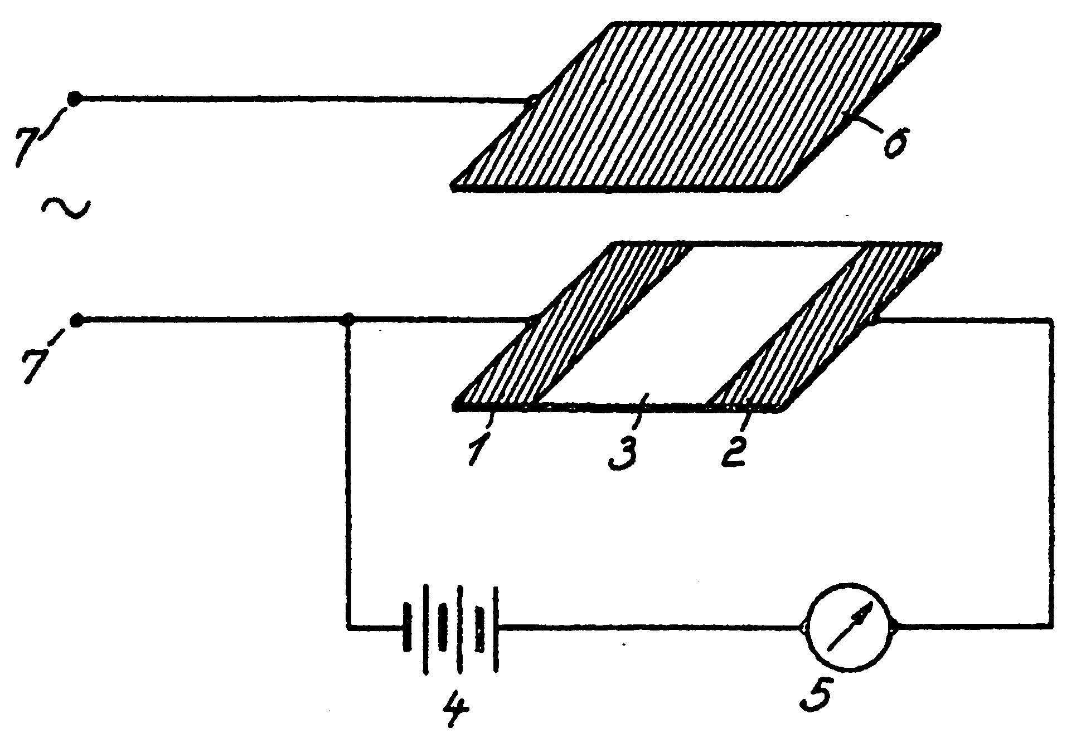
Invention of the Field-Effect Transistor
In 1935, a British patent was issued to Oskar Heil.
A working MOSFET was not demonstrated until 1955.
EE130/230M Spring 2013
Lecture 19, Slide <number>

Slide 5
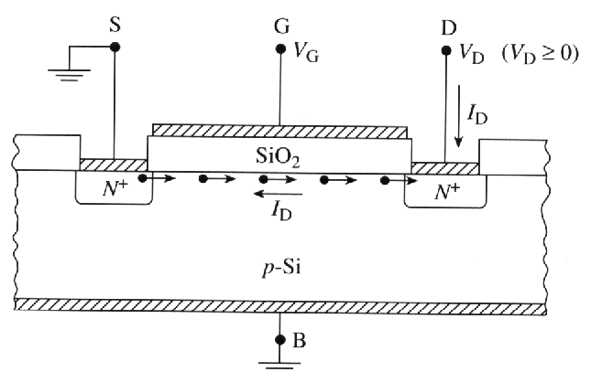
Modern Field Effect Transistor (FET)
An electric field is applied normal to the surface of the semiconductor (by applying a voltage to an overlying electrode), to modulate the conductance of the semiconductor.
Drift current flowing between 2 doped regions (“source” & “drain”) is modulated by varying the voltage on the “gate” electrode.
EE130/230M Spring 2013
Lecture 19, Slide <number>

Slide 6
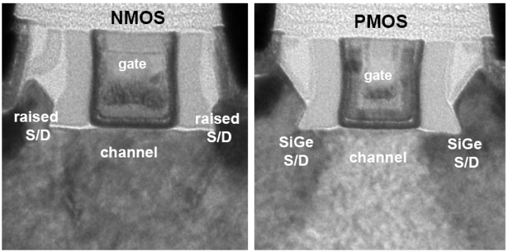
The MOSFET
Metal-Oxide-Semiconductor Field-Effect Transistor:
GATE LENGTH, L_{g}
OXIDE THICKNESS, T_{ox}
Gate
Intel’s 32nm CMOSFETs
Desired characteristics:
  High ON current
  Low OFF current
Source
Drain
Substrate
Current flowing between the SOURCE and DRAIN is controlled by the voltage on the GATE electrode
“N-channel” & “P-channel” MOSFETs operate in a complementary manner
  “CMOS” = Complementary MOS
V_{T}
CURRENT
|GATE VOLTAGE|
EE130/230M Spring 2013
Lecture 19, Slide <number>

Slide 7
N-channel vs. P-channel
NMOS
PMOS
N+ poly-Si
P+ poly-Si
N+
N+
P+
P+
p-type Si
n-type Si
For current to flow, V_{GS} > V_{T}
Enhancement mode: V_{T} > 0
Depletion mode: V_{T} < 0
  Transistor is ON when V_{G}=0V
For current to flow, V_{GS} < V_{T}
Enhancement mode: V_{T} < 0
Depletion mode: V_{T} > 0
  Transistor is ON when V_{G}=0V
EE130/230M Spring 2013
Lecture 19, Slide <number>

Slide 8
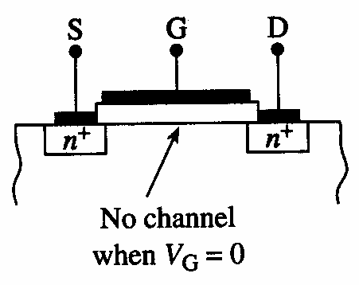
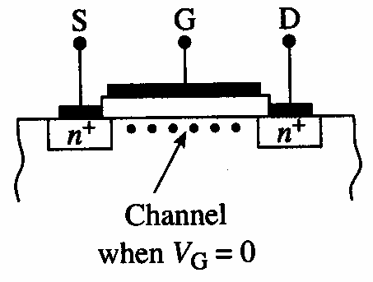
Enhancement Mode vs. Depletion Mode
Enhancement Mode
Depletion Mode
Conduction between source
and drain regions is enhanced
by applying a gate voltage
A gate voltage must be applied
to deplete the channel region
in order to turn off the transistor
EE130/230M Spring 2013
Lecture 19, Slide <number>

Slide 9
CMOS Devices and Circuits
CIRCUIT SYMBOLS
CMOS INVERTER CIRCUIT
N-channel
MOSFET
P-channel
MOSFET
V_{DD}
V_{OUT}
INVERTER
LOGIC SYMBOL
S
V_{DD}
D
V_{IN}
V_{OUT}
D
S
V_{IN}
GND
0
V_{DD}
When V_{G} = V_{DD} , the NMOSFET is on and the PMOSFET is off.
When V_{G} = 0, the PMOSFET is on and the NMOSFET is off.
EE130/230M Spring 2013
Lecture 19, Slide <number>
Notes:
And let’s move on to the FinFET based designs.
We will start with the conventional double gated 6-T configuration. Here is our proposed layout.
For gate WF adjustment, we are using angled implants. Therefore, from a process integration perspective, this type of layout prefers a single gate WF material. We are using 4.75eV gate WF here, which is close to the mid-gap. So our devices do have relatively high Vts, and that does reduce the cell leakage as I will mention later.
From the layout, you see that we no longer need the big gap between N and P type devices. This is b/c for FinFETs, the substrate doesn’t define the transistor type, so we can have seamless transition from N-type to P-type active, avoiding the two contacts.
So with 1 fin on the pull down devices, which is equivalent to having a beta ratio of 1, we can achieve 175mV of read margin. And the layout takes up about 0.36um².
So we do end up with a stable cell and less area compared to the bulk SRAM cell.

Slide 10
“Pull-Down” and “Pull-Up” Devices
In CMOS logic gates, NMOSFETs are used to connect the output to GND, whereas PMOSFETs are used to connect the output to V_{DD}.
  An NMOSFET functions as a pull-down device when it is turned on (gate voltage = V_{DD})
  A PMOSFET functions as a pull-up device when it is turned on (gate voltage = GND)
V_{DD}
A₁
A₂
A_{N}
Pull-up
network
input signals
…
PMOSFETs only
F(A₁, A₂, …, A_{N})
A₁
A₂
A_{N}
Pull-down
network
…
NMOSFETs only
EE130/230M Spring 2013
Lecture 19, Slide <number>

Slide 11
CMOS NAND Gate
V_{DD}
A | B | F
0 | 0 | 1
0 | 1 | 1
1 | 0 | 1
1 | 1 | 0
A
B
F
A
B
EE130/230M Spring 2013
Lecture 19, Slide <number>

Slide 12
CMOS NOR Gate
V_{DD}
A | B | F
0 | 0 | 1
0 | 1 | 0
1 | 0 | 0
1 | 1 | 0
A
B
F
B
A
EE130/230M Spring 2013
Lecture 19, Slide <number>

Slide 13
CMOS Pass Gate
A
X
Y
Y = X if A
A
EE130/230M Spring 2013
Lecture 19, Slide <number>

