Slide 1
Lecture 2
OUTLINE
Important quantities
Semiconductor Fundamentals (cont’d)
  Energy band model
  Band gap energy
  Density of states
  Doping
Reading: Pierret 2.2-2.3, 3.1.5; Hu 1.3-1.4,1.6, 2.4

Slide 2
Important Quantities
Electronic charge, q = 1.6×10⁻¹⁹ C
Permittivity of free space, ε_{o} = 8.854×10⁻¹⁴ F/cm
Boltzmann constant, k = 8.62×10⁻⁵ eV/K
Planck constant, h = 4.14×10⁻¹⁵ eVs
Free electron mass, m_{o} = 9.1×10⁻³¹ kg
Thermal voltage kT/q = 26 mV at room temperature
kT = 0.026 eV = 26 meV at room temperature
kTln(10) = 60 meV at room temperature
1 eV = 1.6 x 10⁻¹⁹ Joules
EE130/230M Spring 2013
Lecture 2, Slide <number>

Slide 3
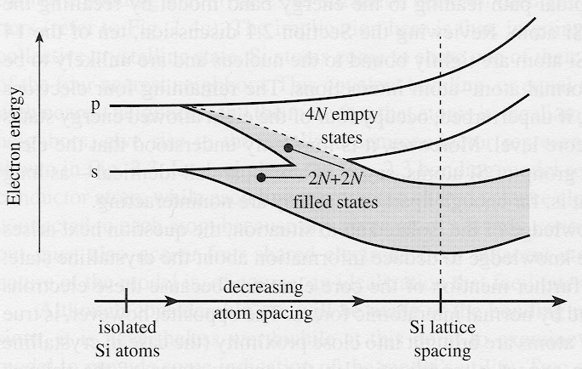
Si: From Atom to Crystal
Energy states in Si atom → energy bands in Si crystal
The highest nearly-filled band is the valence band
The lowest nearly-empty band is the conduction band
EE130/230M Spring 2013
Lecture 2, Slide <number>

Slide 4
Energy Band Diagram
E_{c}
electron energy
E_{v}
distance
Simplified version of energy band model, showing only the bottom edge of the conduction band (E_{c}) and the top edge of the valence band (E_{v})
E_{c} and E_{v} are separated by the band gap energy E_{G}
EE130/230M Spring 2013
Lecture 2, Slide <number>

Slide 5
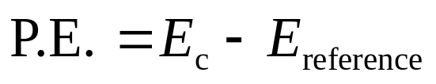
Electrons and Holes (Band Model)
Conduction electron = occupied state in the conduction band
Hole = empty state in the valence band
Electrons & holes tend to seek lowest-energy positions
→ Electrons tend to fall and holes tend to float up (like bubbles in water)
electron kinetic energy
E_{c}
E_{c} represents the electron potential energy.
Increasing electron energy
Increasing hole energy
E_{v}
hole kinetic energy
EE130/230M Spring 2013
Lecture 2, Slide <number>

Slide 6
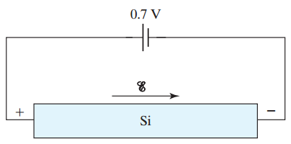
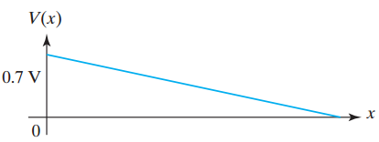

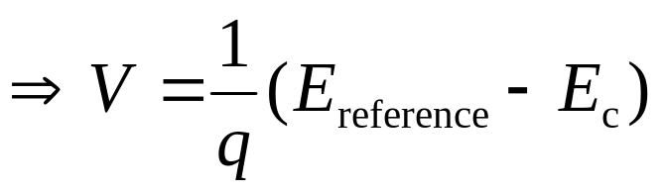
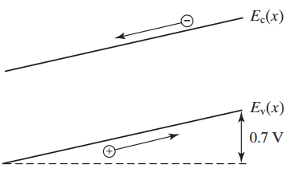
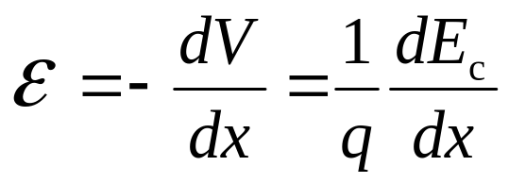
Electrostatic Potential, V and Electric Field, E
The potential energy of a particle with charge -q is related to the electrostatic potential V(x):
0.7 eV
Variation of E_{c} with position is called “band bending.”
EE130/230M Spring 2013
Lecture 2, Slide <number>

Slide 7
Measuring the Band Gap Energy
E_{G} can be determined from the minimum energy of photons that are absorbed by the semiconductor
E_{c}
photon
hν > E_{G}
E_{v}
Band gap energies of selected semiconductors
Semiconductor | Ge | Si | GaAs
Band gap energy (eV) | 0.67 | 1.12 | 1.42
EE130/230M Spring 2013
Lecture 2, Slide <number>

Slide 8
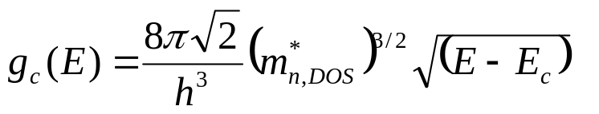
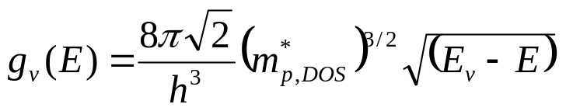
Density of States
E
dE
E_{c}
E_{c}
density of states, g(E)
E_{v}
E_{v}
g(E)dE = number of states per cm³ in the energy range between E and E+dE
Near the band edges:
Electron and hole
density-of-states effective masses
for E ≥ E_{c}
 | Si | Ge | GaAs
m_{n,DOS}*/m_{o} | 1.08 | 0.56 | 0.067
m_{p,DOS}*/m_{o} | 0.81 | 0.29 | 0.47
for E ≤ E_{v}
EE130/230M Spring 2013
Lecture 2, Slide <number>

Slide 9
E_{G} and Material Classification
silicon dioxide
silicon
metal
E_{c}
E_{c}
E_{G} = 1.12 eV
E_{v}
E_{G} = ~ 9 eV
E_{v}
E_{c}
E_{v}
Neither filled bands nor empty bands allow current flow
Insulators have large E_{G}
Semiconductors have small E_{G}
Metals have no band gap (conduction band is partially filled)
EE130/230M Spring 2013
Lecture 2, Slide <number>

Slide 10
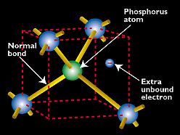
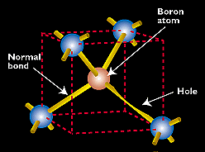
Doping
By substituting a Si atom with a special impurity atom (Column V or Column III element), a conduction electron or hole is created.
Donors: P, As, Sb
Acceptors: B, Al, Ga, In
N_{D} ≡ ionized donor concentration (cm⁻³)
N_{A} ≡ ionized acceptor concentration (cm⁻³)
EE130/230M Spring 2013
Lecture 2, Slide <number>

Slide 11
Doping Silicon with a Donor
Example: Add arsenic (As) atom to the Si crystal
The loosely bound 5th valence electron of the As atom “breaks free” and becomes a mobile electron for current conduction.
EE130/230M Spring 2013
Lecture 2, Slide <number>

Slide 12
Doping Silicon with an Acceptor
Example: Add boron (B) atom to the Si crystal
The B atom accepts an electron from a neighboring Si atom, resulting in a missing bonding electron, or “hole”. The hole is free to roam around the Si lattice, carrying current as a positive charge.
EE130/230M Spring 2013
Lecture 2, Slide <number>

Slide 13
Doping (Band Model)
Donor ionization energy
E_{c}
E_{D}
E_{A}
E_{v}
Acceptor ionization energy
Ionization energy of selected donors and acceptors in silicon
 | Donors |  |  | Acceptors
Dopant | Sb | P | As | B | Al | In
Ionization energy (meV) E_{c}-E_{D} or E_{A}-E_{v} | 39 | 45 | 54 | 45 | 67 | 160
EE130/230M Spring 2013
Lecture 2, Slide <number>

Slide 14
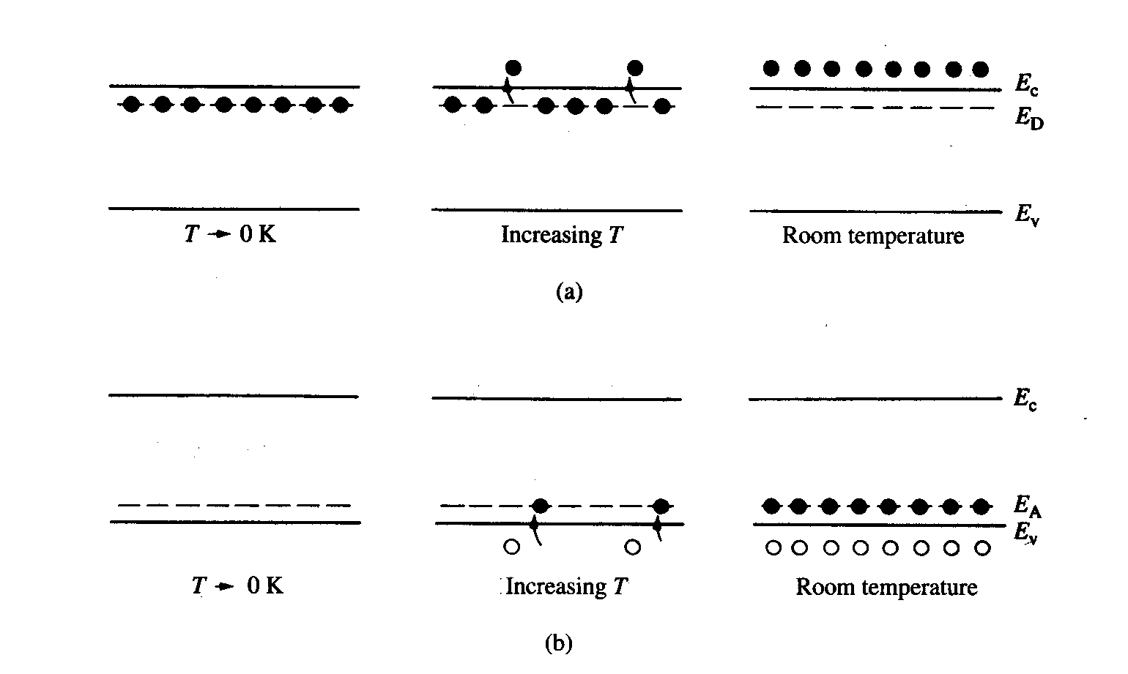
Dopant Ionization
EE130/230M Spring 2013
Lecture 2, Slide <number>

Slide 15
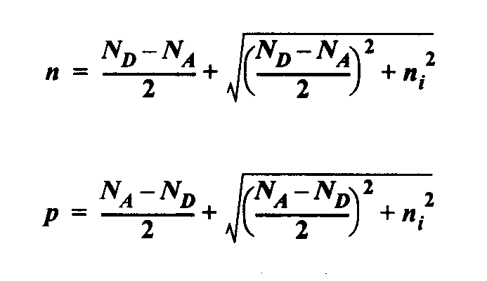
Charge-Carrier Concentrations
Charge neutrality condition: N_{D} + p = N_{A} + n
At thermal equilibrium, np = n_{i}² (“Law of Mass Action”)
Note: Carrier concentrations depend on net dopant concentration!
EE130/230M Spring 2013
Lecture 2, Slide <number>

Slide 16
n-type Material (n > p)
N_{D} > N_{A} (more specifically, N_{D} – N_{A} >> n_{i}):
EE130/230M Spring 2013
Lecture 2, Slide <number>

Slide 17
p-type Material (p > n)
N_{A} > N_{D} (more specifically, N_{A} – N_{D} >> n_{i}):
EE130/230M Spring 2013
Lecture 2, Slide <number>

Slide 18
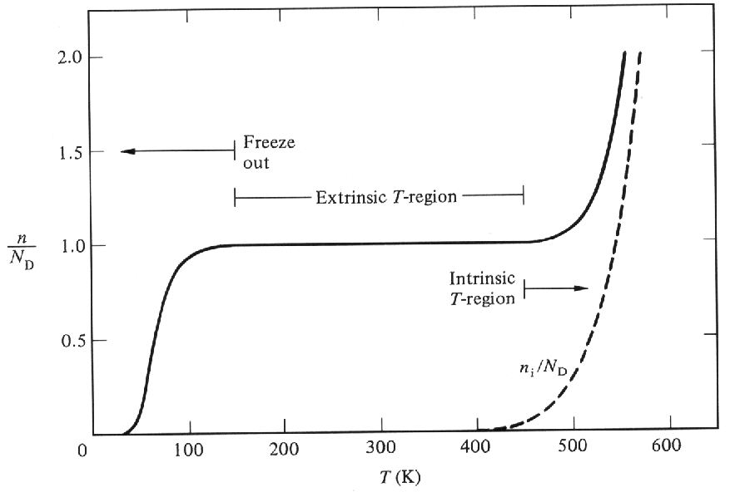
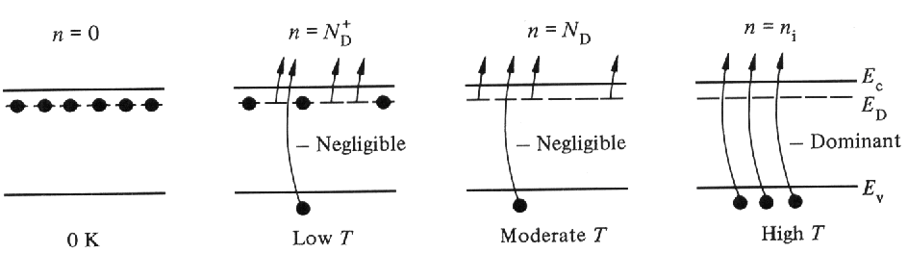
Carrier Concentration vs. Temperature
EE130/230M Spring 2013
Lecture 2, Slide <number>

Slide 19
Terminology
donor: impurity atom that increases n
acceptor: impurity atom that increases p
n-type material: contains more electrons than holes
p-type material: contains more holes than electrons
majority carrier: the most abundant carrier
minority carrier: the least abundant carrier
intrinsic semiconductor: n = p = n_{i}
extrinsic semiconductor: doped semiconductor
such that majority carrier concentration = net dopant concentration
EE130/230M Spring 2013
Lecture 2, Slide <number>

Slide 20
Summary
Allowed electron energy levels in an atom give rise to bands of allowed electron energy levels in a crystal.
  The valence band is the highest nearly-filled band.
  The conduction band is the lowest nearly-empty band.
The band gap energy is the energy required to free an electron from a covalent bond.
  E_{G} for Si at 300 K = 1.12 eV
  Insulators have large E_{G}; semiconductors have small E_{G}
EE130/230M Spring 2013
Lecture 2, Slide <number>

Slide 21
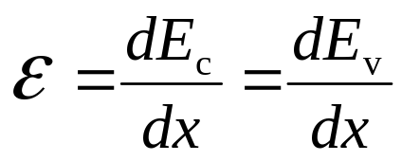
Summary (cont’d)
E_{c} represents the electron potential energy
Variation in E_{c}(x) → variation in electric potential V
Electric field
E - E_{c} represents the electron kinetic energy
EE130/230M Spring 2013
Lecture 2, Slide <number>

Slide 22
Summary (cont’d)
Dopants in silicon:
  Reside on lattice sites (substituting for Si)
  Have relatively low ionization energies (<50 meV)
    → ionized at room temperature
  Group-V elements contribute conduction electrons, and are called donors
  Group-III elements contribute holes, and are called acceptors
Dopant concentrations typically range from 10¹⁵ cm⁻³ to 10²⁰ cm⁻³
EE130/230M Spring 2013
Lecture 2, Slide <number>

