Slide 1
Lecture 20
OUTLINE
The MOSFET (cont’d)
Qualitative theory
Field-effect mobility
Long-channel I-V characteristics
Reading: Pierret 17.2, 18.3.4; Hu 6.3-6.6

Slide 2
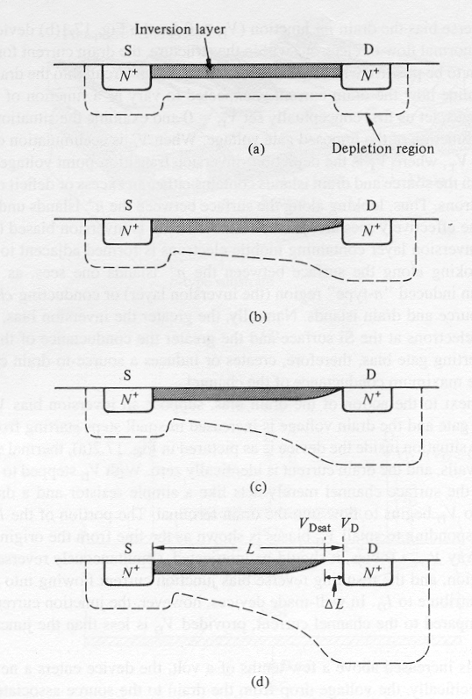
Qualitative Theory of the NMOSFET
V_{GS} < V_{T} :
depletion layer
The potential barrier to electron flow from the source
into the channel is lowered by applying V_{GS}> V_{T}
V_{GS} > V_{T} :
V_{DS} ≈ 0
V_{DS} > 0
Electrons flow from the source to the drain by drift, when V_{DS}>0. (I_{DS} > 0)
The channel potential varies from V_{S} at the source end to V_{D} at the drain end.
EE130/230M Spring 2013
Lecture 20, Slide <number>

Slide 3
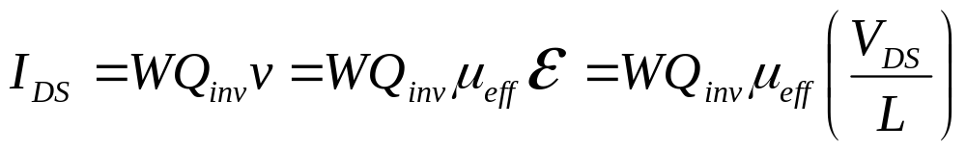
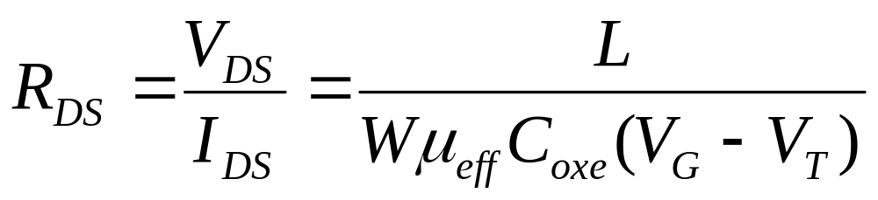
MOSFET Linear Region of Operation
For small values of V_{DS} (i.e. for V_{DS} << V_{G}−V_{T}),
where μ_{eff} is the effective carrier mobility
Hence the NMOSFET can be modeled as a resistor:
EE130/230M Spring 2013
Lecture 20, Slide <number>

Slide 4
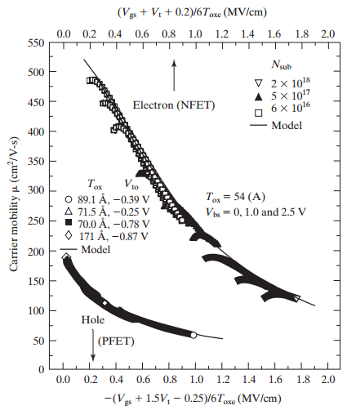

Field-Effect Mobility, μ_{eff}
Scattering mechanisms:
Coulombic scattering
phonon scattering
surface roughness
scattering
EE130/230M Spring 2013
Lecture 20, Slide <number>

Slide 5
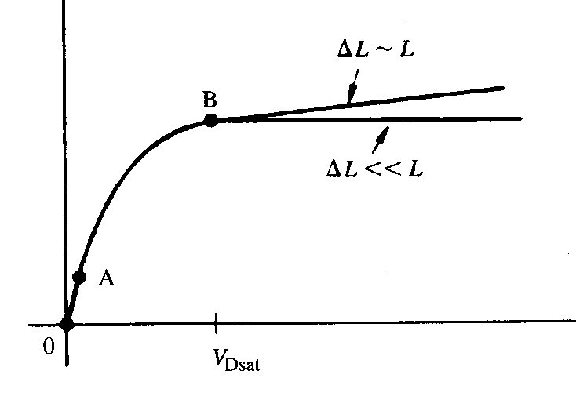
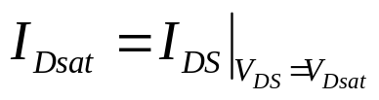
MOSFET Saturation Region of Operation
V_{DS} = V_{GS}-V_{T}
V_{DS} > V_{GS}-V_{T}
When V_{D} is increased to be equal to V_{G}-V_{T}, the inversion-layer charge density at the drain end of the channel equals 0, i.e. the channel becomes “pinched off”
As V_{D} is increased above V_{G}-V_{T}, the length ΔL of the “pinch-off” region increases. The voltage applied across the inversion layer is always V_{Dsat}=V_{GS}-V_{T}, and so the current saturates.
If ΔL is significant compared to L, then I_{DS} will increase slightly with increasing V_{DS}>V_{Dsat}, due to “channel-length modulation”
I_{D}
V_{DS}
EE130/230M Spring 2013
Lecture 20, Slide <number>

Slide 6
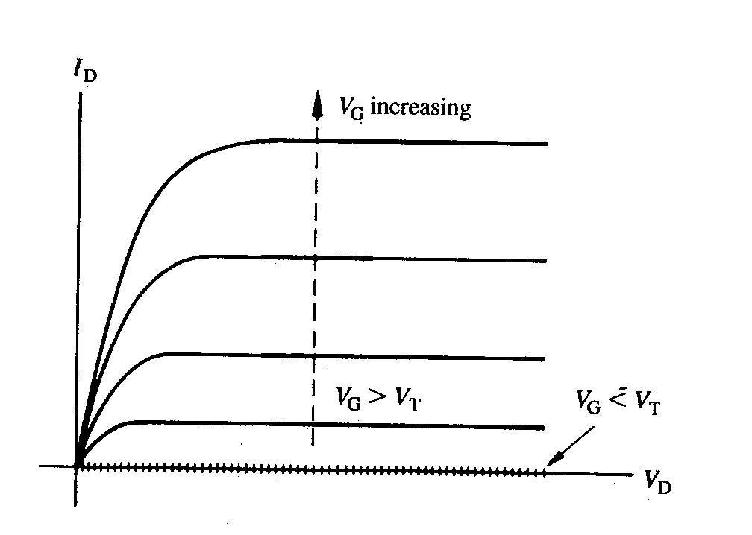
Ideal MOSFET I-V Characteristics
Enhancement-Mode N-channel MOSFET
Linear
region
EE130/230M Spring 2013
Lecture 20, Slide <number>

Slide 7
Impact of Inversion-Layer Bias
When a MOS device is biased into inversion, a pn junction exists between the surface and the bulk.
If the inversion layer contacts a heavily doped region of the same type, it is possible to apply a bias to this pn junction.
N+ poly-Si
V_{G} is biased so that surface is inverted
n-type inversion layer is contacted by N+ region
If a bias V_{C} is applied to the channel, a reverse bias (V_{B}-V_{C}) is applied between the channel and body
+
+
+
+
+
+
+
+
SiO₂
N+
-
-
-
-
-
-
-
-
-
p-type Si
EE130/230M Spring 2013
Lecture 20, Slide <number>

Slide 8
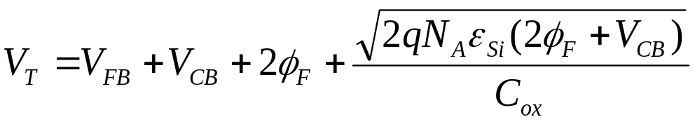
Effect of V_{CB} on φ_{S}, W, and V_{T}
Application of a reverse body bias → non-equilibrium
  → 2 Fermi levels (one in n-type region, one in p-type region) are separated by qV_{BC} ➔ φ_{S} is increased by V_{CB}
Reverse body bias widens W, increases Q_{dep} and hence V_{T}
EE130/230M Spring 2013
Lecture 20, Slide <number>

Slide 9
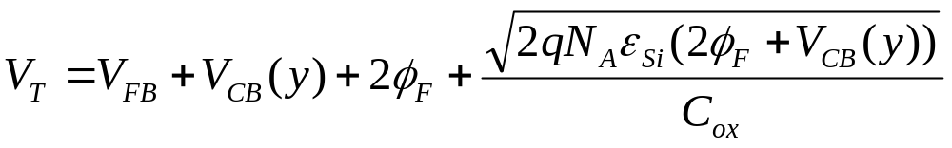
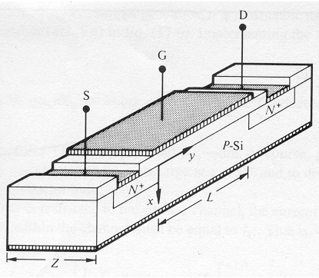
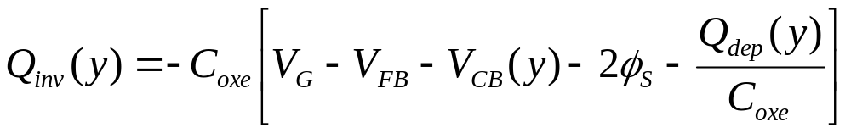
Derivation of NMOSFET I-V
V_{D} > V_{S}
Current in the channel flows by drift
Channel voltage V_{C}(y) varies continuously between the source and the drain
Channel inversion charge density
W
EE130/230M Spring 2013
Lecture 20, Slide <number>

Slide 10
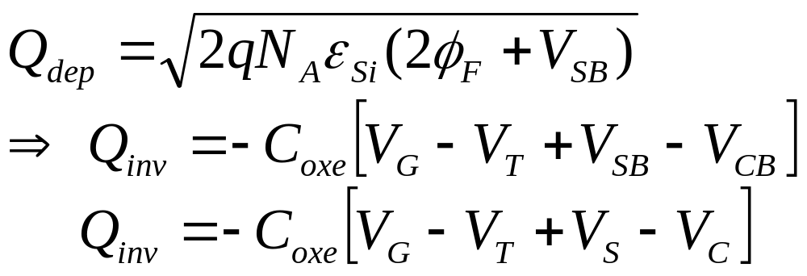
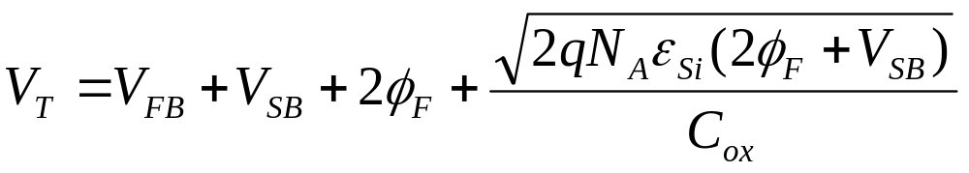
1st-Order Approximation
If we neglect the variation of Q_{dep} with y, then
where V_{T} = threshold voltage at the source end:
EE130/230M Spring 2013
Lecture 20, Slide <number>

Slide 11
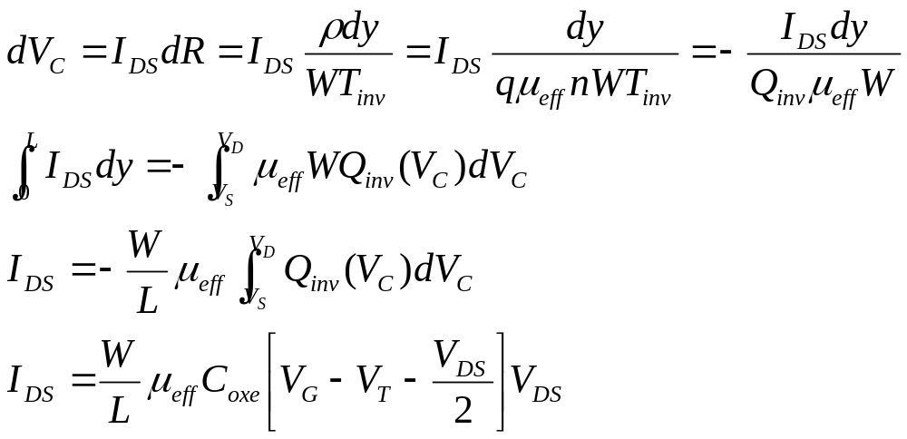
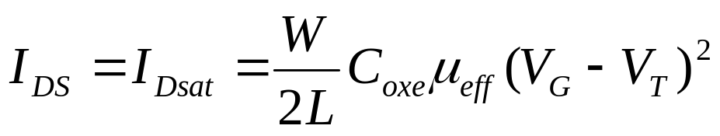
NMOSFET Current (1st-order approx.)
Consider an incremental length dy in the channel. The voltage drop across this region is
in the linear region
in the saturation region
EE130/230M Spring 2013
Lecture 20, Slide <number>

Slide 12
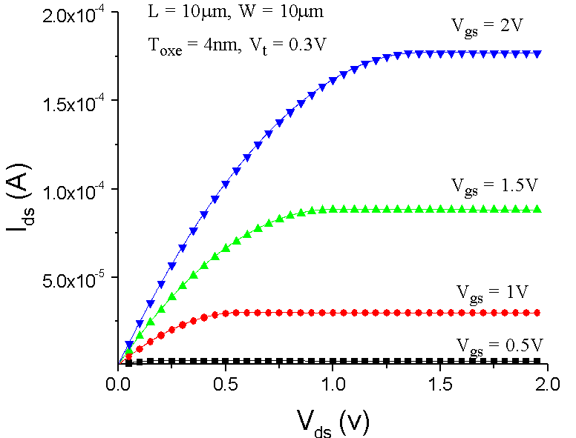

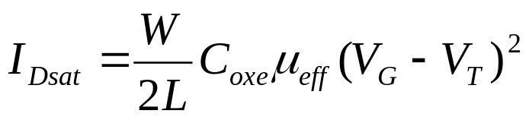
Saturation Current, I_{Dsat}
(1st-order approximation)
In the saturation region:
EE130/230M Spring 2013
Lecture 20, Slide <number>

Slide 13
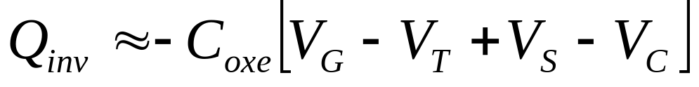
Problem with “Square Law Theory”
Ignores variation in depletion width with distance y:
EE130/230M Spring 2013
Lecture 20, Slide <number>

Slide 14
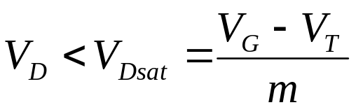
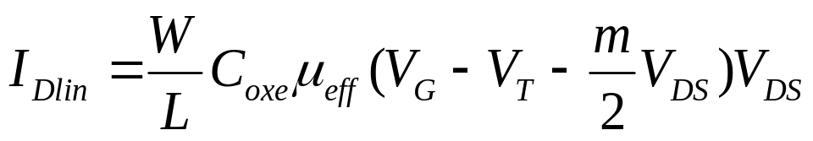

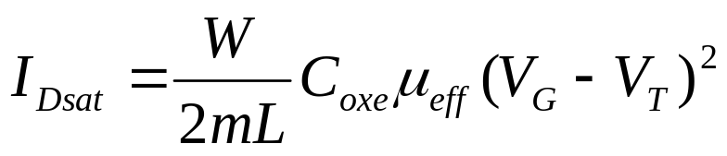
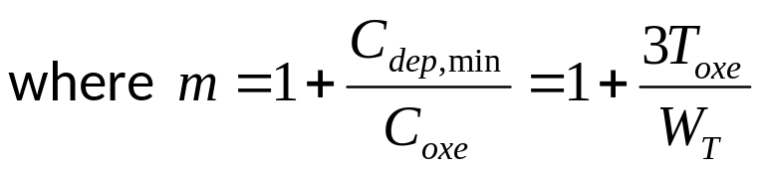

Modified (Bulk-Charge) I-V Model
In linear region:
In saturation region:
EE130/230M Spring 2013
Lecture 20, Slide <number>

Slide 15

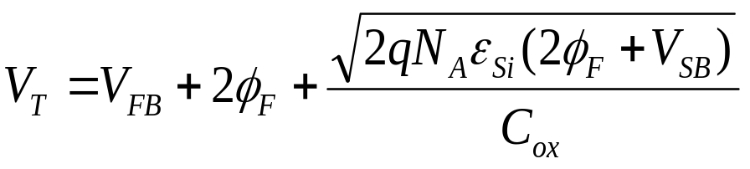
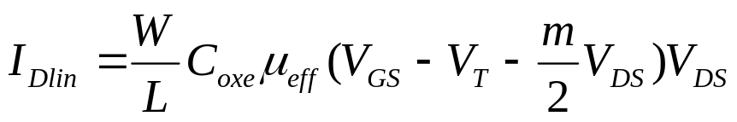
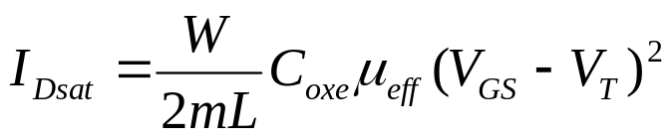


MOSFET Threshold Voltage, V_{T}
The expression that was previously derived for V_{T} is the gate voltage referenced to the body voltage that is required reach the threshold condition:
Usually, the terminal voltages for a MOSFET are all referenced to the source voltage. In this case,
and the equations for I_{DS} are
EE130/230M Spring 2013
Lecture 20, Slide <number>

Slide 16
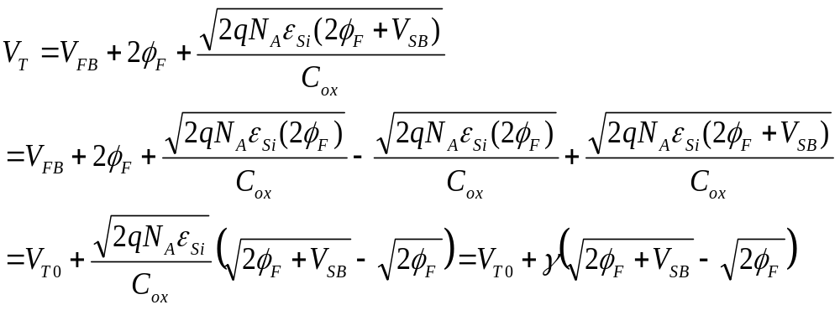
The Body Effect
Note that V_{T} is a function of V_{SB}:
where γ is the body effect parameter
When the source-body pn junction is reverse-biased, |V_{T}| is increased. Usually, we want to minimize γ so that I_{Dsat} will be the same for all transistors in a circuit.
EE130/230M Spring 2013
Lecture 20, Slide <number>

Slide 17
MOSFET V_{T} Measurement
V_{T} can be determined by plotting I_{DS} vs. V_{GS}, using a low value of V_{DS}
I_{DS}
V_{GS}
EE130/230M Spring 2013
Lecture 20, Slide <number>

Slide 18
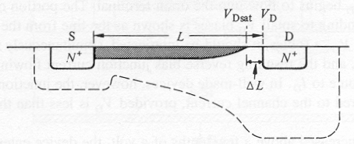
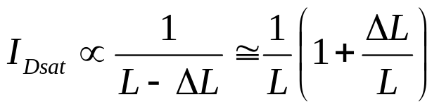

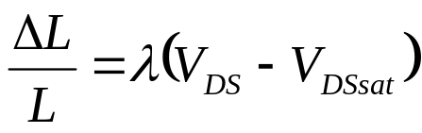
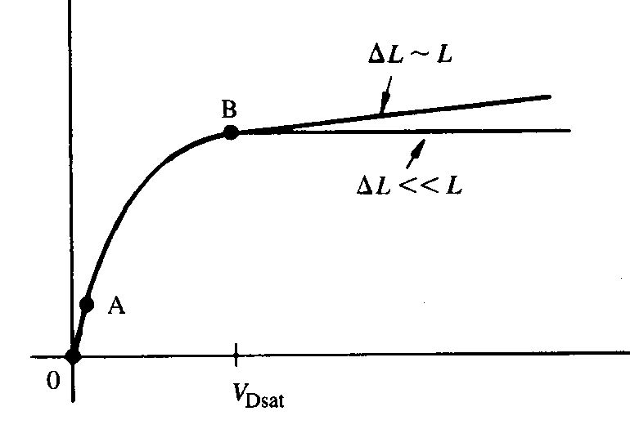
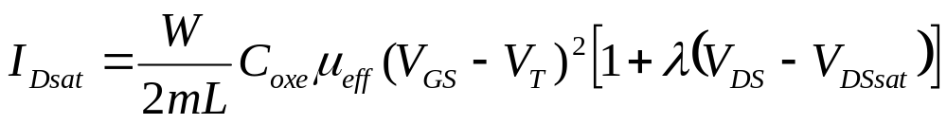
Channel Length Modulation
Recall that as V_{DS} is increased above V_{Dsat}, the width ΔL of the depletion region between the pinch-off point and the drain increases, i.e. the inversion layer length decreases.
I_{DS}
V_{DS}
EE130/230M Spring 2013
Lecture 20, Slide <number>

Slide 19
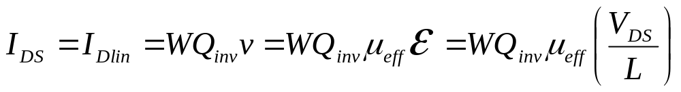
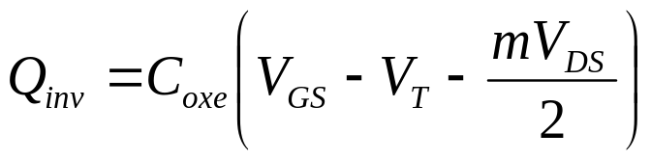
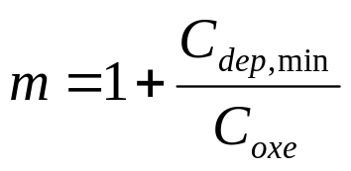

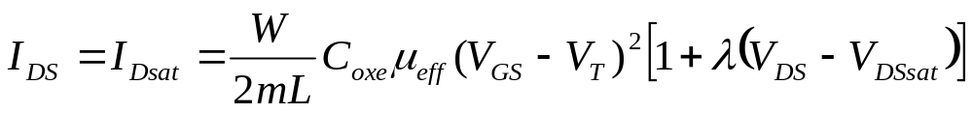
Long-Channel MOSFET I-V Summary
In the ON state (V_{GS}>V_{T} for NMOS; V_{GS}<V_{T} for PMOS), the inversion layer at the semiconductor surface forms a “channel” for current to flow by carrier drift from source to drain
In the linear region of operation (V_{DS} < (V_{GS}−V_{T})/m):
In the saturation region of operation (V_{DS} > (V_{GS}−V_{T})/m):
EE130/230M Spring 2013
Lecture 20, Slide <number>

