Slide 1
Lecture 21
OUTLINE
The MOSFET (cont’d)
P-channel MOSFET
CMOS inverter analysis
Sub-threshold current
Small signal model
Reading: Pierret 17.3; Hu 6.7, 7.2

Slide 2
P-Channel MOSFET
The PMOSFET turns on when V_{GS} < V_{T}
  Holes flow from SOURCE to DRAIN
    ⇒ DRAIN is biased at a lower potential than the SOURCE
In a CMOS technology, the PMOS & NMOS threshold voltages are usually symmetric about 0, i.e. V_{Tp} = -V_{Tn}
V_{G}
V_{DS} < 0
I_{DS} < 0
|I_{DS}| increases with
  |V_{GS} - V_{T}|
  |V_{DS}| (linear region)
V_{S}
V_{D}
GATE
I_{D}
P⁺
P⁺
N
V_{B}
EE130/230M Spring 2013
Lecture 21, Slide <number>

Slide 3
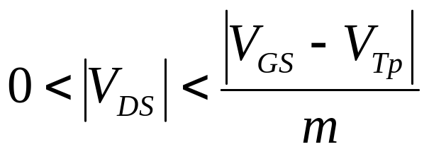
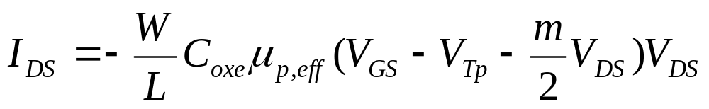
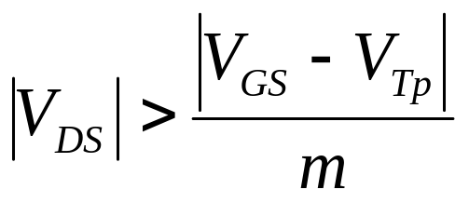
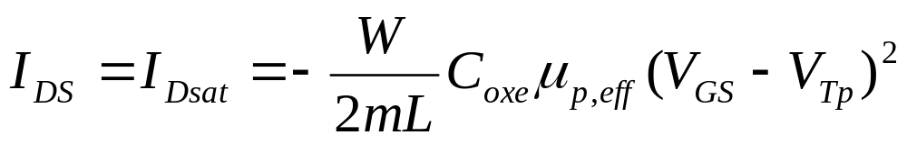
Long-Channel PMOSFET I-V
Linear region:
Saturation region:
m = 1 + (3T_{oxe}/W_{T}) is the bulk-charge factor
EE130/230M Spring 2013
Lecture 21, Slide <number>

Slide 4
CMOS Inverter: Intuitive Perspective
CIRCUIT
SWITCH MODELS
V_{DD}
V_{DD}
V_{DD}
G
S
R_{p}
D
V_{OUT} = 0V
V_{OUT} = V_{DD}
V_{IN}
V_{OUT}
D
R_{n}
G
S
Low static power consumption, since
one MOSFET is always off in steady state
V_{IN} = V_{DD}
V_{IN} = 0V
EE130/230M Spring 2013
Lecture 21, Slide <number>

Slide 5
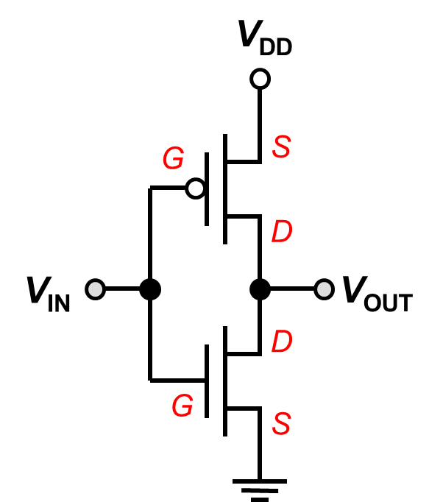
Voltage Transfer Characteristic
N: sat
P: sat
V_{OUT}
N: off
P: lin
C
V_{DD}
N: sat
P: lin
A
B
D
E
N: lin
P: sat
N: lin
P: off
0
V_{IN}
V_{DD}
0
EE130/230M Spring 2013
Lecture 21, Slide <number>

Slide 6
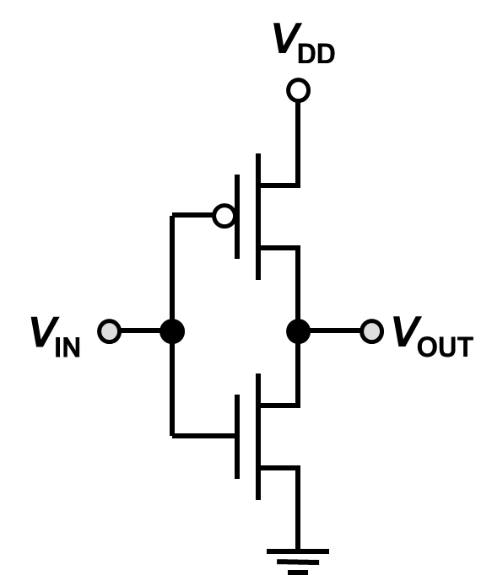
CMOS Inverter Load-Line Analysis
–
V_{GSp}=V_{IN}-V_{DD}
+
V_{IN} = V_{DD} + V_{GSp}
–
V_{DSp}=V_{OUT}-V_{DD}
+
I_{Dn}=-I_{Dp}
V_{OUT} = V_{DD} + V_{DSp}
increasing
V_{IN}
V_{IN} = 0 V
V_{IN} = V_{DD}
I_{Dn}=-I_{Dp}
increasing
V_{IN}
0
V_{OUT}=V_{DSn}
V_{DD}
0
V_{DSp} = - V_{DD}
V_{DSp} = 0
EE130/230M Spring 2013
Lecture 21, Slide <number>

Slide 7
Load-Line Analysis: Region A
–
V_{GSp}=V_{IN}-V_{DD}
+
–
V_{DSp}=V_{OUT}-V_{DD}
+
I_{Dn}=-I_{Dp}
V_{IN} ≤ V_{Tn}
I_{Dn}=-I_{Dp}
0
V_{OUT}=V_{DSn}
V_{DD}
0
EE130/230M Spring 2013
Lecture 21, Slide <number>

Slide 8
Load-Line Analysis: Region B
–
V_{GSp}=V_{IN}-V_{DD}
+
–
V_{DSp}=V_{OUT}-V_{DD}
+
I_{Dn}=-I_{Dp}
I_{Dn}=-I_{Dp}
V_{DD}/2 > V_{IN} > V_{Tn}
0
V_{OUT}=V_{DSn}
V_{DD}
0
EE130/230M Spring 2013
Lecture 21, Slide <number>

Slide 9
Load-Line Analysis: Region D
–
V_{GSp}=V_{IN}-V_{DD}
+
–
V_{DSp}=V_{OUT}-V_{DD}
+
I_{Dn}=-I_{Dp}
I_{Dn}=-I_{Dp}
V_{DD} – |V_{Tp}| > V_{IN} > V_{DD}/2
0
V_{OUT}=V_{DSn}
V_{DD}
0
EE130/230M Spring 2013
Lecture 21, Slide <number>

Slide 10
Load-Line Analysis: Region E
–
V_{GSp}=V_{IN}-V_{DD}
+
–
V_{DSp}=V_{OUT}-V_{DD}
+
I_{Dn}=-I_{Dp}
V_{IN} > V_{DD} – |V_{Tp}|
I_{Dn}=-I_{Dp}
0
V_{OUT}=V_{DSn}
V_{DD}
0
EE130/230M Spring 2013
Lecture 21, Slide <number>

Slide 11
MOSFET Effective Drive Current, I_{EFF}
M. H. Na et al., IEDM Technical Digest, pp. 121-124, 2002
CMOS inverter chain:
I_{H} + I_{L}
V₁
V₂
V₃
V_{DD}
V₂
I_{EFF} =
t_{pLH}
V₃
2
V_{DD}/2
t_{pHL}
V₁
TIME
I_{Dsat}
I_{H}
V_{IN} = V_{DD}
CMOS
inverter:
V_{DD}
S
D
NMOS DRAIN CURRENT
V_{IN}
V_{OUT}
D
I_{L}
S
V_{IN} = ½V_{DD}
GND
0.5V_{DD}
V_{DD}
NMOS DRAIN VOLTAGE = V_{OUT}
EE130/230M Spring 2013
Lecture 21, Slide <number>

Slide 12
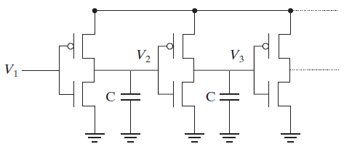
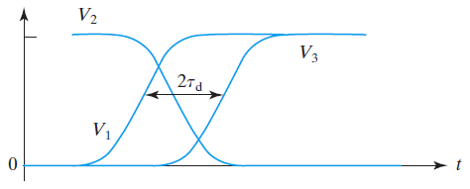
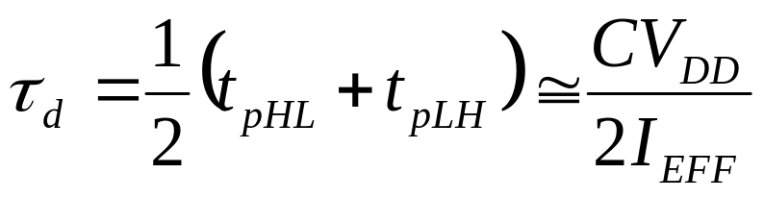
Propagation Delay, τ_{d}
CMOS inverter chain:
V_{DD}
Voltage waveforms:
V_{DD}
τ_{d} is reduced by increasing I_{EFF} and reducing load capacitance C
EE130/230M Spring 2013
Lecture 21, Slide <number>

Slide 13
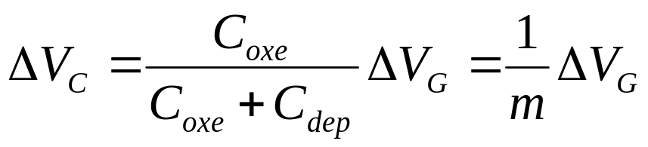
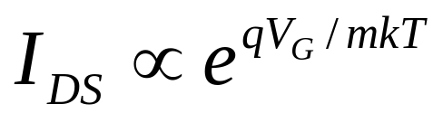
Sub-Threshold Current
For |V_{G}| < |V_{T}|, MOSFET current flow is limited by carrier diffusion into the channel region.
The electric potential in the channel region varies linearly with V_{G}, according to the capacitive voltage divider formula:
As the potential barrier to diffusion increases linearly with decreasing V_{G}, the diffusion current decreases exponentially:
EE130/230M Spring 2013
Lecture 21, Slide <number>

Slide 14
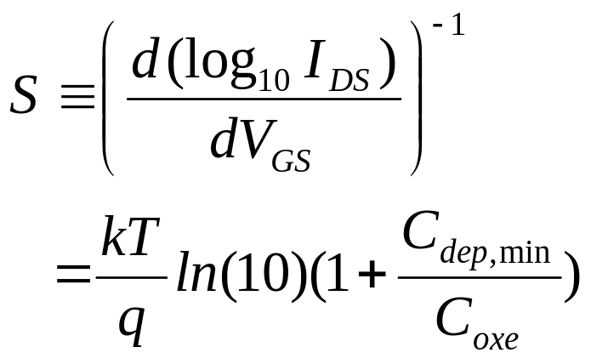
Sub-Threshold Swing, S
log I_{D}
Inverse slope is subthreshold swing, S
[mV/dec]
NMOSFET Energy Band Profile
V_{GS}
0
V_{T}
n(E) ∝ exp(-E/kT)
increasing E
Source
increasing
V_{GS}
Drain
distance
EE130/230M Spring 2013
Lecture 21, Slide <number>

Slide 15
V_{T} Design Trade-off
Low V_{T} is desirable for high ON current:
    I_{Dsat} ∝ (V_{DD} - V_{T})^{η} 1 < η < 2
But high V_{T} is needed for low OFF current:
log I_{D}
Low V_{T}
V_{T} cannot be aggressively reduced!
High V_{T}
I_{OFF,low VT}
I_{OFF,high VT}
V_{GS}
0
EE130/230M Spring 2013
Lecture 21, Slide <number>

Slide 16
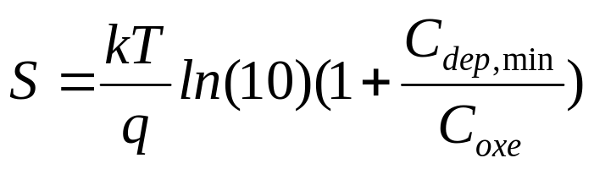
How to minimize S?
EE130/230M Spring 2013
Lecture 21, Slide <number>

Slide 17
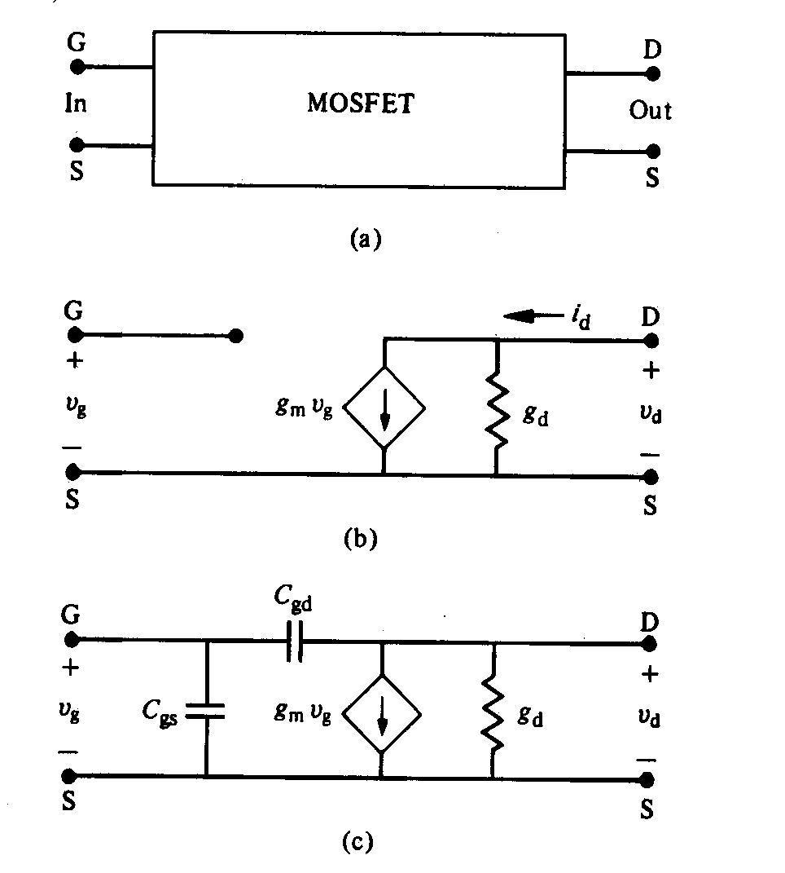
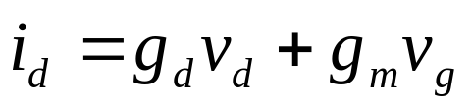
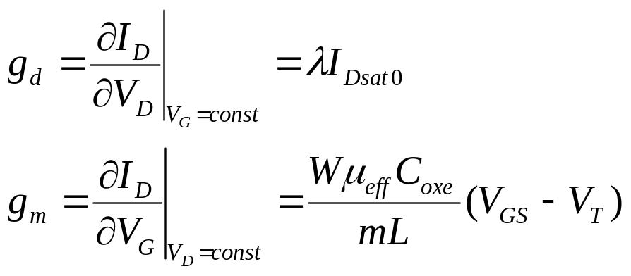
MOSFET Small Signal Model
Conductance parameters:
A small change in V_{G} or V_{DS} will result in a small change in I_{D}
low-frequency:
high-frequency:
EE130/230M Spring 2013
Lecture 21, Slide <number>

Slide 18
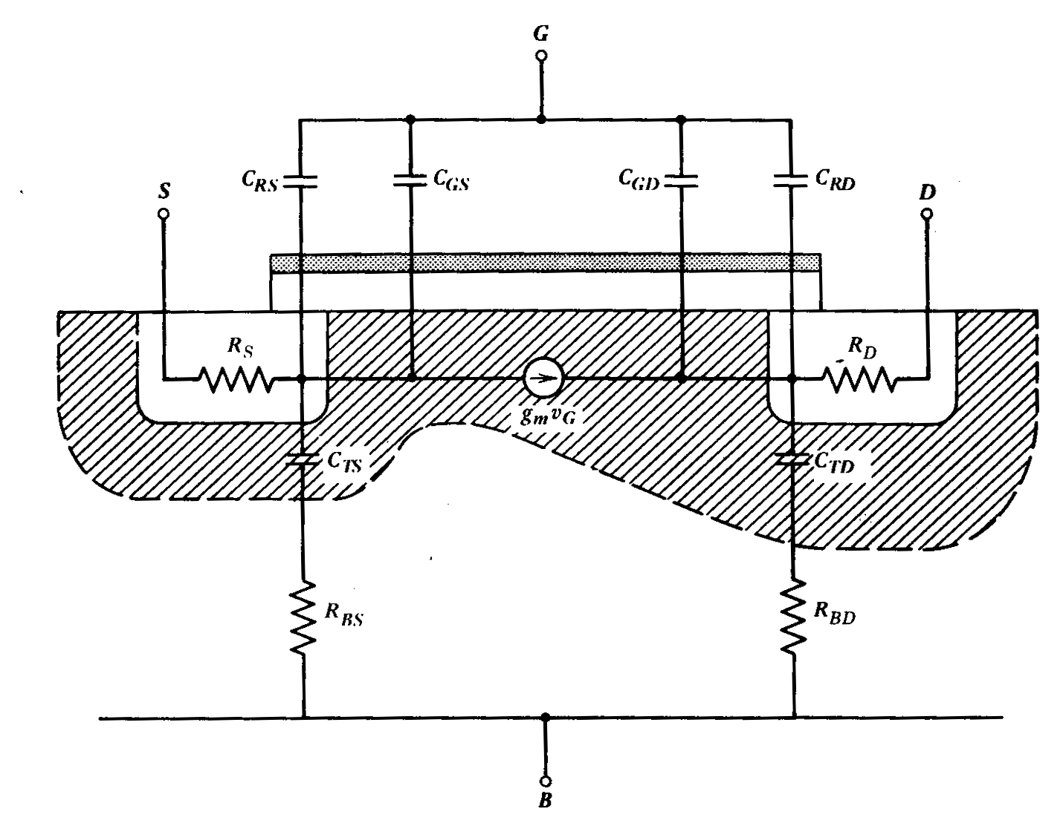
Parasitic Components
EE130/230M Spring 2013
Lecture 21, Slide <number>

Slide 19
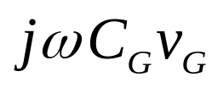
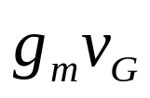
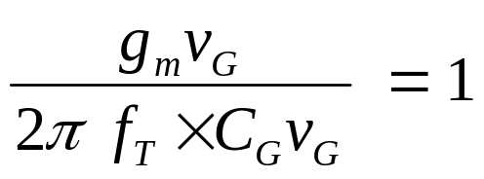
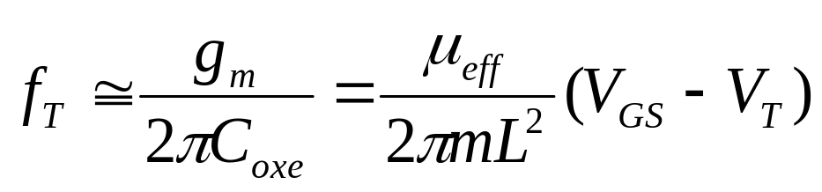
MOSFET Cutoff Frequency, f_{T}
The cut-off frequency f_{T} is defined as the frequency when the
current gain is reduced to 1.
input current =
v_{G} here is ac signal
C_{G} is approximately equal to the
gate capacitance, ≅ W L C_{ox}
output current =
At the cutoff frequency (ω_{T} = 2πf_{T}):
  Higher MOSFET operating frequency is achieved by decreasing the channel length L
EE130/230M Spring 2013
Lecture 21, Slide <number>

