Slide 1
Lecture 22
OUTLINE
The MOSFET (cont’d)
Velocity saturation
Short channel effect
MOSFET scaling approaches
Reading: Pierret 19.1; Hu 7.1, 7.3

Slide 2
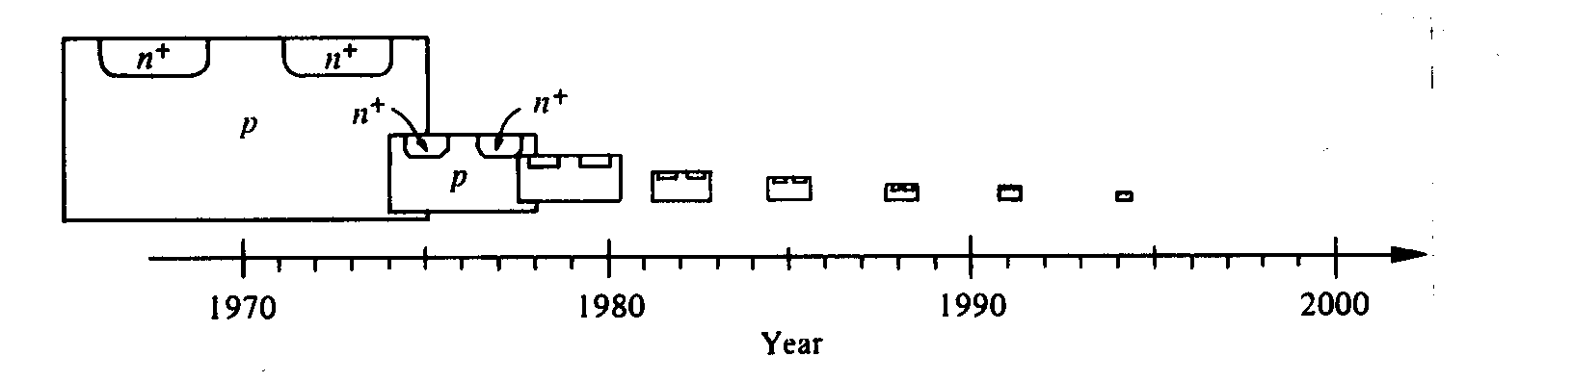
MOSFET Scaling
MOSFETs have been steadily miniaturized over time
  1970s: ~ 10 μm
  Today: ~30 nm
Reasons:
  Improved circuit operating speed
  Increased device density --> lower cost per function
EE130/230M Spring 2013
Lecture 22, Slide <number>

Slide 3
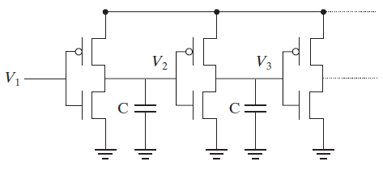
Benefit of Transistor Scaling
As MOSFET lateral dimensions (e.g. channel length L) are reduced:
  I_{Dsat} increases → decreased effective “R”
  gate and junction areas decrease → decreased load “C”
→ faster charging/discharging (i.e. τ_{d} is decreased)
EE130/230M Spring 2013
Lecture 22, Slide <number>

Slide 4
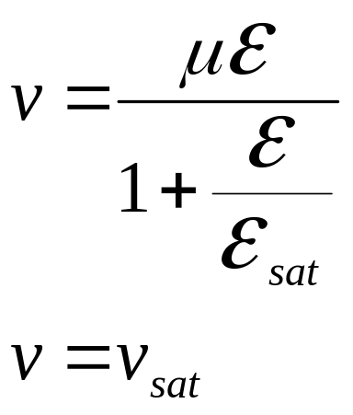
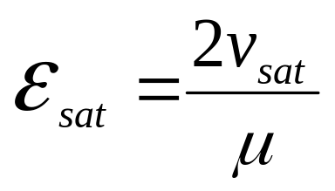
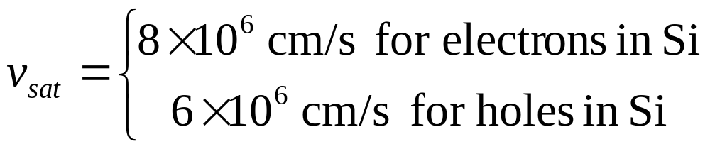
Velocity Saturation
Velocity saturation limits I_{Dsat} in sub-micron MOSFETS
Simple model:
E_{sat} is the electric field at velocity saturation:
for ε < ε _{sat}
for ε ≥ ε_{sat}
EE130/230M Spring 2013
Lecture 22, Slide <number>

Slide 5
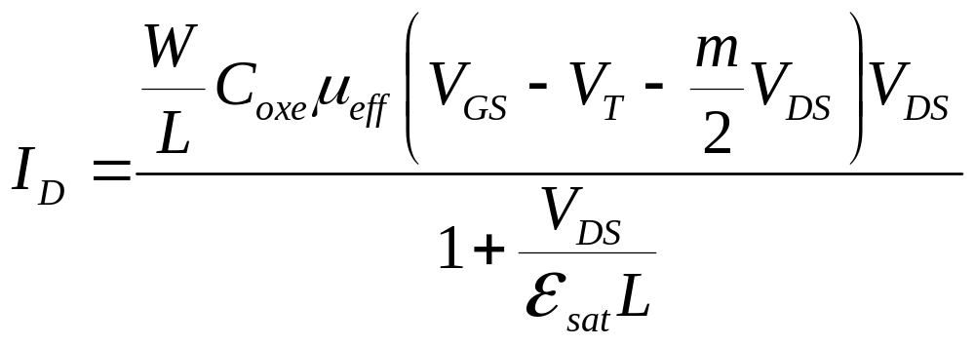
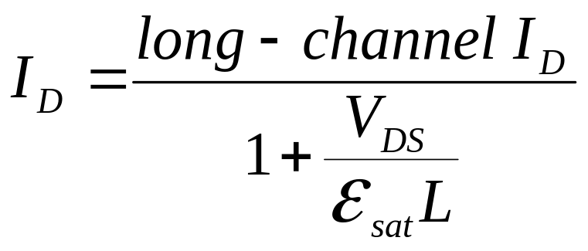
MOSFET I-V with Velocity Saturation
In the linear region:
EE130/230M Spring 2013
Lecture 22, Slide <number>

Slide 6
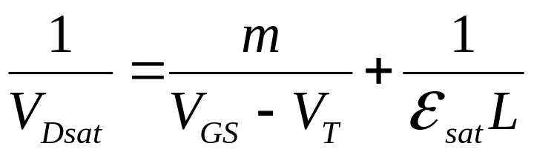
Drain Saturation Voltage, V_{Dsat}
If ε_{sat}L >> V_{GS}-V_{T} then the MOSFET is considered “long-channel”. This condition can be satisfied when
  L is large, or
  V_{GS} is close to V_{T}
EE130/230M Spring 2013
Lecture 22, Slide <number>

Slide 7
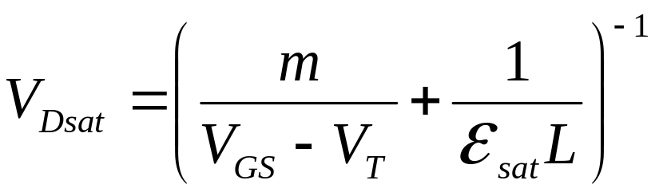
Example: Drain Saturation Voltage
Question: For V_{GS} = 1.8 V, find V_{Dsat} for an NMOSFET with T_{oxe} = 3 nm, V_{T} = 0.25 V, and W_{T} = 45 nm, if L =
(a) 10 μm, (b) 1 μm, (c) 0.1 μm (d) 0.05 μm
Solution: From V_{GS} , V_{T} and T_{oxe}, μ_{eff} is 200 cm²V⁻¹s⁻¹.
E_{sat}= 2v_{sat} / μ_{eff} = 8 ×10⁴ V/cm
m = 1 + 3T_{oxe}/W_{T} = 1.2
EE130/230M Spring 2013
Lecture 22, Slide <number>

Slide 8
(a) L = 10 μm: V_{Dsat}= (1/1.3V + 1/80V)⁻¹ = 1.3 V
(b) L = 1 μm: V_{Dsat}= (1/1.3V + 1/8V)⁻¹ = 1.1 V
(c) L = 0.1 μm: V_{Dsat}= (1/1.3V + 1/.8V)⁻¹ = 0.5 V
(d) L = 0.05 μm: V_{Dsat}= (1/1.3V + 1/.4V)⁻¹ = 0.3 V
EE130/230M Spring 2013
Lecture 22, Slide <number>

Slide 9
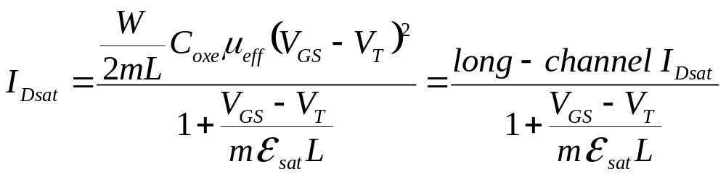
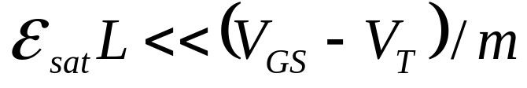
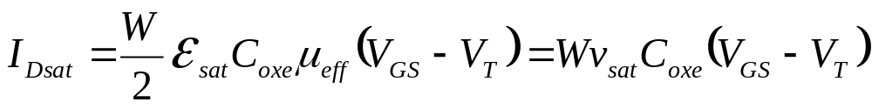
I_{Dsat} with Velocity Saturation
Substituting V_{Dsat} for V_{DS} in the linear-region I_{D} equation gives
For very short channel length:
I_{Dsat} is proportional to V_{GS}–V_{T} rather than (V_{GS} – V_{T})²
I_{Dsat} is not dependent on L
EE130/230M Spring 2013
Lecture 22, Slide <number>

Slide 10
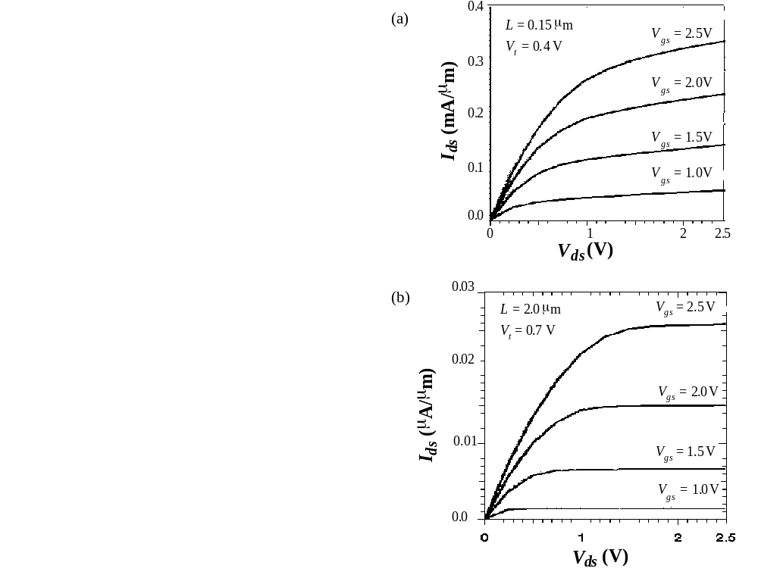
Short- vs. Long-Channel NMOSFET
Short-channel NMOSFET:
  I_{Dsat} is proportional to V_{GS}-V_{Tn} rather than (V_{GS}-V_{Tn})²
  V_{Dsat} is lower than for long-channel MOSFET
  Channel-length modulation is apparent
EE130/230M Spring 2013
Lecture 22, Slide <number>

Slide 11
Velocity Overshoot
When L is comparable to or less than the mean free path, some of the electrons travel through the channel without experiencing a single scattering event
→ projectile-like motion (“ballistic transport”)
The average velocity of carriers exceeds v_{sat}
e.g. 35% for L = 0.12 μm NMOSFET
Effectively, v_{sat} and ε_{sat} increase when L is very small
EE130/230M Spring 2013
Lecture 22, Slide <number>

Slide 12
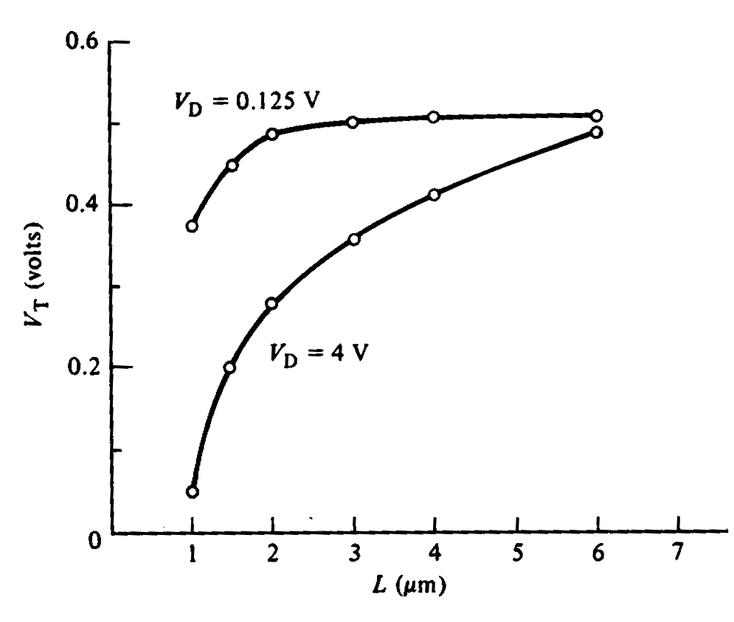
The Short Channel Effect (SCE)
“V_{T} roll-off”
|V_{T}| decreases with L
  Effect is exacerbated by
  high values of |V_{DS}|
This effect is undesirable (i.e. we want to minimize it!) because circuit designers would like V_{T} to be invariant with transistor dimensions and bias condition
EE130/230M Spring 2013
Lecture 22, Slide <number>

Slide 13
Qualitative Explanation of SCE
Before an inversion layer forms beneath the gate, the surface of the Si underneath the gate must be depleted (to a depth W_{T})
The source & drain pn junctions assist in depleting the Si underneath the gate
  Portions of the depletion charge in the channel region are balanced by charge in S/D regions, rather than by charge on the gate
  Less gate charge is required to invert the semiconductor surface (i.e. |V_{T}| decreases)
EE130/230M Spring 2013
Lecture 22, Slide <number>

Slide 14
The smaller L is, the greater the percentage of depletion charge balanced by the S/D pn junctions:
depletion
charge
supported
by gate
(simplified
analysis)
V_{G}
n⁺
n⁺
r_{j}
p
depletion region
Large L:
Small L:
S
D
S
D
Depletion charge supported by S/D
Depletion charge supported by S/D
EE130/230M Spring 2013
Lecture 22, Slide <number>

Slide 15
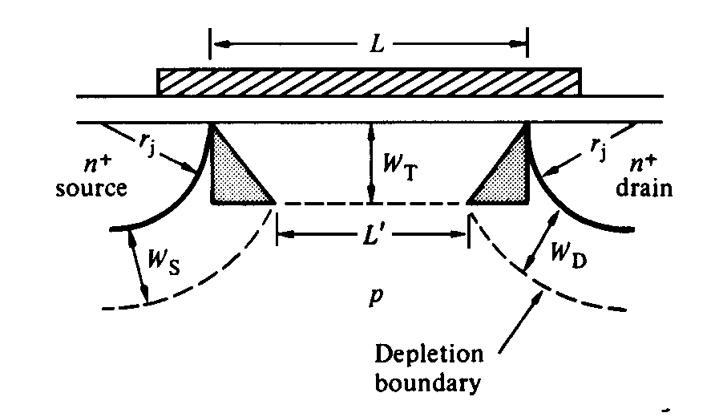
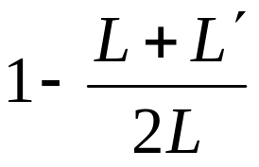
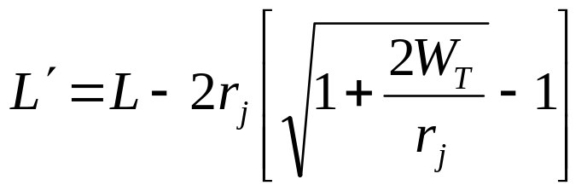
First-Order Analysis of SCE
The gate supports the depletion charge in the trapezoidal region. This is smaller than the rectangular depletion region underneath the gate, by the factor
This is the factor by which the depletion charge Q_{dep} is reduced from the ideal
One can deduce from simple geometric analysis that
W_{T}
EE130/230M Spring 2013
Lecture 22, Slide <number>

Slide 16
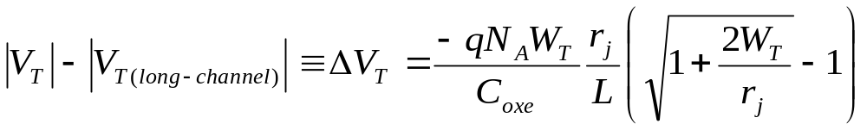
V_{T} Roll-Off: First-Order Model
Minimize ΔV_{T} by
reducing T_{oxe}
reducing r_{j}
increasing N_{A}
(trade-offs: degraded μ_{eff}, m)
MOSFET vertical dimensions should be
scaled along with horizontal dimensions!
EE130/230M Spring 2013
Lecture 22, Slide <number>

Slide 17
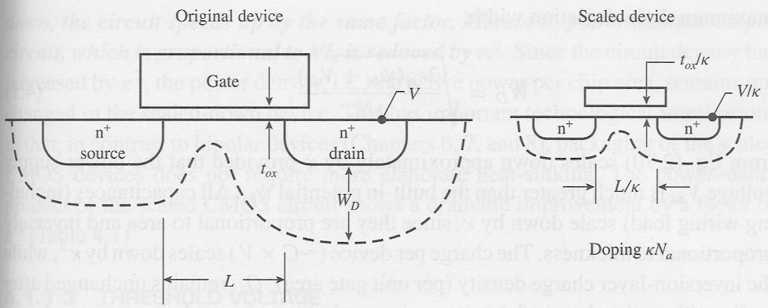
MOSFET Scaling: Constant-Field Approach
MOSFET dimensions and the operating voltage (V_{DD}) each are scaled by the same factor κ>1, so that the electric field remains unchanged.
EE130/230M Spring 2013
Lecture 22, Slide <number>

Slide 18
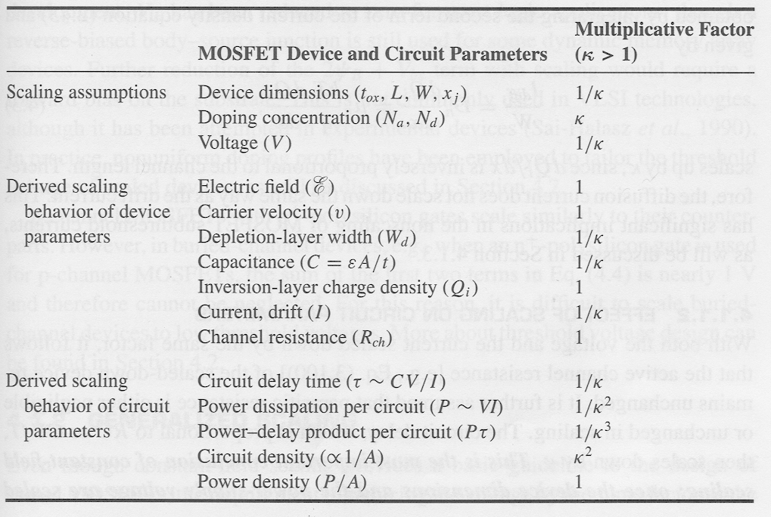
Constant-Field Scaling Benefits
Circuit speed
improves by κ
Power dissipation
per function
is reduced by κ²
EE130/230M Spring 2013
Lecture 22, Slide <number>

Slide 19
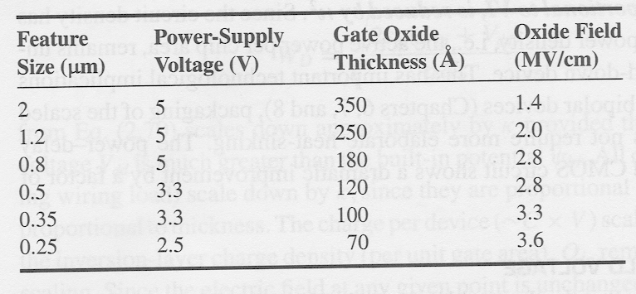
Since V_{T} cannot be scaled down aggressively, the operating voltage (V_{DD}) has not been scaled down in proportion to the MOSFET channel length:
EE130/230M Spring 2013
Lecture 22, Slide <number>

Slide 20
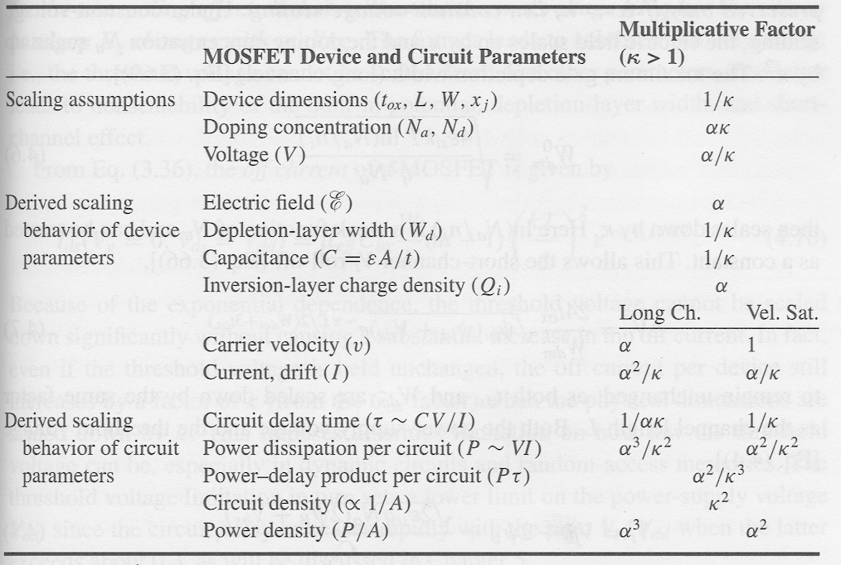
MOSFET Scaling: Generalized Approach
Electric field intensity increases by a factor α>1
N_{body} must be scaled up by α to suppress short-channel effects
Reliability and
power density
are issues
EE130/230M Spring 2013
Lecture 22, Slide <number>

