Slide 1
Lecture 23
OUTLINE
The MOSFET (cont’d)
Drain-induced effects
Source/drain structure
CMOS technology
Reading: Pierret 19.1,19.2; Hu 6.10, 7.3
Optional Reading: Pierret 4; Hu 3

Slide 2
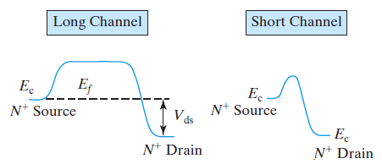
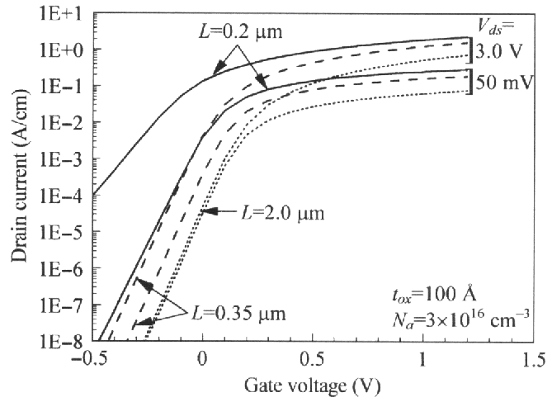
Drain Induced Barrier Lowering (DIBL)
As the source and drain get closer, they become electrostatically coupled, so that the drain bias can affect the potential barrier to carrier diffusion at the source junction
→ V_{T} decreases (i.e. OFF state leakage current increases)
EE130/230M Spring 2013
Lecture 23, Slide <number>

Slide 3
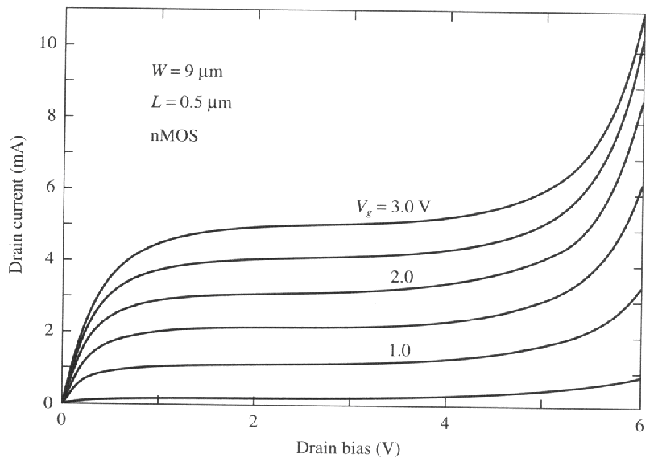
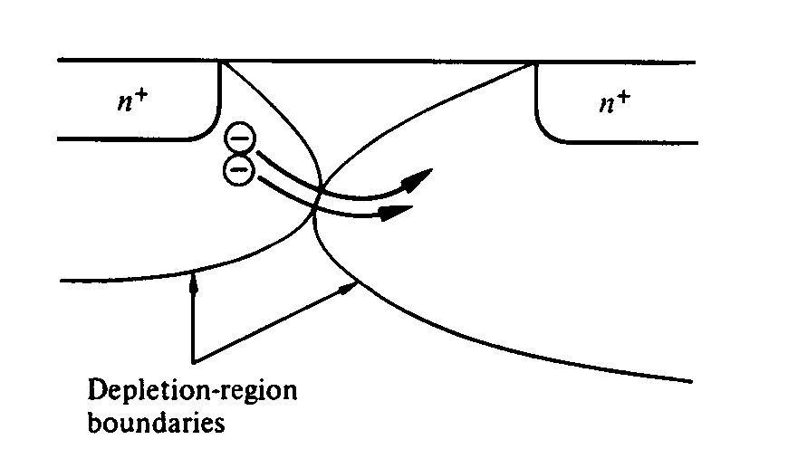
Punchthrough
A large drain bias can cause the drain-junction depletion region to merge with the source-junction depletion region, forming a sub-surface path for current conduction.
I_{Dsat} increases rapidly with V_{DS}
This can be mitigated by doping the semiconductor more heavily in the sub-surface region, i.e. using a “retrograde” doping profile.
EE130/230M Spring 2013
Lecture 23, Slide <number>

Slide 4
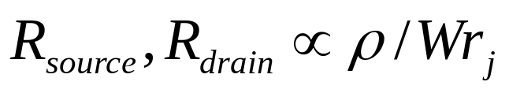
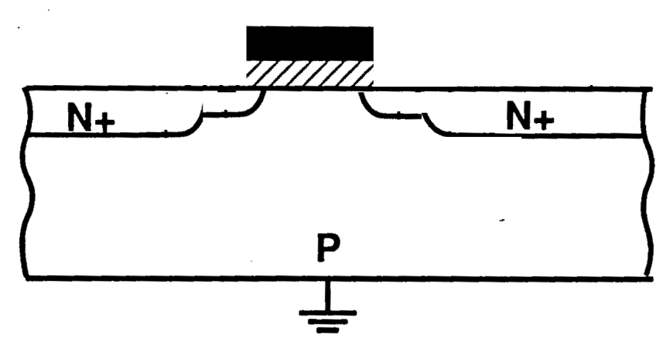
Source and Drain (S/D) Structure
To minimize the short channel effect and DIBL, we want shallow (small r_{j}) S/D regions − but the parasitic resistance of these regions increases when r_{j} is reduced.
where ρ = resistivity of the S/D regions
Shallow S/D “extensions” may be used to effectively reduce r_{j} with a relatively small increase in parasitic resistance
EE130/230M Spring 2013
Lecture 23, Slide <number>

Slide 5
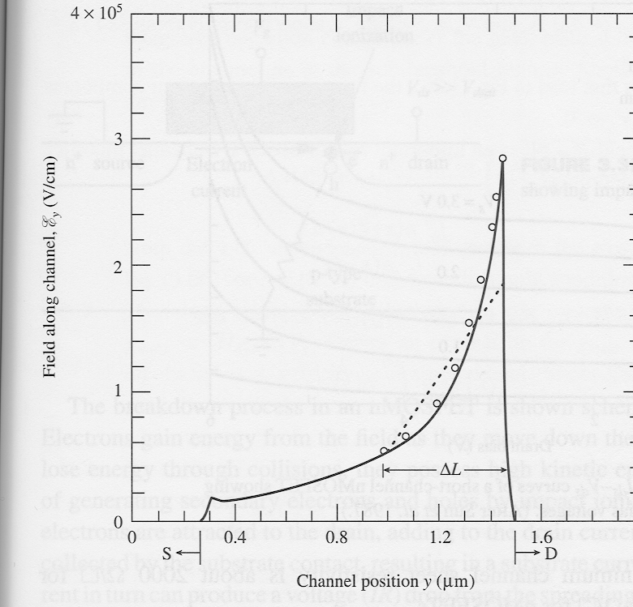
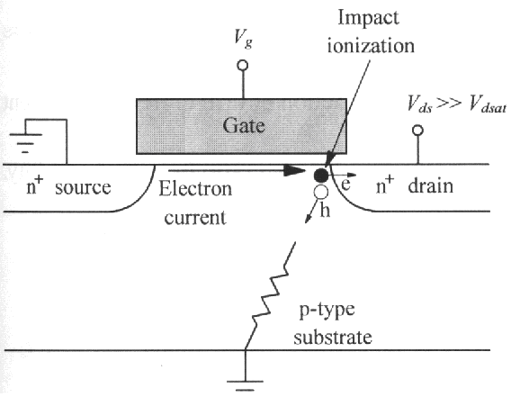
E-Field Distribution Along the Channel
The lateral electric field peaks at the drain end of the channel.
  E_{peak} can be as high as 10⁶ V/cm
High E-field causes problems:
  Damage to oxide interface & bulk
  (trapped oxide charge → V_{T} shift)
  substrate current due to impact ionization:
EE130/230M Spring 2013
Lecture 23, Slide <number>

Slide 6
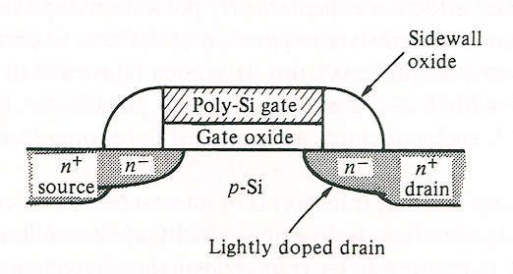
Lightly Doped Drain (LDD) Structure
Lower pn junction doping results in lower peak E-field
  “Hot-carrier” effects are reduced
  Parasitic resistance is increased
EE130/230M Spring 2013
Lecture 23, Slide <number>

Slide 7
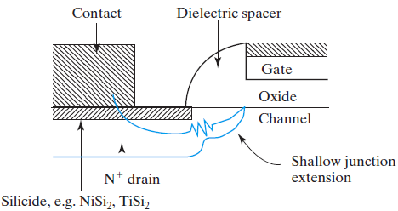
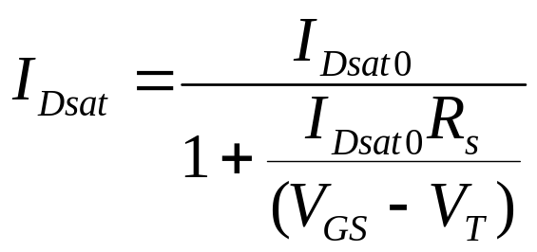
Parasitic Source-Drain Resistance
G
R_{S}
R_{D}
S
D
For short-channel MOSFET, I_{Dsat0} ∝ V_{GS} – V_{T} , so that
→ I_{Dsat} is reduced by ~15% in a 0.1 μm MOSFET.
V_{Dsat} is increased to V_{Dsat0} + I_{Dsat} (R_{S} + R_{D})
EE130/230M Spring 2013
Lecture 23, Slide <number>

Slide 8
Summary: MOSFET OFF State vs. ON State
OFF state (V_{GS} < V_{T}):
  I_{DS} is limited by the rate at which carriers diffuse across the source pn junction
  Minimum subthreshold swing S, and DIBL are issues
ON state (V_{GS} > V_{T}):
  I_{DS} is limited by the rate at which carriers drift across the channel
  Punchthrough is of concern at high drain bias
    I_{Dsat} increases rapidly with V_{DS}
  Parasitic resistances reduce drive current
    source resistance R_{S} reduces effective V_{GS}
    source & drain resistances R_{S} & R_{D} reduce effective V_{DS}
EE130/230M Spring 2013
Lecture 23, Slide <number>

Slide 9
CMOS Technology
Need p-type regions (for NMOS) and n-type regions (for PMOS)
on the wafer surface, e.g.:
Single-well technology
n-well must be deep enough
to avoid vertical punch-through
(N_{A})
(N_{D})
n-well
p-substrate
(N_{A})
p-well
(N_{D})
n-well
Twin-well technology
Wells must be deep enough to avoid vertical punch-through
p- or n-substrate
(lightly doped)
EE130/230M Spring 2013
Lecture 23, Slide <number>

Slide 10
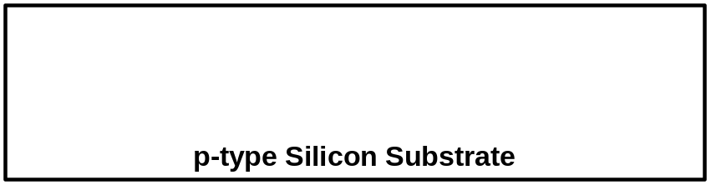
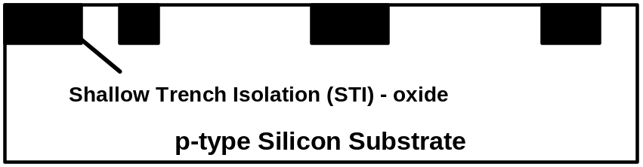
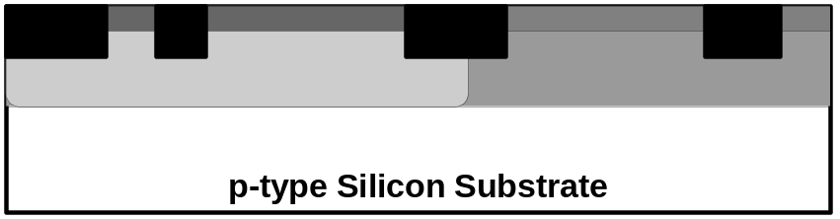
Sub-Micron CMOS Fabrication Process
A series of lithography, etch, and fill steps are used to create silicon mesas isolated by silicon-dioxide
Lithography and implant steps are used to form the NMOS and PMOS wells and the channel/body doping profiles
EE130/230M Spring 2013
Lecture 23, Slide <number>

Slide 11
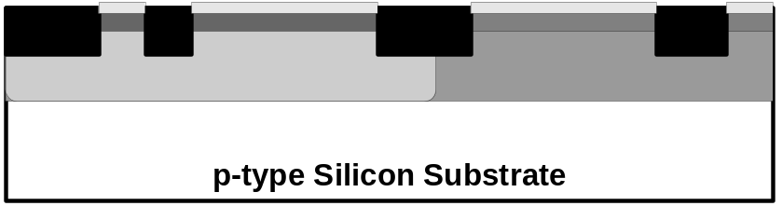
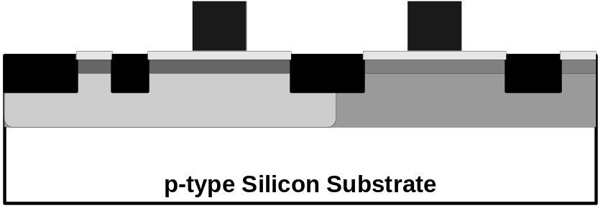
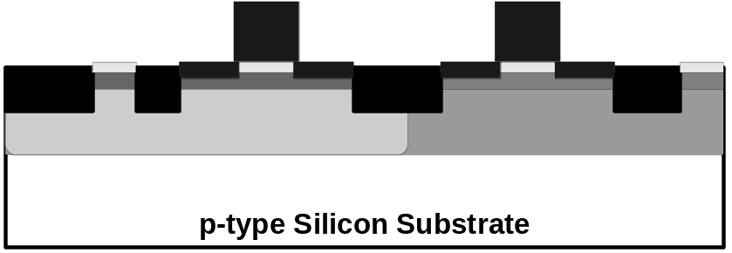
The thin gate dielectric layer is formed
Poly-Si is deposited and patterned to form gate electrodes
Lithography and implantation are used to form NLDD and PLDD regions
EE130/230M Spring 2013
Lecture 23, Slide <number>

Slide 12
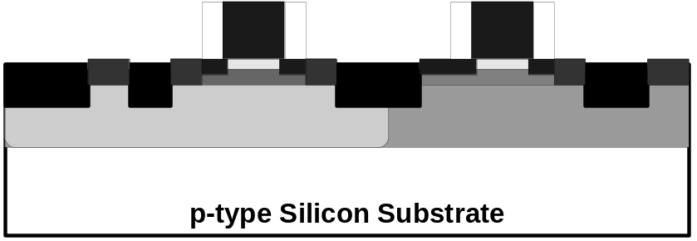
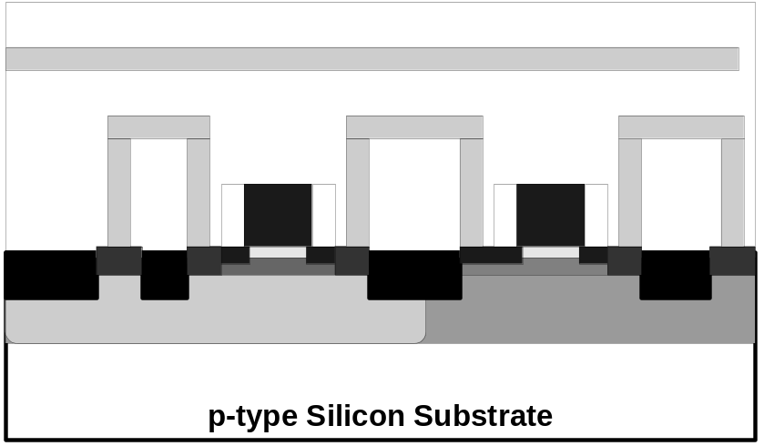
A series of steps is used to form the deep source / drain regions as well as body contacts
A series of steps is used to encapsulate the devices and form metal interconnections between them.
EE130/230M Spring 2013
Lecture 23, Slide <number>

Slide 13
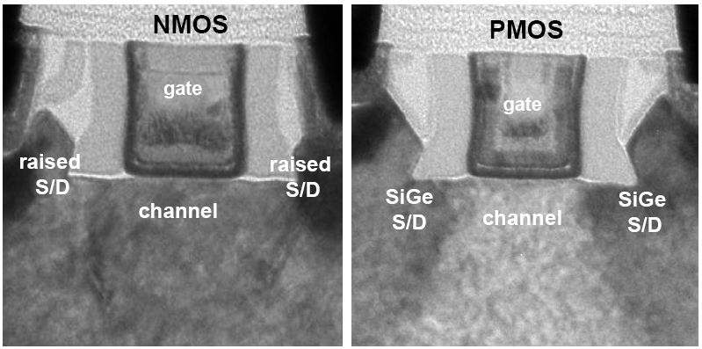
Intel’s 32 nm CMOS Technology
Strained channel regions → μ_{eff}↑
High-k gate dielectric and metal gate electrodes → C_{oxe}↑
Cross-sectional TEM views of Intel’s 32nm CMOS devices
P. Packan et al., IEDM Technical Digest, pp. 659-662, 2009
EE130/230M Spring 2013
Lecture 23, Slide <number>

