Slide 1
Lecture 24
OUTLINE
The Bipolar Junction Transistor
Introduction
BJT Fundamentals
Reading: Pierret 10; Hu 8.1

Slide 2
Introduction
In recent decades, the higher layout density and low-power advantage of CMOS technology has eroded the BJT’s dominance in integrated-circuit products.
  (higher circuit density → better system performance)
BJTs are still preferred in some integrated circuit applications because of their high speed and superior intrinsic gain.
  faster circuit speed
  larger power dissipation
    → limits device density (~10⁴ transistors/chip)
EE130/230M Spring 2013
Lecture 24, Slide <number>

Slide 3
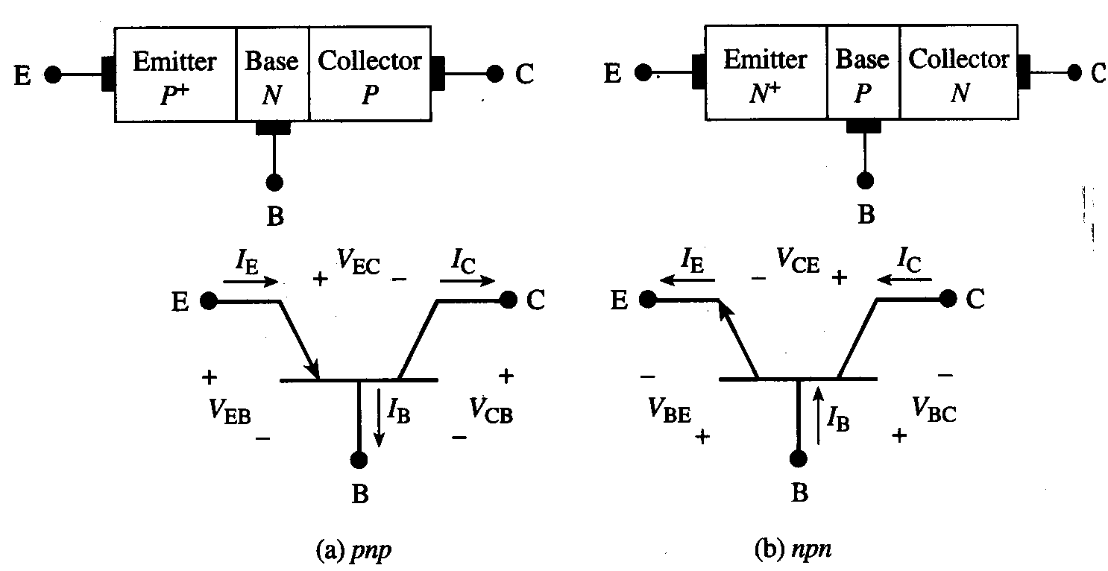
BJT Types and Definitions
The BJT is a 3-terminal device, with two types: PNP and NPN
V_{EB} = V_{E} – V_{B}
V_{CB} = V_{C} – V_{B}
V_{EC} = V_{E} – V_{C}
= V_{EB} - V_{CB}
V_{BE} = V_{B} – V_{E}
V_{BC} = V_{B} – V_{C}
V_{CE} = V_{C} – V_{E}
= V_{CB} - V_{EB}
Note: The current flow sign convention used in the Pierret textbook does not follow IEEE convention (currents defined as positive flowing into a terminal); nevertheless, we will use it.
EE130/230M Spring 2013
Lecture 24, Slide <number>

Slide 4
Review: Current Flow in a
Reverse-Biased pn Junction
In a reverse-biased pn junction, there is negligible diffusion of majority carriers across the junction. The reverse saturation current is due to drift of minority carriers across the junction and depends on the rate of minority-carrier generation close to the junction (within ~one diffusion length of the depletion region).
  We can increase this reverse current by increasing the rate of minority-carrier generation, e.g. by
  optical excitation of carriers (e.g. photodiode)
  electrical injection of minority carriers into the vicinity of the junction…
EE130/230M Spring 2013
Lecture 24, Slide <number>

Slide 5
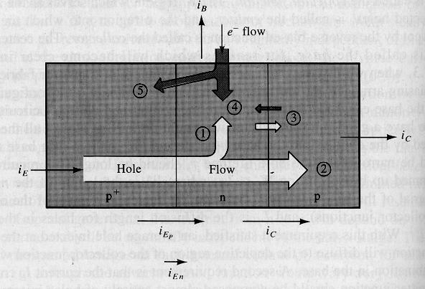
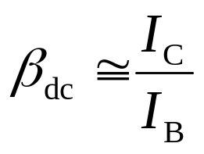
PNP BJT Operation (Qualitative)
A forward-biased “emitter” pn junction is used to inject minority carriers into the vicinity of a reverse-biased “collector” pn junction.
→ The collector current is controlled via the base-emitter junction.
“Active mode”:
V_{EB} > 0
V_{CB} < 0
I_{Cn}
“Emitter”
“Collector”
“Base”
I_{Cp}
current gain
EE130/230M Spring 2013
Lecture 24, Slide <number>

Slide 6
BJT Design
To achieve high current gain:
  The injected minority carriers should not recombine within the quasi-neutral base region
  The emitter junction current is comprised almost entirely of carriers injected into the base (rather than carriers injected into the emitter)
EE130/230M Spring 2013
Lecture 24, Slide <number>

Slide 7
Base Current Components
(Active Mode of Operation)
The base current consists of majority carriers supplied for
  Recombination of injected minority carriers in the base
  Injection of carriers into the emitter
  Reverse saturation current in collector junction
    Reduces | I_{B} |
  Recombination in the base-emitter depletion region
EMITTER
BASE
COLLECTOR
p-type
n-type
p-type
EE130/230M Spring 2013
Lecture 24, Slide <number>

Slide 8
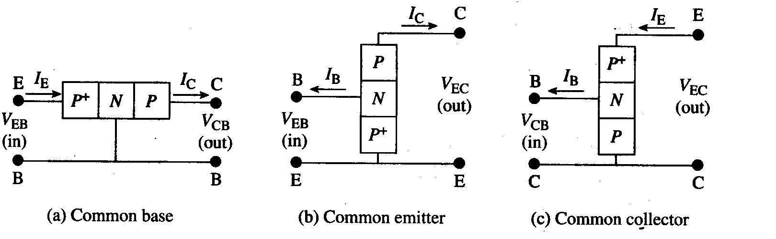
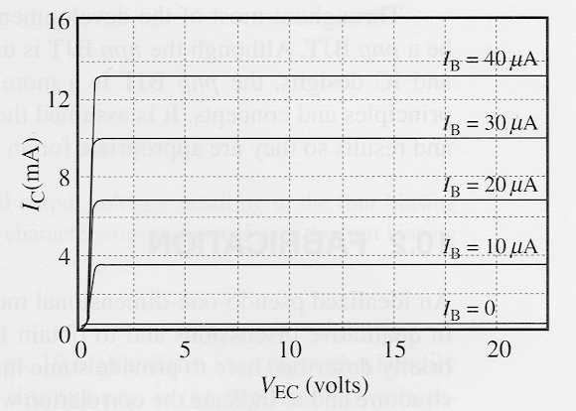
BJT Circuit Configurations
Output Characteristics for Common-Emitter Configuration
EE130/230M Spring 2013
Lecture 24, Slide <number>

Slide 9
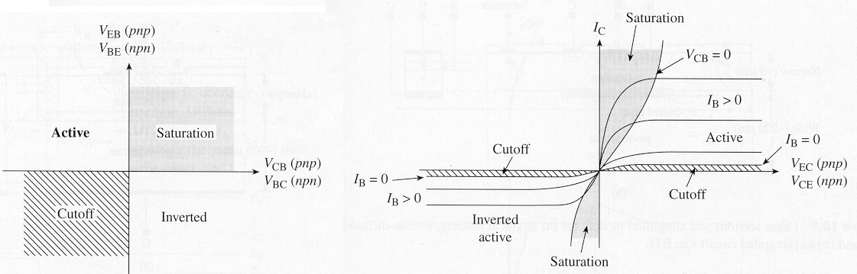
BJT Modes of Operation
Common-emitter output characteristics
(I_{C} vs. V_{CE})
Mode | Emitter Junction | Collector Junction
CUTOFF | reverse bias | reverse bias
Forward ACTIVE | forward bias | reverse bias*
Reverse ACTIVE | reverse bias* | forward bias
SATURATION | forward bias | forward bias
EE130/230M Spring 2013
Lecture 24, Slide <number>
*more precisely: not strongly forward biased

Slide 10
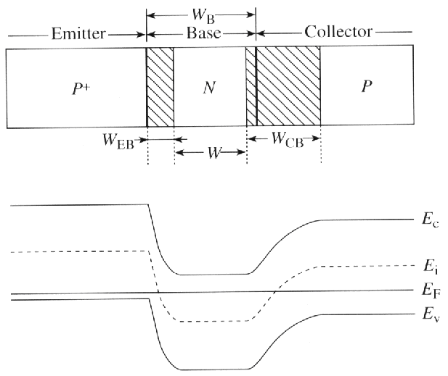
BJT Electrostatics
Under normal operating conditions, the BJT may be viewed electrostatically as two independent pn junctions
EE130/230M Spring 2013
Lecture 24, Slide <number>

Slide 11
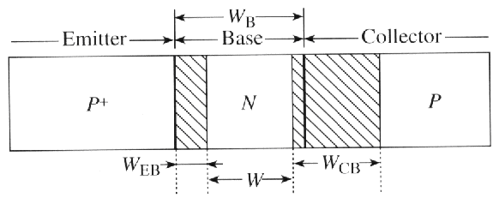
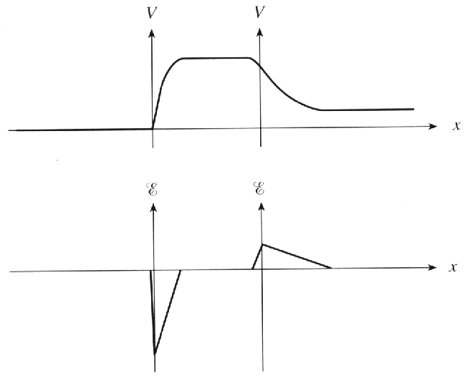
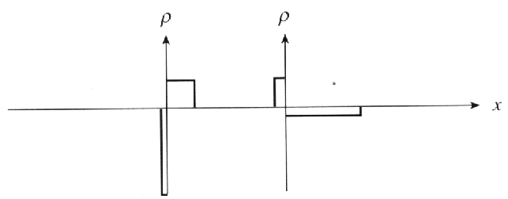
Electrostatic potential, V(x)
Electric field, ε(x)
Charge density, ρ(x)
EE130/230M Spring 2013
Lecture 24, Slide <number>

Slide 12
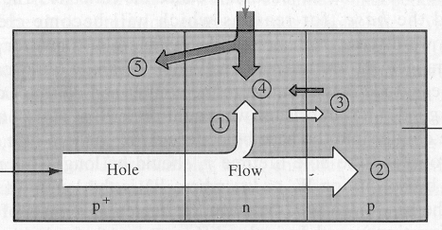
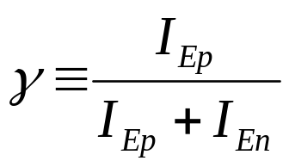
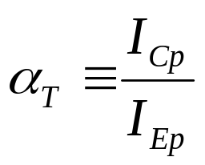
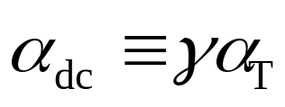
BJT Performance Parameters (PNP)
Emitter Efficiency:
  Decrease (5) relative to (1+2) to increase efficiency
Base Transport Factor:
  Decrease (1) relative to (2) to increase transport factor
Common-Base d.c. Current Gain:
EE130/230M Spring 2013
Lecture 24, Slide <number>

Slide 13
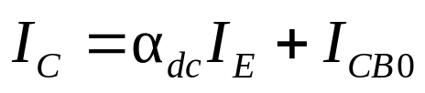
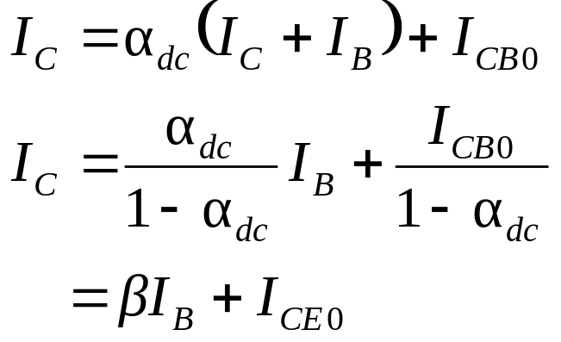
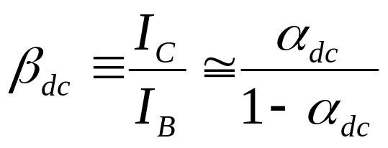
Collector Current (PNP)
The collector current is comprised of
Holes injected from emitter, which do not recombine in the base ← (2)
Reverse saturation current of collector junction ← (3)
  where I_{CB0} is the collector current
  which flows when I_{E} = 0
Common-Emitter d.c. Current Gain:
EE130/230M Spring 2013
Lecture 24, Slide <number>

Slide 14
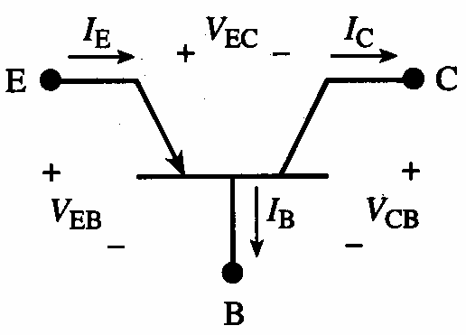
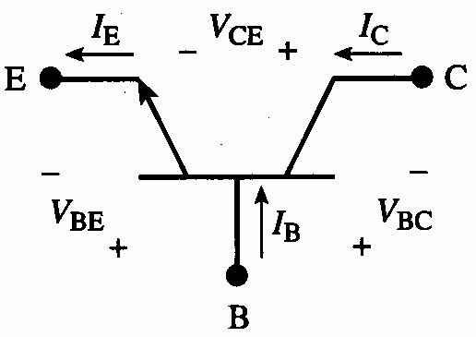
Summary: BJT Fundamentals
Notation & conventions:
Electrostatics:
  Under normal operating conditions, the BJT may be viewed electrostatically as two independent pn junctions
I_{E} = I_{B} + I_{C}
pnp BJT
npn BJT
EE130/230M Spring 2013
Lecture 24, Slide <number>

Slide 15
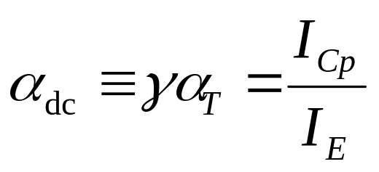
BJT Performance Parameters
Emitter efficiency
Base transport factor
Common base d.c. current gain
Common emitter d.c. current gain
EE130/230M Spring 2013
Lecture 24, Slide <number>

