Slide 1
Lecture 25
OUTLINE
The BJT (cont’d)
Ideal transistor analysis
Narrow base and narrow emitter
Ebers-Moll model
Base-width modulation
Reading: Pierret 11.1-11.2; Hu 8.2-8.6

Slide 2
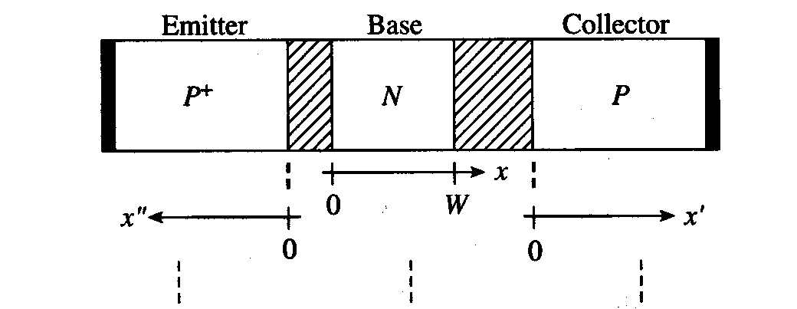
Notation (PNP BJT)
N_{E} ≡ N_{AE}
D_{E} ≡ D_{N}
τ_{E} ≡ τ_{n}
L_{E} ≡ L_{N}
n_{E0} ≡ n_{p0} = n_{i}²/N_{E}
N_{B} ≡ N_{DB}
D_{B} ≡ D_{P}
τ_{B} ≡ τ_{p}
L_{B} ≡ L_{P}
p_{B0} ≡ p_{n0} ≡ n_{i}²/N_{B}
N_{C} ≡ N_{AC}
D_{C} ≡ D_{N}
τ_{C} ≡ τ_{n}
L_{C} ≡ L_{N}
n_{C0} ≡ n_{p0} ≡ n_{i}²/N_{C}
EE130/230M Spring 2013
Lecture 25, Slide <number>

Slide 3
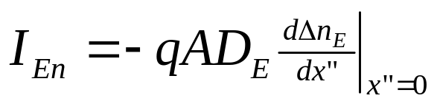
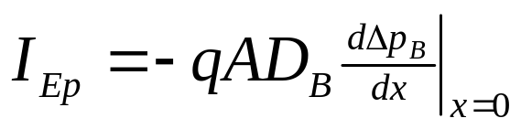
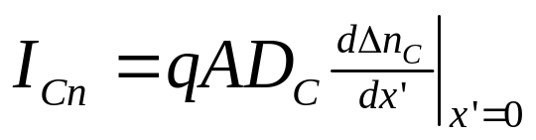
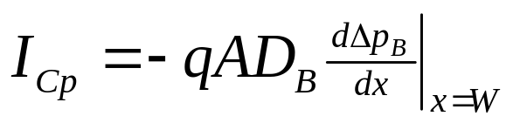
“Game Plan” for I-V Derivation
Solve the minority-carrier diffusion equation in each quasi-neutral region to obtain excess minority-carrier profiles
  different set of boundary conditions for each region
Find minority-carrier diffusion currents at depletion region edges
Add hole & electron components together → terminal currents
EE130/230M Spring 2013
Lecture 25, Slide <number>

Slide 4
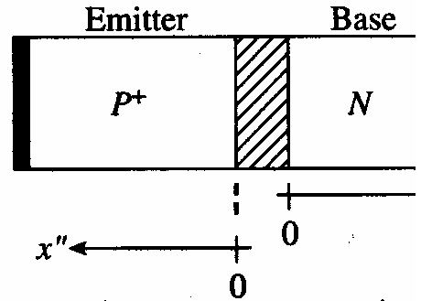
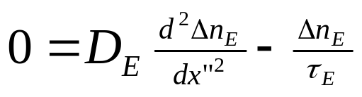
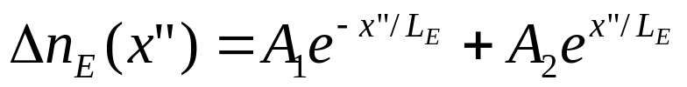
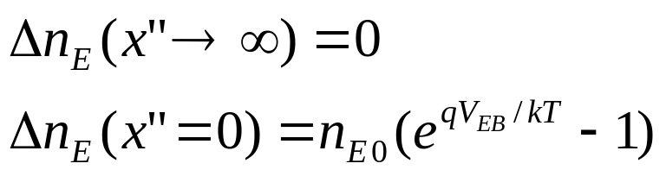
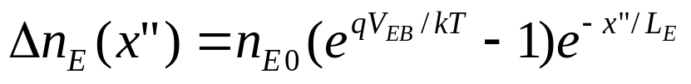
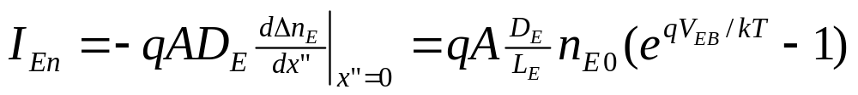
Emitter Region Analysis
Diffusion equation:
General solution:
Boundary conditions:
Solution:
EE130/230M Spring 2013
Lecture 25, Slide <number>

Slide 5
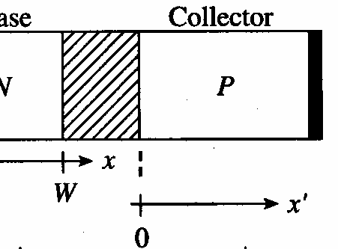
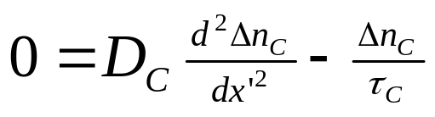
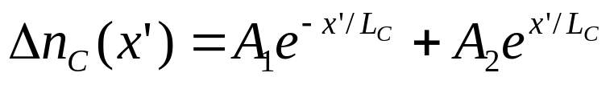
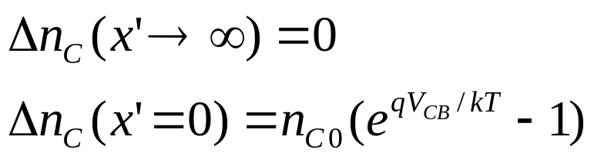
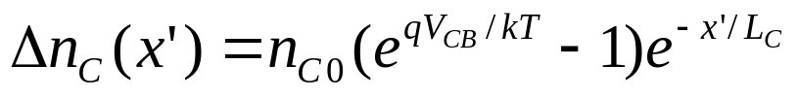
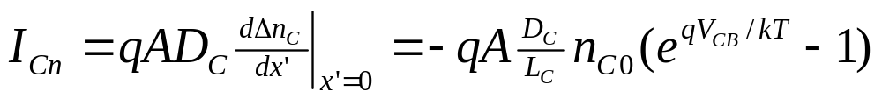
Collector Region Analysis
Diffusion equation:
General solution:
Boundary conditions:
Solution:
EE130/230M Spring 2013
Lecture 25, Slide <number>

Slide 6
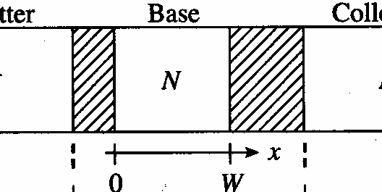
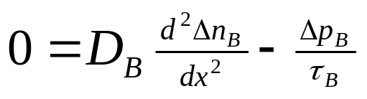
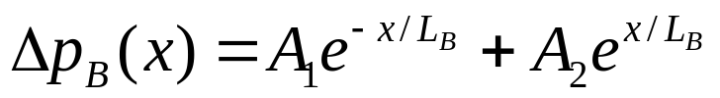
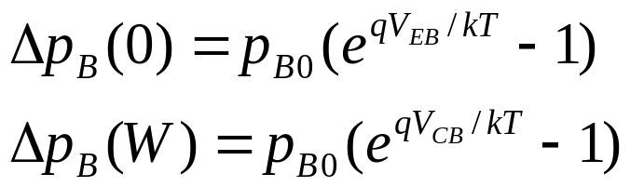
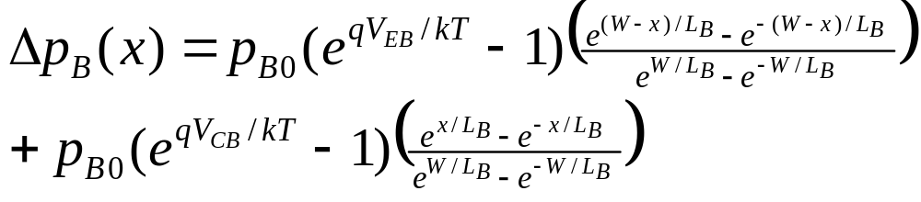
Base Region Analysis
Diffusion equation:
General solution:
Boundary conditions:
Solution:
EE130/230M Spring 2013
Lecture 25, Slide <number>

Slide 7
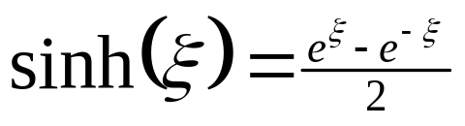
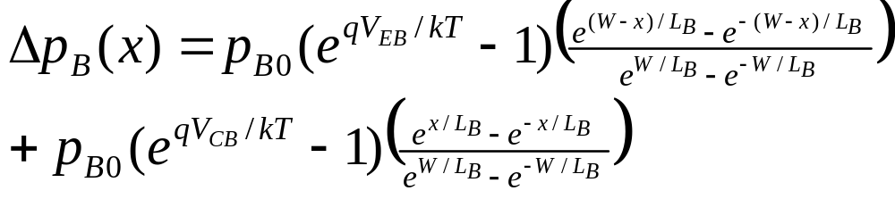
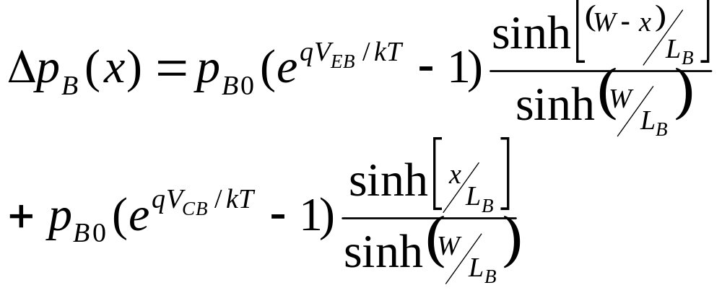
Since
we can write
as
EE130/230M Spring 2013
Lecture 25, Slide <number>

Slide 8
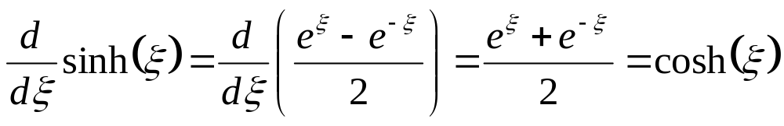
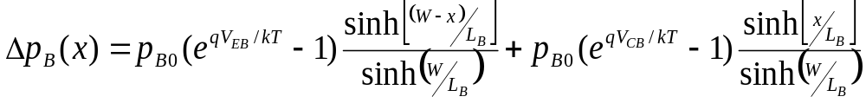
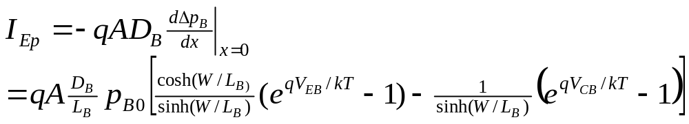
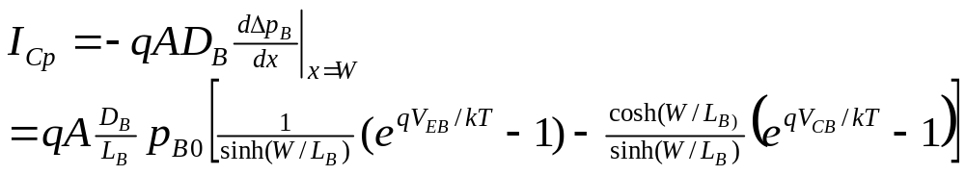
EE130/230M Spring 2013
Lecture 25, Slide <number>

Slide 9
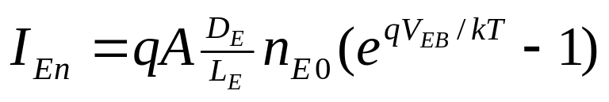
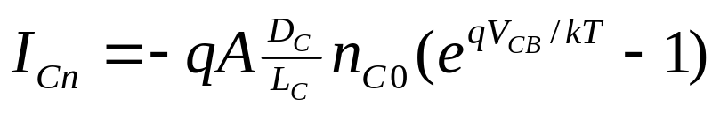
BJT Terminal Currents
We know:
Therefore:
EE130/230M Spring 2013
Lecture 25, Slide <number>

Slide 10
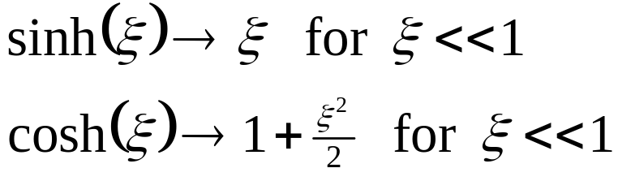
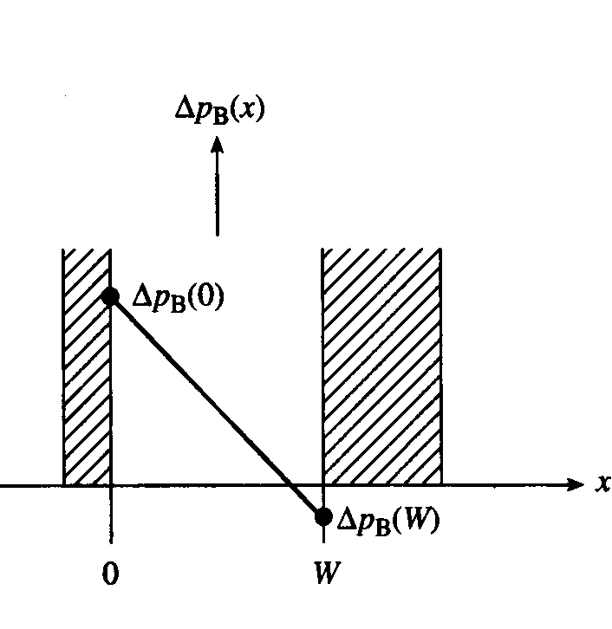
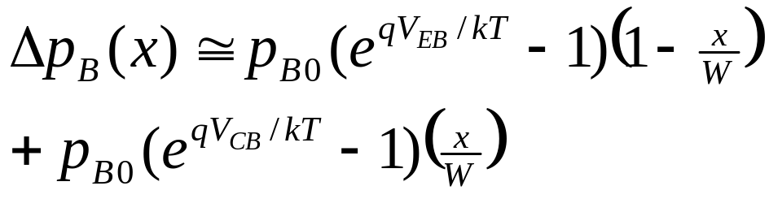
BJT with Narrow Base
In practice, we make W << L_{B} to achieve high current gain. Then, since
we have:
EE130/230M Spring 2013
Lecture 25, Slide <number>

Slide 11
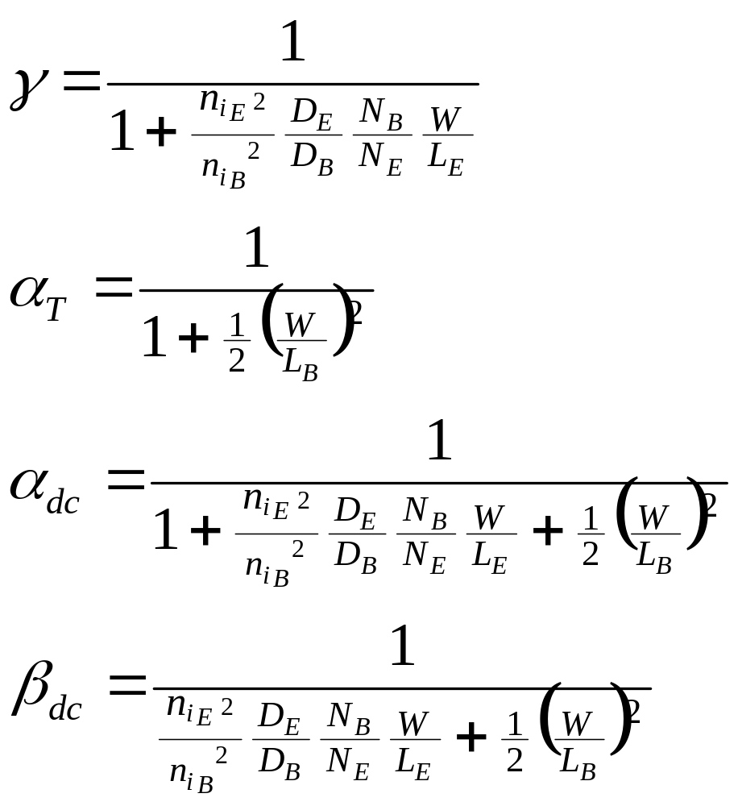
BJT Performance Parameters
Assumptions:
  emitter junction forward biased, collector junction reverse biased
  W << L_{B}
EE130/230M Spring 2013
Lecture 25, Slide <number>

Slide 12
BJT with Narrow Emitter
Replace with W_{E}’ if emitter is narrow
EE130/230M Spring 2013
Lecture 25, Slide <number>

Slide 13
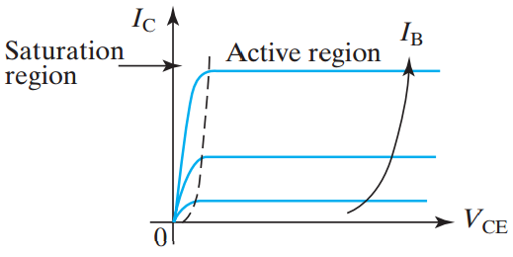
Ebers-Moll Model
increasing
(npn) or V_{EC} (pnp)
The Ebers-Moll model is a large-signal equivalent circuit which describes both the active and saturation regions of BJT operation.
Use this model to calculate I_{B} and I_{C} given V_{BE} and V_{BC}
EE130/230M Spring 2013
Lecture 25, Slide <number>

Slide 14
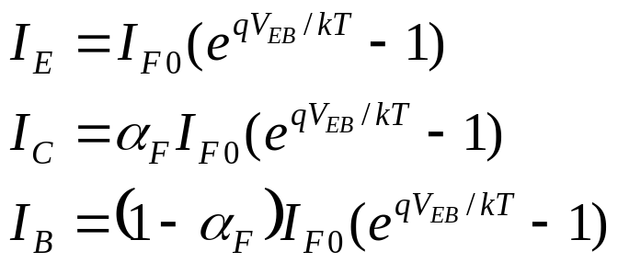
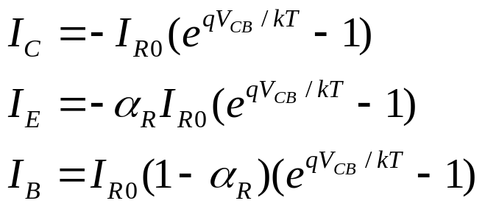
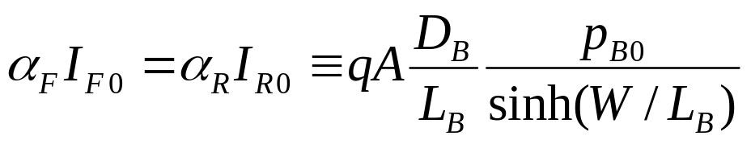
If only V_{EB} is applied (V_{CB} = 0):
V
EB
V
CB
I
B
E
B
C
I
C
a_{R} : reverse common base gain
a_{F} : forward common base gain
If only V_{CB} is applied (V_{EB} = 0): :
Reciprocity relationship:
EE130/230M Spring 2013
Lecture 25, Slide <number>

Slide 15
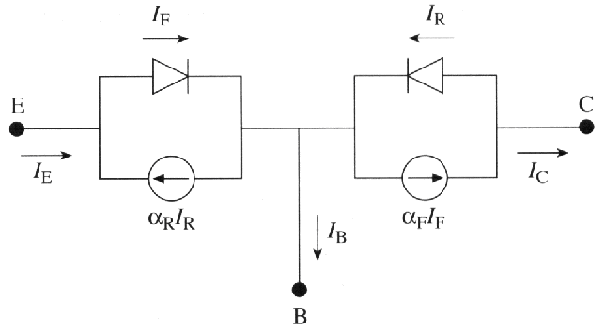
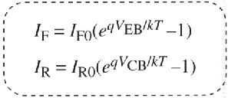
In the general case, both V_{EB} and V_{CB} are non-zero:
I_{C}: C-B diode current + fraction of E-B diode current that makes it to the C-B junction
I_{E}: E-B diode current + fraction of C-B diode current that makes it to the E-B junction
Large-signal equivalent circuit for a pnp BJT
EE130/230M Spring 2013
Lecture 25, Slide <number>

Slide 16
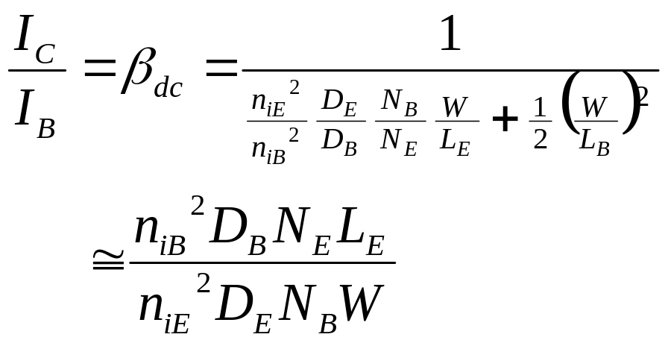

Base-Width Modulation
Common Emitter Configuration, Active Mode Operation
W
I_{E}
P+
N
P
I_{C}
+
−
V_{EB}
Δp_{B}(x)
I_{C}
(V_{CB}=0)
x
V_{EC}
0
W(V_{BC})
EE130/230M Spring 2013
Lecture 25, Slide <number>

Slide 17
Ways to Reduce Base-Width Modulation
Increase the base width, W
Increase the base dopant concentration N_{B}
Decrease the collector dopant concentration N_{C}
Which of the above is the most acceptable action?
EE130/230M Spring 2013
Lecture 25, Slide <number>

Slide 18
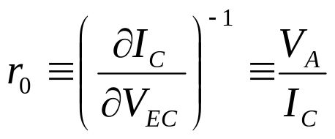
Early Voltage, V_{A}
Output resistance:
A large V_{A} (i.e. a large r_{o} ) is desirable
I_{C}
I_{B3}
I_{B2}
I_{B1}
V_{A}
0
V_{EC}
EE130/230M Spring 2013
Lecture 25, Slide <number>

Slide 19
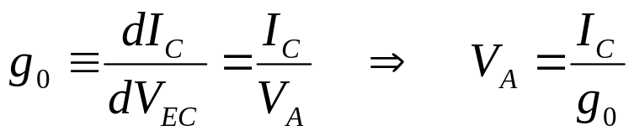
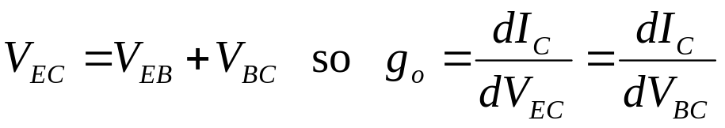
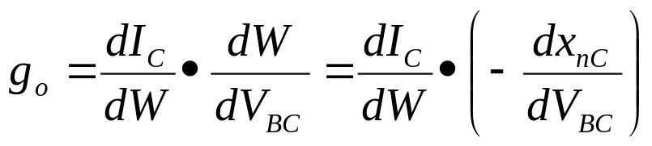
Derivation of Formula for V_{A}
Output conductance:
for fixed V_{EB}
where x_{nC} is the width of the
collector-junction depletion region
on the base side
x_{nC}
P+
N
P
EE130/230M Spring 2013
Lecture 25, Slide <number>

Slide 20
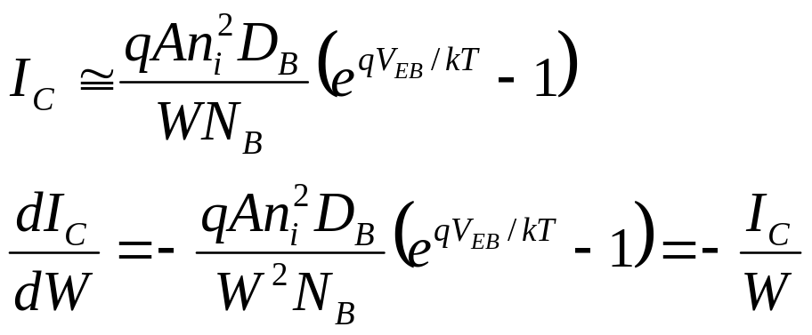
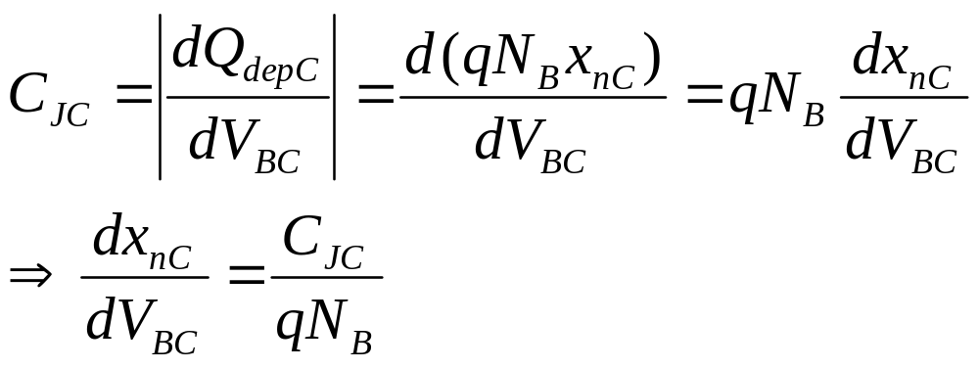
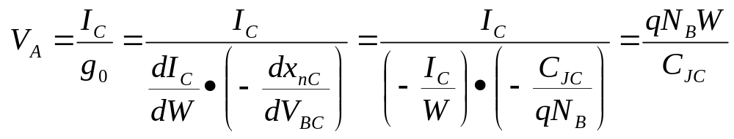
EE130/230M Spring 2013
Lecture 25, Slide <number>

Slide 21
Summary: BJT Performance Requirements
High gain (β_{dc} >> 1)
  One-sided emitter junction, so emitter efficiency γ ≈ 1
    Emitter doped much more heavily than base (N_{E} >> N_{B})
  Narrow base, so base transport factor α_{T} ≈ 1
    Quasi-neutral base width << minority-carrier diffusion length (W << L_{B})
I_{C} determined only by I_{B} (I_{C} ≠ function of V_{CE},V_{CB})
  One-sided collector junction, so quasi-neutral base width W does not change drastically with changes in V_{CE} (V_{CB})
    Based doped more heavily than collector (N_{B} > N_{C})
        (W = W_{B} – x_{nEB} – x_{nCB} for PNP BJT)
EE130/230M Spring 2013
Lecture 25, Slide <number>

