Slide 1
Lecture 26
OUTLINE
The BJT (cont’d)
Breakdown mechanisms
Non-ideal effects
Gummel plot & Gummel numbers
Modern BJT structures
Base transit time
Reading: Pierret 11.2-11.3, 12.2.2; Hu 8.4,8.7

Slide 2
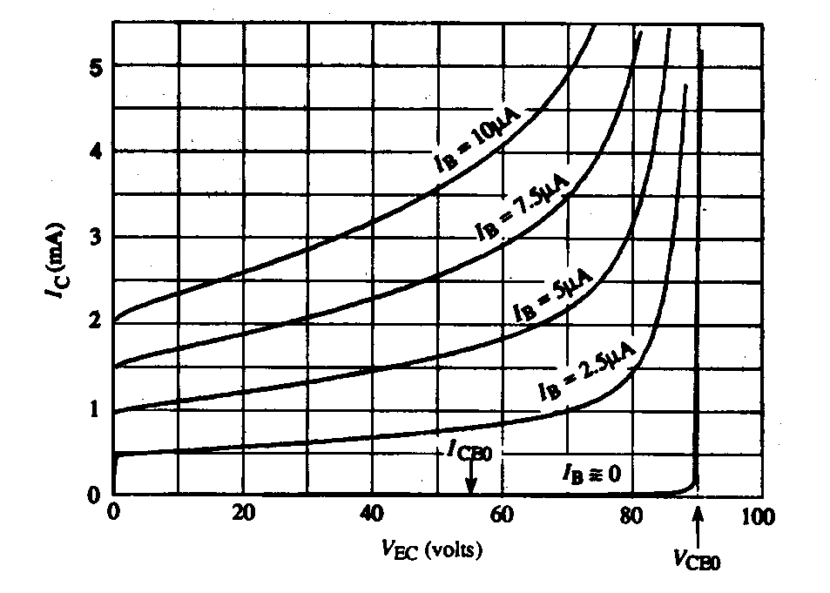
BJT Breakdown Mechanisms
In the common-emitter configuration, for high output voltage V_{EC}, the output current I_{C} will increase rapidly due to one of two mechanisms:
  punch-through
  avalanche
EE130/230M Spring 2013
Lecture 26, Slide <number>

Slide 3
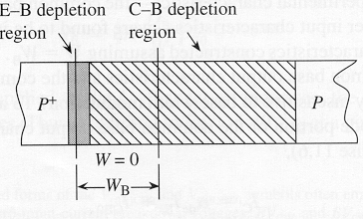
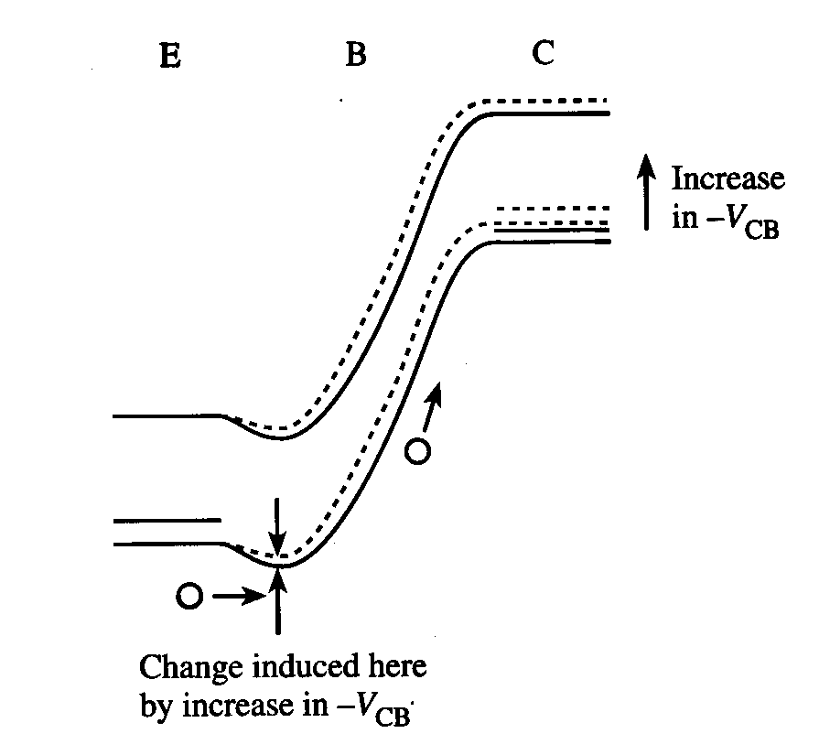
Punch-Through
E-B and E-B depletion regions in the base touch → W = 0
As |V_{CB}| increases, the potential barrier to hole injection decreases and therefore I_{C} increases
EE130/230M Spring 2013
Lecture 26, Slide <number>

Slide 4
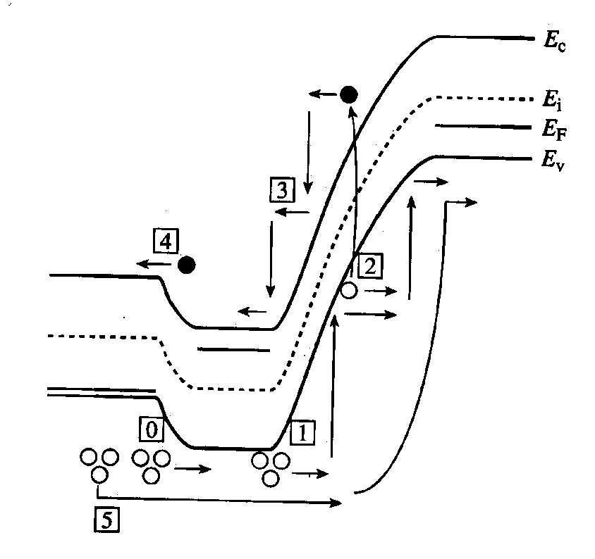
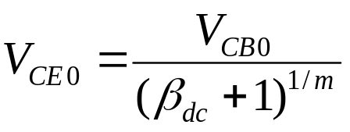

Avalanche Multiplication
Holes are injected into the base [0], then collected by the B-C junction
  Some holes in the B-C depletion region have enough energy to generate EHP [1]
Generated electrons are swept into the base [3], then injected into emitter [4]
  Each injected electron results in the injection of I_{Ep}/I_{En} holes from the emitter into the base [0]
PNP BJT:
For each EHP created in the C-B depletion region by impact ionization,
(I_{Ep}/I_{En})+1 > β_{dc} additional holes flow into the collector
i.e. carrier multiplication in the C-B depletion region is internally amplified
where V_{CB0} = reverse breakdown voltage of the C-B junction
EE130/230M Spring 2013
Lecture 26, Slide <number>

Slide 5
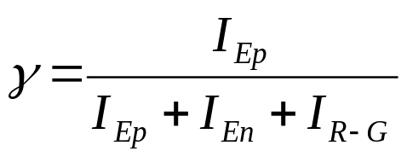
Non-Ideal Effects at Low V_{EB}
In the ideal transistor analysis, thermal R-G currents in the emitter and collector junctions were neglected.
Under active-mode operation with small V_{EB}, the thermal recombination current is likely to be a dominant component of the base current
low emitter efficiency, hence lower gain
  This limits the application of the BJT for amplification
  at low voltages.
EE130/230M Spring 2013
Lecture 26, Slide <number>

Slide 6
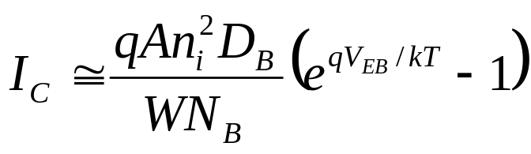
Non-Ideal Effects at High V_{EB}
Decrease in β_{dc} at high I_{C} is caused by:
  high-level injection
  series resistance
  current crowding
EE130/230M Spring 2013
Lecture 26, Slide <number>

Slide 7
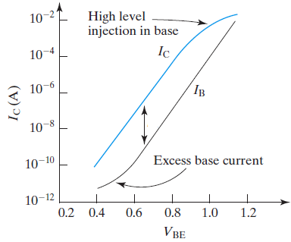
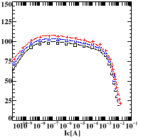
Gummel Plot and β_{dc} vs. I_{C}
β_{dc}
β_{dc}
From top to bottom:
V_{BC} = 2V, 1V, 0V
EE130/230M Spring 2013
Lecture 26, Slide <number>

Slide 8
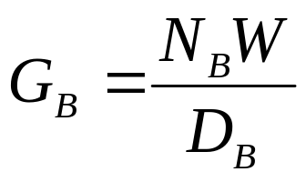
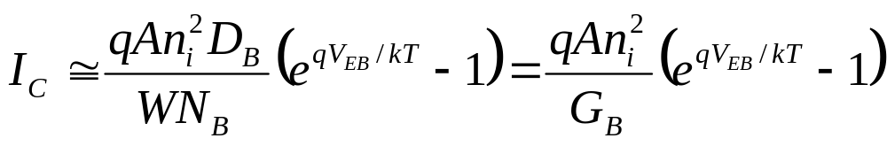
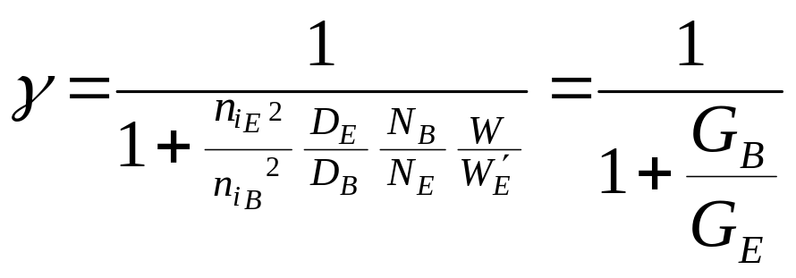
Gummel Numbers
For a uniformly doped base with negligible band-gap narrowing, the base Gummel number is
(total integrated “dose” (#/cm²) of majority carriers in the base, divided by D_{B})
Emitter efficiency
G_{E} is the emitter Gummel number
EE130/230M Spring 2013
Lecture 26, Slide <number>

Slide 9
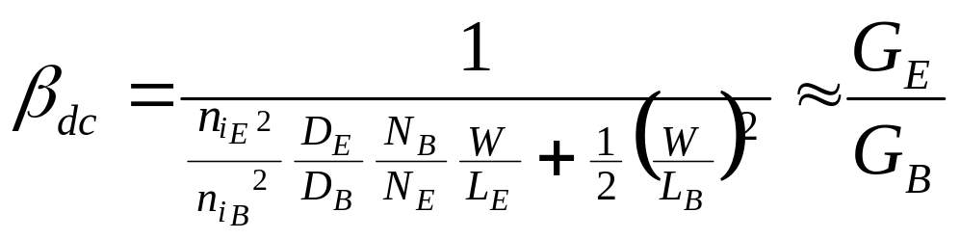
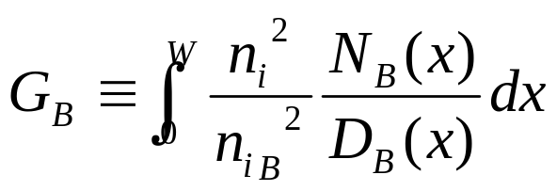

Notice that
In practice, N_{B} and N_{E} are not uniform, i.e. they are functions of x
The more general formulas for the Gummel numbers are
EE130/230M Spring 2013
Lecture 26, Slide <number>

Slide 10
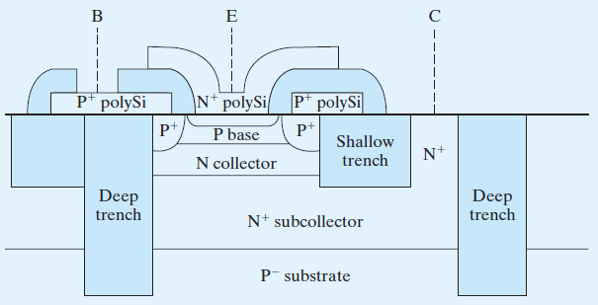
Modern BJT Structure
Features:
Narrow base
n+ poly-Si emitter
Self-aligned p+ poly-Si base contacts
Lightly-doped collector
Heavily-doped epitaxial subcollector
Shallow trenches and deep trenches filled with SiO₂ for electrical isolation
EE130/230M Spring 2013
Lecture 26, Slide <number>

Slide 11
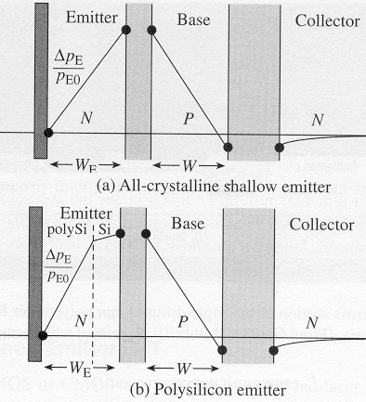
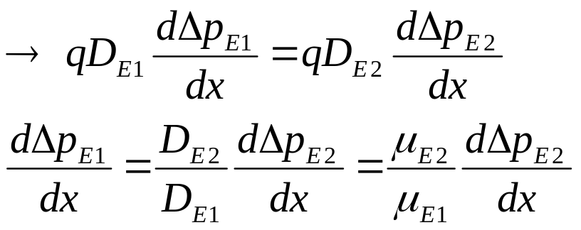
Poly-Si Emitter
β_{dc} is larger for a poly-Si emitter BJT as compared with an all-crystalline emitter BJT, due to reduced dp_{E}(x)/dx at the edge of the emitter depletion region
Continuity of hole current in emitter:
(1→poly-Si; 2→crystalline Si)
EE130/230M Spring 2013
Lecture 26, Slide <number>

Slide 12
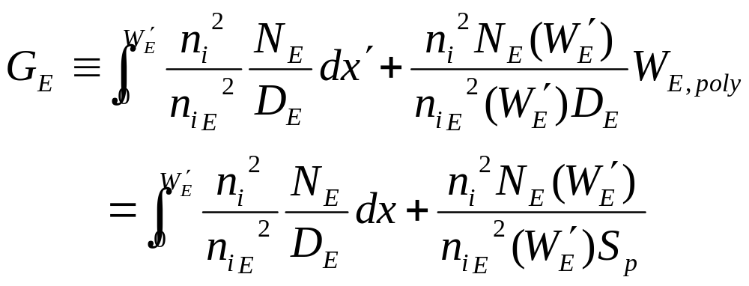
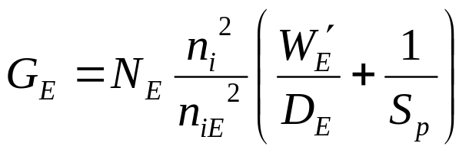
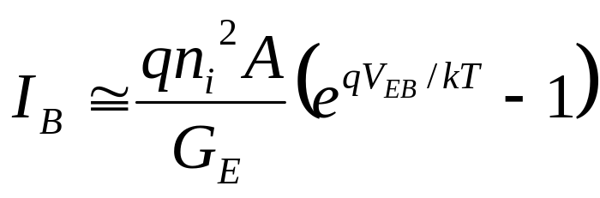
Emitter Gummel Number w/ Poly-Si Emitter
where S_{p} ≡ D_{Epoly}/W_{Epoly} is the surface recombination velocity
For a uniformly doped emitter,
EE130/230M Spring 2013
Lecture 26, Slide <number>

Slide 13
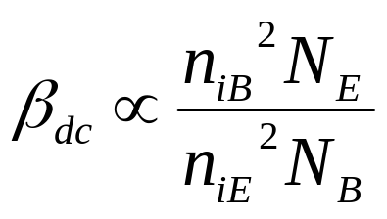
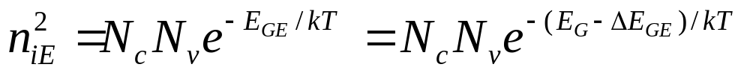
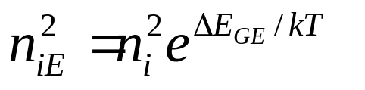
Emitter Band Gap Narrowing
To achieve large β_{dc}, N_{E} is typically very large, so that band gap narrowing is significant (ref. Lecture 3, Slide 20).
ΔE_{GE} is negligible for N_{E} < 1E18/cm³
N = 10¹⁸ cm⁻³: ΔE_{G} = 35 meV
N = 10¹⁹ cm⁻³: ΔE_{G} = 75 meV
EE130/230M Spring 2013
Lecture 26, Slide <number>

Slide 14
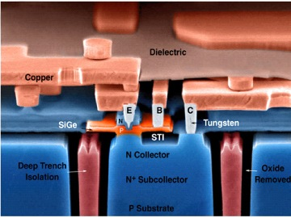
Narrow Band Gap (Si_{1-x}Ge_{x}) Base
To improve β_{dc}, we can increase n_{iB} by using a base material (Si_{1-x}Ge_{x}) that has a smaller band gap
  for x = 0.2, ΔE_{GB} is 0.1 eV
This allows a large β_{dc} to be achieved with large N_{B} (even >N_{E}), which is advantageous for
  reducing base resistance
  increasing Early voltage (V_{A})
courtesy of J.D. Cressler (GATech)
EE130/230M Spring 2013
Lecture 26, Slide <number>

Slide 15
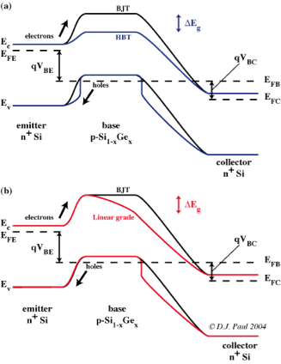
Heterojunction Bipolar Transistors
Uniform Ge concentration in base
Linearly graded Ge concentration in base
→ built-in E-field
EE130/230M Spring 2013
Lecture 26, Slide <number>

Slide 16

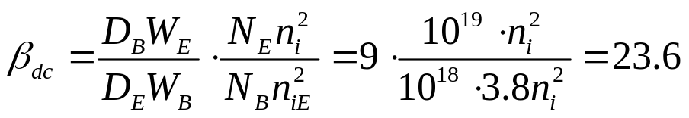

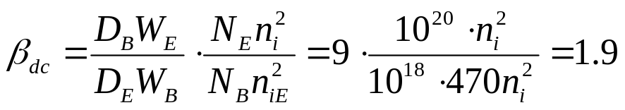


Example: Emitter Band Gap Narrowing
If D_{B} = 3D_{E} , W_{E} = 3W_{B} , N_{B} = 10¹⁸ cm⁻³, and n_{iB}² = n_{i}², find β_{dc} for
(a) N_{E} = 10¹⁹ cm⁻³,
(b) N_{E} = 10²⁰ cm⁻³, and
(c) N_{E} = 10¹⁹ cm⁻³ and a Si_{1-x}Ge_{x} base with ΔE_{GB} = 60 meV
(a) For N_{E} = 10¹⁹ cm⁻³, ΔE_{GE} ≈ 35 meV
(b) For N_{E} = 10²⁰cm⁻³, ΔE_{gE} ≈ 160 meV:
(c)
EE130/230M Spring 2013
Lecture 26, Slide <number>

Slide 17
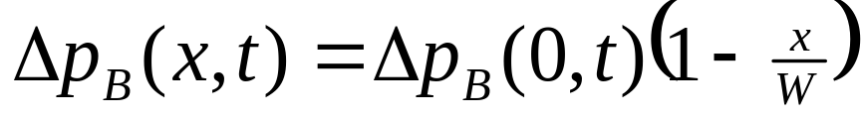
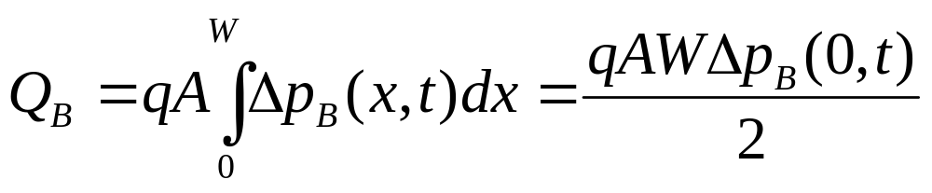
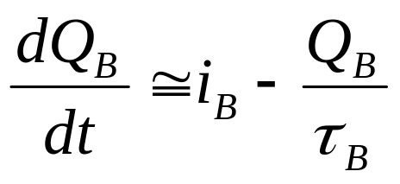
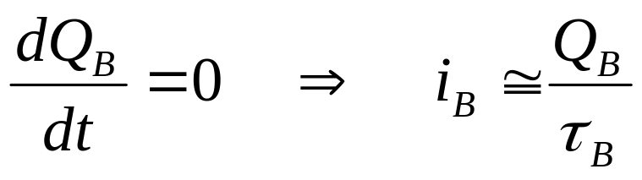
Charge Control Model
A PNP BJT biased in the forward-active mode has excess
minority-carrier charge Q_{B} stored in the quasi-neutral base:
In steady state,
EE130/230M Spring 2013
Lecture 26, Slide <number>

Slide 18
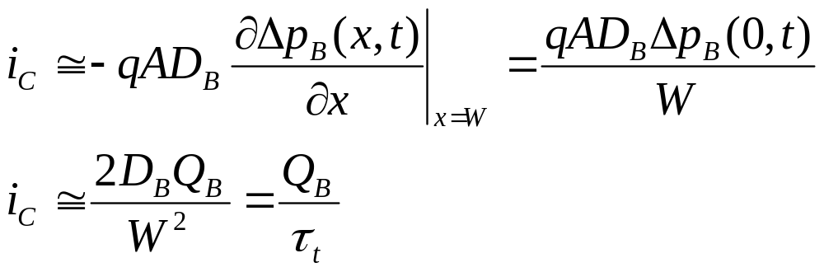
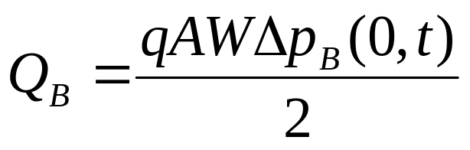
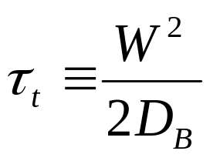
Base Transit Time, τ_{t}
time required for minority carriers to diffuse across the base
sets the switching speed limit of the transistor
EE130/230M Spring 2013
Lecture 26, Slide <number>

Slide 19
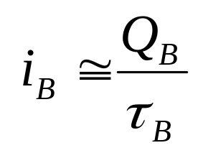
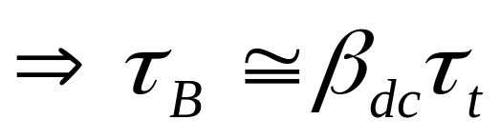
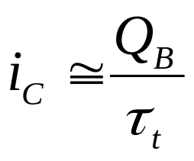
Relationship between τ_{B} and τ_{t}
The time required for one minority carrier to recombine in the base is much longer than the time it takes for a minority carrier to cross the quasi-neutral base region.
EE130/230M Spring 2013
Lecture 26, Slide <number>

Slide 20
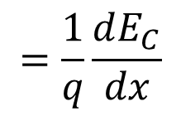
Built-in Base E-Field to Reduceτ_{t}
The base transit time can be reduced by building into the base an electric field that aids the flow of minority carriers.
1. Fixed E_{GB} , N_{B} decreases from emitter to collector:
E
-
B
C
E_{c}
E_{f}
E_{v}
2. Fixed N_{B} , E_{GB} decreases from emitter to collector:
E
-
B
C
E_{c}
E_{f}
E
E_{v}
EE130/230M Spring 2013
Lecture 26, Slide <number>

Slide 21
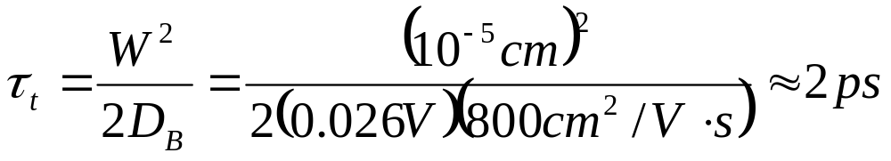
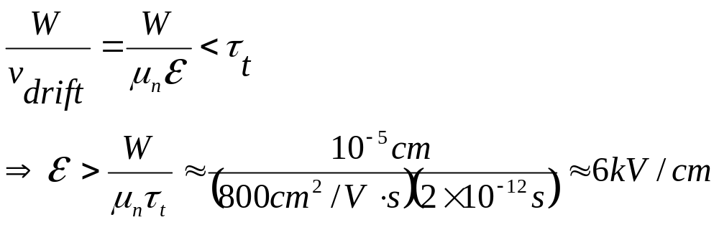
EXAMPLE: Drift Transistor
Given an npn BJT with W=0.1μm and N_{B}=10¹⁷cm⁻³ (μ_{n}=800cm²/V⋅s), find τ_{t} and estimate the base electric field required to reduce τ_{t}
EE130/230M Spring 2013
Lecture 26, Slide <number>

