Slide 1
Lecture 27
OUTLINE
The BJT (cont’d)
Small-signal model
Cutoff frequency
Transient (switching) response
Reading: Pierret 12; Hu 8.8-8.9

Slide 2
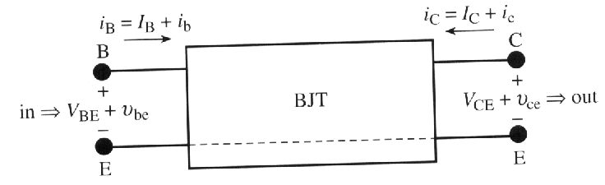
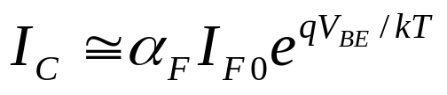

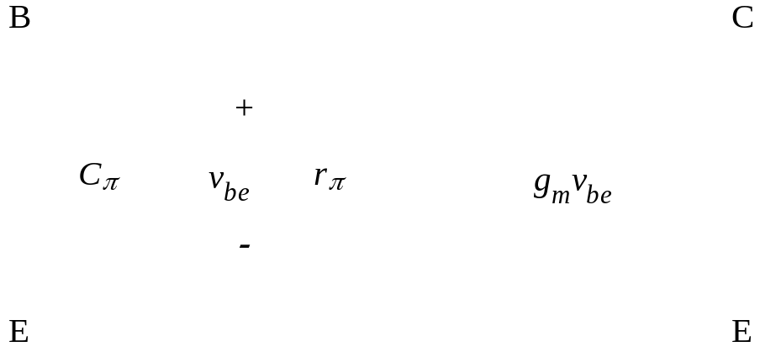
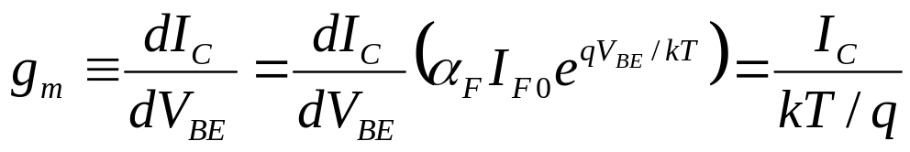
Small-Signal Model
Common-emitter configuration,
forward-active mode:
“hybrid pi”
BJT small signal model:
Transconductance:
EE130/230M Spring 2013
Lecture 27, Slide <number>

Slide 3
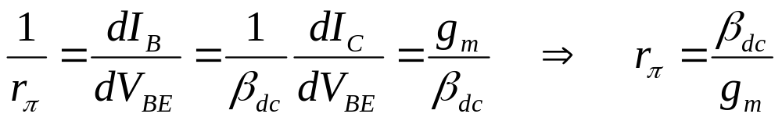
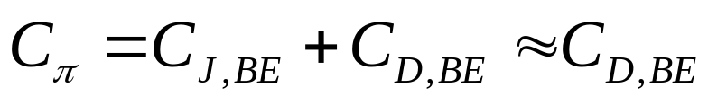
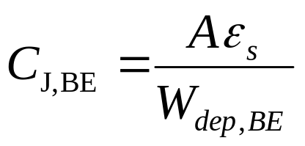
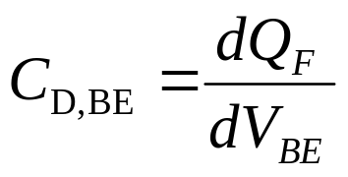
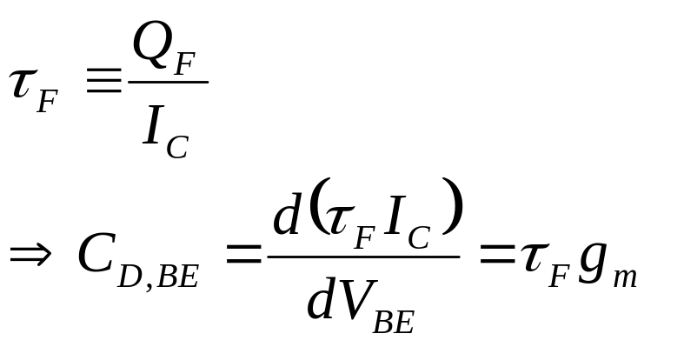
Small-Signal Model (cont.)
where Q_{F} is the magnitude of minority-carrier charge stored in the base and emitter regions
forward transit time
EE130/230M Spring 2013
Lecture 27, Slide <number>

Slide 4
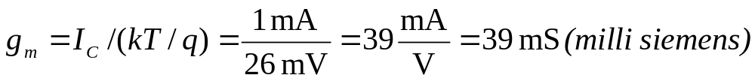
Example
A BJT is biased at I_{C} = 1 mA and V_{CE} = 3V. β_{dc} = 90, τ_{F} = 5ps, T = 300K.
Find (a) g_{m} , (b) r_{π} , (c) C_{π} .
Solution:
(a)
(b) r_{π} = β_{dc} / g_{m} = 90/0.039 = 2.3 kΩ
(c)
EE130/230M Spring 2013
Lecture 27, Slide <number>

Slide 5
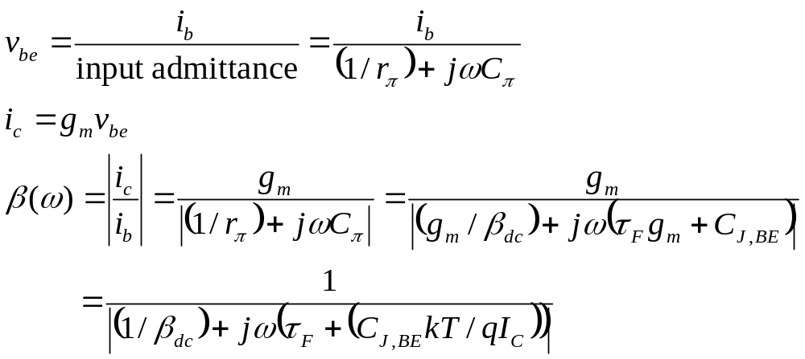
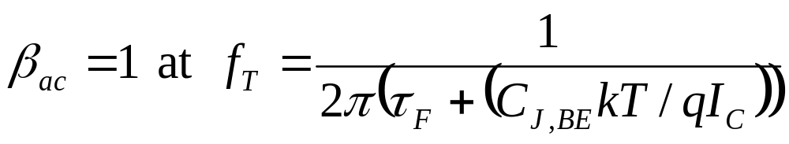
Cutoff Frequency, f_{T}
The cutoff frequency is defined to be the frequency (f = ω/2π) at which the short-circuit a.c. current gain equals 1:
EE130/230M Spring 2013
Lecture 27, Slide <number>

Slide 6
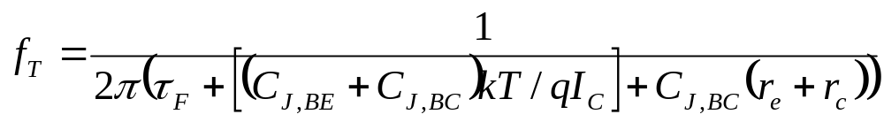
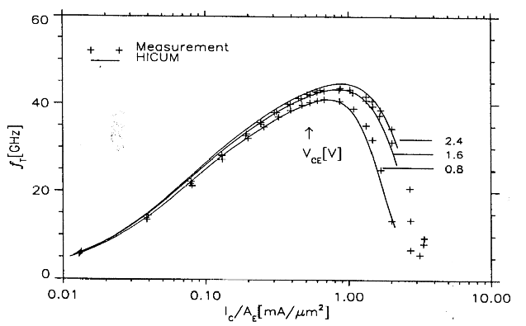
For the full BJT equivalent circuit:
f_{T} is commonly used
as a metric for the
speed of a BJT.
Si/SiGe HBT by IBM
To maximize f_{T}:
increase I_{C}
minimize C_{J,BE}, C_{J,BC}
minimize r_{e}, r_{c}
minimize τ_{F}
EE130/230M Spring 2013
Lecture 27, Slide <number>

Slide 7
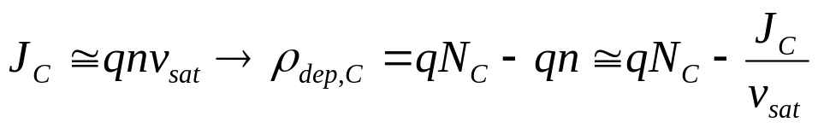
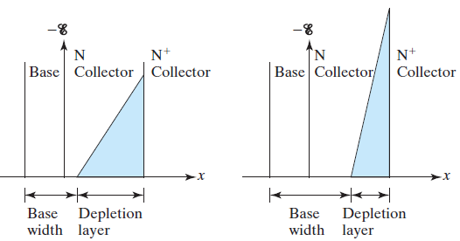
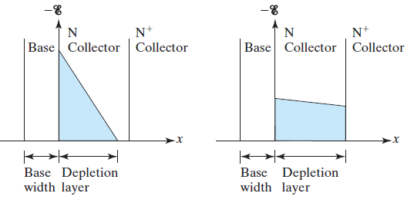
Base Widening at High I_{C}: Kirk Effect
For a NPN BJT:
At very high current densities (>0.5mA/μm²), the density of mobile charge passing through the collector depletion region exceeds the ionized dopant charge density:
increasing I_{C}
→ The base width (W) is effectively increased (referred to as “base push out”)
→ τ_{F} increases and hence f_{T} decreases.
This effect can be avoided by increasing N_{C} → increased C_{J,BC} , decreased V_{CE0}
EE130/230M Spring 2013
Lecture 27, Slide <number>

Slide 8
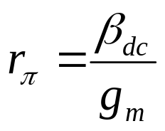
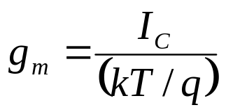
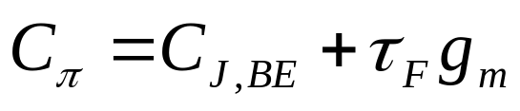
Summary: BJT Small Signal Model
Hybrid pi model for the common-emitter configuration, forward-active mode:
EE130/230M Spring 2013
Lecture 27, Slide <number>

Slide 9
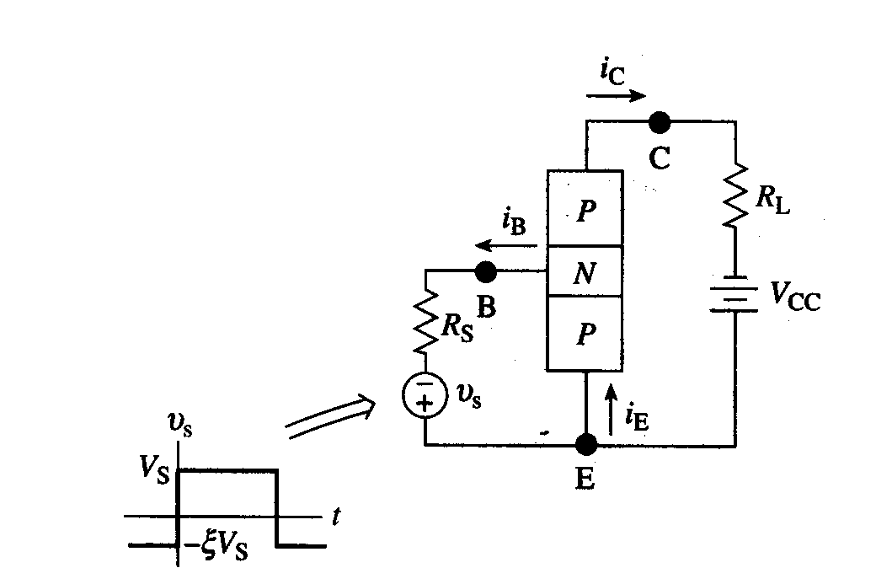
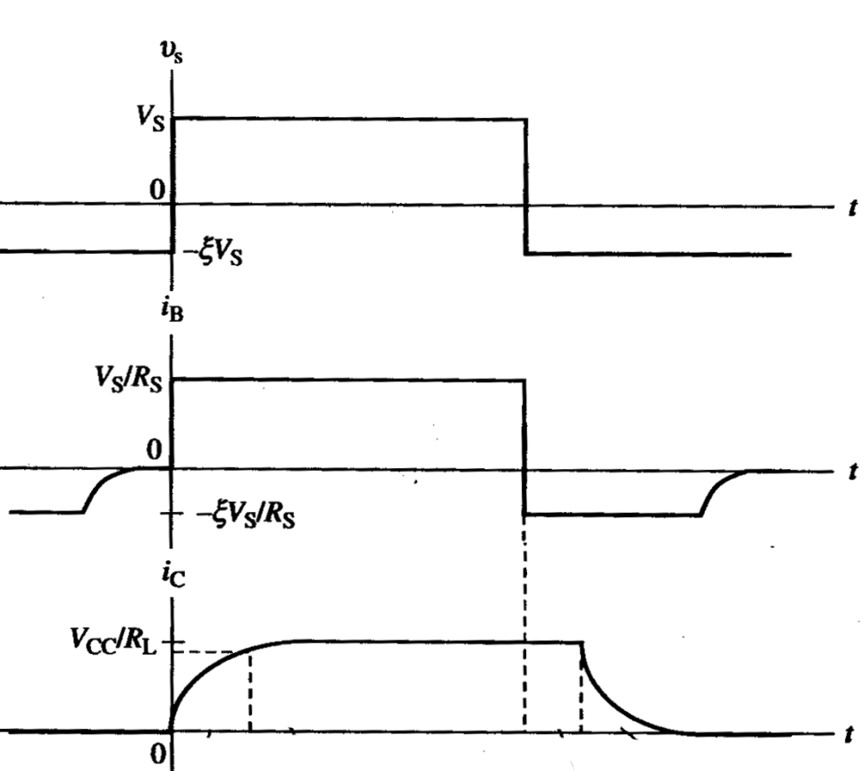
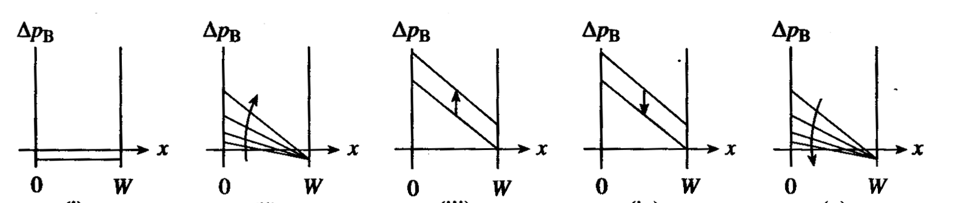
BJT Switching - Qualitative
EE130/230M Spring 2013
Lecture 27, Slide <number>

Slide 10
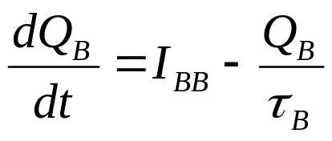
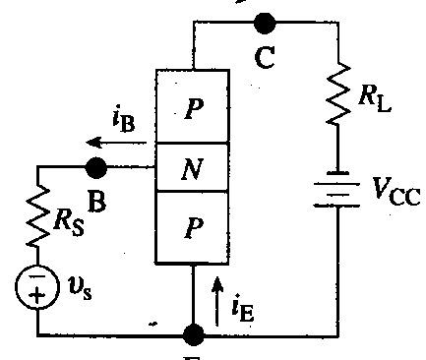
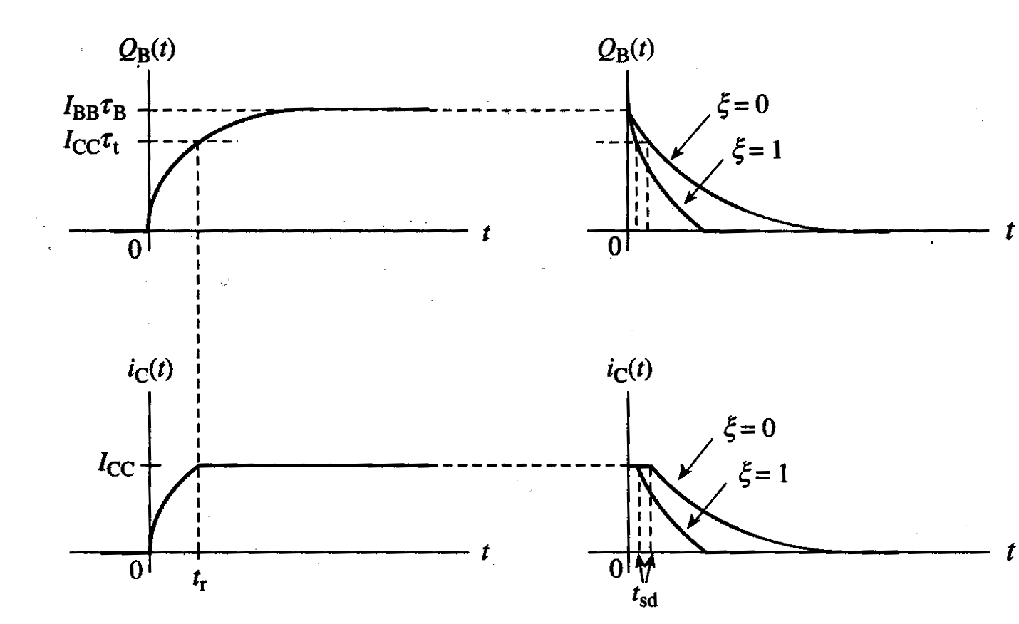
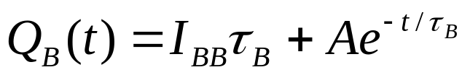
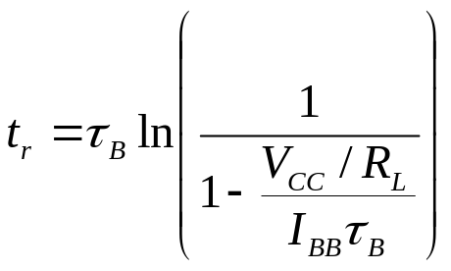
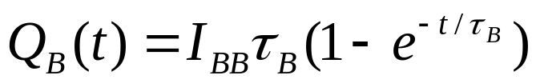
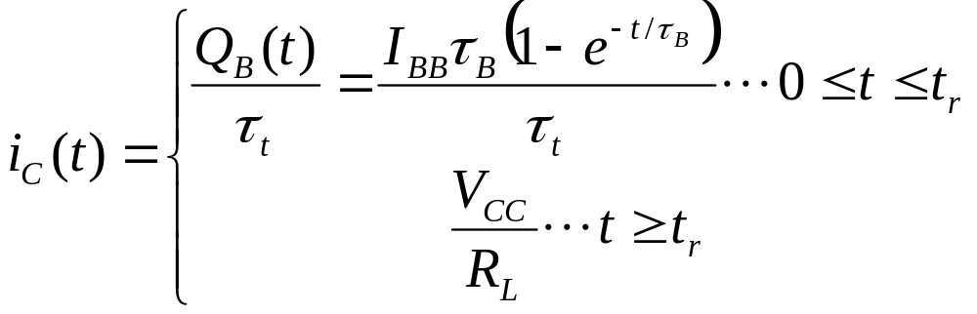
Turn-on Transient Response
The general solution is:
Initial condition: Q_{B}(0)=0
since transistor is in cutoff
where I_{BB}=V_{S}/R_{S}
EE130/230M Spring 2013
Lecture 27, Slide <number>

Slide 11
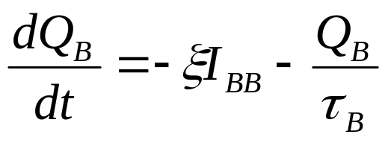
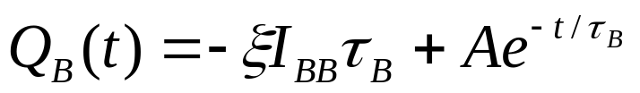
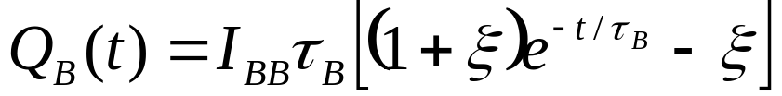
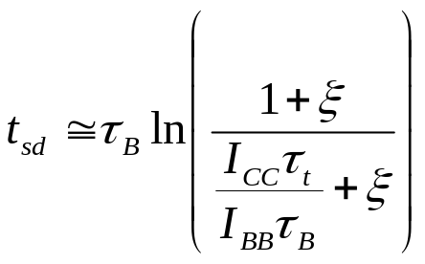
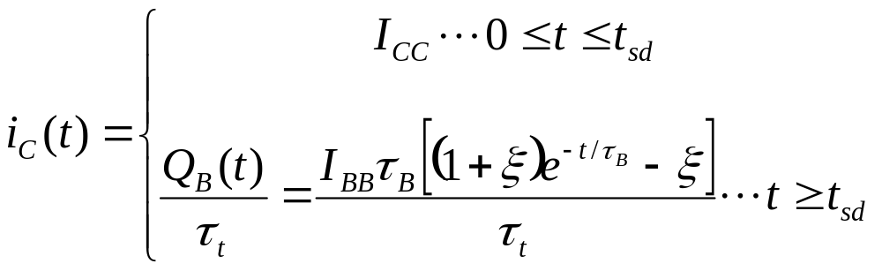
Turn-off Transient Response
The general solution is:
Initial condition: Q_{B}(0)=I_{BB}τ_{B}
EE130/230M Spring 2013
Lecture 27, Slide <number>

Slide 12
Reducing τ_{B} for Faster Turn-Off
The speed at which a BJT is turned off is dependent on the amount of excess minority-carrier charge stored in the base, Q_{B}, and also the recombination lifetime, τ_{B}.
  By reducing τ_{B}, the carrier removal rate is increased
  Example: Add recombination centers (Au atoms) in the base
EE130/230M Spring 2013
Lecture 27, Slide <number>

Slide 13
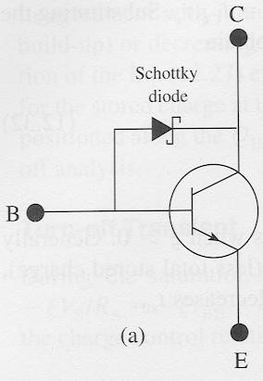
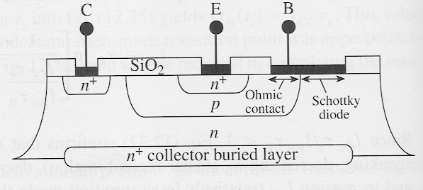
Schottky-Clamped BJT
When the BJT enters the saturation mode, the Schottky diode begins to conduct and “clamps” the C-B junction voltage at a relatively low positive value.
  → reduced stored charge in quasi-neutral base
EE130/230M Spring 2013
Lecture 27, Slide <number>

