Slide 1
Lecture 3
OUTLINE
Semiconductor Fundamentals (cont’d)
  Thermal equilibrium
  Fermi-Dirac distribution
    Boltzmann approximation
  Relationship between E_{F} and n, p
  Degenerately doped semiconductor
Reading: Pierret 2.4-2.5; Hu 1.7-1.10

Slide 2
Thermal Equilibrium
No external forces are applied:
  electric field = 0, magnetic field = 0
  mechanical stress = 0
  no light
Dynamic situation in which every process is balanced by its inverse process
  Electron-hole pair (EHP) generation rate = EHP recombination rate
Thermal agitation → electrons and holes exchange energy with the crystal lattice and each other
  → Every energy state in the conduction band and valence band has a certain probability of being occupied by an electron
EE130/230M Spring 2013
Lecture 3, Slide <number>

Slide 3
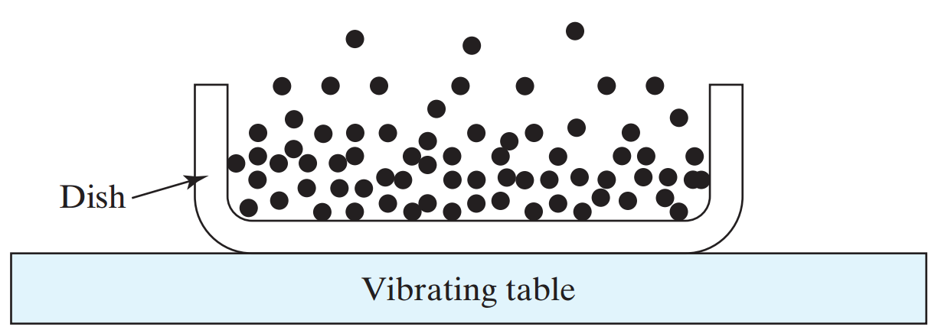
Analogy for Thermal Equilibrium
Sand particles
There is a certain probability for the electrons in the conduction band to occupy high-energy states under the agitation of thermal energy (vibrating atoms).
EE130/230M Spring 2013
Lecture 3, Slide <number>

Slide 4
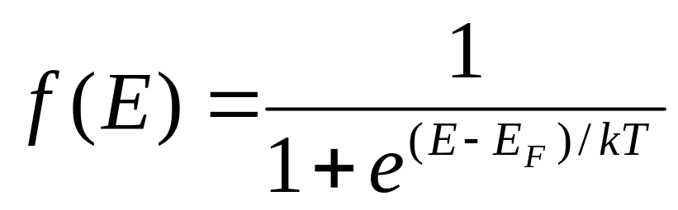
Fermi Function
Probability that an available state at energy E is occupied:
E_{F} is called the Fermi energy or the Fermi level
There is only one Fermi level in a system at equilibrium.
If E >> E_{F} :
If E << E_{F} :
If E = E_{F} :
EE130/230M Spring 2013
Lecture 3, Slide <number>

Slide 5
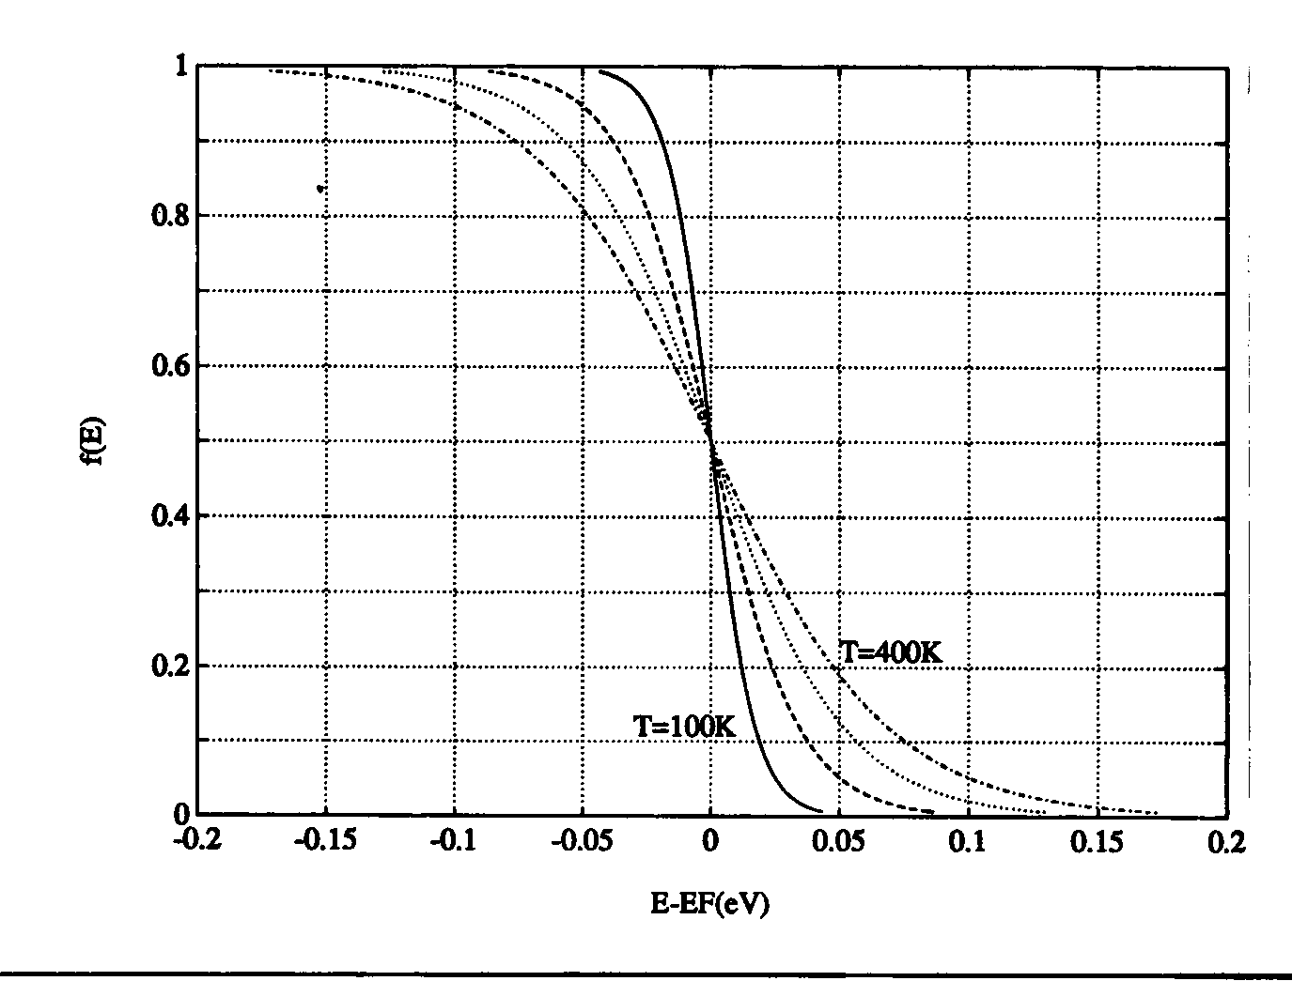
Effect of Temperature on f(E)
EE130/230M Spring 2013
Lecture 3, Slide <number>

Slide 6
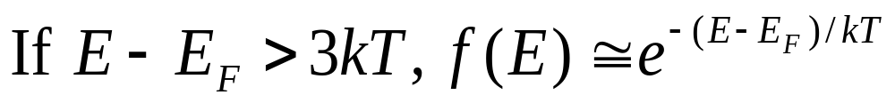
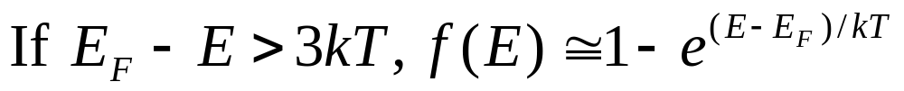
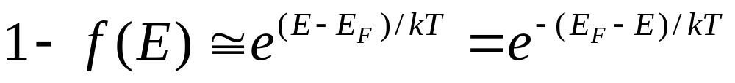
Boltzmann Approximation
Probability that a state is empty (i.e. occupied by a hole):
EE130/230M Spring 2013
Lecture 3, Slide <number>

Slide 7
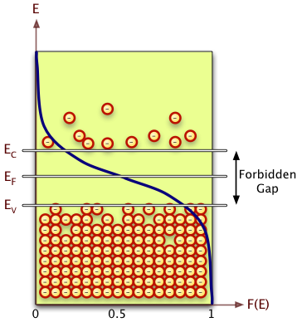
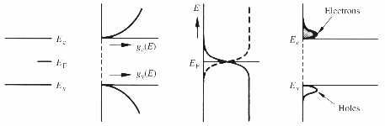
Equilibrium Distribution of Carriers
Obtain n(E) by multiplying g_{c}(E) and f(E)
cnx.org/content/m13458/latest
Energy band
diagram
Density of
States, g_{c}(E)
×
Probability of
occupancy, f(E)
=
Carrier
distribution, n(E)
EE130/230M Spring 2013
Lecture 3, Slide <number>

Slide 8
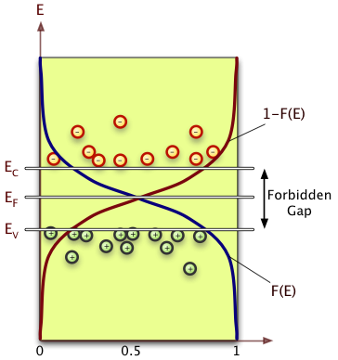
cnx.org/content/m13458/latest
Obtain p(E) by multiplying g_{v}(E) and 1-f(E)
Energy band
diagram
Density of
States, g_{v}(E)
×
Probability of
occupancy, 1-f(E)
=
Carrier
distribution, p(E)
EE130/230M Spring 2013
Lecture 3, Slide <number>

Slide 9
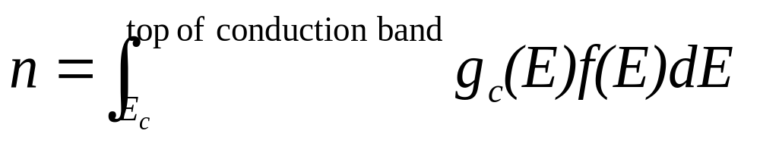
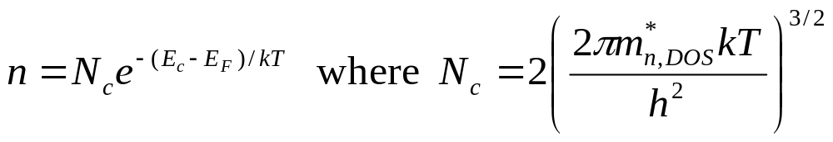
Equilibrium Carrier Concentrations
Integrate n(E) over all the energies in the conduction band to obtain n:
By using the Boltzmann approximation, and extending the integration limit to ∞, we obtain
EE130/230M Spring 2013
Lecture 3, Slide <number>

Slide 10
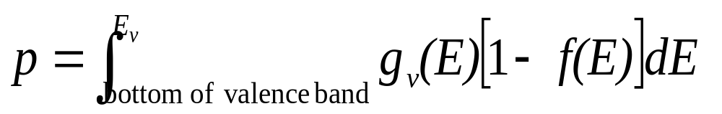
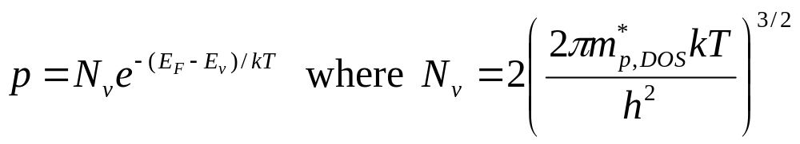
Integrate p(E) over all the energies in the valence band to obtain p:
By using the Boltzmann approximation, and extending the integration limit to -∞, we obtain
EE130/230M Spring 2013
Lecture 3, Slide <number>

Slide 11
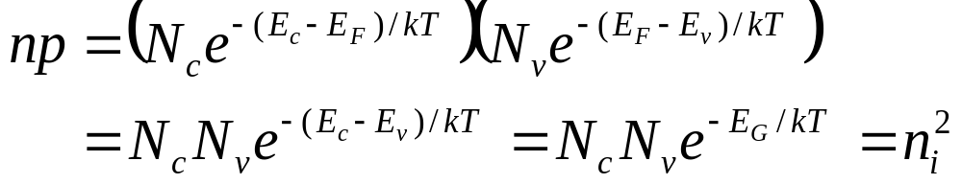
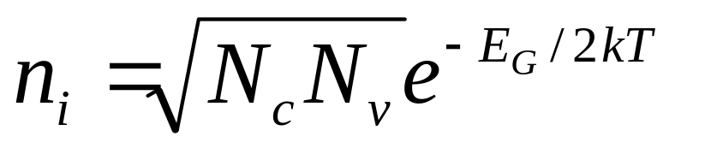
Intrinsic Carrier Concentration
Effective Densities of States at the Band Edges (@ 300K)
 | Si | Ge | GaAs
N_{c} (cm⁻³) | 2.8 × 10¹⁹ | 1.04 × 10¹⁹ | 4.7 × 10¹⁷
N_{v} (cm⁻³) | 1.04 × 10¹⁹ | 6.0 × 10¹⁸ | 7.0 × 10¹⁸
EE130/230M Spring 2013
Lecture 3, Slide <number>

Slide 12
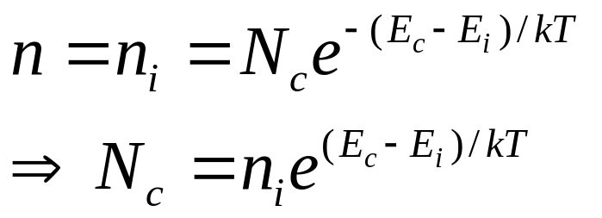
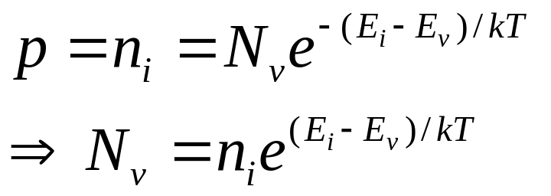
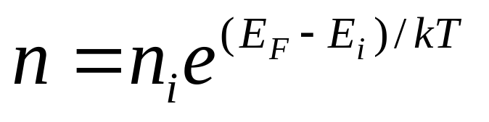
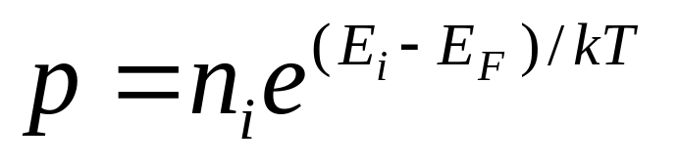
n(n_{i}, E_{i}) and p(n_{i}, E_{i})
In an intrinsic semiconductor, n = p = n_{i} and E_{F} = E_{i}
EE130/230M Spring 2013
Lecture 3, Slide <number>

Slide 13
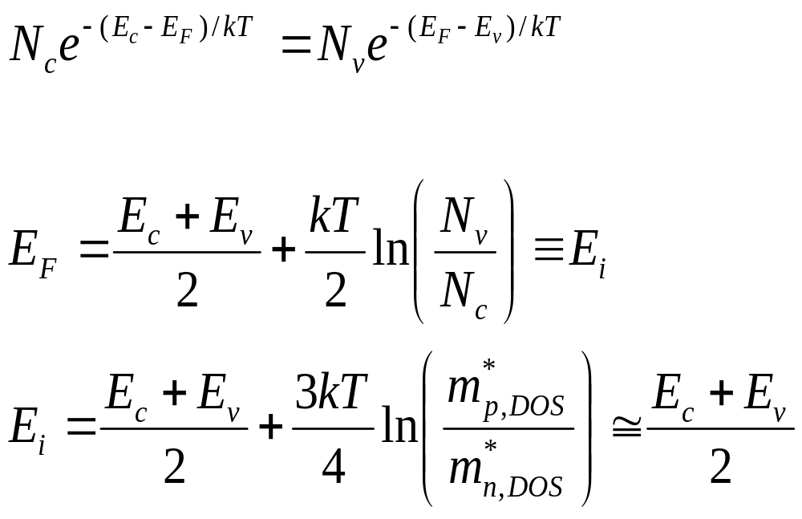
Intrinsic Fermi Level, E_{i}
To find E_{F} for an intrinsic semiconductor, use the fact that n = p:
EE130/230M Spring 2013
Lecture 3, Slide <number>

Slide 14
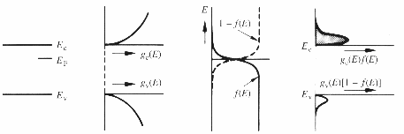
n-type Material
Energy band
diagram
Density of
States
Probability
of occupancy
Carrier
distributions
EE130/230M Spring 2013
Lecture 3, Slide <number>

Slide 15
Example: Energy-band diagram
Question: Where is E_{F} for n = 10¹⁷ cm⁻³ (at 300 K) ?
EE130/230M Spring 2013
Lecture 3, Slide <number>

Slide 16
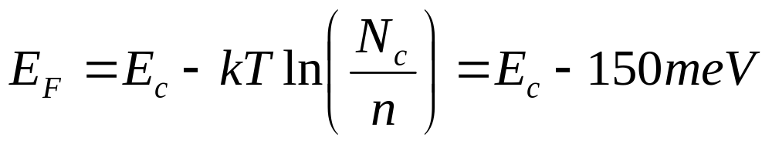
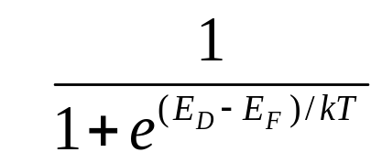
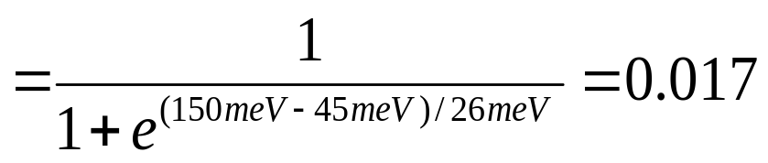
Example: Dopant Ionization
Consider a phosphorus-doped Si sample at 300K with N_{D} = 10¹⁷ cm⁻³.
What fraction of the donors are not ionized?
Hint: Suppose at first that all of the donor atoms are ionized.
Probability of non-ionization ≅
EE130/230M Spring 2013
Lecture 3, Slide <number>

Slide 17
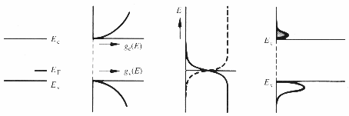
p-type Material
Energy band
diagram
Density of
States
Probability
of occupancy
Carrier
distributions
EE130/230M Spring 2013
Lecture 3, Slide <number>

Slide 18
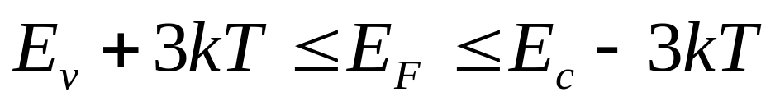
Non-degenerately Doped Semiconductor
Recall that the expressions for n and p were derived using the Boltzmann approximation, i.e. we assumed
E_{c}
3kT
E_{F} in this range
3kT
E_{v}
The semiconductor is said to be non-degenerately doped in this case.
EE130/230M Spring 2013
Lecture 3, Slide <number>

Slide 19
Degenerately Doped Semiconductor
If a semiconductor is very heavily doped, the Boltzmann approximation is not valid.
  In Si at T=300K: E_{c}-E_{F} < 3k_{B}T if N_{D} > 1.6x10¹⁸ cm⁻³
  E_{F}-E_{v} < 3k_{B}T if N_{A} > 9.1x10¹⁷ cm⁻³
  The semiconductor is said to be degenerately doped in this case.
Terminology:
  “n+” → degenerately n-type doped. E_{F} ≅ E_{c}
  “p+” → degenerately p-type doped. E_{F} ≅ E_{v}
EE130/230M Spring 2013
Lecture 3, Slide <number>

Slide 20
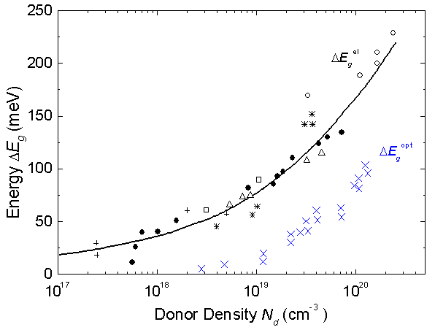
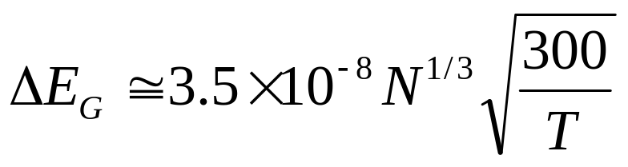
Band Gap Narrowing
If the dopant concentration is a significant fraction of the silicon atomic density, the energy-band structure is perturbed → the band gap is reduced by ΔE_{G} :
R. J. Van Overstraeten and R. P. Mertens,
Solid State Electronics vol. 30, 1987
N = 10¹⁸ cm⁻³: ΔE_{G} = 35 meV
N = 10¹⁹ cm⁻³: ΔE_{G} = 75 meV
EE130/230M Spring 2013
Lecture 3, Slide <number>

Slide 21
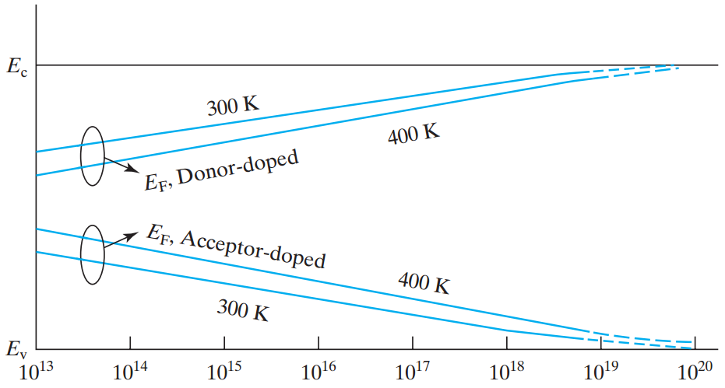
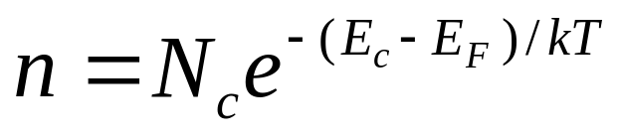
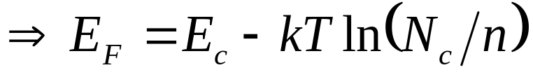
Dependence of E_{F} on Temperature
Net Dopant Concentration (cm⁻³)
EE130/230M Spring 2013
Lecture 3, Slide <number>

Slide 22
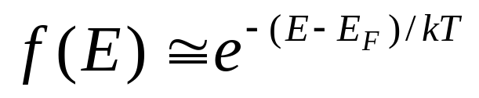
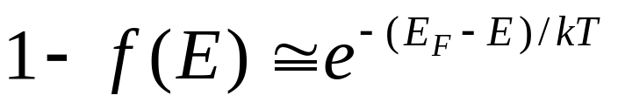
Summary
Thermal equilibrium:
  Balance between internal processes with no external stimulus (no electric field, no light, etc.)
  Fermi function
    Probability that a state at energy E is filled with an electron, under equilibrium conditions.
    Boltzmann approximation:
      For high E, i.e. E – E_{F} > 3kT:
      For low E, i.e. E_{F} – E > 3kT:
EE130/230M Spring 2013
Lecture 3, Slide <number>

Slide 23
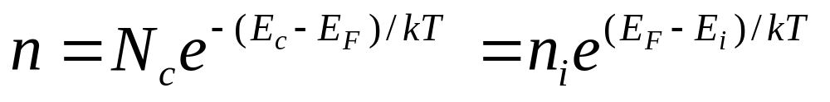
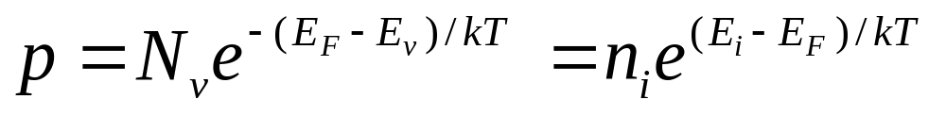
Summary (cont’d)
Relationship between E_{F} and n, p :
Intrinsic carrier concentration :
The intrinsic Fermi level, E_{i}, is located near midgap.
EE130/230M Spring 2013
Lecture 3, Slide <number>

Slide 24
Summary (cont’d)
If the dopant concentration exceeds 10¹⁸ cm⁻³, silicon is said to be degenerately doped.
  The simple formulas relating n and p exponentially to E_{F} are not valid in this case.
For degenerately doped n-type (n+) Si: E_{F} ≅ E_{c}
For degenerately doped p-type (p+) Si: E_{F} ≅ E_{v}
EE130/230M Spring 2013
Lecture 3, Slide <number>

