Slide 1
Lecture 4
OUTLINE
Semiconductor Fundamentals (cont’d)
  Properties of carriers in semiconductors
  Carrier drift
    Scattering mechanisms
    Drift current
  Conductivity and resistivity
Reading: Pierret 3.1; Hu 1.5, 2.1-2.2

Slide 2
Mobile Charge Carriers in Semiconductors
Three primary types of carrier action occur inside a semiconductor:
  Drift: charged particle motion under the influence of an electric field.
  Diffusion: particle motion due to concentration gradient or temperature gradient.
  Recombination-generation (R-G)
EE130/230M Spring 2013
Lecture 4, Slide <number>

Slide 3
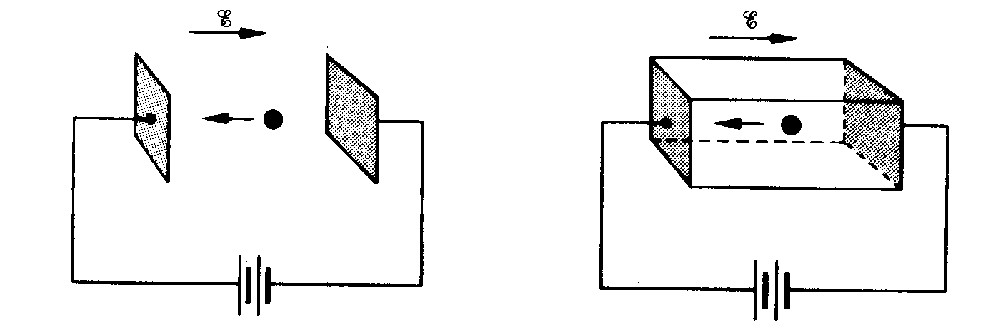
Electrons as Moving Particles
In vacuum
In semiconductor
F = (-q)E = m_{o}a
F = (-q)E = m_{n}*a
where m_{n}* is the
conductivity effective mass
EE130/230M Spring 2013
Lecture 4, Slide <number>

Slide 4
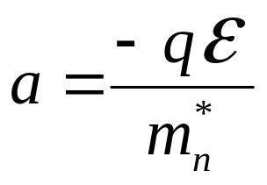
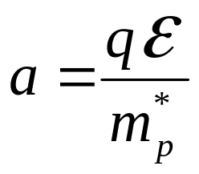
Conductivity Effective Mass, m*
Under the influence of an electric field (E-field), an electron or a hole is accelerated:
electrons
holes
Electron and hole conductivity effective masses
 | Si | Ge | GaAs
m_{n}*/m_{o} | 0.26 | 0.12 | 0.068
m_{p}*/m_{o} | 0.39 | 0.30 | 0.50
m_{o} = 9.1×10⁻³¹ kg
EE130/230M Spring 2013
Lecture 4, Slide <number>

Slide 5
Carrier Scattering
Mobile electrons and atoms in the Si lattice are always in random thermal motion.
  Electrons make frequent collisions with the vibrating atoms
    “lattice scattering” or “phonon scattering” – increases with increasing T
Other scattering mechanisms:
  deflection by ionized impurity atoms
  deflection due to Coulombic force between carriers
    “carrier-carrier scattering” – only significant at high carrier concentrations
The net current in any direction is zero, if no E-field is applied.
3
2
1
electron
4
EE130/230M Spring 2013
Lecture 4, Slide <number>
5

Slide 6
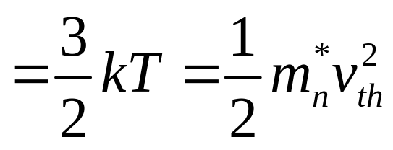
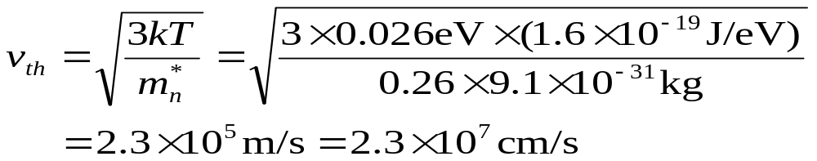
Thermal Velocity, v_{th}
Average electron kinetic energy
EE130/230M Spring 2013
Lecture 4, Slide <number>

Slide 7
Carrier Drift
When an electric field (e.g. due to an externally applied voltage) exists within a semiconductor, mobile charge-carriers will be accelerated by the electrostatic force:
2
3
1
4
electron
5
E
Electrons drift in the direction opposite to the E-field → net current
Because of scattering, electrons in a semiconductor do not undergo constant acceleration. However, they can be viewed as quasi-classical particles moving at a constant average drift velocity v_{dn}
EE130/230M Spring 2013
Lecture 4, Slide <number>

Slide 8
Carrier Drift (Band Model)
E_{c}
E_{v}
EE130/230M Spring 2013
Lecture 4, Slide <number>

Slide 9
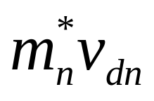
Electron Momentum
With every collision, the electron loses momentum
Between collisions, the electron gains momentum
–qEτ_{mn}
  τ_{mn} ≡ average time between electron scattering events
Conservation of momentum →
|m_{n}*v_{dn} | = | qEτ_{mn}|
EE130/230M Spring 2013
Lecture 4, Slide <number>

Slide 10
Carrier Mobility, μ
For electrons:
|v_{dn}| = qEτ_{mn} / m_{n}* ≡ μ_{n}E
μ_{n} ≡ [qτ_{mn} / m_{n}*] is the electron mobility
Similarly, for holes:
|v_{dp}|= qEτ_{mp} / m_{p}* ≡ μ_{p}E
μ_{p} ≡ [qτ_{mp} / m_{p}*] is the hole mobility
Electron and hole mobilities for intrinsic semiconductors @ 300K
 | Si | Ge | GaAs | InAs
μ_{n} (cm²/Vs) | 1400 | 3900 | 8500 | 30,000
μ_{p} (cm²/Vs) | 470 | 1900 | 400 | 500
EE130/230M Spring 2013
Lecture 4, Slide <number>

Slide 11
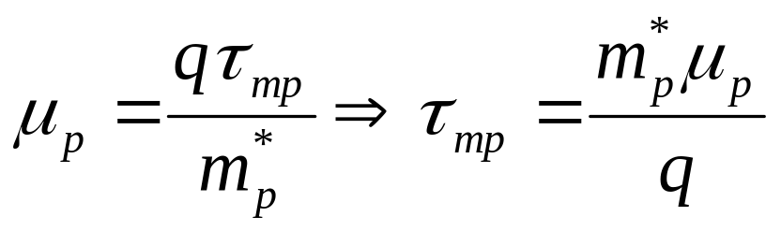
Example: Drift Velocity Calculation
a) Find the hole drift velocity in an intrinsic Si sample for E = 10³ V/cm.
b) What is the average hole scattering time?
Solution:
a)
b)
v_{dp} = μ_{p}E
EE130/230M Spring 2013
Lecture 4, Slide <number>

Slide 12
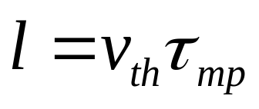
Mean Free Path
Average distance traveled between collisions
EE130/230M Spring 2013
Lecture 4, Slide <number>

Slide 13
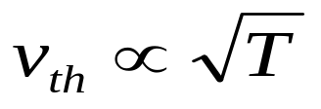
Mechanisms of Carrier Scattering
Dominant scattering mechanisms:
  1. Phonon scattering (lattice scattering)
  2. Impurity (dopant) ion scattering
Phonon scattering limited mobility decreases with increasing T:
μ = qτ / m
EE130/230M Spring 2013
Lecture 4, Slide <number>

Slide 14
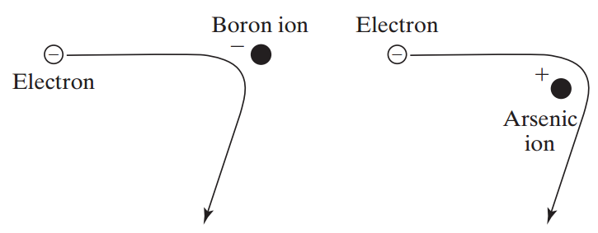
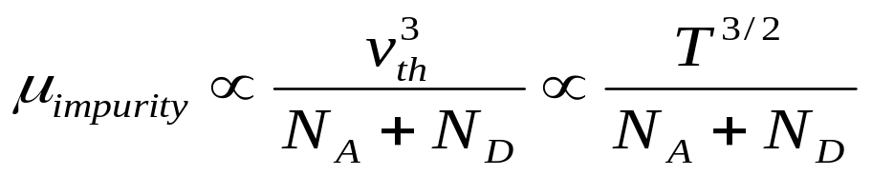
Impurity Ion Scattering
There is less change in the electron’s direction if the electron travels by the ion at a higher speed.
Ion scattering limited mobility increases with increasing T:
EE130/230M Spring 2013
Lecture 4, Slide <number>

Slide 15
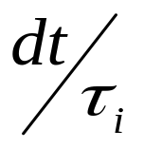
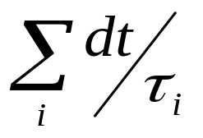
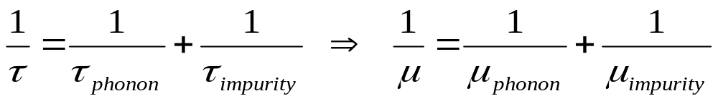
Matthiessen's Rule
The probability that a carrier will be scattered by mechanism i within a time period dt is
  τ_{i} ≡ mean time between scattering events due to mechanism i
→ Probability that a carrier will be scattered by any mechanism within a time period dt is
EE130/230M Spring 2013
Lecture 4, Slide <number>

Slide 16
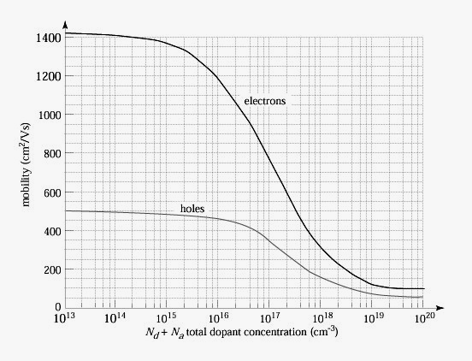
Mobility Dependence on Doping
Carrier mobilities in Si at 300K
EE130/230M Spring 2013
Lecture 4, Slide <number>

Slide 17
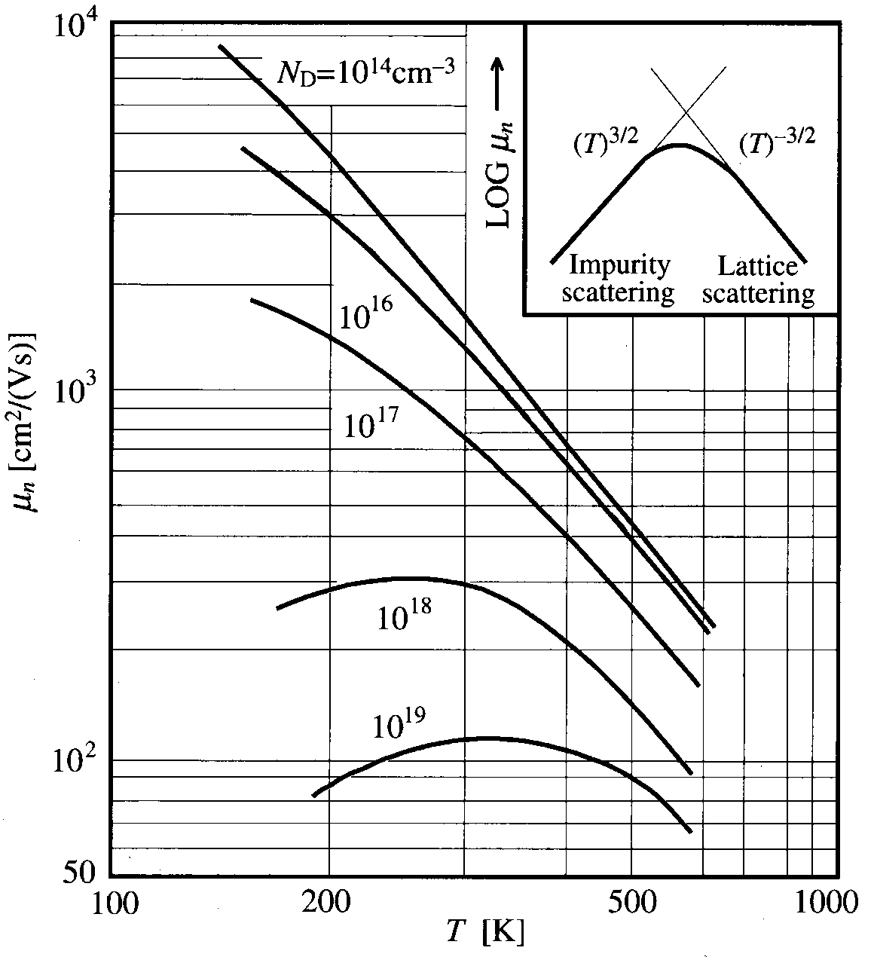
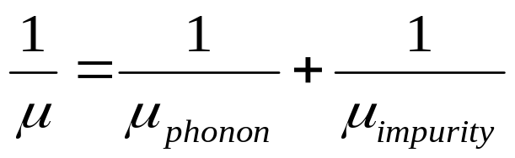
Mobility Dependence on Temperature
EE130/230M Spring 2013
Lecture 4, Slide <number>

Slide 18
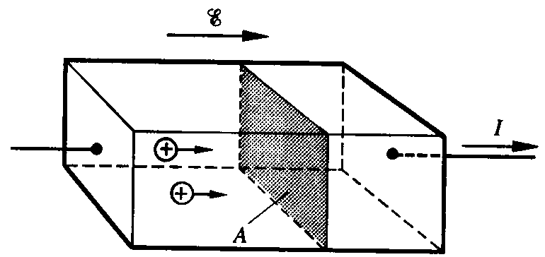
Hole Drift Current Density, J_{p,drift}
v_{dp} Δt A = volume from which all holes cross plane in time Δt
p v_{dp} Δt A = number of holes crossing plane in time Δt
q p v_{dp} Δt A = hole charge crossing plane in time Δt
q p v_{dp} A = hole charge crossing plane per unit time = hole current
→ Hole drift current per unit area J_{p,drift} = q p v_{dp}
EE130/230M Spring 2013
Lecture 4, Slide <number>

Slide 19
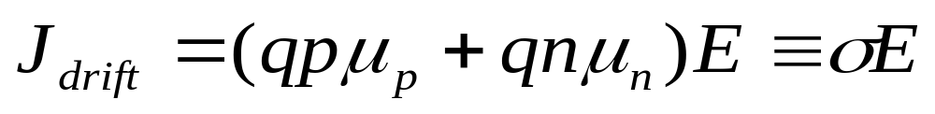
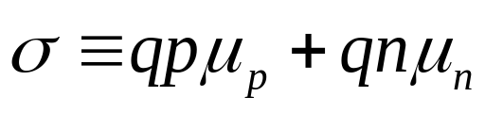
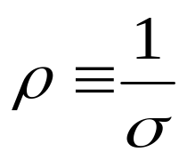
Conductivity and Resistivity
In a semiconductor, both electrons and holes conduct current:
The conductivity of a semiconductor is
  Unit: mho/cm
The resistivity of a semiconductor is
  Unit: ohm-cm
EE130/230M Spring 2013
Lecture 4, Slide <number>

Slide 20
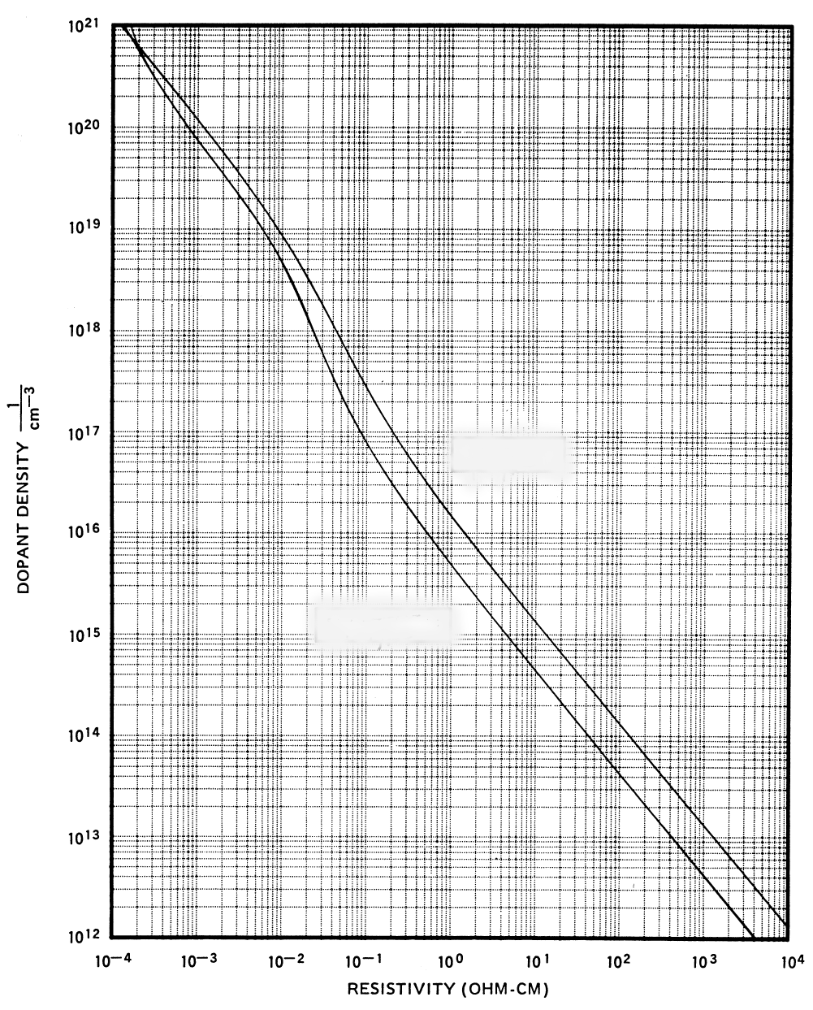
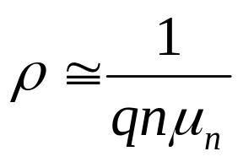
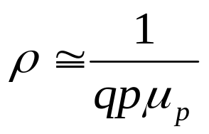
Resistivity Dependence on Doping
For n-type material:
For p-type material:
p-type
n-type
Note: This plot (for Si) does not apply to compensated material (doped with both acceptors and donors).
EE130/230M Spring 2013
Lecture 4, Slide <number>

Slide 21
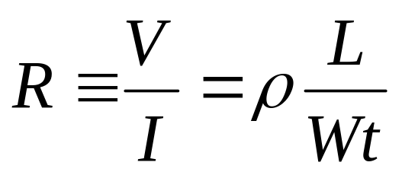
Electrical Resistance
I
V
_
+
W
t
uniformly doped semiconductor
L
Resistance
[Unit: ohms]
where ρ is the resistivity
EE130/230M Spring 2013
Lecture 4, Slide <number>

Slide 22
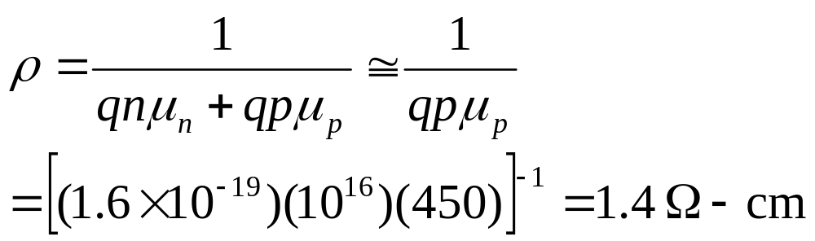
Example: Resistance Calculation
What is the resistivity of a Si sample doped with 10¹⁶/cm³ Boron?
Answer:
EE130/230M Spring 2013
Lecture 4, Slide <number>

Slide 23
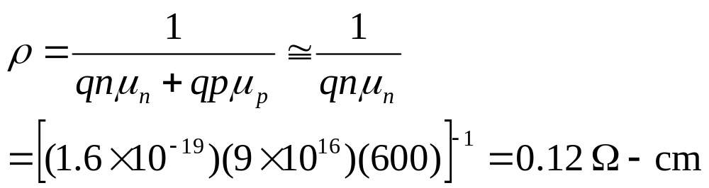
Example: Dopant Compensation
Consider the same Si sample doped with 10¹⁶/cm³ Boron, and additionally doped with 10¹⁷/cm³ Arsenic. What is its resistivity?
Answer:
EE130/230M Spring 2013
Lecture 4, Slide <number>

Slide 24
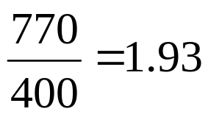
Example: T Dependence of ρ
Consider a Si sample doped with 10¹⁷cm⁻³ As. How will its resistivity change when the temperature is increased from T=300K to T=400K?
Answer:
The temperature dependent factor in σ (and therefore ρ) is μ_{n}.
From the mobility vs. temperature curve for 10¹⁷ cm⁻³, we find that μ_{n} decreases from 770 at 300K to 400 at 400K.
Thus, ρ increases by
EE130/230M Spring 2013
Lecture 4, Slide <number>

Slide 25
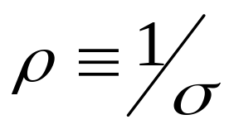
Summary
Electrons and holes can be considered as quasi-classical particles with effective mass m*
In the presence of an electric field E, carriers move with average drift velocity v_{d} = μE , μ is the carrier mobility
  Mobility decreases w/ increasing total concentration of ionized dopants
  Mobility is dependent on temperature
    decreases w/ increasing T if lattice scattering is dominant
    decreases w/ decreasing T if impurity scattering is dominant
The conductivity (σ) hence the resistivity (ρ) of a semiconductor is dependent on its mobile charge carrier concentrations and mobilities
EE130/230M Spring 2013
Lecture 4, Slide <number>

