Slide 1
Lecture 5
OUTLINE
Semiconductor Fundamentals (cont’d)
  Carrier diffusion
    Diffusion current
    Einstein relationship
  Generation and recombination
    Excess carrier concentrations
    Minority carrier recombination lifetime
Reading: Pierret 3.2-3.3; Hu 2.3, 2.5-2.6

Slide 2
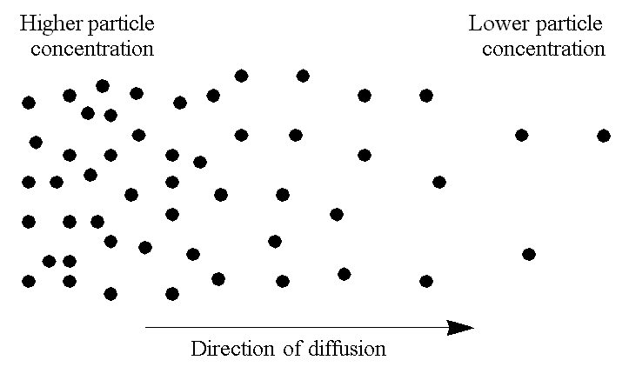
Diffusion
Particles diffuse from regions of higher concentration to regions of lower concentration region, due to random thermal motion.
EE130/230M Spring 2013
Lecture 5, Slide <number>

Slide 3
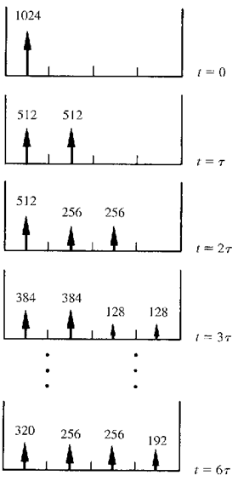
1-D Diffusion Example
Thermal motion causes particles to move into an adjacent compartment every t seconds
  Each particle has an equal probability of jumping to the left or jumping to the right.
EE130/230M Spring 2013
Lecture 5, Slide <number>

Slide 4
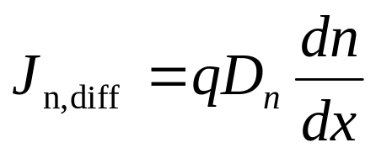
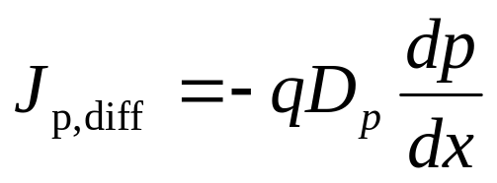
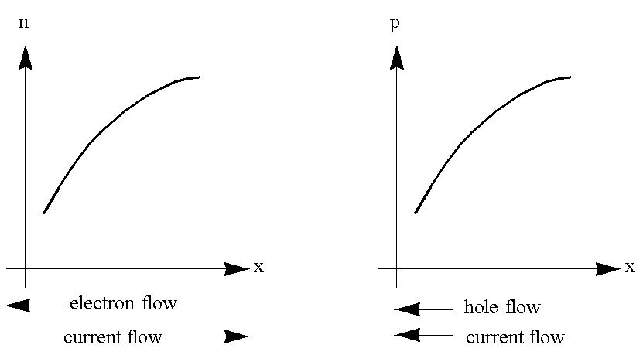
Diffusion Current
D is the diffusion constant, or diffusivity.
EE130/230M Spring 2013
Lecture 5, Slide <number>

Slide 5
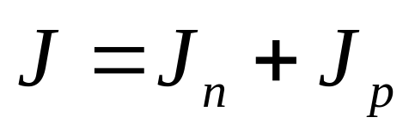
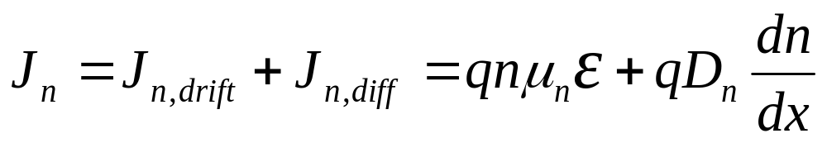

Total Current
EE130/230M Spring 2013
Lecture 5, Slide <number>

Slide 6
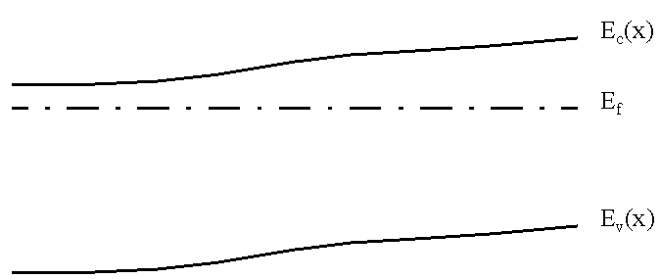
Non-Uniformly-Doped Semiconductor
The position of E_{F} relative to the band edges is determined by the carrier concentrations, which is determined by the net dopant concentration.
In equilibrium E_{F} is constant; therefore, the band-edge energies vary with position in a non-uniformly doped semiconductor:
E_{c}(x)
E_{F}
E_{v}(x)
EE130/230M Spring 2013
Lecture 5, Slide <number>

Slide 7
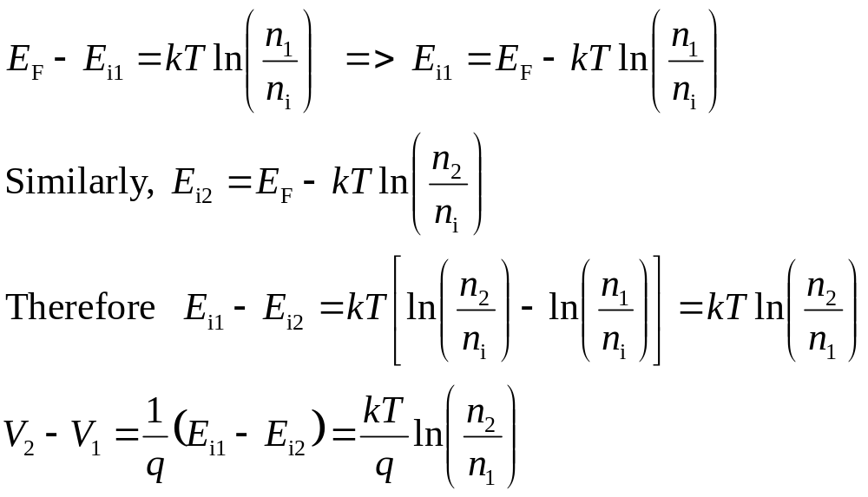
Potential Difference due to n(x), p(x)
The ratio of carrier densities at two points depends exponentially on the potential difference between these points:
EE130/230M Spring 2013
Lecture 5, Slide <number>

Slide 8
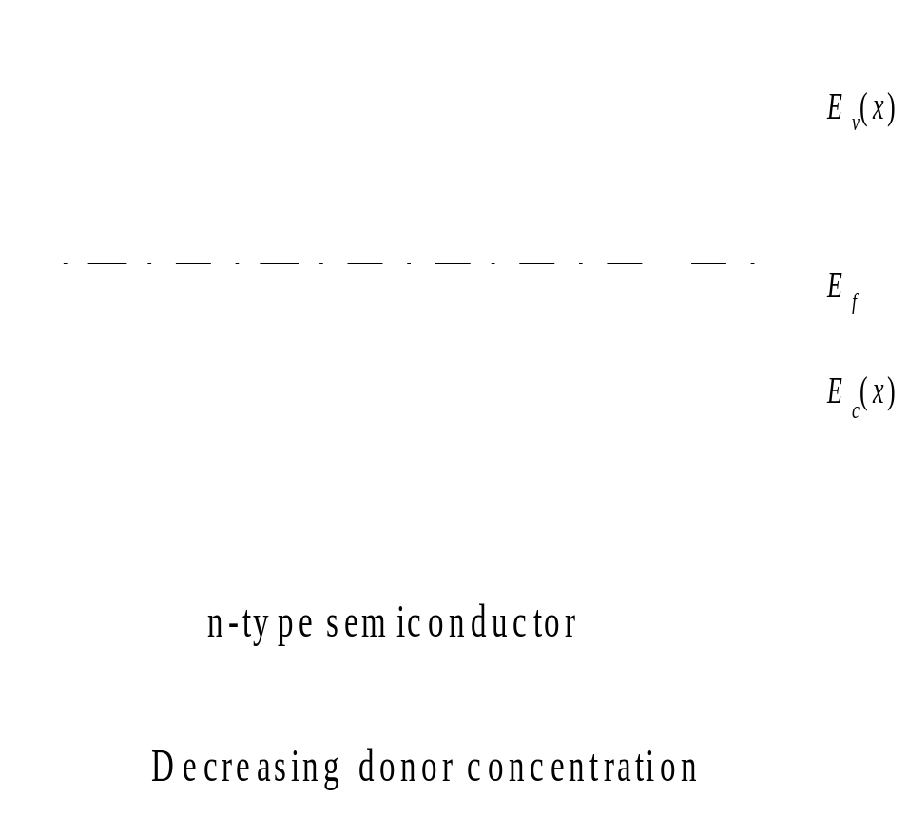
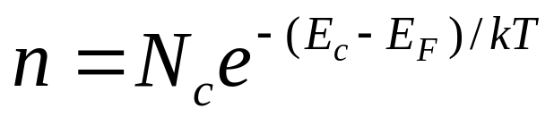
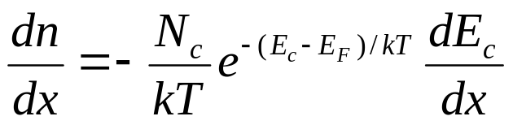
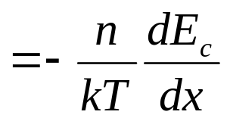
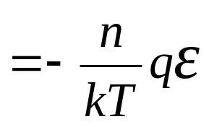
Built-In Electric Field due to n(x), p(x)
Consider a piece of a non-uniformly doped semiconductor:
E_{c}(x)
E_{F}
E_{v}(x)
EE130/230M Spring 2013
Lecture 5, Slide <number>

Slide 9
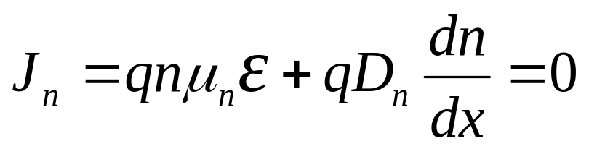
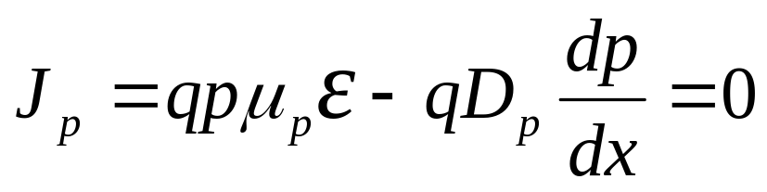
Einstein Relationship between D, μ
In equilibrium there is no net flow of electrons or holes
➔ The drift and diffusion current components must balance each other exactly. (A built-in electric field exists, such that the drift current exactly cancels out the diffusion current due to the concentration gradient.)
J_{n} = 0 and J_{p} = 0
The Einstein relationship is valid for a non-degenerate semiconductor, even under non-equilibrium conditions.
EE130/230M Spring 2013
Lecture 5, Slide <number>

Slide 10
Example: Diffusion Constant
What is the hole diffusion constant in a sample of silicon with μ_{p} = 410 cm² / V s ?
Answer:
Remember: kT/q = 26 mV at room temperature.
EE130/230M Spring 2013
Lecture 5, Slide <number>

Slide 11



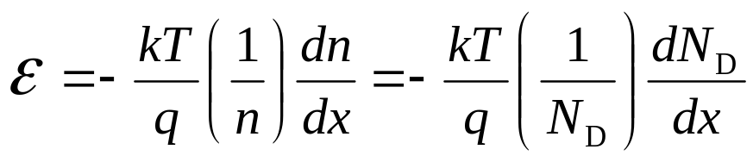
Quasi-Neutrality Approximation
If the dopant concentration profile varies gradually with position, then the majority-carrier concentration distribution does not differ much from the dopant concentration distribution.
  n-type material:
  p-type material:
  in n-type material
EE130/230M Spring 2013
Lecture 5, Slide <number>

Slide 12
Generation and Recombination
Generation:
Recombination:
Generation and recombination processes act to change the carrier concentrations, and thereby indirectly affect current flow
EE130/230M Spring 2013
Lecture 5, Slide <number>

Slide 13
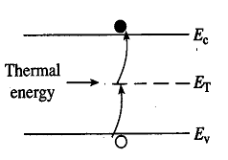
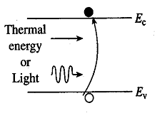
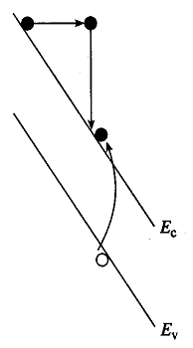
Generation Processes
Band-to-Band
R-G Center
Impact Ionization
EE130/230M Spring 2013
Lecture 5, Slide <number>

Slide 14
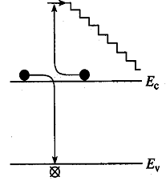
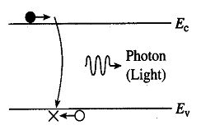
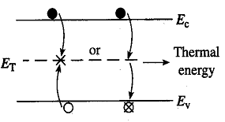
Recombination Processes
Direct
R-G Center
Auger
Recombination in Si is primarily via R-G centers
EE130/230M Spring 2013
Lecture 5, Slide <number>

Slide 15
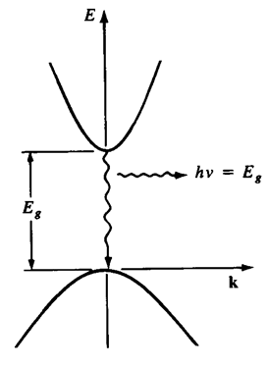
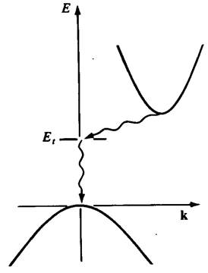
Direct vs. Indirect Band Gap Materials
Energy (E) vs. momentum (ħk) Diagrams
Direct:
Indirect:
Little change in momentum
is required for recombination
momentum is conserved by
photon emission
Large change in momentum
is required for recombination
momentum is conserved by
phonon + photon emission
EE130/230M Spring 2013
Lecture 5, Slide <number>

Slide 16
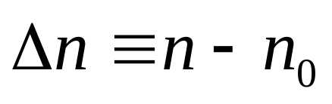
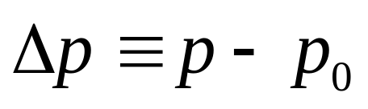
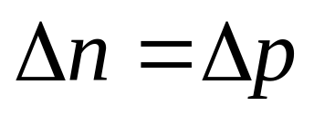
Excess Carrier Concentrations
equilibrium values
Charge neutrality condition:
EE130/230M Spring 2013
Lecture 5, Slide <number>

Slide 17
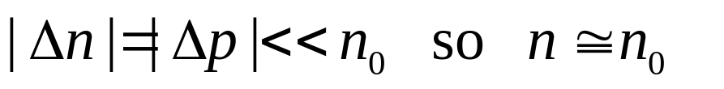
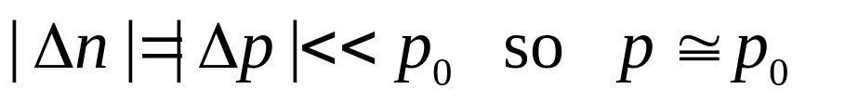
“Low-Level Injection”
Often the disturbance from equilibrium is small, such that the majority-carrier concentration is not affected significantly:
  For an n-type material:
  For a p-type material:
  However, the minority carrier concentration can be significantly affected.
EE130/230M Spring 2013
Lecture 5, Slide <number>

Slide 18
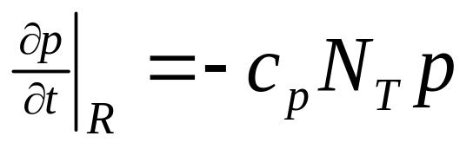
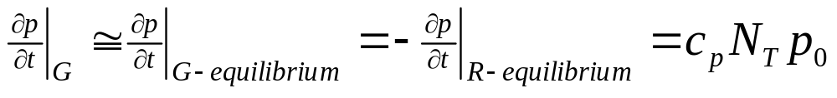
Indirect Recombination Rate
Suppose excess carriers are introduced into an n-type Si sample (e.g. by temporarily shining light onto it) at time t = 0.
How does p vary with time t > 0?
Consider the rate of hole recombination via traps:
Under low-level injection conditions, the hole generation rate is not significantly affected:
EE130/230M Spring 2013
Lecture 5, Slide <number>

Slide 19
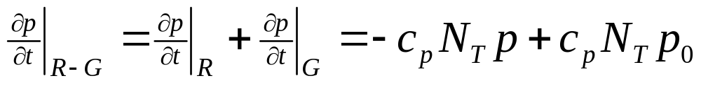
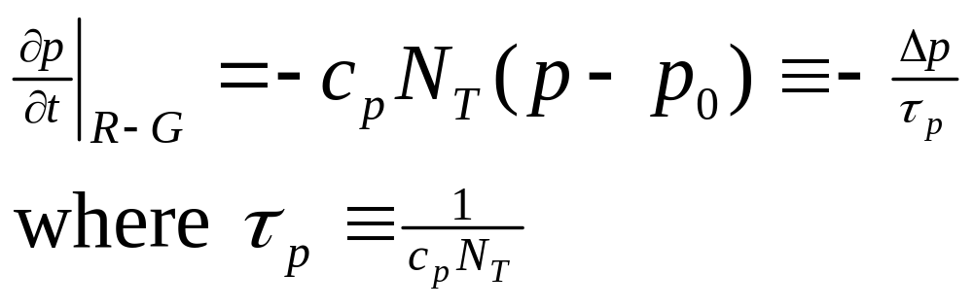
The net rate of change in p is therefore
EE130/230M Spring 2013
Lecture 5, Slide <number>

Slide 20
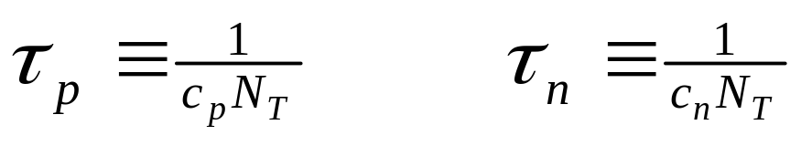
Minority Carrier (Recombination) Lifetime
The minority carrier lifetime τ is the average time an excess minority carrier “survives” in a sea of majority carriers
τ ranges from 1 ns to 1 ms in Si and depends on the density of metallic impurities (contaminants) such as Au and Pt, and the density of crystalline defects. These impurities/defects give rise to localized energy states deep within the band gap. Such deep traps capture electrons or holes to facilitate recombination and are called recombination-generation centers.
EE130/230M Spring 2013
Lecture 5, Slide <number>

Slide 21
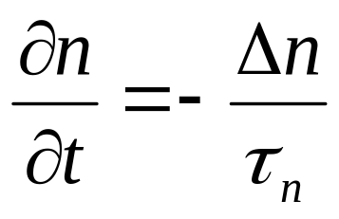
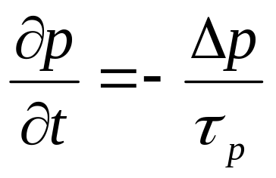
Relaxation to Equilibrium State
Consider a semiconductor with no current flow in which thermal equilibrium is disturbed by the sudden creation of excess holes and electrons. The system will relax back to the equilibrium state via the R-G mechanism:
for electrons in p-type material
for holes in n-type material
EE130/230M Spring 2013
Lecture 5, Slide <number>

Slide 22
Example: Photoconductor
Consider a sample of Si doped with 10¹⁶ cm⁻³ boron,
with recombination lifetime 1 μs. It is exposed continuously to light, such that electron-hole pairs are generated throughout the sample at the rate of 10²⁰ per cm³ per second, i.e. the generation rate G_{L} = 10²⁰/cm³/s
What are p₀ and n₀ ?
What are Δn and Δp ?
(Hint: In steady-state, generation rate equals recombination rate.)
EE130/230M Spring 2013
Lecture 5, Slide <number>

Slide 23
What are p and n ?
What is the np product ?
Note: The np product can be very different from n_{i}².
EE130/230M Spring 2013
Lecture 5, Slide <number>

Slide 24
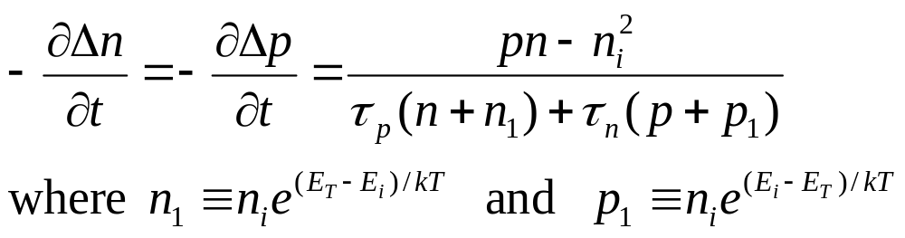
Net Recombination Rate (General Case)
For arbitrary injection levels, the net rate of carrier recombination is:
EE130/230M Spring 2013
Lecture 5, Slide <number>

Slide 25

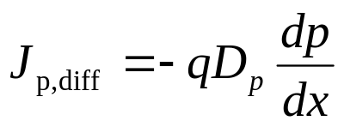
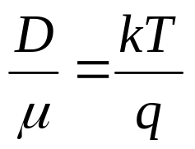
Summary
Electron/hole concentration gradient → diffusion
Current flowing in a semiconductor is comprised of drift and diffusion components for electrons and holes
  In equilibrium J_{n} = J_{n,drift} + J_{n,diff} = 0 and J_{p} = J_{p,drift} + J_{p,diff} = 0
The characteristic constants of drift and diffusion are related:
J = J_{n,drift} + J_{n,diff} + J_{p,drift} + J_{p,diff}
EE130/230M Spring 2013
Lecture 5, Slide <number>

Slide 26
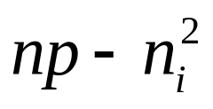
Summary (cont’d)
Generation and recombination (R-G) processes affect carrier concentrations as a function of time, and thereby current flow
  Generation rate is enhanced by deep (near midgap) states due to defects or impurities, and also by high electric field
  Recombination in Si is primarily via R-G centers
The characteristic constant for (indirect) R-G is the minority carrier lifetime:
Generally, the net recombination rate is proportional to
EE130/230M Spring 2013
Lecture 5, Slide <number>

