Slide 1
Lecture 6
OUTLINE
Semiconductor Fundamentals (cont’d)
  Continuity equations
  Minority carrier diffusion equations
  Minority carrier diffusion length
  Quasi-Fermi levels
Reading: Pierret 3.4-3.5; Hu 4.7

Slide 2
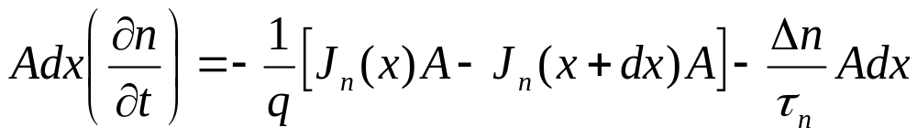
Derivation of Continuity Equation
Consider carrier-flux into/out-of an infinitesimal volume:
Area A, volume Adx
J_{n}(x)
J_{n}(x+dx)
dx
EE130/230M Spring 2013
Lecture 6, Slide <number>

Slide 3
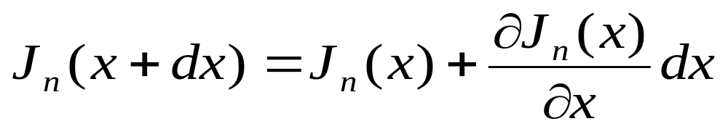
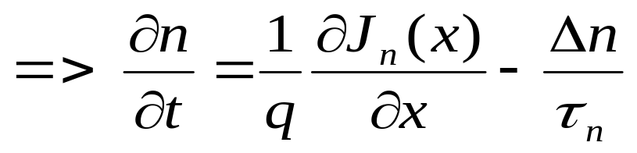
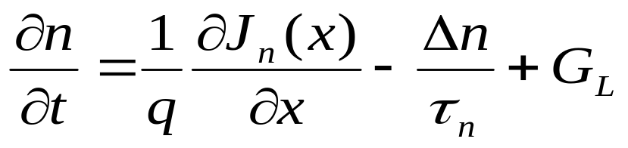
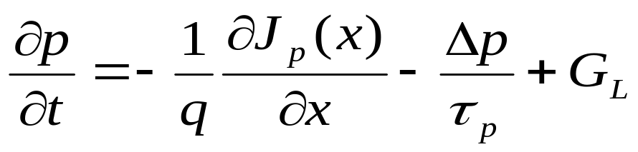
Continuity
Equations:
EE130/230M Spring 2013
Lecture 6, Slide <number>

Slide 4
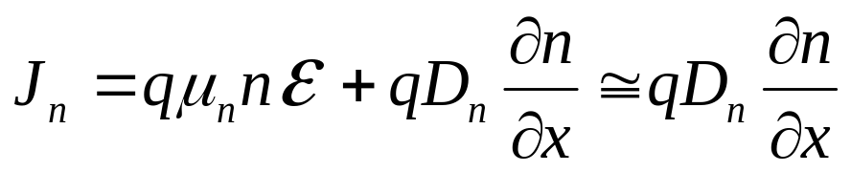
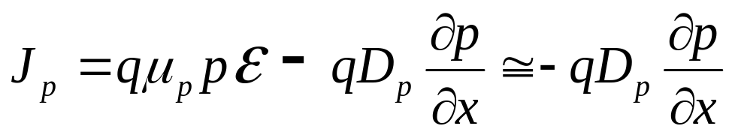
Derivation of
Minority Carrier Diffusion Equations
The minority carrier diffusion equations are derived from the general continuity equations, and are applicable only for minority carriers.
Simplifying assumptions:
  1. The electric field is small, such that
  in p-type material
  in n-type material
  2. n₀ and p₀ are independent of x (i.e. uniform doping)
  3. low-level injection conditions prevail
EE130/230M Spring 2013
Lecture 6, Slide <number>

Slide 5

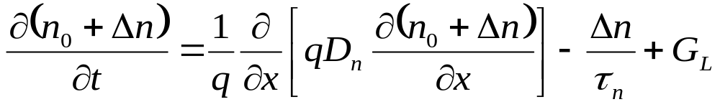
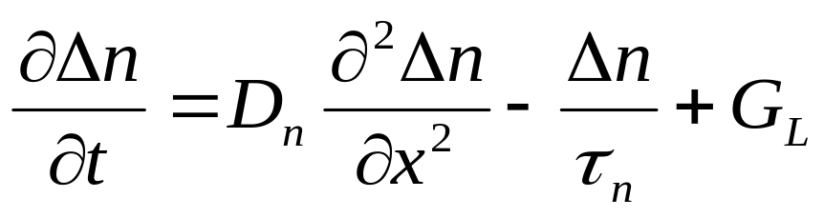
Starting with the continuity equation for electrons:
EE130/230M Spring 2013
Lecture 6, Slide <number>

Slide 6
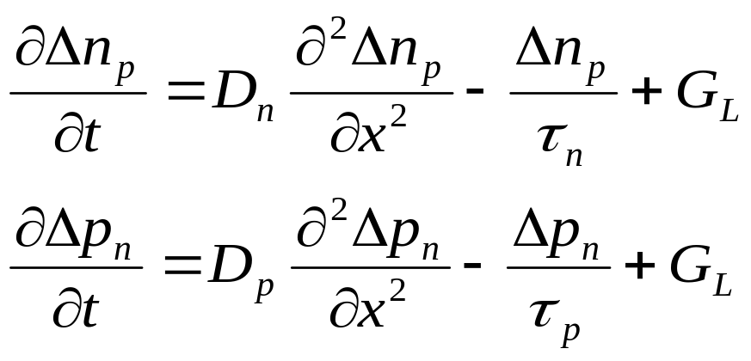
Carrier Concentration Notation
The subscript “n” or “p” is used to explicitly denote n-type or p-type material, e.g.
  p_{n} is the hole (minority-carrier) concentration in n-type mat’l
  n_{p} is the electron (minority-carrier) concentration in n-type mat’l
Thus the minority carrier diffusion equations are
EE130/230M Spring 2013
Lecture 6, Slide <number>

Slide 7
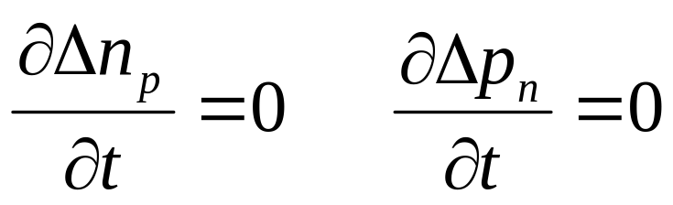
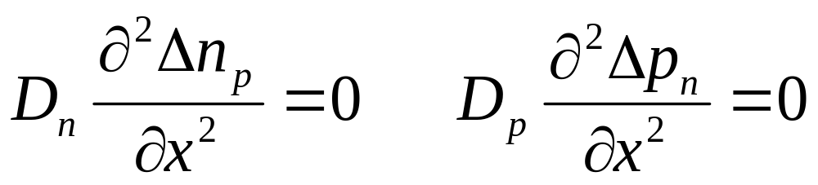
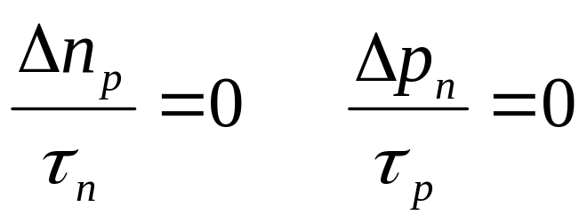
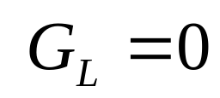
Simplifications (Special Cases)
Steady state:
No diffusion current:
No R-G:
No light:
EE130/230M Spring 2013
Lecture 6, Slide <number>

Slide 8
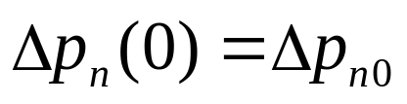
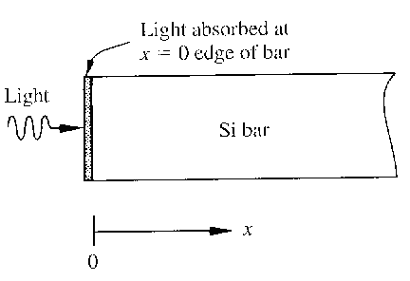
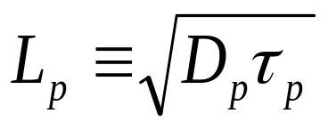
Example
Consider an n-type Si sample illuminated at one end:
  constant minority-carrier injection at x = 0
  steady state; no light absorption for x > 0
L_{p} is the hole diffusion length:
EE130/230M Spring 2013
Lecture 6, Slide <number>

Slide 9
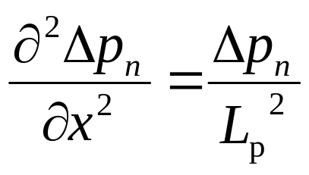
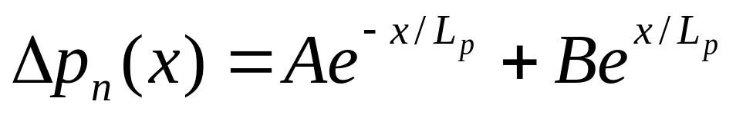
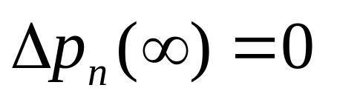
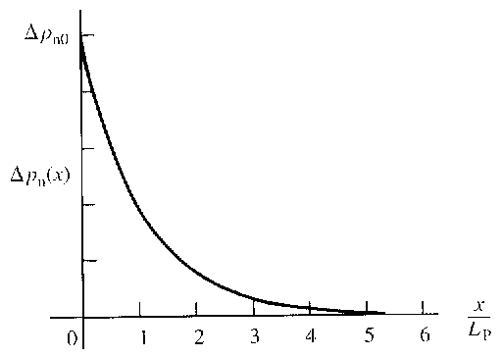
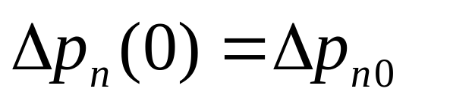
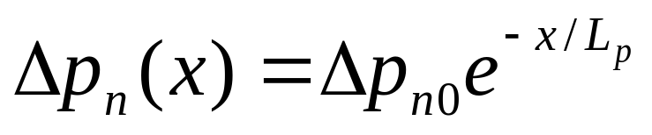
The general solution to the equation
is
where A, B are constants determined by boundary conditions:
Therefore, the solution is
EE130/230M Spring 2013
Lecture 6, Slide <number>

Slide 10
Minority Carrier Diffusion Length
Physically, L_{p} and L_{n} represent the average distance that minority carriers can diffuse into a sea of majority carriers before being annihilated.
Example: N_{D} = 10¹⁶ cm⁻³; τ_{p} = 10⁻⁶ s
EE130/230M Spring 2013
Lecture 6, Slide <number>

Slide 11
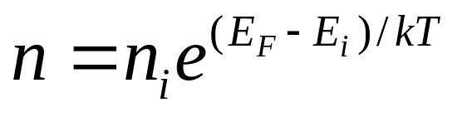
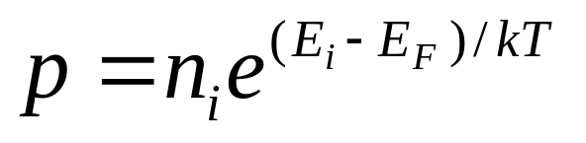
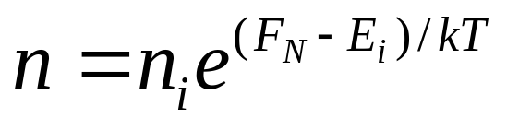
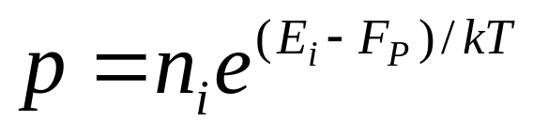
Quasi-Fermi Levels
Whenever Δn = Δp ≠ 0, np ≠ n_{i}². However, we would like to preserve and use the relations:
These equations imply np = n_{i}², however. The solution is to introduce two quasi-Fermi levels F_{N} and F_{P} such that
EE130/230M Spring 2013
Lecture 6, Slide <number>

Slide 12
Example: Quasi-Fermi Levels
Consider a Si sample with N_{D} = 10¹⁷ cm⁻³ and Δn = Δp = 10¹⁴ cm⁻³.
What are p and n ?
What is the np product ?
EE130/230M Spring 2013
Lecture 6, Slide <number>

Slide 13
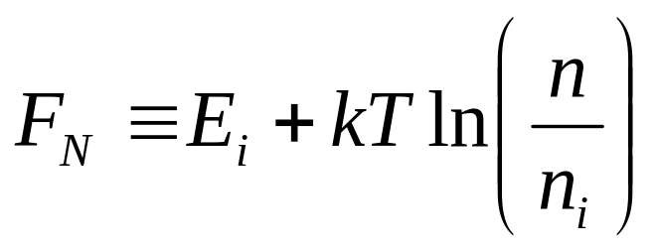
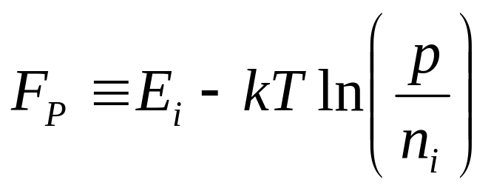
Find F_{N} and F_{P} :
EE130/230M Spring 2013
Lecture 6, Slide <number>

Slide 14
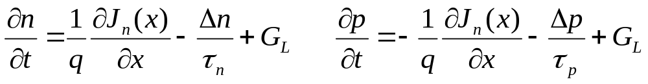
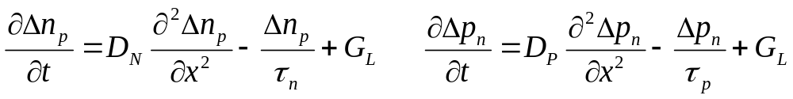
Summary
The continuity equations are established based on conservation of carriers, and therefore hold generally:
The minority carrier diffusion equations are derived from the continuity equations, specifically for minority carriers under certain conditions (small E-field, low-level injection, uniform doping profile):
EE130/230M Spring 2013
Lecture 6, Slide <number>

