Slide 1
Lecture 7
OUTLINE
Poisson’s equation
Work function
Metal-Semiconductor Contacts
  Equilibrium energy band diagrams
  Depletion-layer width
Reading: Pierret 5.1.2, 14.1-14.2; Hu 4.16

Slide 2
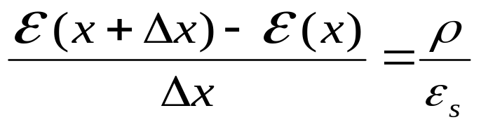
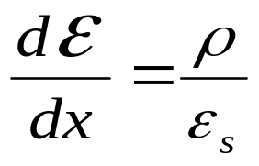
Poisson’s Equation
Gauss’ Law:
area A
E(x)
E(x+Δx)
Δx
ε_{s} : permittivity (F/cm)
ρ : charge density (C/cm³)
EE130/230M Spring 2013
Lecture 7, Slide <number>

Slide 3
Charge Density in a Semiconductor
Assuming the dopants are completely ionized:
ρ = q (p – n + N_{D} – N_{A})
EE130/230M Spring 2013
Lecture 7, Slide <number>

Slide 4
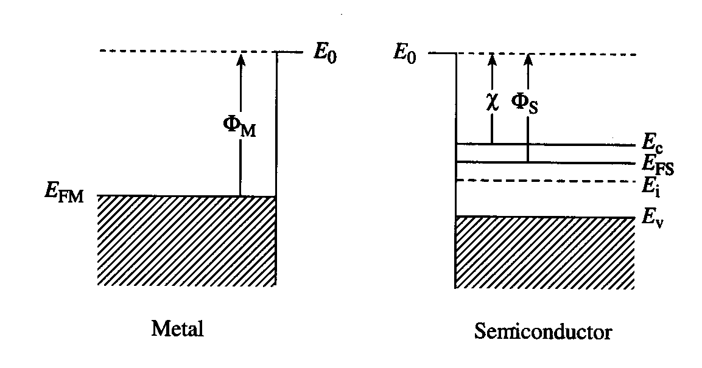
Work Function
Ε₀: vacuum energy level
Φ_{M}: metal work function
Φ_{S}: semiconductor work function
EE130/230M Spring 2013
Lecture 7, Slide <number>

Slide 5
Metal-Semiconductor Contacts
There are 2 kinds of metal-semiconductor contacts:
rectifying
  “Schottky diode”
non-rectifying
  “ohmic contact”
EE130/230M Spring 2013
Lecture 7, Slide <number>

Slide 6

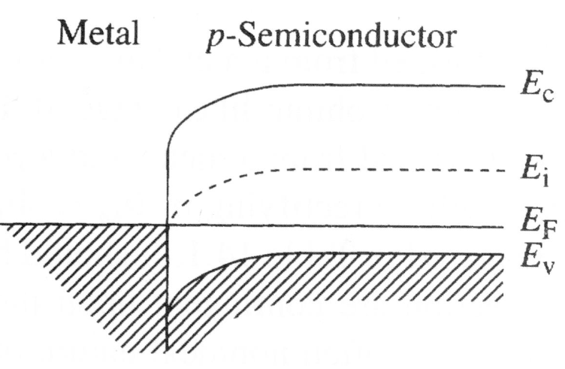

Ideal M-S Contact: Φ_{M} < Φ_{S}, p-type
p-type
semiconductor
Band diagram instantly
after contact formation:
Equilibrium band diagram:
Schottky Barrier Height:
Φ_{Bp}
qV_{bi} = Φ_{Bp}– (E_{F} – E_{v})_{FB}
W
EE130/230M Spring 2013
Lecture 7, Slide <number>

Slide 7
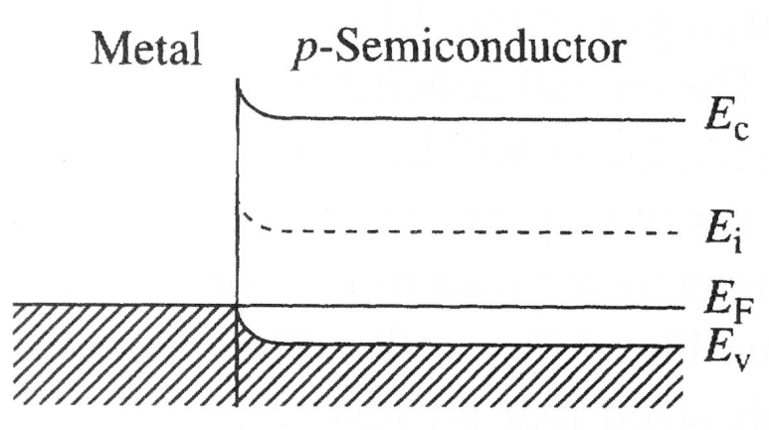
Ideal M-S Contact: Φ_{M} > Φ_{S}, p-type
p-type
semiconductor
Band diagram instantly
after contact formation:
Equilibrium band diagram:
EE130/230M Spring 2013
Lecture 7, Slide <number>

Slide 8
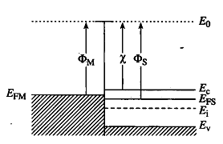

Ideal M-S Contact: Φ_{M} < Φ_{S}, n-type
Band diagram instantly
after contact formation:
Equilibrium band diagram:
EE130/230M Spring 2013
Lecture 7, Slide <number>

Slide 9
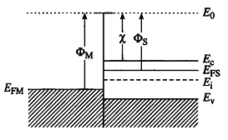
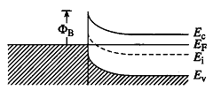

Ideal M-S Contact: Φ_{M} > Φ_{S}, n-type
Band diagram instantly
after contact formation:
Equilibrium band diagram:
qV_{bi} = Φ_{Bn}– (E_{c} – E_{F})_{FB}
_{n}
Schottky Barrier Height:
W
EE130/230M Spring 2013
Lecture 7, Slide <number>

Slide 10
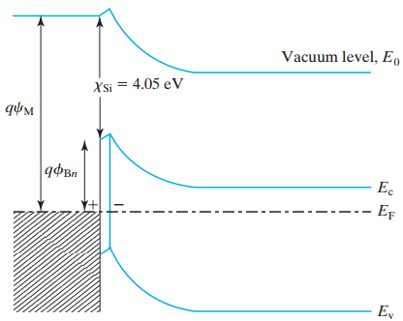
Effect of Interface States on Φ_{Bn}
Ideal M-S contact:
  Φ_{Bn} = Φ_{M} – χ
Real M-S contacts:
  A high density of allowed energy states in the band gap at the M-S interface “pins” E_{F} to be within the range 0.4 eV to 0.9 eV below E_{c}
Φ_{M}
Φ_{Bn}
EE130/230M Spring 2013
Lecture 7, Slide <number>

Slide 11
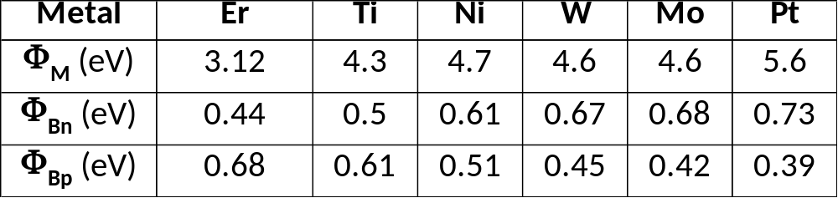
Schottky Barrier Heights: Metal on Si
Φ_{Bn} tends to increase with increasing metal work function
EE130/230M Spring 2013
Lecture 7, Slide <number>

Slide 12
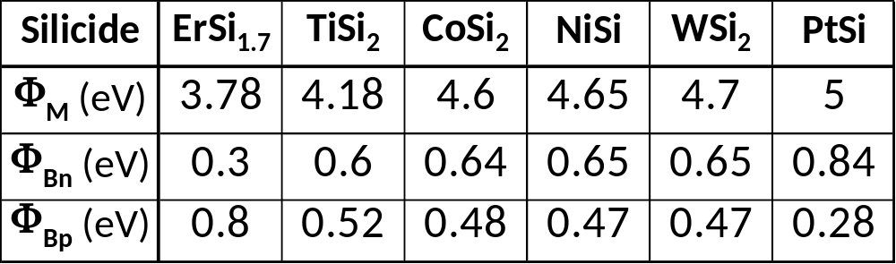
Schottky Barrier Heights: Silicide on Si
Silicide-Si interfaces are more stable than metal-silicon interfaces and hence are much more prevalent in ICs. After metal is deposited on Si, a thermal annealing step is applied to form a silicide-Si contact. The term metal-silicon contact includes silicide-Si contacts.
EE130/230M Spring 2013
Lecture 7, Slide <number>

Slide 13
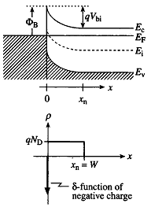
The Depletion Approximation
The semiconductor is depleted of mobile carriers to a depth W
In the depleted region (0 ≤ x ≤ W ):
        ρ = q (N_{D} – N_{A})
Beyond the depleted region (x > W ):
        ρ = 0
EE130/230M Spring 2013
Lecture 7, Slide <number>

Slide 14
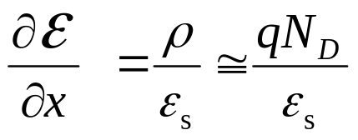
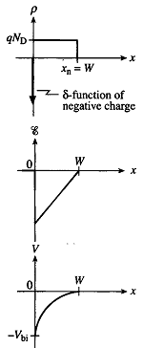
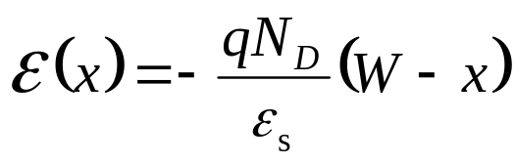
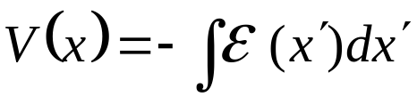
Electrostatics
Poisson’s equation:
The solution is:
EE130/230M Spring 2013
Lecture 7, Slide <number>

Slide 15
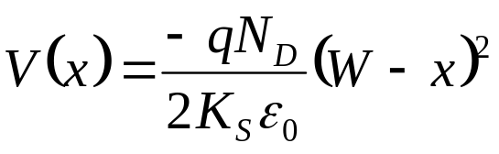
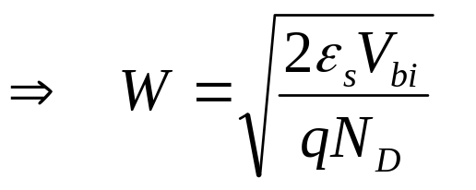
Depletion Width, W
At x = 0, V = -V_{bi}
W decreases with increasing N_{D}
EE130/230M Spring 2013
Lecture 7, Slide <number>

Slide 16
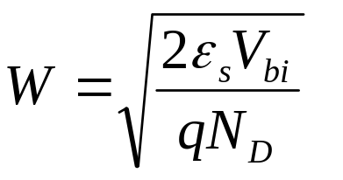
Summary: Schottky Diode (n-type Si)
metal
Φ_{M} > Φ_{S}
n-type Si
E_{o}
Φ_{M}
χ_{Si}
qV_{bi} = Φ_{Bn} – (E_{c} – E_{FS})_{FB}
Φ_{Bn}
E_{c}
E_{F}
Depletion width
E_{v}
W
EE130/230M Spring 2013
Lecture 7, Slide <number>

Slide 17
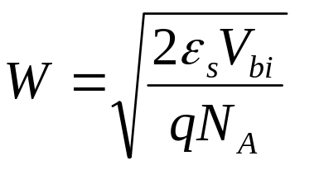
Summary: Schottky Diode (p-type Si)
metal
Φ_{M} < Φ_{S}
p-type Si
E_{o}
χ_{Si}
E_{c}
Φ_{M}
E_{F}
Depletion width
E_{v}
Φ_{Bp}
qV_{bi} = Φ_{Bp}– (E_{F} – E_{v})_{FB}
W
EE130/230M Spring 2013
Lecture 7, Slide <number>

