Slide 1
Lecture 8
OUTLINE
Metal-Semiconductor Contacts (cont’d)
  Current flow in a Schottky diode
  Schottky diode applications
  Small-signal capacitance
  Practical ohmic contacts
Reading: Pierret 14.2-14.3; Hu 4.17-4.21

Slide 2
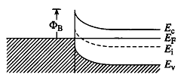
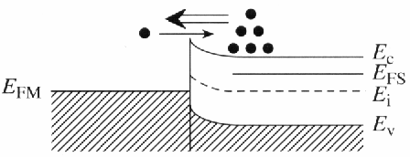
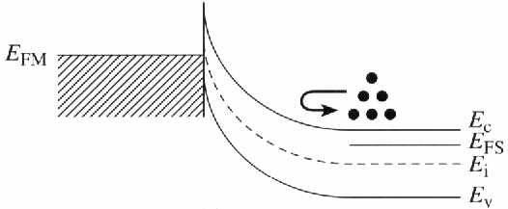
Voltage Drop across the M-S Contact
Under equilibrium conditions (V_{A} = 0), the voltage drop across the semiconductor depletion region is the built-in voltage V_{bi}.
If V_{A} ≠ 0, the voltage drop across the semiconductor depletion region is V_{bi} - V_{A}.
EE130/230M Spring 2013
Lecture 8, Slide <number>

Slide 3
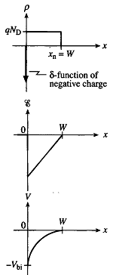
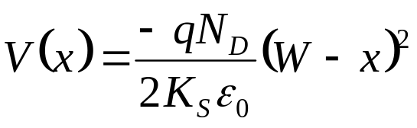
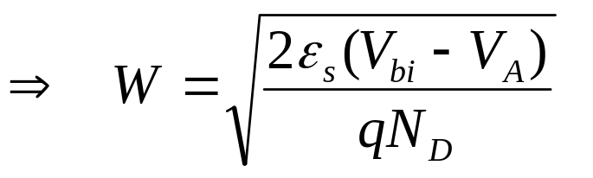
Depletion Width, W, for V_{A} ≠ 0
Last time, we found that
At x = 0, V = - (V_{bi} - V_{A})
W increases with increasing –V_{A}
W decreases with increasing N_{D}
EE130/230M Spring 2013
Lecture 8, Slide <number>

Slide 4
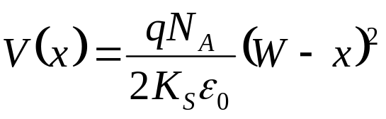
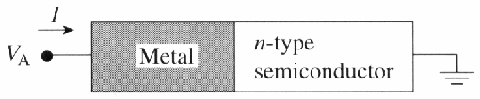
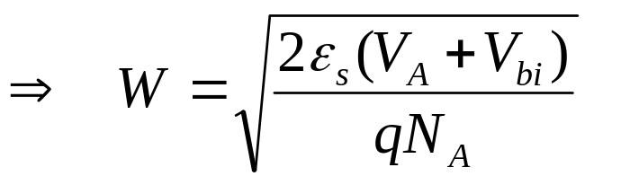
W for p-type Semiconductor
p-type
semiconductor
At x = 0, V = V_{bi} + V_{A}
W increases with increasing V_{A}
W decreases with increasing N_{A}
EE130/230M Spring 2013
Lecture 8, Slide <number>

Slide 5
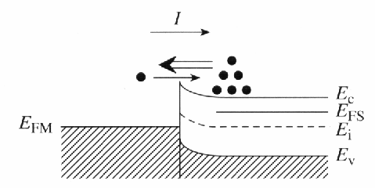
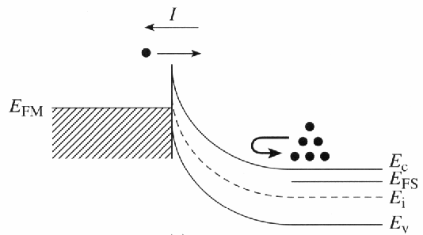
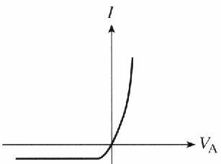
Current Flow
FORWARD BIAS
Current is determined by majority-carrier flow across the M-S junction:
  Under forward bias, majority-carrier diffusion from the semiconductor into the metal dominates
  Under reverse bias, majority-carrier diffusion from the metal into the semiconductor dominates
REVERSE BIAS
EE130/230M Spring 2013
Lecture 8, Slide <number>

Slide 6
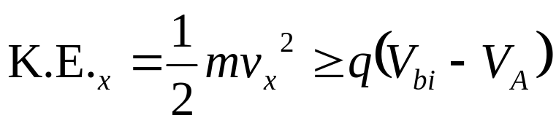
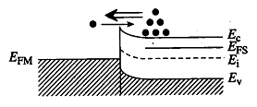
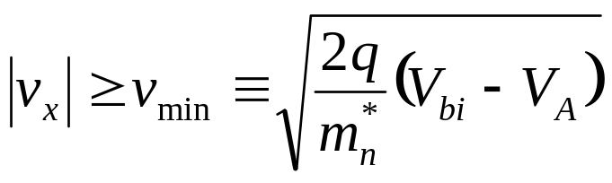
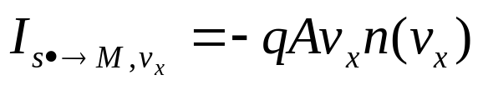
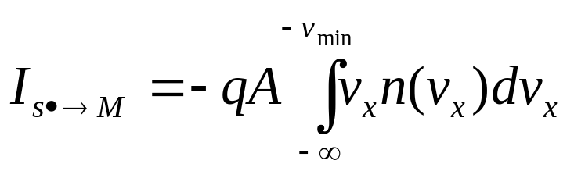
Thermionic Emission Theory
Electrons can cross the junction into the metal if
Thus the current for electrons at a given velocity is:
So, the total current over the barrier is:
EE130/230M Spring 2013
Lecture 8, Slide <number>

Slide 7
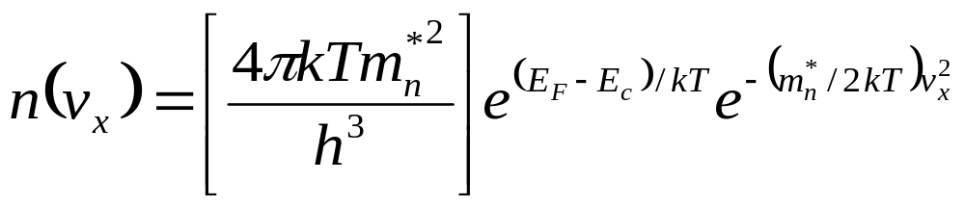
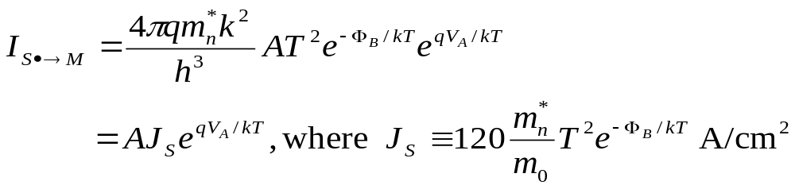
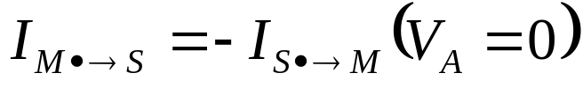
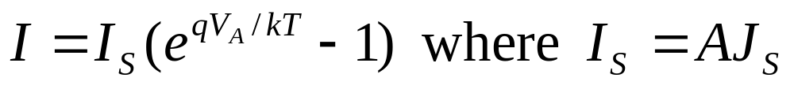
Schottky Diode I - V
For a nondegenerate semiconductor, it can be shown that
We can then obtain
In the reverse direction, the electrons always see the same barrier Φ_{B}, so
Therefore
EE130/230M Spring 2013
Lecture 8, Slide <number>

Slide 8
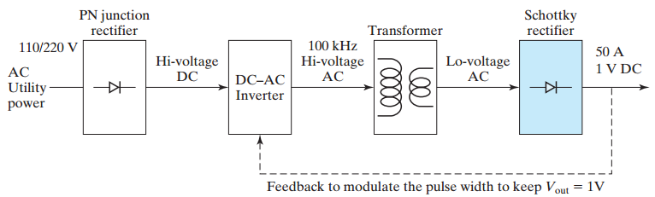
Applications of Schottky Diodes
I_{S} of a Schottky diode is 10³ to 10⁸ times larger than that of a pn junction diode, depending on Φ_{B} .
  → Schottky diodes are preferred rectifiers for low-voltage, high-current applications.
Block Diagram of a Switching Power Supply
EE130/230M Spring 2013
Lecture 8, Slide <number>

Slide 9
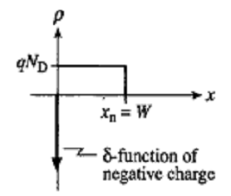
Charge Storage in a Schottky Diode
Charge is “stored” on both sides of the M-S contact.
  The applied bias V_{A} modulates this charge.
EE130/230M Spring 2013
Lecture 8, Slide <number>

Slide 10
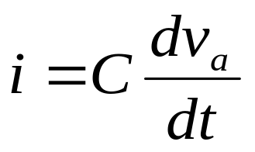
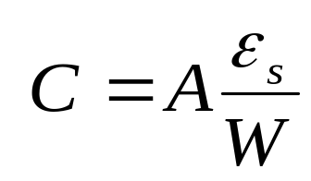
Small-Signal Capacitance
If an a.c. voltage v_{a} is applied in series with the d.c. bias V_{A}, the charge stored in the Schottky contact will be modulated at the frequency of the a.c. voltage
  displacement current will flow:
EE130/230M Spring 2013
Lecture 8, Slide <number>

Slide 11
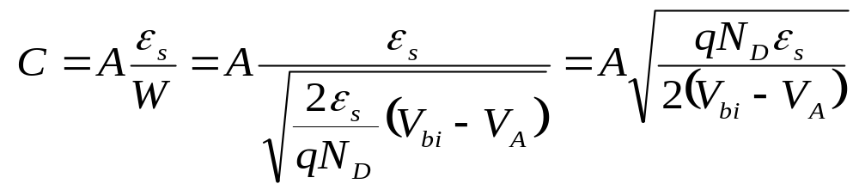
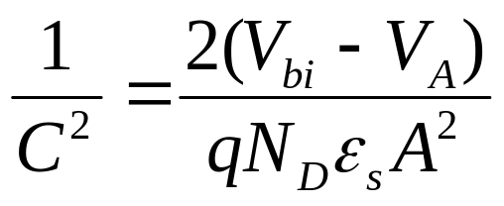
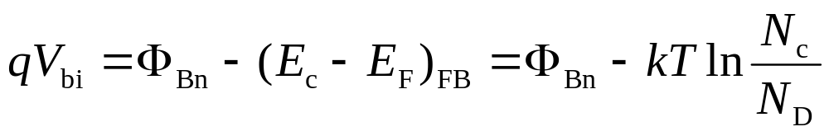
Using C-V Data to Determine Φ_{B}
Once V_{bi} and N_{D} are known, Φ_{Bn} can be determined:
EE130/230M Spring 2013
Lecture 8, Slide <number>

Slide 12
Practical Ohmic Contact
In practice, most M-S contacts are rectifying
To achieve a contact which conducts easily in both directions, we dope the semiconductor very heavily
  → W is so narrow that carriers can “tunnel” directly through the barrier
EE130/230M Spring 2013
Lecture 8, Slide <number>

Slide 13
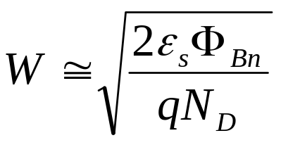
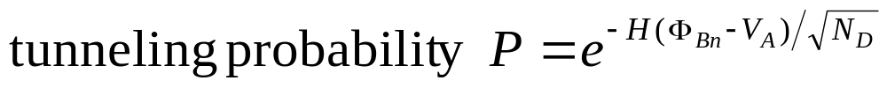
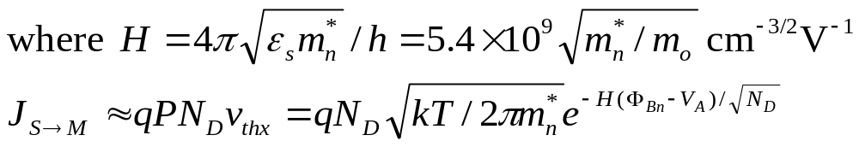
Tunneling Current Density
Equilibrium Band Diagram
Band Diagram for V_{A}≠0
qV_{bi}≅Φ_{Bn}
q(V_{bi}-V_{A})
E_{FM}
E_{c}, E_{FS}
E_{FM}
E_{c}, E_{FS}
E_{v}
E_{v}
EE130/230M Spring 2013
Lecture 8, Slide <number>

Slide 14
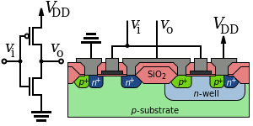
Example: Ohmic Contacts in CMOS
EE130/230M Spring 2013
Lecture 8, Slide <number>

Slide 15
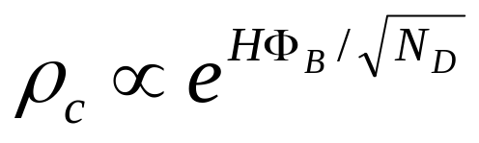
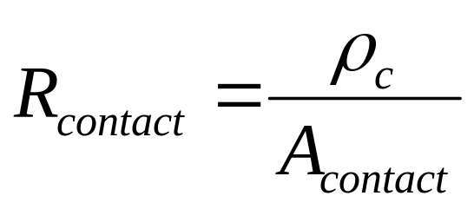
Specific Contact Resistivity, ρ_{c}
Unit: Ω-cm²
  ρ_{c} is the resistance of a 1 cm² contact
For a practical ohmic contact,
  → want small Φ_{B}, large N_{D} for small contact resistance
EE130/230M Spring 2013
Lecture 8, Slide <number>

Slide 16
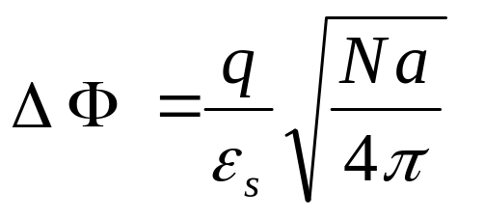
Approaches to Lowering Φ_{B}
Image-force barrier lowering
ΔΦ
Φ_{Bo}
N = dopant concentration in surface region
a = width of heavily doped surface region
E_{F}
E_{c}
metal
n+ Si
  → Very high active dopant concentration desired
Φ_{M} engineering
  Impurity segregation via silicidation
  Dual ( low-Φ_{M} / high-Φ_{M} ) silicide technology
A. Kinoshita et al. (Toshiba), 2004 Symp. VLSI Technology Digest, p. 168
Band-gap reduction
  strain
  germanium incorporation
A. Yagishita et al. (UC-Berkeley), 2003 SSDM Extended Abstracts, p. 708
M. C. Ozturk et al. (NCSU),
2002 IEDM Technical Digest, p. 375
EE130/230M Spring 2013
Lecture 8, Slide <number>

Slide 17
Voltage Drop across an Ohmic Contact
Ideally, R_{contact} is very small, so little voltage is dropped across the ohmic contact, i.e. V_{A} ≈ 0 Volts
  equilibrium conditions prevail
EE130/230M Spring 2013
Lecture 8, Slide <number>

Slide 18
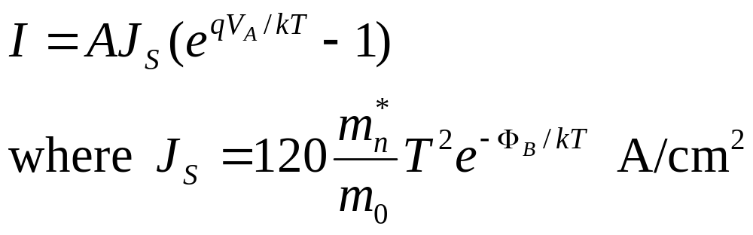
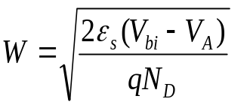
Summary
Charge is “stored” in a Schottky diode.
  The applied bias V_{A} modulates this charge and thus the voltage drop across the semiconductor depletion region
  → The flow of majority carriers into the metal depends exponentially on V_{A}
small-signal capacitance
EE130/230M Spring 2013
Lecture 8, Slide <number>

Slide 19
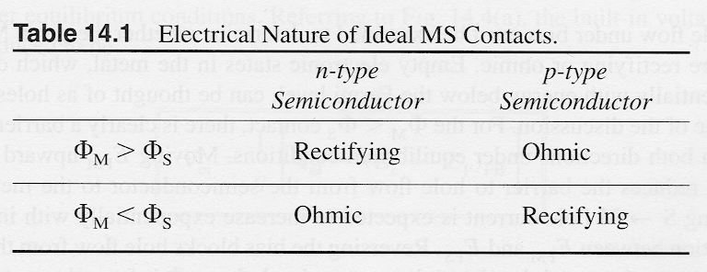
Summary (cont’d)
E_{c}
E_{c}
E_{F}
E_{v}
E_{F}
E_{v}
E_{c}
E_{c}
E_{F}
E_{F}
E_{v}
E_{v}
Since it is difficult to achieve small Φ_{B} in practice, ohmic
contacts are achieved with heavy doping, in practice:
E_{c}
E_{F}
E_{c}
E_{F}
E_{v}
E_{v}
EE130/230M Spring 2013
Lecture 8, Slide <number>

