Slide 1
Lecture 9
OUTLINE
pn Junction Diodes
  Electrostatics (step junction)
Reading: Pierret 5; Hu 4.1-4.2

Slide 2
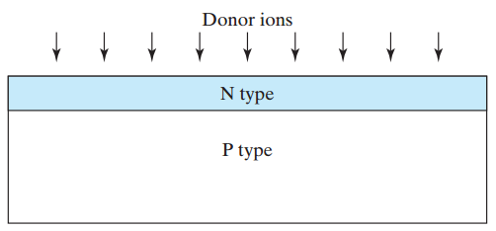
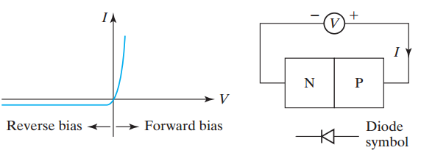
pn Junctions
A pn junction is typically fabricated by implanting or diffusing donor atoms into a p-type substrate to form an n-type layer:
A pn junction has a rectifying current-vs.-voltage characteristic:
EE130/230M Spring 2013
Lecture 9, Slide <number>

Slide 3
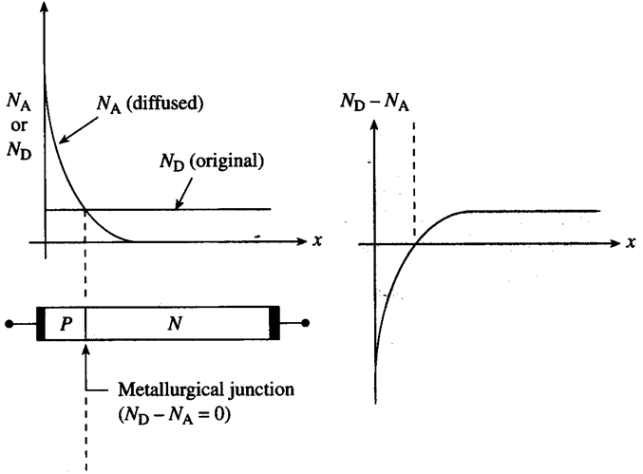
Terminology
Doping Profile:
EE130/230M Spring 2013
Lecture 9, Slide <number>

Slide 4
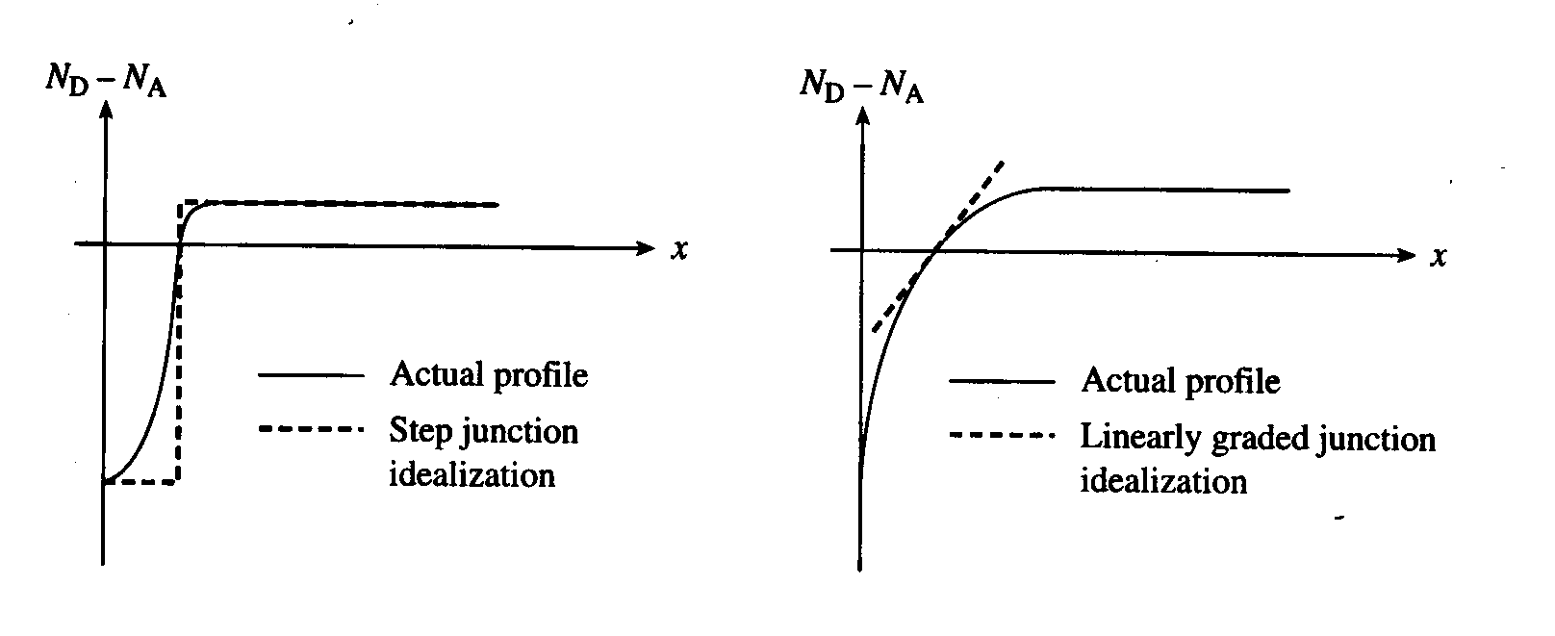
Idealized pn Junctions
In the analysis going forward, we will consider only the net dopant concentration on each side of the pn junction:
  N_{A} ≡ net acceptor doping on the p side: (N_{A}-N_{D})_{p-side}
  N_{D} ≡ net donor doping on the n side: (N_{D}-N_{A})_{n-side}
EE130/230M Spring 2013
Lecture 9, Slide <number>

Slide 5
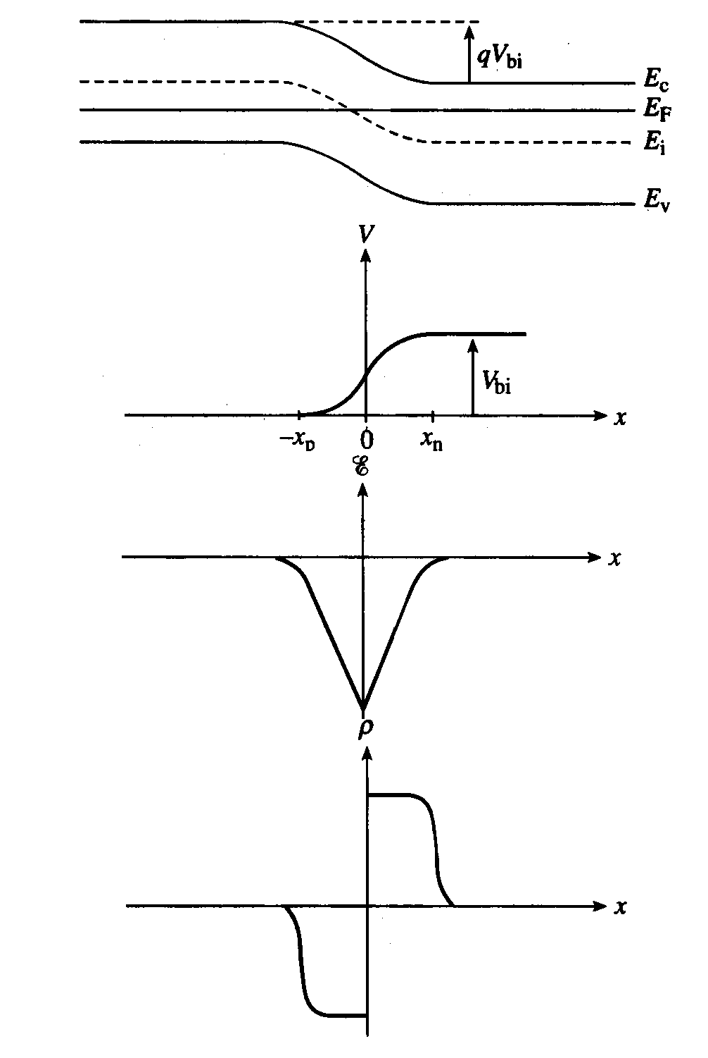
Electrostatics (Step Junction)
Band diagram:
Electrostatic potential:
Electric field:
Charge density:
EE130/230M Spring 2013
Lecture 9, Slide <number>

Slide 6
“Game Plan” to obtain ρ(x), E(x), V(x)
Find the built-in potential V_{bi}
Use the depletion approximation → ρ (x)
  (depletion widths x_{p}, x_{n} unknown)
Integrate ρ (x) to find E(x)
  Apply boundary conditions E(-x_{p})=0, E(x_{n})=0
Integrate E(x) to obtain V(x)
  Apply boundary conditions V(-x_{p})=0, V(x_{n})=V_{bi}
For E(x) to be continuous at x=0, N_{A}x_{p} = N_{D}x_{n}
  Solve for x_{p}, x_{n}
EE130/230M Spring 2013
Lecture 9, Slide <number>

Slide 7

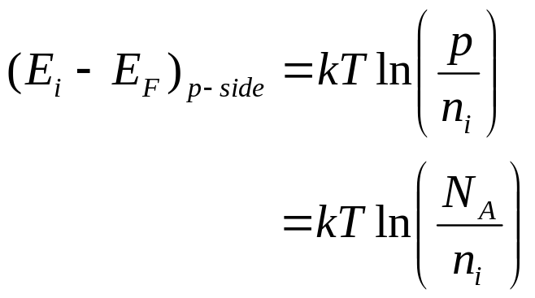
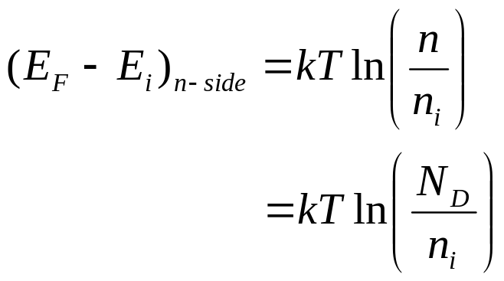
Built-In Potential V_{bi}
For non-degenerately doped material:
EE130/230M Spring 2013
Lecture 9, Slide <number>

Slide 8
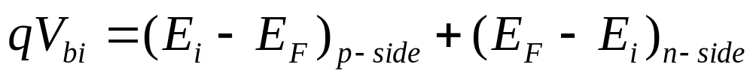
What if one side is degenerately doped?
p⁺n junction
n⁺p junction
EE130/230M Spring 2013
Lecture 9, Slide <number>

Slide 9
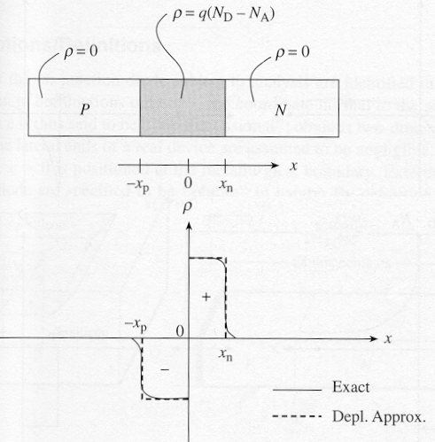
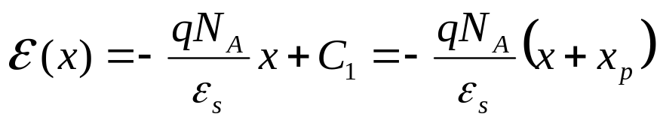
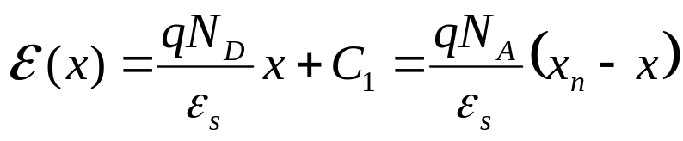
The Depletion Approximation
In the depletion region on the p side, ρ = –qN_{A}
In the depletion region on the n side, ρ = qN_{D}
EE130/230M Spring 2013
Lecture 9, Slide <number>

Slide 10
Electric Field Distribution
E(x)
-x_{p}
x_{n}
x
The electric field is continuous at x = 0
→ N_{A}x_{p} = N_{D}x_{n}
EE130/230M Spring 2013
Lecture 9, Slide <number>

Slide 11
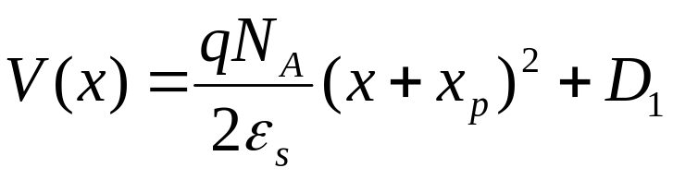
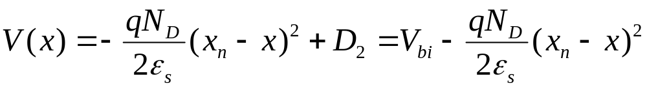
Electrostatic Potential Distribution
On the p side:
Choose V(-x_{p}) to be 0
⇒ V(x_{n}) = V_{bi}
On the n side:
EE130/230M Spring 2013
Lecture 9, Slide <number>

Slide 12
Derivation of Depletion Width
At x = 0, expressions for p side and n side must be equal:
We also know that N_{A}x_{p} = N_{D}x_{n}
EE130/230M Spring 2013
Lecture 9, Slide <number>

Slide 13
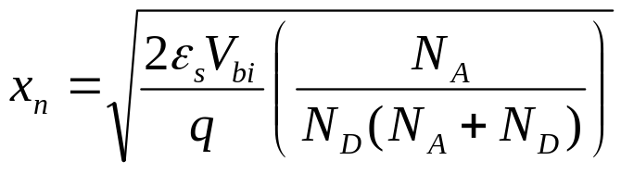
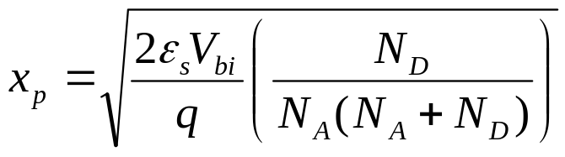
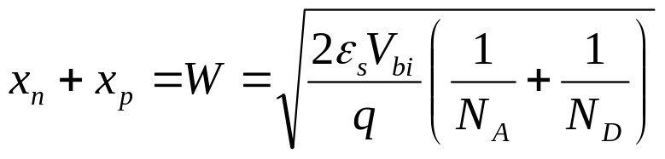
Depletion Width
Eliminating x_{p}, we have:
Eliminating x_{n}, we have:
Summing, we have:
EE130/230M Spring 2013
Lecture 9, Slide <number>

Slide 14
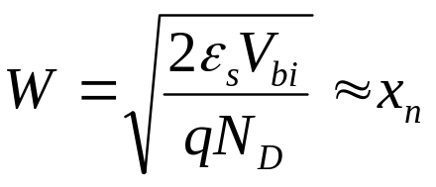

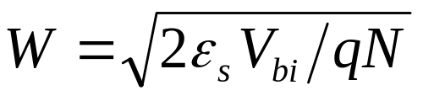
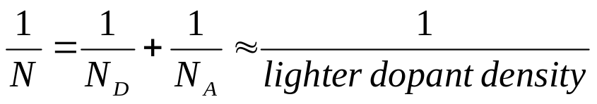
Depletion Width in a One-Sided Junction
If N_{A} >> N_{D} as in a p⁺n junction:
What about a n⁺p junction?
where
EE130/230M Spring 2013
Lecture 9, Slide <number>

Slide 15
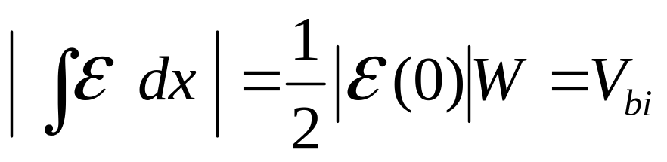
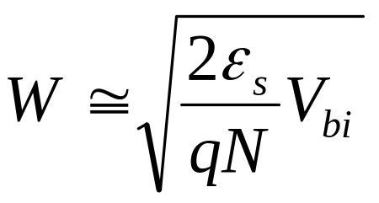
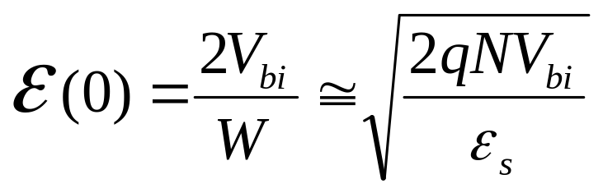
Peak E-Field in a One-Sided Junction
EE130/230M Spring 2013
Lecture 10, Slide <number>

Slide 16
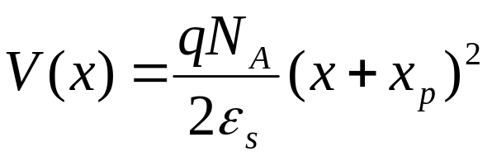
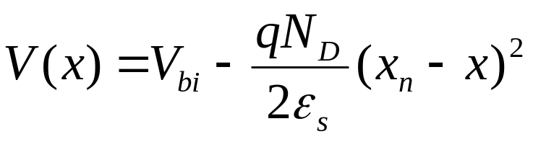
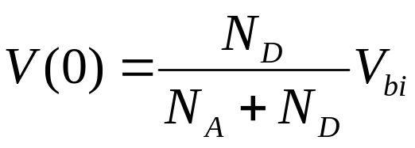
V(x) in a One-Sided Junction
p side
n side
EE130/230M Spring 2013
Lecture 9, Slide <number>

Slide 17
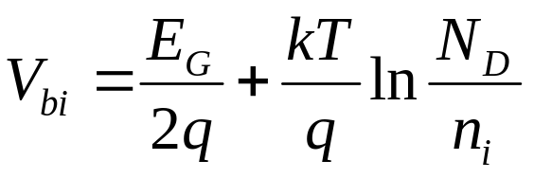
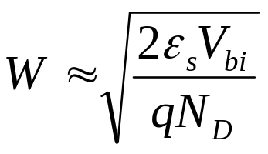


Example: One-Sided pn Junction
A p⁺n junction has N_{A}=10²⁰ cm⁻³ and N_{D} =10¹⁷cm⁻³.
Find (a) V_{bi} (b) W (c) x_{n} and (d) x_{p} .
EE130/230M Spring 2013
Lecture 9, Slide <number>

Slide 18
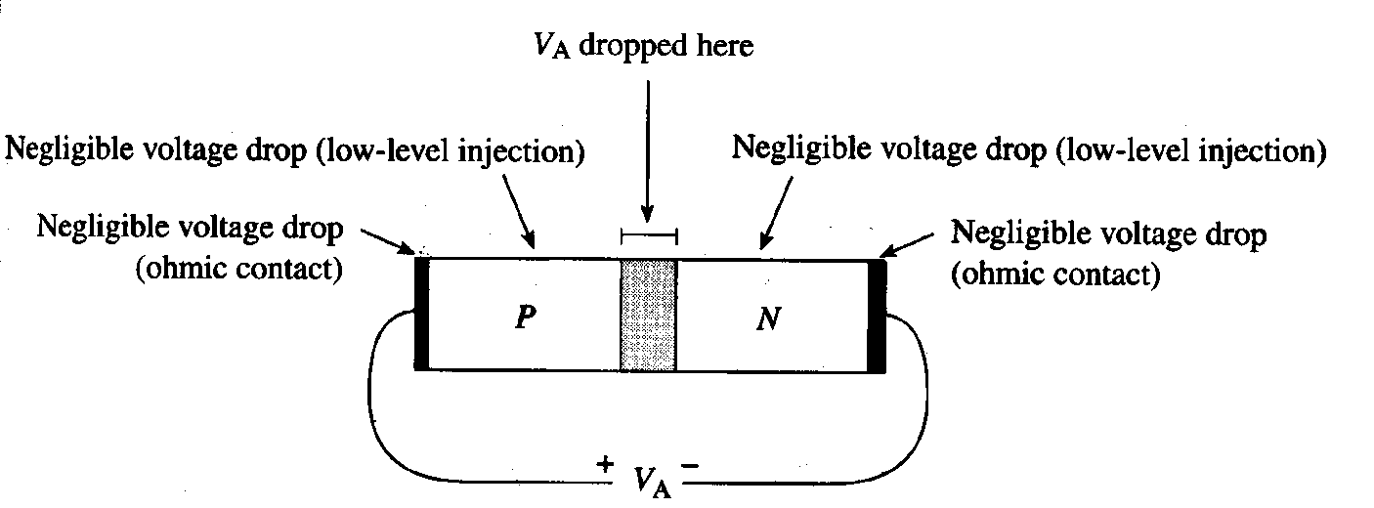
Voltage Drop across a pn Junction
Note that V_{A} should be significantly smaller than V_{bi} in order for low-level injection conditions to prevail in the quasi-neutral regions.
EE130/230M Spring 2013
Lecture 9, Slide <number>

Slide 19
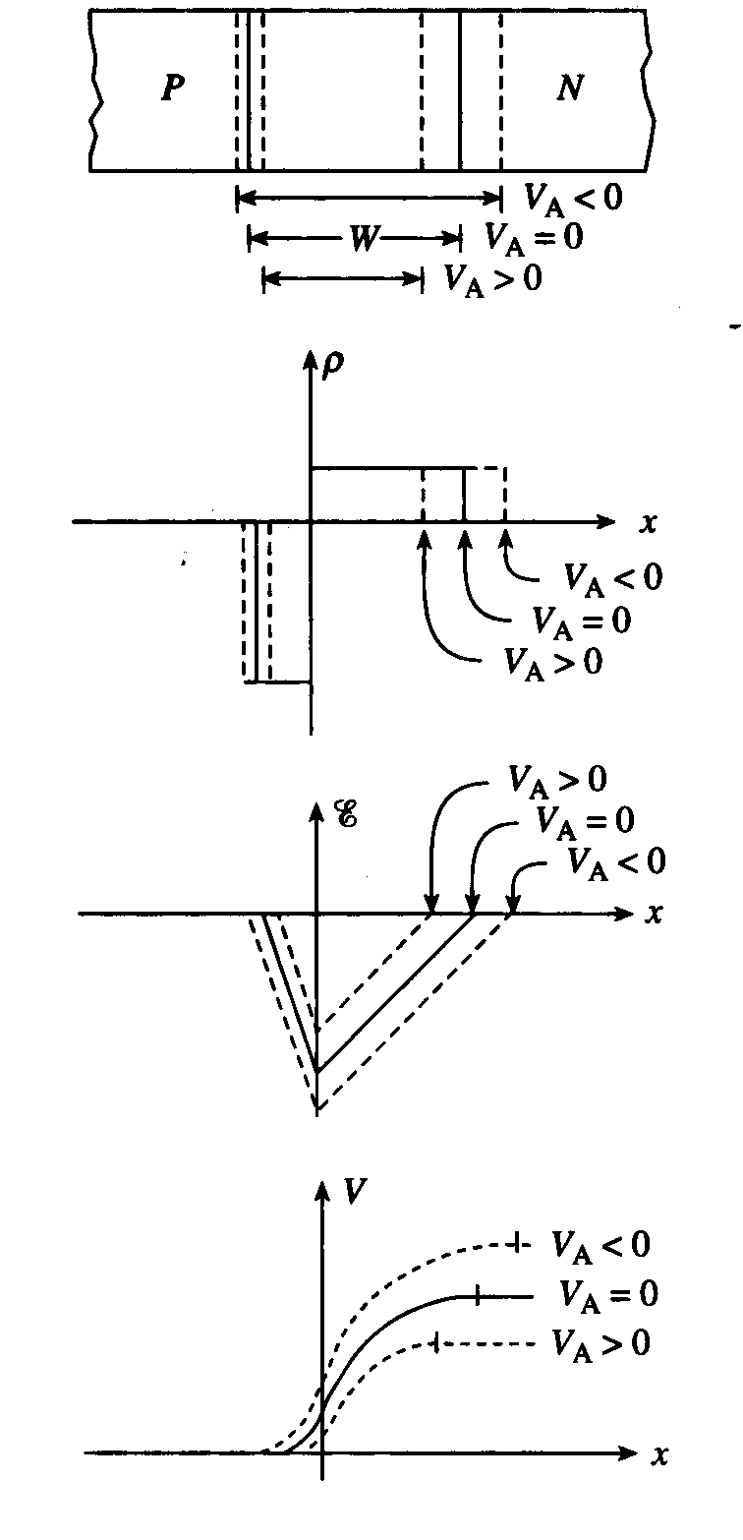
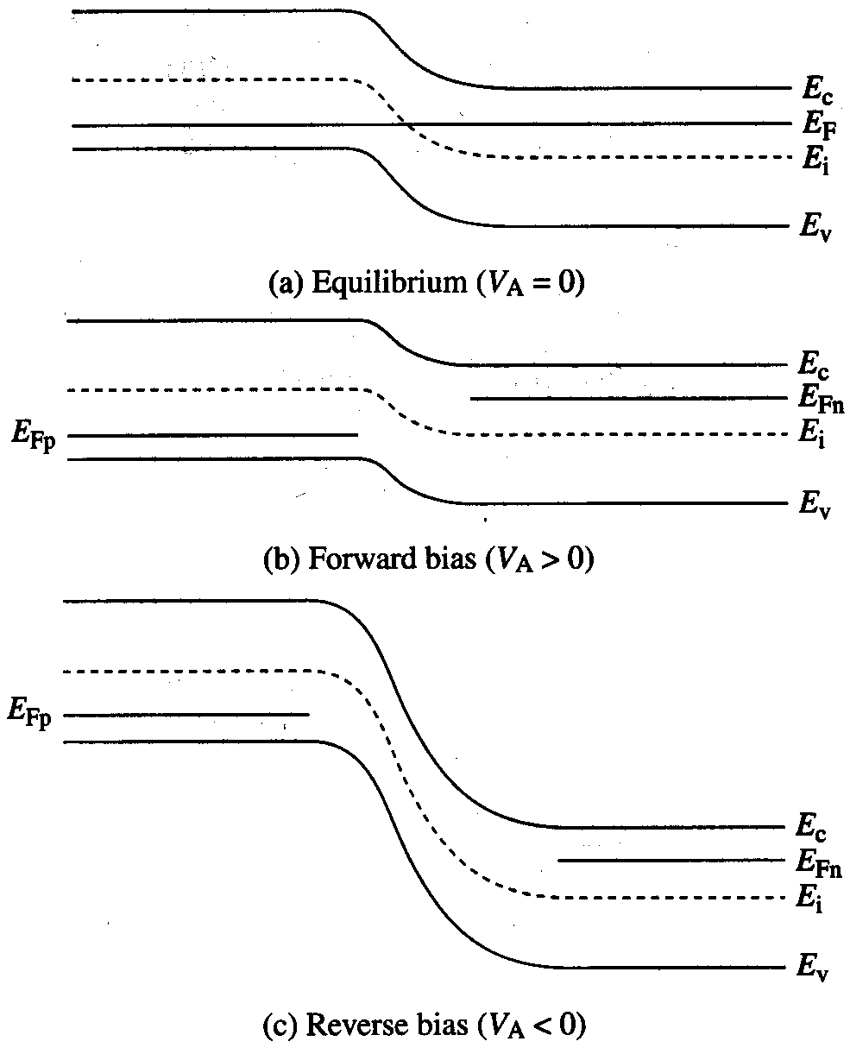
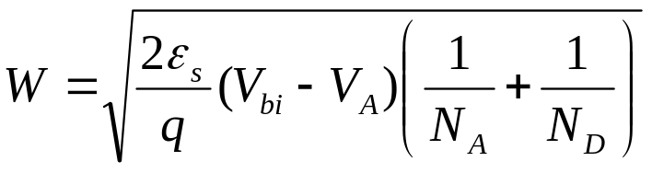
Effect of Applied Voltage
EE130/230M Spring 2013
Lecture 9, Slide <number>

Slide 20
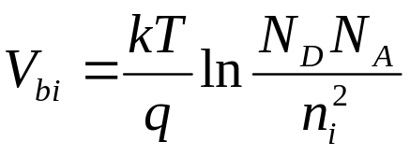
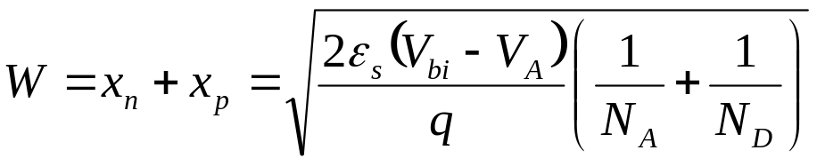
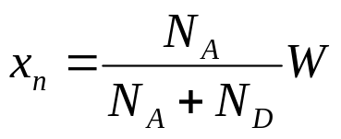
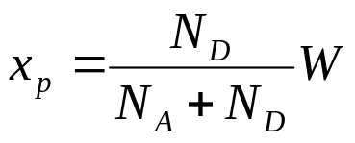
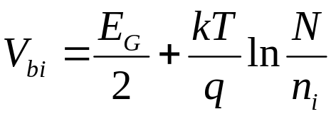
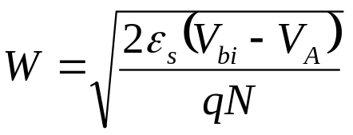
Summary
For a non-degenerately-doped pn junction:
  Built-in potential
  Depletion width
For a one-sided junction:
  Built-in potential
  Depletion width
EE130/230M Spring 2013
Lecture 9, Slide <number>

Slide 21
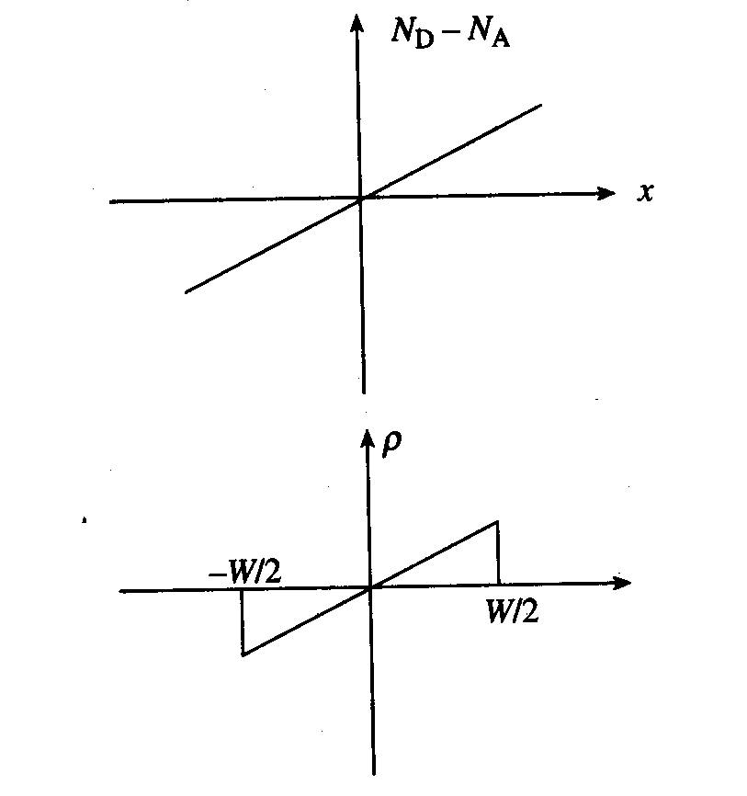
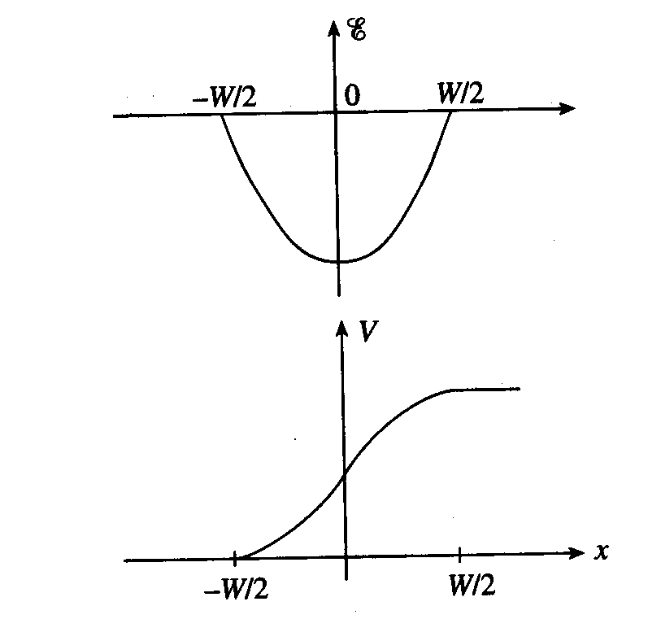
Linearly Graded pn Junction
EE130/230M Spring 2013
Lecture 9, Slide <number>

