Slide 2
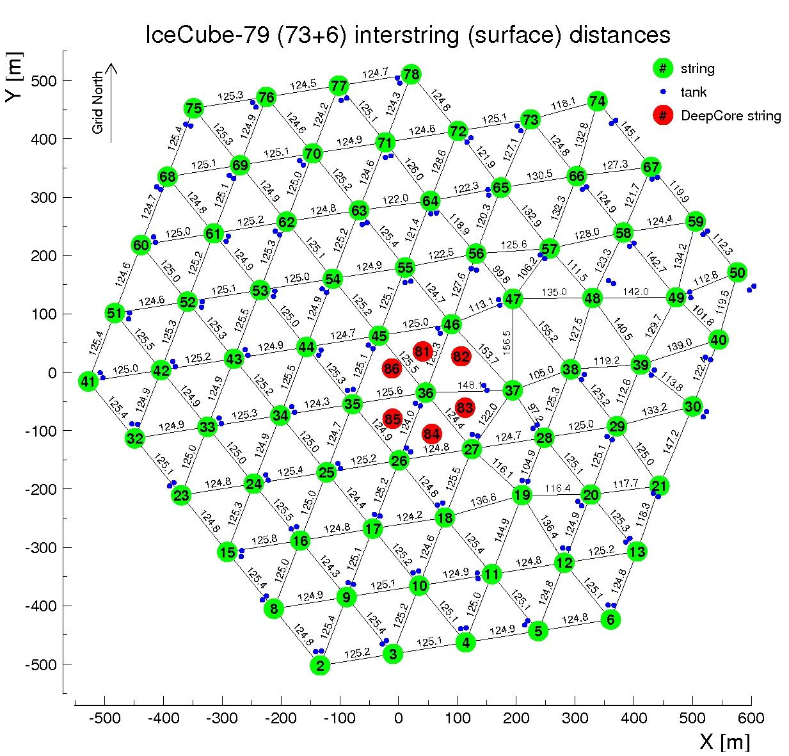

Slide 3
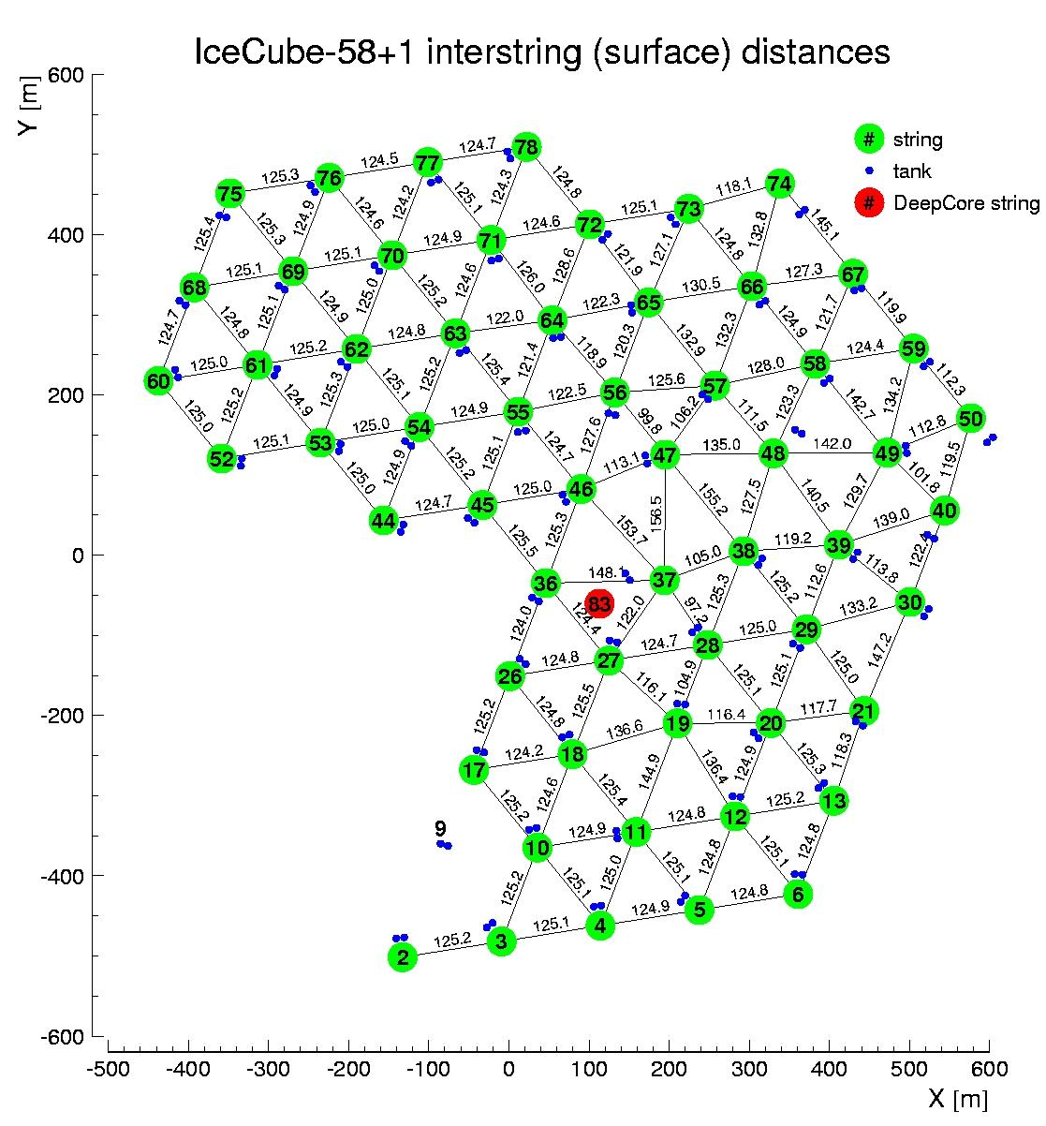

Slide 4
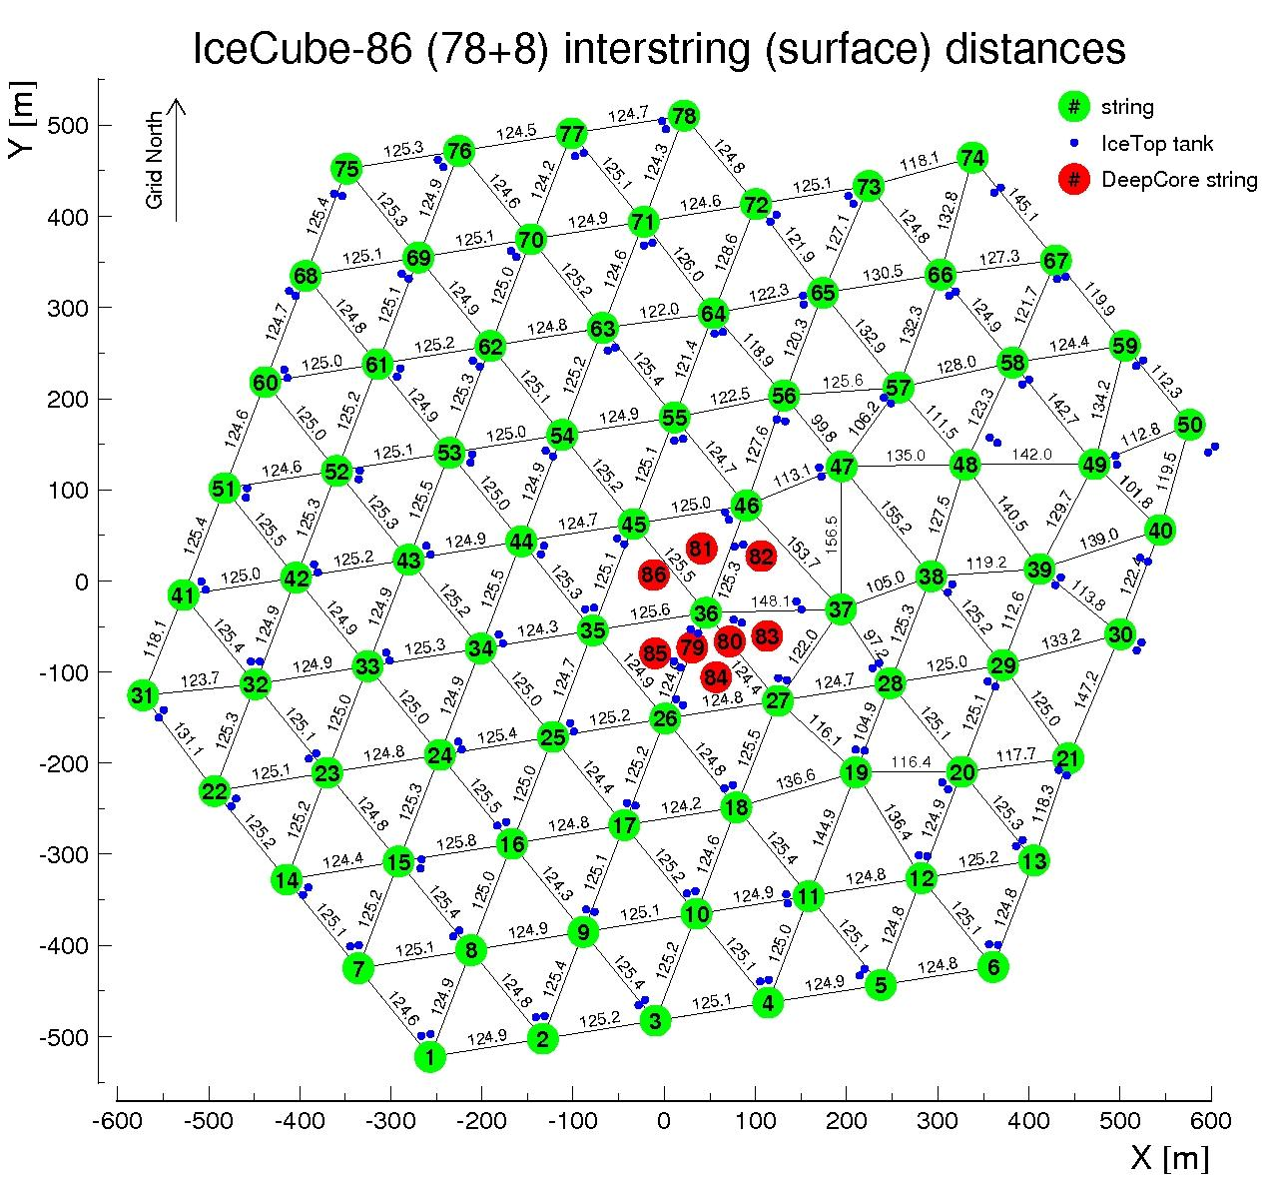

Slide 6
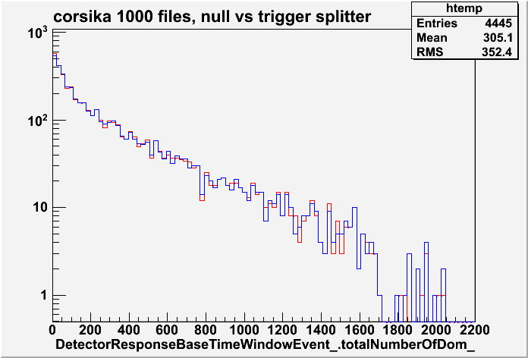
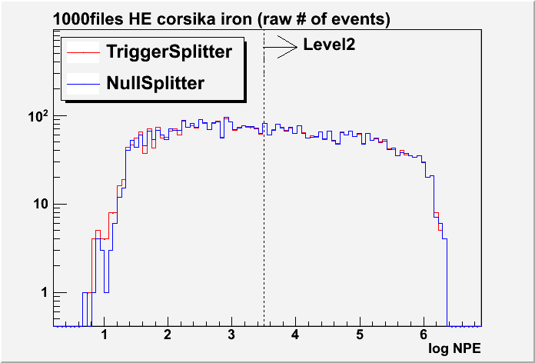
Corsika 1000 files trigger-splitter null-splitter (raw distribution)

Slide 7
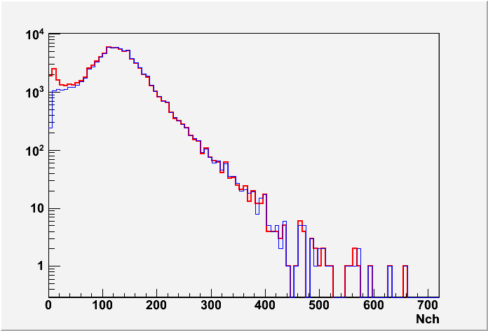
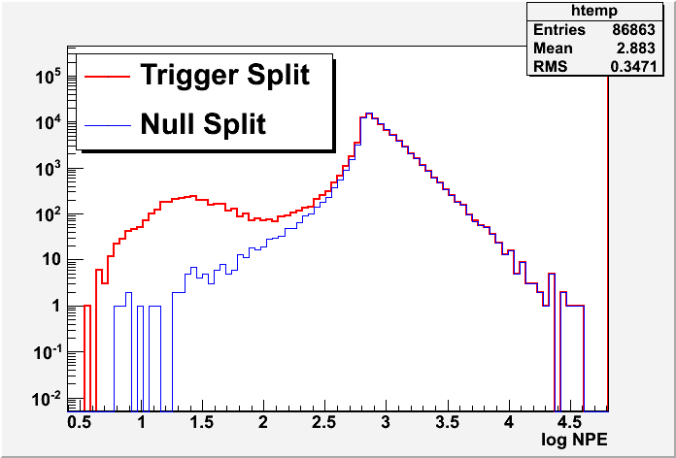
IC59 run115140 trigger-splitter null-splitter

Slide 8
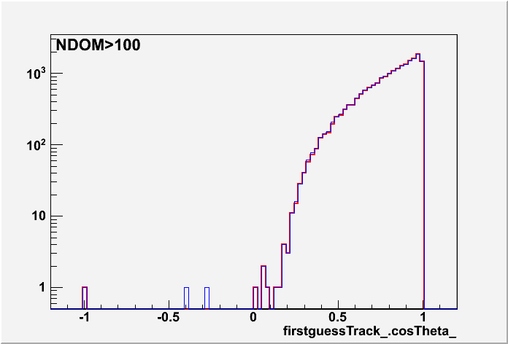
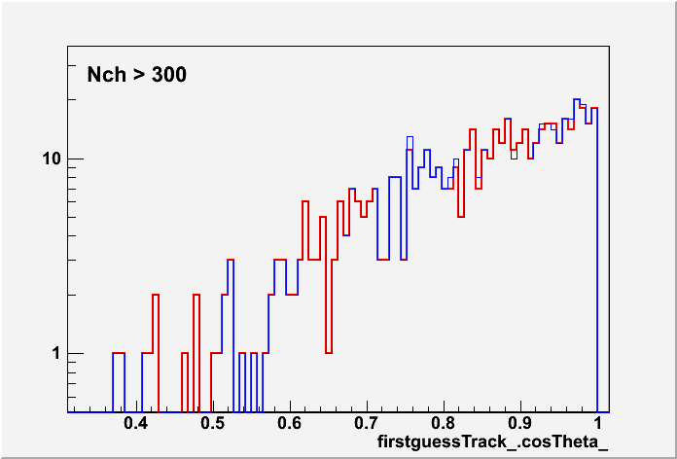
IC59 run115140 trigger-splitter null-splitter 2

Slide 9
Example Triggers IC86-I, Corsika
===== I3TriggerHierarchy =====
*** TRIGGER DUMP - BEGIN***
GLOBAL MERGED 0 configID not set FIRED length = 23.0951 mus time = 0 mus
GLOBAL THROUGHPUT 0 configID not set FIRED length = 20 mus time = 0 mus
IN_ICE VOLUME 0 21001 FIRED length = 0.9861 mus time = 10 mus
GLOBAL THROUGHPUT 0 configID not set FIRED length = 20 mus time = 0 mus
IN_ICE STRING 0 1007 FIRED length = 1.4388 mus time = 10 mus
GLOBAL THROUGHPUT 0 configID not set FIRED length = 21.2352 mus time = 0 mus
IN_ICE SIMPLE_MULTIPLICITY 0 1006 FIRED length = 5.2352 mus time = 10 mus
GLOBAL THROUGHPUT 0 configID not set FIRED length = 20 mus time = 1.0399 mus
IN_ICE VOLUME 0 21001 FIRED length = 0.9555 mus time = 11.0399 mus
GLOBAL THROUGHPUT 0 configID not set FIRED length = 20 mus time = 1.5474 mus
IN_ICE STRING 0 1007 FIRED length = 1.3719 mus time = 11.5474 mus
GLOBAL THROUGHPUT 0 configID not set FIRED length = 20 mus time = 2.0629 mus
IN_ICE VOLUME 0 21001 FIRED length = 0.9902 mus time = 12.0629 mus
GLOBAL THROUGHPUT 0 configID not set FIRED length = 20 mus time = 3.0951 mus
IN_ICE VOLUME 0 21001 FIRED length = 0.749 mus time = 13.0951 mus
GLOBAL THROUGHPUT 0 configID not set FIRED length = 20 mus time = 1.6167 mus
IN_ICE SIMPLE_MULTIPLICITY 0 1011 FIRED length = 3.6185 mus time = 11.6167 mus
*** TRIGGER DUMP - END***
===== I3TriggerHierarchy =====
*** TRIGGER DUMP - BEGIN***
GLOBAL MERGED 0 configID not set FIRED length = 27.9489 mus time = 0 mus
GLOBAL THROUGHPUT 0 configID not set FIRED length = 20 mus time = 0 mus
IN_ICE VOLUME 0 21001 FIRED length = 0.9944 mus time = 10 mus
GLOBAL THROUGHPUT 0 configID not set FIRED length = 20 mus time = 0 mus
IN_ICE STRING 0 1007 FIRED length = 1.4928 mus time = 10 mus
GLOBAL THROUGHPUT 0 configID not set FIRED length = 27.2307 mus time = 0 mus
IN_ICE SIMPLE_MULTIPLICITY 0 1006 FIRED length = 11.2307 mus time = 10 mus
GLOBAL THROUGHPUT 0 configID not set FIRED length = 20 mus time = 1.033 mus
IN_ICE VOLUME 0 21001 FIRED length = 0.9667 mus time = 11.033 mus
GLOBAL THROUGHPUT 0 configID not set FIRED length = 20 mus time = 1.5575 mus
IN_ICE STRING 0 1007 FIRED length = 1.3913 mus time = 11.5575 mus
GLOBAL THROUGHPUT 0 configID not set FIRED length = 20 mus time = 2.0544 mus
IN_ICE VOLUME 0 21001 FIRED length = 0.9487 mus time = 12.0544 mus
GLOBAL THROUGHPUT 0 configID not set FIRED length = 20 mus time = 3.0768 mus
IN_ICE STRING 0 1007 FIRED length = 1.4067 mus time = 13.0768 mus
GLOBAL THROUGHPUT 0 configID not set FIRED length = 20 mus time = 3.0768 mus
IN_ICE VOLUME 0 21001 FIRED length = 0.9994 mus time = 13.0768 mus
GLOBAL THROUGHPUT 0 configID not set FIRED length = 20 mus time = 4.1817 mus
IN_ICE VOLUME 0 21001 FIRED length = 0.7125 mus time = 14.1817 mus
GLOBAL THROUGHPUT 0 configID not set FIRED length = 20 mus time = 7.9489 mus
IN_ICE VOLUME 0 21001 FIRED length = 0.8744 mus time = 17.9489 mus
*** TRIGGER DUMP - END***
===== I3TriggerHierarchy =====
*** TRIGGER DUMP - BEGIN***
GLOBAL THROUGHPUT 0 configID not set FIRED length = 20.4918 mus time = 0 mus
IN_ICE SIMPLE_MULTIPLICITY 0 1006 FIRED length = 4.49185 mus time = 10 mus
*** TRIGGER DUMP - END***
===== I3TriggerHierarchy =====
*** TRIGGER DUMP - BEGIN***
GLOBAL THROUGHPUT 0 configID not set FIRED length = 20 mus time = 0 mus
IN_ICE SIMPLE_MULTIPLICITY 0 1006 FIRED length = 1.36739 mus time = 10 mus
*** TRIGGER DUMP - END***
===== I3TriggerHierarchy =====
*** TRIGGER DUMP - BEGIN***
GLOBAL THROUGHPUT 0 configID not set FIRED length = 32.123 mus time = 0 mus
IN_ICE SIMPLE_MULTIPLICITY 0 1006 FIRED length = 16.123 mus time = 10 mus
*** TRIGGER DUMP - END***
===== I3TriggerHierarchy =====
*** TRIGGER DUMP - BEGIN***
GLOBAL THROUGHPUT 0 configID not set FIRED length = 29.2065 mus time = 0 mus
IN_ICE SIMPLE_MULTIPLICITY 0 1006 FIRED length = 13.2065 mus time = 10 mus
*** TRIGGER DUMP - END***
****************
===== I3TriggerHierarchy =====
*** TRIGGER DUMP - BEGIN***
GLOBAL THROUGHPUT 0 configID not set FIRED length = 20 mus time = 0 mus
IN_ICE SIMPLE_MULTIPLICITY 0 1006 FIRED length = 3.47577 mus time = 10 mus
*** TRIGGER DUMP - END***

Slide 10
Example Triggers: IC86-II, IC86-III
===== I3TriggerHierarchy =====
*** TRIGGER DUMP - BEGIN***
GLOBAL MERGED 0 configID not set FIRED length = 22.239 mus time = 6 mus
GLOBAL THROUGHPUT 0 configID not set FIRED length = 10.856 mus time = 10.12 mus
IN_ICE VOLUME 0 21001 FIRED length = 0.856 mus time = 14.12 mus
GLOBAL THROUGHPUT 0 configID not set FIRED length = 11.406 mus time = 9.115 mus
IN_ICE STRING 0 1007 FIRED length = 1.406 mus time = 13.115 mus
GLOBAL THROUGHPUT 0 configID not set FIRED length = 10.982 mus time = 9.073 mus
IN_ICE VOLUME 0 21001 FIRED length = 0.982 mus time = 13.073 mus
GLOBAL THROUGHPUT 0 configID not set FIRED length = 10.955 mus time = 8.071 mus
IN_ICE VOLUME 0 21001 FIRED length = 0.955 mus time = 12.071 mus
GLOBAL THROUGHPUT 0 configID not set FIRED length = 11.393 mus time = 7.632 mus
IN_ICE STRING 0 1007 FIRED length = 1.393 mus time = 11.632 mus
GLOBAL THROUGHPUT 0 configID not set FIRED length = 10.98 mus time = 7.022 mus
IN_ICE VOLUME 0 21001 FIRED length = 0.98 mus time = 11.022 mus
GLOBAL THROUGHPUT 0 configID not set FIRED length = 11.275 mus time = 6.143 mus
IN_ICE STRING 0 1007 FIRED length = 1.275 mus time = 10.143 mus
GLOBAL THROUGHPUT 0 configID not set FIRED length = 10.927 mus time = 6 mus
IN_ICE VOLUME 0 21001 FIRED length = 0.927 mus time = 10 mus
GLOBAL THROUGHPUT 0 configID not set FIRED length = 22.239 mus time = 6 mus
IN_ICE SIMPLE_MULTIPLICITY 0 1006 FIRED length = 12.239 mus time = 10 mus
*** TRIGGER DUMP - END***
===== I3TriggerHierarchy =====
*** TRIGGER DUMP - BEGIN***
GLOBAL MERGED 0 configID not set FIRED length = 27.907 mus time = 6 mus
GLOBAL THROUGHPUT 0 configID not set FIRED length = 14.867 mus time = 19.04 mus
IN_ICE SIMPLE_MULTIPLICITY 0 1011 FIRED length = 4.867 mus time = 23.04 mus
GLOBAL THROUGHPUT 0 configID not set FIRED length = 10.914 mus time = 14.138 mus
IN_ICE VOLUME 0 21001 FIRED length = 0.914 mus time = 18.138 mus
GLOBAL THROUGHPUT 0 configID not set FIRED length = 10.516 mus time = 13.425 mus
IN_ICE STRING 0 1007 FIRED length = 0.516 mus time = 17.425 mus
GLOBAL THROUGHPUT 0 configID not set FIRED length = 11 mus time = 13.074 mus
IN_ICE VOLUME 0 21001 FIRED length = 1 mus time = 17.074 mus
GLOBAL THROUGHPUT 0 configID not set FIRED length = 11.355 mus time = 11.917 mus
IN_ICE STRING 0 1007 FIRED length = 1.355 mus time = 15.917 mus
GLOBAL THROUGHPUT 0 configID not set FIRED length = 10.869 mus time = 11.917 mus
IN_ICE VOLUME 0 21001 FIRED length = 0.869 mus time = 15.917 mus
GLOBAL THROUGHPUT 0 configID not set FIRED length = 12.867 mus time = 11.462 mus
IN_ICE SIMPLE_MULTIPLICITY 0 1011 FIRED length = 2.867 mus time = 15.462 mus
GLOBAL THROUGHPUT 0 configID not set FIRED length = 10.923 mus time = 10.914 mus
IN_ICE VOLUME 0 21001 FIRED length = 0.923 mus time = 14.914 mus
GLOBAL THROUGHPUT 0 configID not set FIRED length = 11.457 mus time = 10.335 mus
IN_ICE STRING 0 1007 FIRED length = 1.457 mus time = 14.335 mus
GLOBAL THROUGHPUT 0 configID not set FIRED length = 10.999 mus time = 9.885 mus
IN_ICE VOLUME 0 21001 FIRED length = 0.999 mus time = 13.885 mus
GLOBAL THROUGHPUT 0 configID not set FIRED length = 11.483 mus time = 8.809 mus
IN_ICE STRING 0 1007 FIRED length = 1.483 mus time = 12.809 mus
GLOBAL THROUGHPUT 0 configID not set FIRED length = 10.987 mus time = 8.809 mus
IN_ICE VOLUME 0 21001 FIRED length = 0.987 mus time = 12.809 mus
GLOBAL THROUGHPUT 0 configID not set FIRED length = 10.185 mus time = 6 mus
IN_ICE VOLUME 0 21001 FIRED length = 0.185 mus time = 10 mus
GLOBAL THROUGHPUT 0 configID not set FIRED length = 10.185 mus time = 6 mus
IN_ICE STRING 0 1007 FIRED length = 0.185 mus time = 10 mus
GLOBAL THROUGHPUT 0 configID not set FIRED length = 27.907 mus time = 6 mus
IN_ICE SIMPLE_MULTIPLICITY 0 1006 FIRED length = 17.907 mus time = 10 mus
*** TRIGGER DUMP - END***
===== I3TriggerHierarchy =====
*** TRIGGER DUMP - BEGIN***
GLOBAL MERGED 0 configID not set FIRED length = 13.402 mus time = 6 mus
GLOBAL THROUGHPUT 0 configID not set FIRED length = 10.551 mus time = 8.851 mus
IN_ICE VOLUME 0 21001 FIRED length = 0.551 mus time = 12.851 mus
GLOBAL THROUGHPUT 0 configID not set FIRED length = 10.953 mus time = 8.449 mus
IN_ICE STRING 0 1007 FIRED length = 0.953 mus time = 12.449 mus
GLOBAL THROUGHPUT 0 configID not set FIRED length = 10.998 mus time = 7.814 mus
IN_ICE VOLUME 0 21001 FIRED length = 0.998 mus time = 11.814 mus
GLOBAL THROUGHPUT 0 configID not set FIRED length = 10.218 mus time = 7.814 mus
IN_ICE STRING 0 1007 FIRED length = 0.218 mus time = 11.814 mus
GLOBAL THROUGHPUT 0 configID not set FIRED length = 10.896 mus time = 6.779 mus
IN_ICE VOLUME 0 21001 FIRED length = 0.896 mus time = 10.779 mus
GLOBAL THROUGHPUT 0 configID not set FIRED length = 13.402 mus time = 6 mus
IN_ICE SIMPLE_MULTIPLICITY 0 1006 FIRED length = 3.402 mus time = 10 mus
*** TRIGGER DUMP - END***

Slide 11
Example Triggers: IC59, IC86-IC79
===== I3TriggerHierarchy =====
*** TRIGGER DUMP - BEGIN***
GLOBAL MERGED 0 configID not set FIRED length = 27.55 mus time = 0 mus
GLOBAL THROUGHPUT 0 configID not set FIRED length = 20 mus time = 0 mus
IN_ICE STRING 0 1007 FIRED length = 1.4889 mus time = 10 mus
GLOBAL THROUGHPUT 0 configID not set FIRED length = 24.9769 mus time = 0 mus
IN_ICE SIMPLE_MULTIPLICITY 0 1006 FIRED length = 8.9769 mus time = 10 mus
GLOBAL THROUGHPUT 0 configID not set FIRED length = 20 mus time = 1.5192 mus
IN_ICE STRING 0 1007 FIRED length = 1.3969 mus time = 11.5192 mus
GLOBAL THROUGHPUT 0 configID not set FIRED length = 20 mus time = 3.2388 mus
IN_ICE STRING 0 1007 FIRED length = 0.8626 mus time = 13.2388 mus
GLOBAL THROUGHPUT 0 configID not set FIRED length = 20 mus time = 7.55 mus
IN_ICE STRING 0 1007 FIRED length = 1.4269 mus time = 17.55 mus
GLOBAL THROUGHPUT 0 configID not set FIRED length = 23.0282 mus time = 2.0801 mus
IN_ICE SIMPLE_MULTIPLICITY 0 1008 FIRED length = 3.0282 mus time = 12.0801 mus
*** TRIGGER DUMP - END***
===== I3TriggerHierarchy =====
*** TRIGGER DUMP - BEGIN***
GLOBAL MERGED 0 configID not set FIRED length = 25.2269 mus time = 0 mus
GLOBAL THROUGHPUT 0 configID not set FIRED length = 20 mus time = 0 mus
IN_ICE STRING 0 1007 FIRED length = 1.4742 mus time = 10 mus
GLOBAL THROUGHPUT 0 configID not set FIRED length = 25.2269 mus time = 0 mus
IN_ICE SIMPLE_MULTIPLICITY 0 1006 FIRED length = 9.2269 mus time = 10 mus
GLOBAL THROUGHPUT 0 configID not set FIRED length = 20 mus time = 1.5092 mus
IN_ICE STRING 0 1007 FIRED length = 1.4838 mus time = 11.5092 mus
GLOBAL THROUGHPUT 0 configID not set FIRED length = 20 mus time = 3.1101 mus
IN_ICE STRING 0 1007 FIRED length = 1.2349 mus time = 13.1101 mus
*** TRIGGER DUMP - END***
IC59 NullSplit (full event vs InIceSplit)
Duration difference ~7000nsec

Slide 12
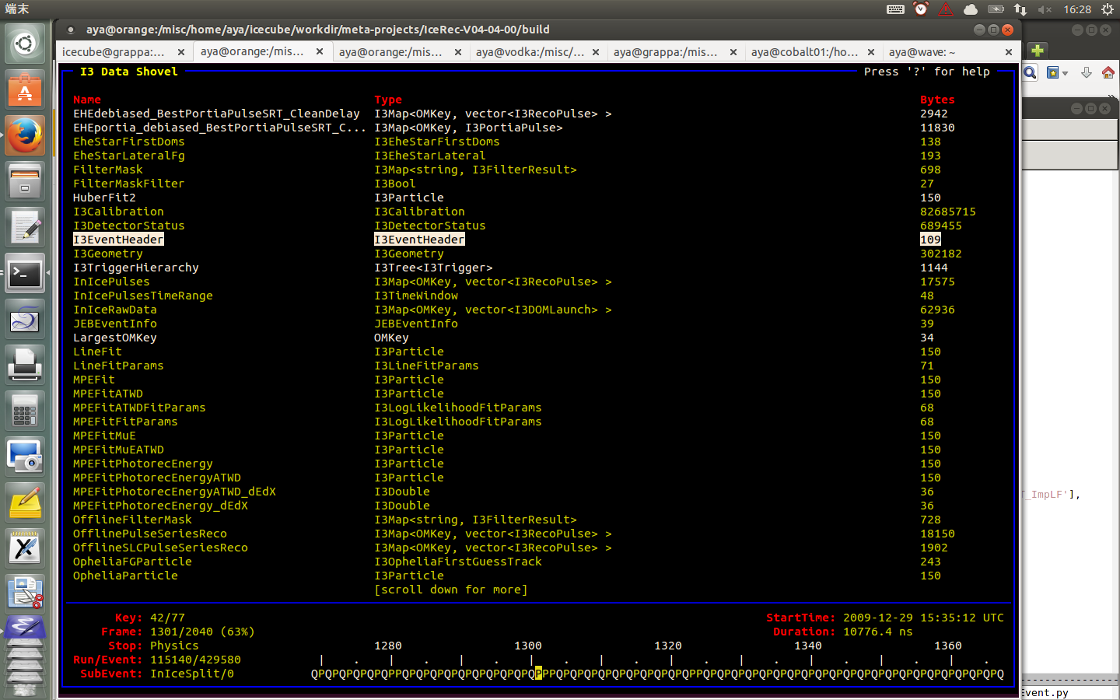
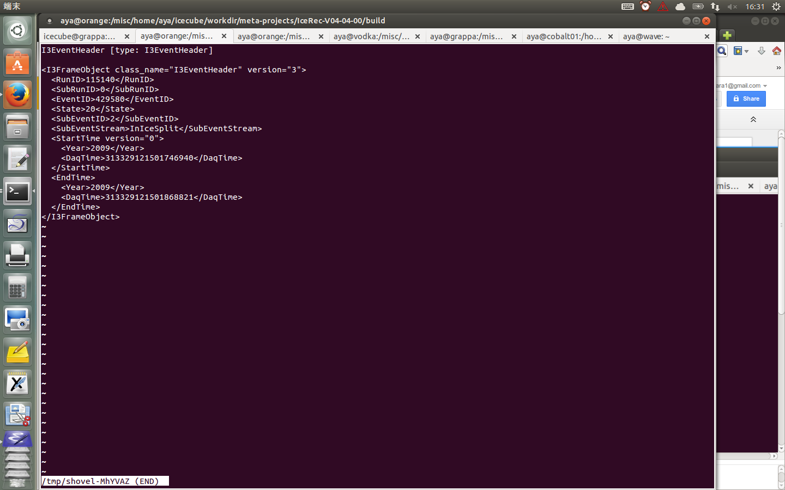

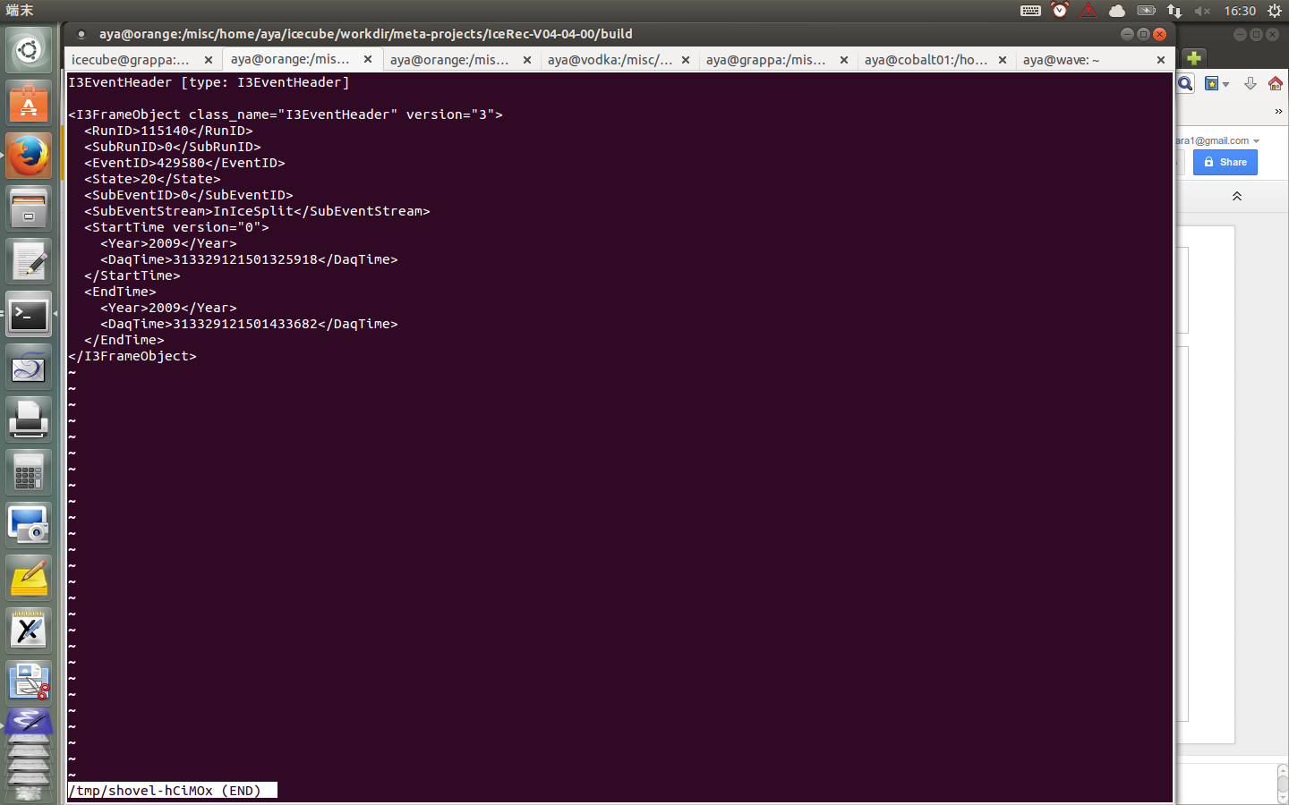
Level2 IC59 files

Slide 13
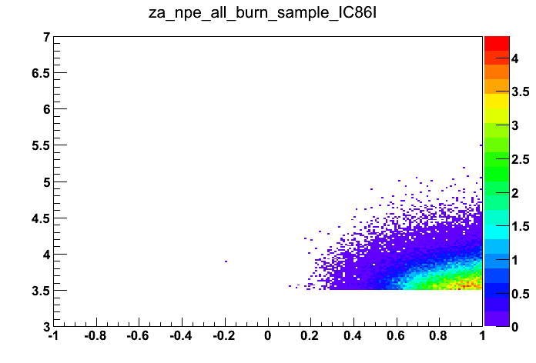
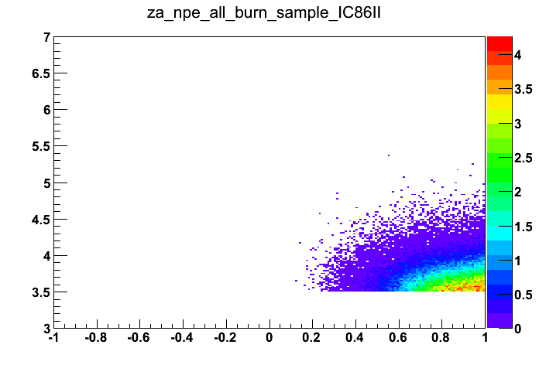

3 years NPE vs cos za distributions

Slide 14
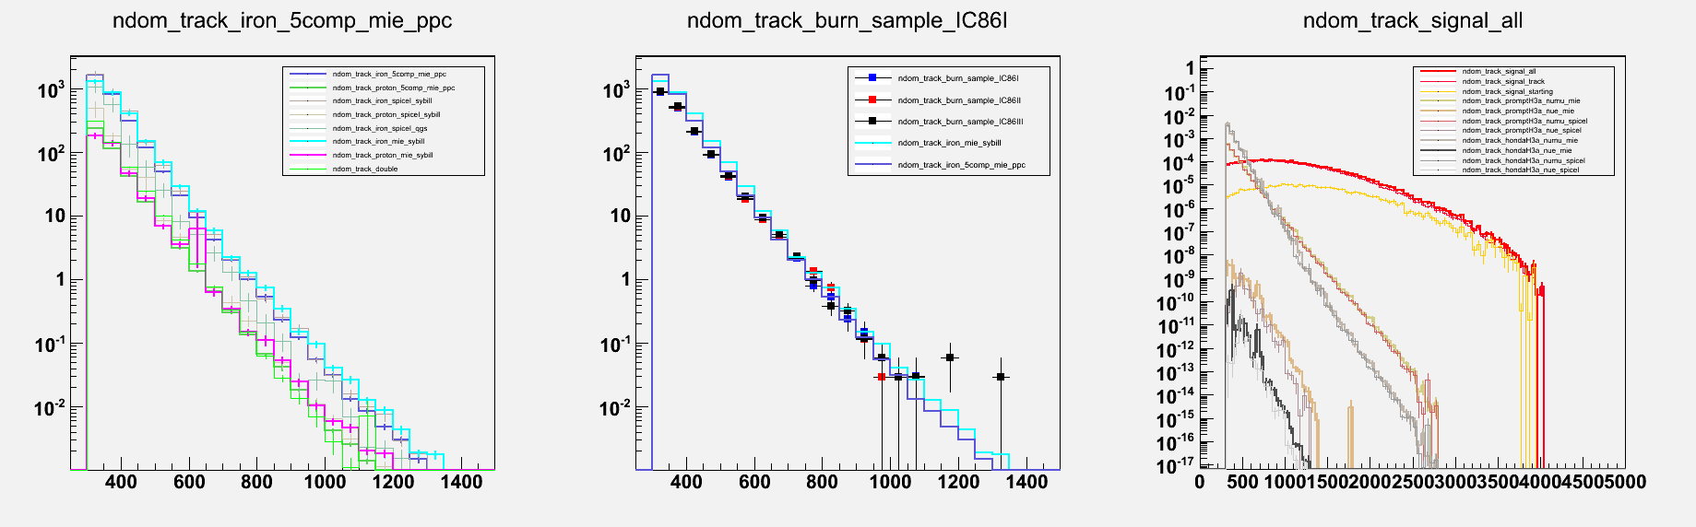
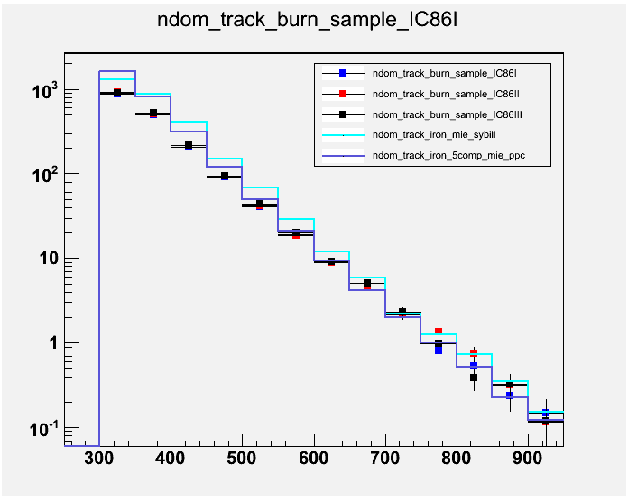
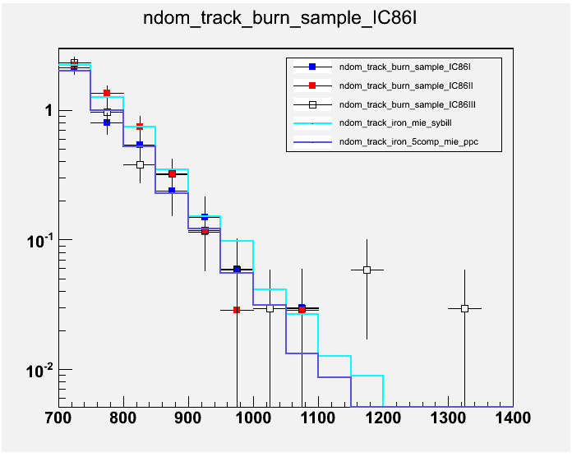

Slide 15
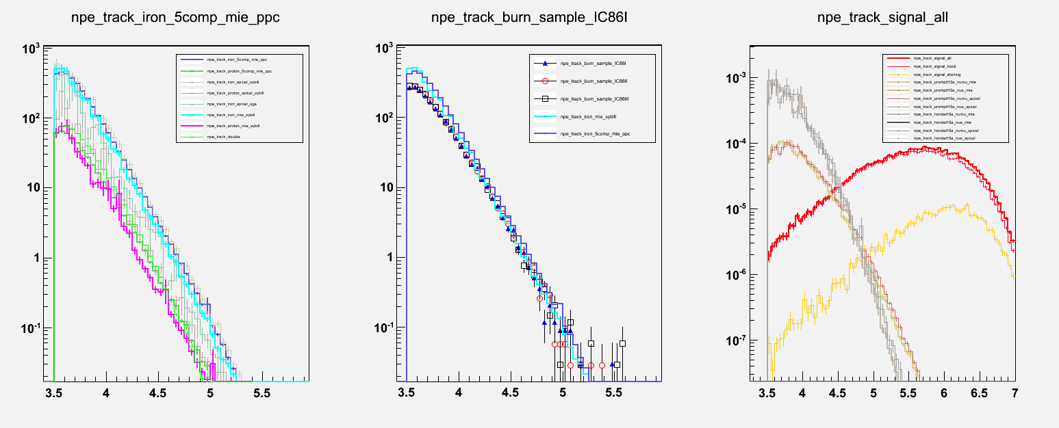
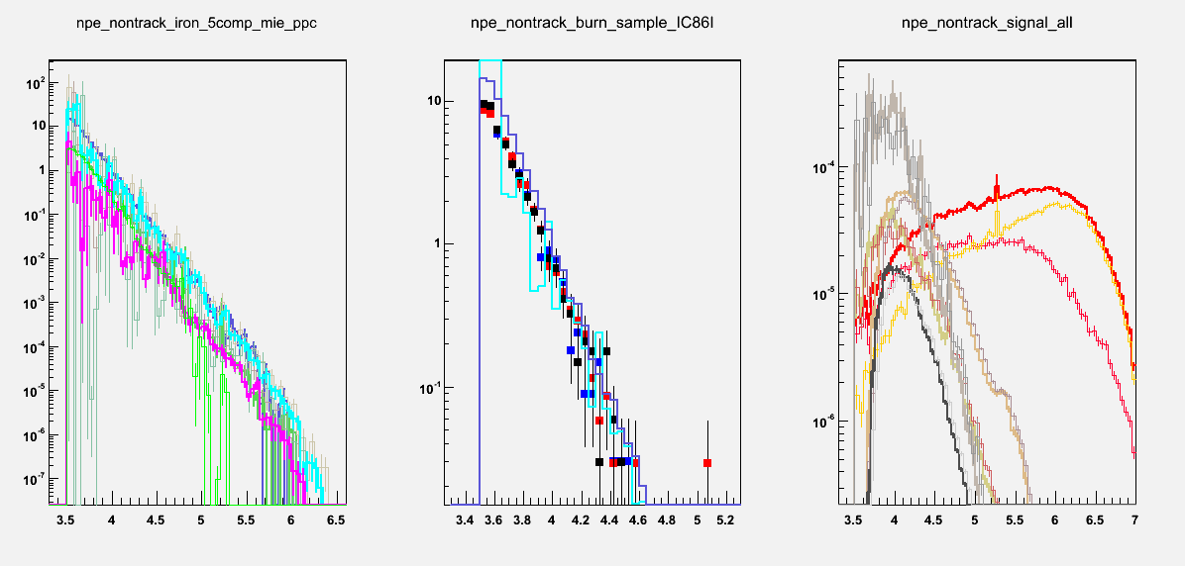

Slide 16
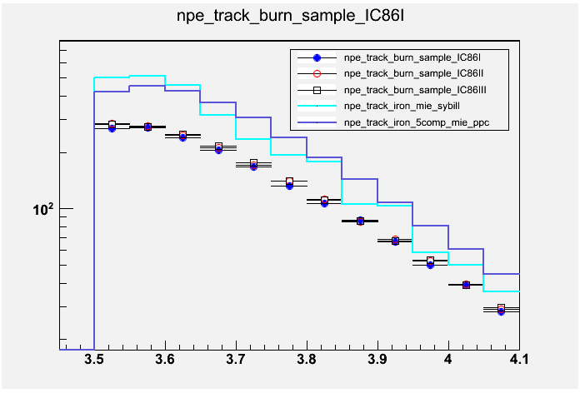
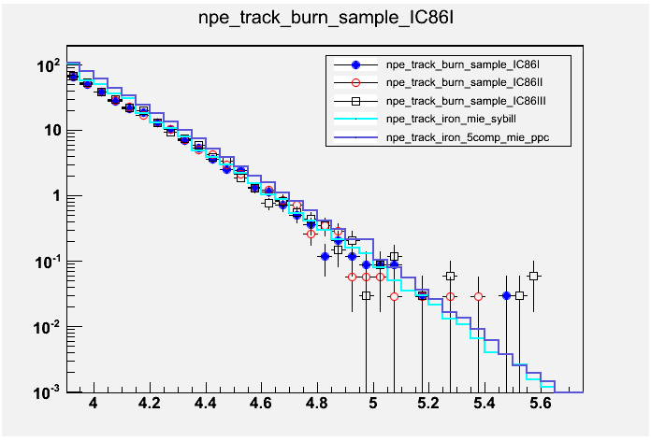

Slide 17
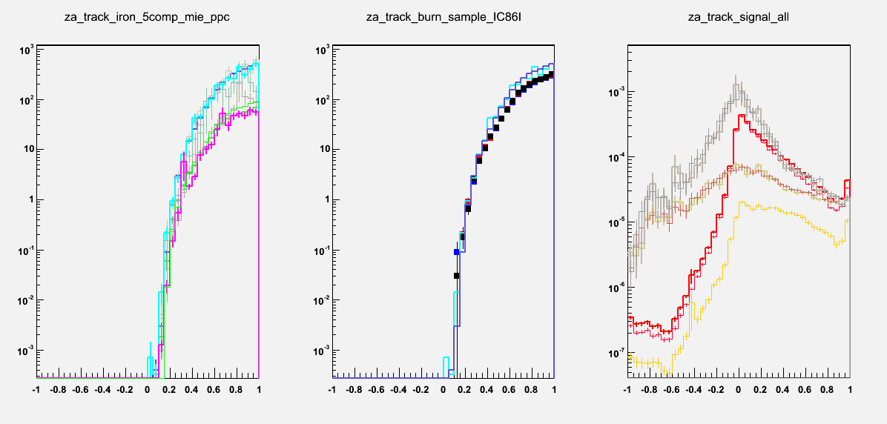
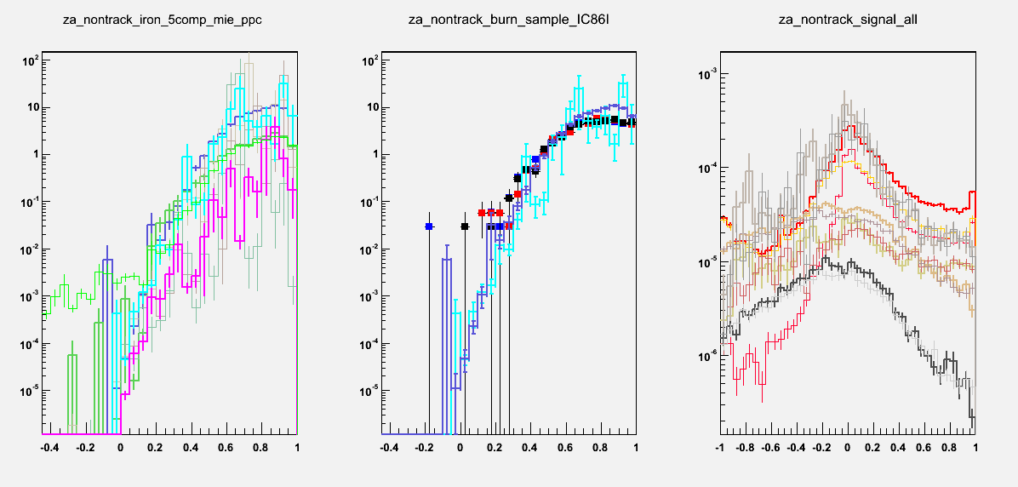

Slide 18
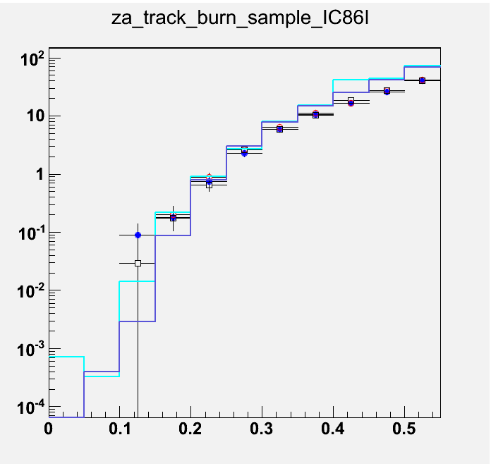
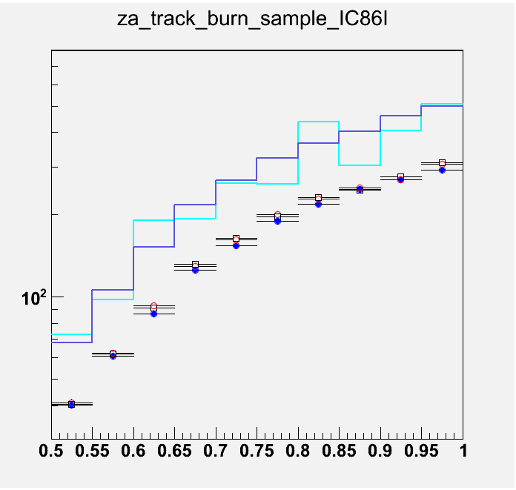

Slide 19
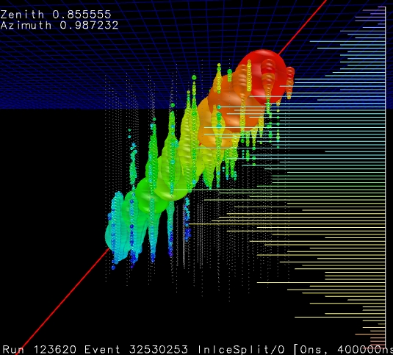
IC86III: Largest Nch events Nch 1342, 1188

Slide 20
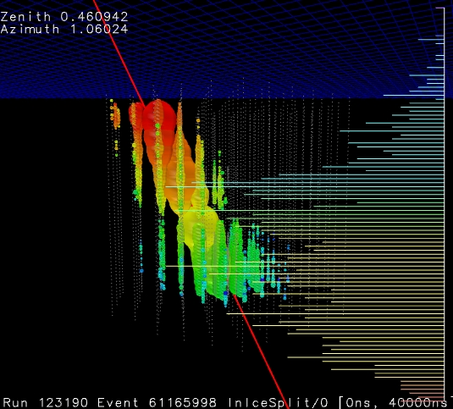
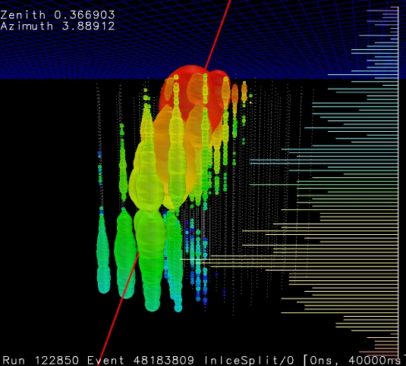
IC86-III: 2x10^5, 3x10^5
Nch 1174

Slide 21
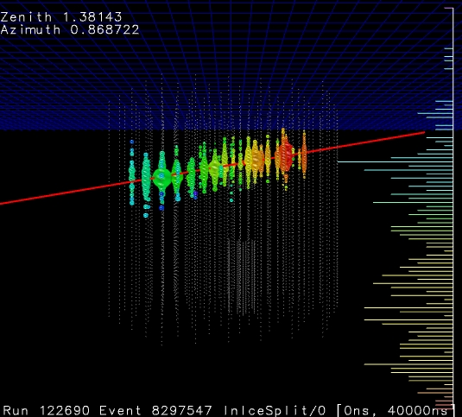
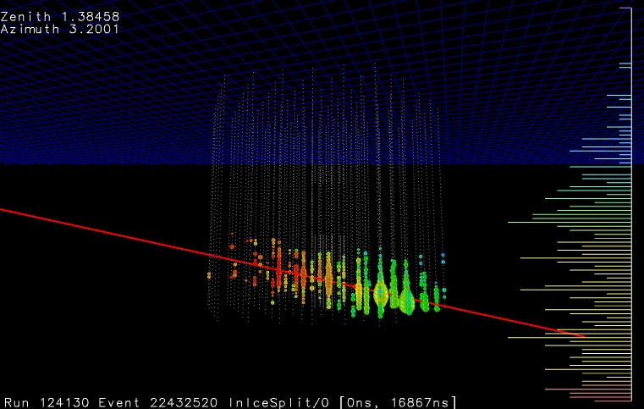
IC86III: cos za < 0.2

Slide 22
Current status
Processing IC59/IC79/IC86I burn sample with Trigger-Splitter
Simulations should not be matter, processing for IC59/IC79

