Slide 1
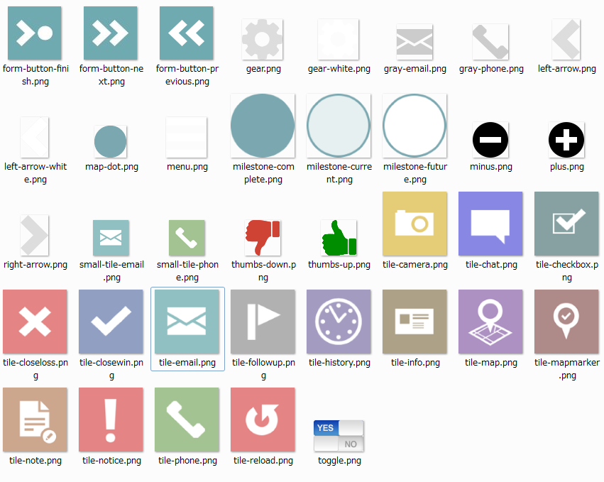
common/images/icons

Slide 2

common/images

