Slide 1
OC - Project 2
Exploratory Data Analysis
of
Educational Management Systems
World Bank
Stephane Lanchec

Slide 2
Business goal
International expansion for our online training programs company ‘academy’
Primary target audience:
Secondary to tertiary students
Workscope
Exploratory Analysis of a education management systems dataset
(Source: World Bank)
Identify countries with high customers potential
Which countries should we be settled in first
Customers potential evolution for these candidate countries

Slide 3
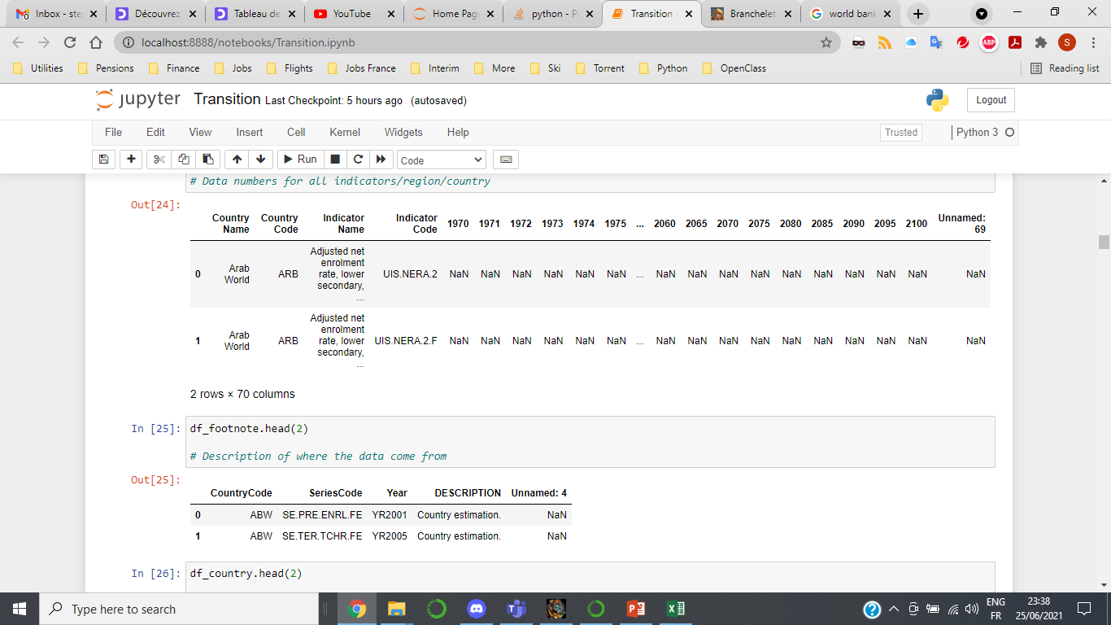
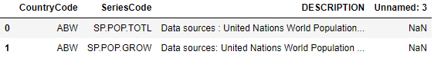
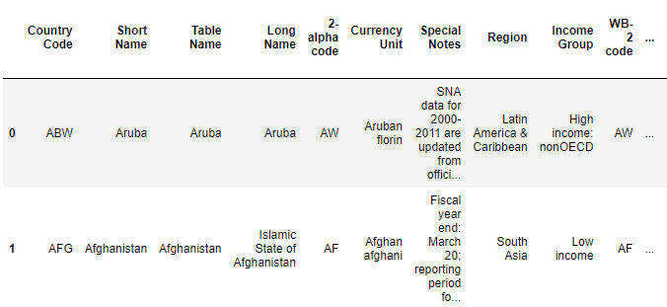
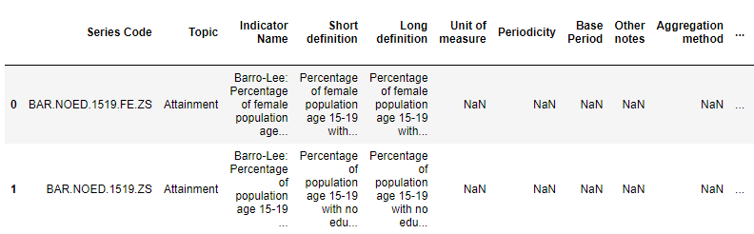
Data set available
EdStatsData.csv
Loading the data into the dataframe
df_data = pd.read_csv ("EdStatsData.csv")
Df_data.head(2)
EdStatsFootNote.csv
EdStatsCountry-Series.csv
EdStatsCountry.csv
EdStatsSeries.csv

Slide 4
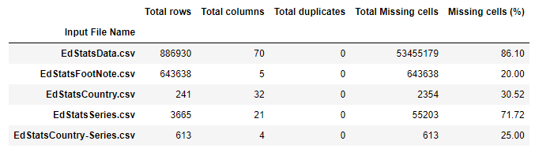
Data Set description
Input data | Description
EdStatsData.csv | Numbers by indicators/country 1970-2100
EdStatsFootNote.csv | Data source estimation
EdStatsCountry.csv | Economical country description
EdStatsCountrySeries.csv | Country codes and data source
EdStatsSeries.csv | Detailed indicators description
World Bank website | All related data

Slide 5
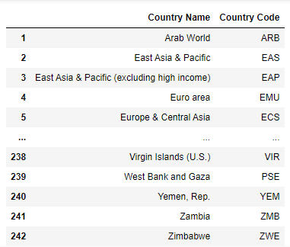
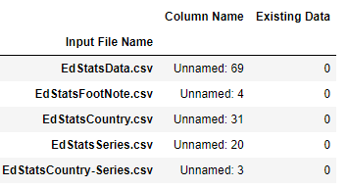
Data cleaning & arrangement
Analysis of the last column in files
Return zero data
Removal of last column
Pandas.DataFrame.drop()
First focus on EdStatsData.csv
Association Country Name-Country Code
Pandas.DataFrame.drop_duplicates()

Slide 6
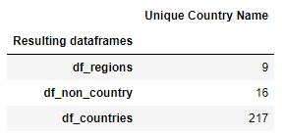
Geographic data analysis
Data processing on label ‘Country Name’
242 ‘Country Name’ divided into 3 categories
regions
non_country
countries
South Asia
SS Africa
N America
MENA
Latin America
E Asia Pacific
Europe & Central Asia…
High income
Low & Middle income
Arab World
Low income
Lower middle income
HIPC
World…
Afghanistan
Zimbabwe
.
.
.
.
.

Slide 7
Data cleaning phases – Indicators choice
Number of Indicators
Timeframe reduction from 2000 to 2016 only
3665
1st Phase
Indicators availability: Choice by filter exclusion
2nd Phase
Semantic analysis: Choice by keywords exclusion
3rd Phase
Indicators hand picked: Choice by inclusion
“Pandas.DataFrame.isin()” amongst “Indicators Code”
“Pandas.DataFrame.dropna(thresh=filter)” 60%
“~Pandas.Series.str.contains()” amongst “Indicators Name”
142
136
Statictical analysis on 6 indicators
6

Slide 8
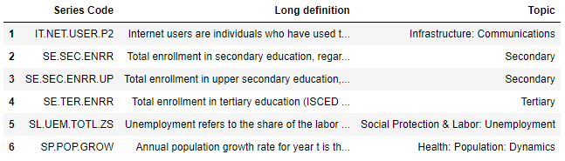
Indicators list
Internet
users
Students enrolment
secondary
tertiary
Population growth
Unemployment

Slide 9
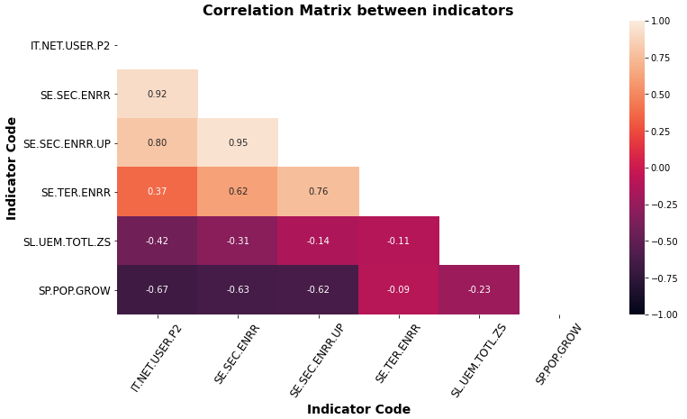
Correlation Matrix Heatmap
IT.NET.USER: Internet users
SE.SEC.ENRR: Enrolment secondary
SE.SEC.ENRR.UP: Enrolment upper secondary
SE.TER.ENRR: Enrolment tertiary
SL.UEM.TOTL.ZS: Unemployment
SP.POP.GROW: Population growth
Strong positive correlation between Internet users and students enrolment in secondary-tertiary
Strong negative correlation between Internet users & population growth or unemployment
No linear correlation between unemployment & student enrolment

Slide 10
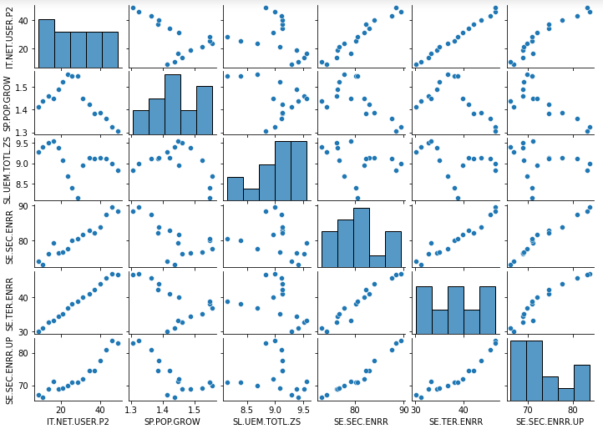
Bivariate Analysis

Slide 11
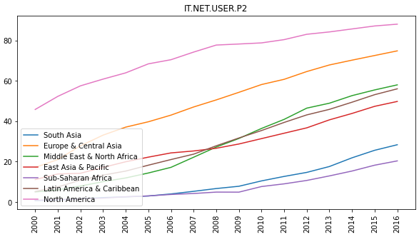
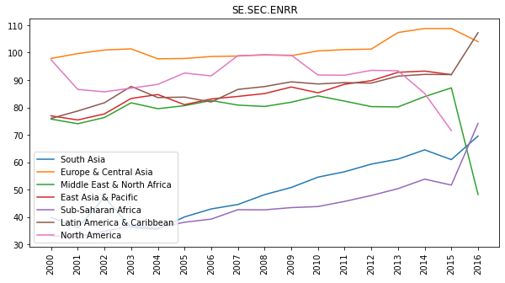
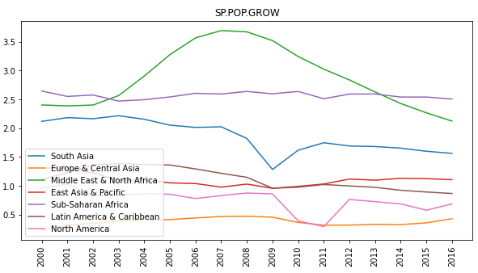
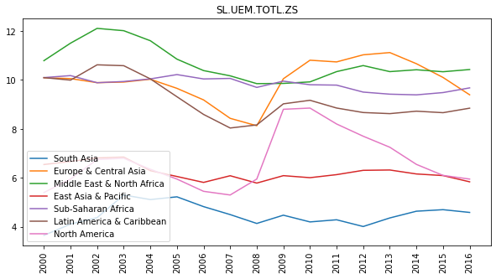
Indicators trends
Last value
Median
Internet users
Secondary
students
enrolment
Mean
Mean
Population
growth
Unemployment

Slide 12
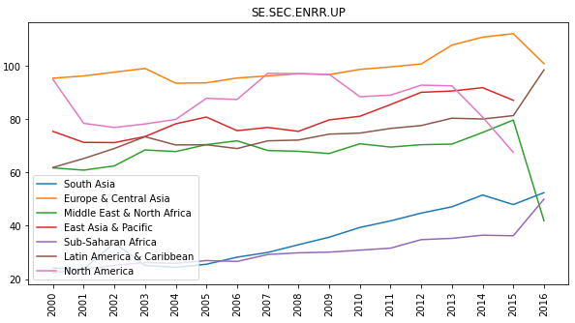
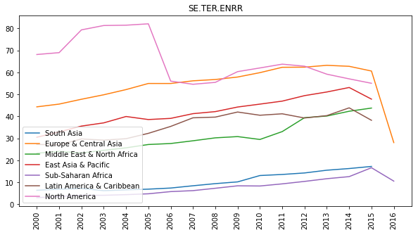
Indicators trends & averaging method
Median
Upper
secondary
students
enrolment
Median
Tertiary
students
enrolment
Indicator Code | Description | Method | Trend
IT.NET.USER.P2 | Internet users | Last value | Linear increase
SP.POP.GROW | Population growth | Mean | Fluctuations
SL.UEM.TOTL.ZS | Unemployment | Mean | Fluctuations
SE.SEC.ENRR | Secondary students | Median | Weak linear
SE.SEC.ENRR.UP | Upper Sec. students | Median | Weak linear
SE.TER.ENRR | Tertiary students | Median | Weak linear

Slide 13
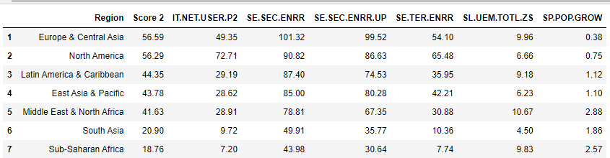
Candidates regions
Europe & Central Asia and North America have low population growth but high scores
Latin America, East Asia & MENA have an average of 30% internet users, good secondary enrolment but low tertiary enrolment
South Asia & Sub-Saharan Africa have very low internet users (<10%) and enrolment students
Logistically and technically difficult to expand business at the moment

Slide 14
Candidates regions
 | Europe & CA | North America | Latin America | East Asia Pacific | MENA | South Asia | SS Africa
IT users | High | High | Medium | Medium | Medium | Low | Low
Sec. enr. | High | High | High | High | Medium | Low | Low
Up sec. enr. | High | High | High | High | Medium | Low | Low
Ter. Enr. | High | High | Medium | Medium | Medium | Low | Low
Unemployment | High | Medium | High | Medium | High | Low | High
Pop. growth | Low | Low | Medium | Medium | High | High | High
High potential
Short - Middle term
High potential
Middle - Long term
Low potential
Short & Long term

Slide 15
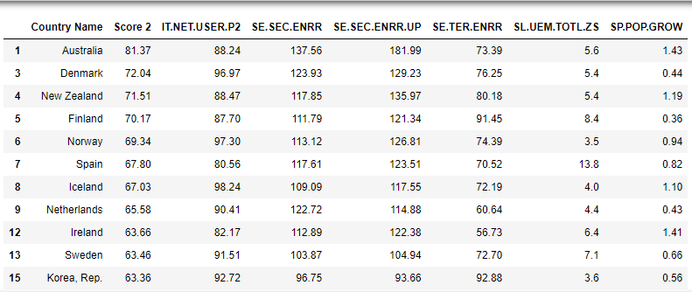
Candidates countries

Slide 16
Acronymes
Gini index: Measure of the distribution of income across a population
EGRA: Oral assessment of the most basic foundation skills (early grades)
PIRLS: Trends in student achievement in mathematics, science, and reading
PISA: Assessment that measures 15-year-old students' reading, mathematics, and science
TIMSS: Trends data on the mathematics and science achievement of U.S. students compared to that of students in other countries
DHS: Collect, analyse accurate and representative data on population, health, HIV, and nutrition
SACMEQ: Assessment on mathematics & reading proficiency
PASEC: Mean performance on different subject, grades distribution
LLECE: Mean performance on different subject, grades distribution
SABER: Produce comparative data and knowledge on education policies and institutions

Slide 17
 | IT users | Sec enr. | Up Sec enr. | Ter. Enr. | Unemployment | Pop growth
Europe & Central Asia | High | High | High | High | High | Low
North America | High | High | High | High | Medium | Low
Latin America | Medium | High | High | Medium | High | Medium
East Asia Pacific | Medium | High | High | Medium | Medium | Medium
MENA | Medium | Medium | Medium | Medium | High | High
South Asia | Low | Low | Low | Low | Low | High
SS Africa | Low | Low | Low | Low | High | High

