Slide 1
OC - Project 4
Prediction of CO2 Emissions from Seattle
Exploratory Analysis
Of a Database
from the city of Seattle
Stephane Lanchec

Slide 2
NutriSteph
Application that returns the Nutriscore & Nutrigrade of products
What’s new?
No need for a food database
Works for non-referenced products
Works for any product across the globe
Just take a picture of the list of ingredients on the product
Integrated algorithm: Nutrients Nutriscore/grade
Integrated dictionary/translator to grade any product in the world
Users language choice

Slide 3
Technical Process

Slide 4
Dataset Overview & Cleaning

Slide 5
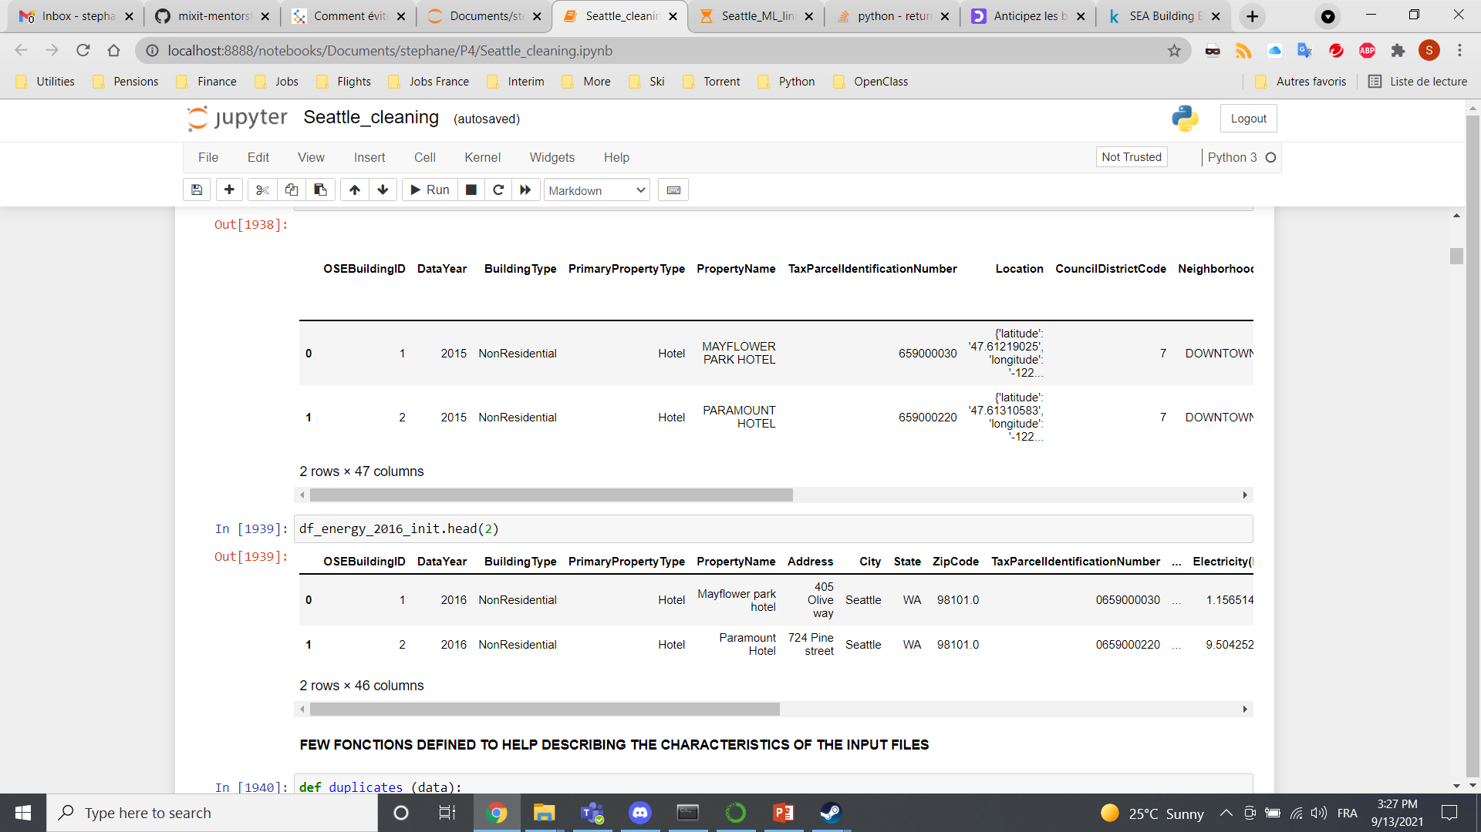
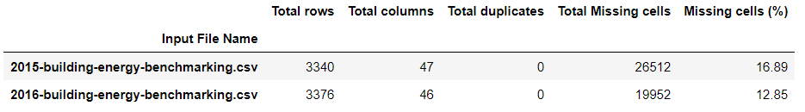
Data set available
SEA Building Energy Benchmarking is an open database from the city of Seattle.
df_data = pd.read_csv (“2015-building-energy-benchmarking.csv")
df_data.head(2)

Slide 6
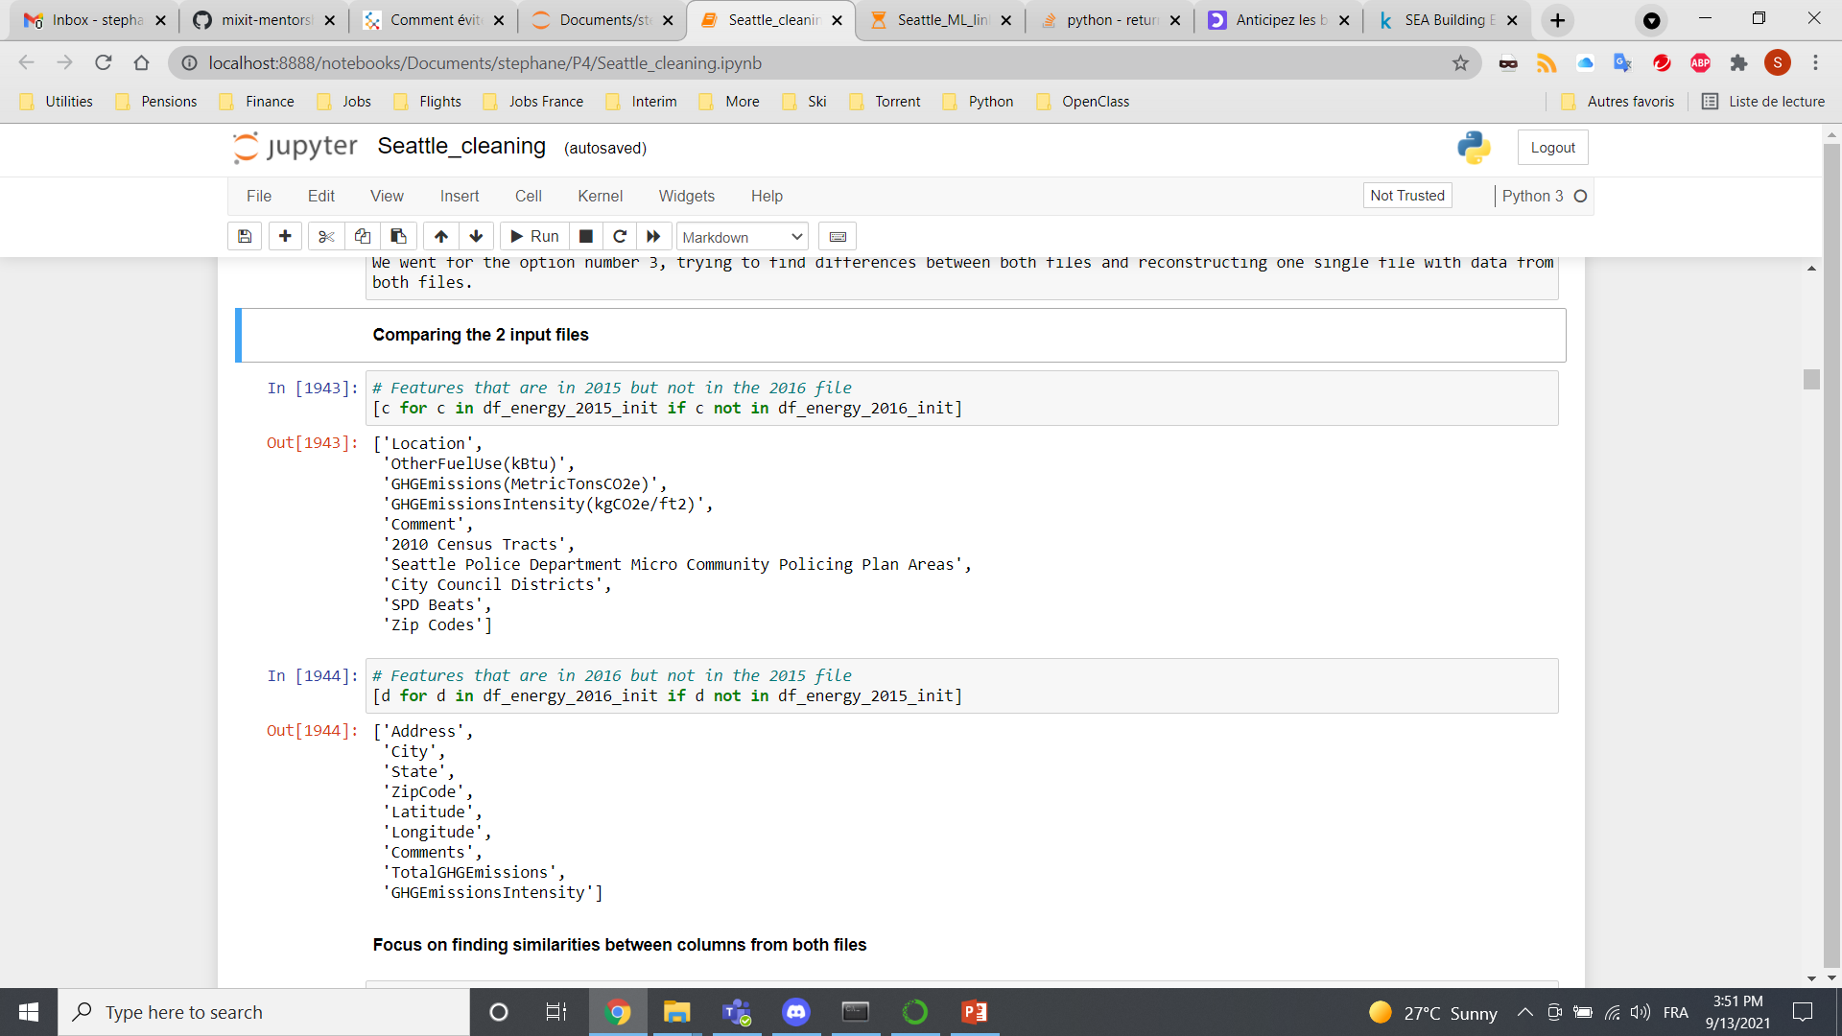
Data cleaning Phase 1: Differences focus
Features in 2015 but not in 2016
Features in 2016 but not in 2015
Split of the json "Location" column
Same units?
Features related
to crime or safety
=
drop

Slide 7
Data cleaning Phase 2: Country name

Slide 8
Data cleaning Phase 3/4
Focus on Nutriscore: Removal of all products with no Nutriscore information (Phase 3)
Removal of redundant products categories (Phase 4):

Slide 9
Dataset Exploration

Slide 10
Regression Models Evaluation
Dummy regression
Linear regression
Lasso regression
Ridge regression
ElasticNet regression
SVM regression
KNN
Random Forest
XGBoost
Impact of
Linear
v
Log scale

Slide 11
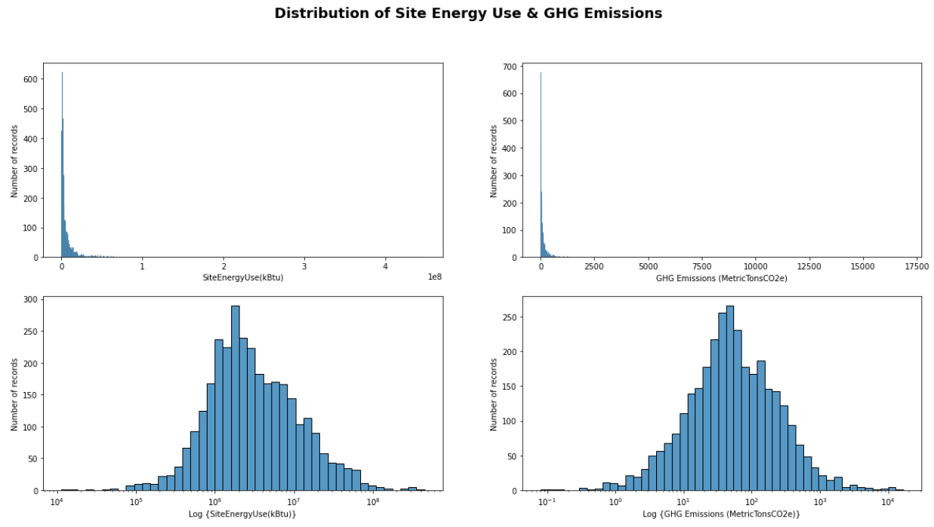
Linear v Log scale
Log transform is used to convert a skewed distribution to a normal / less skewed distribution
TransformedTargetRegressor (regressor, func=np.log1p, inverse_func=np.expm1)
Function to apply to y
before passing to fit
Function to apply to the
prediction of the regressor

Slide 12
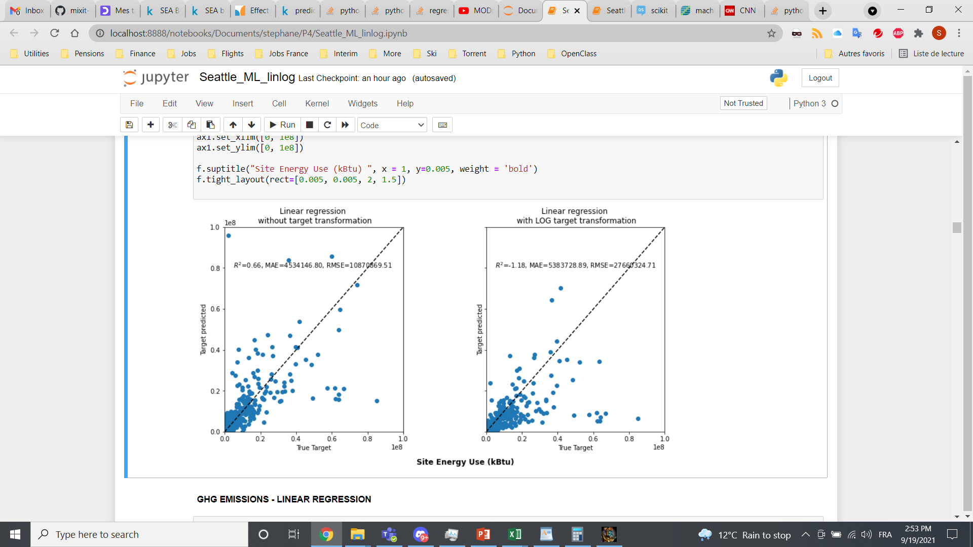
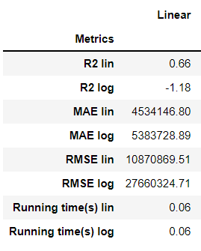
Linear regression

Slide 13
ElasticNet regression
.
.
.

Slide 14
RandomForest regression
Linear regression vs. Dummy regression (baseline)
Coefficient of determination: how well the regression model fits the actual data
R2 = 0.65, scattered data between actual & forecasts

Slide 15
XGBoost regression

Slide 16
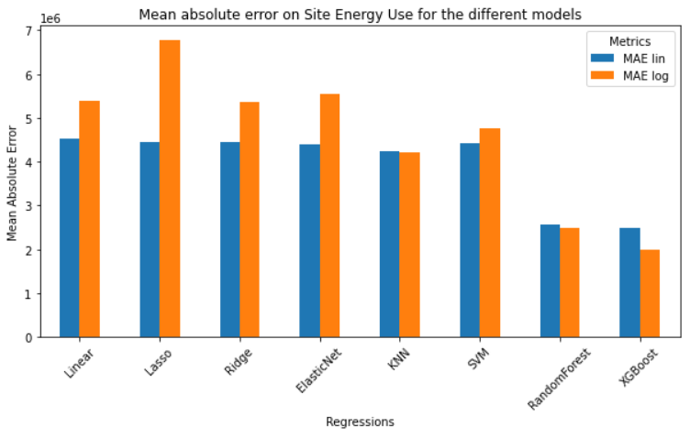

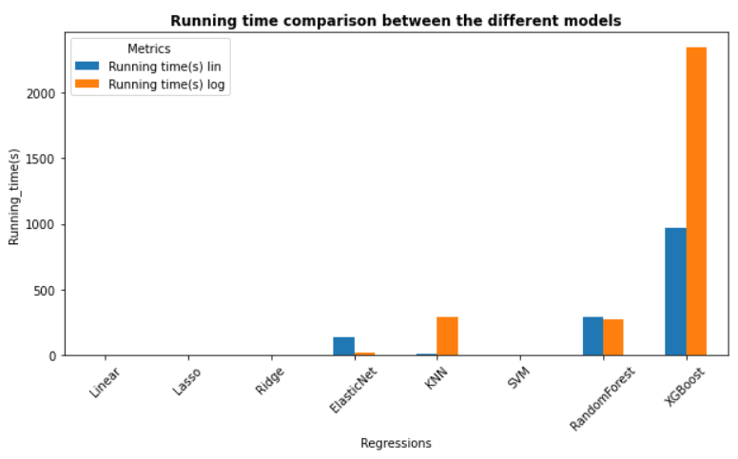
Results for Site Energy Use

Slide 17
Results for GHG Emissions

Slide 18
Regression improvement

Slide 19
Discussions
An algorithm based on linear regression and one hot encoding has been performed to relate nutrients and category to the Nutriscore/Grade
Adding the products category to the nutrients in the model improves the performance of the model
The coefficient of determination increases from 0.80 to 0.93
Investigation of different regressions possible: Ridge, Lasso…in order to estimate the impact
Work would still need to be done on identifying labels from different countries (serving size in the US v 100g in Europe…)
Might need to work on subcategories like olive oil for instance graded D then C (misclassification of many foods through Nutriscore)

Slide 20
Conclusions

Slide 21
ANalysis Of VAriance

