Slide 1
OC - Project 4
Prediction of CO2 Emissions from Seattle
Exploratory Analysis
Of a Database
from the city of Seattle
Stephane Lanchec

Slide 2
NutriSteph
Application that returns the Nutriscore & Nutrigrade of products
What’s new?

Slide 3
Technical Process

Slide 4
Dataset Overview & Cleaning

Slide 5
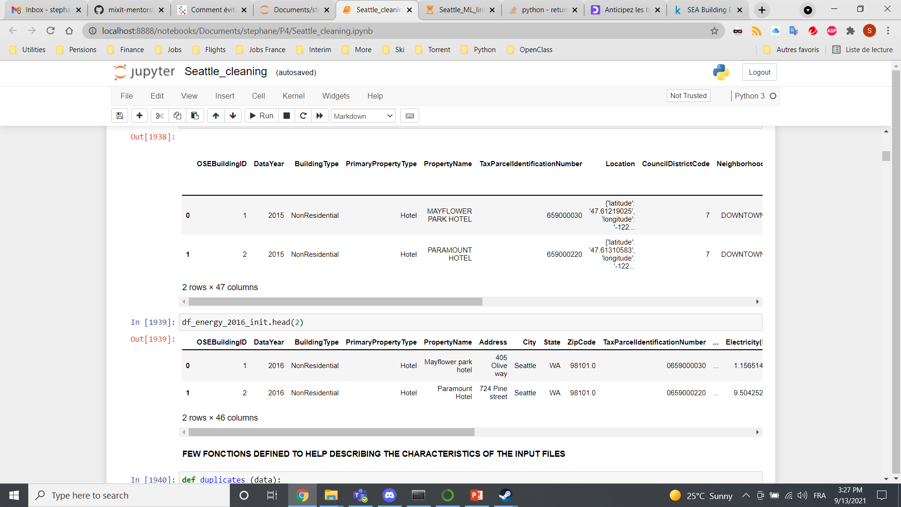
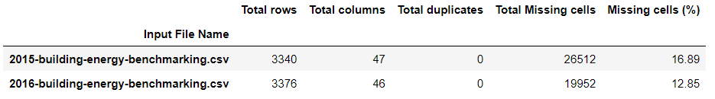
Data set available
SEA Building Energy Benchmarking is an open database from the city of Seattle.
df_data = pd.read_csv (“2015-building-energy-benchmarking.csv")
df_data.head(2)

Slide 6
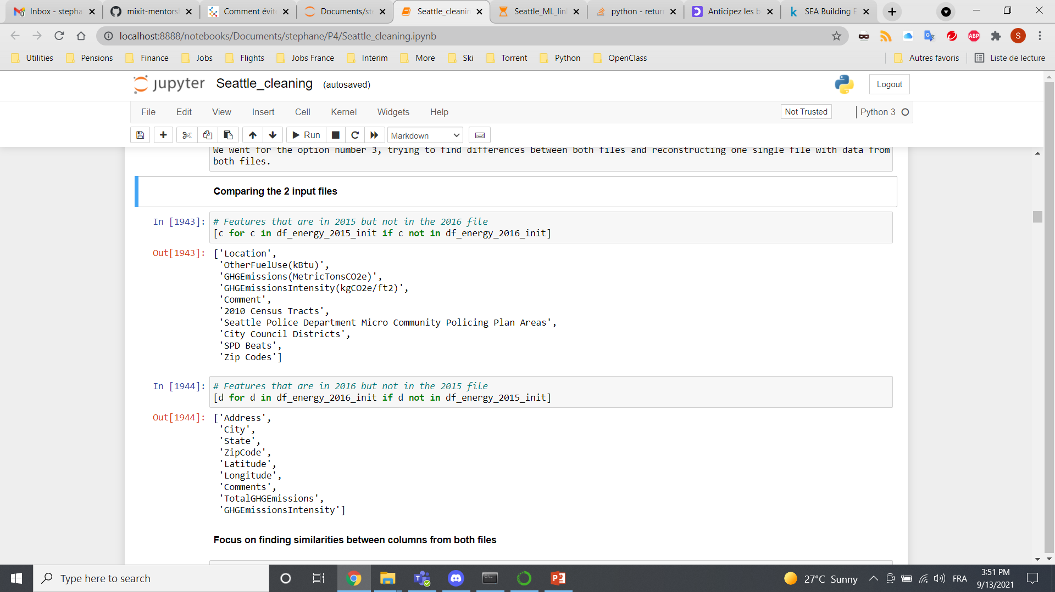
Data cleaning Phase 1: Differences focus
Features in 2015 but not in 2016
Features in 2016 but not in 2015
Split of the json "Location" column
Same units?
Features related
to crime or safety
=
drop

Slide 7
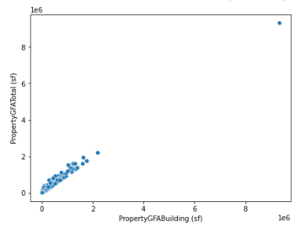
Data cleaning Phase 2: Similarities focus
Drop redundant categories: GHGEmissionsIntensity = GHGEmissionsIntensity(kgCO2e/ft2)
TotalGHGEmissions = GHGEmissions(MetricTonsCO2e)
Concatenate both files (6695 rows × 47 columns)
Converting strings in titlecase str.title() for homogeneity between both files
Drop Weather Normalized WN features (SiteEUIWN, Source EUIWN & SiteEnergyUseWN)
Categories with different units for Electricity and Natural Gas (kBtu over kWh and therms)
Focus on non-Residential Drop Building Type = Multifamily
Negative data removed, targets (SiteEnergyUse & GHG Emissions) values = 0 removed
Outlier removed: University of Washington (x5 range)

Slide 8
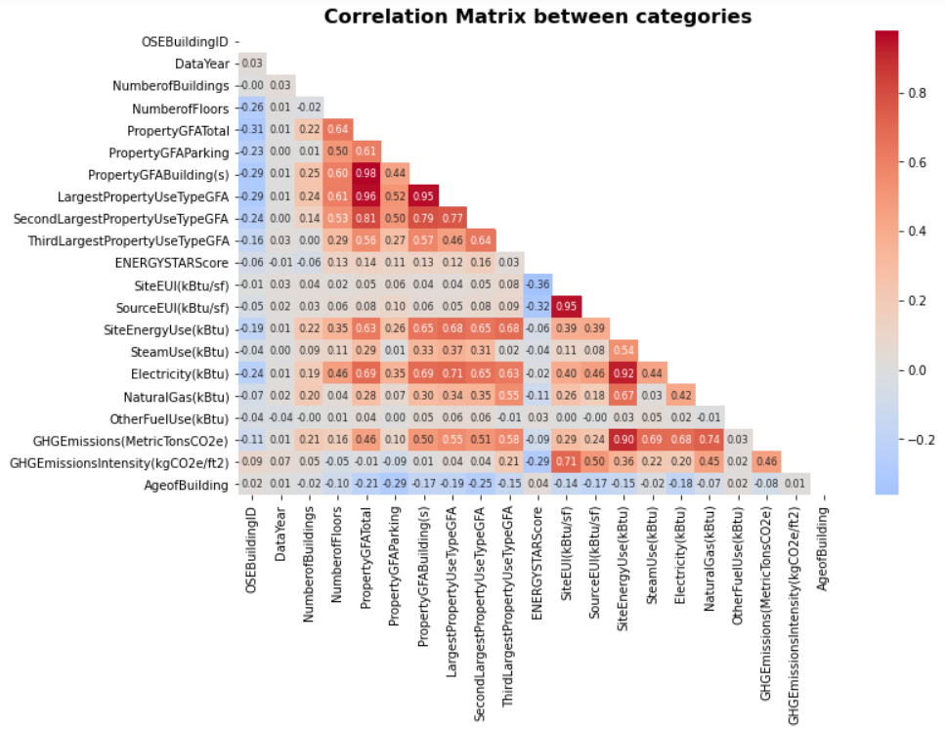
Data cleaning Phase 3: Feature collinearity
Feature Engineering: drop features that are highly correlated with each other by creating new inputs
Data leakage happens when your training data contains information about the target
DO NOT USE
Electricity(kBtu), NaturalGas(kBtu),
SteamUse(kBtu), OtherFuelUse(kBtu)
Our 2 targets
Multicollinearity reduces the precision of the estimated coefficients, which weakens the statistical power of your regression model.

Slide 9
Feature Engineering
Features dropped
Relationship
Features dropped
YearBuilt
LargestPropertyUseTypeGFA
SecondLargestPropertyUseTypeGFA
SecondLargestPropertyUseType
ThirdLargestProperty UseTypeGFA
ThirdLargestProperty UseType
PropertyGFAParking
PropertyGFABuilding(s)
DataYear – YearBuilt
PropertyGFATotal / NumberofBuildings
PropertyGFATotal / NumberofFloors
PropertyGFABuilding / PropertyGFATotal
PropertyGFAParking / PropertyGFATotal
AgeofBuilding
MeanBuildingGFA
MeanFloorGFA
BuildingGFApct
ParkingGFApct

Slide 10
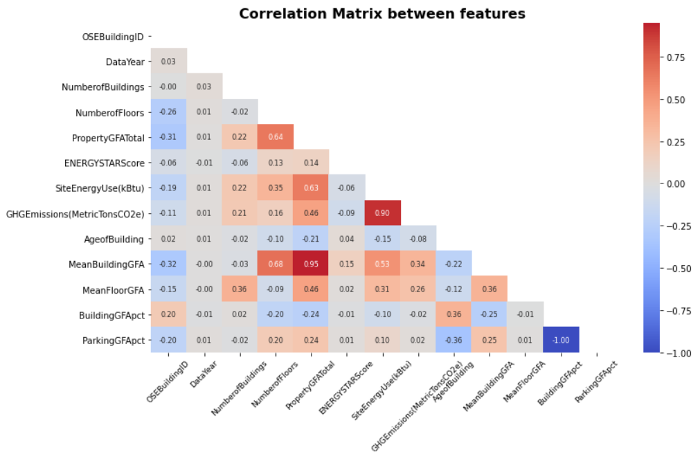
Final cleaning phase
Not critical column:
OSEBuildingID
PropertyName
Address
City
State
ZipCode
Outlier
YearENERGYSTARcertified
ENERGYSTARScore
Pearsons coefficients < 0.7, multicollinearity reduced.
End of cleaning phase: From 6695 rows × 47 columns 3173 rows x 17 columns

Slide 11
Machine Learning models

Slide 12
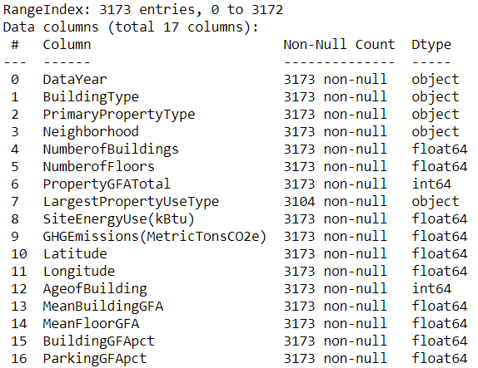
Dataset preparation
scaler = StandardScaler()
categorical_transformer = OneHotEncoder()
preprocessor = ColumnTransformer(transformers=
[('num', scaler, num_data ),
('cat', categorical_transformer, cat_data)])
Dataset split (80% training, 20% testing)
X_train, X_test, y_train, y_test = train_test_split(X, y, test_size=0.2, random_state=42)
num_data: 10 numerical columns = int or float (excluding our 2 target features)
cat_data: 5 categorical columns = object

Slide 13
Regression Models Evaluation
Dummy regression
Linear regression
Lasso regression
Ridge regression
ElasticNet regression
SVM regression
KNN
Random Forest
XGBoost
Impact of
Linear
v
Log scale
Is it worth transforming into log?

Slide 14
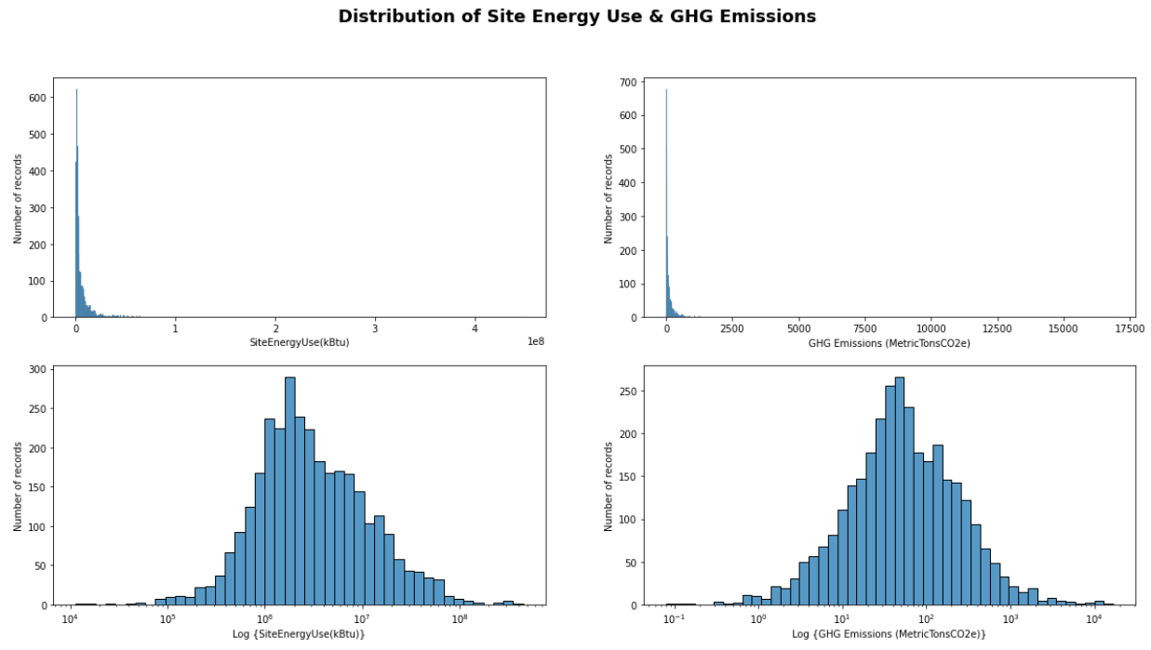
Linear v Log scale
Log transform is used to convert a skewed distribution to a normal / less skewed distribution.
Data normalization
TransformedTargetRegressor (regressor, func=np.log1p, inverse_func=np.expm1)
Function to apply to y
before passing to fit
Function to apply to the
prediction of the regressor

Slide 15
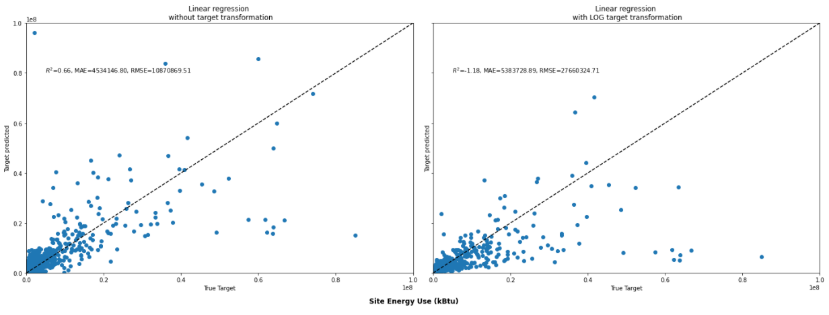
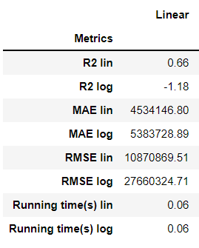
Linear regression

Slide 16
Gridsearchcv & Hyperparameters

Slide 17
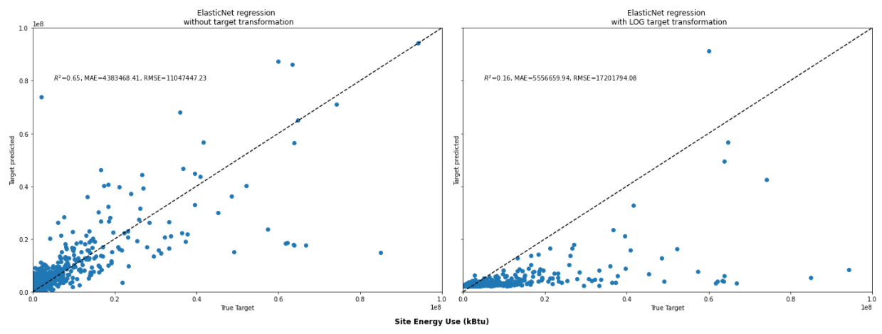
ElasticNet regression
params_eNet = {"regressor__alpha": np.logspace(-4, 0, num=5), # Constant that multiplies the penalty terms. Defaults to 1.0
# alpha=0 the penalty function reduces to the L1 (ridge) term
# alpha=1, we get the L2 (lasso) term.
"regressor__l1_ratio": [.001, .01, .1, .5, .7, .9, .95, .99, 1], # The ElasticNet mixing parameter,
# with 0 <= l1_ratio <= 1.
# For l1_ratio = 0 the penalty is an L2 penalty.
# For l1_ratio = 1 it is an L1 penalty.
# For 0 < l1_ratio < 1, the penalty is a combination of L1 and L2.
"regressor__max_iter": [10, 50, 100, 1000, 10000]} # The maximum number of iterations (default = 1000)
.
.
.

Slide 18
RandomForest regression

Slide 19
XGBoost regression

Slide 20
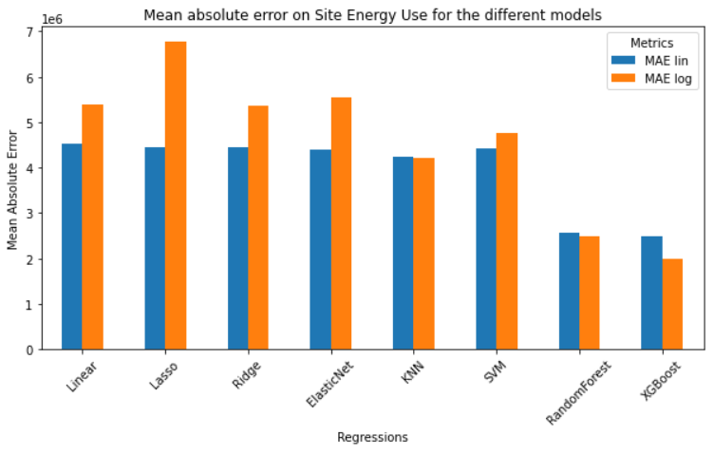

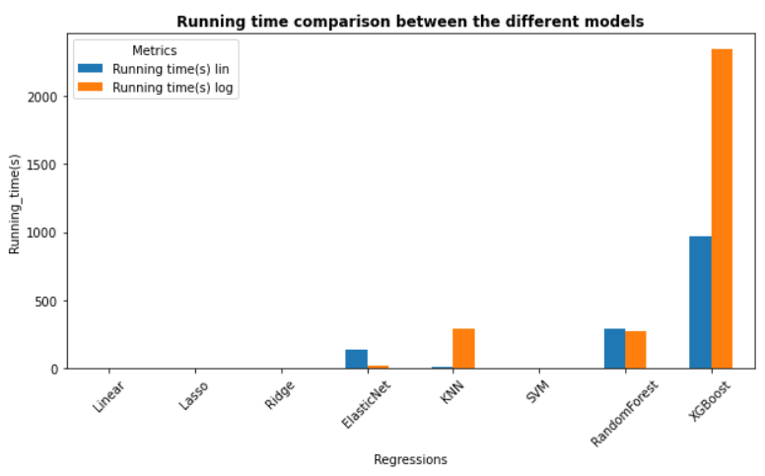
Results for Site Energy Use

Slide 21
Results for GHG Emissions

Slide 22
Impact of ENERGYSTARScore

Slide 23
Regression improvement

Slide 24
Discussions
Jdfjfvdj
Dckcsdfjcdj
Dkvdfjdfvj
vfdkjfdvjfdvj

Slide 25
Conclusions

Slide 26
Improvements
Use VIF (Variance Inflation Factor) for collinearity
Feature importance
Early stopping for XGBoost (not available in RandomForest)
Validation curve (overfitting check)
Learning curve (possible improvement check)

