Slide 1
ECS effort data
KAIWEN WANG

Slide 2
Data description

Slide 3
License Dataset of 2019
Data source: from ZheJiang Government Public Dataset.
N: 14839 vessels (16101 in yearbook of 2019).
Gear name, operation type, min mesh size…
Engine power, tonnage, length, shape, build time…
Licence ID, vessel name, nationality, calling code, register code…
Fishing sites, season, target species.

Slide 4
GFW dataset
Data description: predicted effort data using VMS data by Neural network.
t: 2012 to 2016, daily or annual data
mmsi code, flag
fishing hours, lon_bin, lat_bin (10th degree)
tonnage, engine power, length.

Slide 5
Exploratory dataset
Use MMSI/CC to match vessels in GWF annual effort data of 2016, condtional on:
Vessels’ fishing method is licensed as single- or double- otter trawler.
Vessels’ annual fishing effort in ECS is postive.
Some of the gear type listed in GFW dataset is mismatched with that on license. Prediction/reporting error? License change? or Illicit gear usage?

Slide 6
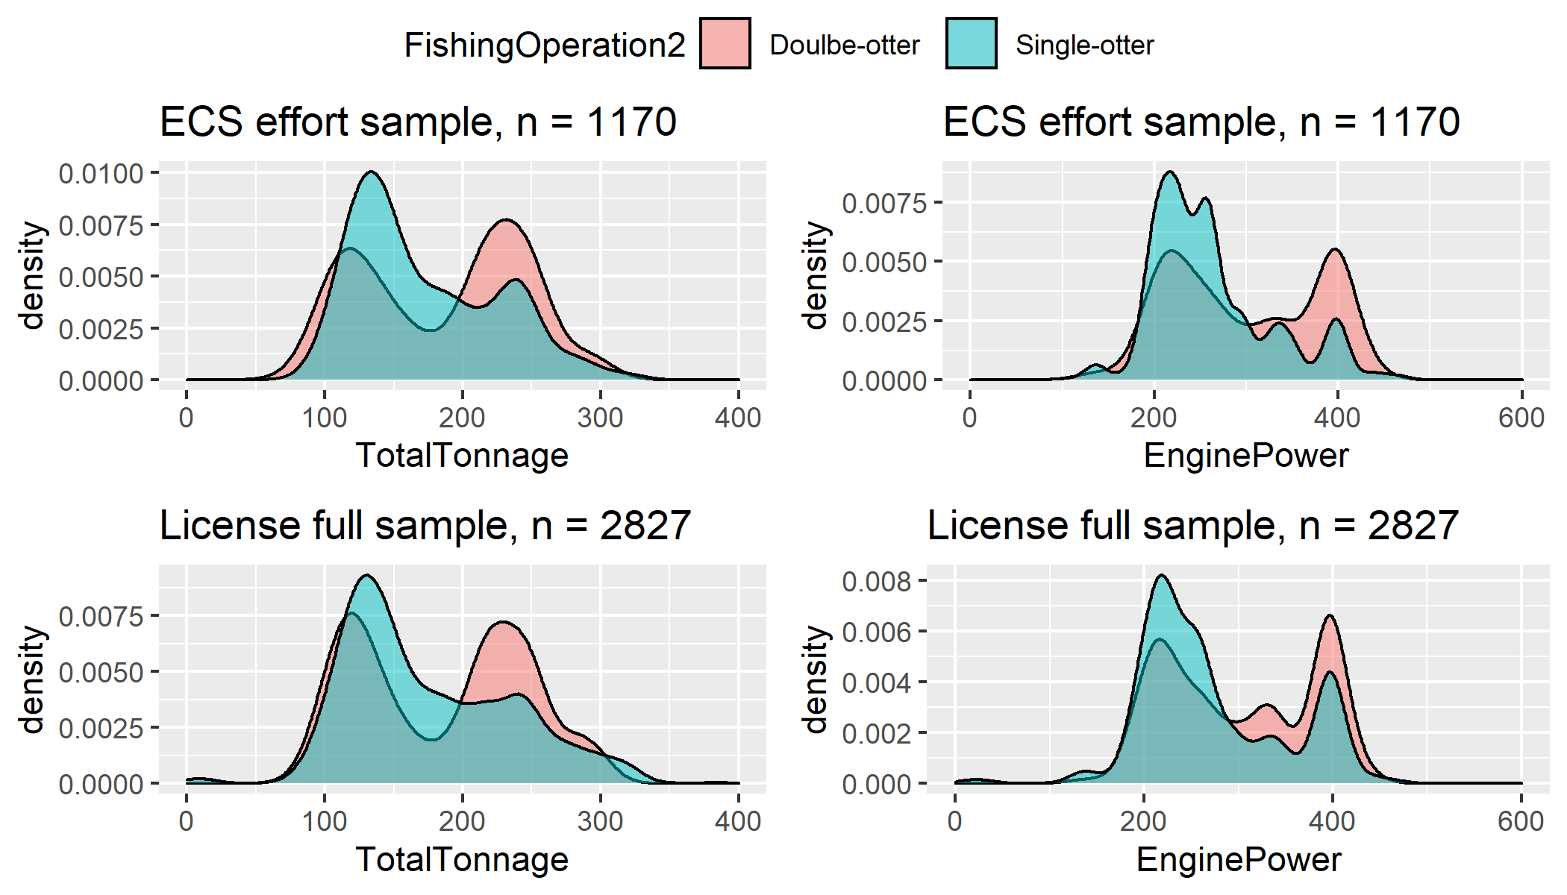
Matched sample vs. Full sample

Slide 7
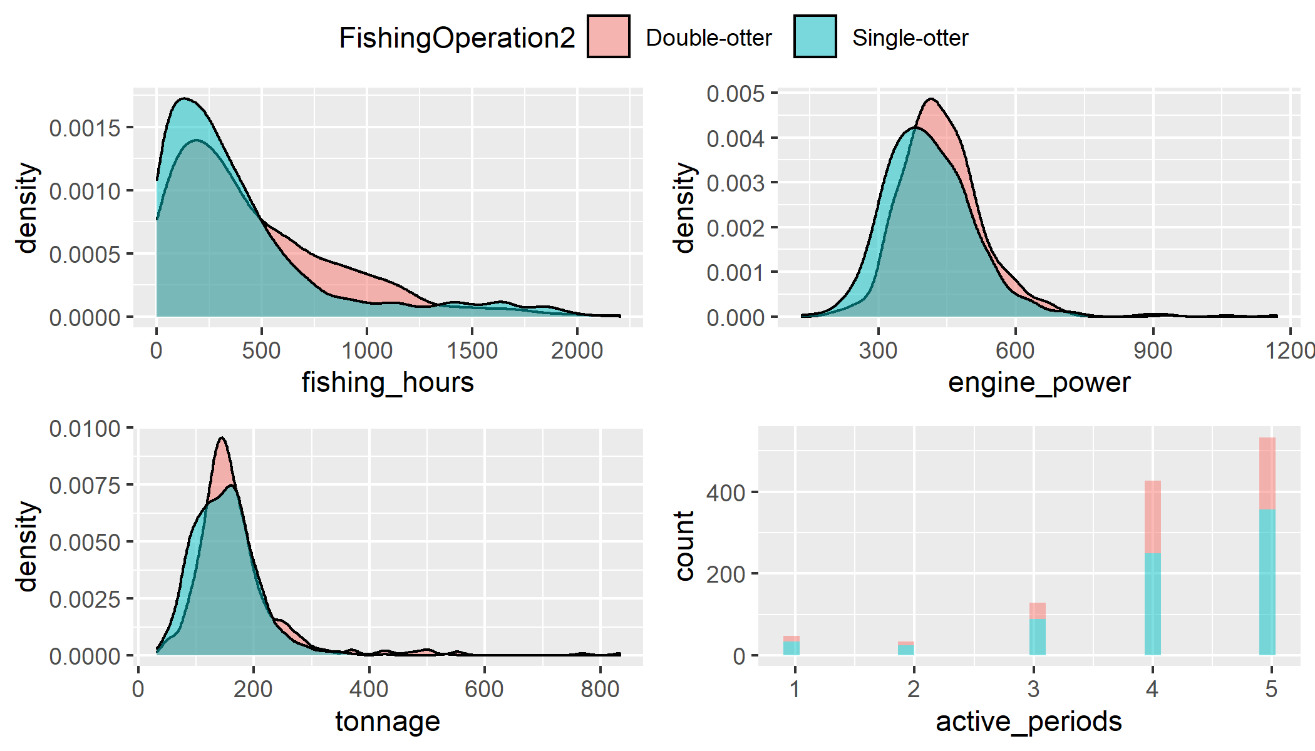
GFW data description

Slide 8
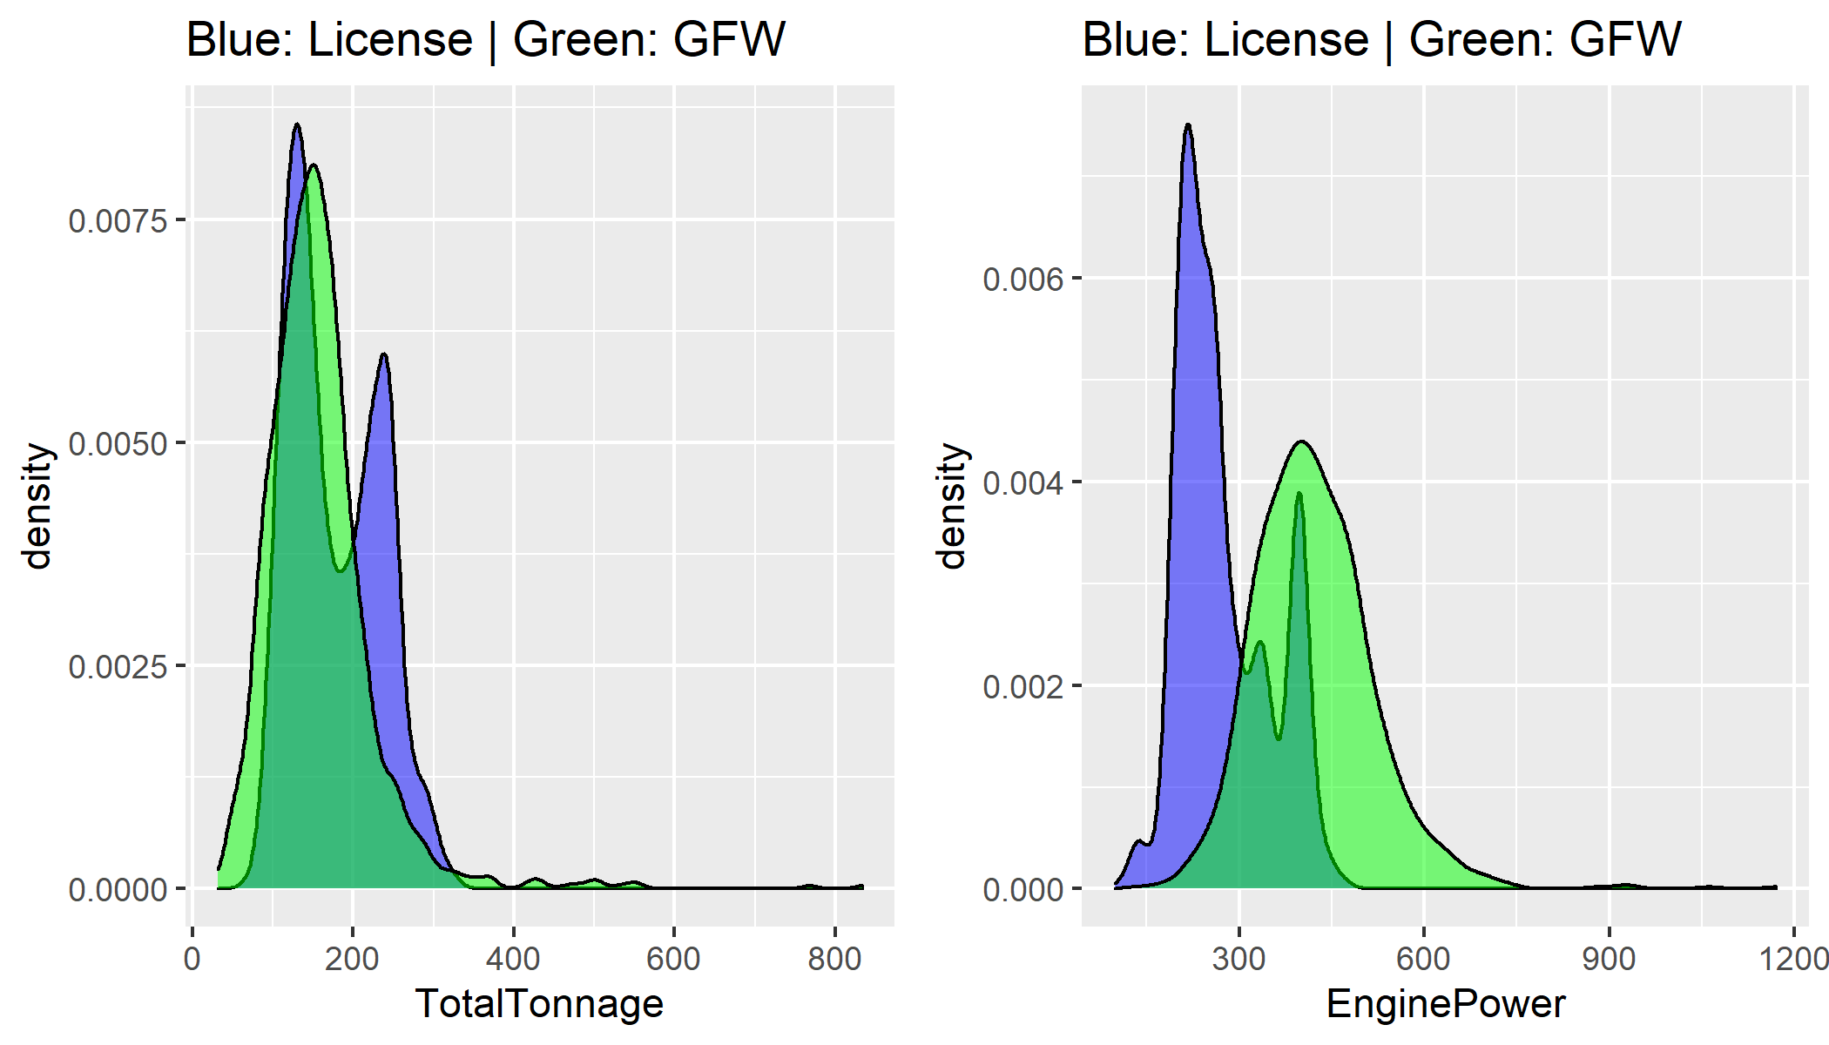
License data vs. GFW data

Slide 9
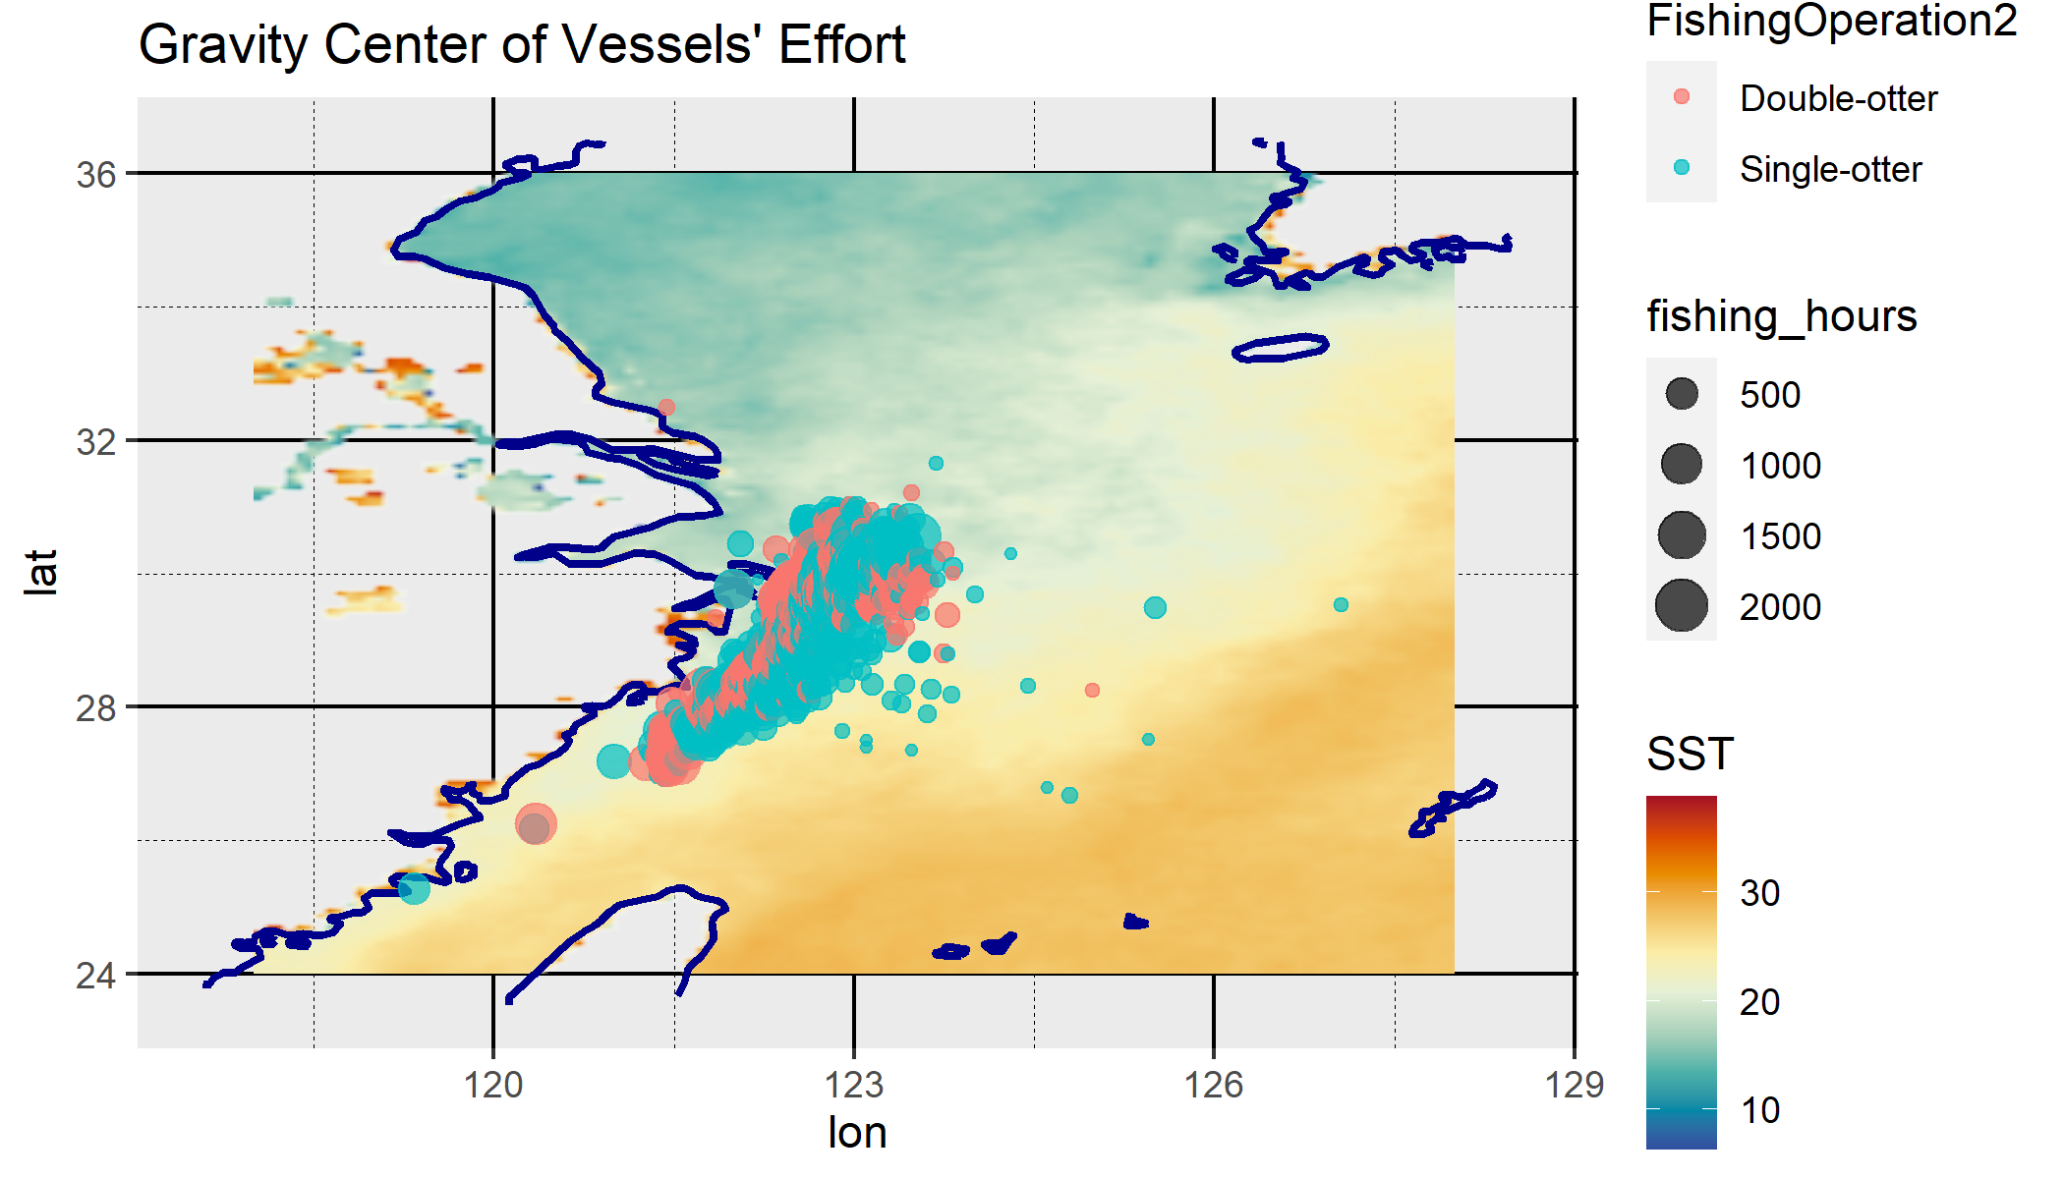
Gravity of vessel fishing effort in ECS

Slide 10
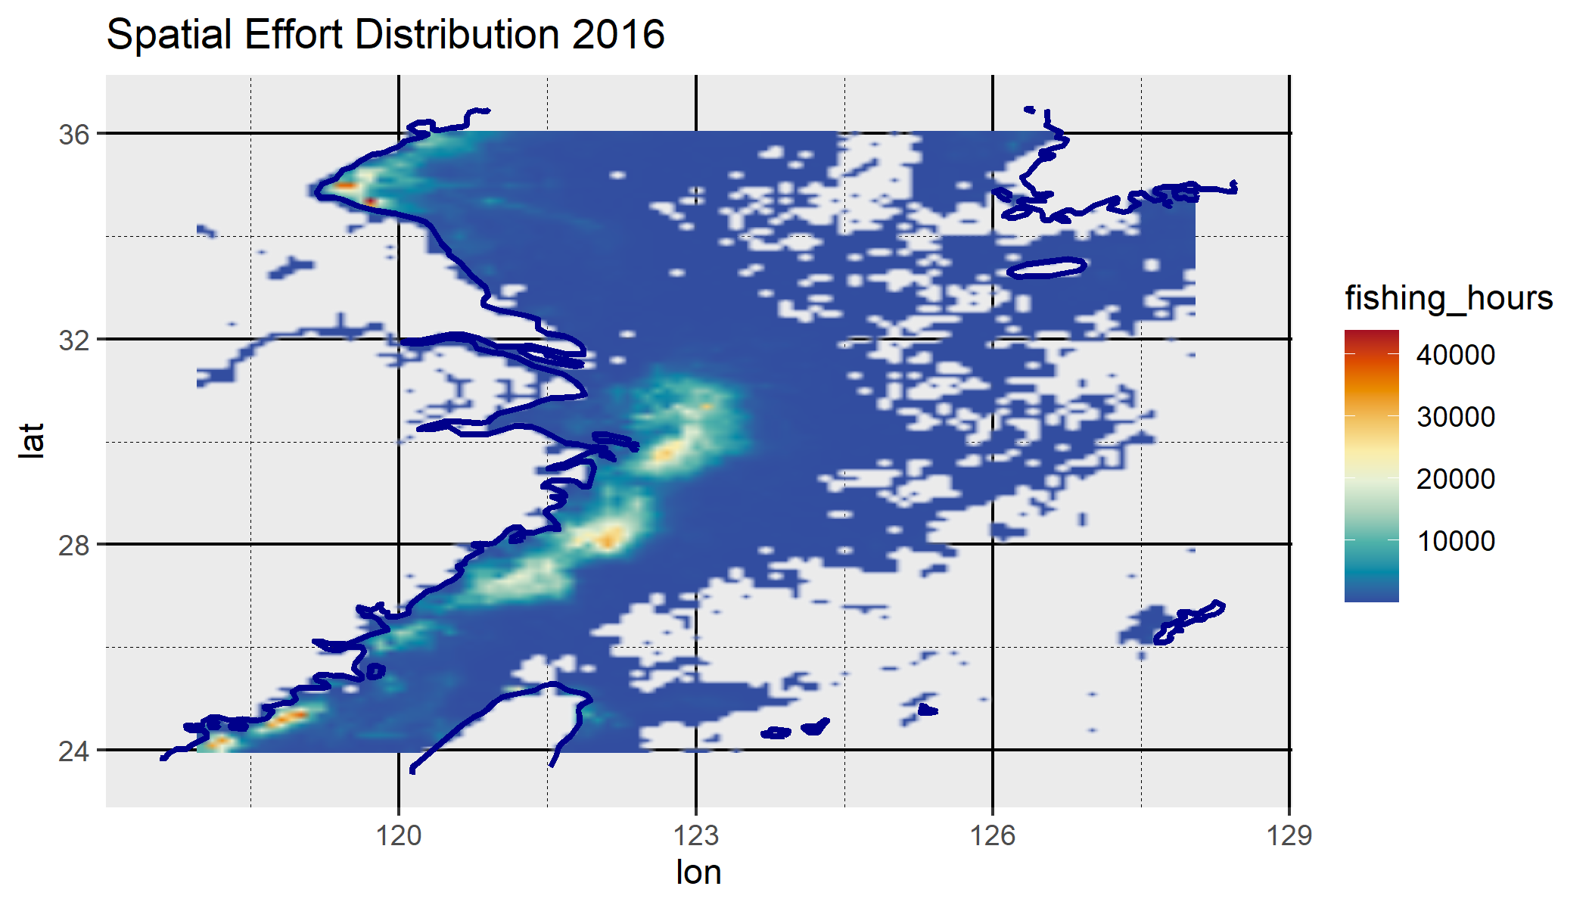
Spatial Effort distribution in ECS

Slide 11
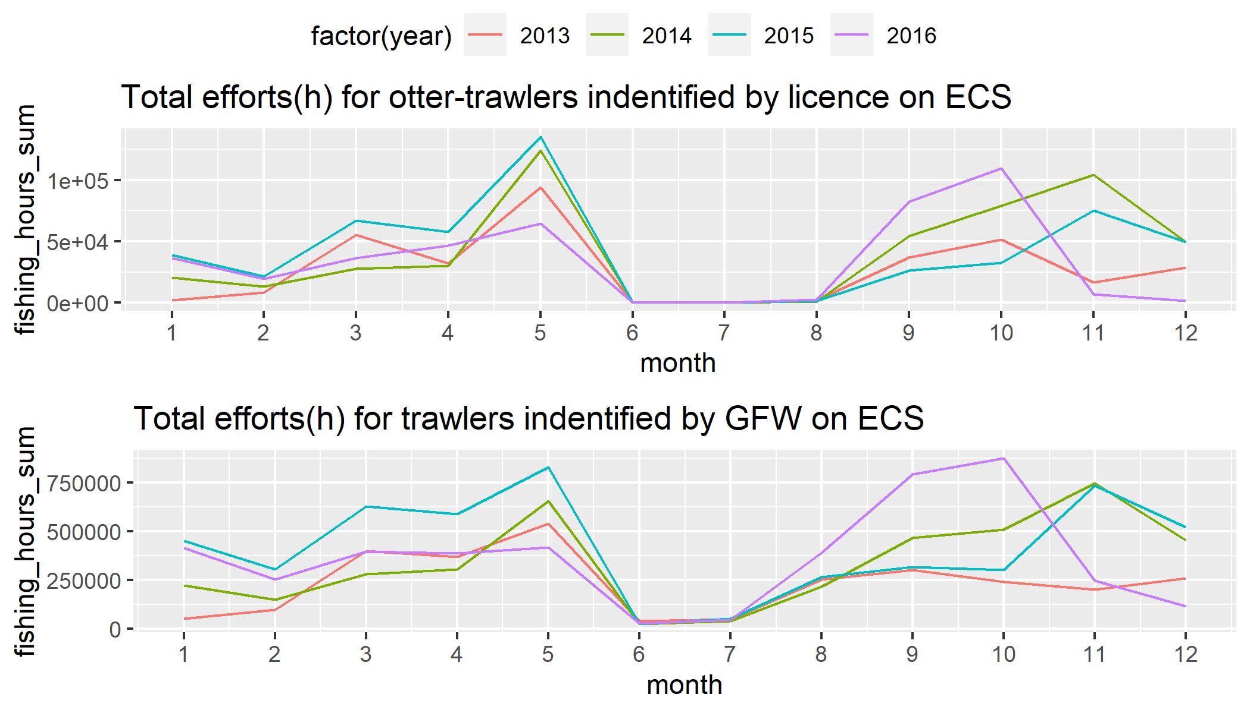
Temporal Effort distribution in ECS

Slide 12
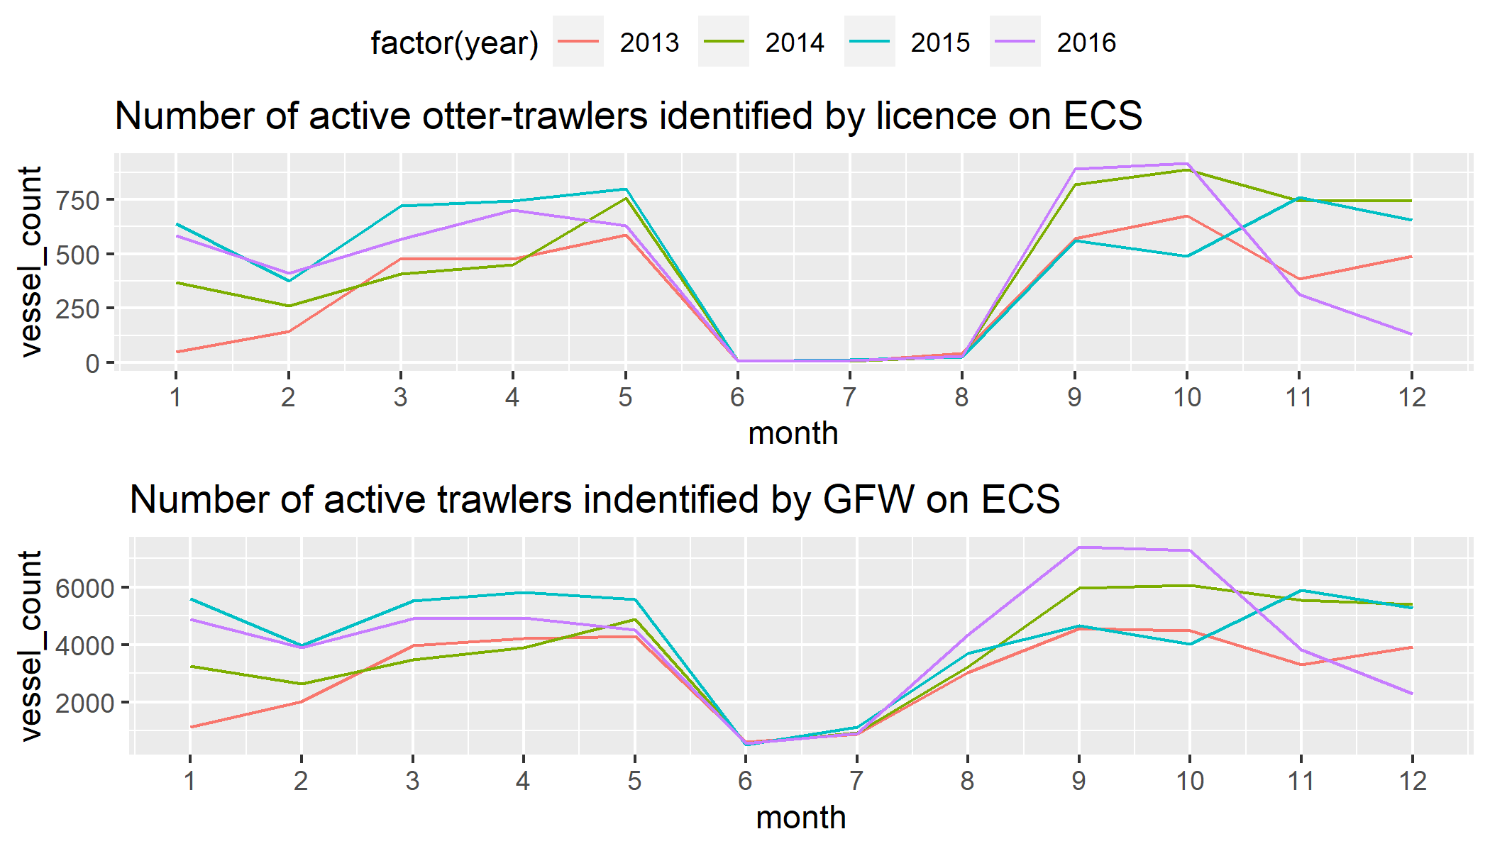
Temporal vessel distribution in ECS

Slide 13
Fishery subsidy and Fishing effort

Slide 14
Fishery subsidy reform
[2019 - 2014]. Fuel subsidy is issued annually to fishing vessels according to fishing operations and engine power:
$\text{Subsidy}=\text{Subsidy coefficient of gear}×\text{Engine power}$
[2015 - 2019]. Fuel subsidy is issued based on vessel length. Vessels are categorized as Large, medium, and small vessels and receives category-corresponding annual subsidy:
$\text{Subsidy}=1_{A}\left(\text{Length category}\right)×\text{Subsidy limit}$
[2020]. Double-otters can no longer receive fishery subsidy.

Slide 15
Research goal: evaluate policy impact of fishery subsidy
Motivation: The fishey subsidy is based on vessel capacity rather than actual effort input. It is unclear how will subsidy as a revenue transfer impact fisher’s production decision.
Identification strategy: There can be discountinuity in the distribution of vessel length after switching from capacity-based policy to length-based policy.

